Slide 1
Mechanisms to Raise Awareness about Smartwatch Data Collection
Mehmed Mustafa, Chris Warin
Lab Course on Computer Security and Privacy

Slide 2
Summary
Introduction
Foundations
Related Work
Approach
Discussion
Conclusion

Slide 3
Introduction
Privacy-paradox
Main goal of our work
Questions to be answered
Our solution – briefly:
Feedback types
Ring
Icon
Notification

Slide 4
Foundations – Smartwatches
What is a smartwatch ?
Features
Have WiFi/Bluetooth connectivity
Support mobile applications
Have their own operating system
Peripheral devices (sensors)
A
B

Slide 5

Foundations – Tizen applications
Native applications – C/C++ based
Advantages
Disadvantages
Web applications – HTML5 based
Advantages
Disadvantages
.Net applications – C# based
Advantages
Disadvantages

Slide 6
Foundations – .Net applications
.Net framework
Xamarin Forms
TizenFX

Slide 7
Related work
Users have wearable privacy concerns [1], [2]
But also misunderstandings and false beliefs [8]
Important to raise awareness
Various apps giving context-dependent feedback
Haptic feedback for pedestrian navigation [3]
Visual and haptic feedback to assist deaf people [4]
Visual feedback to assist rescuers during CPR [5]
Both together?
Study to question the impact of timing of privacy feedback on UX [7]
Serious game to raise awareness [6]

Slide 8
Approach – System requirements
System -> Detect sensor accesses -> Notify the user
User -> Suspend the sensor usage
User Interface -> Designed following the general principles
Feedbacks -> adapted to the core settings of the device
Communication -> minimal, fast and efficient
User -> overal feels comfortable and full control over their privacy

Slide 9
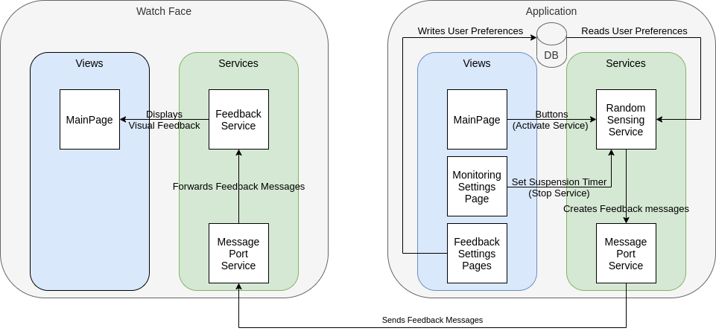
Approach – System Overview

Slide 10
Approach – Services
Human activity services:
Health – Heart rate monitor
Location – GPS
Activity – Pedometer
Privacy permission service
Random sensing service
Message port service
Feedback service

Slide 11
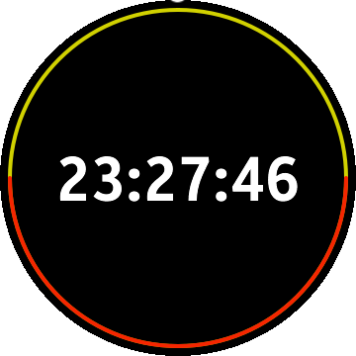
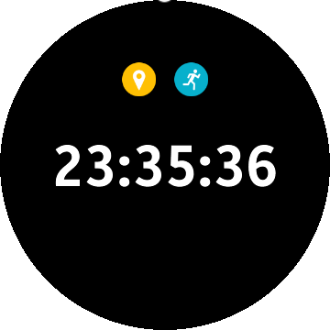
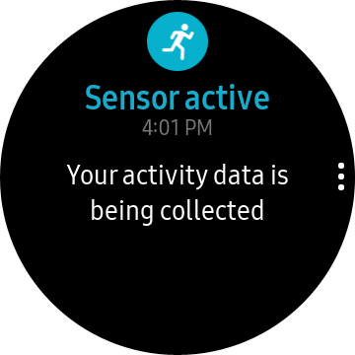
Approach – Supported feedback types
Visual feedbacks
Ring feedback
Icon feedback
Notification feedback
Other feedbacks
Vibration
Sound

Slide 12
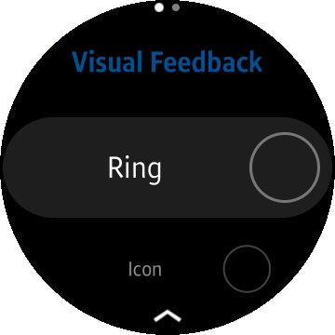
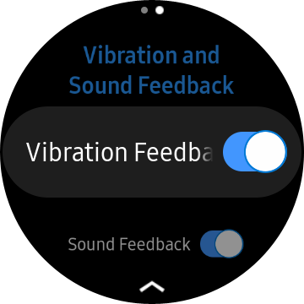
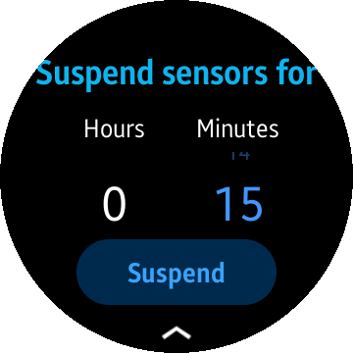
Approach – Main application
Views
Main page
Visual feedback settings
Other feedback settings
Sensors suspension setting

Slide 13
Approach – Watch face application
Normal mode
Ambient mode

Slide 14
Discussion - First approach
Global sensor monitoring application
Detects when a sensor is accessed by other apps
Triggers feedback
Not feasible
No API to know if a sensor is being used outside of the app
Required info present in system log
But app has no read access

Slide 15
Discussion - Second approach
Advantages
Good granularity of feedback
Different combinations/intensities of feedback
Gives control to user
Can suspend sensor access with timer
Designed to be shared
Separated Watch Face + App
Limits
Less generic that first approach
Still only a prototype
Can be bypassed by user

Slide 16
Conclusion
Lack of APIs to have global information about sensors
Developers must implement transparency mechanisms themselves
Our solution:
To be shared to community?
Aims to put users in control + raise data collection awareness
Case Study necessary to assess efficiency

Slide 17
Thanks for your attention!
Do you have any questions?

Slide 18
References
[1] P. Datta, A. S. Namin, and M. Chatterjee, “A survey of privacy concerns in wearable devices,” in 2018 IEEE International Conference on Big Data (Big Data), IEEE, 2018, pp. 4549–4553.
[2] V. G. Motti and K. Caine, “Users’ privacy concerns about wearables,” in International Conference on Financial Cryptography and Data Security, Springer, 2015, pp. 231–244.
[3] D. Dobbelstein, P. Henzler, and E. Rukzio, “Unconstrained pedestrian navigation based on vibro-tactile feedback around the wristband of a smartwatch,” in Proceedings of the 2016 CHI Conference Extended Abstracts on Human Factors in Computing Systems, 2016, pp. 2439–2445.
[4] S. Goodman, S. Kirchner, R. Guttman, D. Jain, J. Froehlich, and L. Findlater, “Evaluating smartwatch-based sound feedback for deaf and hard-of-hearing users across contexts,” in Proceedings of the 2020 CHI Conference on Human Factors in Computing Systems, 2020, pp. 1–13.
[5] J. Lee, Y. Song, J. Oh, Y. Chee, C. Ahn, H. Shin, H. Kang, and T. H. Lim, “Smartwatch feedback device for high-qualit chest compressions by a single rescuer during infant cardiac arrest: A randomized, controlled simulation study,” European Journal of Emergency Medicine, vol. 26, no. 4, p. 266, 2019.
[6] M. Williams, J. R. Nurse, and S. Creese, “(smart) watch out! encouraging privacy-protective behavior through interactive games,” International Journal of Human-Computer Studies, vol. 132, pp. 121–137, 2019.
[7] S. Patil, R. Hoyle, R. Schlegel, A. Kapadia, and A. J. Lee, “Interrupt now or inform later? comparing immediate and delayed privacy feedback,” in Proceedings of the 33rd Annual ACM Conference on Human Factors in Computing Systems, 2015, pp. 1415–1418.
[8] E. S. Udoh and A. Alkharashi, “Privacy risk awareness and the behavior of smartwatch users: A case study of indiana university students,” in 2016 Future Technologies Conference (FTC), IEEE, 2016, pp. 926–931.

