Slide 1
AI Multi-Agent Pull Request Reviewer
Supervisor name: Prof. Srinivasa K.G.
Group Members: Aksh Verma
Gaurav Singh
Date: 12-03-2026
Harsh Kaushik
International Institute of Information Technology, Naya Raipur

Slide 2
Content
Introduction & Problem Statement
Motivation: Issues and Challenges in Code Review
Solution & Key Features
System Architecture
Multi-Agent Pipeline
Workflow & Implementation
Sample Output & Results
Plan of Action & Future Work
Conclusion & Future Directions
07/03/26
International Institute of Information Technology, Naya Raipur

Slide 3
Introduction
AI Multi-Agent PR Reviewer is an automated code review system that analyses GitHub pull requests using multiple specialised AI agents.
The system fetches the PR diff, runs specialised AI agents, aggregates their outputs, and posts a structured review comment on the PR.
Goal: Assist developers by providing faster and more consistent code reviews.
Automated detection of bugs, security vulnerabilities, and performance issues.
Integration directly with GitHub pull request workflow via CLI.
07/03/26
International Institute of Information Technology, Naya Raipur

Slide 4
Motivation: Why Automate Code Review?
Code reviews are essential but face several challenges:
Manual reviews are time-consuming and slow development cycles.
Review quality depends heavily on individual reviewer experience.
Security vulnerabilities may be overlooked under workload pressure.
Performance issues often remain unnoticed during review.
Teams delay reviews due to competing priorities.
This project introduces an AI-powered automated review system to assist developers in identifying issues earlier and more consistently.
07/03/26
International Institute of Information Technology, Naya Raipur

Slide 5
Solution & Key Features
Multi-Agent Architecture: Specialised agents analyse separate aspects of each PR simultaneously.
Automated PR Review: Automatically generates a structured review report from the diff.
GitHub Integration: Fetches PR diffs and posts review comments directly on the PR.
Structured Output: Sections include Summary, Bugs, Security Issues, Performance, Style Suggestions.
Modular System: New analysis agents can be added easily to extend functionality.
07/03/26
International Institute of Information Technology, Naya Raipur

Slide 6
System Architecture
Developer opens a Pull Request on GitHub.
AI PR Reviewer CLI Tool is triggered: node pr-reviewer.js.
GitHub API is called to fetch the Pull Request Diff (modified files, code changes).
Diff Parser splits the diff into individual file-level changes.
Multi-Agent Pipeline: Risk Agent → Security Agent → Performance Agent → Style Agent → PR Review Agent.
Result Aggregator merges all agent outputs into a structured JSON result object.
Review Formatter converts results to markdown and posts via GitHub Comment API.
07/03/26
International Institute of Information Technology, Naya Raipur

Slide 7
Research Gap
Existing tools lack multi-dimensional analysis: Most automated tools focus on a single aspect (e.g., linting) and miss security or performance issues.
No integrated end-to-end review pipeline: Current solutions require separate tools for each concern, increasing developer overhead.
Limited AI-powered contextual analysis: Static tools cannot understand business logic or provide meaningful contextual review comments.
07/03/26
International Institute of Information Technology, Naya Raipur

Slide 8
Objectives of the Project
Design and implement a modular multi-agent AI architecture for comprehensive code review.
Integrate with the GitHub API to automate pull request diff retrieval and comment posting.
Develop specialised agents: Risk Agent, Security Agent, Performance Agent, Style Agent, PR Review Agent.
Aggregate and format agent outputs into a structured, actionable review report.
Ensure modularity so new analysis agents can be added with minimal development effort.
07/03/26
International Institute of Information Technology, Naya Raipur

Slide 9
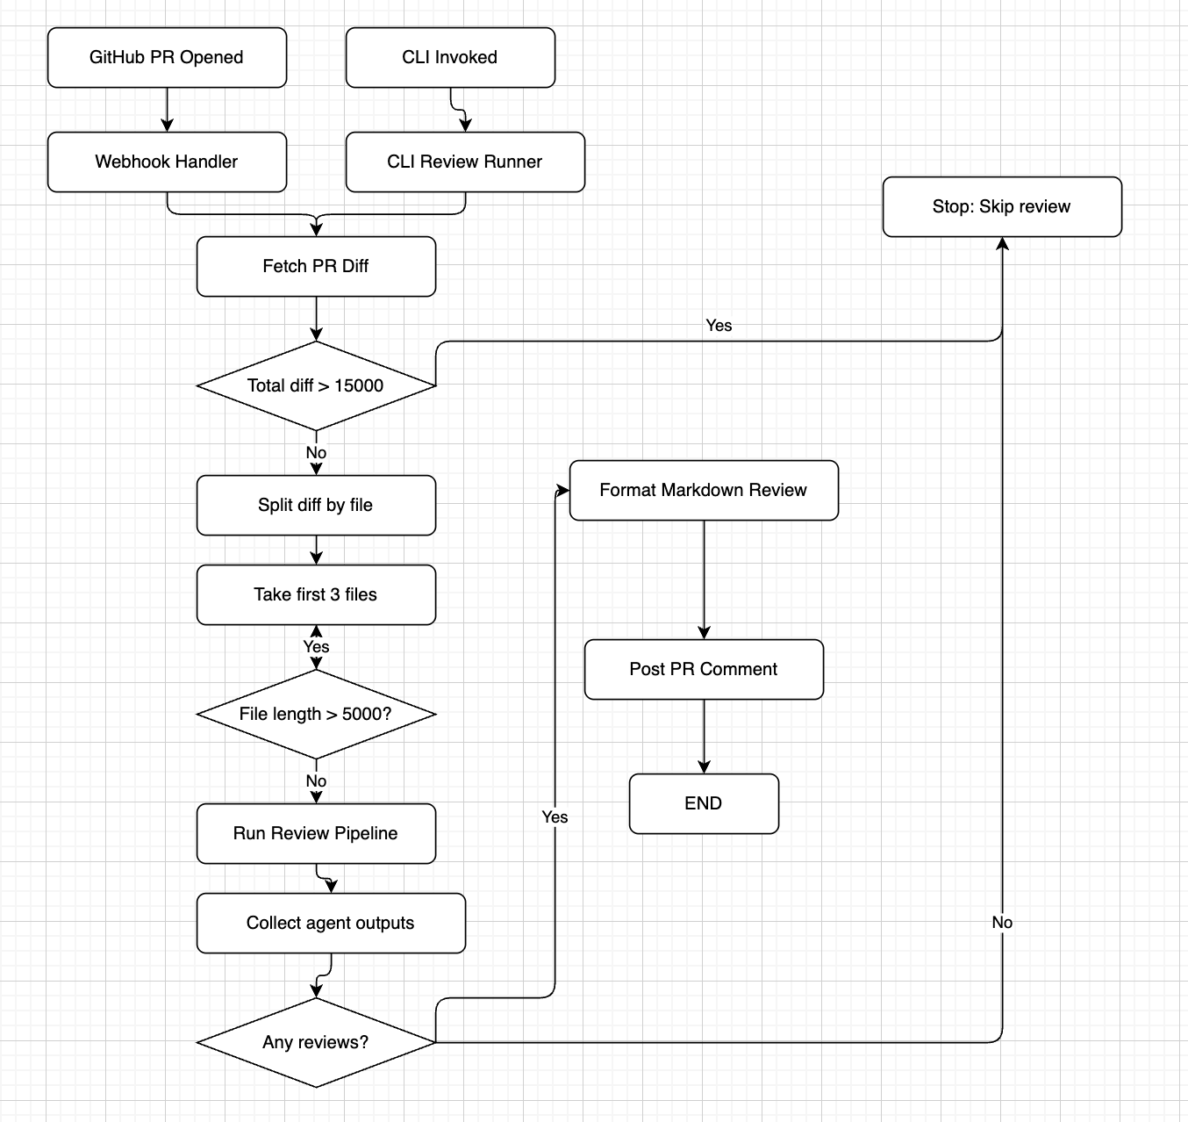
Proposed Methodology: Workflow
07/03/26
International Institute of Information Technology, Naya Raipur

Slide 10
Agent Description
Each agent independently analyses the PR diff and returns structured findings. Data source: GitHub REST API (live PR diffs).
Agent Name | Input | Analysis Type | Output / Findings
Risk Agent | PR diff (all files) | Risk assessment | risk_score, reason
Security Agent | PR diff (all files) | Vulnerability scan | Hardcoded secrets, unsafe functions
Performance Agent | PR diff (all files) | Efficiency review | Slow loops, redundant ops
Style Agent | PR diff (all files) | Code style check | Naming, formatting issues
PR Review Agent | All agent outputs | Summary generation | Final review comment
07/03/26
International Institute of Information Technology, Naya Raipur

Slide 11
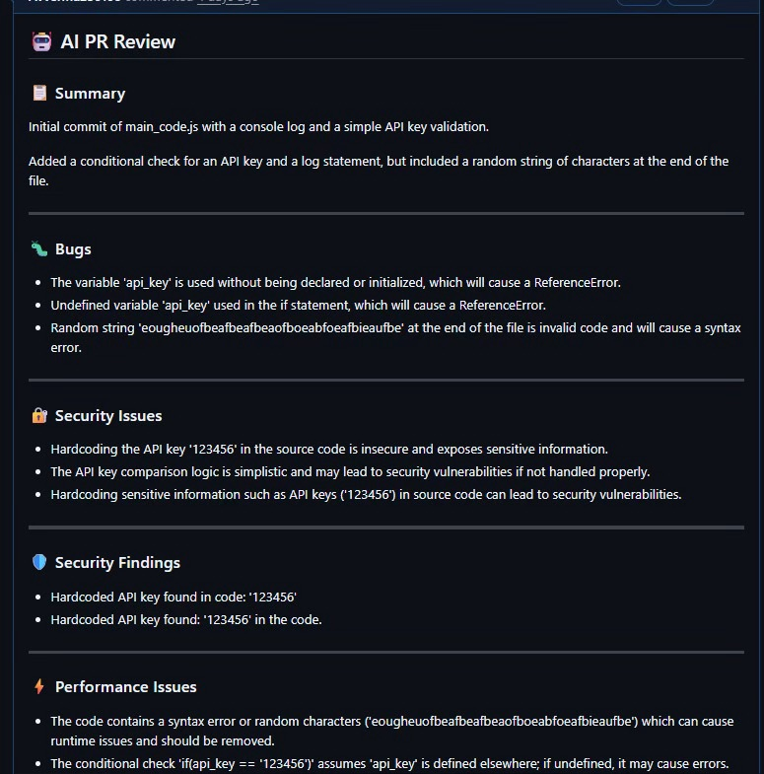
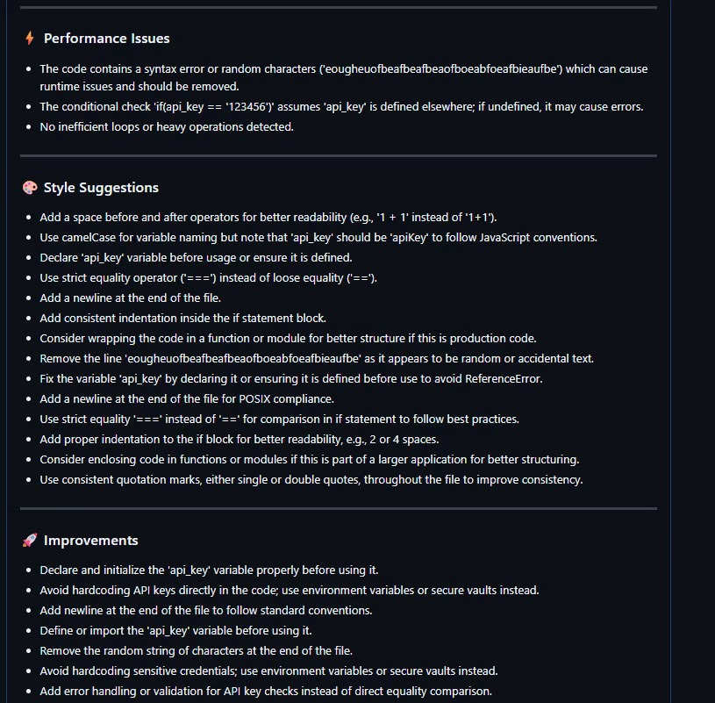
Results & Discussion
Sample review for a pull request
Summary: Added a new login function with JWT-based authentication.
Security Findings: Avoid using eval() potential code injection vulnerability detected.
Performance Issues: Nested loop O(n^2) detected - can be optimised.
Style Suggestions: Function name addUser should follow camelCase naming conventions.
Risk Score: 4/10 - Changes modify authentication logic, requires careful review.
System analysed 3 files and produced a structured review in under 10 seconds.
07/03/26
International Institute of Information Technology, Naya Raipur

Slide 12
Conclusion & Future Directions
Successfully implemented a modular, multi-agent AI system for automated GitHub PR review.
The system reduces manual review effort and catches bugs, security and performance issues automatically.
Future Directions:
Add CI/CD pipeline integration via GitHub Actions Webhook triggers.
Train domain-specific fine-tuned models for more accurate code analysis.
Add support for more programming languages and frameworks.
Build a dashboard to track review history and agent performance metrics.
07/03/26
International Institute of Information Technology, Naya Raipur

Slide 13
Plan of Action
Phase 1 (Complete): CLI tool, GitHub API integration, diff parser, all 5 core agents.
Phase 2 (In Progress): Improve agent accuracy, add test coverage, handle edge cases.
Phase 3 (Upcoming): CI/CD integration via GitHub Actions Webhook automation.
Phase 4 (Future): Model fine-tuning on domain-specific code review datasets.
Phase 5(Future): Automated analysis of suggestion mails to create GitHub Issues.
07/03/26
International Institute of Information Technology, Naya Raipur

Slide 14

Thank You
..
Dr. Shyama Prasad Mukherjee International Institute of Information Technology, Naya Raipur
07/03/26
International Institute of Information Technology, Naya Raipur

