Slide 1
Simplifying the Metro Saga: Unleashing the Power of Route Wrangler

Slide 2
Project Description
Making Metro navigation easy and accessible to everyone

Slide 3
Introduction
Route Wrangler is a navigation tool designed to simplify metro navigation for urban commuters.
Importance of accessible and easy metro navigation:
Urban commuters often face challenges in navigating complex metro systems, leading to inefficiencies and delays.
Route Wrangler aims to address these challenges by providing a user-friendly navigation solution.
Data Structures Used-
Route Wrangler leverages graph, stack, and array data structures along with Dijkstra's Algorithm to optimize route finding.

Slide 4
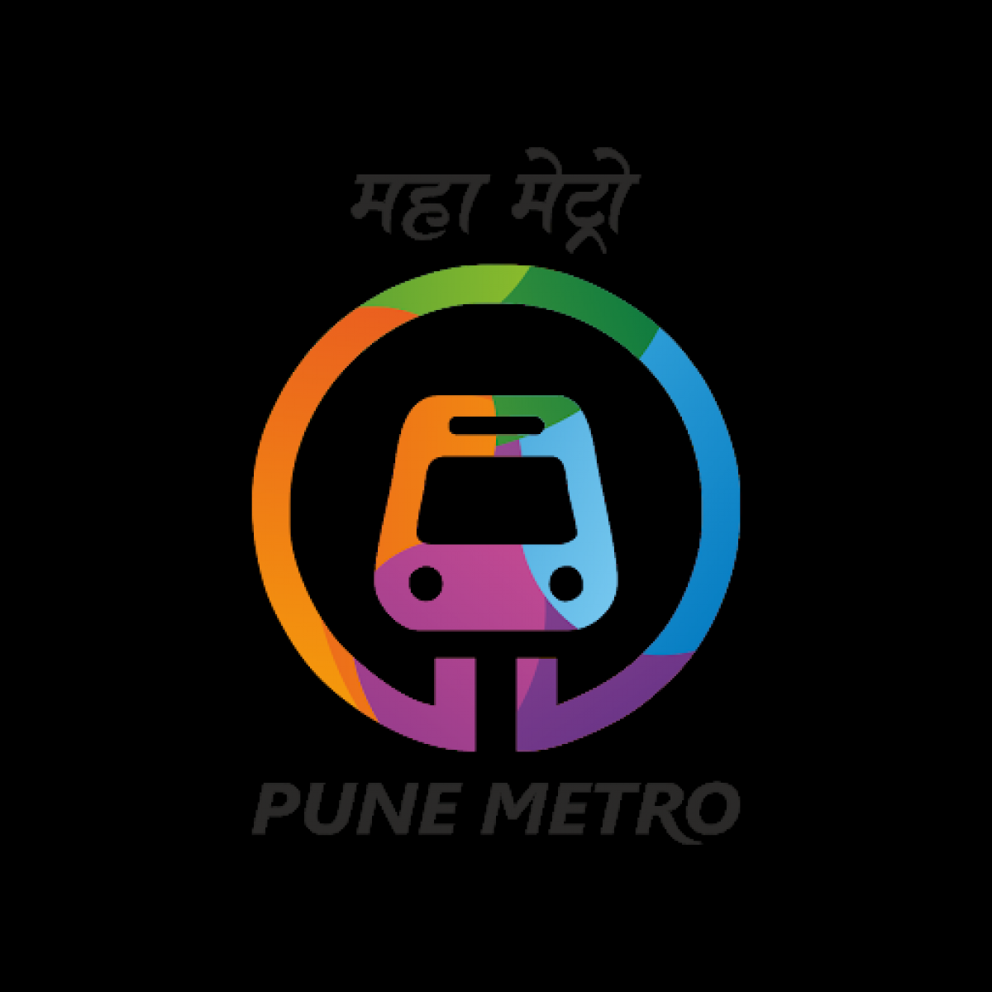

Slide 5
Project Overview
Route Wrangler is a navigation tool designed to simplify metro travel for commuters.
The primary goal is to make metro navigation easy, accessible, and efficient for all users.
With the ever-growing complexity of urban metro systems, there's an increasing need for accessible and easy-to-use navigation solutions.
Objectives:
To provide users with accurate and real-time navigation information within metro systems.
To optimize travel routes and minimize commute times.

Slide 6
Problem Statement
Current Challenges in Metro Navigation:
Complex metro networks often confuse commuters, leading to longer travel times and frustrations.
Lack of accessible navigation solutions makes metro travel difficult for people with disabilities or special needs.
Need for a Solution:
There's a pressing need for a navigation tool that simplifies metro travel, catering to the diverse needs of commuters.

Slide 7
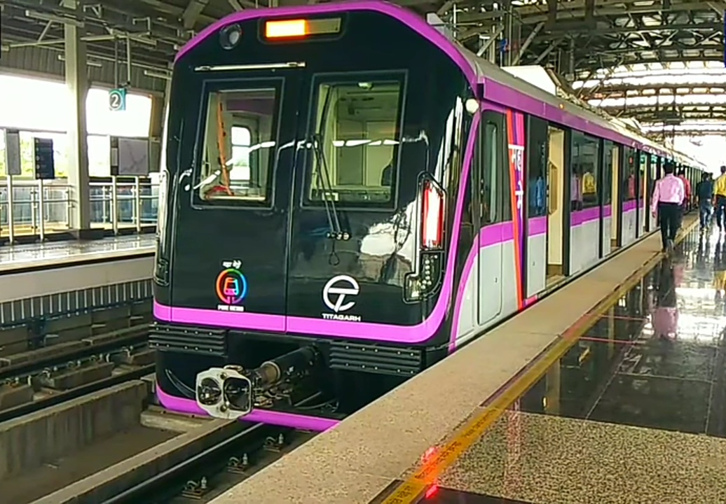

Slide 8
Data Structures Used
Graph: Represents metro networks and stations, facilitating route calculation.
Stack: Used in the implementation of certain algorithms within Metro Saga.
Array: Utilized for efficient data storage and manipulation.
These data structures play a crucial role in optimizing route calculations and improving overall performance.

Slide 9
Dijkstra’s Algorithm
Dijkstra's Algorithm is a graph-based algorithm used for finding the shortest path from a source node to all other nodes in a graph.
It is particularly well-suited for metro navigation due to its efficiency and accuracy in route calculation.
Application in Route Wrangler:
Route Wrangler utilizes Dijkstra's Algorithm to compute the optimal routes between metro stations, ensuring efficient travel for commuters.

Slide 10
Key Features
User-Friendly Interface: Route Wrangler boasts an intuitive and easy-to-use interface, making metro navigation hassle-free.
Real-Time Updates: Provides users with real-time information on metro schedules, delays, and route changes.
Accessibility Features: Designed to accommodate the needs of all commuters, including those with disabilities or special requirements.

Slide 11
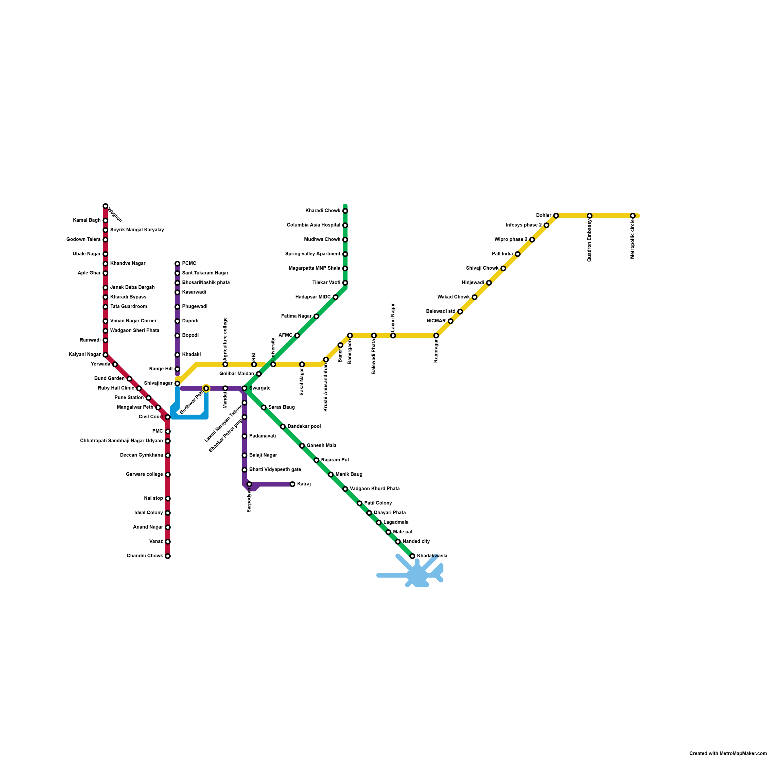
Metro Map

Slide 12
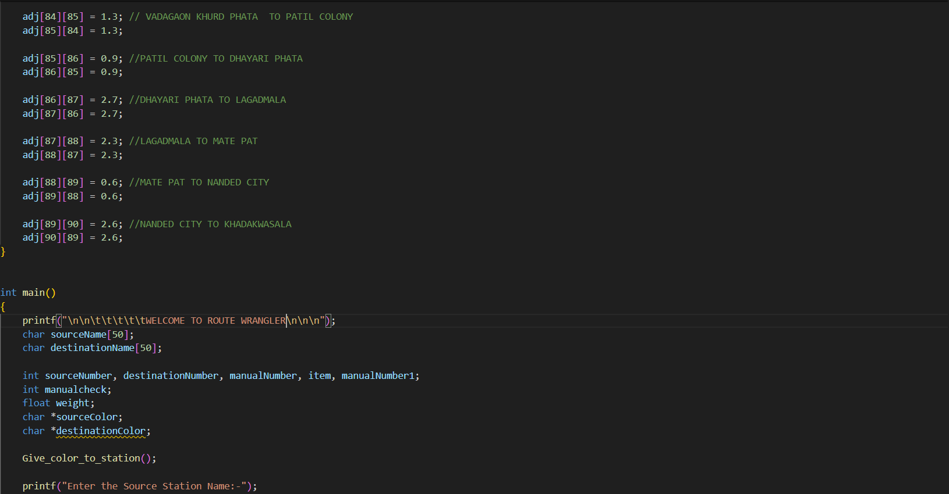
Working

Slide 13
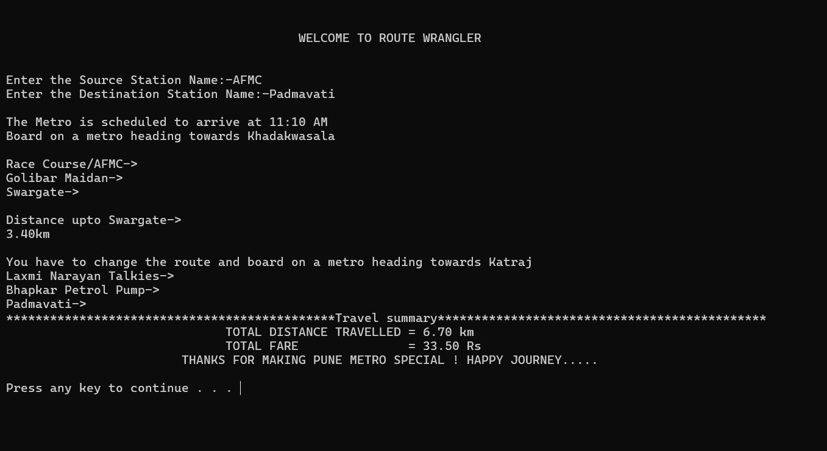
Working

Slide 14
Tech Stack Used
Programming Languages:C language
Data Structures: Graph, Stack, Array.
The combination of these technologies forms the backbone of Route Wrangler, ensuring its robustness and efficiency.

Slide 15
Desired Results
Improved Navigation Efficiency: Reduced travel times and minimized route deviations.
Positive User Feedback: Commuters appreciate the simplicity and effectiveness of Route Wrangler.
Impact on Urban Mobility: Route Wrangler has contributed to enhancing urban mobility by making metro travel more accessible and user-friendly.

Slide 16
Conclusion
Route Wrangler has successfully addressed the challenges of metro navigation, offering a user-friendly and efficient solution for commuters.
We remain committed to further improving Route Wrangler and making metro travel accessible to everyone.
Thank you for your attention and interest in Route Wrangler.

Slide 17
Group Members
Alok Jaiswal(MIS-612203076)
Krish Pawargi(MIS-612203100)
Gaurav Jadhav(MIS-612203073)

Slide 18


