Slide 2
OPINION ANALYSIS OF TEXTUAL DATA
MENTOR
Mr. Amrendra Nath Tripathi
Assistant Professor
Dept. of Cybernetics
School of Computer Science

Slide 3
Team Members & Role
Sr. No | Name Of Student | Specialization and Semester | Roll No. | SAP ID | Role of Student
1. | Amresh Garg | CCVT & 6th SEM | R110219009 | 500077157 | CODING AND IMPLEMENTATION
2. | Gaurav Porwal | CCVT & 6th SEM | R110219054 | 500076356 | RESEARCH AND DOCUMENTATION
3. | Sudip Maji | CCVT & 6th SEM | R110219140 | 500076608 | CODING AND IMPLEMENTATION
4. | Utkarsh Bahuguna | CCVT & 6th SEM | R110219146 | 500075285 | RESEARCH AND DOCUMENTATION

Slide 4
Introduction
Opinion Analysis is the extraction of opinions from a source using basic language processing and computational analysis. It is the computational process of identifying and classifying the opinion expressed over a text in order to determine whether that opinion or attitude expressed is positive, negative, or neutral sentiment. Because opinions are central to almost all human activities, analysis has a wide range of applications. The goal of this project is to examine the Sentiment and polarity of the given data.
For example: This product is amazing!
This sentence expresses a positive opinion about the product as a whole.

Slide 5
Literature Review
The research on opinion analysis so far has mainly focused on two things:
To identifying whether the given textual entity is subjective or objective.
To identifying the polarity of that subjective textual entity after removing the objective content.
In this project, we have used the research paper of Pang, Lee, and Vaithyananthan[1] proposed in 2002 that focuses on the fundamentals and the basic applications of opinion analysis. It basically classified movies reviews into two categories: positive and negative, expanding on the basic task of classifying a movie review as either positive or negative in order to predict star ratings on a 3- or 4-star rating.

Slide 6
Problem Statements
As social media is increasing day by day, it has become a great platform for people to express their views and share opinion. So, it is very vital to recognize whether these opinion or emotions are even wholesome or not.
We can analyze reviews and articles and determine what public thinks of them.

Slide 7
Motivation
The motivation behind our opinion analysis system is to produce an output value that indicates how the sentence or document is positive, negative, or neutral.
Opinion analysis is extremely useful in social network monitoring because it allows us to get a sense of what the general public thinks about certain topics.
It aims to divide or distribute the content according to their sentiments and helps reader to choose the type of content they want to read.

Slide 8
Objective
Our main objective is to determine the emotional tone behind series of words , used to gain an understanding
of the attitude, opinions and emotions expressed within an online mention. It also helps in understanding
public opinion. Companies use opinion analysis in doing market research and figuring out if their
customers like a particular product or not.
Sub objectives:
To evaluate the persons opinion in certain cases.
To determine the emotional tone behind the series of the word.
To teach the machine to analyze the various grammatical nuances.
To implement an algorithm for automatic classification of text into positive or negative .

Slide 9
Methodologies
HInput Textual Data
Classify the textual data
Calculate the overall positive, negative and neutral percentage
SSeparate Sentences
Calculate Sentiment of Each Sentence
Positive
NNegative
Extract Opinions
Classify verb/opinion to positive ,negative and neutral
Opinion Verb repository

Slide 10
System Requirements: (Software/Hardware)
Hardware Requirements:
Minimum RAM requirement for proper functioning is 2 GB.
Required input as well as output devices.
Operating System:
Windows/Linux
Software Requirements-
Spring Tool Suit
AWS (EC2 and S3 Bucket)
Spring Boot 1.5.10. RELEASE requires Java 11
Spring Framework 4.3.14. release or above
PuTTY

Slide 11
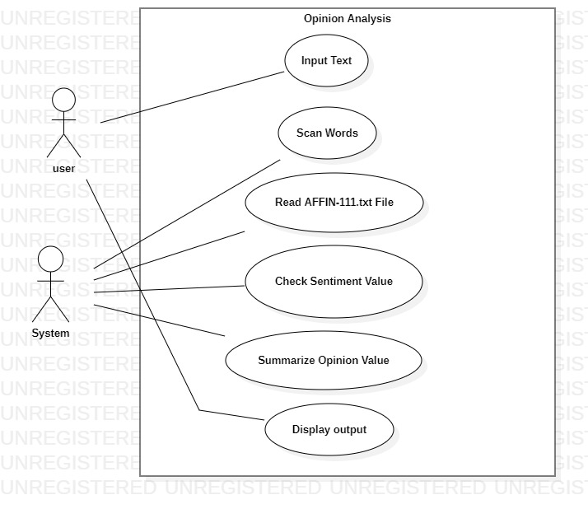
Use Case Diagram

Slide 12
Algorithm:
Start
Import Message class
Message class take input from the user
Import MessageHolder
MessageHolder class stores the messages till the user presses SUBMIT
Calls PopulateMessage() function
Messages populated.
Import Dictionary class.
Open AF1NN file.
It checks sentiments.
Add the value of sentiments.
Import Analysis class
Search for input words and set sentiment values accordingly.
Check values of sentiments.
Differentiate positive, negative and neutral sentiment.
Calculate overall sentiment. percentage of positive, negative and neutral.
Show output general sentiment on output screen.
End

Slide 13
PERT CHART
Start
25-JAN-22
Study Period
06-FEB-22
07-FEB-22
Requirements Gathering
18-FEB-22
19-FEB-22
02-MARCH-22
Design
03-MARCH-22
Pseudo Code
14-MARCH-22
End
15-MARCH-22
10-APRIL-22
Coding and implementation

Slide 14
References & GIT link
Bo Pang, Lillian Lee, and Shivakumar Vaithyanathan. 2002. Thumbs up? Sentiment Classification using Machine Learning Techniques. EMNLP Proceedings.
Bo Pang and Lillian Lee. 2004. A Sentimental Education: Sentiment Analysis Using Subjectivity Summarization Based on Minimum Cuts. ACL Proceedings.
Bo Pang and Lillian Lee. 2005. Seeing stars: Exploiting class relationships for sentiment categorization with respect to rating scales. ACL Proceedings.
P. Turney, “Thumbs up or thumbs down? Semantic orientation applied to unsupervised classification of reviews,” Proceedings of the Association for Computational Linguistics (ACL), pp. 417–424, 2002
https://github.com/amreshgarg21/Opinion-Analysis-Web-Using-Spring-MVC-Boot

