Slide 1

AuthMark
AI Image Authenticity Verification Using Invisible Digital Watermarking
Digital Watermarking and Steganography
Gaurish Todi 23BCI0262
Prakamya Bhuvi 23BCI0256
Faculty: Dr. Diviya M.
Vellore Institute of Technology, Vellore
Notes:
Introduce the project: AuthMark signs AI-generated images with an invisible watermark and later verifies authenticity and locates tampering. Introduce team members and faculty.

Slide 2
Problem Statement: Images Can No Longer Be Trusted
1
AI images look real
2
Metadata is fragile
Generative models produce photos that people and basic tools cannot tell apart from camera photos.
EXIF and provenance tags vanish the moment an image is screenshotted, re-saved or shared on social media.
3
Edits go unnoticed
4
No cheap proof of origin
A small local change (swapped face, removed object) is invisible to the eye and gives no proof of where it happened.
There is no lightweight way to show who created an image and that it is unchanged since creation.
We need a mark that is invisible, cannot be forged, survives normal sharing, and shows where an image was edited.
Notes:
Frame the problem: provenance via metadata does not survive sharing, and AI edits are invisible. The watermark lives in the pixels, so it travels with the image.

Slide 3
Aim, Objectives, Scope & Novelty
AIM
OBJECTIVES
SCOPE & NOVELTY
Build an end-to-end system that signs AI-generated images with an invisible, key-protected watermark, then verifies authenticity and pinpoints tampered regions.
Invisible: PSNR above 40 dB
Unforgeable: HMAC-signed payload
Robust to JPEG, noise, rescale
Locate edits with a tamper map
Usable: CLI and web interface
- Most academic watermarking embeds a plain logo or random bits, which anyone can copy or replace. Here the payload is Creator ID + timestamp + an HMAC-SHA256 tag, so the mark proves origin and cannot be forged without the key.
- Tamper localization from the watermark itself: The same payload is repeated over the whole image
Notes:
Aim is the one-sentence goal. Objectives are measurable. Be upfront about the boundary: crop, rotation, strong blur and full regeneration are outside what this version handles.

Slide 4
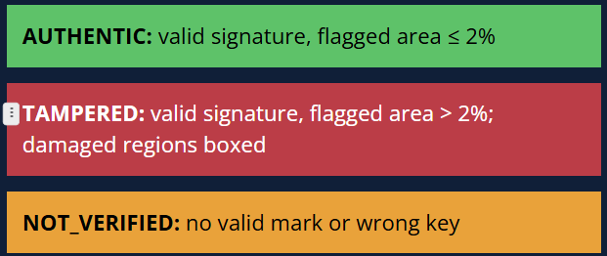
The Full Process in Simple Words
1
2
3
4
Create
Sign and hide
Share
Verify
An AI image is generated and uploaded to AuthMark.
A small secret code (who, when, plus a lock made with your key) is hidden across the whole image. It looks unchanged.
The image is posted, compressed or resized. Enough copies of the code survive.
Anyone with the key re-reads the code, checks the lock, and compares every region.
Three possible answers
Think of a letter signed in invisible ink with your personal pen.
Copies can circulate, but nobody can fake your signature without the pen. Scribble over one paragraph and the signature breaks exactly there.
Notes:
Explain in layman terms: sign, hide, share, verify. The invisible-ink letter analogy: same idea. Then explain the three verdicts shown on the left.

Slide 5
Technology Stack
LIBRARIES AND TOOLS
ALGORITHMS AND SECURITY
Python 3.13
Implementation language
Haar DWT
Splits luminance into frequency bands
NumPy and SciPy
Array maths, DCT, filters
8x8 block DCT
Mid-frequency coefficients carry the mark
Pillow
Image I/O, colour conversion, JPEG
QIM
Quantization Index Modulation embeds each bit
Streamlit
Web interface (Sign and Verify tabs)
HMAC-SHA256
Key-based signature; blocks forgery
Matplotlib and Pytest
Result charts; 11 unit tests
Soft majority voting
Recovers bits after distortion
Notes:
Everything is plain Python with NumPy/SciPy; the DWT is hand-written Haar so there is no heavy dependency. Security comes from HMAC-SHA256 with a secret key.

Slide 6
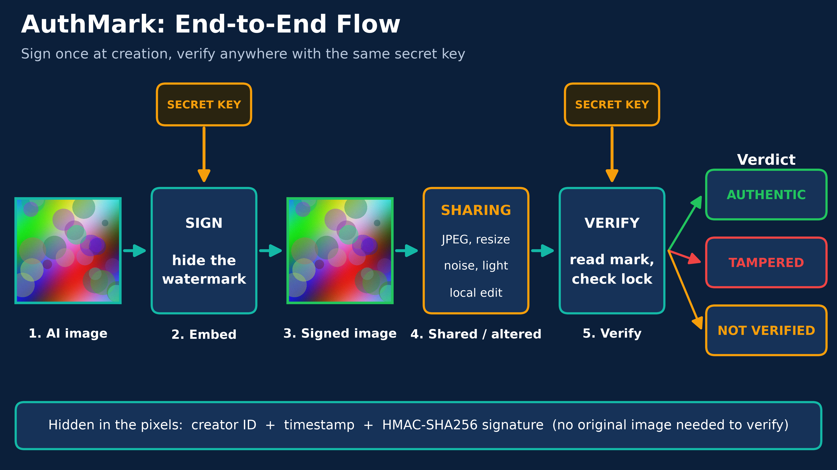
End-to-End Architecture
Sign
Payload + key go into the embed engine; output is a lossless PNG.
Survive
The mark must survive JPEG, noise, brightness and rescale.
Verify
HMAC check first, then block consensus decides the verdict.
Notes:
Walk left to right: signing service, hostile distribution channel, verification service. Green boxes survive, amber is detected, red breaks the mark. Both services share the secret key and are reached through the Streamlit UI or CLI.

Slide 7
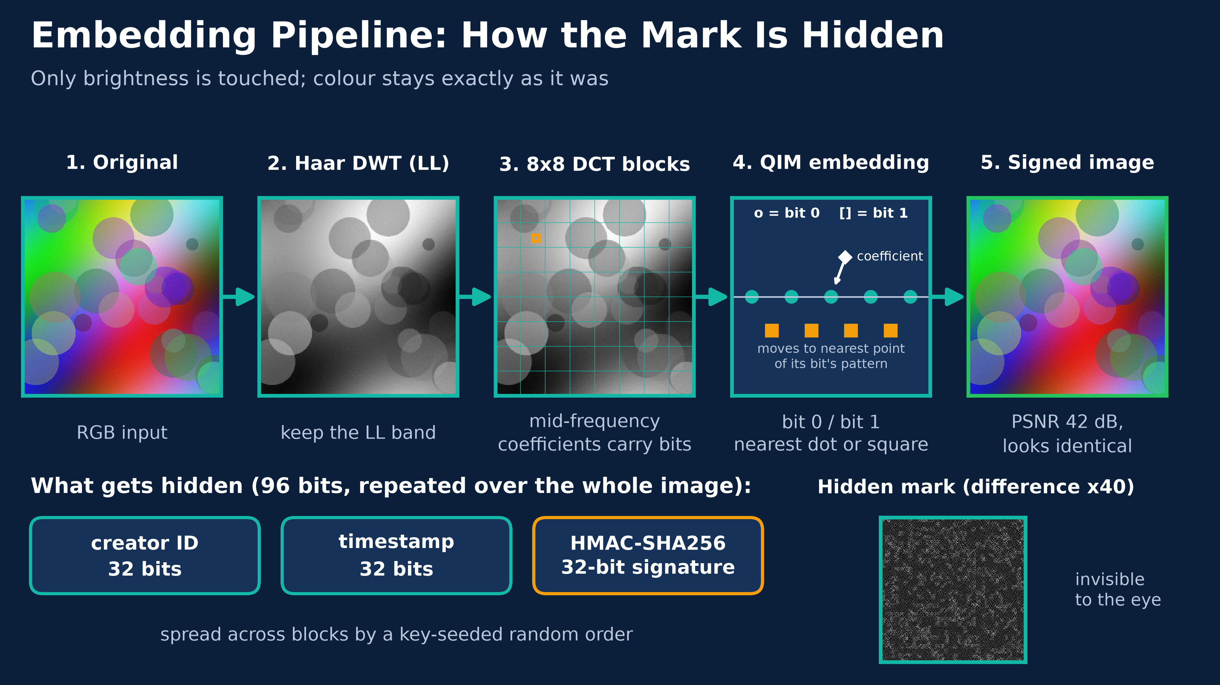
Embedding Pipeline: DWT, DCT, QIM
Luminance only
Colour channels pass through untouched, keeping it invisible.
Spread by key
A key-seeded permutation scatters each bit over many blocks.
QIM rule
Each coefficient snaps to the lattice of its bit; delta = 28.
Notes:
Convert to YCbCr, take Y, Haar DWT, and work in the LL band with 8x8 DCT blocks. Six mid-frequency coefficients per block are quantized onto the lattice for bit 0 or bit 1. A larger delta is more robust but less invisible.

Slide 8
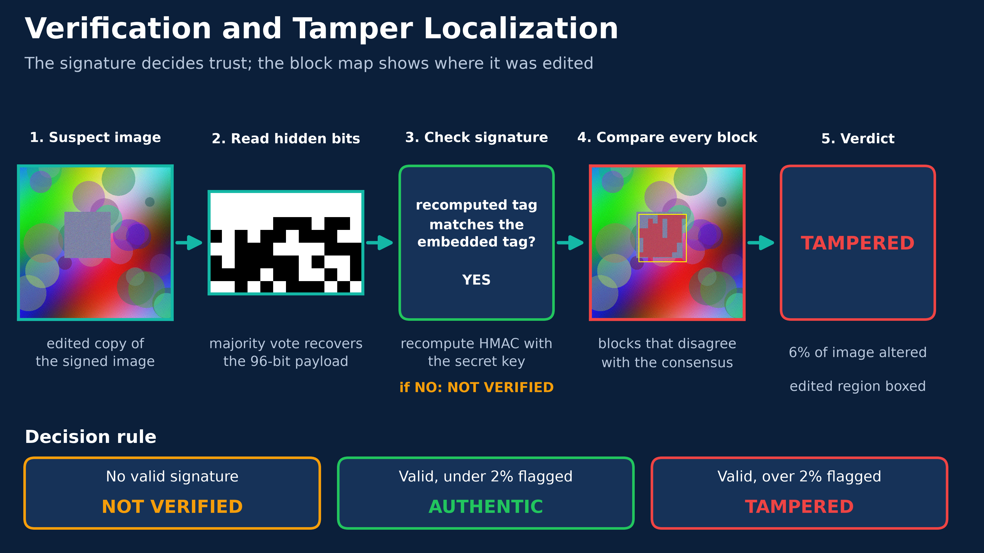
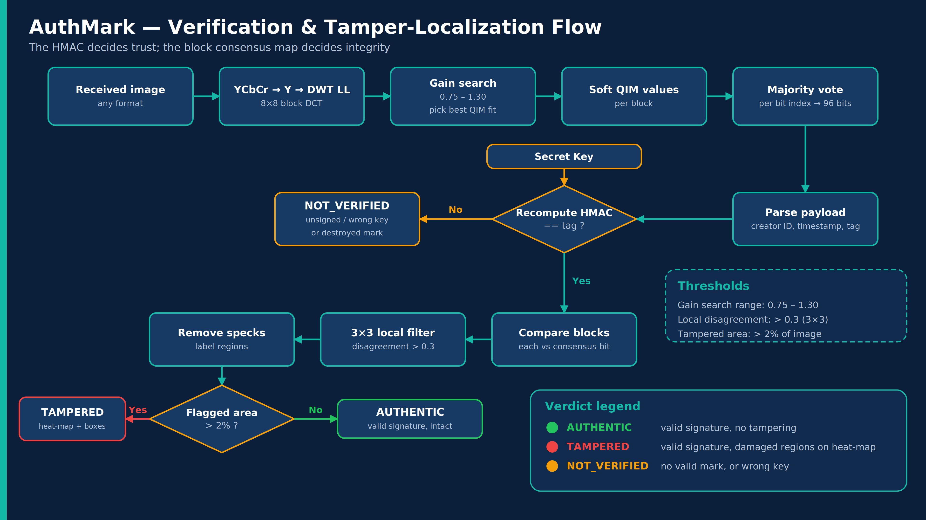
Verification and Tamper-Localization Flow
Trust
The HMAC match decides whether the mark is genuine.
Integrity
Blocks that disagree with the consensus form a tamper map.
Thresholds
Local filter above 0.3; verdict TAMPERED above 2% area.
Notes:
Extract bits by soft majority vote after a gain search for brightness changes. If the recomputed HMAC fails: NOT_VERIFIED. Otherwise compare each block with the consensus, filter, label regions, and apply the 2 percent area threshold.

Slide 9
Metrics, Validation and Verification Results
42.2 dB
0.982
PSNR (invisibility)
SSIM
8 / 8
No false
edits detected (9% and 4% patches)
false accepts (unsigned and wrong key)
Tested on 8 synthetic 512 x 512 images; every attack applied to all 8, each image checked against its own key.
Notes:
Imperceptibility: PSNR 42.2 dB and SSIM 0.982. Robustness: the mark verifies on 8 of 8 images after JPEG down to quality 50, noise up to sigma 8, brightness 1.1, 50 percent rescale, and light blur. Blur radius 1.0 and cropping break it, which is the stated boundary. Verification: all 8 pasted-patch edits at both sizes were flagged TAMPERED and there were no false accepts among 16 unsigned or wrong-key checks.

Slide 10
Conclusion
WHAT WE ACHIEVED
FUTURE WORK
Invisible signed watermark (42 dB PSNR)
Survives JPEG q=50, noise, rescale
Pinpoints edited regions on a heat-map
Working CLI and Streamlit web app
Ed25519 for public verification
Sync pattern for crop resistance
Learned (HiDDeN-style) watermarking
Real photo and Stable Diffusion tests
AuthMark gives AI images a hidden, forge-proof signature: who made it, when, and exactly where it was changed. Thank you. Questions?
Notes:
Summarize achievements, be honest about limitations, then point to future work. Offer a live demo: sign an image, verify it, then verify the tampered copy.

