Slide 1
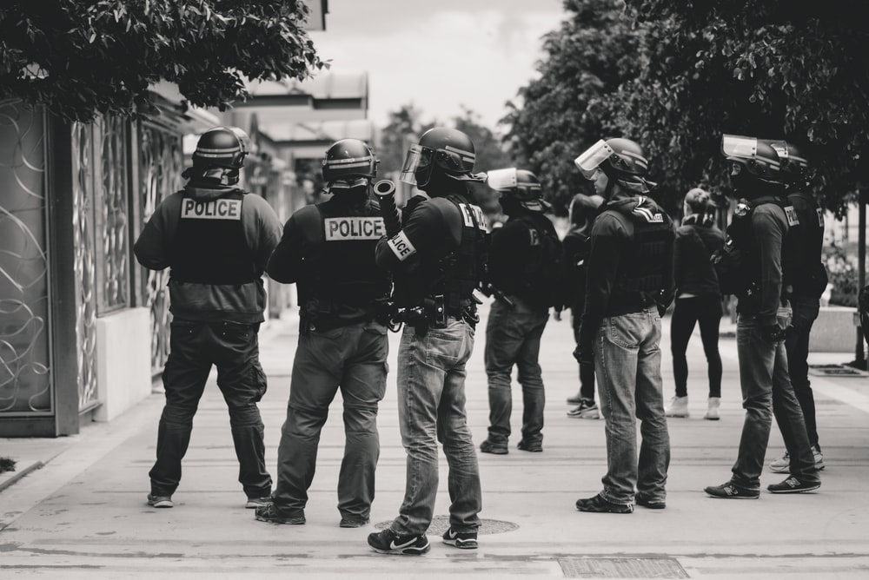


Notes:
Hello check it out

Slide 2
Team - Hac’KP-61 AI-FOR-GOOD
Predictive Policing Using Bigdata Analysis
Zaid Kesarani
Backend Development
B.tech {CE}
Institute of Advanced Research,Gandhinagar
Siddhant Pandey
Machine Learning
B.tech {CE}
Institute of Advanced Research,Gandhinagar
Dr. Sachin Sharma
Mentor
Assistant Professor
Institute of Advanced Research,Gandhinagar
Gautam Bhattathiri
Frontend Development
B.tech {CE}
Institute of Advanced Research,Gandhinagar
Raghav Joshi
Frontend Development
B.tech {CE}
Institute of Advanced Research,Gandhinagar

Slide 3

Problem
In today’s world of extensive crime, fighting it is a major concern.
According to the National Judicial Data reports, on an average, out of every 100 people worldwide, 12 people are affected by crime-related activities.
In India alone, more than 3.7 crores cases were pending in courts as of 2014.
Data is the new oil, and is assuming centrality.
There is hardly any sector left which does not find itself pacing to catch up with the Cyclops–Technology and its humongous feed–Data.
So why leave out policing and homeland security?

Slide 4
Solution
Indian Police have long used brains and brawn, but now “dataDetective”, blending Sherlock Holmes’s logic and intuition with modern technology promises to make the policing more efficient.
The premise is simple: criminals follow patterns, and with our web based application, police can determine where the next crime may occur and can prevent it.
The key to success in predictive policing is getting as much data as possible to determine the patterns.

Slide 5






Implementation
Data Preprocessing
Algorithm training
Backend Development
Frontend Development
Deployment
Final Product

Slide 6


Graphical Analysis
Working
Visualized Data
1970
1982
1995
2006
2015
Prediction
{Beta Phase}

Slide 7


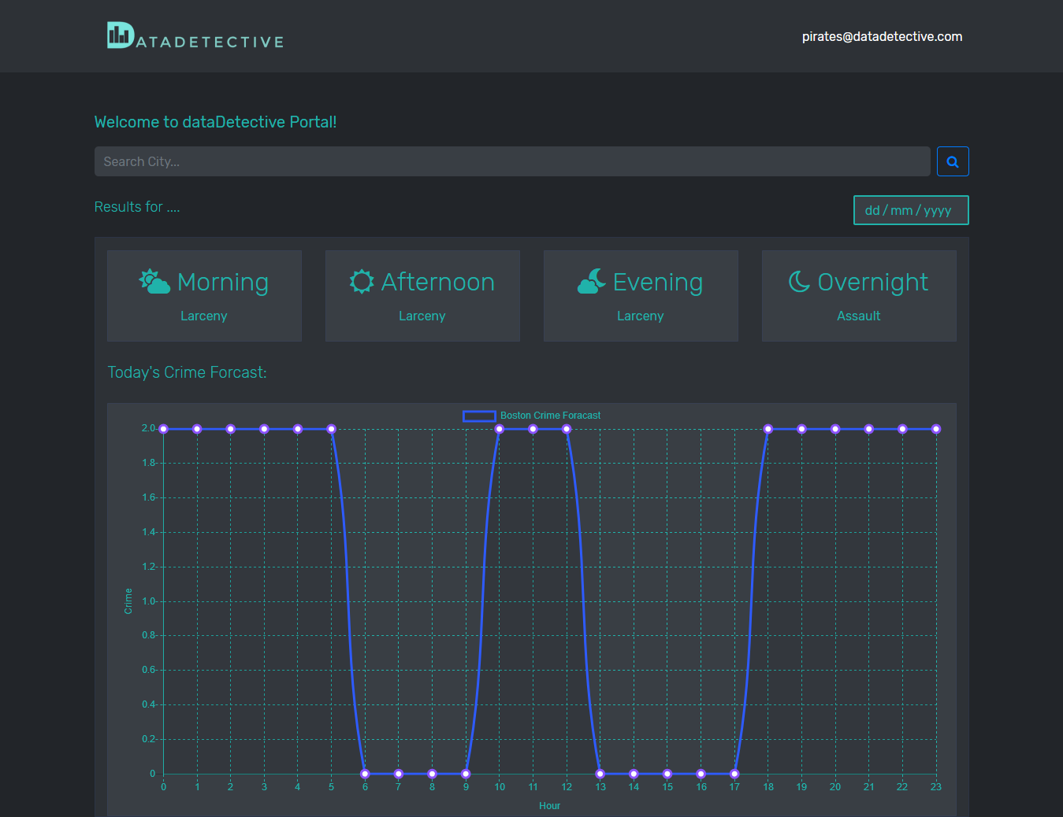

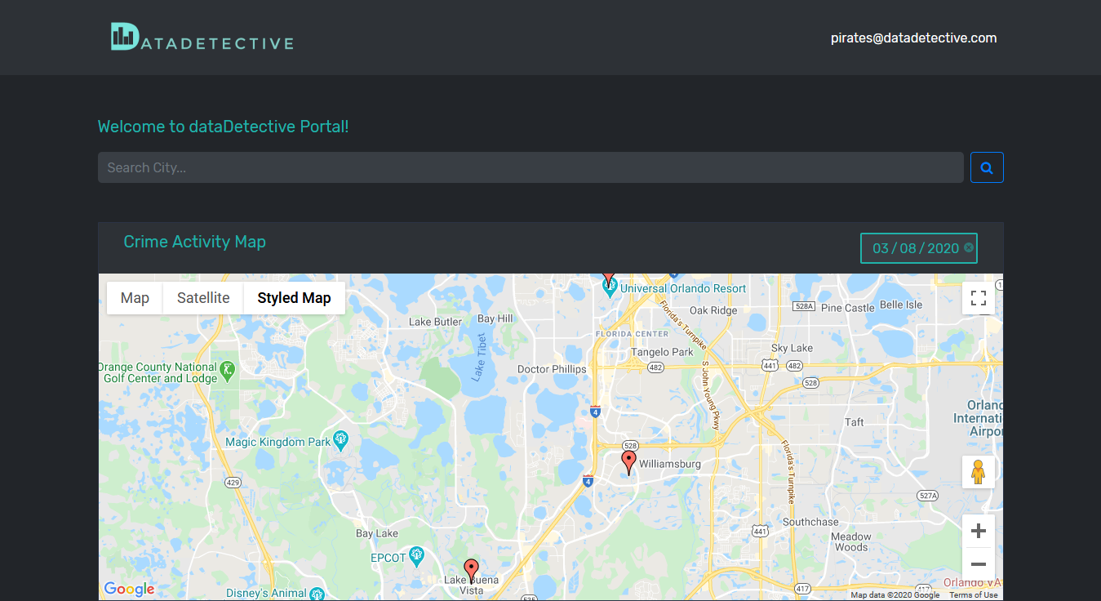

Interactive Web UI/UX
The web-app
Summarised Dashboard
User-friendly application

Slide 8
IMPACT
Crime anatomization of women and children abuse
Crime pattern identification
Redeployment of police resources
Hotspot Analysis
Crime prediction

Slide 9
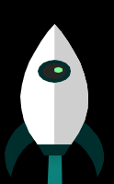
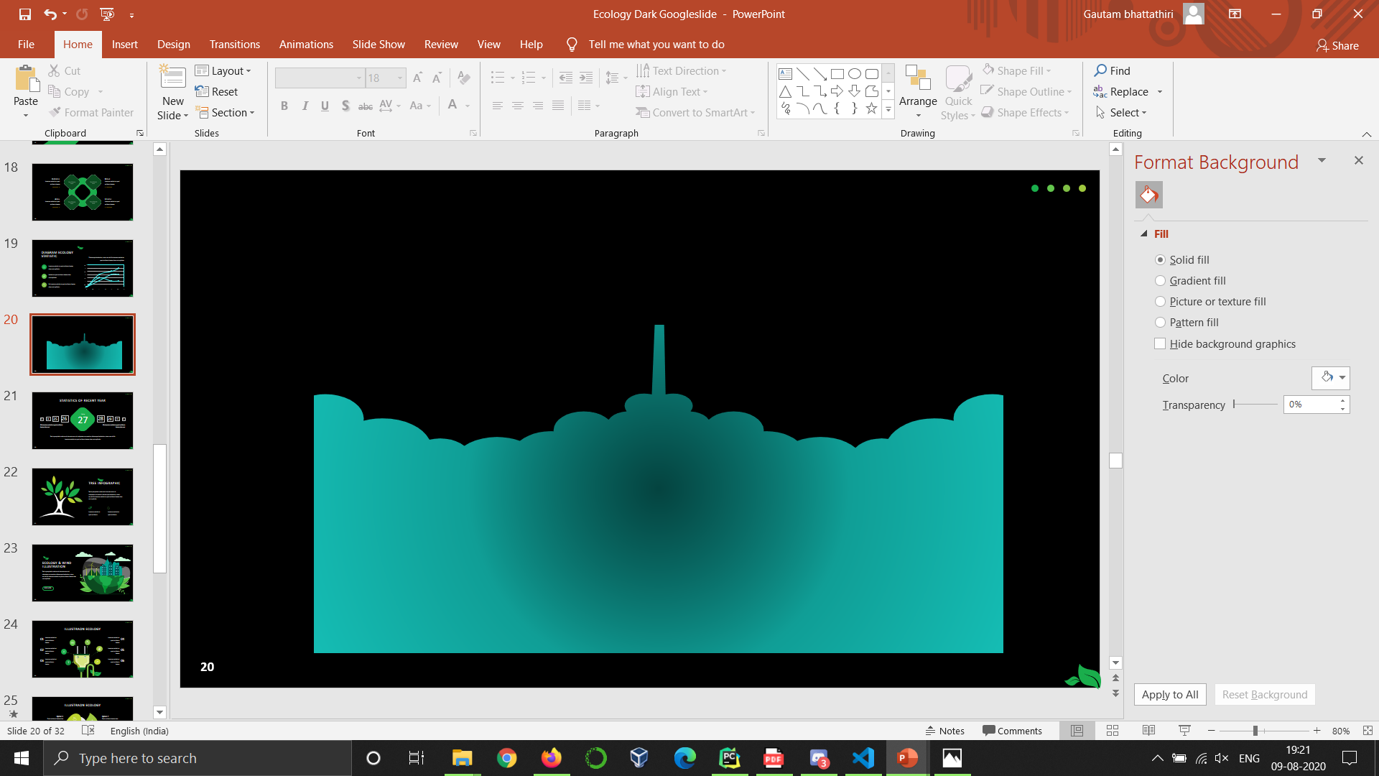
VISION
Tracking and subverting terror activity
Enhance Crime probability for efficient policing
More effective data analysis
Civilian-accessible application product

Slide 10

Thank You
AI-powered predictive policing, coupled with higher resource allocation for law enforcement and evolved laws is the next-gen policing that our security apparatus need to adapt to, to suit the emerging needs and times for outsmarting criminals with the power of data.

