Slide 1

Angular e il progetto AVANT: Secure by design
Intro
Introduction to Angular and the application of its key principles in the AVANT project
04/05/26

Slide 2
Agenda
04/05/26
Talking about Angular and his environment
Talking about AVANT project

Slide 3
5 questions about Angular
Talking about Angular and his environment
Angular e il progetto AVANT: Secure by design
Who
What
When
Where
Why
How
Anyone who is or wants to become a front-end or full-stack developer
Let’s dive in!
Easy to use for those familiar with the MVC patter, it ensures a clear separation of concernes
Angular is an open-source framework based on TS
Used by large and small companies and independent developers
It’s used to create scalable web apps

Slide 4
Foundaments of Angular
Talking about Angular and his environment
Angular e il progetto AVANT: Secure by design
TS
Familiarity with Asyncronus programmig
Knowledge of JS, JSON, HTML and CSS
Knowledge of procedural programming

Slide 5
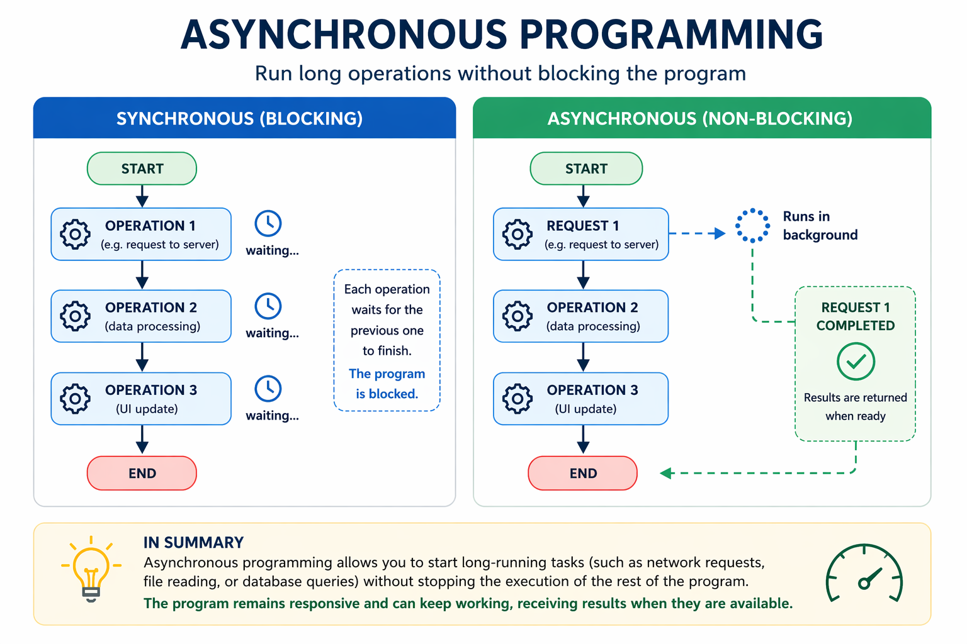
What is asynchronus programming
Talking about Angular and his environment
Angular e il progetto AVANT: Secure by design

Slide 6
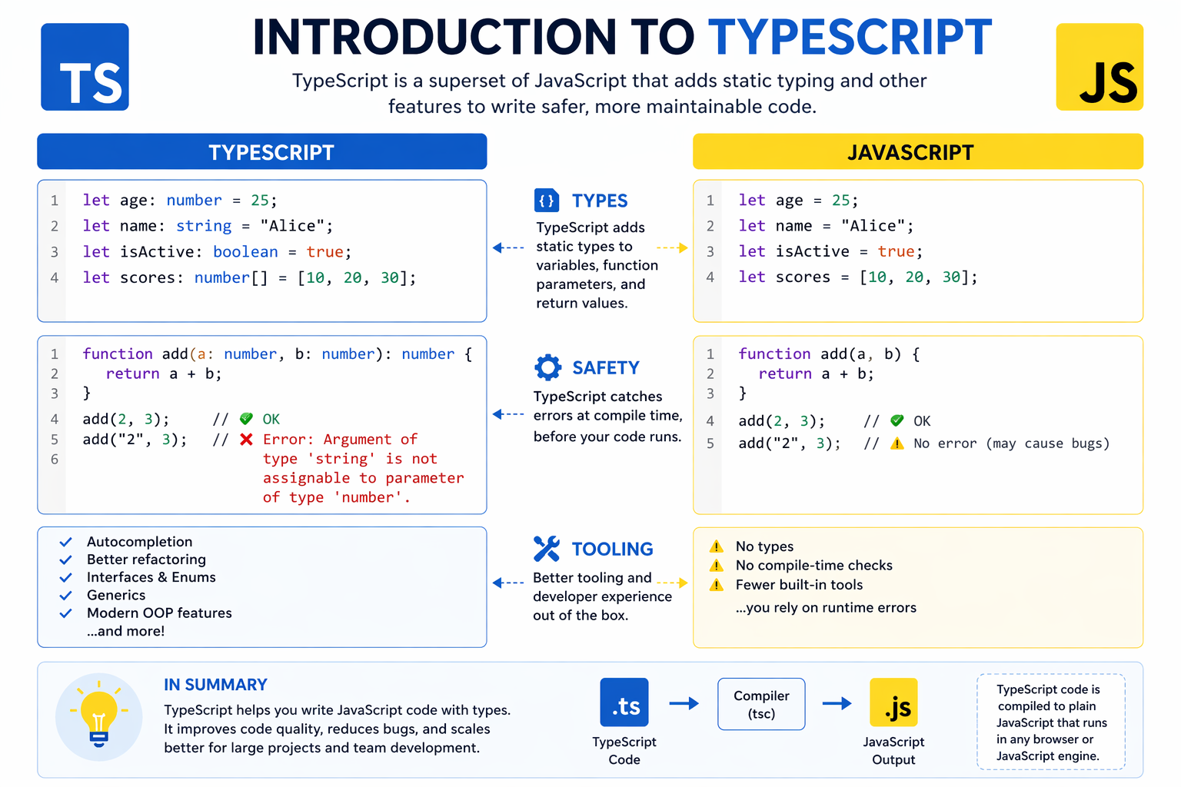
What is TypeScript
Talking about Angular and his environment
Angular e il progetto AVANT: Secure by design

Slide 7
How does an Angular developer think?
Talking about Angular and his environment
Angular e il progetto AVANT: Secure by design
Do I need to move data from one part of the app to another?
Can the solution I'm about to implement be used elsewhere?
Do I need to communicate with a server?
A new request/issue has come in that needs to be resolved
Angular dev
Do I need to add a new graphic element?
Does this change affect the entire project?

Slide 8
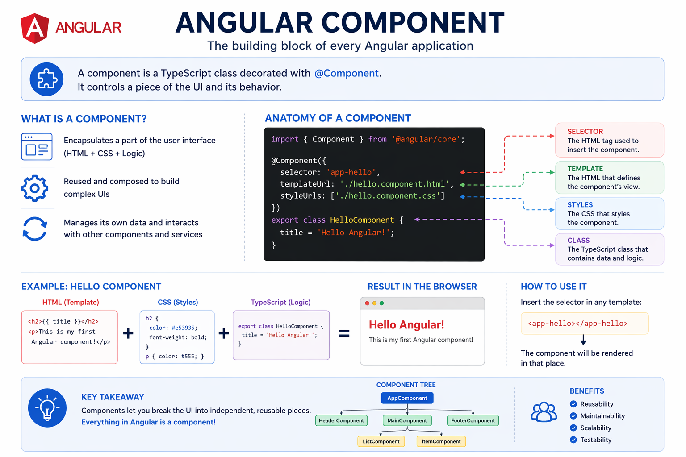
What is an Angular component?
Talking about Angular and his environment
Angular e il progetto AVANT: Secure by design

Slide 9
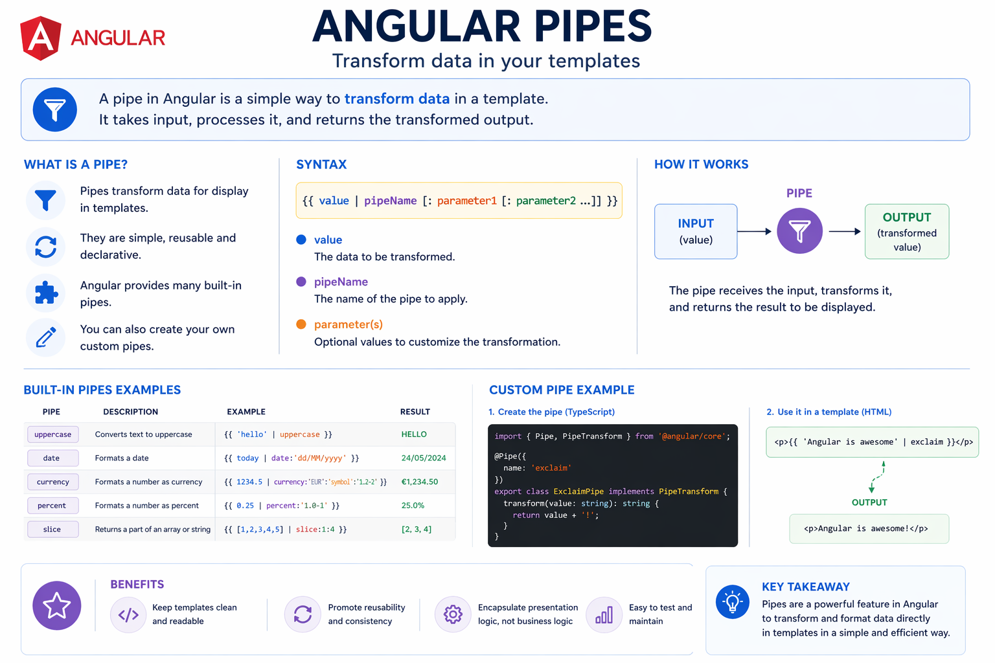
How I can trasform my data?
Talking about Angular and his environment
Angular e il progetto AVANT: Secure by design

Slide 10
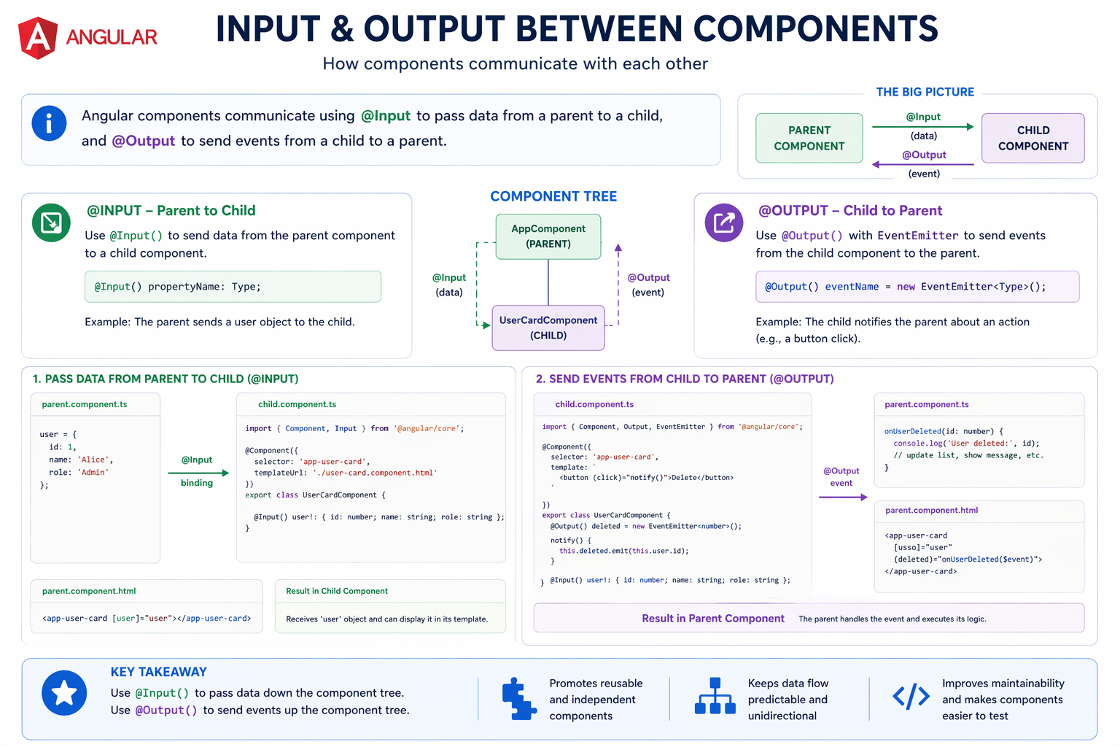
How the components share the data?
Talking about Angular and his environment
Angular e il progetto AVANT: Secure by design

Slide 11
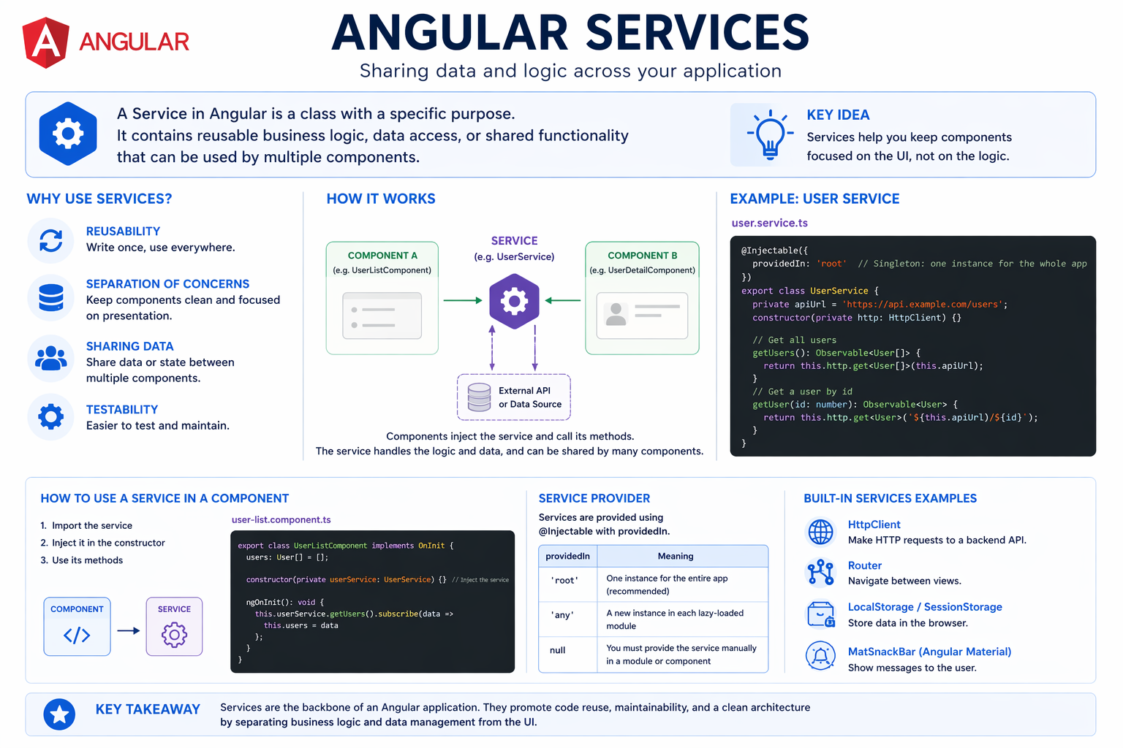
How I can improve the separation of concerns?
Talking about Angular and his environment
Angular e il progetto AVANT: Secure by design

Slide 12
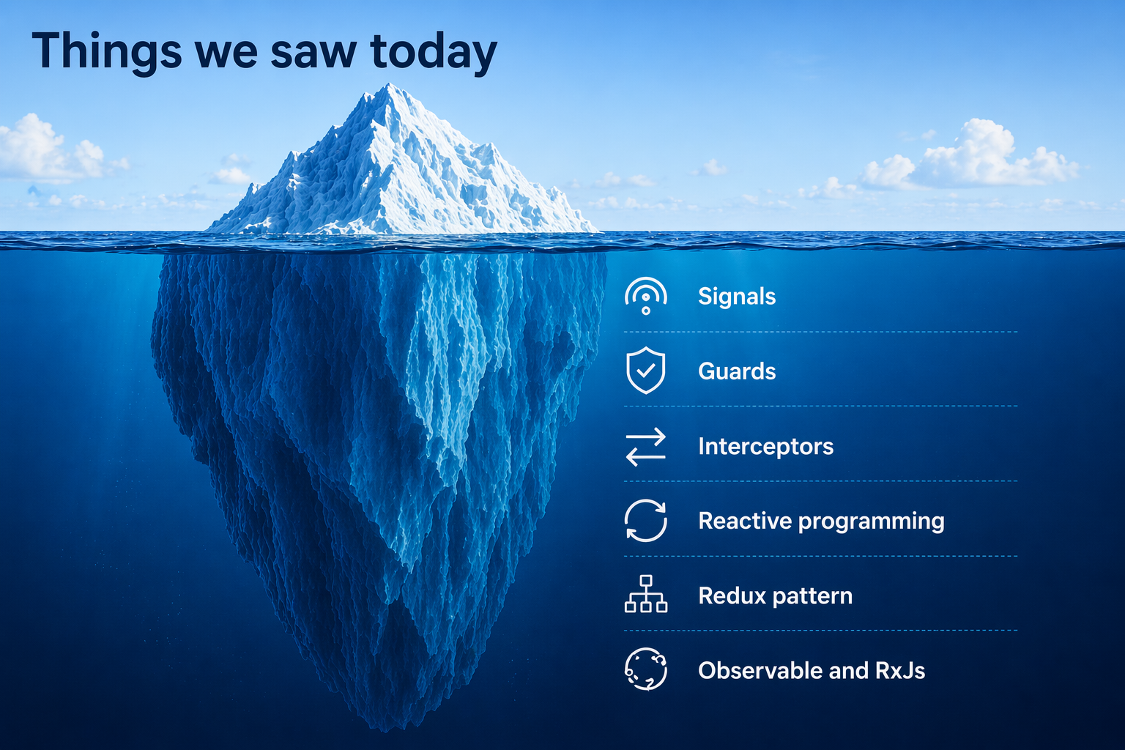
Our iceberg
Talking about Angular and his environment
Angular e il progetto AVANT: Secure by design

Slide 13
Using this concept we have developed RATING-DT
Talking about AVANT project
Angular e il progetto AVANT: Secure by design
A cyber-security tool that can assess the risks of a business service
It can give information and analytics about how it’s asset are vulnerable and risks exposed
And now let’s see how it works with a live demo!

Slide 14
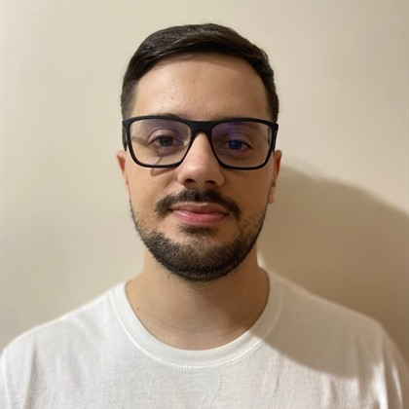
Francesco Vicidomini francesco.vicidomini@eng.it
Technical Researcher Specialist

