Slide 1
An Evaluation of Path Planning Methods with Dynamic Obstacles
Jacob Ward, Matthew Boler

Slide 2
Outline
Introduction
Problem Definition
Prior Art
Simulation Environment
Kalman Filter
Follow-The-Gap
A*
D*-lite
Performance Comparisons
Conclusions and Future Work
2

Slide 3
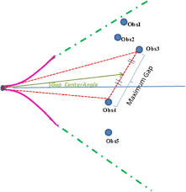
Follow-the-Gap
Geometric planning/control algorithm
Steer towards weighted average of goal and largest gap
Simple, cheap, safe
Sub-optimal paths
3

Slide 4
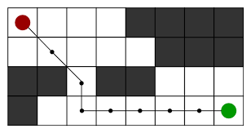
A*
Best-first global search
Build shortest path of nodes connecting start and goal
Optimal, fast
Dangerous, expensive
4

Slide 5
Content (Left)
Liberal content here
Fake news
Failing New York Times citation here
5

Slide 6
Content (Left)
Liberal content here
Fake news
Failing New York Times citation here
6

Slide 7
Content (Full)
Fully express your ideations!
There’s lots of room
But, don’t get carried away
No one wants to read a novel during your presentation
Well, at least not a novel you’ve provided on your slides
7

Slide 8
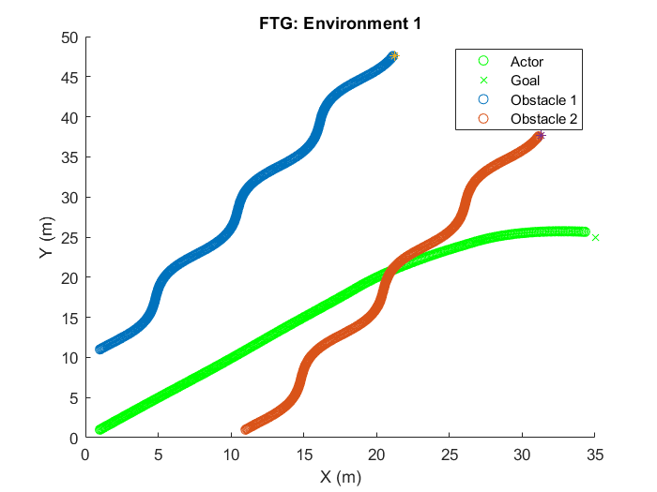
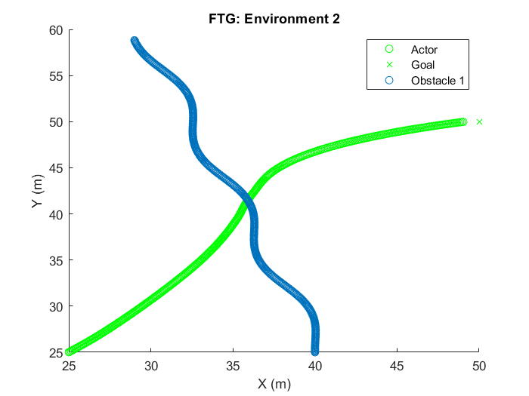
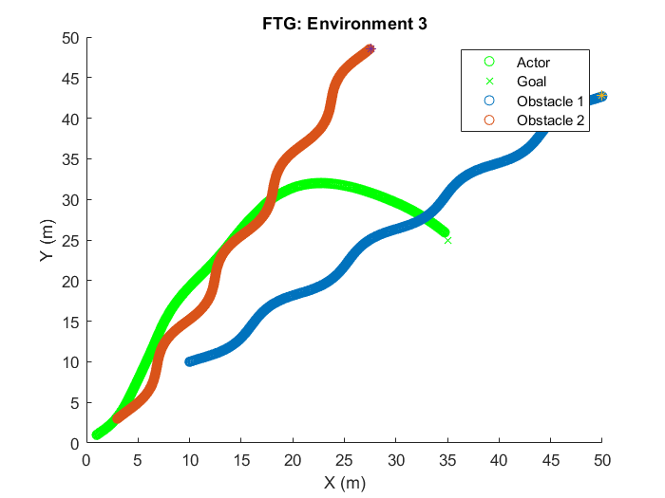
Performance (FTG)
8

Slide 9
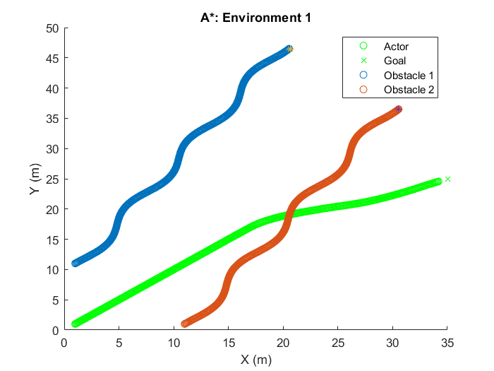
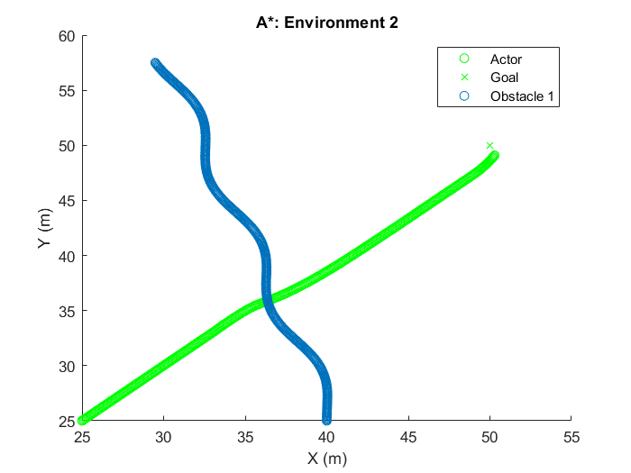
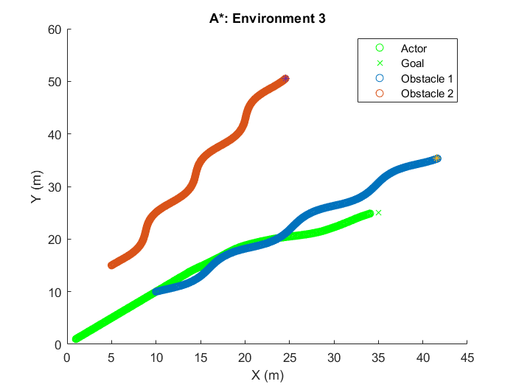
Performance (A*)
9

Slide 10
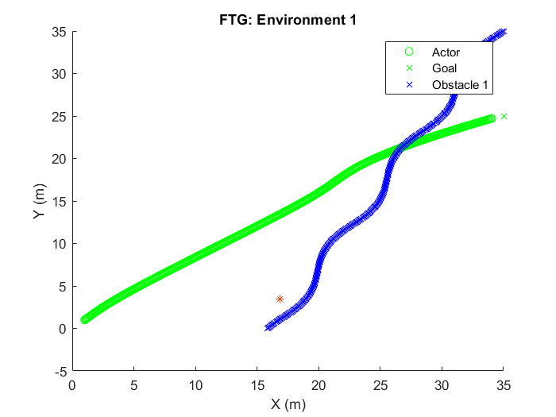
Performance (D*-lite)
10

Slide 11
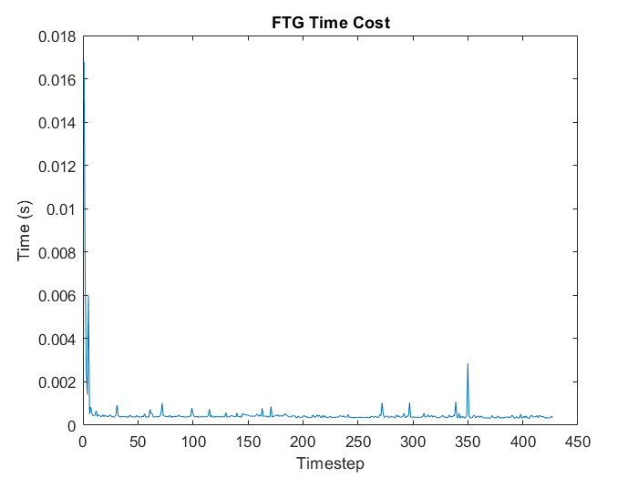
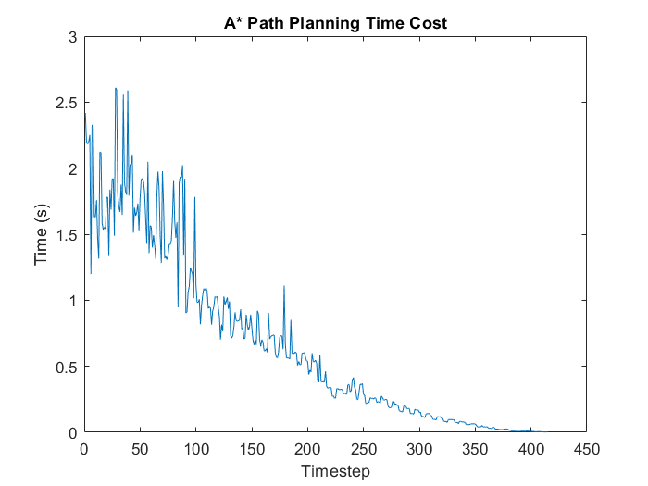
Computational Cost
11

Slide 12
Section Divider
Subheading
12

Slide 13
Content (Left)
Liberal content here
Fake news
Failing New York Times citation here
13

Slide 14
Content (Right)
Conservative Content
Confirmation bias here
Alternative facts too!
14

Slide 15
Content (L & R)
I want this side to say “Auburn!”
I want this side to say “Tigers!”
15

Slide 16
Questions?
Thank You!
16

