Slide 1
Mamba Vision
Γεώργιος Αλεξάκης

Slide 2
Agenda
Introduction & Contextual Background
Evolution of vision Backbones
NextVit Architecture
MambaVision Architecture
Experimental Setup
Classification Results
Implications & Conclusion

Slide 3
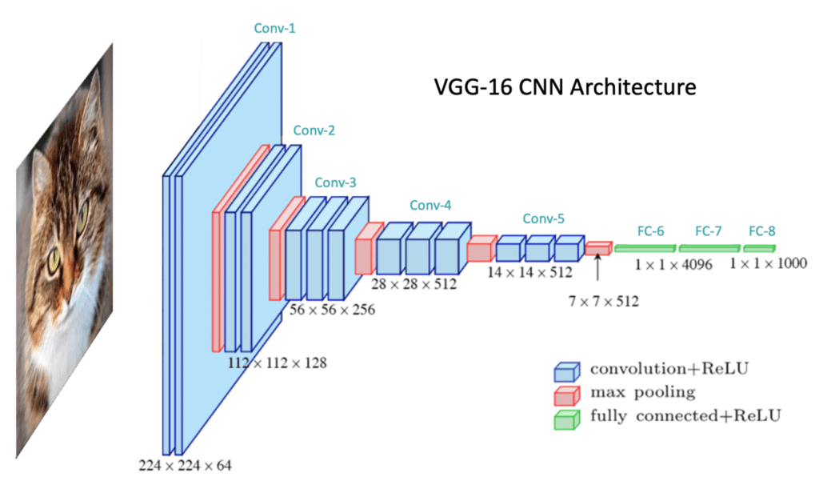
Evolution of Vision Backbones
CNN Era (ResNet, EfficientNet):
Local inductive biases
hierarchical features
limited long-range modeling
Vision Transformer (ViT):
Global self-attention from layer 1
Strong performance
O(N²) complexity
Prohibitive for high-res
Key limitation:
Pure global attention is expensive
Pure local convs miss distant dependencies

Slide 4
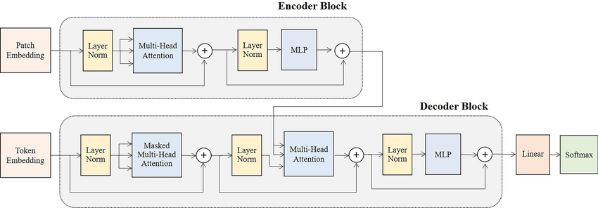
Evolution of Vision Backbones
CNN Era (ResNet, EfficientNet):
Local inductive biases
hierarchical features
limited long-range modeling
Vision Transformer (ViT):
Global self-attention from layer 1
Strong performance
O(N²) complexity
Prohibitive for high-res
Key limitation:
Pure global attention is expensive
Pure local convs miss distant dependencies

Slide 5
Evolution of Vision Backbones
CNN Era (ResNet, EfficientNet):
Local inductive biases
hierarchical features
limited long-range modeling
Vision Transformer (ViT):
Global self-attention from layer 1
Strong performance
O(N²) complexity
Prohibitive for high-res
Key limitation:
Pure global attention is expensive
Pure local convs miss distant dependencies

Slide 6
Visual Transformers

Slide 7
Next-ViT
Why Next-ViT
Core Design Goals
CNNs = fast but limited global modeling
ViTs = strong accuracy but high latency
Industrial deployment needs speed + accuracy
Goal: Transformer-level performance with CNN-like speed
Efficient inference
Reduce Transformer latency bottlenecks
Balance local + global feature learning
Optimize for real-world deployment

Slide 8
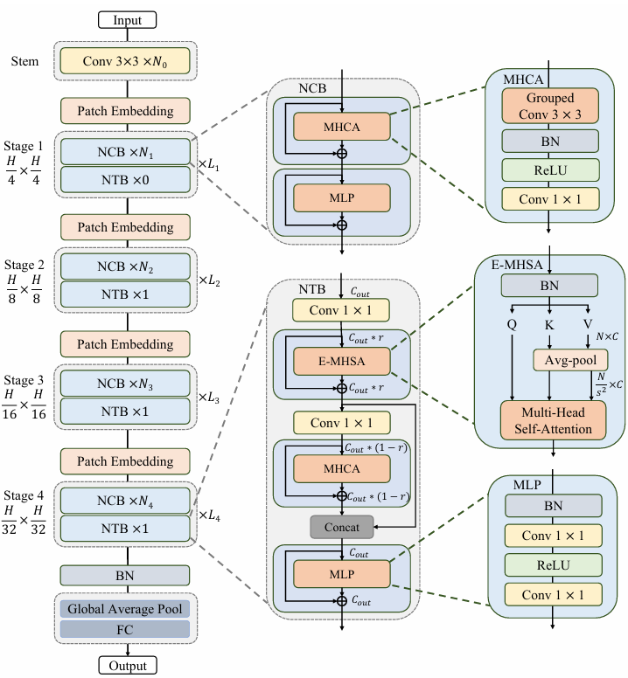
Next-ViT architecture
Hierarchical 4-stage pyramid
Progressive down-sampling
Channel expansion across stages
Hybrid CNN + Transformer pipeline
Patch embedding
Feature scaling per stage

Slide 9
Next Hybrid Strategy (NHS)
Next Convolution Block (NCB)
Next Transformer Block (NTB)
Traditional:
  CNN → CNN → Transformer
NHS:
  (NCB × N) + (NTB × 1) in every stage
NHS Block Pattern
  (NCB × N + NTB × 1) × L
  Transformer appears in all stages
  Maintains efficiency
  Improves downstream performance

Slide 10
Next Convolution Block (NCB)
Captures local spatial features
CNN-like efficiency
Transformer-like structure
Designed for low latency
NCB Structure:
  Multi-Head Convolutional Attention (MHCA)
  MLP

Slide 11
  Multi-Head Convolutional Attention (MHCA)
Replaces Self-Attention with group convolution
Multi-head channel splitting
Efficient local attention
Hardware-friendly implementation

Slide 12
  Next Transformer Block (NTB)
Captures global dependencies
Handles long-range context
Mixes low-frequency & high-frequency signals
Lightweight Transformer design
NTB Structure:
  Efficient MHSA (E-MHSA)
  MHCA (local refinement)
  MLP

Slide 13
  Efficient Multi-Head Self-Attention
  (E-MHSA)
Spatial reduction before attention
Average pooling reduces token count
Lower compute cost than standard MHSA

Slide 14
  Multi-Frequency Signal Mixing
E-MHSA = low-frequency (global)
MHCA = high-frequency (local
Concatenation merges both
Improves texture + structure representation

Slide 15
State Space Models for vision tasks

Slide 16
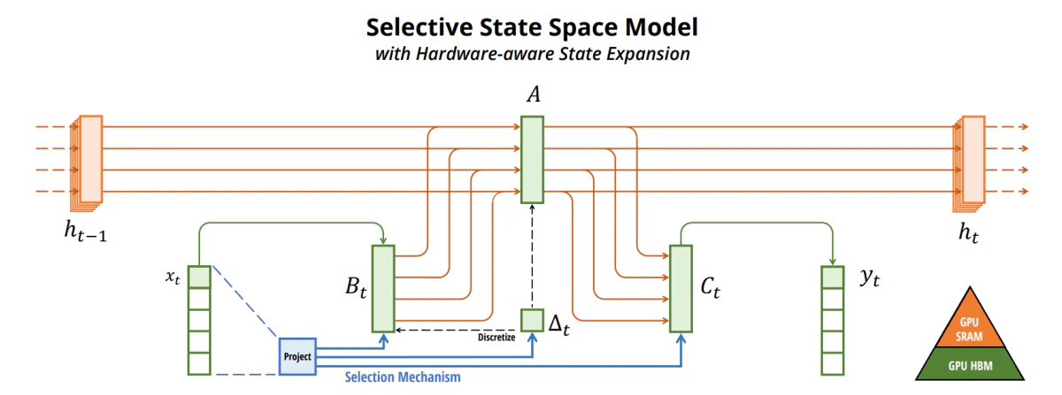
Emergence of State Space Models (SSMs)
Mamba introduces selective SSMs
Linear complexity O(N)
Data-dependent selection
Competitive with Transformers in language

Slide 17
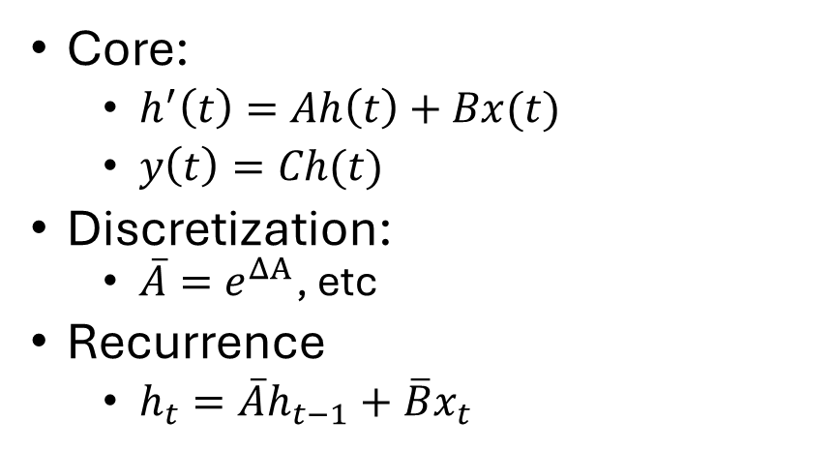
Theoretical Foundations: Continuous SSM
Core:
  $h^{′}\left(t\right)=Ah\left(t\right)+Bx(t)$
  $y\left(t\right)=Ch(t)$
Discretization:
  $\overline{A}=e^{ΔA}$, etc
Recurrence
  $h_{t}=\overline{A}h_{t−1}+\overline{B}x_{t}$

Slide 18
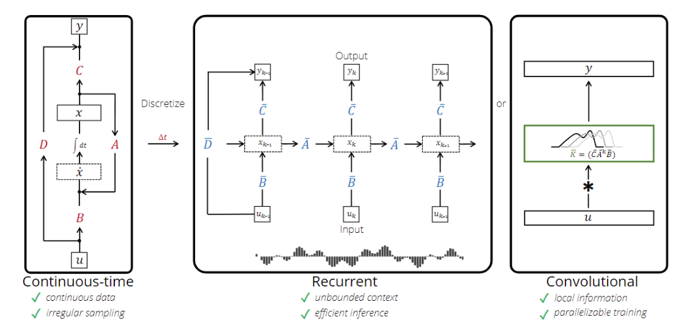
Discretization & Efficient Views
Recurrence → efficient inference
Unrolled → global convolution (parallel training)

Slide 19
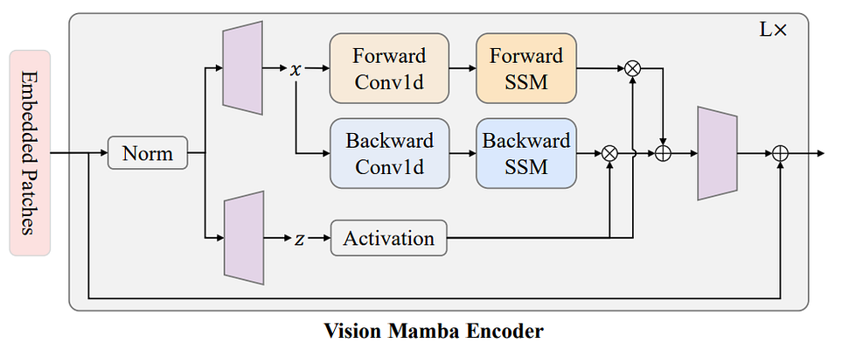
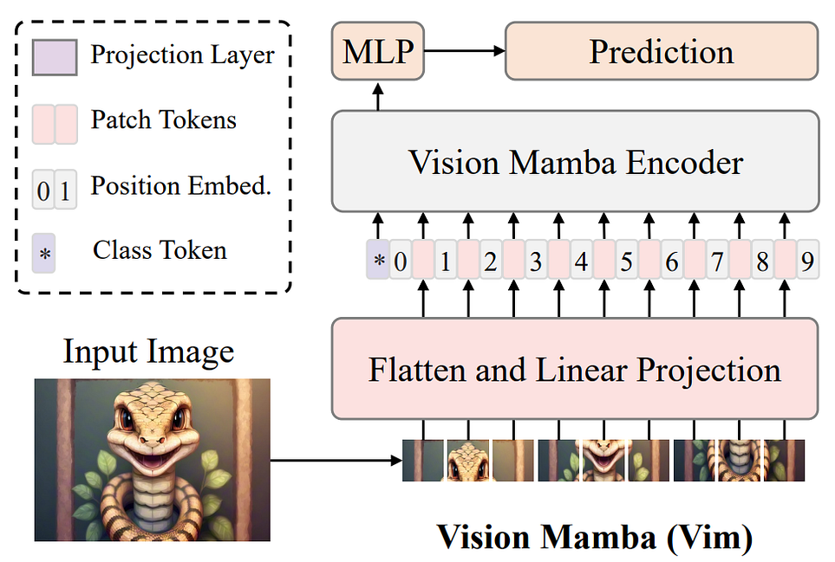
The Vision-Mamba Gap & Hybrid Motivation
Direct 1D → 2D adaptation hard:
Images are non-causal, isotropic
Bidirectional context needed
Early attempts (Vim, VMamba):
Bi-/cross-scan
latency overhead
incomplete global context
MambaVision insight:
Hybrid
Best-of-both-worlds

Slide 20
Theoretical Challenges in Vision & Hybrid Solution
Unidirectional recurrence vs. isotropic image context
Information dilution over long flattened sequences
MambaVision solution
Don't force SSM to do everything
Pair with attention at end for global reasoning

Slide 21
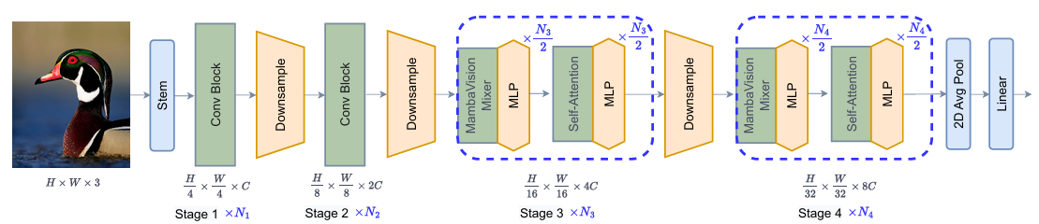
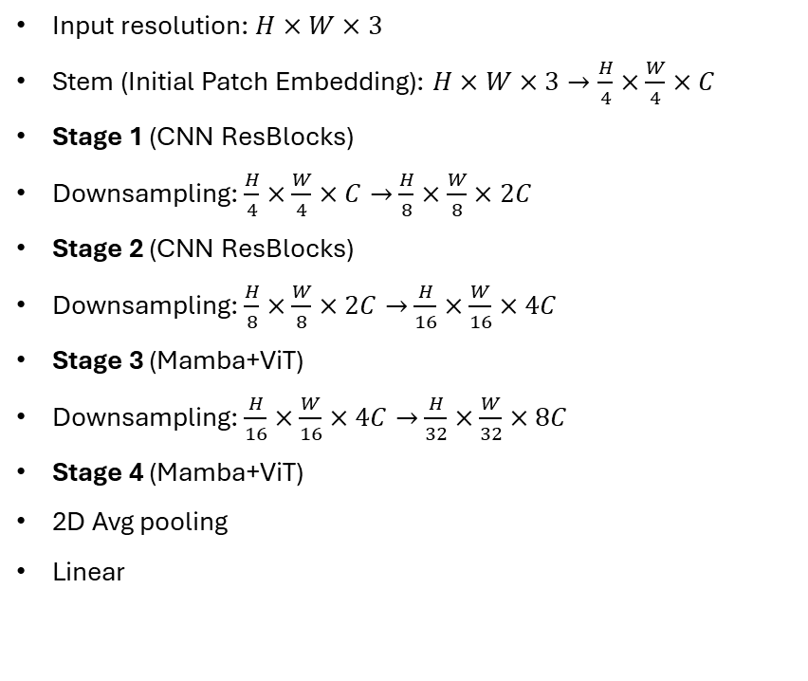
Macro Design – Hierarchical Structure
Input resolution: $H×W×3$
Stem (Initial Patch Embedding): $H×W×3→\frac{H}{4}×\frac{W}{4}×C$
Stage 1 (CNN ResBlocks)
Downsampling: $\frac{H}{4}×\frac{W}{4}×C→$ $\frac{H}{8}×\frac{W}{8}×2C$
Stage 2 (CNN ResBlocks)
Downsampling: $\frac{H}{8}×\frac{W}{8}×2C→$ $\frac{H}{16}×\frac{W}{16}×4C$
Stage 3 (Mamba+ViT)
Downsampling: $\frac{H}{16}×\frac{W}{16}×4C→$ $\frac{H}{32}×\frac{W}{32}×8C$
Stage 4 (Mamba+ViT)
2D Avg pooling
Linear

Slide 22
Early Stages – Why CNNs?
High-res → mostly local dependencies
Conv ResBlocks: Efficient edge/texture detection
Avoid wasteful SSM/Attention at high resolution

Slide 23
Hybrid Stages
First half layers → MambaVision Mixer (linear complexity)
Second half → Self-Attention
SSM pre-processes → refined features → attention maximizes value

Slide 24
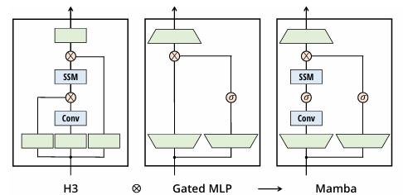
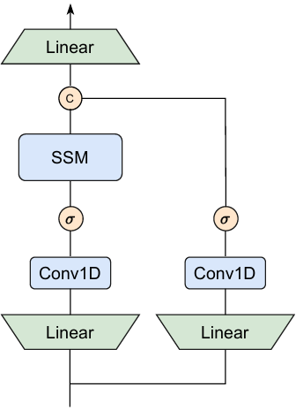
Micro Design – MambaVision Mixer
Causal conV → Regular conv
Improved performance across all metrics
Gating → Concat
Learns richer feature representations
Enhanced global context understanding
Symmetric dual-branch:
Branch 1: Selective Scan (long-range)
Branch 2: Additional conv
MambaVision

Slide 25
Experimental Results

Slide 26
Imports
import time
import random
import torch
from PIL import Image
from tqdm import tqdm
from pycocotools.coco import COCO
from transformers import AutoModelForImageClassification, pipeline
from timm.data.transforms_factory import create_transform
import torchvision

Slide 27
Config
COCO_ROOT = "coco"
ANN_FILE = f"{COCO_ROOT}/annotations/instances_val2017.json"
IMG_DIR = f"{COCO_ROOT}/val2017"
NUM_IMAGES = 100
RESOLUTION = 224
DEVICE = "cuda" if torch.cuda.is_available() else "cpu"

Slide 28
Load COCO
coco = COCO(ANN_FILE)
img_ids = coco.getImgIds()
sample_ids = random.sample(img_ids, NUM_IMAGES)
cat_map = coco.loadCats(coco.getCatIds())
coco_id_to_name = {c["id"]: c["name"] for c in cat_map}

Slide 29
Load Models
print("Loading NextViT...")
pipe = pipeline("image-classification", model="timm/nextvit_small.bd_in1k", device=0)
print("Loading MambaVision...")
model_name = "nvidia/MambaVision-B-21K"
model = AutoModelForImageClassification.from_pretrained(model_name, trust_remote_code=True)
model.eval().to(DEVICE)
print("✅ Models loaded")

Slide 30
Mamba transform
input_resolution = (3, RESOLUTION, RESOLUTION)
transform = create_transform(
input_size=input_resolution,
is_training=False,
mean=model.config.mean,
std=model.config.std,
crop_mode=model.config.crop_mode,
crop_pct=model.config.crop_pct
)

Slide 31
COCO → IMAGENET NAME MATCH
imagenet_labels = model.config.id2label
def coco_to_imagenet_match(coco_names, pred_label):
pred_label = pred_label.lower()
for coco_name in coco_names:
if coco_name.lower() in pred_label or pred_label in coco_name.lower():
return True
return False

Slide 32
Benchmark Initialization
correct_mamba = 0
correct_nextvit = 0
total = 0
mamba_time = 0
nextvit_time = 0
print("Running COCO benchmark...")

Slide 33
GPU Warmup
for img_id in sample_ids[:5]:
img_info = coco.loadImgs(img_id)[0]
img_path = f"{IMG_DIR}/{img_info['file_name']}"
img = Image.open(img_path).convert("RGB")
inputs = transform(img).unsqueeze(0).cuda()
with torch.no_grad():
_ = model(inputs)
_ = pipe(img_path)
torch.cuda.synchronize()

Slide 34
Evaluation Loop
for img_id in tqdm(sample_ids):
img_info = coco.loadImgs(img_id)[0]
img_path = f"{IMG_DIR}/{img_info['file_name']}"
img = Image.open(img_path).convert("RGB")
# GT labels from COCO
ann_ids = coco.getAnnIds(imgIds=img_id)
anns = coco.loadAnns(ann_ids)
coco_labels = set()
for ann in anns:
coco_labels.add(coco_id_to_name[ann["category_id"]])
if len(coco_labels) == 0:
continue

Slide 35
Model inference
# ---------------- MAMBA ----------------
inputs = transform(img).unsqueeze(0).cuda()
torch.cuda.synchronize()
t0 = time.time()
with torch.no_grad():
outputs = model(inputs)
torch.cuda.synchronize()
mamba_time += time.time() - t0
logits = outputs["logits"]
mamba_idx = logits.argmax(-1).item()
mamba_label = model.config.id2label[mamba_idx]
# ---------------- NEXTVIT ----------------
torch.cuda.synchronize()
t0 = time.time()
nextvit_out = pipe(img_path)
torch.cuda.synchronize()
nextvit_time += time.time() - t0
nextvit_label = nextvit_out[0]["label"]
# ---------------- ACCURACY ----------------
if coco_to_imagenet_match(coco_labels, mamba_label):
correct_mamba += 1
if coco_to_imagenet_match(coco_labels, nextvit_label):
correct_nextvit += 1
total += 1

Slide 36
Printing Results
mamba_acc = correct_mamba / max(total, 1)
nextvit_acc = correct_nextvit / max(total, 1)
mamba_tput = total / mamba_time
nextvit_tput = total / nextvit_time
print("\n================ COCO RESULTS ================")
print(f"Images evaluated: {total}")
print("----------------------------------------------")
print(f"MambaVision Top-1 Accuracy: {mamba_acc:.4f}")
print(f"NextViT Top-1 Accuracy: {nextvit_acc:.4f}")
print("----------------------------------------------")
print(f"MambaVision Throughput: {mamba_tput:.2f} img/sec")
print(f"NextViT Throughput: {nextvit_tput:.2f} img/sec")
print("==============================================")

Slide 37
Results
Evaluated 100 images from COCO dataset
MambaVision:
  Higher accuracy
  Higher throughput
Both accuracies are low (COCO for evaluation vs ImageNet for training)
================ COCO RESULTS ================
Images evaluated: 100
----------------------------------------------
MambaVision Top-1 Accuracy: 0.3800
NextViT Top-1 Accuracy: 0.3300
----------------------------------------------
MambaVision Throughput: 38.38 img/sec
NextViT Throughput: 26.20 img/sec
==============================================

Slide 38
Conclusion - Redefining the Efficiency-Accuracy Frontier in Computer Vision

Slide 39
Conclusion - Redefining the Efficiency-Accuracy Frontier in Computer Vision
Vision Backbone Evolution
MambaVision
Key Innovations
Broader Impact
CNNs: Efficient, local (translation invariance)
ViTs: Global context via self-attention, but quadratic cost
SSMs (Mamba): Linear-time modeling, strong in language, challenging for 2D non-causal images
Novel hybrid architecture: CNN + SSM (Mamba) + Transformer
Redesigned "vision-friendly" Mamba block: Removes causality, adds symmetric branches
Self-attention integrated only in final stages → balances efficiency & global modeling
Strong results in downstream tasks: object detection, semantic segmentation
Scalable for foundation model pre-training
Blueprint for next-gen efficient, high-performance vision backbones
Performance Breakthrough
Achieves new state-of-the-art Pareto front on ImageNet-1K
Superior Top-1 accuracy and image throughput tradeoff

Slide 40
Conclusion - Redefining the Efficiency-Accuracy Frontier in Computer Vision
Vision Backbone Evolution
MambaVision
Key Innovations
Broader Impact
CNNs: Efficient, local (translation invariance)
ViTs: Global context via self-attention, but quadratic cost
SSMs (Mamba): Linear-time modeling, strong in language, challenging for 2D non-causal images
Novel hybrid architecture: CNN + SSM (Mamba) + Transformer
Redesigned "vision-friendly" Mamba block: Removes causality, adds symmetric branches
Self-attention integrated only in final stages → balances efficiency & global modeling
Strong results in downstream tasks: object detection, semantic segmentation
Scalable for foundation model pre-training
Blueprint for next-gen efficient, high-performance vision backbones
Performance Breakthrough
Achieves new state-of-the-art Pareto front on ImageNet-1K
Superior Top-1 accuracy and image throughput tradeoff

Slide 41
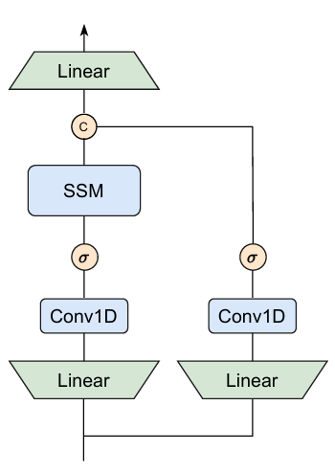
Conclusion - Redefining the Efficiency-Accuracy Frontier in Computer Vision
Vision Backbone Evolution
MambaVision
Key Innovations
Broader Impact
CNNs: Efficient, local (translation invariance)
ViTs: Global context via self-attention, but quadratic cost
SSMs (Mamba): Linear-time modeling, strong in language, challenging for 2D non-causal images
Novel hybrid architecture: CNN + SSM (Mamba) + Transformer
Redesigned "vision-friendly" Mamba block: Removes causality, adds symmetric branches
Self-attention integrated only in final stages → balances efficiency & global modeling
Strong results in downstream tasks: object detection, semantic segmentation
Scalable for foundation model pre-training
Blueprint for next-gen efficient, high-performance vision backbones
Performance Breakthrough
Achieves new state-of-the-art Pareto front on ImageNet-1K
Superior Top-1 accuracy and image throughput tradeoff

Slide 42
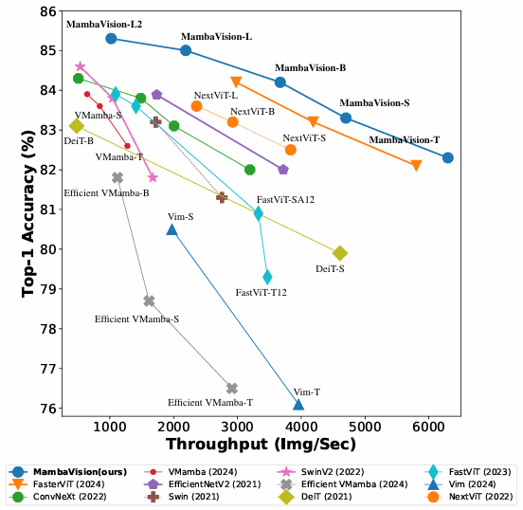
Conclusion - Redefining the Efficiency-Accuracy Frontier in Computer Vision
Vision Backbone Evolution
MambaVision
Key Innovations
Broader Impact
CNNs: Efficient, local (translation invariance)
ViTs: Global context via self-attention, but quadratic cost
SSMs (Mamba): Linear-time modeling, strong in language, challenging for 2D non-causal images
Novel hybrid architecture: CNN + SSM (Mamba) + Transformer
Redesigned "vision-friendly" Mamba block: Removes causality, adds symmetric branches
Self-attention integrated only in final stages → balances efficiency & global modeling
Strong results in downstream tasks: object detection, semantic segmentation
Scalable for foundation model pre-training
Blueprint for next-gen efficient, high-performance vision backbones
Performance Breakthrough
Achieves new state-of-the-art Pareto front on ImageNet-1K
Superior Top-1 accuracy and image throughput tradeoff

Slide 43
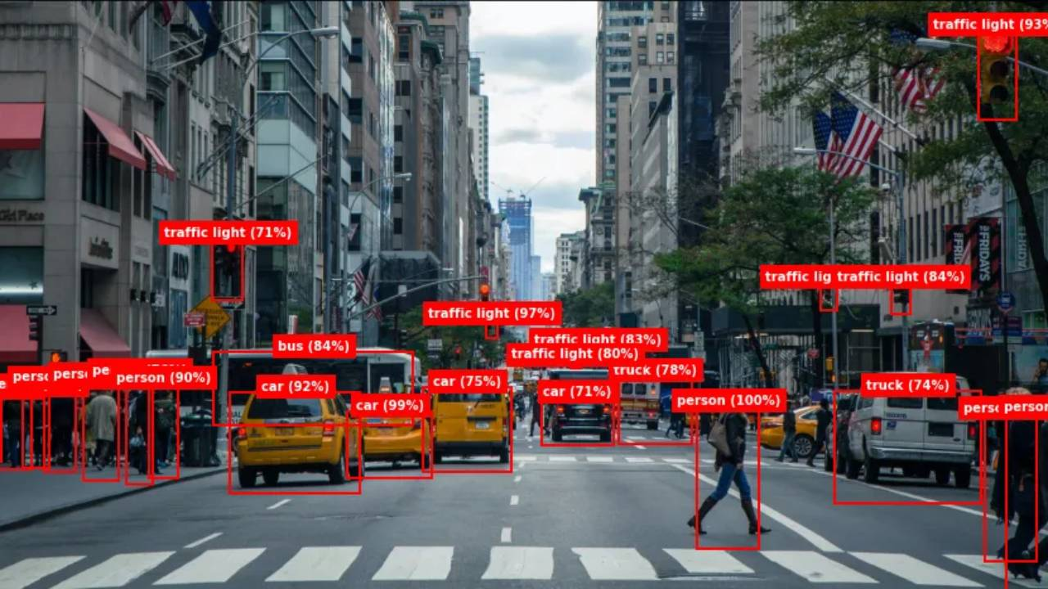
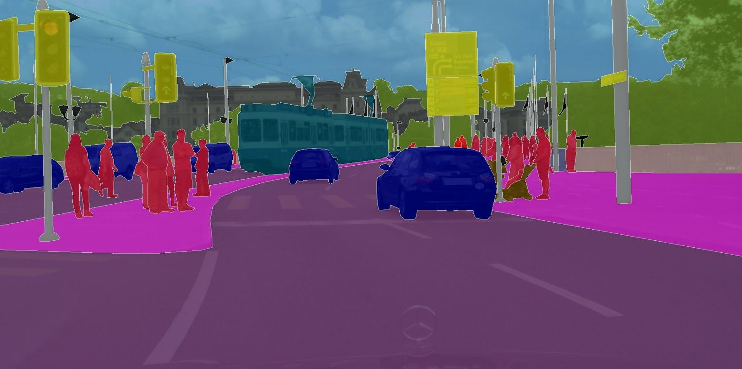
Conclusion - Redefining the Efficiency-Accuracy Frontier in Computer Vision
Vision Backbone Evolution
MambaVision
Key Innovations
Performance Breakthrough
Broader Impact
CNNs: Efficient, local (translation invariance)
ViTs: Global context via self-attention, but quadratic cost
SSMs (Mamba): Linear-time modeling, strong in language, challenging for 2D non-causal images
Novel hybrid architecture: CNN + SSM (Mamba) + Transformer
Redesigned "vision-friendly" Mamba block: Removes causality, adds symmetric branches
Self-attention integrated only in final stages → balances efficiency & global modeling
Achieves new state-of-the-art Pareto front on ImageNet-1K
Superior Top-1 accuracy and image throughput tradeoff
Strong results in downstream tasks: object detection, semantic segmentation
Scalable for foundation model pre-training
Blueprint for next-gen efficient, high-performance vision backbones

