Slide 1
A Quantitative Comparison of Docker Containers vs Multithreading
George Aslanidis

Slide 2
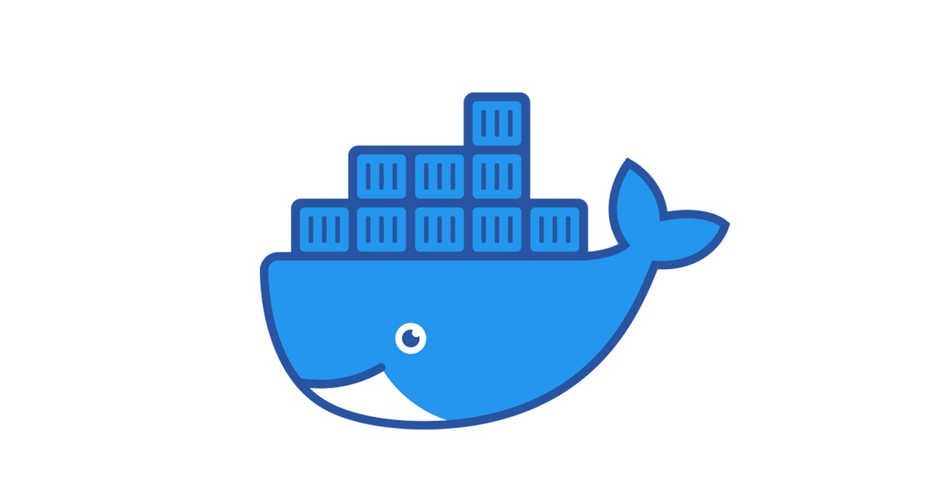
Introduction
Goal:
  To understand when Multiple Docker Containers and Multithreading Should be Used
Comparing Two Execution Models:
  Multithreading (Gunicorn with 20 Threads)
  Multiple Docker Containers (20 Containers)
Same Flask Application
Measure:
  CPU Usage
  Memory Usage

Slide 3
Basic Concepts
Threads:
  Multiple threads in one process
  Shared Memory
  Lightweight and Efficient
  Less Isolation
Containers:
  Run as Separate Processes
  Isolated Environments
  Different Dependencies and Memory
  Higher Resource Usage

Slide 4
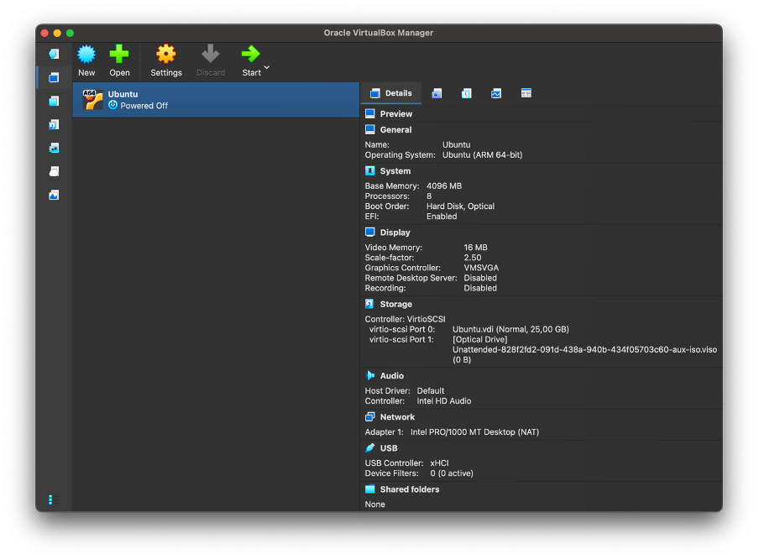
Setup
Oracle VirtualBox
Linux Ubuntu 6.14.0-37-generic

Slide 5
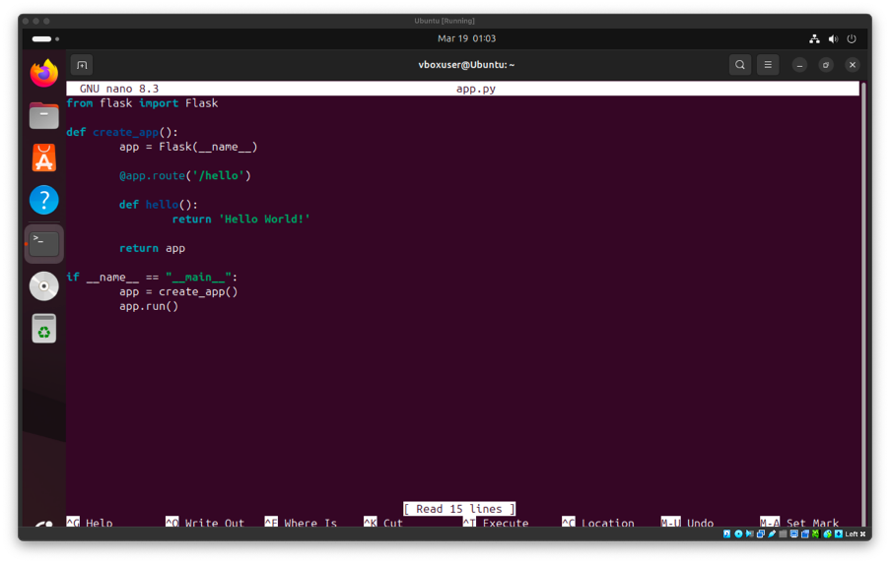
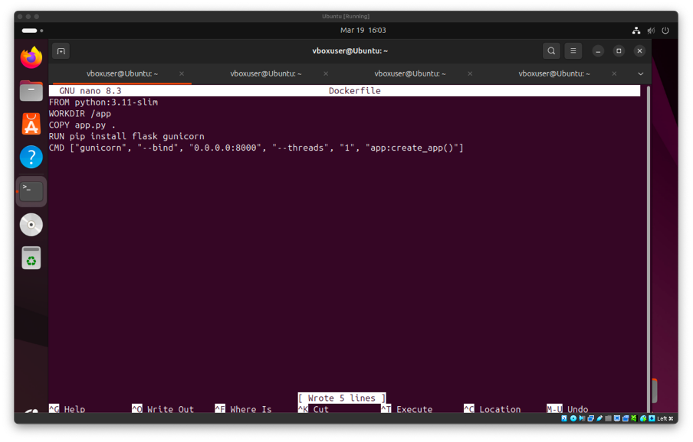
Setup
Flask Application
Dockerfile for the Creation of the Image

Slide 6
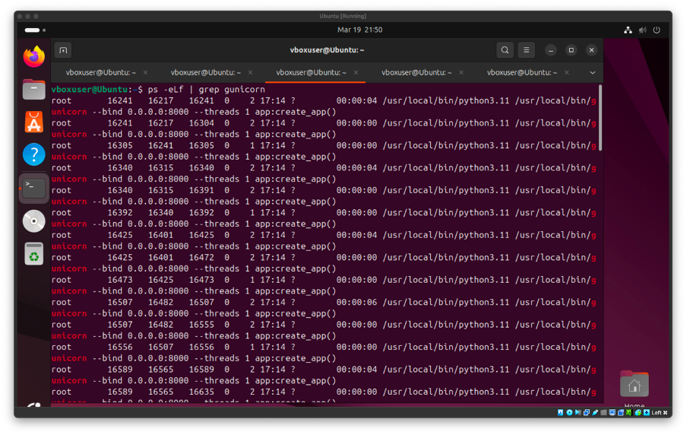
Multithread Experiment
Execution (Starting the Threads):
  gunicorn --threads 20 'app:create_app()'
Verification for the Threads:
  ps -eLf | grep gunicorn
Send 20 Requests:
  for i in {1..20}; do curl http://127.0.0.1:8000/hello & done; wait

Slide 7
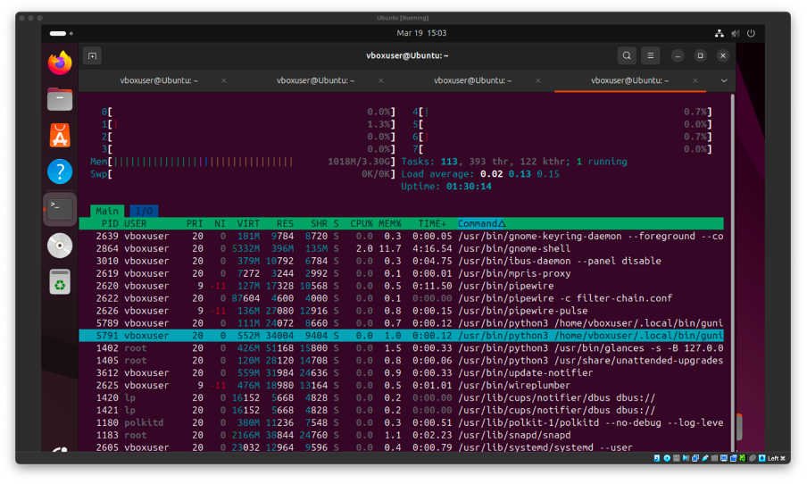
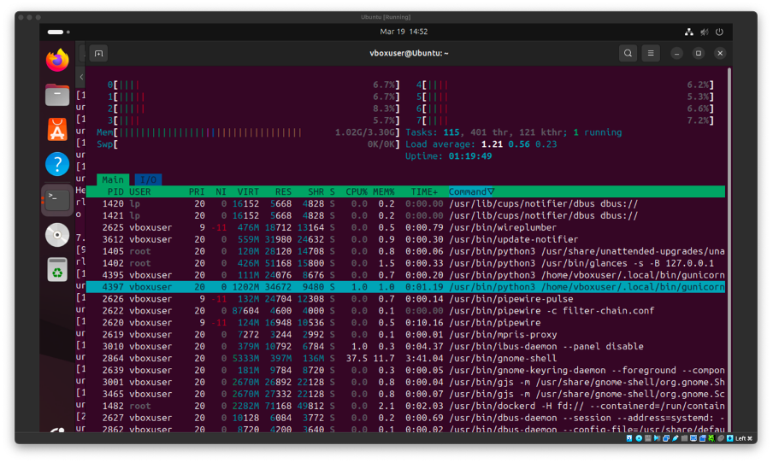
Multithread Experiment
System is in Idle State (No Requests)
During Concurrent Requests
CPU: 0% - 1%
Memory: 1.018GB
CPU: 5% - 8%
Memory: 1.02GB

Slide 8
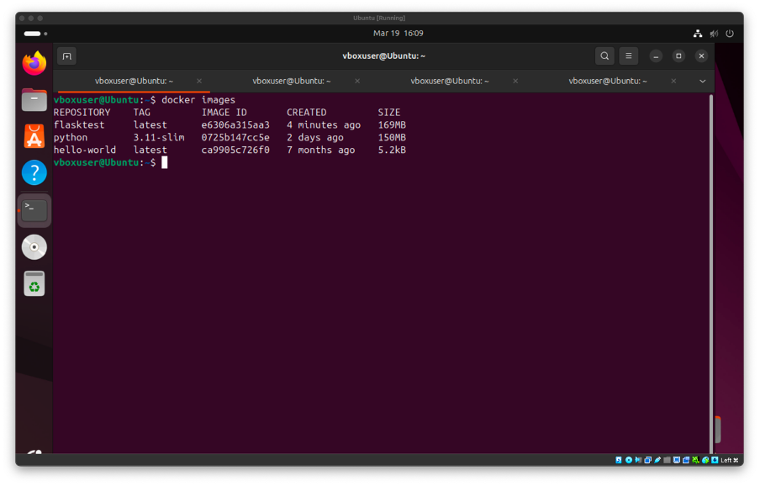
Docker Experiment
Image Creation:
  docker build -t flasktest .
Creation of 20 Docker Containers:
  for i in {1..20}; do docker run -d -p $((8000+i)):8000 flasktest; done
Send 20 Requests:
  for i in {1..20}; do curl http://127.0.0.1:$((8000+i))/hello & done; wait

Slide 9
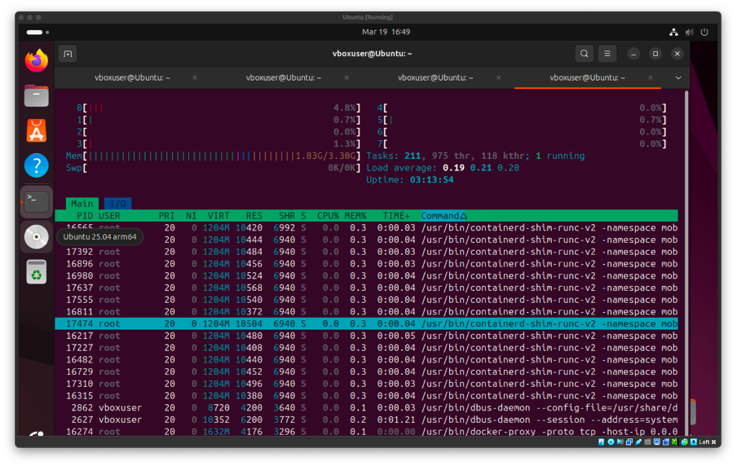
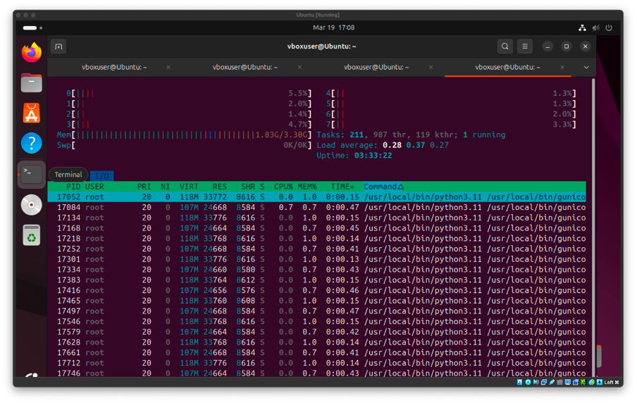
Docker Experiment
System is in Idle State (No Requests)
During Concurrent Requests
CPU: 0% - 4%
Memory: 1.83GB
CPU: 1% - 5%
Memory: 1.83GB

Slide 10
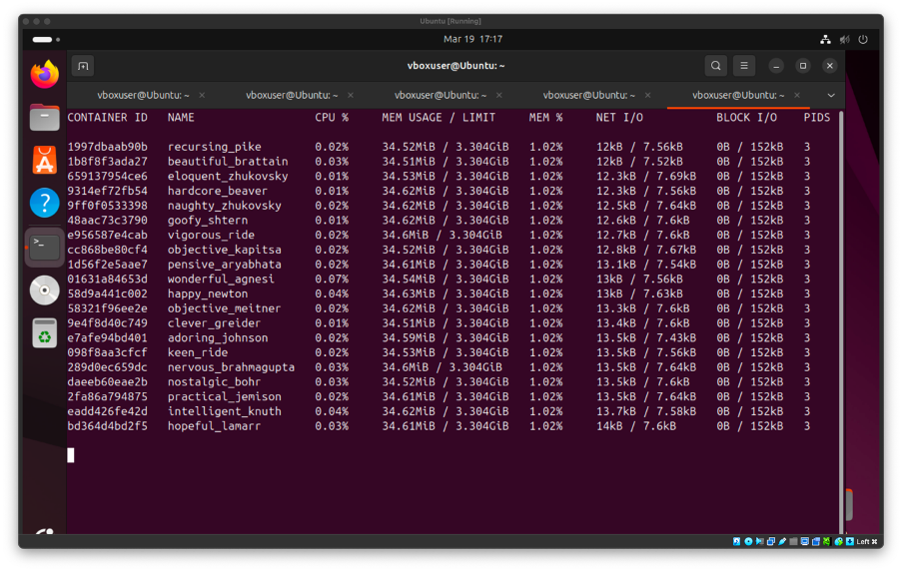
Docker Experiment
docker stats
CPU: 0.01% - 0.04%
Memory: 1.83GB
Containers (Processes): 20

Slide 11
Comparison
CPU Usage:
  Similar in both cases
    Multithreading: 0% - 8%
    Docker Containers: 0% - 5%
Memory Usage:
  Higher in Containers
    1.83GB
Threads Share Memory
Containers Use Separate Resources

Slide 12
Conclusion
Multithreading:
  Low Memory Usage
  Efficient
Containers:
  Higher Memory Usage
  Isolation
  Easier to Deploy
  Better Scalability

Slide 13
Bibliography
[1] “What is Docker?,” Docker Documentation. Accessed: Mar. 18, 2026. [Online]. Available: https://docs.docker.com/get-started/docker-overview/
[2] A. Silberschatz, P. B. Galvin, and G. Gagne, Operating System Concepts Essentials, 2nd ed. Hoboken, NJ, USA: Wiley, 2013.
[3] “Application Setup — Flask Documentation (3.1.x).” Accessed: Mar. 19, 2026. [Online]. Available: https://flask.palletsprojects.com/en/stable/tutorial/factory/
[4] “Gunicorn - Python WSGI HTTP Server for UNIX.” Accessed: Mar. 19, 2026. [Online]. Available: https://gunicorn.org/quickstart/
[5] “Looping Statements | Shell Script,” GeeksforGeeks. Accessed: Mar. 19, 2026. [Online]. Available: https://www.geeksforgeeks.org/linux-unix/looping-statements-shell-script/

Slide 14
Thank You!

