Slide 1




Loan Approval Prediction and Analysis Using Machine Learning and Power BI
DATA MINING & WAREHOUSING (DMW) PROJECT
Supervised Machine Learning — Binary Classification | Finance / Banking
Atharva Gaikwad - 09

Slide 2



Introduction
Loan decisions in banking
Data-driven approach
Banks assess every application before approving a loan.
Historical application data can reveal patterns linked to approval.
Machine learning
Business intelligence
Classification models predict whether a loan is approved or rejected.
Power BI turns the data into an interactive dashboard.

Slide 3



Problem Statement
Given an applicant's personal and financial details, predict whether the loan application will be Approved or Rejected.
Input
Model
Output
Applicant profile, income, loan details, credit history, property area
Logistic Regression and K-Nearest Neighbors
loan_status: Approved (1) or Rejected (0)

Slide 4
Objectives
1
Analyze loan application data to identify useful patterns
2
Clean, encode and prepare the data for machine learning
3
Predict loan approval using Logistic Regression and KNN
4
Compare the models using accuracy, precision, recall and F1 score
5
Build an interactive Power BI dashboard for loan analysis

Slide 5
Dataset & Attributes
Column | Meaning
loan_id | Unique ID of the loan application
gender | Gender of the applicant
married | Marital status of the applicant
dependents | Number of dependents
education | Education level of the applicant
self_employed | Whether the applicant is self-employed
applicantincome | Income of the applicant
coapplicantincome | Income of the co-applicant
loanamount | Loan amount requested
loan_amount_term | Repayment term of the loan
credit_history | Credit history indicator
property_area | Area where the property is located
loan_status | Loan outcome: approved or rejected
TARGET VARIABLE
loan_status
Y = Loan Approved
N = Loan Rejected
loan_id
Identifier only, so it is excluded from the 11 input features
Records in dataset: 614

Slide 6
Data Preprocessing
Loaded the loan dataset using Pandas
Checked dataset structure and data types
Handled missing values
1
2
3
Cleaned categorical values
Converted target: Y → 1 (Approved), N → 0 (Rejected)
Removed loan_id from the ML features
4
5
6
Encoded categorical variables for machine learning
Split the data into training and testing sets
Prepared the data for classification models
7
8
9

Slide 7








Exploratory Data Analysis
Analysis was performed to identify the relationship between each attribute and loan approval.
Approval distribution
Approved vs rejected applications
Credit history
Relationship with loan status
Property area
Relationship with loan status
Education
Relationship with loan status
Gender
Relationship with loan status
Applicant income
Distribution and link to approval
Co-applicant income
Distribution and link to approval
Loan amount
Distribution and link to approval
Loan amount term
Distribution and link to approval

Slide 8
Machine Learning Methodology
01
Dataset
02
Data Cleaning
03
Exploratory Data Analysis
04
Feature Preparation
05
Train/Test Split
Target: loan_status
Approved = 1, Rejected = 0
09
Power BI Dashboard
08
Prediction
07
Model Evaluation
06
Logistic Regression + KNN
Both models were evaluated using accuracy, precision, recall and F1 score.

Slide 9
Logistic Regression
A classification algorithm for binary outcomes
Estimates the probability that an application is approved
Probability is converted to a class: Approved (1) or Rejected (0)
Simple, fast and easy to interpret
Applicant features
Estimated probability of approval
Predicted class: 1 (Approved) or 0 (Rejected)
86.18%
Accuracy
84.00%
Precision
98.82%
Recall
90.81%
F1 Score

Slide 10
K-Nearest Neighbors (KNN)
Classifies an applicant using nearby observations
Finds the K most similar applicants in the data
Assigns the class most common among those neighbors
Simple, distance-based method
Value of K used: 5
Approved
Rejected
New applicant
Illustrative
81.30%
Accuracy
81.00%
Precision
95.29%
Recall
87.57%
F1 Score

Slide 11
Model Performance Comparison
Metric | Logistic Regression | KNN
Accuracy | 86.18% | 81.30%
Precision | 84.00% | 81.00%
Recall | 98.82% | 95.29%
F1 Score | 90.81% | 87.57%
Logistic Regression performed better overall in this project, leading on all four evaluated metrics.

Slide 12
New Applicant Prediction
Attribute | Test applicant value
Gender | Male
Married | Yes
Dependents | 1
Education | Graduate
Self Employed | No
Applicant Income | 6000
Coapplicant Income | 1500
Loan Amount | 150
Loan Amount Term | 360
Credit History | 1
Property Area | Semiurban
Prediction generated using the trained Logistic Regression and KNN models.
Logistic Regression
Prediction: Approved
KNN
Prediction: Approved

Slide 13
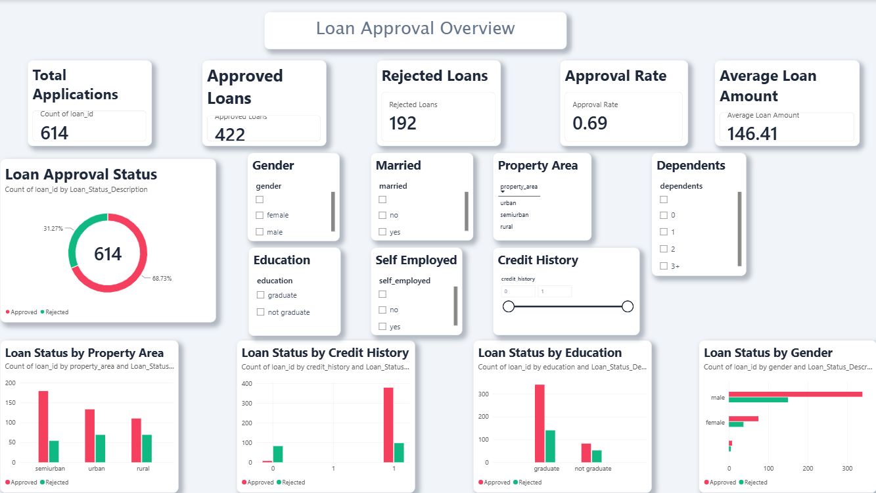
Power BI Dashboard
Total Applications
Approved Loans
Rejected Loans
Approval Rate
Average Loan Amount
Average Applicant Income
[ INSERT POWER BI DASHBOARD SCREENSHOT HERE ]
Replace this box with your final dashboard image
Visualizations
Loan approval status (donut)
Status by property area
Status by credit history
Status by education
Status by gender
Income vs loan amount (scatter)
Avg loan amount by education
Avg total income by loan status
Status by loan term
Self-employment distribution
Slicers
Gender, Education, Married, Self Employed, Credit History, Property Area, Dependents
Built with Power Query and DAX

Slide 14

Key Findings
86.18%
Logistic Regression accuracy
KNN: 81.30%
98.82%
Logistic Regression recall
KNN: 95.29%
90.81%
Logistic Regression F1 score
KNN: 87.57%
Logistic Regression led KNN on accuracy, precision, recall and F1 score in this project.
Both models showed high recall, identifying most of the approved applications.
Credit history, property area, education, gender and income attributes were explored against loan status.
The Power BI dashboard supports interactive exploration of these patterns.

Slide 15


Conclusion
Machine learning can assist in loan approval classification.
Logistic Regression achieved better overall performance than KNN on this dataset.
Credit history and financial/application attributes can be useful for loan analysis.
Power BI provides an interactive way to explore loan application patterns.
The project demonstrates the combination of machine learning and business intelligence.

Slide 16
Future Scope & References
Future Scope
References
Try additional classification algorithms
Hyperparameter tuning
Feature engineering
Larger and more recent datasets
Deployment as a web application / API
Real-time loan prediction
Explainable AI for individual predictions
Python documentation
docs.python.org
Pandas documentation
pandas.pydata.org
Scikit-learn documentation
scikit-learn.org
Microsoft Power BI documentation
learn.microsoft.com/power-bi
Kaggle: Loan Prediction dataset
kaggle.com

