Slide 2
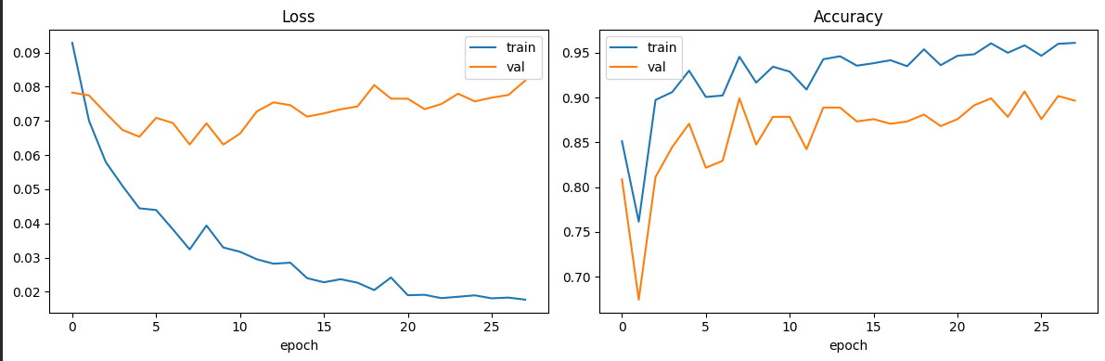
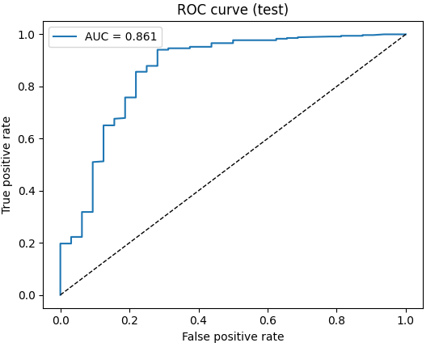
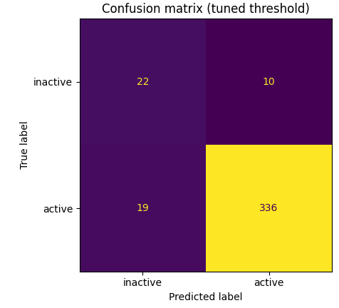
Classical DNN – Binary classifier
Best model: epoch 8, Val AUC 0.9085
Train AUC 0.9346
Test set results
Test accuracy: 0.9251
 | Threshold | Accuracy
DNN (thr=0.5) | 0.50 | 0.925
DNN (tuned thr) | 0.49 | 0.925

Slide 3
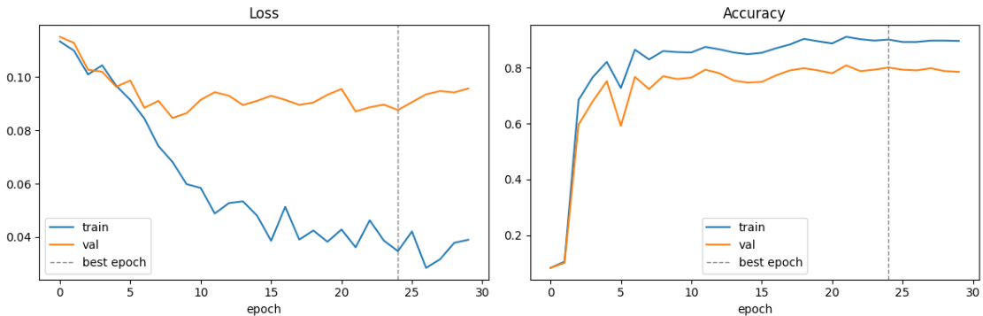
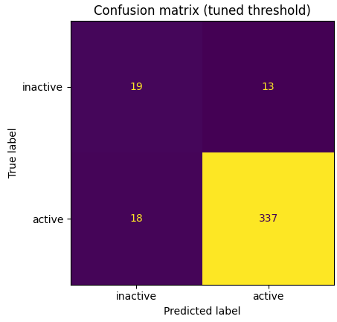
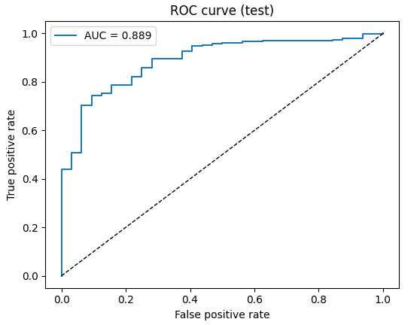
Hybrid QML- Binary classification – Basic entangler 4 qubits, 2 rep
Best epoch: 25
Train acc: 0.9012
Val acc: 0.8010
Test set results
 | threshold | accuracy
Qiskit hybrid (thr=0.5) | 0.50 | 0.853
Qiskit hybrid (tuned thr) | 0.07 | 0.920

Slide 4
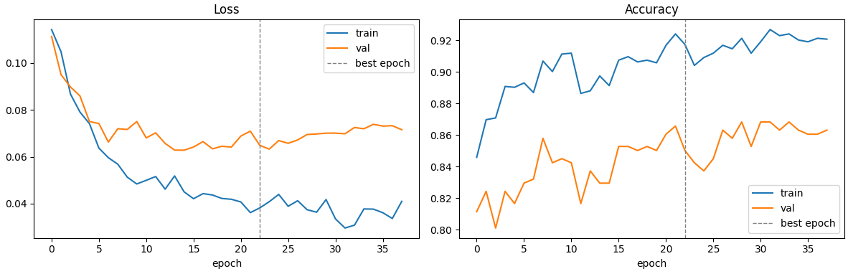
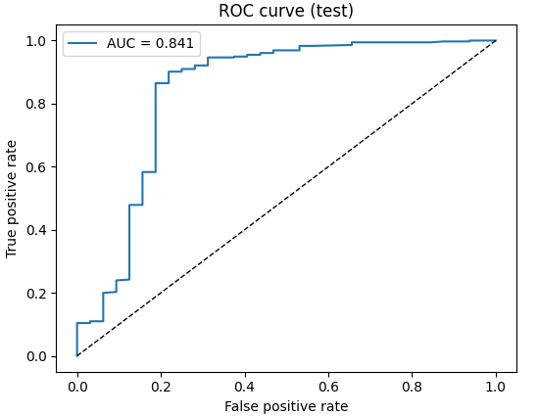
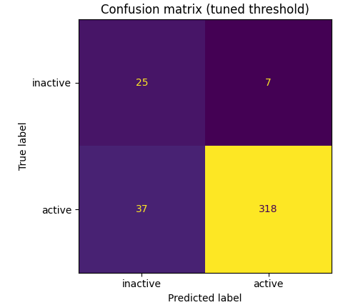
Hybrid QML- Binary classification – Basic entangler 4 qubits, 4 rep
Best epoch: 23
Train acc: 0.9174
Val acc: 0.8501
Test set results
 | threshold | accuracy
Hybrid QML (thr=0.5) | 0.50 | 0.884
Hybrid QML (tuned thr) | 0.47 | 0.886

Slide 5
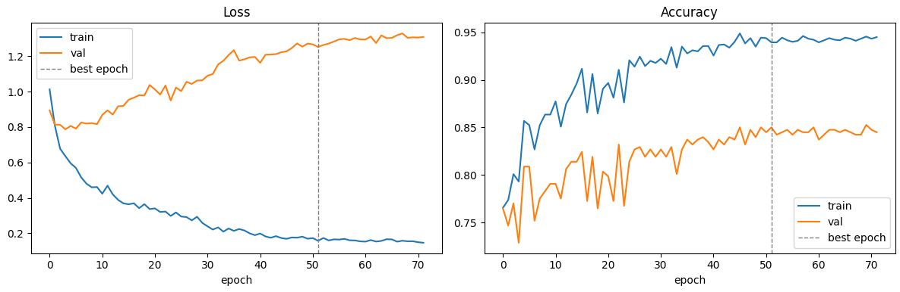
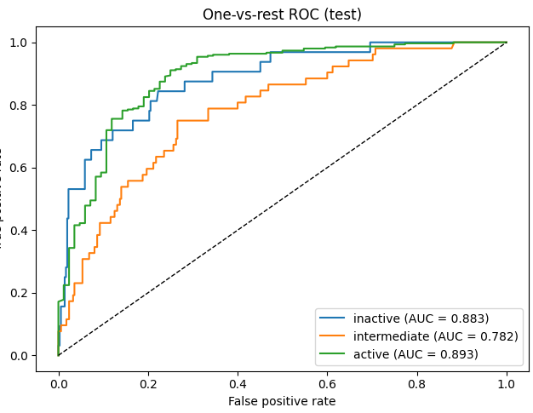
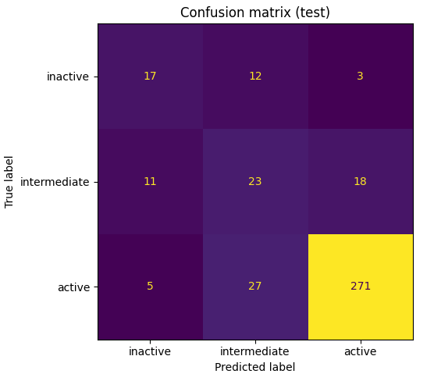
Classical DNN – Multi-class classification
Best epoch: 52
Train acc: 0.9395
Val acc: 0.8501
Test set results
Test samples: 387
Test accuracy: 0.8036

Slide 6
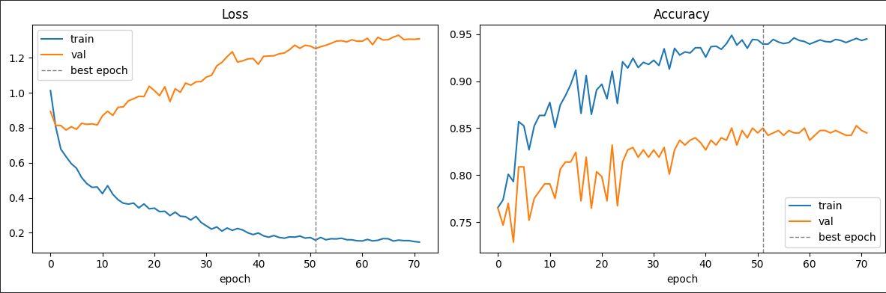
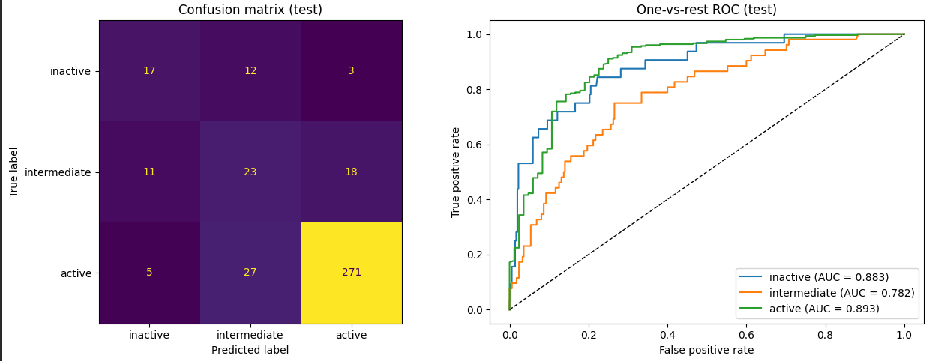
Hybrid QML- 3 class classification – Basic entangler 4 qubits, 2 rep
Best epoch: 52
Train acc: 0.9395
Val acc: 0.8501
Test set results
Test samples: 387 Test accuracy: 0.8036

Slide 7
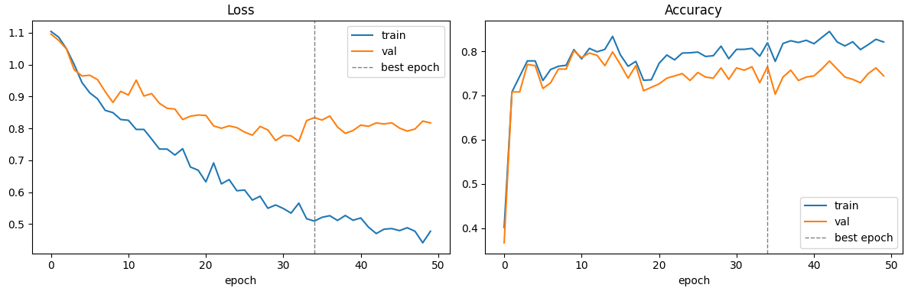
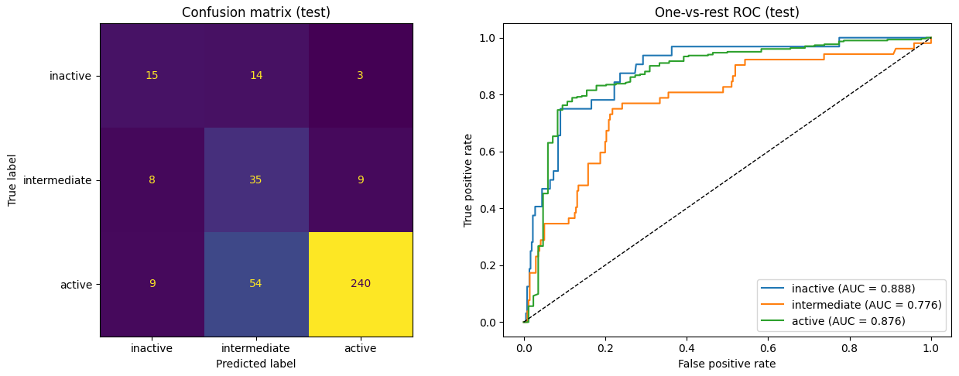
Hybrid QML- 3 class classification – Basic entangler 4 qubits, 4 rep
Best epoch: 35
Train acc: 0.8192
Val acc: 0.7649
Test set results
Test samples: 387 Test accuracy: 0.8036

Slide 8
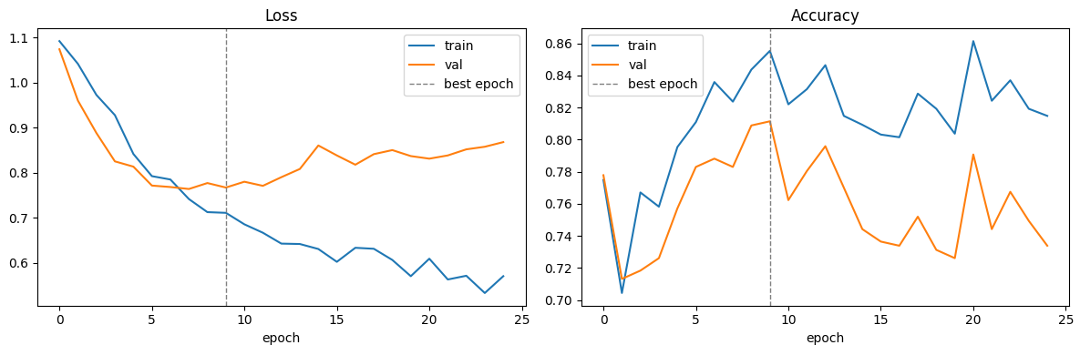
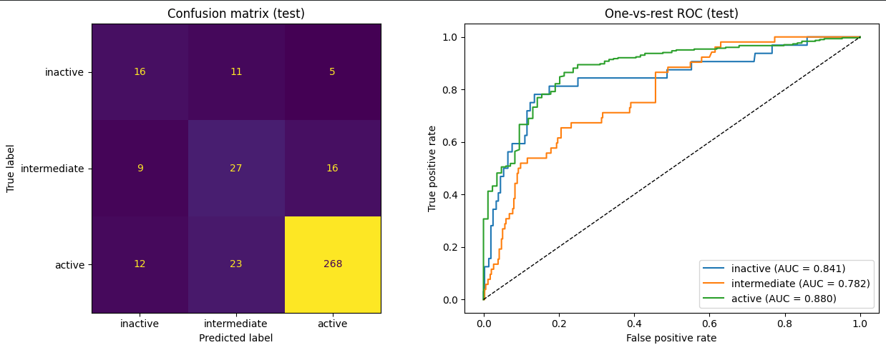
Hybrid QML- 3 class classification – Basic entangler 4 qubits, 8 rep
Best epoch: 10
Train acc: 0.8552
Val acc: 0.8114
Test set results
Test samples: 387 Test accuracy: 0.7494

Slide 9
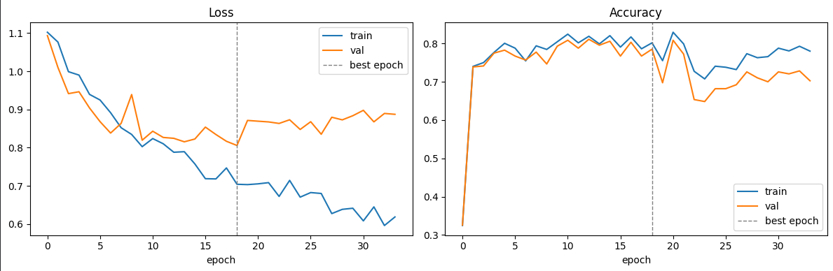
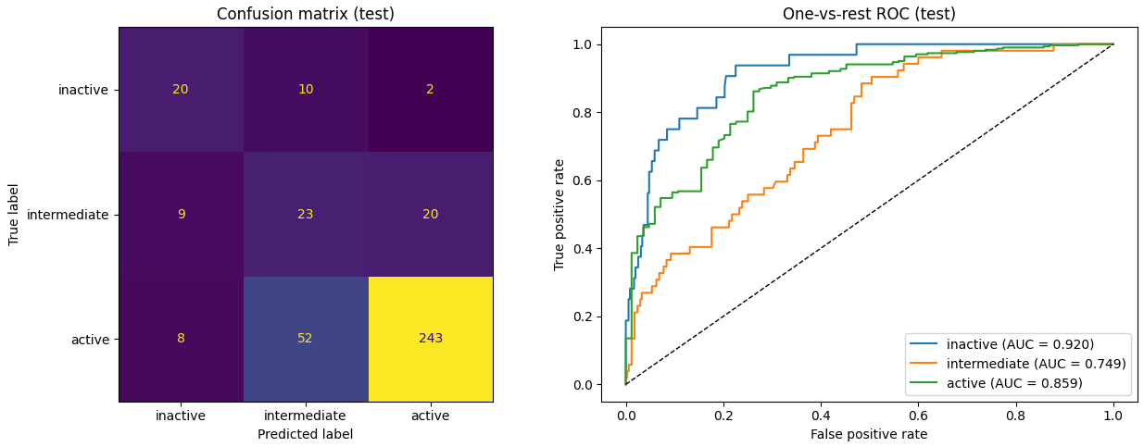
Hybrid QML- 3 class classification – Basic entangler 8 qubits, 2 rep
Best epoch: 19
Train acc: 0.8020
Val acc: 0.7855
Test set results
Test samples: 387 Test accuracy: 0.7390

Slide 10
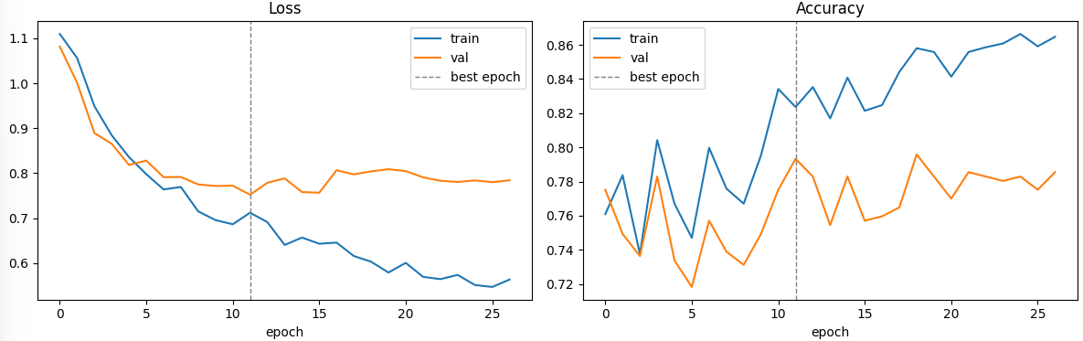
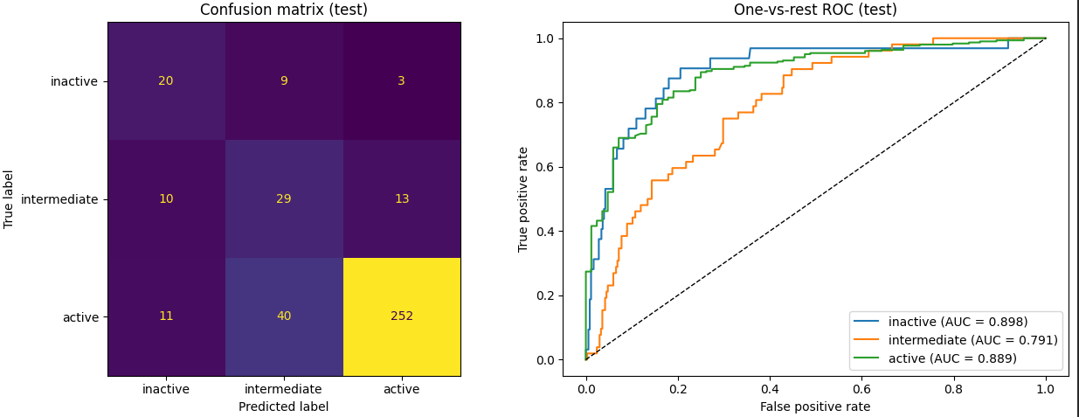
Hybrid QML- 3 class classification – Basic entangler 8 qubits, 4 rep
Best epoch: 12
Train acc: 0.8236
Val acc: 0.7933
Test set results
Test samples: 387 Test accuracy: 0.7778

Slide 11
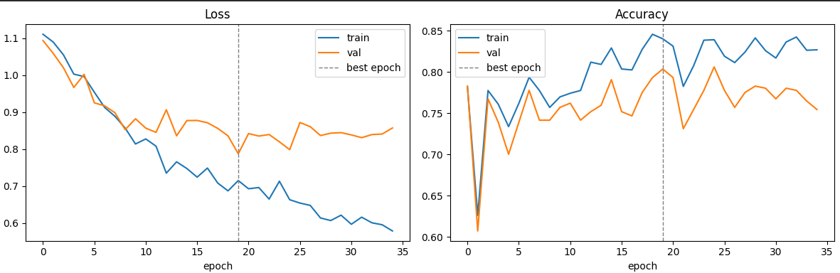
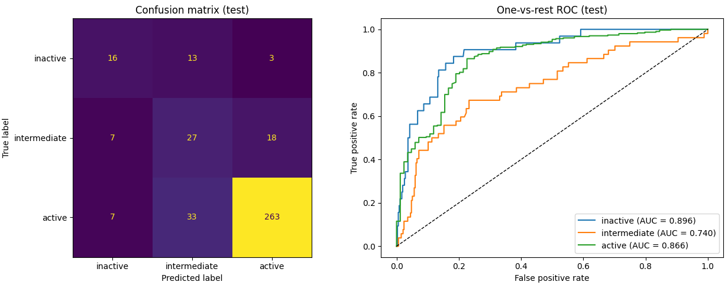
Hybrid QML- 3 class classification – Basic entangler 8 qubits, 1 rep
Best epoch: 20
Train acc: 0.8403
Val acc: 0.8036
Test set results
Test samples: 387
Test accuracy: 0.7907

