Slide 1


Code Quality and Analysis Tool
2023, June 16
Giovanni Brunetti

Slide 2
What is SonarQube?
SonarQube is an open-source tool developed by SonarSource that helps programmers analyze and improve the quality of their code. It is a continuous integration tool used for detect and prevent defects, vulnerabilities and code smells in a code base.

Slide 3
How it works
SonarQube offers reports on duplicated code, coding standards, unit tests, code coverage, code complexity, comments, bugs, and security vulnerabilities. It supports over 20 programming languages making it a highly versatile tool.
It uses several code analysis techniques to identify potential problems in the source code, including:
Analysis of code quality metrics and indicators, such as cyclomatic complexity, code duplication, and test coverage.
Analysis of coding rules and best practices, such as error handling, proper use of libraries, security and code optimization.
Code security analysis, looking for vulnerabilities and potential security issues.

Slide 4
Metrics and Key Features
Code coverage: indicates the percentage of code that is executed during testing. A 100% coverage indicates that all lines of code have been executed at least once during testing.
Cyclomatic complexity: indicates the complexity of the program's control flow. High cyclomatic complexity values indicate that the code may be difficult to understand, test, and maintain.
Number of vulnerabilities: indicates the number of potential code vulnerabilities identified during code security analysis.
Code duplication: indicates the percentage of duplicated code in the project. The presence of duplicated code can make the code more difficult to maintain and can lead to consistency issues.
Technical debt: indicates the cost of fixing the code over time. High technical debt indicates that the code will require more time and resources to fix in the future.
Number of code smells: indicates the number of violations of coding best practices that could lead to maintainability and readability issues.
Quality Gate: allows you to define acceptability rules and metrics for your code, If the code does not meet all defined criteria, the Quality Gate fails and the code analysis is considered unacceptable.
And others…

Slide 5
When and Why use it
In the development phase
Improve code quality
Verify that all use cases are tested
Before acquiring ownership on a project:
Is project tested?
Does it respect language conventions?
In the Release phase
Ensures that every program you put out is high quality and meets desired standards

Slide 6
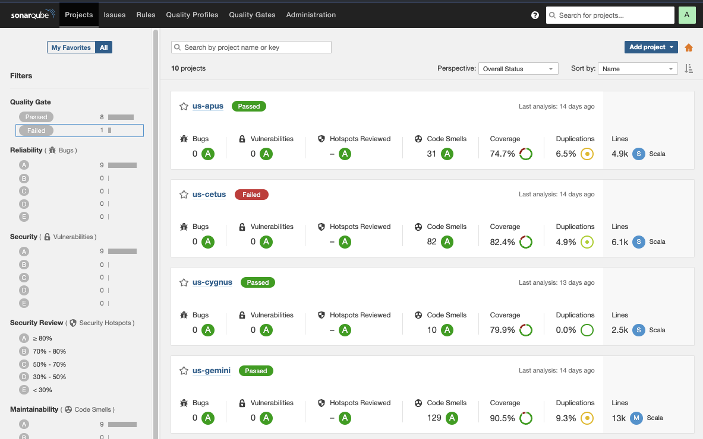
Sonar Dashboard - General

Slide 7
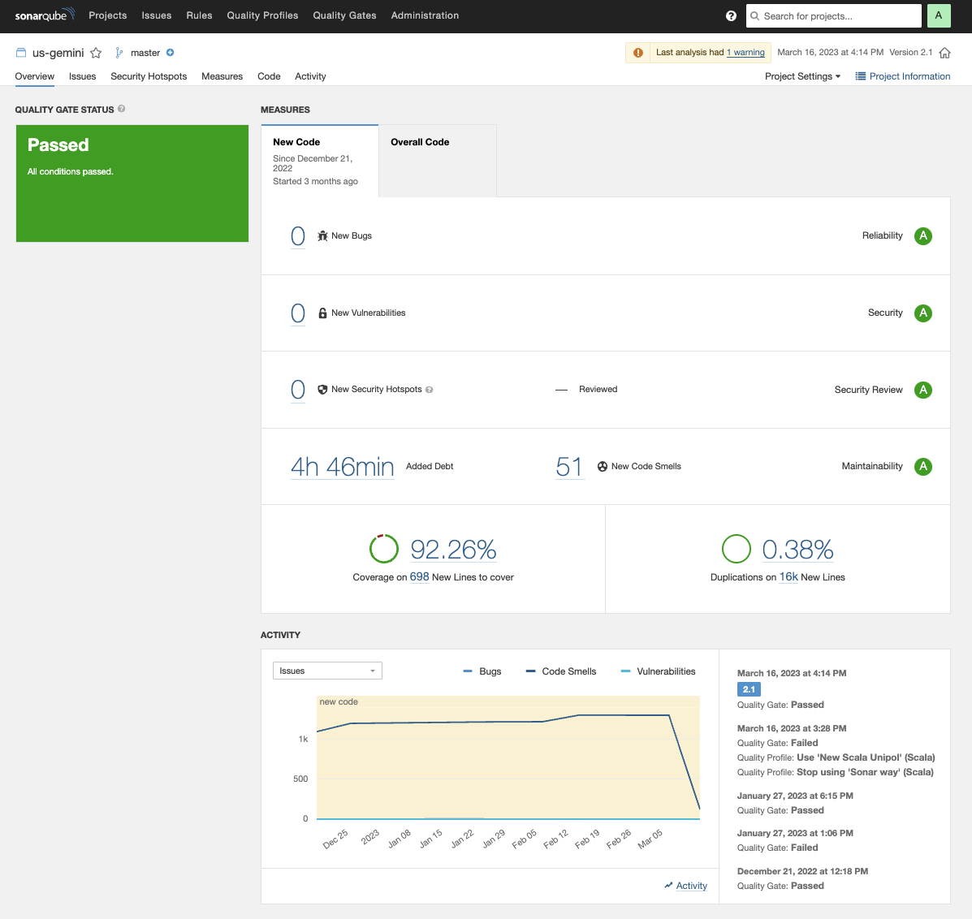
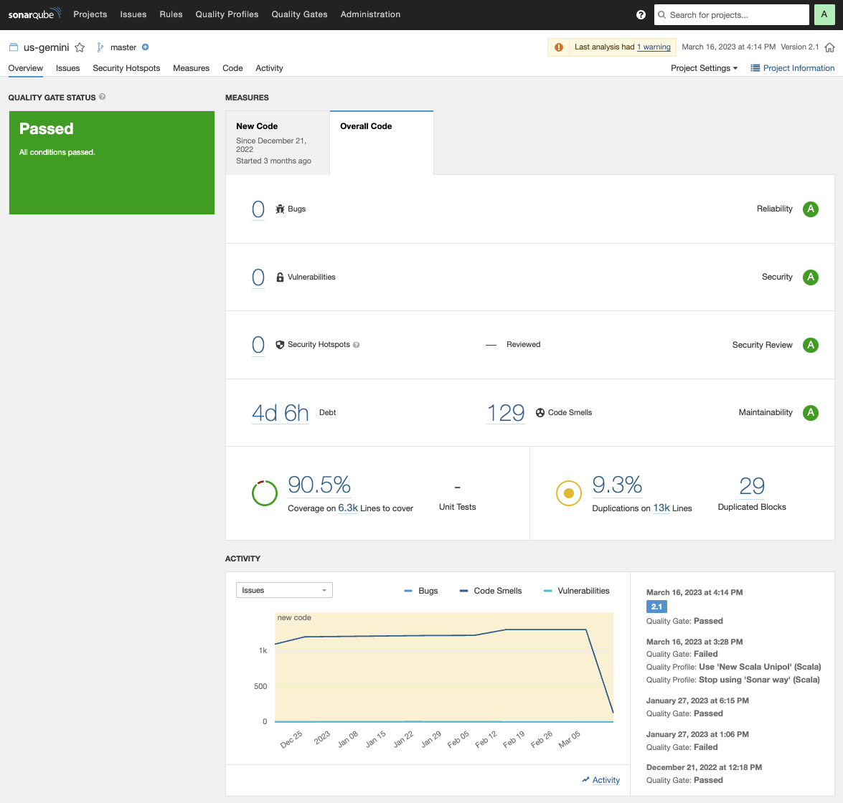
Sonar Dashboard – Overview Project

Slide 8
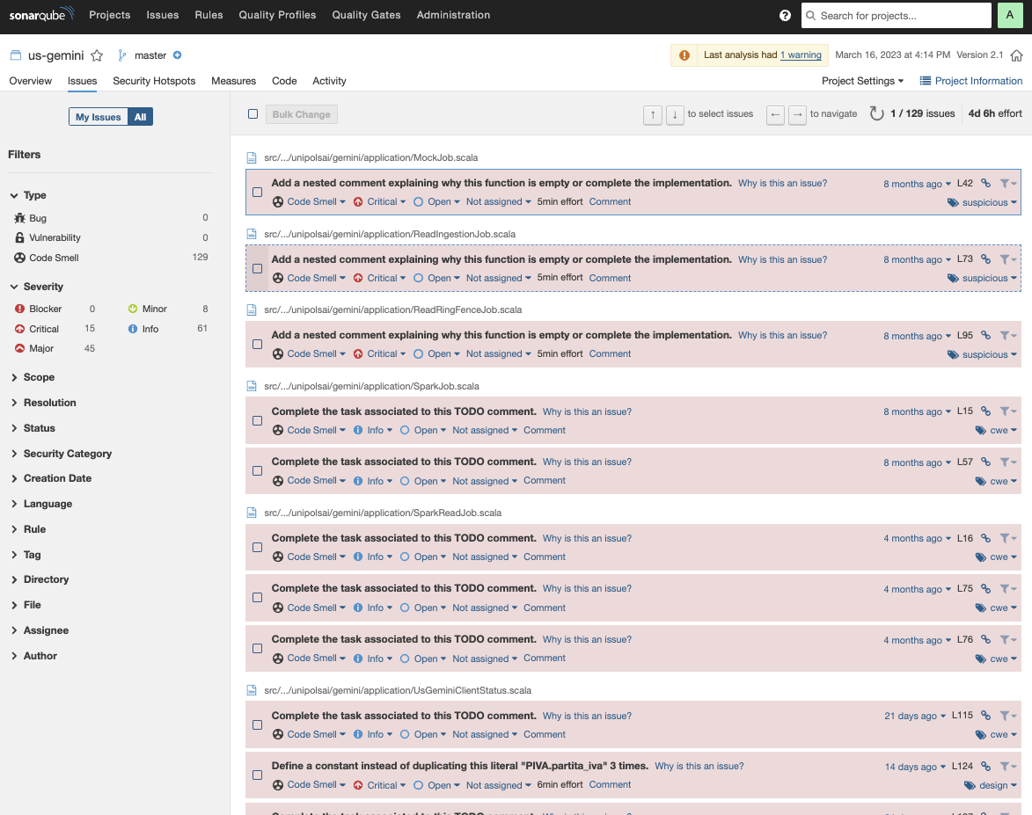
Sonar Dashboard – Overview Project

Slide 9
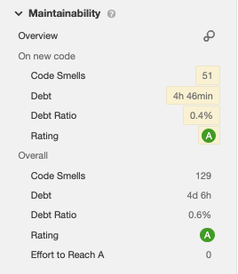
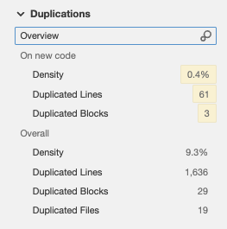

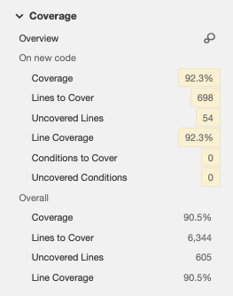
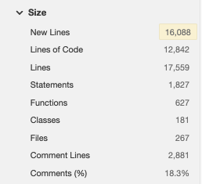
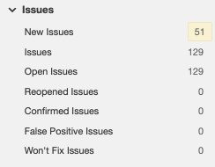
Sonar Dashboard – Overview Project

Slide 10
How use it locally
To use SonarQube in a local environment you can use simply use docker.
Once Docker has been installed, you can download and launch a local version of Sonarquube through the command:
docker run –d –p 9000:9000 sonarqube
With this command the SonarQube image will be automatically downloaded and run. The web interface will be available at localhost:9000 with default credentials admin/admin
IMPORTANT: Actually official image of SonarQube is not supported by new silicon processor by Apple. You can run run this command instead of previous one:
docker run –d –p 9000:9000 mwizner/sonarqube:8.7.1-community

Slide 11
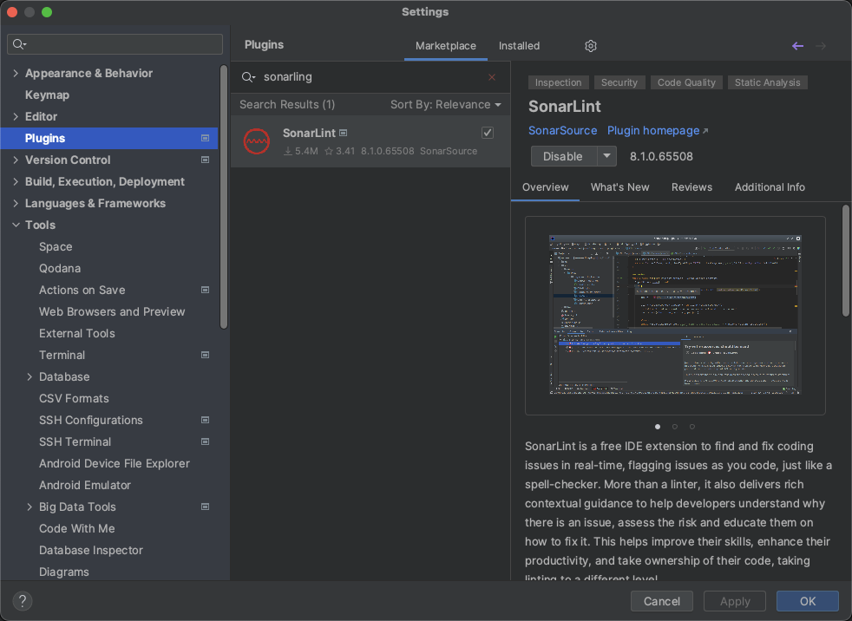
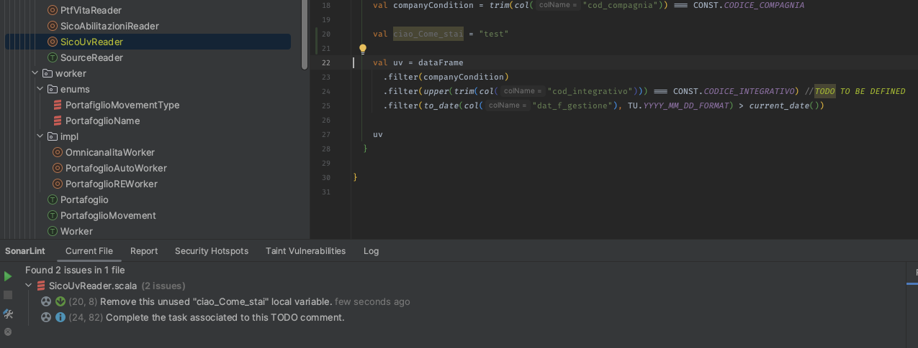
How use it in IDE
To use Sonar in your project you can use the plugin SonarLint:
SonarLint is a free IDE plugin which helps developer to fix known bugs and vulnerabilities, follow coding standards & best practices: Plugin Page.
Provides clear guidance on fixing the code issues before you commit to the source code.
Project is analysed using SonarQube server and retrieves the appropriate settings and quality profile for your projects.

Slide 12
How to use in Maven Project (Scala)
To use Sonar in maven projects you need to:
Add Scoverage plugin in your pom:
Create an xml report:
Launch sonar analysis:
A complete script to execute Sonar analysis is available here: SonarQube Script

Slide 13
How to use in Jenkins (Scala)
To use Sonar in Jenkins pipeline you need to:
Install sonar plugin
Install scoverage plugin
Install cobertura plugin

Slide 14
DEMO
Scala Project: https://github.com/GB1609/SonarQubeDemo

Slide 15
To Know…
Quality Profile Setup
Quality Gate Setup
Fail SonarQube Projects with Quality Gate Rules criteria.
User and Groups
Token creation, password change, email notifications

Slide 16
Conclusion
SonarQube performs static analysis of the code to evaluate the quality of it in terms of maintenance, reliability, efficiency and safety. The analysis of the quality code instead is performed in real time and it provides detailed feedback on the code, suggestions to improve it and report on the progress of the project.
SonarQube is an excellent resource for development teams, as it helps to improve the software development process, identify code problems and to provide useful feedback to improve the quality of the code.

