Slide 1
NSLab: Network Security Laboratory of Tsinghua University, Beijing, China
Authors name here
presenter
September 23, 2010

Slide 2
Content
Background
Design
Evaluation
Conclusion

Slide 3
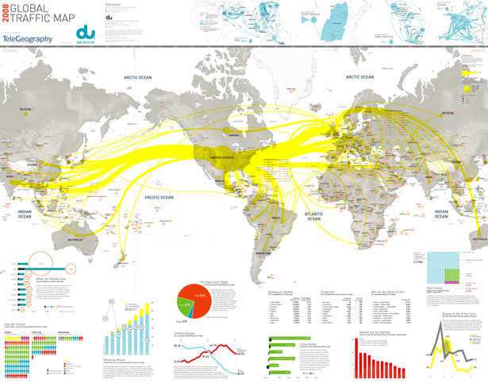
Background
Flow management over Internet
Decades long efforts
Latency, bandwidth
Congestion avoiding
Focus on problems over Internet
Two main challenges
Precious Modeling is difficult to give
No perfect experimental platform
Effective flow management is still lacking

Slide 4
NSLab: Network Security Laboratory of Tsinghua University
Thanks for the participation!
Any question, feel free to contact
Author (author@nslab.tsinghua)
Authors name here
presenter
September 23, 2010

