Slide 1
IPHIS: IMMUTABLE PERSONAL HEALTH INFORMATION SYSTEM C#
Presented By: Priyanka p. Dakare.
Created Date: 1-08-2018
Sponsored By: ReyGlobal

Slide 2
Abstract Class
Abstract classes are classes that contain one or more abstract methods. An abstract method is a method that is declared, but contains no implementation.
Example.
public abstract void MyMethod(); //abstract method
An abstract class can contain either abstract methods or non abstract methods.
We can not create a object of abstract class. Access member using derived class.

Slide 3
In Other Words, The abstract keyword enables you to create classes and class members that are incomplete and must be implemented in the derived class
To use an abstract class you have to inherit it from another class, provide implementations to the abstract methods in it.
Note that an abstract class does not mean that it should contain only abstract members ,also it contain non abstract members.
For example:
abstract class absClass
{
public void NonAbstractMethod()//non-abstract member
{
Console.WriteLine("NonAbstract Method");
}
}

Slide 4
using System;
namespace adstractdemo1
{
public abstract class user_base
{
public abstract void getName();
public abstract void displayName();
public void address()
{
Console.WriteLine("Address");
string add = Console.ReadLine();
Console.WriteLine("address= " + add);
}
}
}
Program:
Abstract class

Slide 5
using System;
namespace adstractdemo1
{
public class doctor : user_base
{
string name;
public override void displayName()
{
Console.WriteLine(" my name= " + name);
}
public override void getName()
{
Console.WriteLine("I'm doctor..:");
name = Console.ReadLine();
}
}
}

Slide 6
using System;
namespace adstractdemo1
{
public class doctor : user_base
{
string name;
public override void displayName()
{
Console.WriteLine(" my name= " + name);
}
public override void getName()
{
Console.WriteLine("I'm doctor..:");
name = Console.ReadLine();
}
}
}

Slide 7
using System;
namespace adstractdemo1
{
class Program
{
public static void Main(string[] args)
{
doctor d = new doctor();
d.getName();
d.displayName();
d.address();
Console.WriteLine("____________");
patient p = new patient();
p.getName();
p.displayName();
p.address();
Console.WriteLine("____________");
Console.ReadLine();
}
}
}

Slide 8
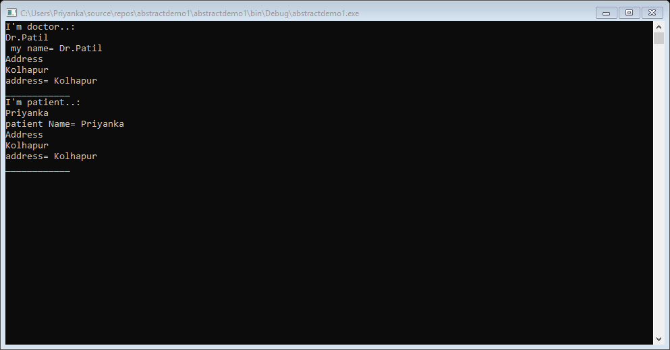
OUTPUT:

Slide 9
Virtual
The virtual keyword is used to modify a method, property, indexer, or event declaration and allow for it to be overridden in a derived class .
Syntax:
public virtual double methodName()
{
//body
}
By default, methods are non-virtual. We can't override a non-virtual method.

Slide 10
A virtual method is created in the base class that can be overriden in the derived class.
We create a virtual method in the base class using the virtual keyword and that method is overriden in the derived class using the override keyword.

Slide 11
using System;
namespace virtual2
{
public class Doctor
{
string dname,add;
int phno;
public virtual void register()
{
Console.WriteLine("Doctor Registeration");
Console.WriteLine("Enter Doctor Name:");
dname = Console.ReadLine();
Console.WriteLine("Enter Doctor Phone no:");
phno = Convert.ToInt32(Console.ReadLine());
Console.WriteLine("Enter Address");
add = Console.ReadLine();
}
public virtual void displayName()
{
Console.WriteLine("Doctor Name:"+dname);
Console.WriteLine("Doctor phone number:" + phno);
Console.WriteLine("Address:"+add);
Console.ReadLine();
}
Program:
virtual method

Slide 12
public class patient1 : Doctor
{
string pname, addr;
int ph_no;
public override void register()
{
Console.WriteLine("Patient Registeration");
Console.WriteLine("Enter Patient Name:");
pname = Console.ReadLine();
Console.WriteLine("Enter Patient Phone no:");
ph_no = Convert.ToInt32(Console.ReadLine());
Console.WriteLine("Enter Address");
addr = Console.ReadLine();
}
public override void displayName()
{
Console.WriteLine("Patient Name:" + pname);
Console.WriteLine("Patient phone number:" + ph_no);
Console.WriteLine("Address:" + addr);
Console.ReadLine();

Slide 13
}
}
class Program
{
static void Main()
{
Doctor b1 = new Doctor();
b1.register();
b1.displayName();
Console.WriteLine("___________");
patient1 b2 = new patient1();
b2.register();
b2.displayName();
Console.ReadLine();
}
}
}

Slide 14
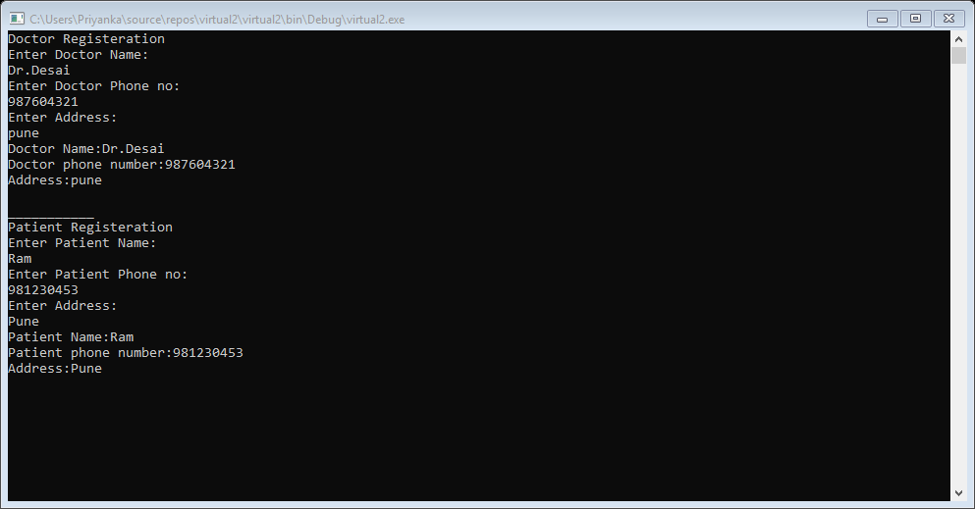
OUTPUT:

Slide 15
Delegate
A delegate is a reference type variable that holds the reference to a method. The reference can be changed at runtime.
Delegates are especially used for implementing events and the call-back methods. All delegates are implicitly derived from the System.Delegate class.
Syntax for delegate declaration is –
delegate<return_type><delegate_name><Parameter_list>
Example –
Public delegate int MyDelegate(string s);

Slide 16
Instantiating Delegates:
Once a delegate type is declared, a delegate object must be created with the new keyword and be associated with a particular method. When creating a delegate, the argument passed to the new expression is written similar to a method call, but without the arguments to the method
For example-
public delegate void printString(string s);
……
printString ps1=new printString(WriteToScreen);
printString ps2=new printString(WriteToFile);

Slide 17
Program : Delegate
using System;
delegate void mydelegate();
namespace 20_Delegate
{
class Program
{
static public String name, medi,dname;
static void Main(string[] args)
{
mydelegate m = inser;
m += disp;
m();
Console.ReadKey();
}

Slide 18
public static void inser()
{
Console.WriteLine("Enter Doctor Name:");
dname = Console.ReadLine();
Console.WriteLine("Enter the name of patient: ");
name = Console.ReadLine();
Console.WriteLine("Enter preciciptions: ");
medi= Console.ReadLine();
}
public static void disp()
{
Console.WriteLine(" "+ dname + " " + name + " " + medi);
}
}
}

Slide 19
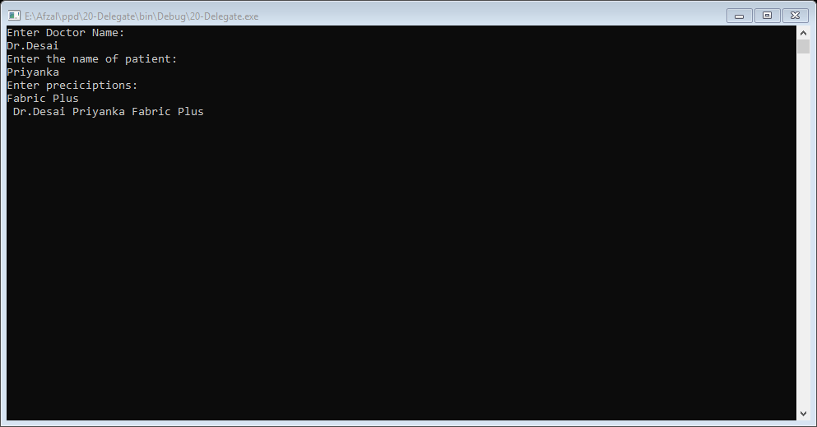
OUTPUT:

Slide 20
Events
Events are user actions such as key press, clicks, mouse movements, etc., or some occurrence such as system generated notifications. Applications need to respond to events when they occur. For example, interrupts. Events are used for inter-process communication.

Slide 21
File Handling
WHAT IS FILE HANDLING ?
To save the information permanently on the disk or reading information from the saved file through C# is known as File Handling.
C# File Handling uses a stream to save or retrieve information.
FILES AND STREAM
A file is a collection of data stored on a disk with specific name, extension and directory path. When you open File using C# for reading and writing purpose it becomes Stream.
A stream is a sequence of bytes traveling from a source to a destination over a communication path.

Slide 22
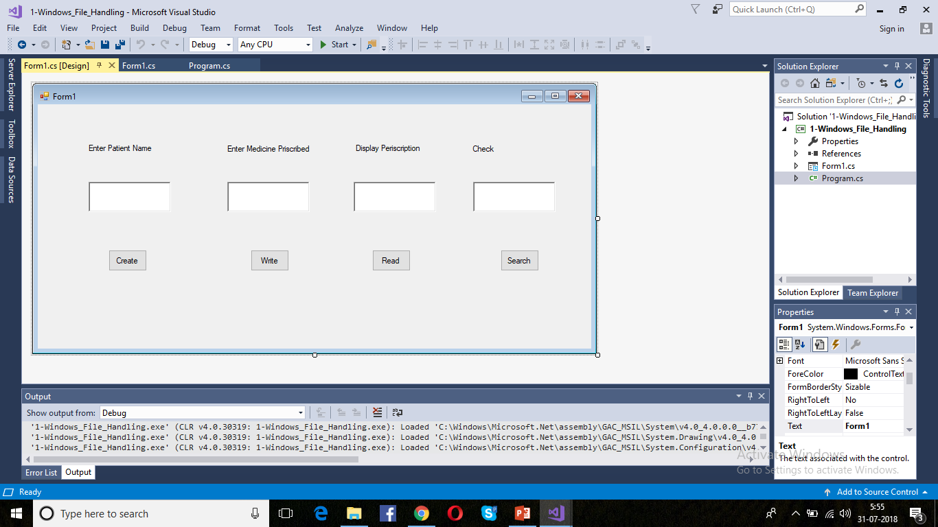
Program : event and FileHandling

Slide 23
//Form1
using System;
using System.Windows.Forms;
using System.IO;
namespace Windows_File_Handling
{
public partial class Form1 : Form
{
public Form1()
{
InitializeComponent();
}
private void button1_Click(object sender, EventArgs e)
{
FileStream f = new FileStream(richTextBox1.Text, FileMode.OpenOrCreate, FileAccess.Write);
MessageBox.Show("File created successfully!");
f.Close();
}

Slide 24
private void button2_Click(object sender, EventArgs e)
{
FileStream f = new FileStream(richTextBox1.Text, FileMode.Open, FileAccess.Write);
StreamWriter sw = new StreamWriter(f);
string st = richTextBox2.Text;
sw.Write(st);
MessageBox.Show("Medicine inserted for patient "+richTextBox1.Text+" file!");
sw.Close();
f.Close();
}
private void button3_Click(object sender, EventArgs e)
{
FileStream f = new FileStream(richTextBox1.Text, FileMode.Open, FileAccess.Read);
StreamReader sr = new StreamReader(f);
string s = sr.ReadToEnd();
richTextBox3.Text = s.ToString() ;
sr.Close();
f.Close();
}

Slide 25
private void button4_Click(object sender, EventArgs e)
{
FileStream f = new FileStream(richTextBox1.Text, FileMode.Open, FileAccess.Read);
string sre = richTextBox4.Text;
if (richTextBox3.Text.Contains(sre))
{
MessageBox.Show("this medicine is precribed!");
}
else
{
MessageBox.Show("this medicine is not precribed!");
}
f.Close();
}
}
}

Slide 26
//Program1
using System;
using System.Collections.Generic;
using System.Linq;
using System.Windows.Forms;
namespace Windows_File_Handling
{
static class Program
{
static void Main()
{
Application.EnableVisualStyles();
Application.SetCompatibleTextRenderingDefault(false);
Application.Run(new Form1());
}
}
}

Slide 27
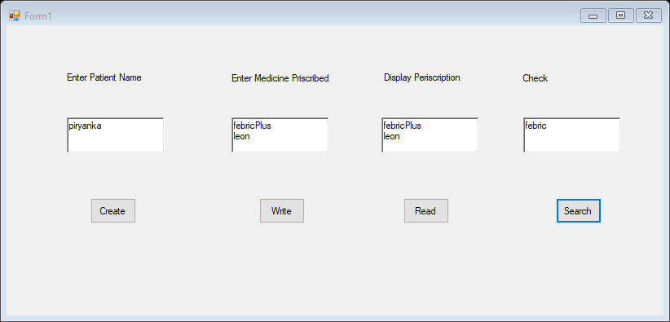
OUTPUT:

Slide 28
Reflection
Reflection objects are used for obtaining type information at runtime. The classes that give access to the metadata of a running program are in the System.Reflection namespace.
The System.Reflection namespace contains classes that allow you to obtain information about the application and to dynamically add types, values, and objects to the application.

Slide 29
Applications of Reflection:
Reflection has the following applications −
It allows view attribute information at runtime.
It allows late binding to methods and properties
It allows creating new types at runtime and then performs some tasks using those types.

Slide 30
Program:Reflection
using System;
using System.Reflection;
using System.Text;
using System.Threading.Tasks;
namespace reflectioneApp1
{
class Program
{
static void Main(string[] args)
{
var assembly=Assembly.GetExecutingAssembly();//The assembly that contains the code that is currently executing.
Console.WriteLine(assembly.FullName);
var types = assembly.GetTypes(); // Gets the types defined in this assembly.
foreach(var type in types )
{
Console.WriteLine("Type:" +type.Name);

Slide 31
var props = type.GetProperties();// Returns all the public properties of the current Type.
foreach (var prop in props)
{
Console.WriteLine("\tProperty:"+prop.Name +"ProprtyType:"+prop.PropertyType);
}
var fields = type.GetFields();// Returns all the public fields of the current Type.
foreach (var field in fields)
{
Console.WriteLine("\t field"+field.Name);
}
var methods = type.GetMethods();// Gets the methods of the current Type.
foreach (var method in methods)
{
Console.WriteLine("\t Method:"+method.Name);
}

Slide 32
}
Console.ReadLine();
}
}
}
public class sample
{
public string Name { get; set; }
public int Age;
public void MyMethod()
{
}
}

Slide 33
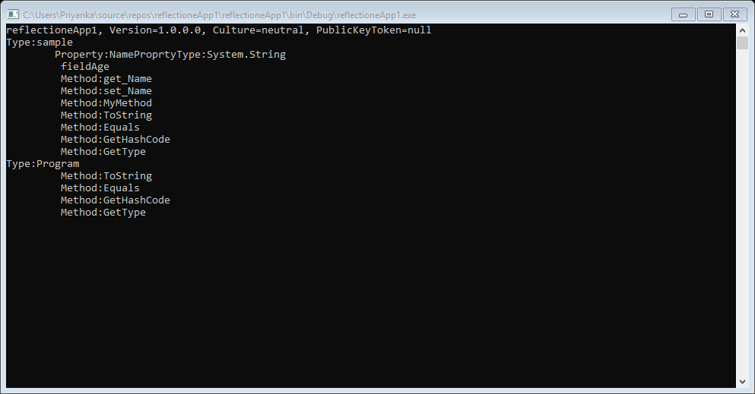
OUTPUT:

Slide 34
Attribute
An attribute is a declarative tag that is used to convey information to runtime about the behaviours of various elements like classes, methods, structures, enumerators, assemblies etc. in your program.
Attributes are used for adding metadata, such as compiler instruction and other information such as comments, description, methods and classes to a program.

Slide 35
in your program. You can add declarative information to a program by using an attribute. A declarative tag is shown by square ([ ]) brackets placed above the element it is used for.
Syntax for specifying an attribute is as follows −
[attribute(positional_parameters, name_parameter = value, ...)]
element

Slide 36
Program:Attribute
#define DEBUG
using System;
using System.Diagnostics;
public class Myclass
{
[Conditional("DEBUG")]
public static void Message(string msg)
{
Console.WriteLine(msg);
}
}

Slide 37
class Test
{
static void register()
{
Myclass.Message("Doctor Name:");
string name = Console.ReadLine();
Myclass.Message("Doctor Age:");
int age = Convert.ToInt32(Console.ReadLine());
Myclass.Message("Doctor Address:");
string add = Console.ReadLine();
Myclass.Message("Doctor id:");
int id = Convert.ToInt32(Console.ReadLine());
Console.WriteLine("_________________");
pregister();
}

Slide 38
static void pregister()
{
Myclass.Message("Patient Name:");
string name = Console.ReadLine();
Myclass.Message("Patient Age:");
int age = Convert.ToInt32(Console.ReadLine());
Myclass.Message("Patient Address:");
string add = Console.ReadLine();
Myclass.Message("Patient id:");
int id = Convert.ToInt32(Console.ReadLine());
}
public static void Main()
{
Myclass.Message("Registeration:");
register();
Console.ReadKey();
}
}

Slide 39
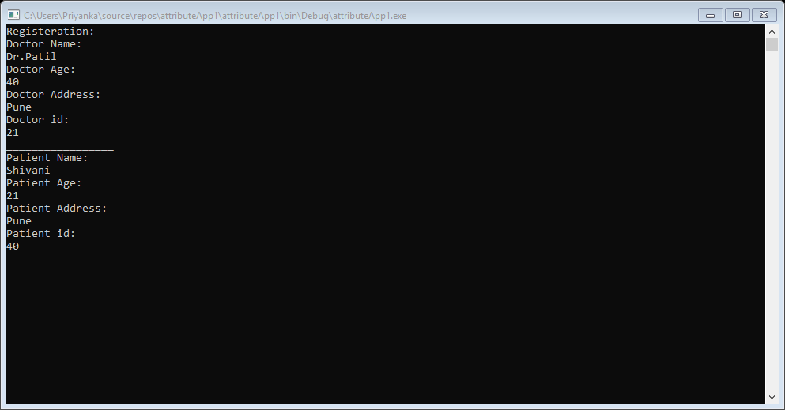
OUTPUT:

