Slide 1

WTF is an API?
And why should you use the GBADs API?

Slide 2
Application Programming Interface
An API is a way to transfer information from one computer program to another.
GBADs
API
Program A
Program B
GBADs
Database
Tables
User
Program
An API glues one program to another.

Slide 3
Why use the GBADs API?
[Current] The data that your model uses is always up to date and you never have to change anything in your code/model to accomplish this.
[Reproducible] Everyone is using the same data - aids in reproducibility and in comparing models.
[Enhanced] The data has been studied by the Informatics team and metadata created or enhanced. Any differences with original, “raw” sources will be annotated.

Slide 4
Why use the GBADs API?
[Efficient] No need to store files of data – everything is stored on GBADs servers and used only when necessary.
[Customized] The GBADs Informatics team is available to set up data in a number of ways that can make your work easier.
[Easy to Use] The API is standardized (same units, ISO3 as country identifier, etc.) so that you do not need to study multiple APIs even if you are using multiple data sources.
[Metadata] Comprehensive, standardized metadata is being developed for all GBADs resources.

Slide 5
Different Ways to Use the API
There are different ways that you can use the API. APIs can allow a choice of user interface from browsers to R code
Option 1
Option 3
Call API through the browser and return data as a Web page
Call API from an R or Python program
Option 2
Option 4
Call API through the browser and return data as a file
Call API using a command in Powershell or shell

Slide 6
How to Approach Learning the GBADs API
APIs are not trivial to use properly. Travel the following roadmap to learning how to take advantage of the GBADs API in your work.
Use the browser to run some examples
In R or Python, run some examples from the documentation
01
03
05
Read
Examples
Practice
Programs
Expert
Read the documentation available from the API interface and other sites..
You have now leveled up to expert – use the API on your own!
Using the browser, create calls to the API to get data that you want.
02
04

Slide 7
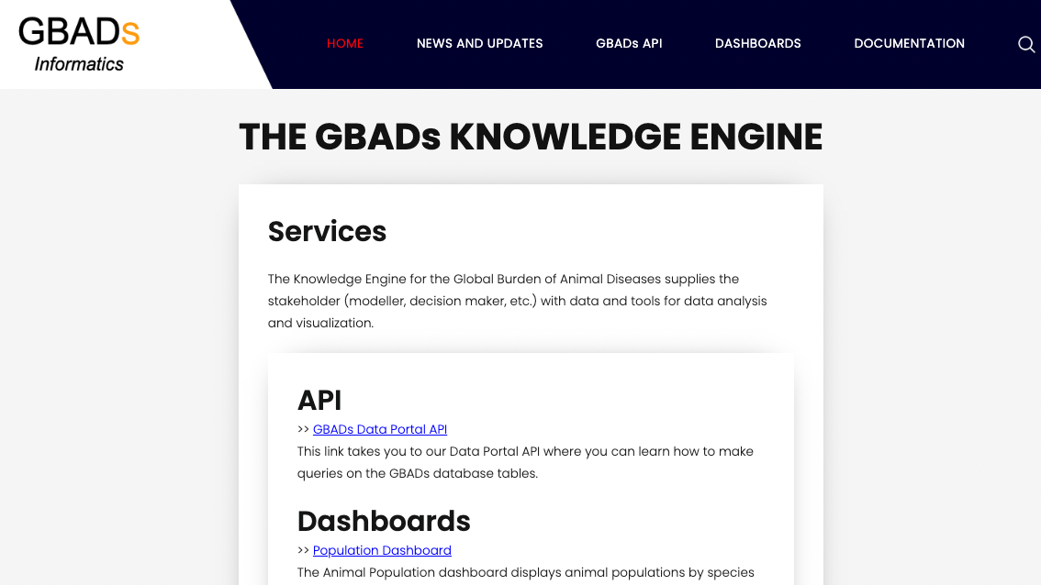

Slide 8
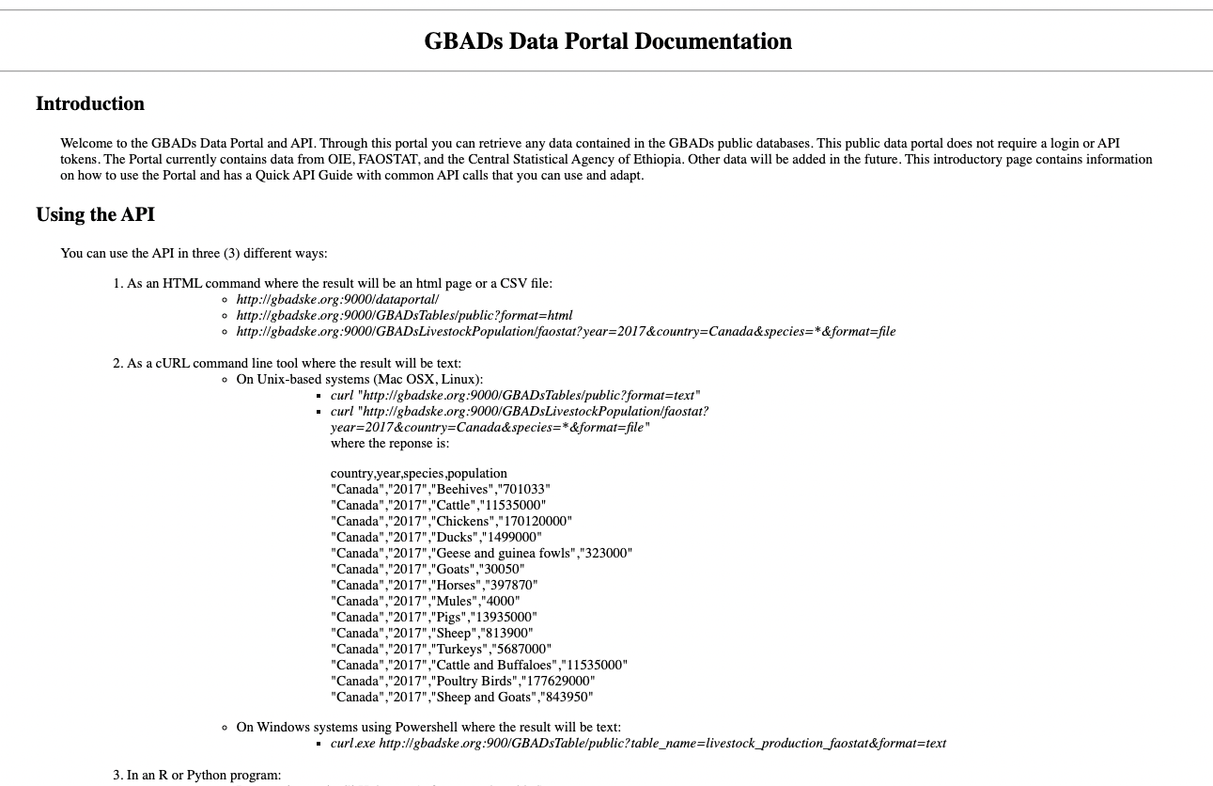
gbadske.org:9000/dataportal/
GBADs
API

Slide 9
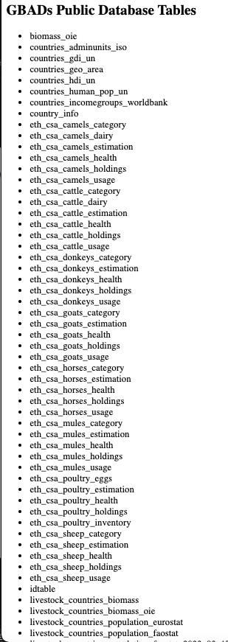
gbadske.org:9000/GBADsTables/public?format=html
GBADs
API

Slide 10
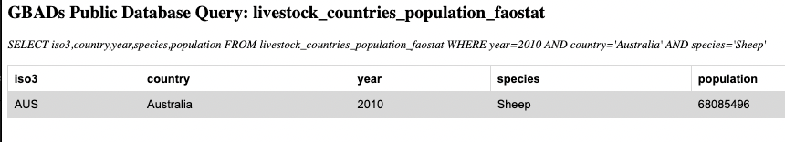
gbadske.org:9000/GBADsLivestockPopulation/faostat?species=Sheep&year=2010&country=Australia&format=html
GBADs
API

Slide 11
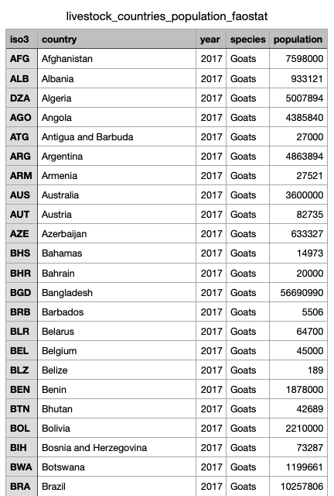
gbadske.org:9000/GBADsPublicQuery/livestock_countries_population_faostat?fields=country,year,species,population&query=year=2017 AND species=‘Goats’&format=file
GBADs
API

