Slide 1
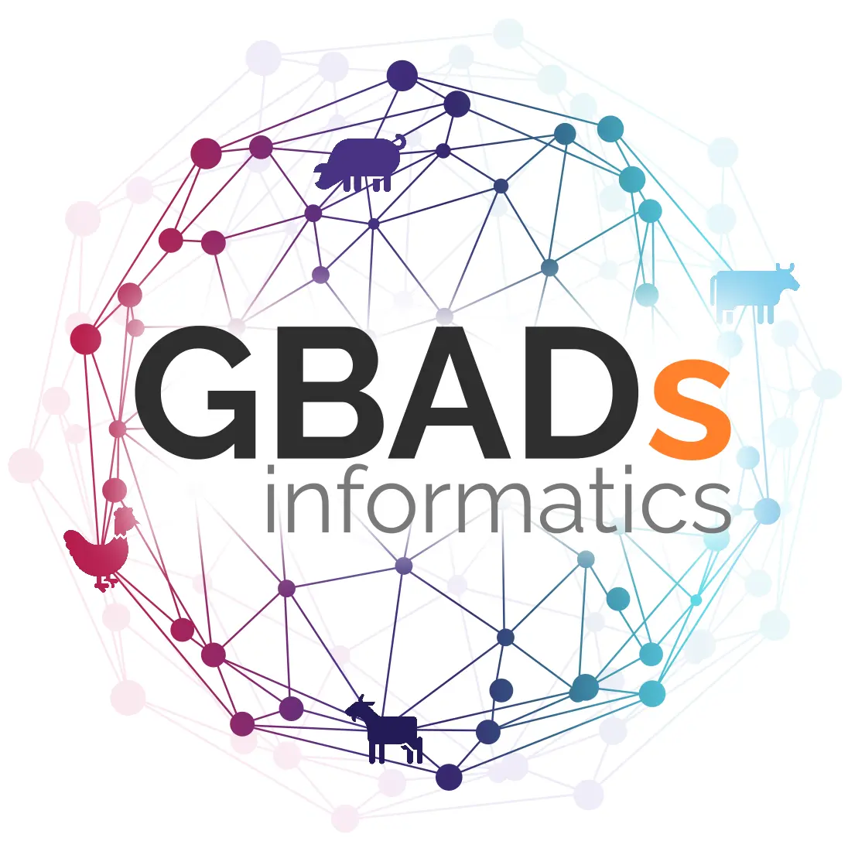
World Café Challenge
How best can GBADs developers, researchers, collaborators, and users take advantage of the GitHub framework?

Slide 2
The Challenge How to Effectively use git and GitHub throughout GBADs
Presenter: Kassy Raymond
Contributions from Deb Stacey
GBADs
Global Burden of Animal Diseases

Slide 3
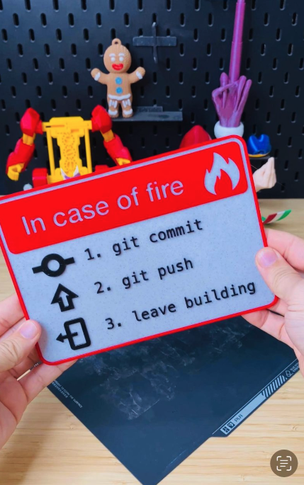
Background git and GitHub
What are git and GitHub and why are they important tools?
GBADs
Global Burden of Animal Diseases
Notes:
Because git and GitHub may not be familiar to everyone, we need to take a few minutes to explain what they are and what they do.

Slide 4
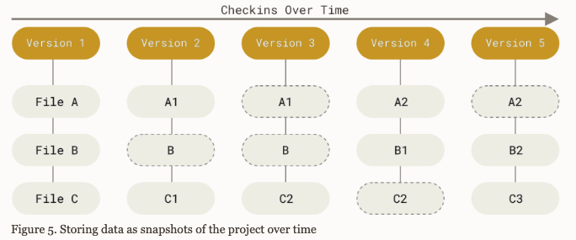
git and GitHub
git is a version control system (VCS) which is a system that tracks changes to files over time
GBADs
https://git-scm.com/
Global Burden of Animal Diseases
Notes:
Think of version control as letting you keep all the different versions of a file without having to keep copying and changing the file names – the VCS does all the work for you. You can revert back to previous versions of a file whenever you need to. Git thinks of its data like a series of snapshots of a miniature filesystem. With Git, every time you commit, or save, Git takes a picture of what all your files look like at that moment and stores a reference to that snapshot. Git is not that scary – really – there are only a few concepts and there are lots of sources of information about using git including free online books.

Slide 5
GitHub
GitHub is a cloud-based platform where you can store, share, and work together with others to write code or, in fact, anything that is composed of files (such as documentation or a book)
GitHub is built on git
Putting your files in a repository on GitHub allows
Sharing
Tracking and managing of the files over time
Collaboration between multiple people
GBADs
https://docs.github.com/en/get-started/start-your-journey/about-github-and-git
Global Burden of Animal Diseases
Notes:
GitHub allows you to store and share in the cloud and uses git as the software to facilitate this. Like git, there are many sources of information about using the many functions of GitHub so that you can share, track, and manage files. GitHub also has collaboration tools to add to the ability of multiple people to work on the project that is in a repository.

Slide 6
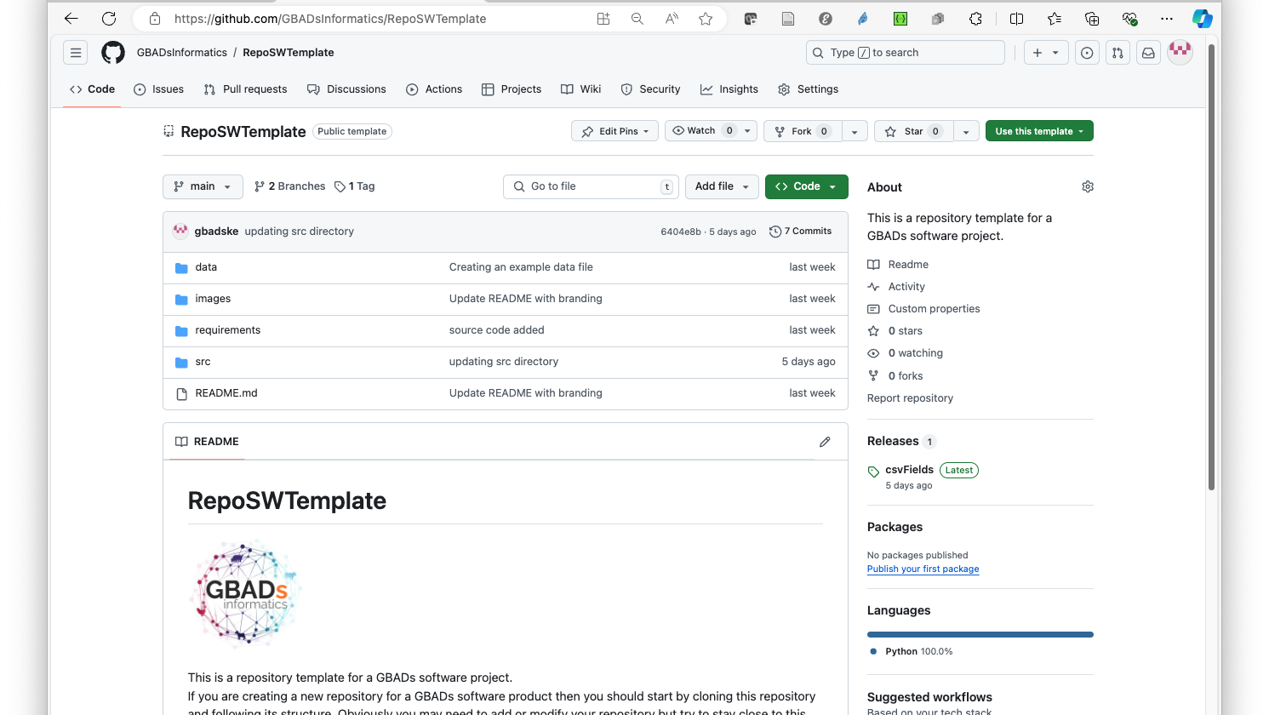
Notes:
Here is an example repository, or “repo” currently on the GBADs Informatics GitHub – it shows the directory structure, readme information, and the fact that there are two branches (total versions) of the code and a release package has been created and is available to download. This is also a “template” for how software repos should be structured.

Slide 7
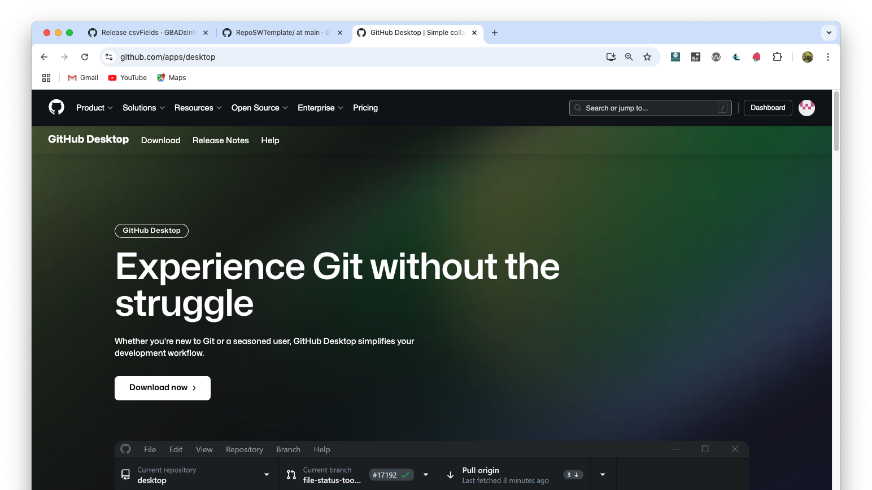
Notes:
There are lots of tools to help you use GitHub and git – the most popular one is GitHub Desktop. There is another one called GitKraken (as in the mythical sea creature) and you can use familiar tools like Visual Studio Code or Rstudio (important for all you R programmers out there). And speaking of R…

Slide 8
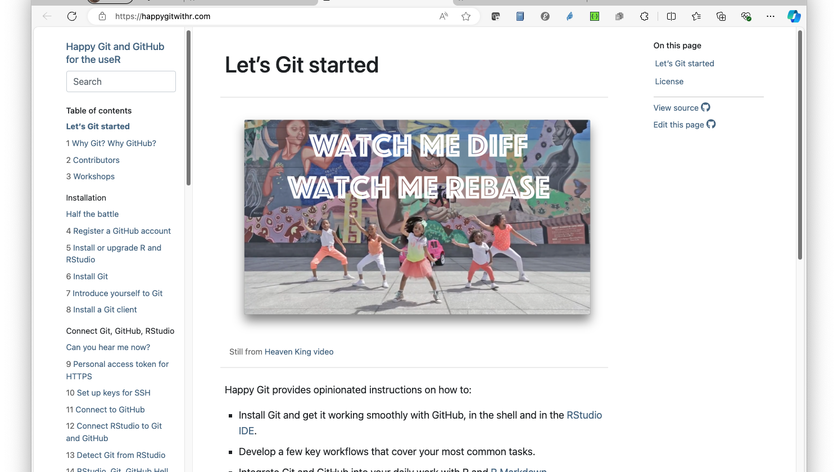
Notes:
There is an online book that shows you how to use git and GitHub for R and the book itself is also in a GitHub repo…

Slide 9
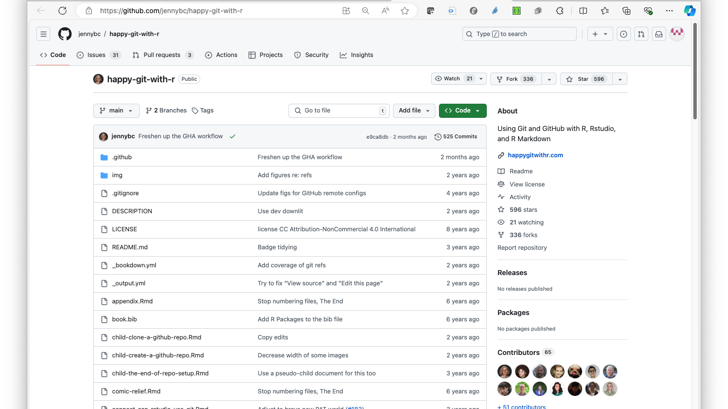
Notes:
This shows that book’s repo – this can be a model for GBADs documentation to use so that many people can collaborate and contribute to documentation, reports, and papers about the work that is being done by GBADs.

Slide 10
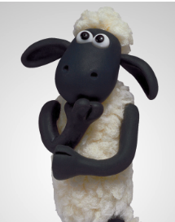
Disadvantages of GitHub and git
Not that well known outside of software development circles
Learning curve – not too steep but steep enough
Poorly structured repos can interfere with the power of GitHub and git
Requires discipline
GBADs
Global Burden of Animal Diseases
Notes:
So what’s the bad news…git and GitHub are non-trivial tools to learn and use. And like all powerful tools, they can be used poorly. Without knowledge about the tools and proper structuring of the repos, git and GitHub will not advance what we what to do in GBADs with regards to software and documentation development. But…

Slide 11
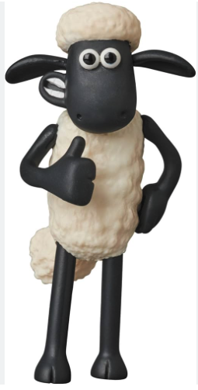
Advantages of GitHub and git
Standard in the software community
It is not just for coding; it is used to write books and documentation
Lots of interaction and communication tools
Encourages best practices
GBADs
Global Burden of Animal Diseases
Notes:
It is worth the time and effort to learn to use git and GitHub effectively – it will enhance collaboration and promote best practices for software development and release.

Slide 12
Questions
Should we expand our use of git and GitHub for both coding projects and documentation?
Should this be a requirement for any software developed by GBADs?
Should this be a requirement for any documentation developed by GBADs?
If it is required, how do we encourage/enforce this?
GBADs
Global Burden of Animal Diseases
Notes:
Now to the questions that we have to answer. First, is this workwhile for us to do? [now I think that you can just read the slide and add any comments that you think are necessary]

Slide 13
Questions
How should we help everyone to embrace git and GitHub?
Dedicated technical support and Workshops – there is obviously a non-trivial cost involved but highly effective
Online documentation (created by others and/or created by Informatics team) – not as costly but not as accessible for some users
Development of best practices for GBADs, e.g. templates for different kinds of repos (software, documentation, etc.) – some cost to develop but requires discipline from users
GBADs
Global Burden of Animal Diseases
Notes:
And if we are going to do this then how do we do this? [now I think that you can just read the slide and add any comments that you think are necessary]

Slide 14
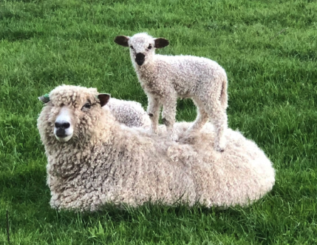
Should we expand our use of git and GitHub for both coding projects and documentation?
How should we help everyone to embrace git and GitHub?
https://www.majesticsheepbreeders.com/faqs/

