Slide 1
Automate Custom UI
Greg Bousley
Logan Jensen
Olufemi Okanlomo
10/02/2025
Notes:
Welcome to [CLASS TITLE]
I am Greg Bousley.
I’ve been with Hyland for a little over three years as an Instructional Designer,
main focus has been creating fun, practical learning content for Alfresco.
excited to spend some time with you today, share what I’ve picked up along the way, and hopefully make things clear, useful, and end with an enjoyable experience.
This session is designed to impart practical skills and solutions that you may apply right away.
With me today are…

Slide 2
Creating a Custom UI in Automate
Angular Theoretics
Angular Architecture
Implement Custom UI to Cloud Application
Notes:
[HANDS-ON] In this course we’ll cover three main topics, and by the end you’ll be able to:
[DEMO] This course will tackle three main objectives. By the end of this course, you should be able to:
Explain the core concepts of an Angular UI
Create a Custom UI Local Dev Environment & apply configuration in order to provide a unique experience
And finally, you’ll be able to Implement your developed Custom UI into your Automate Application so it may be accessed by your intended audience.

Slide 3
TERMINOLOGY
Angular
A TypeScript-based framework, created and maintained by Google, used for building complex, dynamic, and responsive single-page web applications (SPAs)
https://v17.angular.io/guide/what-is-angular
JSON (JavaScript Object Notation)
A lightweight, text-based format for storing and exchanging data that is both human-readable and easily understood by machines
Javascript (JS)
A high-level language that enables interactive and dynamic content on web pages
Node.js
Provides a command-line interface (CLI) and an online registry for JS software packages
NPM (Node Package Manager)
The default package manager for Node.js
TypeScript
Contains the component's logic, data, and methods that respond to user interactions or other events

Slide 4
Angular for Cloud UI
Angular Theoretics

Slide 5
The Shift to Cloud UI Applications
1
2
3
4
Applications are no longer server-rendered
Cloud platforms require dynamic, interactive UI
APIs drive modern applications
UI must be fast, responsive, and scalable
Notes:
The Shift to Cloud UI Applications
Applications are no longer server-rendered
Traditional apps relied on the server to build entire pages
Modern apps move rendering to the frontend (browser)
Enables faster interactions and smoother user experiences
Cloud platforms require dynamic, interactive UI
Users expect real-time feedback and seamless navigation
Interfaces must handle complex workflows without constant reloads
Rich, app-like experiences are now the standard
APIs drive modern applications
The backend no longer sends full pages—it provides data via APIs
Frontend consumes that data and builds the UI dynamically
Enables flexibility, reuse, and integration across systems
UI must be fast, responsive, and scalable
Performance is critical—users expect instant feedback
Applications must scale across users, devices, and environments
Efficient UI design directly impacts user adoption and success
🔹 Key Takeaway
“Modern applications are no longer built around pages—they’re built around experiences powered by APIs.”

Slide 6
What Is a Single Page Application (SPA)?
A Single Page Application..
Loads once
Updates dynamically without full refresh
Communicates with backend via APIs
Runs logic in the browser
Application UI
API
Angular Back End
Notes:
So what does that mean? That brings us to Single Page Applications..
A Single Page Application loads the shell once and then updates content dynamically.
Instead of: Browser → Server → Full HTML Page
We now have: Browser → Angular App → API → JSON → UI Update
This gives:
Faster interactions
Better user experience
Rich UI behavior

Slide 7
Traditional UI vs SPA Model
Traditional Model
Server renders HTML
Full page reloads
UI tightly coupled to backend
SPA Model
Frontend renders UI
Backend exposes APIs
Loose coupling
Independent deployment
Traditional
Model
Browser
Server
HTML Page
Browser
Angular App
REST API
SPA Model
UI Updates
JSON
Response
Notes:
Traditional Model (Server-Rendered Apps)
The server is responsible for building the entire UI
Every user action (click, navigation, submit) triggers a full page reload
The frontend and backend are tightly coupled—they depend heavily on each other
UI updates are slower because the whole page must be regenerated
Changes to the UI often require backend updates and redeployment
👉 Key takeaway: This model is simple to start with, but becomes harder to scale and modernize. SPA Model (Single Page Applications)
The frontend handles rendering using JavaScript frameworks (like Angular)
The backend provides data through APIs, not full HTML pages
The system is loosely coupled—frontend and backend evolve independently
Only parts of the page updates, creating a faster, smoother user experience
Frontend and backend can be developed and deployed separately
👉 Key takeaway: SPAs enable modern, responsive, and scalable cloud applications.

Slide 8
Angular as a Framework (Not Just a Library)
Angular provides:
Architecture
CLI tooling
Dependency Injection
Routing
Form handling
HTTP abstraction
Build system
Angular Application
Components
Services
Modules
UI + Templates
(Building Blocks)
API Calls
Feature Isolation
Notes:
Angular Provides (Core Capabilities)
Architecture
Angular gives you a structured, component-based framework
Encourages clean separation of concerns (components, services, modules)
Helps teams scale applications consistently
CLI Tooling
The Angular CLI automates common tasks (generate components, services, builds)
Reduces setup time and enforces best practices out of the box
Makes development faster and more standardized across teams
Dependency Injection
Built-in system for managing and injecting services where needed
Promotes reusability and testability
Keeps code loosely coupled and easier to maintain
Routing
Enables navigation between views without reloading the page
Supports SPA behavior with clean URLs and lazy loading
Helps organize large applications into logical sections
Form Handling
Provides robust tools for handling user input
Supports both template-driven and reactive forms
Built-in validation makes form logic easier to manage
HTTP Abstraction
Simplifies communication with backend APIs
Uses a consistent, observable-based approach for async data
Centralizes API calls and error handling
Build System
Handles bundling, optimization, and environment configuration
Produces production-ready, performant applications
Supports modern tooling without manual setup
🔹 Key Takeaway
“Angular isn’t just a library—it’s a complete framework that provides everything needed to build, scale, and maintain modern web applications.”

Slide 9
Why Angular for Enterprise Cloud Platforms?
Angular is ideal for:
Large teams
Long-lived applications
Complex workflows
Secure authentication flows
Modular architectures
Notes:
Angular is Ideal For
Large Teams
Enforces consistency and structure across developers
Long-Lived Applications
Built for maintainability and scalability over time
Complex Workflows
Handles multi-step logic and dynamic UI with ease
Secure Authentication Flows
Supports modern auth patterns and route protection
Modular Architectures
Encourages reusable, organized feature modules
🔹 Quick Takeaway
“Angular is designed for enterprise applications where structure, scale, and long-term stability matter.”

Slide 10
Component-Based Architecture
Everything is a component:
Header
Navigation
List
Card
Form
Dialog
Benefits:
Reusability
Isolation
Testability
Maintainability
App Component
Header
Sidebar
Router Outlet
Top-level nav component
Branding, user info, global actions
persistent across pages
Navigation component
Provides links to major sections
Move between features
Placeholder for routed components
Dynamically loads feature views
Controlled by Angular Router
Dashboard
Tasks
Notes:
Think Lego blocks.
Each component:
Has its own template
Has its own logic
Can be reused
Can be tested independently
This is foundational to scalable UI systems.
Diagram:
Everything is a component
Components nest inside components
Router swaps feature components dynamically

Slide 11
Angular and TypeScript (Why it Matters)
What is Typescript?
TypeScript is a superset of JavaScript that adds types and structure to your code, making it easier to build, scale, and maintain applications
TypeScript provides:
Strong typing
Interfaces
Compile-time checking
Better tooling
Refactoring safety
Notes:
TypeScript Provides (Why It Matters)
Strong Typing
Lets you define exactly what type of data your variables should hold
Prevents unexpected values from creeping into your application
Makes your code more predictable and easier to understand
Interfaces
Define the shape of objects (what properties and types they must have)
Creates consistency across your application
Acts like a contract between different parts of your code
Compile-Time Checking
Errors are caught before the code runs
Helps you fix issues early instead of debugging at runtime
Reduces production bugs significantly
Better Tooling
Enhanced IDE support (autocomplete, IntelliSense, navigation)
Makes development faster and more efficient
Helps developers understand unfamiliar code quickly
Refactoring Safety
Safely rename variables, methods, or structures across your app
Type system ensures nothing breaks silently
Gives confidence when making large-scale changes
🔹 Key Takeaway
“TypeScript adds structure and safety to JavaScript—helping you catch errors early, scale confidently, and build more maintainable applications.”

Slide 12
Angular in Context of Automate “Workspace”
In our Workspace app:
Angular handles UI rendering
Services handle API communication
Modules isolate features
Routing controls navigation
Notes:
Today, we’ll see Angular not as theory, but inside a real application.
You’ll see:
How components fit together
How services abstract backend calls
How routing creates the app experience

Slide 13
Angular Theoretics Recap
Angular provides:
Structured architecture
Component reusability
Dependency injection
Scalable project organization
Enterprise-grade tooling
Strong typing with TypeScript
Notes:
This is why Angular is a strong foundation for cloud UI applications.
It’s not about popularity — It’s about scalability, structure, and maintainability.

Slide 14
Technologies We’re Leveraging

Slide 15
The Role of NPM & Node.js
Node Package Manager
Simplifies the process of installing, managing, and sharing reusable code modules within Node.js projects
Provides a command-line interface (CLI) to:
Install and manage dependencies
Run project scripts (e.g.: npm start)
Execute tools locally or globally
Node.js
Open-source, cross-platform JavaScript runtime environment that allows you to execute JavaScript code outside of a web browser
Node.js provides the runtime environment for executing JavaScript code, while NPM provides the tools and infrastructure for managing the reusable code modules (packages) that enhance the functionality of Node.js applications.
Notes:
Two technologies we defined earlier bear a little more discussion, as they’re central to how we’ll go about configuring our Uis.
[CLICK] First, we defined the Node Package Manager as The default packager for Node.js, but its role goes more in-depth, as it provides a command line interface that will allow us to command the generator to generate components for us (such as the example you see on the screen). While using the generator is not mandatory to create components, the Angular ecosystem relies heavily on npm. You’ll recall that Angular is template and dependency based, so when the generator is used it’ll edit all of the necessary dependency files to add your component and ensure it’s recognized by the Angular ecosystem.
[CLICK] Let’s move on to Node.js. We defined this as an Open-source, cross-platform JavaScript runtime environment that allows you to execute JavaScript code outside of a web browser. By leveraging JavaScript's asynchronous, event-driven nature it is able to build scalable network applications, including web servers, APIs, and command-line tools.
So, to break it all down… [CLICK – read last bullet]

Slide 16
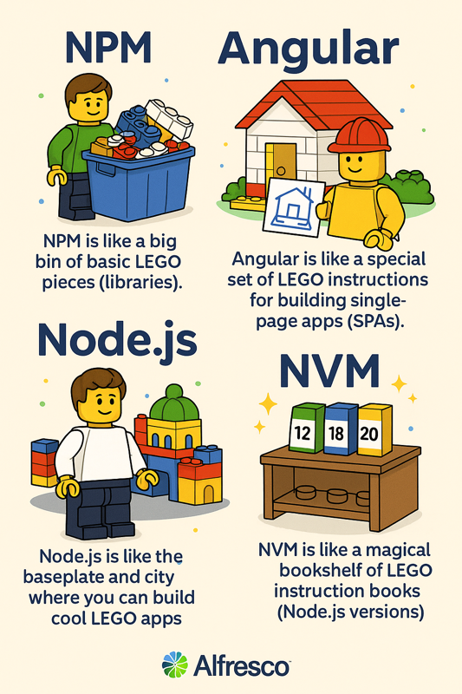
NPM, Node & Angular Explained with Legos
Notes:
Who likes legos?

Slide 17
PUTTING IT TOGETHER
The Angular Framework

Slide 18
Angular Components
Component (MyPage)
The building block of an Angular application
MyPage.component.html
Defines what the user see’s
MyPage.component.ts
Handles the logic and data
MyPage.component.scss
Defines the component’s look (sassy!)
MyPage.component.css
Defines how the component looks
Notes:
What is an Angular Component?
A component is the building block of an Angular application
It controls a specific part of the UI - like a section, page, or feature
Think of it as a self-contained unit that combines logic, layout, and behavior
🔹 What Makes Up a Component?
Template (HTML)
Defines what the user sees
Structure of the UI
Class (TypeScript)
Handles the logic and data
Controls how the component behaves
Styles (CSS/SCSS)
Defines how the component looks
Scoped to that component
Metadata (Decorator)
Connects everything together (@Component)
Tells Angular how to use the component
🔹 Simple Explanation
“A component is a reusable, self-contained piece of UI that combines structure, behavior, and styling into one unit.”
🔹 Key Takeaway
“Angular applications are built by combining many small, focused components working together.”

Slide 19
The Building Blocks that Create Functionality
Components:
Building blocks - self-contained UI units
define what the user sees and how it behaves
Dependencies in Components
Provide external functionality
Angular uses dependency Injection (DI)
Dependencies are provided to components via their constructor
constructor (private dataService: DataService) { }
Services (Shared Logic & Data)
Classes that handle business logic, data access, or shared state
Example uses:
API calls (HTTP requests)
Data sharing between components
Utility functions
Notes:
Components – Start Here (Anchor the audience)
“Let’s start with components—these are really the heart of any Angular application.”
“Components are your building blocks—everything the user sees on screen is driven by a component.”
“Each component is self-contained, meaning it owns its UI and behavior.”
“So if you think about something like a search bar, a chat window, or a dashboard card—each of those would typically be its own component.”
“They define two things: → what the user sees → and how it behaves when the user interacts with it”
👉 Nice transition line:
“But components shouldn’t be doing everything themselves…”
🔌 Dependencies in Components (Introduce the problem + solution)
“This is where dependencies come in.”
“Components often need functionality that lives outside of them—like calling an API or sharing data.”
“Instead of building that logic directly into the component, Angular uses something called Dependency Injection, or DI.”
“Dependency Injection basically means: → Angular gives your component what it needs, instead of the component creating it itself.”
“You’ll typically see this in the constructor like this:”
constructor(private dataService: DataService) {}
“So here, Angular is injecting a DataService into the component.”
“The component can now use it—but it doesn’t need to know how it’s created or managed.”
👉 Key emphasis line:
“This keeps components clean and focused on UI instead of logic.”
🔧 Services – Where the Real Work Happens
“So where does that logic actually live? That’s where services come in.”
“Services are just classes that handle business logic, data access, and shared state.”
“They’re designed to be reusable across multiple components.”
Give relatable examples:
“If you’re making an API call → that goes in a service”
“If multiple components need the same data → that’s handled by a service”
“If you have helper or utility functions → those belong in a service”
👉 Bring it home:
“So instead of duplicating logic across components, you centralize it in services.”
🔁 Wrap It Together (This is your strongest moment)
“So putting it all together:”
“Components handle the UI and interaction”
“Services handle the logic and data”
“And Dependency Injection is what connects the two”
👉 Strong closing line:
“This separation is what makes Angular applications scalable, maintainable, and easy to extend.”

Slide 20
The Building Blocks that Create Functionality
Angular Application
components
Libraries
Custom Page Component
(Typescript File)
import { Router } from '@angular/router'; import { Component } from '@angular/core'; import { TranslateModule } from '@ngx-translate/core';
Router
Component
Translate
constructor(private router: Router) {}
this.router.navigate(['/yourpagename']);
Services: Router, Auth, Translation, etc

Slide 21
AFTER THE HANDS-ON, YOU WILL:
1
2
3
4
Become more familiar with Angular
Analyze a real application
Modify production-style code
Create new features
You’ll go hands-on with editing an Angular application
We’ll start with Automate’s default UI: Workspace, and come to understand its architecture
You’ll make modifications to the Workspace application without disrupting existing functionality
You’ll add new features & components – changing and expanding the functionality of the application
Notes:
We’re not just learning syntax.
We’re building the ability to:
Read enterprise Angular code
Extend existing applications
Think architecturally
That’s the difference between knowing Angular and using Angular professionally.

Slide 22
Hands-On
Create a UI – Download for DEV
Create a project in Automate
Create a Custom UI in proj
Export / download the UI
Configure a local development environment
Edit the UI
Generate a plugin and page
Customize a new portal page
Change routing
Install our Custom UI into Automate Project
Package our development UI
Upload to Automate project
Deploy updated project
What we’re going to do
Notes:
We’re about to dive into the Hands-On portion of this session, so let’s break down the things we’re going to do..
[CLICK] read
[CLICK] read
[CLICK] read

Slide 23
At 9 Second Insurance, we want a custom UI portal that the Claims Team may use to assist customers in filing a claim.
It should promote our branding and allow Claims Team members access to claims processes.
Notes:
The first thing I want us to do is to slip into the mindset of why we’re here. Why is it we’re learning how to create a Custom UI.
[read slide]
So, buried in this request are a few features of a Custom UI in a CIC application.
To dedicate an environment for an internal audience that you can curate to their needs. We can remove access from areas we don’t want this team to access, or empower our claims team with an efficient UI that takes them directly where they need to go.
The Custom UI allows us to enforce branding standards by changing the look, feel, and functionality of the UI.

Slide 24

Content Innovation Cloud Custom UI Hands-On Demo
Notes:
[DEMO] Now, I’ll demo creating and editing a Custom UI in CIC.
[HANDS-ON] Now, it’s time for us to Create our own Custom UI in Automate.
STOP HERE

Slide 25
Virtual Machines
https://onbaselabs.onbase.com/tenant/Training/applications/vms
Username: trainx Password: Learning@Hyland2022!
USER | Virtual Machine
Akshitha Koppaka | TrainBVM01
Alyssa Adcock | TrainBVM02
Bhavya Shah | TrainBVM03
Binyam Taddesse | TrainBVM04
Dan Jordan | TrainBVM05
Fraser Hewson | TrainBVM06
Gary Tidd | TrainBVM07
Giancarlo Montesano | TrainBVM08
USER | Virtual Machine
Guilherme Ribeiro | TrainBVM09
Jared Gibson | TrainBVM10
Jeff Vinca | TrainBVM11
Joshua Puskarich | TrainBVM12
Joyce Calandro | TrainBVM13
Keith Krumbine | TrainBVM14
Kevin Poppe | TrainBVM15
Martin Smolinski | TrainBVM16
USER | Virtual Machine
Mohan Varadharajan | TrainBVM17
Rachana Sonat Patel | TrainBVM18
Raghav Marwah | TrainBVM19
Rahul Dilip Talreja | TrainBVM20
Ranajit Paul | TrainBVM21
Samantha Presti | TrainBVM22
Stan Arnold | TrainBVM23
Tim Gartman | TrainBVM24
USER | Virtual Machine
Tony Parzgnat | TrainBVM25
Yves Prignon | TrainBVM26
Steve Lambert | TrainBVM27
OPEN | TrainBVM28
OPEN | TrainBVM29
OPEN | TrainBVM30
OPEN | TrainBVM31
OPEN | TrainBVM32
Notes:
Go to url in green, use user/pass in purple (if signed into other accnt, sign out..)
You’ll see

Slide 26
Website: experience.hyland.com
Password: HylandAutomate!!
Name | Email | Name | Email
Akshitha Koppaka | TrainB01+EducationServices2@hyland.com | Martin Smolinski | TrainB16+EducationServices2@hyland.com
Alyssa Adcock | TrainB02+EducationServices2@hyland.com | Mohan Varadharajan | TrainB17+EducationServices2@hyland.com
Bhavya Shah | TrainB03+EducationServices2@hyland.com | Rachana Sonat Patel | TrainB18+EducationServices2@hyland.com
Binyam Taddesse | TrainB04+EducationServices2@hyland.com | Raghav Marwah | TrainB19+EducationServices2@hyland.com
Dan Jordan | TrainB05+EducationServices2@hyland.com | Rahul Dilip Talreja | TrainB20+EducationServices2@hyland.com
Fraser Hewson | TrainB06+EducationServices2@hyland.com | Ranajit Paul | TrainB21+EducationServices2@hyland.com
Gary Tidd | TrainB07+EducationServices2@hyland.com | Samantha Presti | TrainB22+EducationServices2@hyland.com
Giancarlo Montesano | TrainB08+EducationServices2@hyland.com | Stan Arnold | TrainB23+EducationServices2@hyland.com
Guilherme Ribeiro | TrainB09+EducationServices2@hyland.com | Tim Gartman | TrainB24+EducationServices2@hyland.com
Jared Gibson | TrainB10+EducationServices2@hyland.com | Tony Parzgnat | TrainB25+EducationServices2@hyland.com
Jeff Vinca | TrainB11+EducationServices2@hyland.com | Yves Prignon | TrainB26+EducationServices2@hyland.com
Joshua Puskarich | TrainB12+EducationServices2@hyland.com |  | TrainB27+EducationServices2@hyland.com
Joyce Calandro | TrainB13+EducationServices2@hyland.com |  | TrainB28+EducationServices2@hyland.com
Keith Krumbine | TrainB14+EducationServices2@hyland.com |  | TrainB29+EducationServices2@hyland.com
Kevin Poppe | TrainB15+EducationServices2@hyland.com |  | TrainB30+EducationServices2@hyland.com
 |  |  | TrainB31+EducationServices2@hyland.com
Notes:
STOP HERE

Slide 27
SUMMARY: Creating a Custom UI in Content Innovation Cloud
Create Custom UI Local Dev Environment
Configure & Code Custom UI
Implement Custom UI to Cloud Application
Notes:
That brings us to the end of this training. In this course, we…
Creates a Custom UI Local Dev Environment
Configures & applied Code elements to a Custom UI in CIC create plugins and pages that delivered a unique user experience.
Then, we Implement our developed Custom UIs into our CIC Applications so it may be accessed by our intended audience.
I hope you found this training relevant and useful.

Slide 28
How likely are you to use or recommend a Custom UI as a business solution?
Notes:
Think of use cases you may have experienced with customers / partners?

Slide 29
In a continuation of this course, which elements, features, or enhancements would you like included in a Custom UI?
Notes:
Business solutions, use cases, customer / partners?

Slide 30
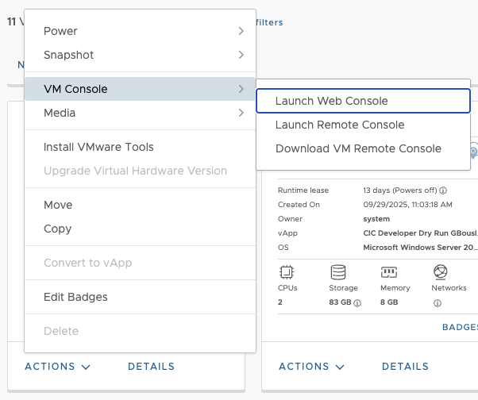
Virtual Machines
https://onbaselabs.onbase.com/tenant/Training/applications/vms
Username: trainx Password: Learning@Hyland2022!
USER | Virtual Machine
Logan Jensen | TrainXVM01
Kiah Wilson | TrainXVM02
William Findley | TrainXVM03
Kristina Detje | TrainXVM04
Olufemi Okanlomo | TrainXVM05
Julie Mallory | TrainXVM06
Shay Coplin | TrainXVM07
2
3
1

Slide 31
Content Innovation Cloud - Login
Experience.hyland.com
Password: HylandAutomate!!
USER | EMAIL
Logan Jensen | trainA01+educationservices@hyland.com
Kiah Wilson | trainA02+educationservices@hyland.com
William Findley | trainA03+educationservices@hyland.com
Kristina Detje | trainA04+educationservices@hyland.com
Greeeeg | trainA05+educationservices@hyland.com
Julie Mallory | trainA06+educationservices@hyland.com
Shay Coplin | trainA08+educationservices@hyland.com

Slide 32
Automate Workspace & Custom UI
Content Innovation Cloud
Automate Applications UI use the Application Development Framework (Workspace)
ADF is based on Angular
ADF sits as a layer on top of Automate and other services
ADF apps can be hosted in a separate environment
Workspace UI (ADF)
Custom UI (Dev)
Automate
Local Environment
Notes:
First, let’s talk about what a Custom UI is within the realm of Automate.
I’ve oversimplified a diagram here depicting Automate within the ecosystem of the Content Innovation Cloud.
[CLICK] The native UI used for Automate is essentially an ADF application we call Workspace. That is the Application Development Framework.
[CLICK] ADF is based on Angular, a templating structure that utilizes customizable components & services designed to build web applications.
[CLICK] The Workspace UI (or ADF app) sits as a layer on top of Automate, and some other services within the CIC and is built to communicate and display the automate service.
[CLICK] One feature of ADP applications is they can operate from a separate environment, similar to how we’ll engage with it in this course, where we’re going to download the workspace UI and host it locally, where we can easily make and view changes, effectively carving out a development space.

Slide 33
Angular UI
Content Innovation Cloud UI’s use Angular
Angular uses a templating structure to manage components, powered by directives, and relies on dependencies
Distinction between data (Model), user interface (View), and logic (Controller/ViewModel)
Components – The Building Blocks of Angular
UI Elements
Pages
Script elements
Login Component
Components consist of 4 elements:
HTML Template: declares what renders on the page
TypeScript Class: defines component behavior
CSS Selector: defines how component is used in template
CSS Style: (optional) visual styles applied to the template
more...
What you need to know
Notes:
Now that we understand that our Workspace UI is in essence an Angular UI, let’s address Angular.
When addressing Angular, there’s a plethora of information to share, but we’re going to dig just deep enough to uncover what we need to know to accomplish today’s task.
[CLICK] So, again, Autmate UIs use Angular.
Angular uses a templating structure to manage components, powered by directives, and relies on dependencies
The purpose of this environment is to make a clear Distinction between data (Model), user interface (View), and logic (Controller/ViewModel)
[CLICK] The area we’ll focus most of our development into is Components, referred to as the building blocks of Angular. These can consist of. [ read slide ]
[CLICK] And finally, Components consist of 4 elements.
HTML Template: declares what renders on the page
TypeScript Class: defines component behavior
CSS Selector: defines how component is used in template
CSS Style: (optional) visual styles applied to the template

Slide 34
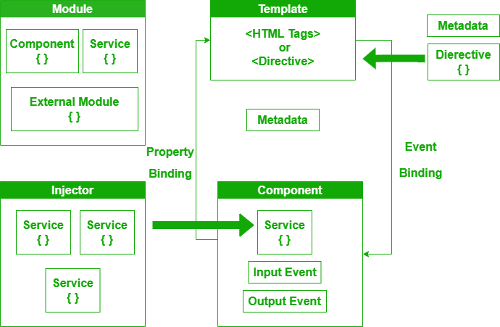
Angular Diagram (simplified)
Core Module
Must have at least one root module (AppModule)
Breaks down the application into chunks
Manages navigation within the application for changing from one view to another view.
Router
Components
The building block of Angular
Consists of a template(HTML view of UI), styles(CSS appearance/design) and a typescript class which contains business logic
Specific data or logic needs to be used across different components
Components can inject services to access their functionality and data
Services
Notes:
Let’s look at a simplified diagram of the some of the features we’ll engage with in this class.
[CLICK] We’ll start with out core module. Every Angular application must have at least one Core module, usually called the AppModule.
[CLICK] Within the core module is a Router, which controls the navigation from one view to another.
[CLICK] Then there’s components, which we now know are the building blocks of our Angular UI.
[CLICK] And finally, services, which deploy specific data or logic that components can employ.
So, I can have a custom component that handles its own functionality within its TypeScript class, or engage a service that is used across multiple components. [ talk about dynamics and efficiency ]

