Slide 1
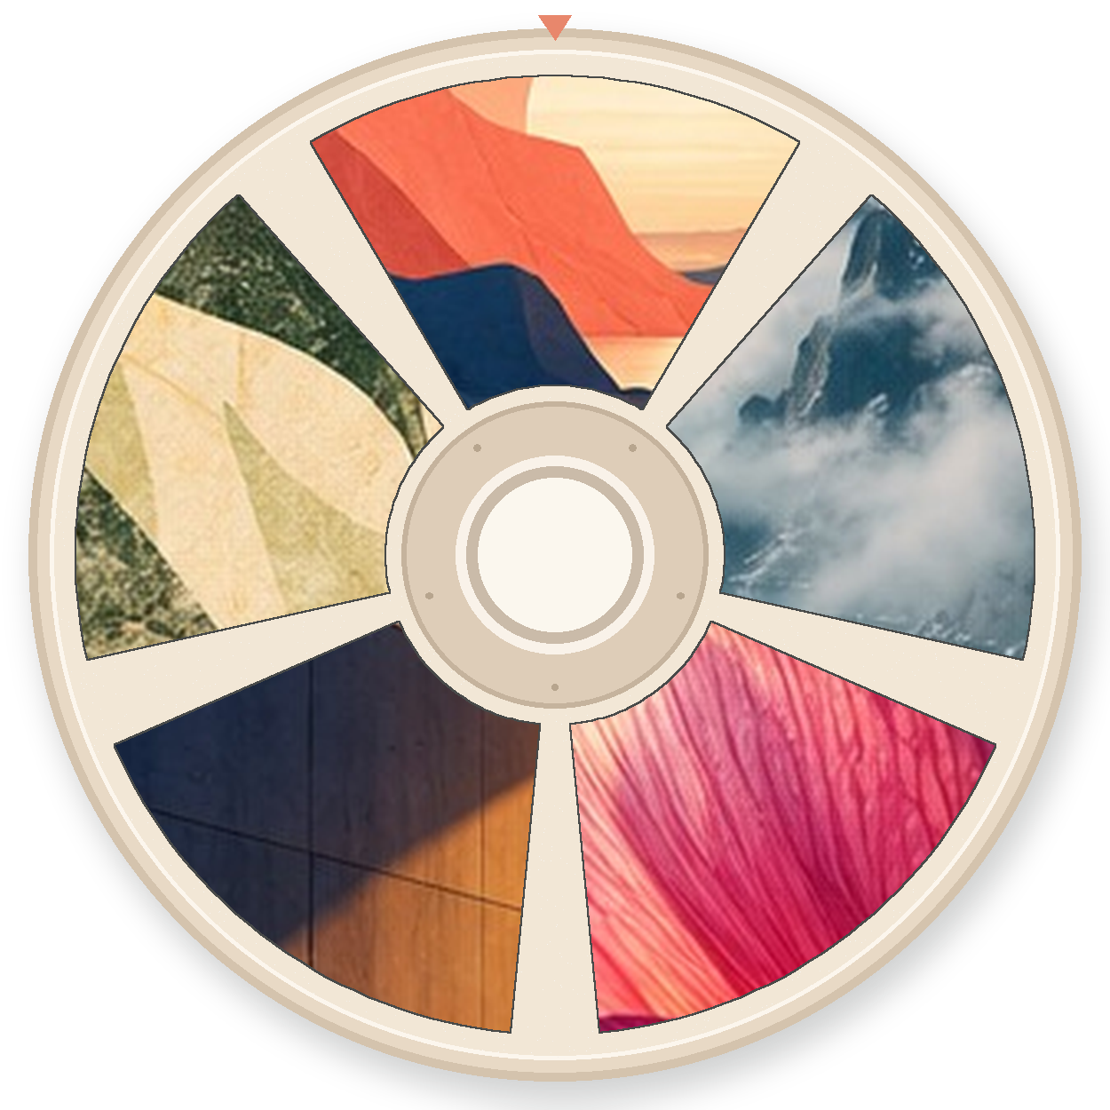
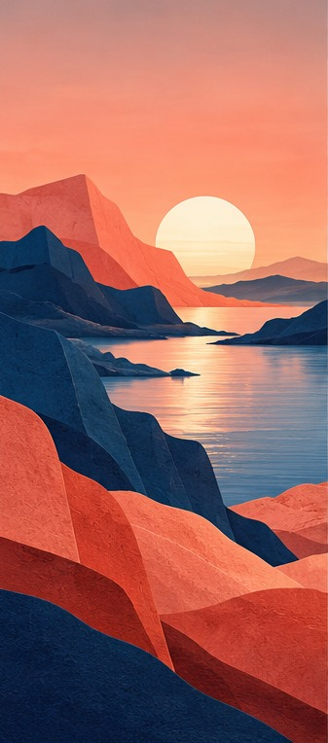

GLIMPSE / ANDROID WALLPAPERS
Glimpse.
glimpse.
Something lovely,
every time you look.
Something lovely, every time you look.
An open-source Android wallpaper manager that moves to your rhythm.
A native Android wallpaper app that makes your screen feel like a window into somewhere else.
PRODUCT + UX PITCH
16 screens · native Android · no proprietary cloud
THE PAPER REEL / CONTINUOUS BROWSING / V4
GLIMPSE / CONCEPT DESIGN / OCT 2026
01

Slide 2
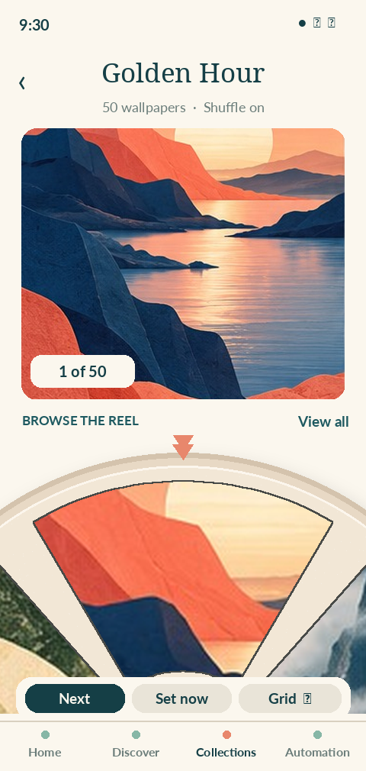
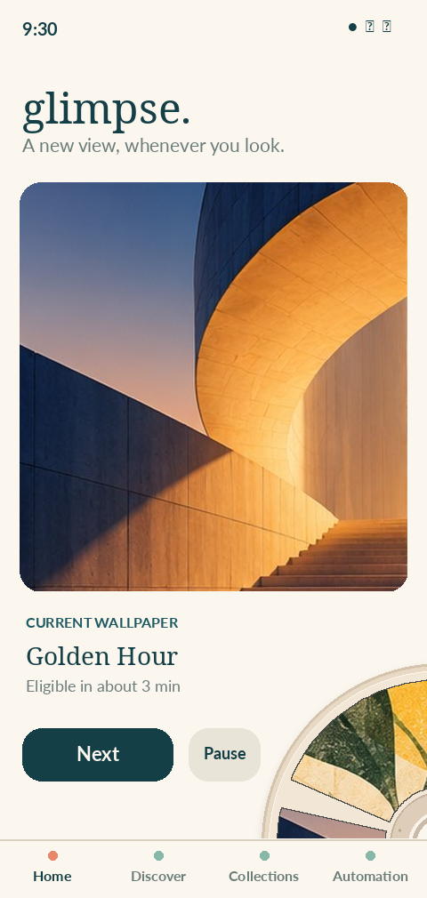
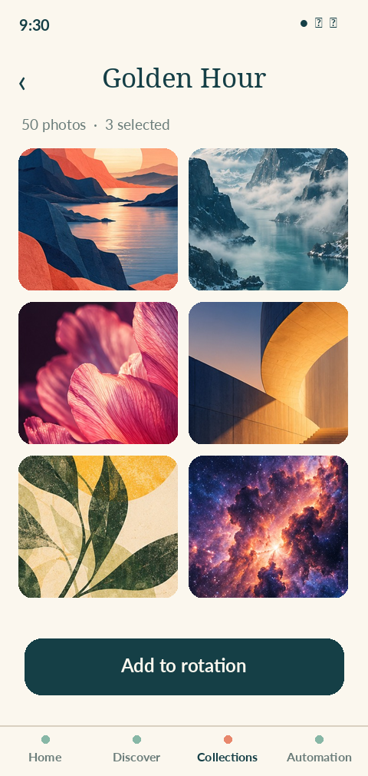
GLIMPSE / REEL PRINCIPLE
A circle bigger than the screen.
The reel continues beyond the viewport. Only the active arc asks for attention.
01 BROWSE
Oversized reel extends beyond left, right and lower edges.
02 GLANCE
Home shows only a smaller crescent beside the current view.
03 ESCAPE
View all opens the ordinary image grid for serious library work.
GLIMPSE / REEL SYSTEM / 2026 • CONCEPT

Slide 3
GLIMPSE / NEW IDENTITY
A reel, freed from its old machinery.
Five generous photographic windows. Paper, light, movement, surprise.
THE OBJECT
The picture,
not the perforation.
A larger opening makes the photograph legible, especially at small sizes. The circular paper shell is now a gentle framework for the imagery, not a historical constraint.
5 windows / 72° per step / pure visual metaphor
GLIMPSE / REEL SYSTEM / 2026 • CONCEPT

Slide 4

GLIMPSE / VISUAL DIALECT
Three expressions of one object.
Different sizes and roles; the same paper, spindle and generous windows.
COLOUR REEL
MONOCHROME GLYPH
Collection identity
Android themed icon
IN CONTEXT
GLIMPSE / REEL SYSTEM / 2026 • CONCEPT

Slide 5
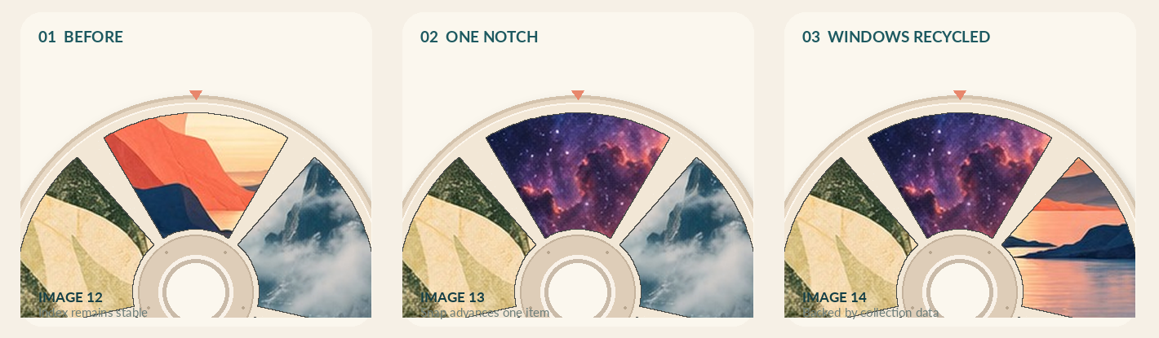
GLIMPSE / INFINITE ILLUSION
The windows move. The collection does not end at five.
One fixed focal position; a few recycled windows; a stable, durable collection behind them.
A finite collection can wrap for browsing without implying an endless source. At a queue boundary, no-repeat shuffle reseeds explicitly and avoids immediate duplicates.
GLIMPSE / REEL SYSTEM / 2026 • CONCEPT

Slide 6
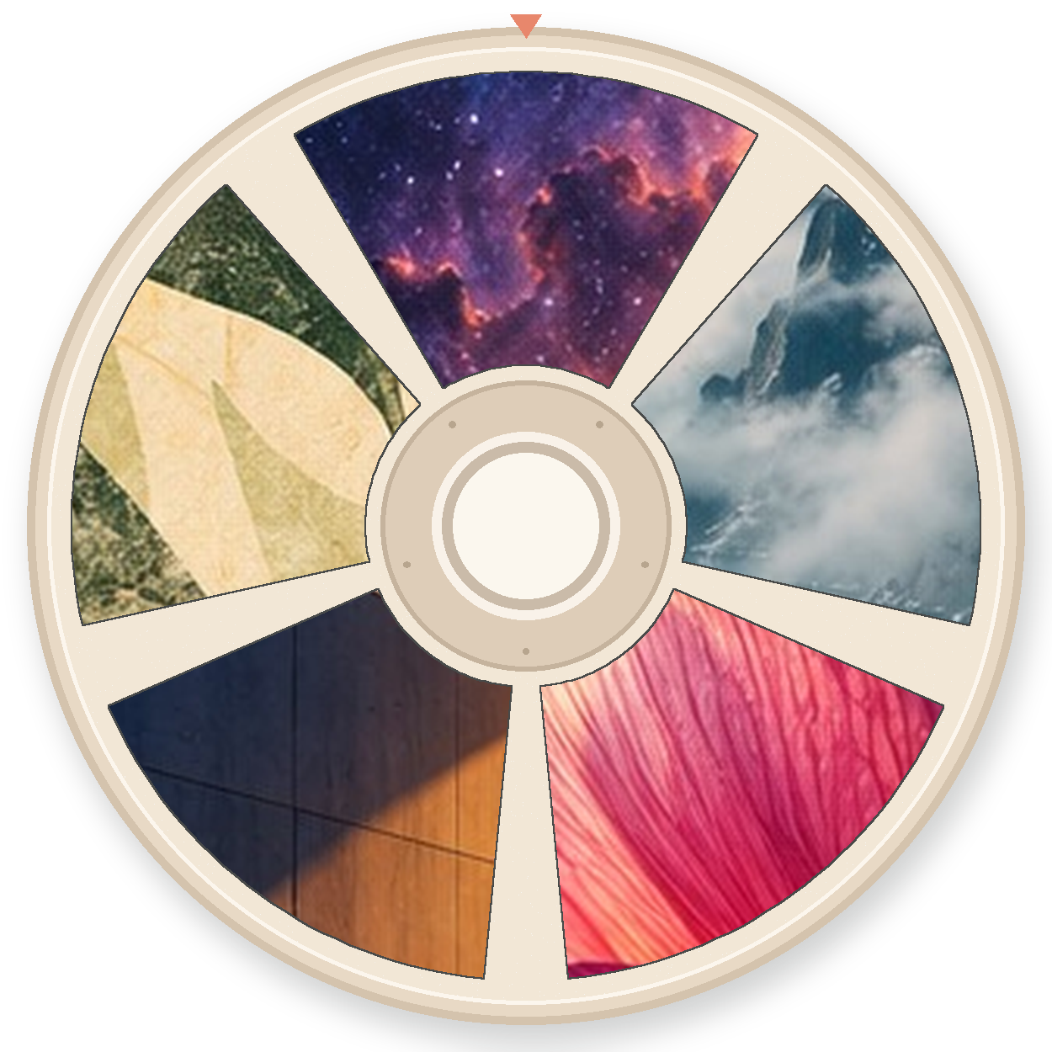
GLIMPSE / REAL INTERACTION
The preview stays still while the reel advances.
Touch and motion follow the user’s intent. Advancing the browser never silently changes the system wallpaper.
NEXT →
BROWSE
NEXT IMAGE
Browse = choose what to view. Set now = deliberately apply. The image count follows actual collection membership.
GLIMPSE / REEL SYSTEM / 2026 • CONCEPT

Slide 7
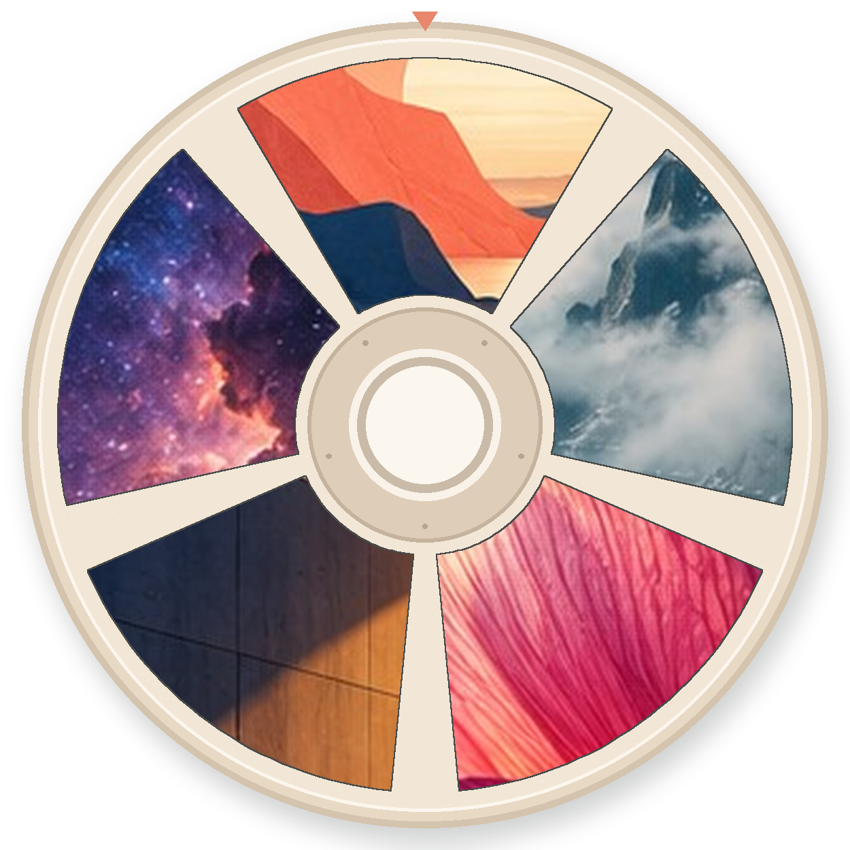
GLIMPSE / COLLECTIONS
The reel is a beautiful cover, not a storage format.
Each collection can show a distinctive crop of its own artwork.
Rainbows
Wild Places
Golden Hour
240 photographs
42 photographs
50 photographs
Open collection
Open collection
Open collection
GLIMPSE / REEL SYSTEM / 2026 • CONCEPT

Slide 8
GLIMPSE / HOME
Let the wallpaper take the stage.
A small reel signature on Home, not a full spinning disk on every surface.
Current image first
Immediate actions
The photograph takes the most space. Collection context stays nearby.
Next, Pause, Share and Set now have ordinary labels and 48dp touch targets.
A little reel peeks in
Scheduling stays honest
A cropped crescent offers recognition and continuity, not an extra navigation burden.
“Next eligible” refers to Android scheduling; it does not claim a guaranteed exact change.
GLIMPSE / REEL SYSTEM / 2026 • CONCEPT

Slide 9
GLIMPSE / BROWSE / GRID
Delight to browse. Efficient to organize.
Two views for the same data. Switch instantly without losing selection or scroll position.
← Immersive inspection
Fast multi-select →
REEL VIEW
GRID VIEW
GLIMPSE / REEL SYSTEM / 2026 • CONCEPT

Slide 10
GLIMPSE / MICROCOPY
Poetry around the edges. Clarity in the controls.
Glimpse should feel warm without ever hiding what an action actually does.
WELCOME
BROWSE
Something lovely, every time you look.
Browse the reel · View all
ACTION
STATE
Next · Set as wallpaper · Share
50 wallpapers · Shuffle without repeats
DIAGNOSTICS
ERROR
Next change eligible in about 3 min
Couldn’t change wallpaper. Try now · Details
GLIMPSE / REEL SYSTEM / 2026 • CONCEPT

Slide 11
GLIMPSE / ACCESSIBILITY
The illusion must never become an obstacle.
A carousel must remain a usable control when its shape, motion or gesture is unavailable.
Tap targets
TalkBack
Large Next / Previous buttons and a persistent View all option.
A linear list, labelled “Image 12 of 50”; actions in logical reading order.
Reduced motion
Large text
Instant image replacement, no reel turn or simulated inertia.
Text sits outside photographic windows; the reel can shrink or collapse.
Gesture conflict
No forced wrap
Vertical scrolling scrolls the page; horizontal drag only in reel region.
Finite “end of collection” mode or seamless browse loop; users can choose.
GLIMPSE / REEL SYSTEM / 2026 • CONCEPT

Slide 12
GLIMPSE / LAYOUT
Responsive by design, not by shrinking the reel.
Clip to the reel’s own container. Keep system bars, tap controls, and content accessibility independent.
SMALL PORTRAIT
LARGE PORTRAIT
LANDSCAPE / TABLET
Less visible arc
Generous arc
Side-docked reel
~60–70% of container width visible, with clear Next / Grid buttons.
More photograph and higher surrounding cards; no tiny windows.
Partial disk on the side, hero photograph and actions in the remaining pane.
360dp
412dp
> 600dp
GLIMPSE / REEL SYSTEM / 2026 • CONCEPT

Slide 13
GLIMPSE / ENGINEERING CONTRACT
A continuous reel is a viewport, not an infinite bitmap.
Reuse a handful of window nodes, keep position as a stable asset ID, and avoid unbounded list indexes.
Domain
collection IDs + deterministic order + shuffle queue + current index
Projection
current + 2 neighbours each side; recycled five-window snapshot
Gesture
pointer input → velocity threshold → one notch snap → selected ID
Rendering
Compose Canvas paths + clipped Coil image thumbnails at bounded resolution
Persistence
save image ID and browsing order; return after process death at same item
Testing
fuzz reorder/remove, empty/singleton sets, state restore, RTL, talkback
GLIMPSE / REEL SYSTEM / 2026 • CONCEPT

Slide 14
GLIMPSE / UX DECISIONS
A little theatre. No deception.
The illusion represents movement through a collection, never a claim of endless new photographs.
End of collection
Large collections
For Browse All, allow finite stop or opt-in wrap. For Shuffle, mark new cycle and avoid recent repeats.
Never load every bitmap. Load neighbouring previews and keep random access through Grid and Search.
Active wallpaper
Touch and motion
Browsing changes only the preview. “Set now” explicitly asks Android to apply the chosen asset.
Reel steps are deliberate and short; no continuous spinning, auto-advance or audio by default.
GLIMPSE / REEL SYSTEM / 2026 • CONCEPT

Slide 15
GLIMPSE / DECISION
Keep the tactile paper. Give the photographs room.
This is Glimpse’s signature interaction; everything else stays legible, native and easy.
THE DESIGN BET
A small window
into somewhere else.
Icon: five large photographic windows.
Collection: reel as thumbnail cover.
Browser: oversized partial reel.
Home: restrained reel accent.
Grid: always one tap away.
GLIMPSE / REEL SYSTEM / 2026 • CONCEPT

Slide 16
GLIMPSE / FOUNDATIONS
The earlier research is retained.
The following slides capture the existing Glimpse product analysis, initial exploratory UI and the Android engineering plan. Some embedded mockup screenshots reflect the pre-reel design and are superseded by the new reel concepts.
Previous visual explorations
Native architecture unchanged
Useful interaction patterns remain; old image assets are evidence of the design process, not the chosen look.
Kotlin, Compose, Room, reliable wallpaper delivery, secure imports, universal sharing and signed APKs remain the implementation direction.
GLIMPSE / REEL SYSTEM / 2026 • CONCEPT

Slide 17
W A L T Z / PRODUCT CONCEPT
The phone can feel alive.
A beautiful experience with the dependability of a well-designed system.
01
Yours first
02
It keeps its promises
Local folders, carefully vetted providers, no Glimpse account.
A persistent rule engine and an honest account of every change.
03
Android native
04
Delight, deliberately
Widgets, Quick Settings, shortcuts, shares and separate destinations.
A warm visual language, polished motion and full accessibility.
GLIMPSE / CONCEPT DESIGN / OCT 2026
02

Slide 18
W A L T Z / RESEARCH
The category’s problem is trust.
The best inspiration came from real bug reports, not feature marketing.
01
Silent schedule failure
02
Broken image references
Changes stop after sleep, reboot or battery management, with little explanation.
Deleted files, rescans and invalid grants can lead to black wallpapers.
03
Source instability
04
Surprising controls
Third-party API changes and rights restrictions interrupt online collections.
What “random”, “every 15 minutes” and “on unlock” mean varies by app.
GLIMPSE / CONCEPT DESIGN / OCT 2026
03

Slide 19

SOPHISTICATED, NOT STERILE
A little personality.
A lot of restraint.
Warm paper, generous breathing room, playful geometry and imagery that does the talking.
SOUND DESIGN, NO DECORATIVE NOISE
GLIMPSE / CONCEPT DESIGN / OCT 2026
04

Slide 20
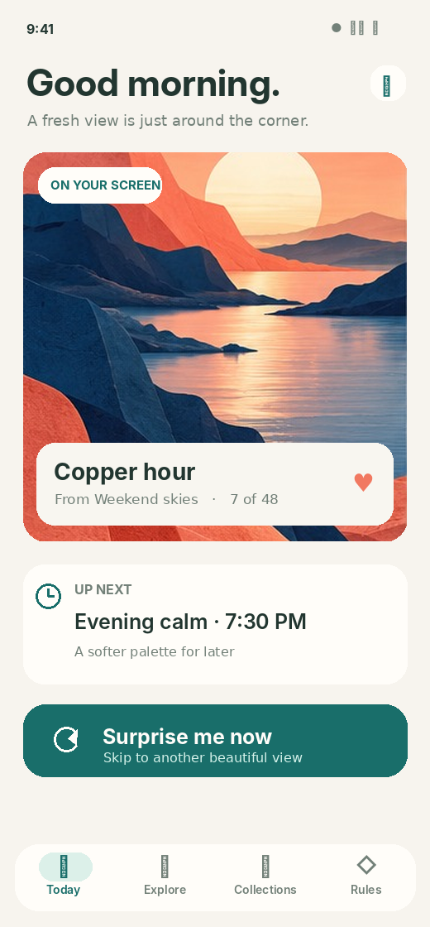
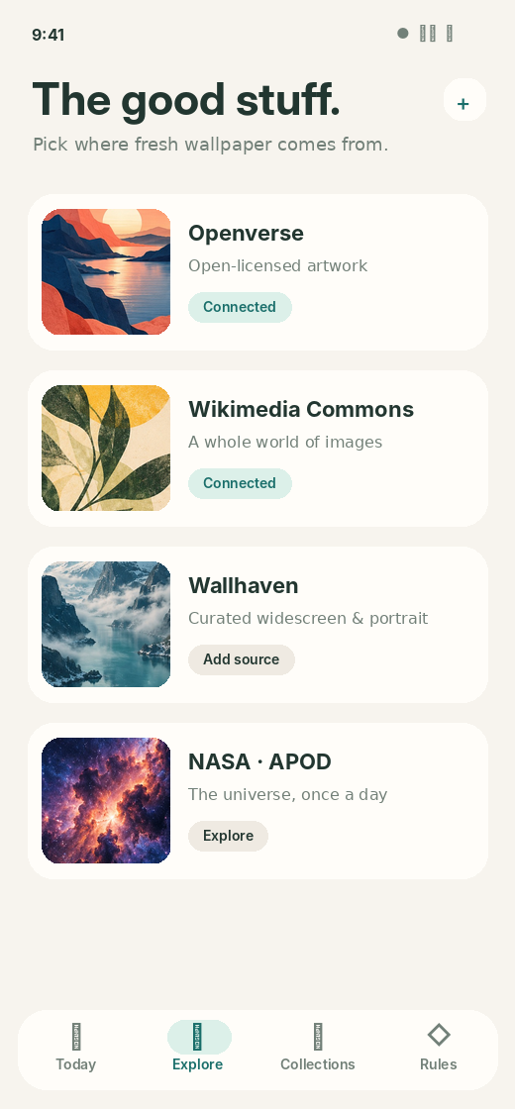
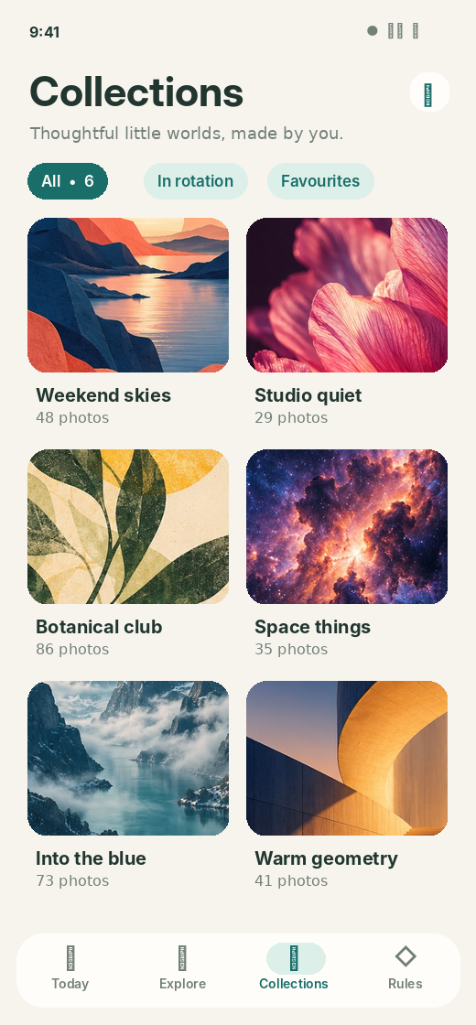
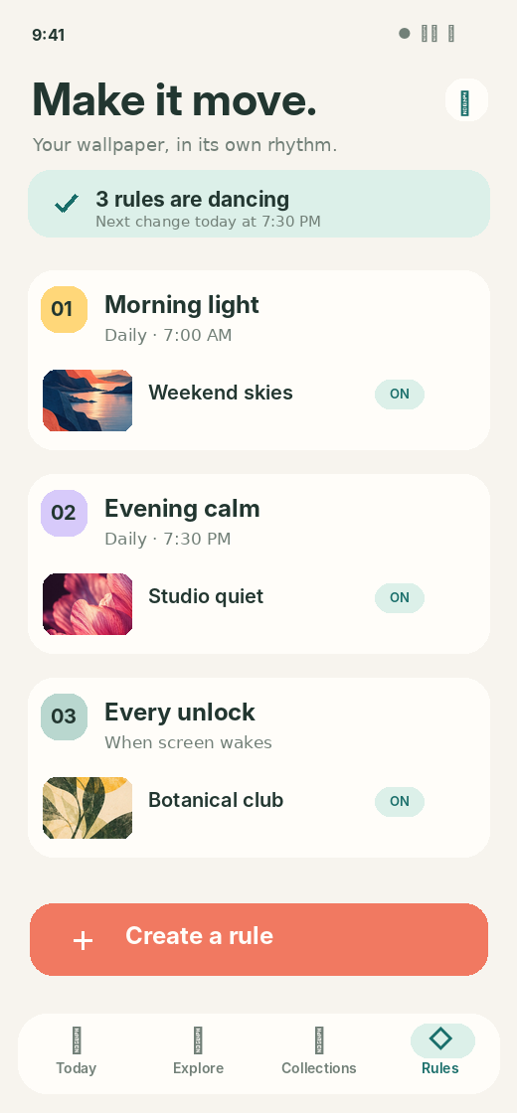
W A L T Z / INFORMATION ARCHITECTURE
Four places, one clear mental model.
Today · Explore · Collections · Rules. Activity and Settings are one tap away.
TODAY
EXPLORE
COLLECTIONS
RULES
GLIMPSE / CONCEPT DESIGN / OCT 2026
05

Slide 21
W A L T Z / PRODUCT CONCEPT
Today feels effortless.
The current image, the next event and one large action.
One dominant action
Surprise me now is immediate. No screen full of obscure settings.
Status in plain language
Show the source, the rotation position and the next eligible action.
Never leave the user guessing
Pause, inspect, undo or diagnose are discoverable without being noisy.
GLIMPSE / CONCEPT DESIGN / OCT 2026
06

Slide 22
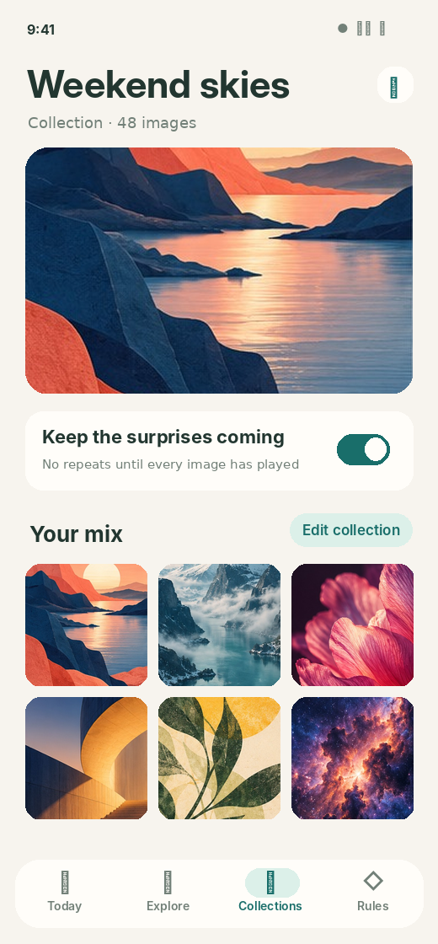
W A L T Z / PRODUCT CONCEPT
A library without a proprietary library.
Powerful organization, entirely built on the user’s existing files and links.
Thoughtful collections
Manual sets, watched folders, smart filters, favourites, exclusions and a persistent no-repeat shuffle bag.
NO DUPLICATED USER LIBRARY
Images stay where they belong. Only small, bounded and disposable render caches live inside Glimpse.
GLIMPSE / CONCEPT DESIGN / OCT 2026
07

Slide 23
W A L T Z / PRODUCT CONCEPT
The world’s images, through legitimate doors.
Provider adapters keep discovery, rights and automation separate.
YOUR FILES
Offline by default
WIKIMEDIA COMMONS
Open-licensed metadata
OPENVERSE
Search across open works
WALLHAVEN
Public API + optional own key
NASA APOD
Rights-screened images
GLIMPSE / CONCEPT DESIGN / OCT 2026
08

Slide 24
W A L T Z / SOURCES & RIGHTS
Content provenance is a product feature.
Every wallpaper carries its source, creator, licence and origin link.
01
Integrated with permission
02
NASA with nuance
Wikimedia Commons, Openverse and Wallhaven, subject to terms and per-image rights.
Some APOD images are third-party copyrighted. Gate automatic use accordingly.
03
Not default: Unsplash
04
Not default: Pexels
Its published API policy restricts replica wallpaper applications.
Its API likewise explicitly restricts wallpaper applications.
GLIMPSE / CONCEPT DESIGN / OCT 2026
09

Slide 25
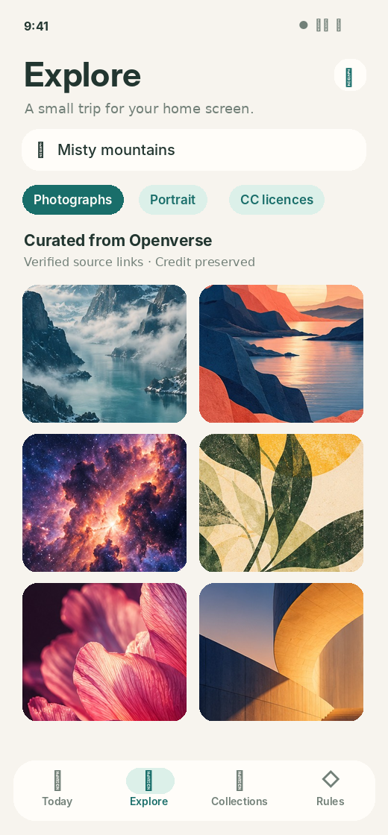


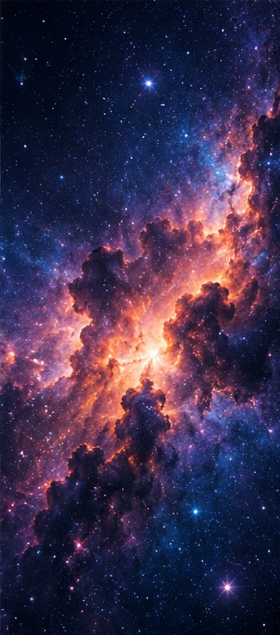
W A L T Z / PRODUCT CONCEPT
Browse with curiosity. Save with confidence.
The images are centre stage; credit and licences stay attached.
Portrait-aware search • image-rights filters • source links
GLIMPSE / CONCEPT DESIGN / OCT 2026
10

Slide 26
W A L T Z / PRODUCT CONCEPT
Collections and rules stay independent.
A scene can reuse a collection across destinations and contexts.
COLLECTION
HOME
Weekend skies
RULE ENGINE
48 artworks · no repeats
When · If · Choose · Apply
LOCK
SAME INPUT, DIFFERENT RULES
GLIMPSE / CONCEPT DESIGN / OCT 2026
11

Slide 27
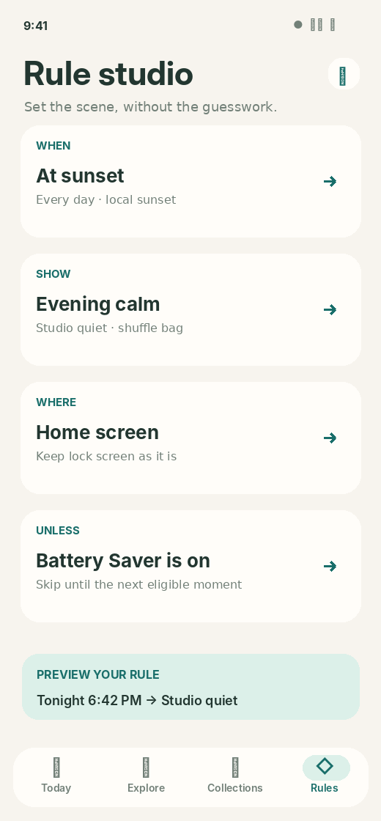
W A L T Z / PRODUCT CONCEPT
Automation reads like a sentence.
Power when desired. A gentle learning curve by default.
WHEN
At sunset
SHOW
Evening calm
WHERE
Home only
UNLESS
Battery Saver
SIMULATE BEFORE SAVING
GLIMPSE / CONCEPT DESIGN / OCT 2026
12

Slide 28
W A L T Z / ENGINEERING
Predictable priorities, every time.
An inspectable evaluation pipeline makes advanced automation safe.
01
Trigger
02
Eligibility
03
Resolution
Time, unlock, widget, intent
Pause, permissions, conditions
Priority + stable tie-break
04
Selection
05
Delivery
06
Explanation
Persistent shuffle reservation
Prepare → apply → reconcile
Success, skip or failure record
GLIMPSE / CONCEPT DESIGN / OCT 2026
13

Slide 29
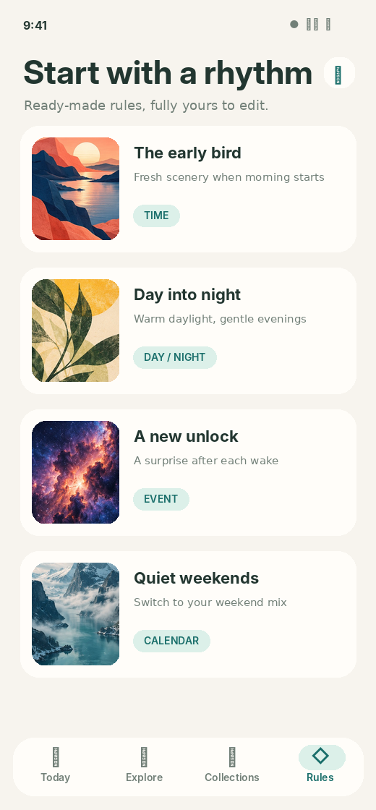
W A L T Z / PRODUCT CONCEPT
Good defaults. Endless combinations.
Users begin with a rhythm, then adjust one idea at a time.
Time of day
Morning scenes and evening calm, with DST-aware window logic.
Context
Weekends, power settings and source availability.
Events
Quick Settings, widgets and optional capability-gated wake mode.
GLIMPSE / CONCEPT DESIGN / OCT 2026
14

Slide 30
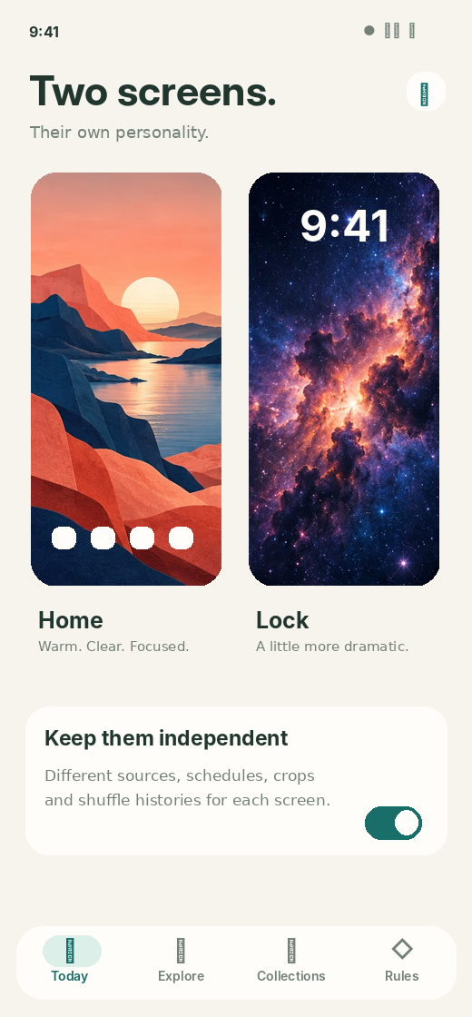
W A L T Z / PRODUCT CONCEPT
Home and lock deserve their own rhythm.
Distinct source pools, edits, shuffle histories and transition policies.
Destination capabilities are detected, not assumed.
HOME
LOCK
GLIMPSE / CONCEPT DESIGN / OCT 2026
15

Slide 31
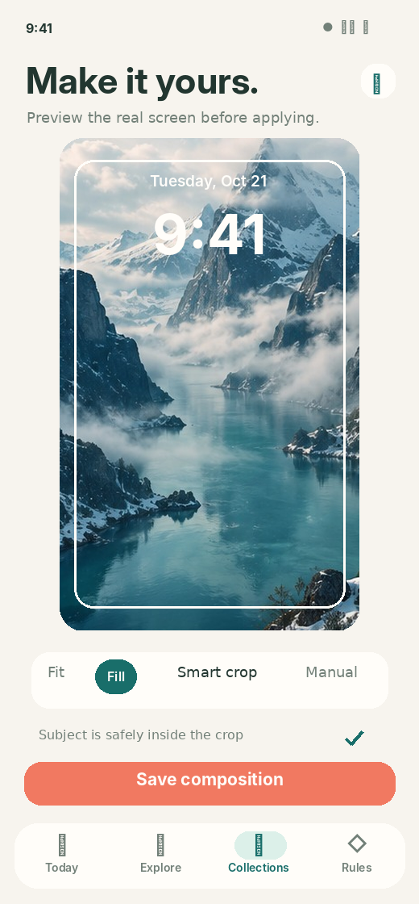
W A L T Z / PRODUCT CONCEPT
Never lose the subject to a bad crop.
Per-image, per-destination composition. Completely reversible.
See the actual frame
Lock clock, launch grid and portrait aspect guides in preview.
Three levels of agency
Auto-fill, smart focal suggestion, or precise pinch-and-pan controls.
Respect originals
Only transform render copies, and preserve editing history.
GLIMPSE / CONCEPT DESIGN / OCT 2026
16

Slide 32
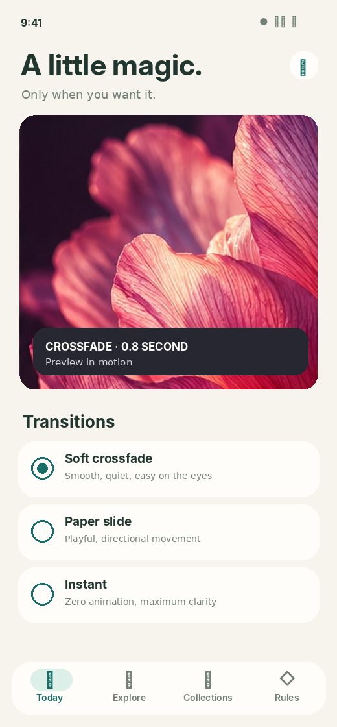
W A L T Z / PRODUCT CONCEPT
Motion is a treat, never a tax.
Static first. Live rendering is optional and must behave when invisible.
01
Instant
02
Soft crossfade
One prepared image and a direct Android static wallpaper update.
A restrained live transition that respects reduced motion.
03
Paper slide
04
Silence by default
A playful optional treatment with predictable GPU cost.
Animations stop when the live surface is not visible.
GLIMPSE / CONCEPT DESIGN / OCT 2026
17

Slide 33
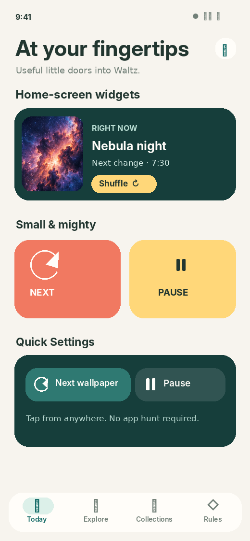
W A L T Z / PRODUCT CONCEPT
Present wherever Android expects it.
The app disappears into useful native controls.
01
Glance widgets
02
Quick Settings
Now / Next, one-tap Shuffle, Pause and full-screen preview.
Discoverable tile request for Skip and Pause / Resume.
03
Pinned shortcuts
04
Automation contracts
Jump to a collection or trigger Next from launcher.
Documented intent entry point for tools such as Tasker.
GLIMPSE / CONCEPT DESIGN / OCT 2026
18

Slide 34
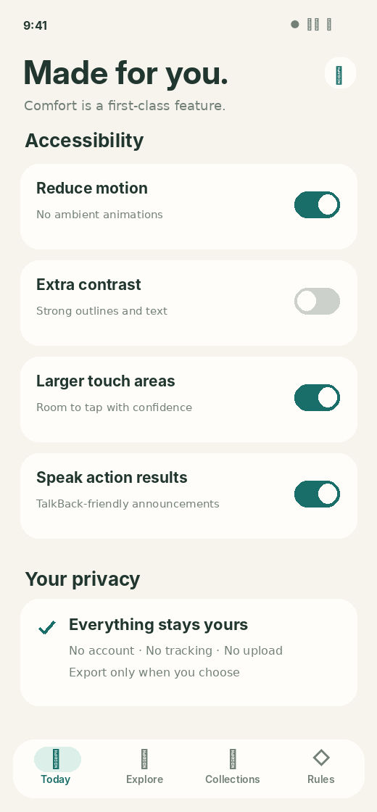
W A L T Z / PRODUCT CONCEPT
Accessibility changes the design for the better.
Not a compliance screen added the week before release.
48 dp
200%
minimum touch targets
scalable text acceptance
AA
Zero
target contrast standard
motion-dependent tasks
GLIMPSE / CONCEPT DESIGN / OCT 2026
19

Slide 35
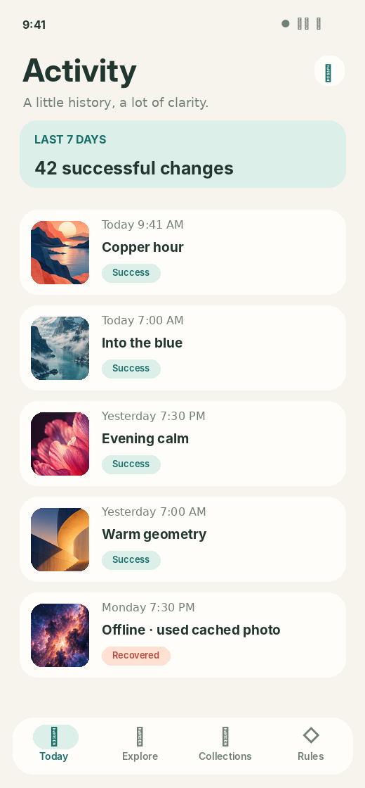
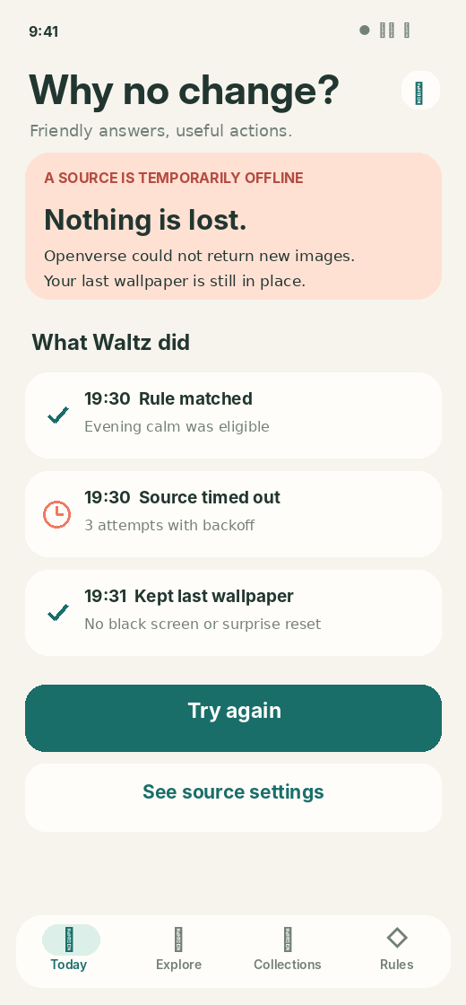
W A L T Z / PRODUCT CONCEPT
When things fail, the app explains itself.
A diary of real outcomes, not a decorative “working” spinner.
Actionable answers
Why it did not change
Which rule was eligible
What source failed
What was preserved
When it will retry
NEVER REPLACE WITH BLACK
GLIMPSE / CONCEPT DESIGN / OCT 2026
20

Slide 36
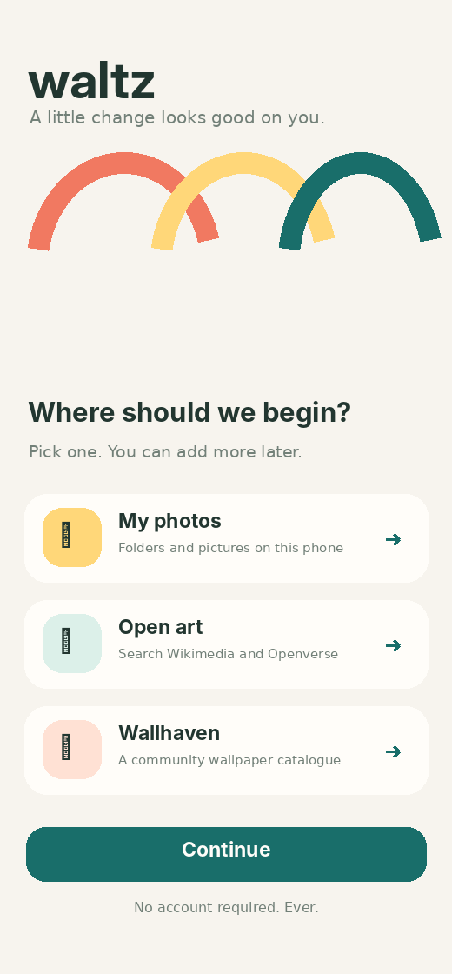
W A L T Z / PRODUCT CONCEPT
Onboarding that does not interrogate.
Start with an image source, preview, then choose a rhythm.
01
Pick existing photos or a vetted source
02
Preview at your real screen ratio
03
Choose home, lock or both
04
Select a ready-made rhythm
No account. No gallery upload. No universal permission request.
GLIMPSE / CONCEPT DESIGN / OCT 2026
21

Slide 37
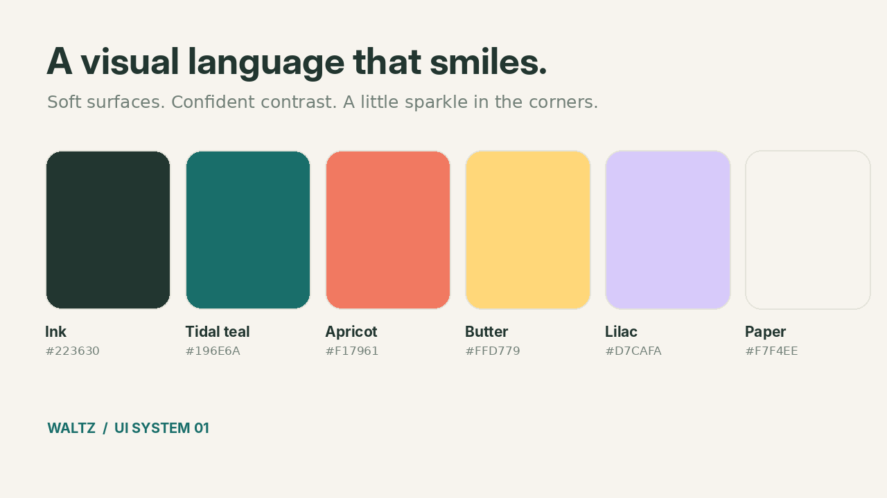
W A L T Z / VISUAL IDENTITY
A design system with a pulse.
Delight in colour relationships, not loudness.
GLIMPSE / CONCEPT DESIGN / OCT 2026
22

Slide 38
W A L T Z / VISUAL IDENTITY
The icon, tokens and components belong together.
Friendly geometry with clear interaction affordances.
PRIMARY ACTION
SECONDARY ACTION
ATTENTION
glimpse
SCHEDULED
Wide hit areas, low visual noise, and unmistakable state.
GLIMPSE / CONCEPT DESIGN / OCT 2026
23

Slide 39
W A L T Z / SYSTEM DESIGN
A modular engine underneath the warmth.
A source is a provider. A rule is a decision. A delivery is a device action.
SOURCE ADAPTERS
Local · Commons · Openverse · Wallhaven
LOCAL REPOSITORY
Room · metadata · licences · bounded cache
PURE RULE ENGINE
Triggers · conditions · conflicts · shuffle
RENDER PIPELINE
Decode · crop · prepare · effects
ANDROID OUTPUT
WallpaperManager · live Engine · widgets
GLIMPSE / CONCEPT DESIGN / OCT 2026
24

Slide 40
W A L T Z / PLATFORM REALITY
We tell the truth about Android.
The operating system gets the final vote on background execution.
01
Inexact schedules
02
Event limitations
Periodic WorkManager has a 15-minute minimum and can be deferred.
Wake and lock triggers need explicitly supported lifecycle modes.
03
OEM behavior
04
Capability gating
Battery managers, launchers and lock surfaces vary substantially.
Show only features the actual device can reliably support.
GLIMPSE / CONCEPT DESIGN / OCT 2026
25

Slide 41
W A L T Z / PRODUCT CONCEPT
Privacy by architecture, not by policy copy.
The app needs no cloud of its own because nothing essential leaves the device.
01
NO ACCOUNT
No identifiers, logins or proprietary hosted galleries.
02
PERMISSION MINIMALISM
User-selected folder/document access instead of all-files.
03
CREDENTIAL CARE
Sensitive keys in secure device storage, never in URLs/logs.
04
DIAGNOSTICS ON DEVICE
Explicit review and export; no secret analytics SDK.
GLIMPSE / CONCEPT DESIGN / OCT 2026
26

Slide 42
W A L T Z / IMPLEMENTATION
Build reliability first. Delight on a stable foundation.
Milestones are vertical slices with exit criteria, not a gallery of unfinished UI.
01
02
03
Platform proof
Local core
Rules + diagnostics
2–3 wk
4–5 wk
3–4 wk
04
05
06
External sources
Native surfaces
Live + hardening
3–4 wk
2–3 wk
5–9 wk
GLIMPSE / CONCEPT DESIGN / OCT 2026
27

Slide 43
W A L T Z / QUALITY
The test matrix is part of the product.
A great experience must survive boredom, abuse and real-world Android.
01
Import torture
02
Long sleep & reboot
20k images, cancelled indexing, restored URI grants, database migrations.
Doze, offline recovery, missed intervals, DST and process death.
03
Rendering gauntlet
04
Inclusive completion
Orientation churn, GPU limits, launcher replacement and live visibility.
TalkBack, keyboard, 200% text, contrast and reduced motion.
GLIMPSE / CONCEPT DESIGN / OCT 2026
28

Slide 44
W A L T Z / UI GALLERY
Sixteen screens, one unmistakable personality.
From first run to diagnosis, every state belongs to the same system.
Full sixteen-screen gallery and downloadable PNG files accompany this deck.
GLIMPSE / CONCEPT DESIGN / OCT 2026
29

Slide 45
A wallpaper manager worth keeping.
Yours to curate.
Yours to automate.
Yours to understand.
GLIMPSE / PRODUCT CONCEPT / 2026
GLIMPSE / CONCEPT DESIGN / OCT 2026
30

Slide 46
W A L T Z / FIRST-RUN CONTRACT
Rainbows in five minutes
One familiar native photo picker. One collection. One rhythm. No rule editor.
1 New collection
Rainbows
2 Add photos
Android Photo Picker
3 Import offline
Count successes & duplicates
4 Use as wallpaper
Home screen
5 Shuffle
Every five minutes
6 Start
Next / Pause / Why

Slide 47
W A L T Z / PLATFORM TRUTH
A kind promise, never a fake one
Google Photos selection is a snapshot. Five-minute rotation is active-use eligibility, with honest OS delays.
Import your picks
Album browsing depends on Android Photo Picker provider. Whole-album select and continuous sync are not guaranteed.
Keep them offline
Verified app-private copies, resumable errors, original photos untouched.
Show what happened
Last applied, next eligible, reason for deferral, and a one-tap remedy.

Slide 48
W A L T Z / COMPLEXITY WITHOUT CONFUSION
73 lives. Four levels of control.
The engine is composable. The interface only reveals complexity when it earns its keep.
1 / Act
2 / Pick a rhythm
Next · Pause · Hide · Pin
Shuffle · interval · destinations
3 / Make a scene
4 / Add rules
Workday · Travel · Rainbows
When · If · Use · Where · Unless

Slide 49
W A L T Z / RELEASE GATES
Make the small thing impeccable
Ship the Rainbow test before the exotic recursive composition engine.
MVP: photos → private offline copies → collection → no-repeat shuffle → five-minute active-use rotation.
Next: scenes, rule precedence, widgets, sources, backup, diagnostics.
Then: nested collection DAGs, weighted mixes, intelligent crops and optional live rendering.

Slide 50
W A L T Z / NATIVE STACK
An actual Android app. No detours.
A signed, sideloadable APK with Kotlin and first-party Android platform integrations.
UI & interaction
Durable foundations
Native distribution
Jetpack Compose + Material 3
Navigation 3
ViewModel + StateFlow
Accessible Glimpse design tokens
Room / SQLite transactions
DataStore preferences
Coroutines & Flow
Hilt dependency injection
API 29 minimum (proposed)
API 37 target (qualification)
Gradle version catalogue
Signed and checksum-verified APK
GLIMPSE / NATIVE ANDROID / 2026 • 35

Slide 51
W A L T Z / ARCHITECTURE
One command path, everywhere.
Widgets, timers, the UI, and Android share intents all use the same domain commands.
ENTRY POINTS
App • widgets • tiles • shortcuts • triggers
COMMAND GATEWAY
Validate • authorize • deduplicate • serialize
PURE RULE ENGINE
Scenes • conditions • weighted shuffle • explanation
PERSISTENT OPERATION
Room state • journal • outbox • recoverable results
ANDROID DELIVERY
WallpaperManager • optional live engine • capabilities
GLIMPSE / NATIVE ANDROID / 2026 • 36

Slide 52
W A L T Z / RELIABILITY
An operation journal, not a hopeful timer.
The Android wallpaper API cannot join a database transaction; Glimpse records intent and reconciles outcomes.
01 REQUEST
Record the source trigger, image, destination and idempotency key.
02 PREPARE
Resolve a valid asset; decode within memory limits and render the crop.
03 APPLY
Call WallpaperManager, capture the actual platform result.
04 RECONCILE
Persist success or failure; retry safely after an interruption.
05 EXPLAIN
Show what changed, what failed, and the next eligible change.
GLIMPSE / NATIVE ANDROID / 2026 • 37

Slide 53
W A L T Z / ANDROID REALITY
Five minutes means something precise.
Sideloading does not defeat Doze, battery restrictions or Android foreground-service rules.
Static / efficient
Live / optional
Truthful interface
OS-managed scheduling
Sub-15-minute intervals are best effort
Resume at next permitted opportunity
WallpaperService.Engine
Animate while wallpaper is visible
Stop work when invisible
Last applied
Next eligible
Why delayed?
Manual Next remains accessible
GLIMPSE / NATIVE ANDROID / 2026 • 38

Slide 54
W A L T Z / IMAGE PIPELINE
The originals are sacred.
Images, collection membership, edit recipes and generated caches are separate objects.
Into Glimpse
In Glimpse
Out of Glimpse
Google Photos picker
Screenshot share or Paste
Storage Access Framework
Approved remote providers
Verify and copy offline
Hash and detect duplicates
Edit non-destructively
Bound image decoding
Android wallpaper targets
Share to compatible apps
Export original or crop
Optional metadata removal
GLIMPSE / NATIVE ANDROID / 2026 • 39

Slide 55
W A L T Z / ANDROID INTEGRATION
Belong on the phone, not just in the app.
System integration is built on supported contracts and explicit permissions.
At a glance
From anywhere
Glance widgets: Next, Pause, Now playing. Compact bitmap memory use.
Quick Settings tile, launcher shortcuts and compatible automation intents.
Share in and out
Keep access scoped
Photo Picker, Android Sharesheet, FileProvider grants and external editor return flows.
No blanket file access, invisible clipboard monitoring or fake direct Lens APIs.
GLIMPSE / NATIVE ANDROID / 2026 • 40

Slide 56
W A L T Z / RELEASE ENGINEERING
An APK people can trust to install.
Sideloading makes signing identity, upgrade safety and provenance first-class requirements.
Build with discipline
Test in the real world
Release properly
Pinned Gradle toolchain
Dependency verification
Secret scanning
PR checks and migrations
Pixel 6 Pro + Samsung + OEM
API 29–37 emulators
Doze, reboot, clock shifts
Accessibility and battery
Permanent signing key
apksigner verification
SHA-256 and changelog
Upgrade / restore rehearsal
GLIMPSE / NATIVE ANDROID / 2026 • 41

Slide 57
W A L T Z / SHIP PLAN
Make the simple case impeccable first.
Each milestone ends in something testable, not an expanding pile of unverified features.
M0 PLATFORM PROOF
Native scaffold, verified image import, WallpaperManager and schedule spike
M1 USEFUL ALPHA
Rainbows import, collection, five-minute eligibility, shuffle and recovery
M2 DAILY DRIVER
Crop, share, widgets, tiles, backup, diagnostics and OEM fixes
M3 EXPRESSIVE ENGINE
Rules, nesting, scene simulator and legally approved content sources
M4 LIVE + POLISH
Optional effects, GPU and battery measurement, final UX refinement
GLIMPSE / NATIVE ANDROID / 2026 • 42

