Slide 1
MINERVA CryoCell — MYRRHA Phase 1
P&ID v3 — Drawing Dissection
Layer hierarchy · piping classes · instrumentation · monochrome · A3 legibility
QCELL (=NA.PS01_PFB712) & RFCELL (=NA.PS01_PFB713)
Standard
SCK CEN AD_01.16 · ISO 10628 · ISA 5.1
Consultant
Mott MacDonald — Bristol, UK
Client
SCK CEN — Boeretang 200, 2400 Mol, BE
MMD Project
411066
Sheets
4 sheets × 4 variants = 16 SVG + 16 PDF (A3 landscape)
Status
S2 — FOR ACCEPTANCE · RESTRICTED
Revision C1 · 2026-06 · v3 refinement (layers / legibility / monochrome / default views)

Slide 2
Deliverable Map & Layer Hierarchy
02
22-layer hierarchical naming · toggleable overlays · consistent across all sheets
Layer stack (bottom → top)
• Naming convention: NN_Group_Detail
– two-digit ordinal controls Z-order / print order
– Group = Background / Piping / Instruments / Signal / Legend
• Piping split by cryogenic class for selective visibility
– 40K, 4K5, 2K, Water, Infra, OutOfScope each on own layer
• Signals separated from process piping
– Pneumatic vs Electric/Software on dedicated layers
• TOGGLEABLE overlays default to display:none
– Legend (16) and Notes (17) toggle on demand — zero clutter by default
• Identical layer tree across all 4 sheets & 4 variants
– see LAYER_NAMING_STANDARD.md for the controlled list
00_Background_TitleBlock
01_Grid_Match-lines
02_Scope_Boundaries
03_Equipment_Vessels
04_Equipment_HX-Cryo
05_Piping_40K
06_Piping_4K5
07_Piping_2K
08_Piping_Water
09_Piping_Infra
10_Piping_OutOfScope
11_Valves_Actuators
12_Instruments_Field
13_Instruments_Panel
14_Signal_Pneumatic
15_Signal_Electric_SW
16_Legend_TOGGLEABLE
17_Notes_TOGGLEABLE
MINERVA CryoCell · P&ID v3 Dissection · SCK CEN / Mott MacDonald
AD_01.16 · ISO 10628 · ISA 5.1

Slide 3
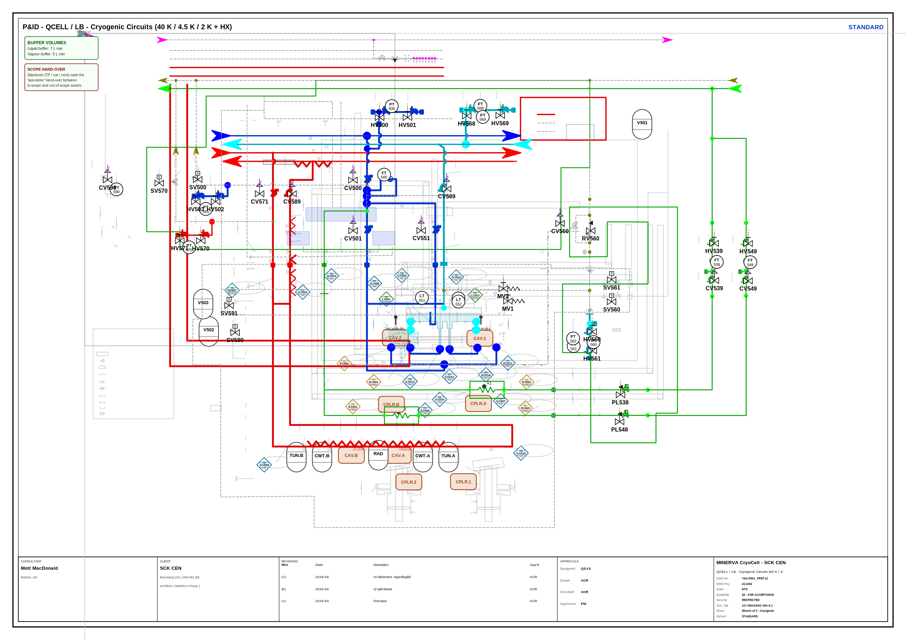
QCELL — Sheet 1 · Cryogenic Circuits
03
40 K / 4.5 K / 2 K + HX · =NA.PS01_PFB712
Highlights
• Three cryogenic temperature classes on one sheet
– 40 K (red) · 4.5 K (blue) · 2 K (cyan)
• RF cavities CAV.1/CAV.2 + couplers + tuners
• DI-water cooling (green) & infrastructure runs
• Buffer-volume & scope hand-over notes
MINERVA CryoCell · P&ID v3 Dissection · SCK CEN / Mott MacDonald
AD_01.16 · ISO 10628 · ISA 5.1

Slide 4
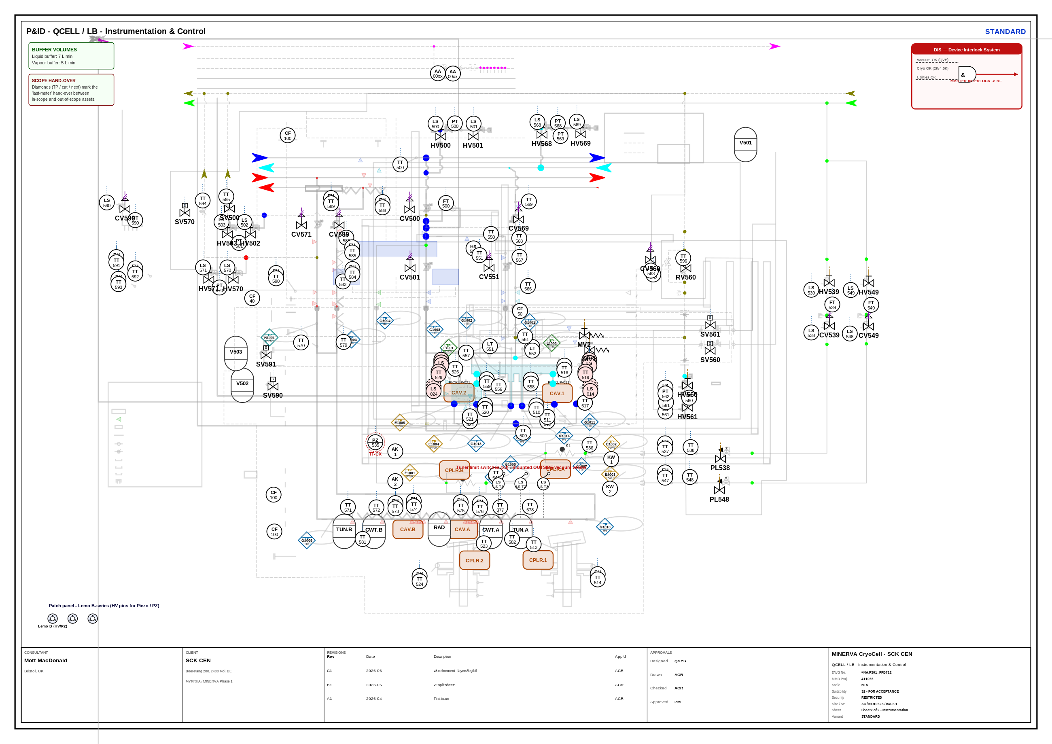
QCELL — Sheet 2 · Instrumentation
04
Signals / loops / ISA bubbles · =NA.PS01_PFB712
Highlights
• Process greyed; instrumentation in foreground
• ISA 5.1 bubbles: field / panel / shared
• Three distinct 0.25 mm signal patterns
– pneumatic (dash+//), electric (dotted), hydraulic (dash-dot)
• Re-allocated piezo sensors PZ535 / PZ525
MINERVA CryoCell · P&ID v3 Dissection · SCK CEN / Mott MacDonald
AD_01.16 · ISO 10628 · ISA 5.1

Slide 5
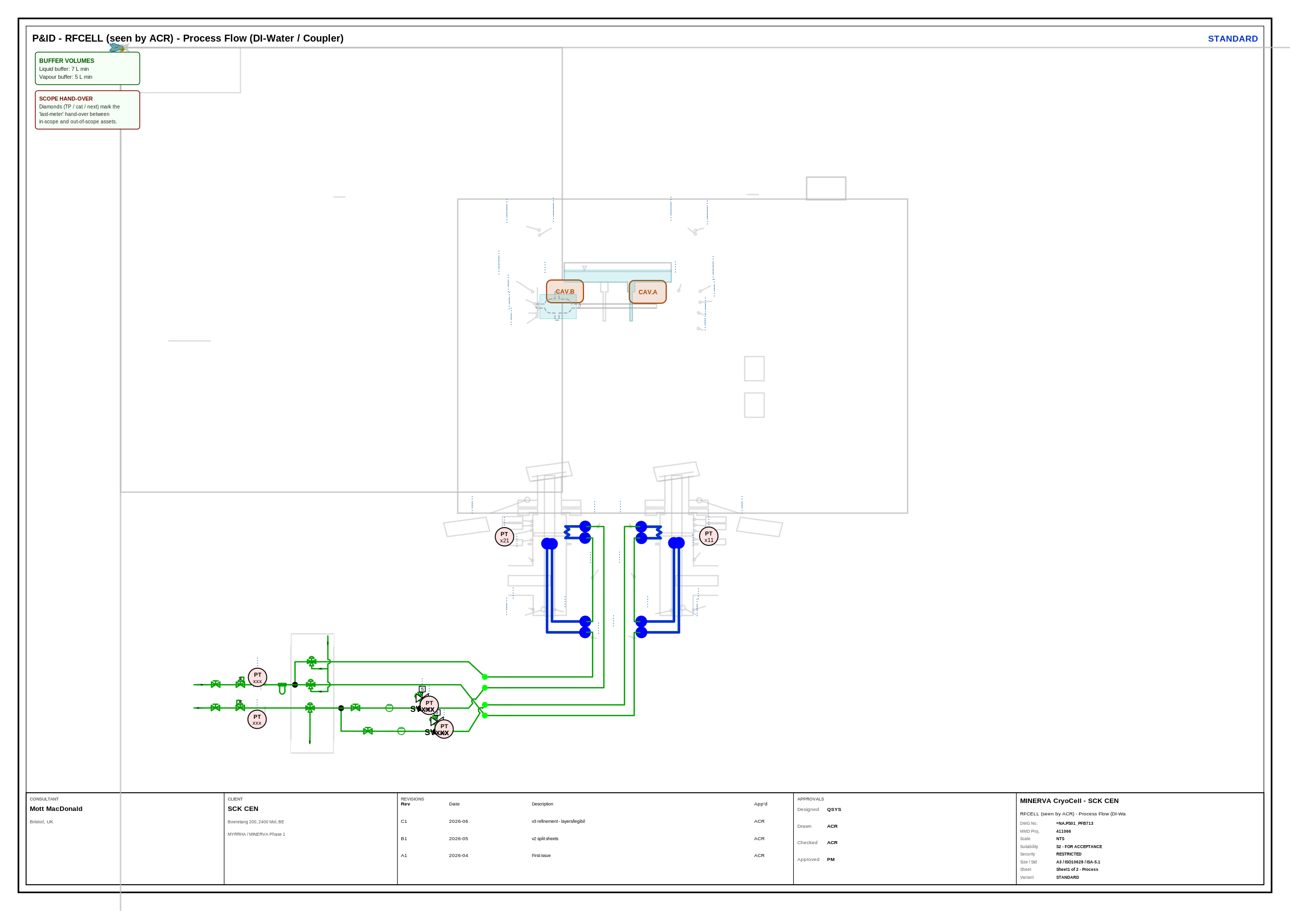
RFCELL — Sheet 1 · Process
05
RF distribution & cooling · =NA.PS01_PFB713
Highlights
• RF power & cooling distribution cell
• Same class colour & line-weight system
• Scope diamonds at the last-metre hand-over
• Shares symbol library with QCELL sheets
MINERVA CryoCell · P&ID v3 Dissection · SCK CEN / Mott MacDonald
AD_01.16 · ISO 10628 · ISA 5.1

Slide 6
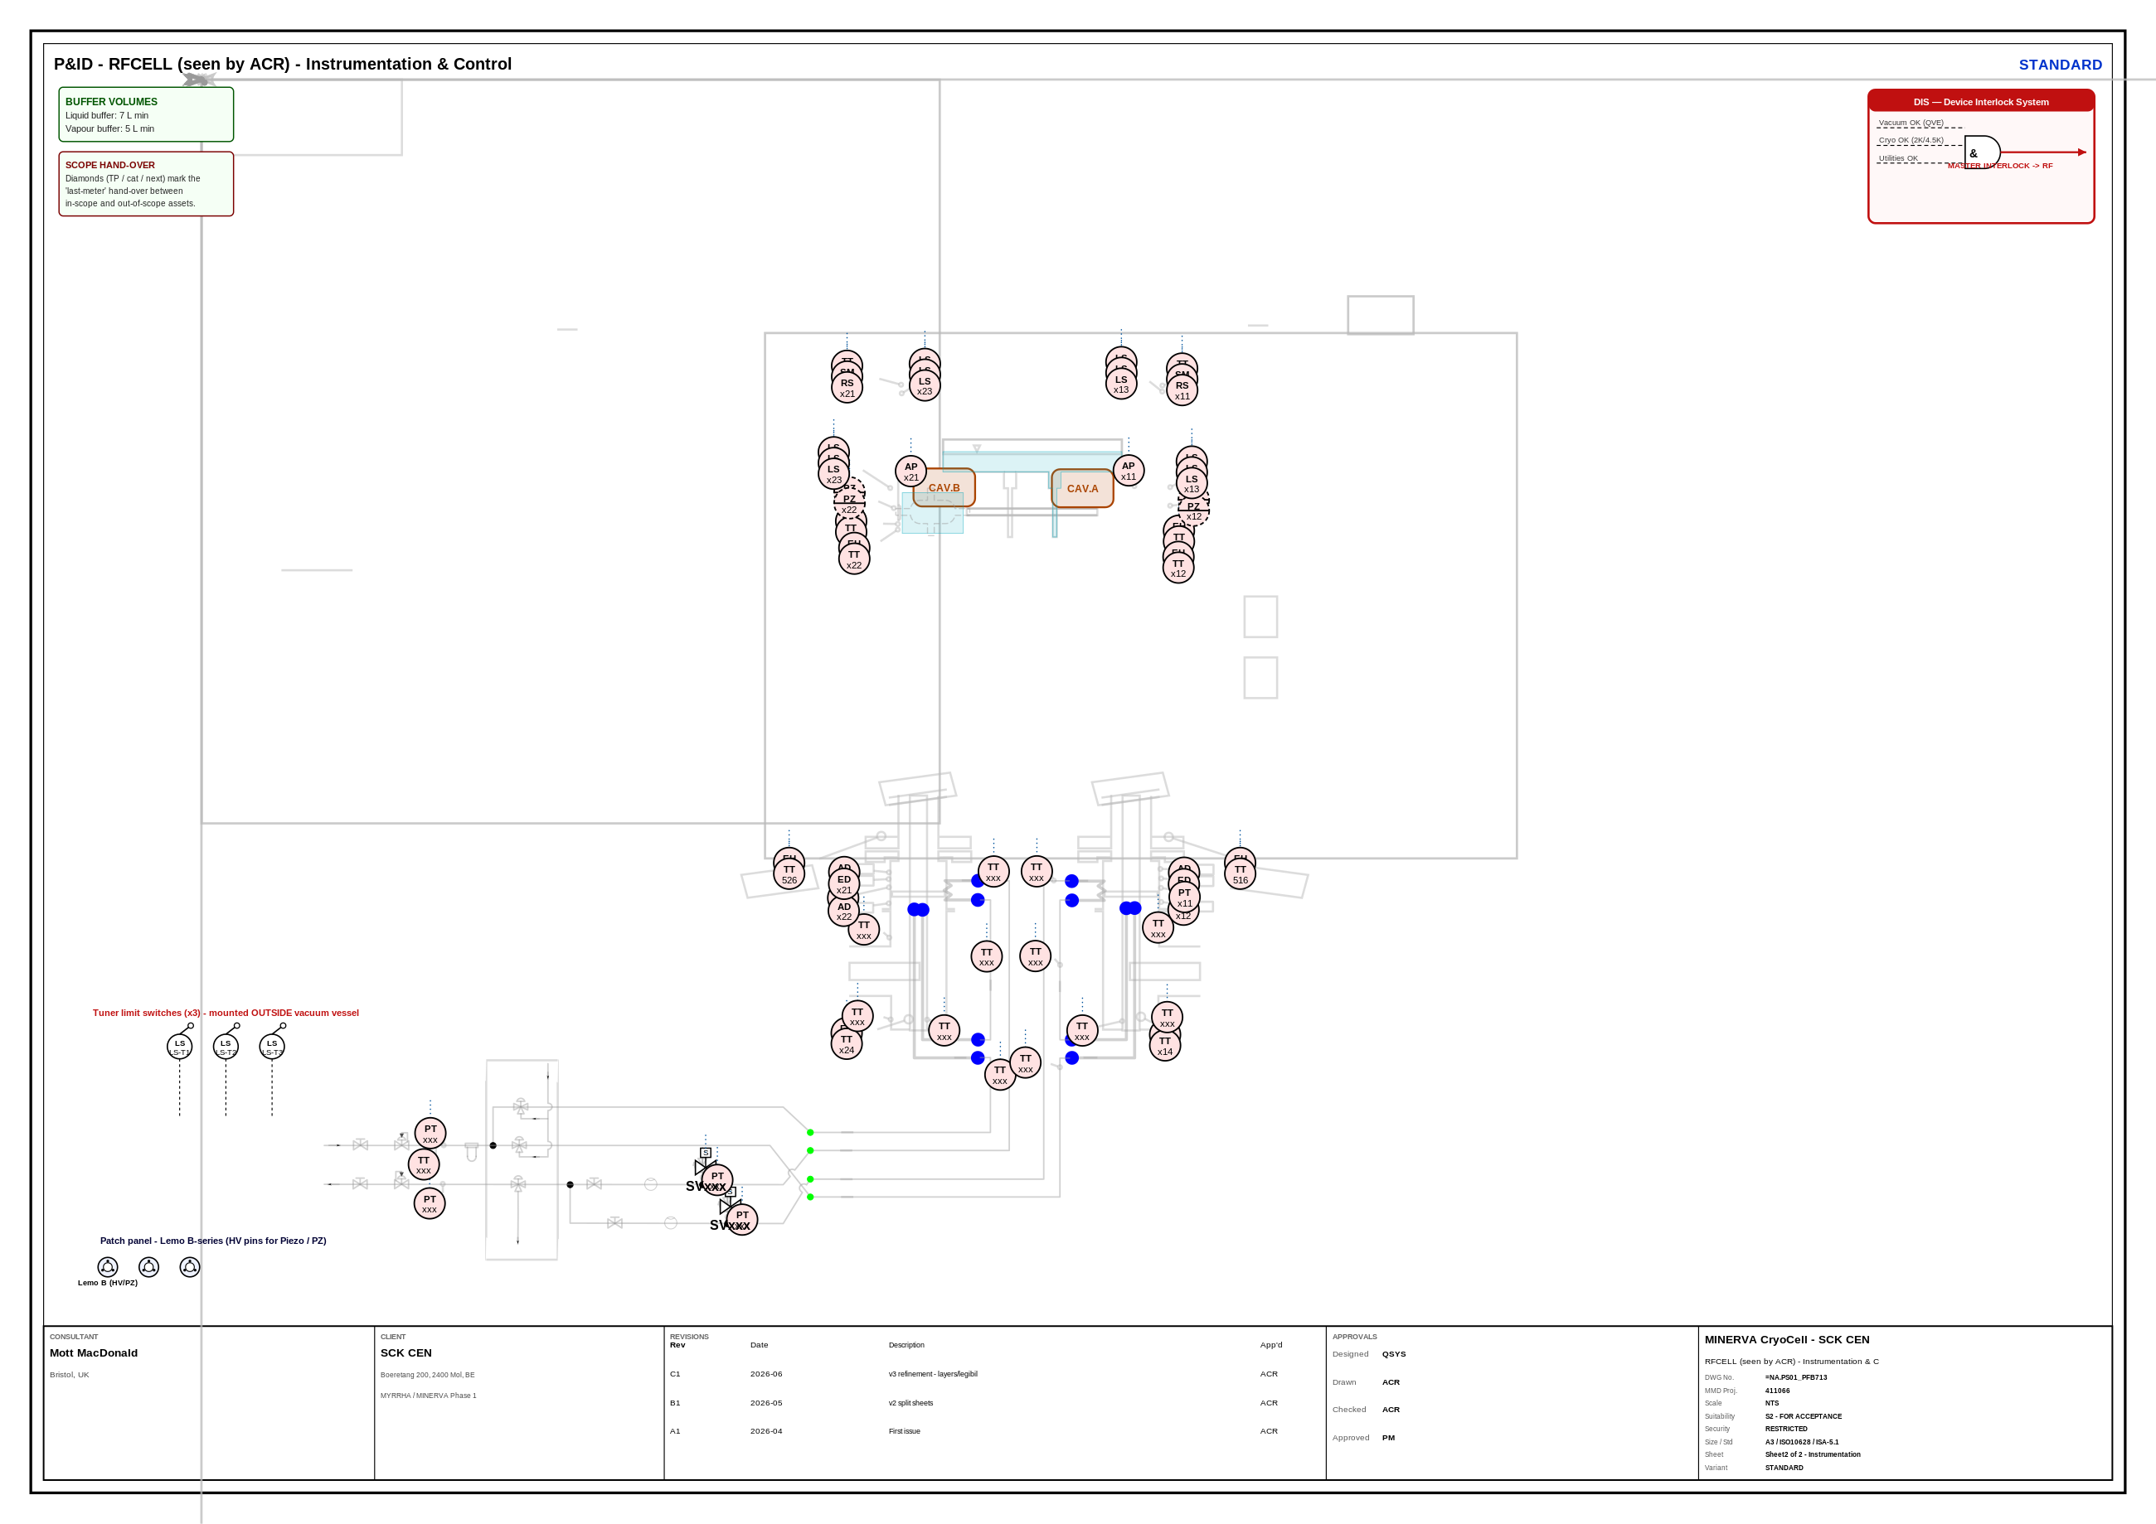
RFCELL — Sheet 2 · Instrumentation
06
Signals / loops / ISA bubbles · =NA.PS01_PFB713
Highlights
• Instrumentation foreground / process backdrop
• Consistent signal-pattern legend
• Panel vs field instrument differentiation
• Cross-references to RFCELL Sheet 1
MINERVA CryoCell · P&ID v3 Dissection · SCK CEN / Mott MacDonald
AD_01.16 · ISO 10628 · ISA 5.1

Slide 7
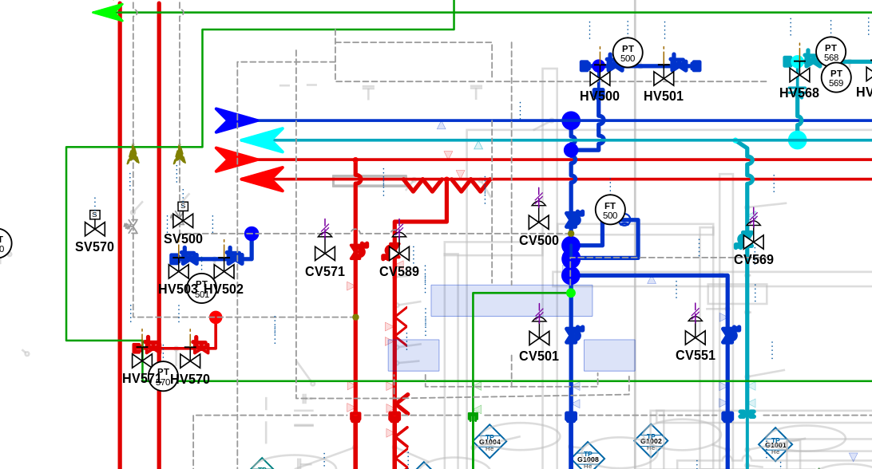
Piping Hierarchy & Line Weights
07
Visual weight communicates importance — readable at A3
Line-weight system
PRIMARY
1.0 mm
main headers per cryo class
BRANCH
0.7 mm
take-offs / sub-runs per class
SECONDARY
0.5 mm
DI-water & utility
OUT-OF-SCOPE
0.35 mm dashed
services beyond hand-over
QCELL Sheet 1 — process-piping detail
SIGNAL
0.25 mm
instrument signal lines
MINERVA CryoCell · P&ID v3 Dissection · SCK CEN / Mott MacDonald
AD_01.16 · ISO 10628 · ISA 5.1

Slide 8
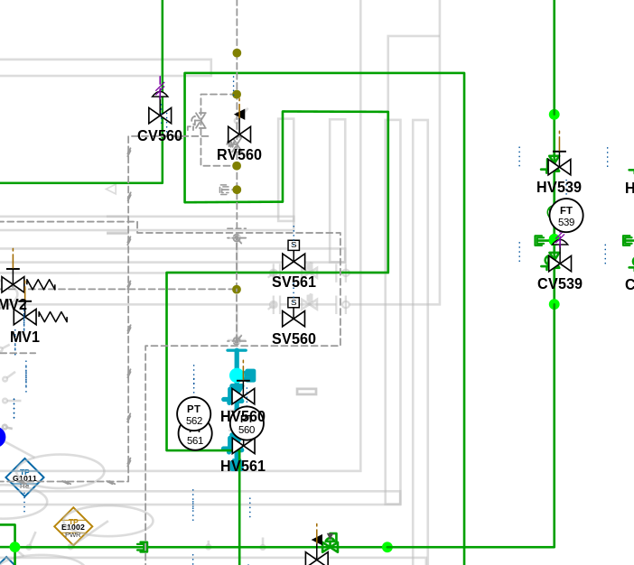
Instrumentation — ISA 5.1 Bubbles & Signals
08
Location modifiers · safety outlines · three signal patterns
• Bubble = ISA 5.1 instrument tag
– plain circle = field-mounted
– single line = panel / main control
– double line = shared display / DCS
– dashed outline = safety / interlock function
• Tag text ≥ 2.0 mm; main tags ≥ 2.5 mm @ A3
• Signal lines kept at 0.25 mm but visually distinct:
– Pneumatic — dashed with // cross-ticks
– Electric — fine dotted
– Hydraulic — dash-dot
• Signals on dedicated layers, separate from process piping
MINERVA CryoCell · P&ID v3 Dissection · SCK CEN / Mott MacDonald
AD_01.16 · ISO 10628 · ISA 5.1

Slide 9
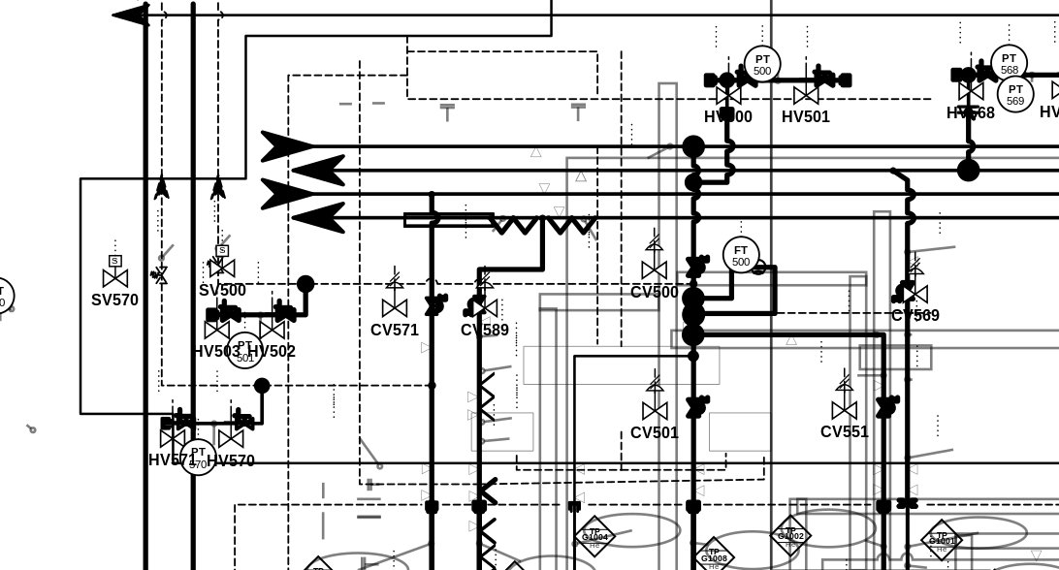
Colour vs Monochrome Variants
09
Every sheet ships full-colour + mono — mono survives B/W plotting & photocopy
STANDARD (full colour)
STANDARD_MONO (black / grey)
• Mono removes class colour — hierarchy now carried by line weight + dash pattern alone
• Marker arrowheads / junction dots recoloured to black; cavity fills switched to white for contrast
• Guarantees legibility when printed on a mono A3 plotter or photocopied
MINERVA CryoCell · P&ID v3 Dissection · SCK CEN / Mott MacDonald
AD_01.16 · ISO 10628 · ISA 5.1

Slide 10
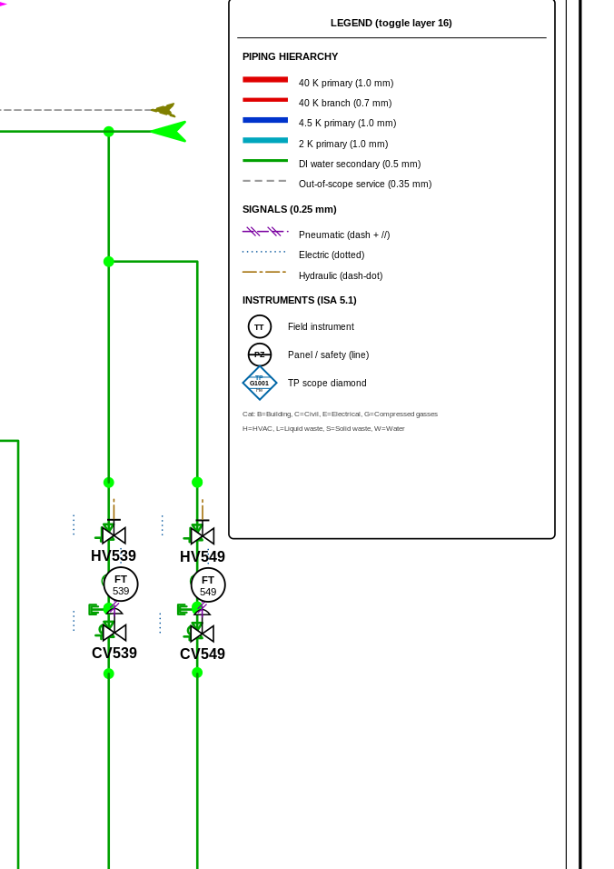
Symbol Library & Toggleable Legend
10
On-sheet legend (layer 16) — hidden by default, one click to reveal
• Legend embedded on the sheet, not a wasteful side panel
– lives on layer 16_Legend_TOGGLEABLE (display:none default)
• Documents the full visual grammar:
– piping hierarchy (primary / branch / secondary / out-of-scope)
– three 0.25 mm signal patterns
– ISA 5.1 instrument bubble families
– 3-compartment scope diamond (TP / cat+num / next system)
• AD_01.16 scope categories spelled out:
– B=Building C=Civil E=Electrical G=Compressed gasses
– H=HVAC L=Liquid waste S=Solid waste W=Water
• Maximises usable drawing area — a core v3 goal
MINERVA CryoCell · P&ID v3 Dissection · SCK CEN / Mott MacDonald
AD_01.16 · ISO 10628 · ISA 5.1

Slide 11
Sensor Re-allocations & New Tags
11
Piezo / magnetic-coupler sensor rationalisation captured in the nomenclature master
Re-allocations
TT535
→
PZ535
coldest piezo (TT-CX) re-tagged as pressure/piezo element
TT525
→
PZ525
warmest piezo (TT-PT100) re-tagged (applied if present in source)
4 × TT
→
CX / PT100
magnetic-coupler sensors redistributed across cryo stages
• Full instrument & equipment register lives in MINERVA_NOMENCLATURE_MASTER.xlsx
– 01_Instruments (297 rows) · 02_Equipment (44) · 03_Re-allocations · 04_New_components
– 05_Layer_map · 06_Colour_LineWeight · 07_Scope_categories
• Every tag traceable from drawing → register → layer → colour/weight
• Re-allocations flagged so reviewers can audit the change set quickly
MINERVA CryoCell · P&ID v3 Dissection · SCK CEN / Mott MacDonald
AD_01.16 · ISO 10628 · ISA 5.1

Slide 12
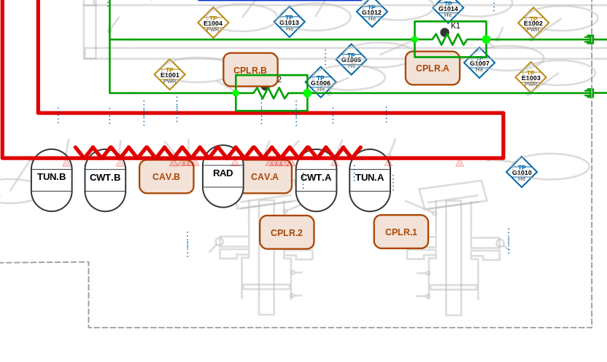
Scope Boundaries — AD_01.16 Diamonds
12
3-compartment hand-over markers at the last-metre boundary
• Diamond = scope hand-over point (TP)
• Three compartments:
– top — TP marker
– middle — category letter + number
– bottom — next system / package
• AD_01.16 categories:
– B Building · C Civil · E Electrical
– G Compressed gasses · H HVAC
– L Liquid waste · S Solid waste · W Water
• Out-of-scope piping drawn 0.35 mm dashed for instant recognition
• Boundaries isolated on layer 02_Scope_Boundaries
MINERVA CryoCell · P&ID v3 Dissection · SCK CEN / Mott MacDonald
AD_01.16 · ISO 10628 · ISA 5.1

Slide 13
Default Views — Embedded Presets
13
5 named view presets stored as SVG <metadata> for the viewer
Preset
What it shows
01 Overview
fit whole sheet · all process layers · legend off
02 Cryogenic
isolate 40K/4K5/2K piping + cryo equipment
03 Instrumentation
instruments + signals foreground, process greyed
04 Scope review
scope boundaries + diamonds + out-of-scope piping
05 Print (mono)
monochrome-ready, legend + notes on, A3 frame
Presets are machine-readable metadata (layer visibility + zoom box) — see DEFAULT_VIEWS_GUIDE.md.
MINERVA CryoCell · P&ID v3 Dissection · SCK CEN / Mott MacDonald
AD_01.16 · ISO 10628 · ISA 5.1

Slide 14
A3 Printing & Deliverable Summary
14
• Drawing frame = A3 landscape 420 × 297 mm
– compact full-width bottom title block (~30 mm)
– no wasteful right-hand panel — max drawing area
• Text sizing tuned for true A3 legibility
– main tags ≥ 2.5 mm · bubbles 2.0 mm · callouts 2.2 mm · legend 1.8 mm
• 16 PDF exported at exact A3 (1190.55 × 841.89 pt)
• Print mono variants for B/W plotters & copies
• See PRINTING_GUIDE_A3.pdf for plotter setup
Deliverables
• 16 SVG (4 sheets × 4 variants)
• 16 PDF (A3, print-ready)
• MINERVA_NOMENCLATURE_MASTER.xlsx
• MINERVA_PID_DISSECTION.pptx
• LAYER_NAMING_STANDARD.md/.pdf
• DEFAULT_VIEWS_GUIDE.md/.pdf
• PRINTING_GUIDE_A3.pdf
MINERVA CryoCell · SCK CEN / Mott MacDonald · AD_01.16 / ISO 10628 / ISA 5.1 · Rev C1 2026-06

