Slide 1
MINERVA CryoCell — P&ID
Revision v5 · Cryogenic-Focus Colour Scheme & Line Nomenclature
• New cryogenic-focus palette: cold header (A/B) on top, thermal shield (D/E), warm WPS (W/S/U) on the bottom
• [LINE]-[SIZE]-[MOC] nomenclature labels + flow-direction arrows on every classified run
• Line specification table, MAIN-LINES-ONLY schematic & Line W temperature-gradient annotation
• 16 production sheets (colour + mono) + 2 single-line schematics + LINE_SPECIFICATION_MASTER.xlsx
SCK CEN · MYRRHA / MINERVA Phase 1 · Mott MacDonald (Bristol, UK) · MMD 411066 · S2 - FOR ACCEPTANCE · RESTRICTED

Slide 2
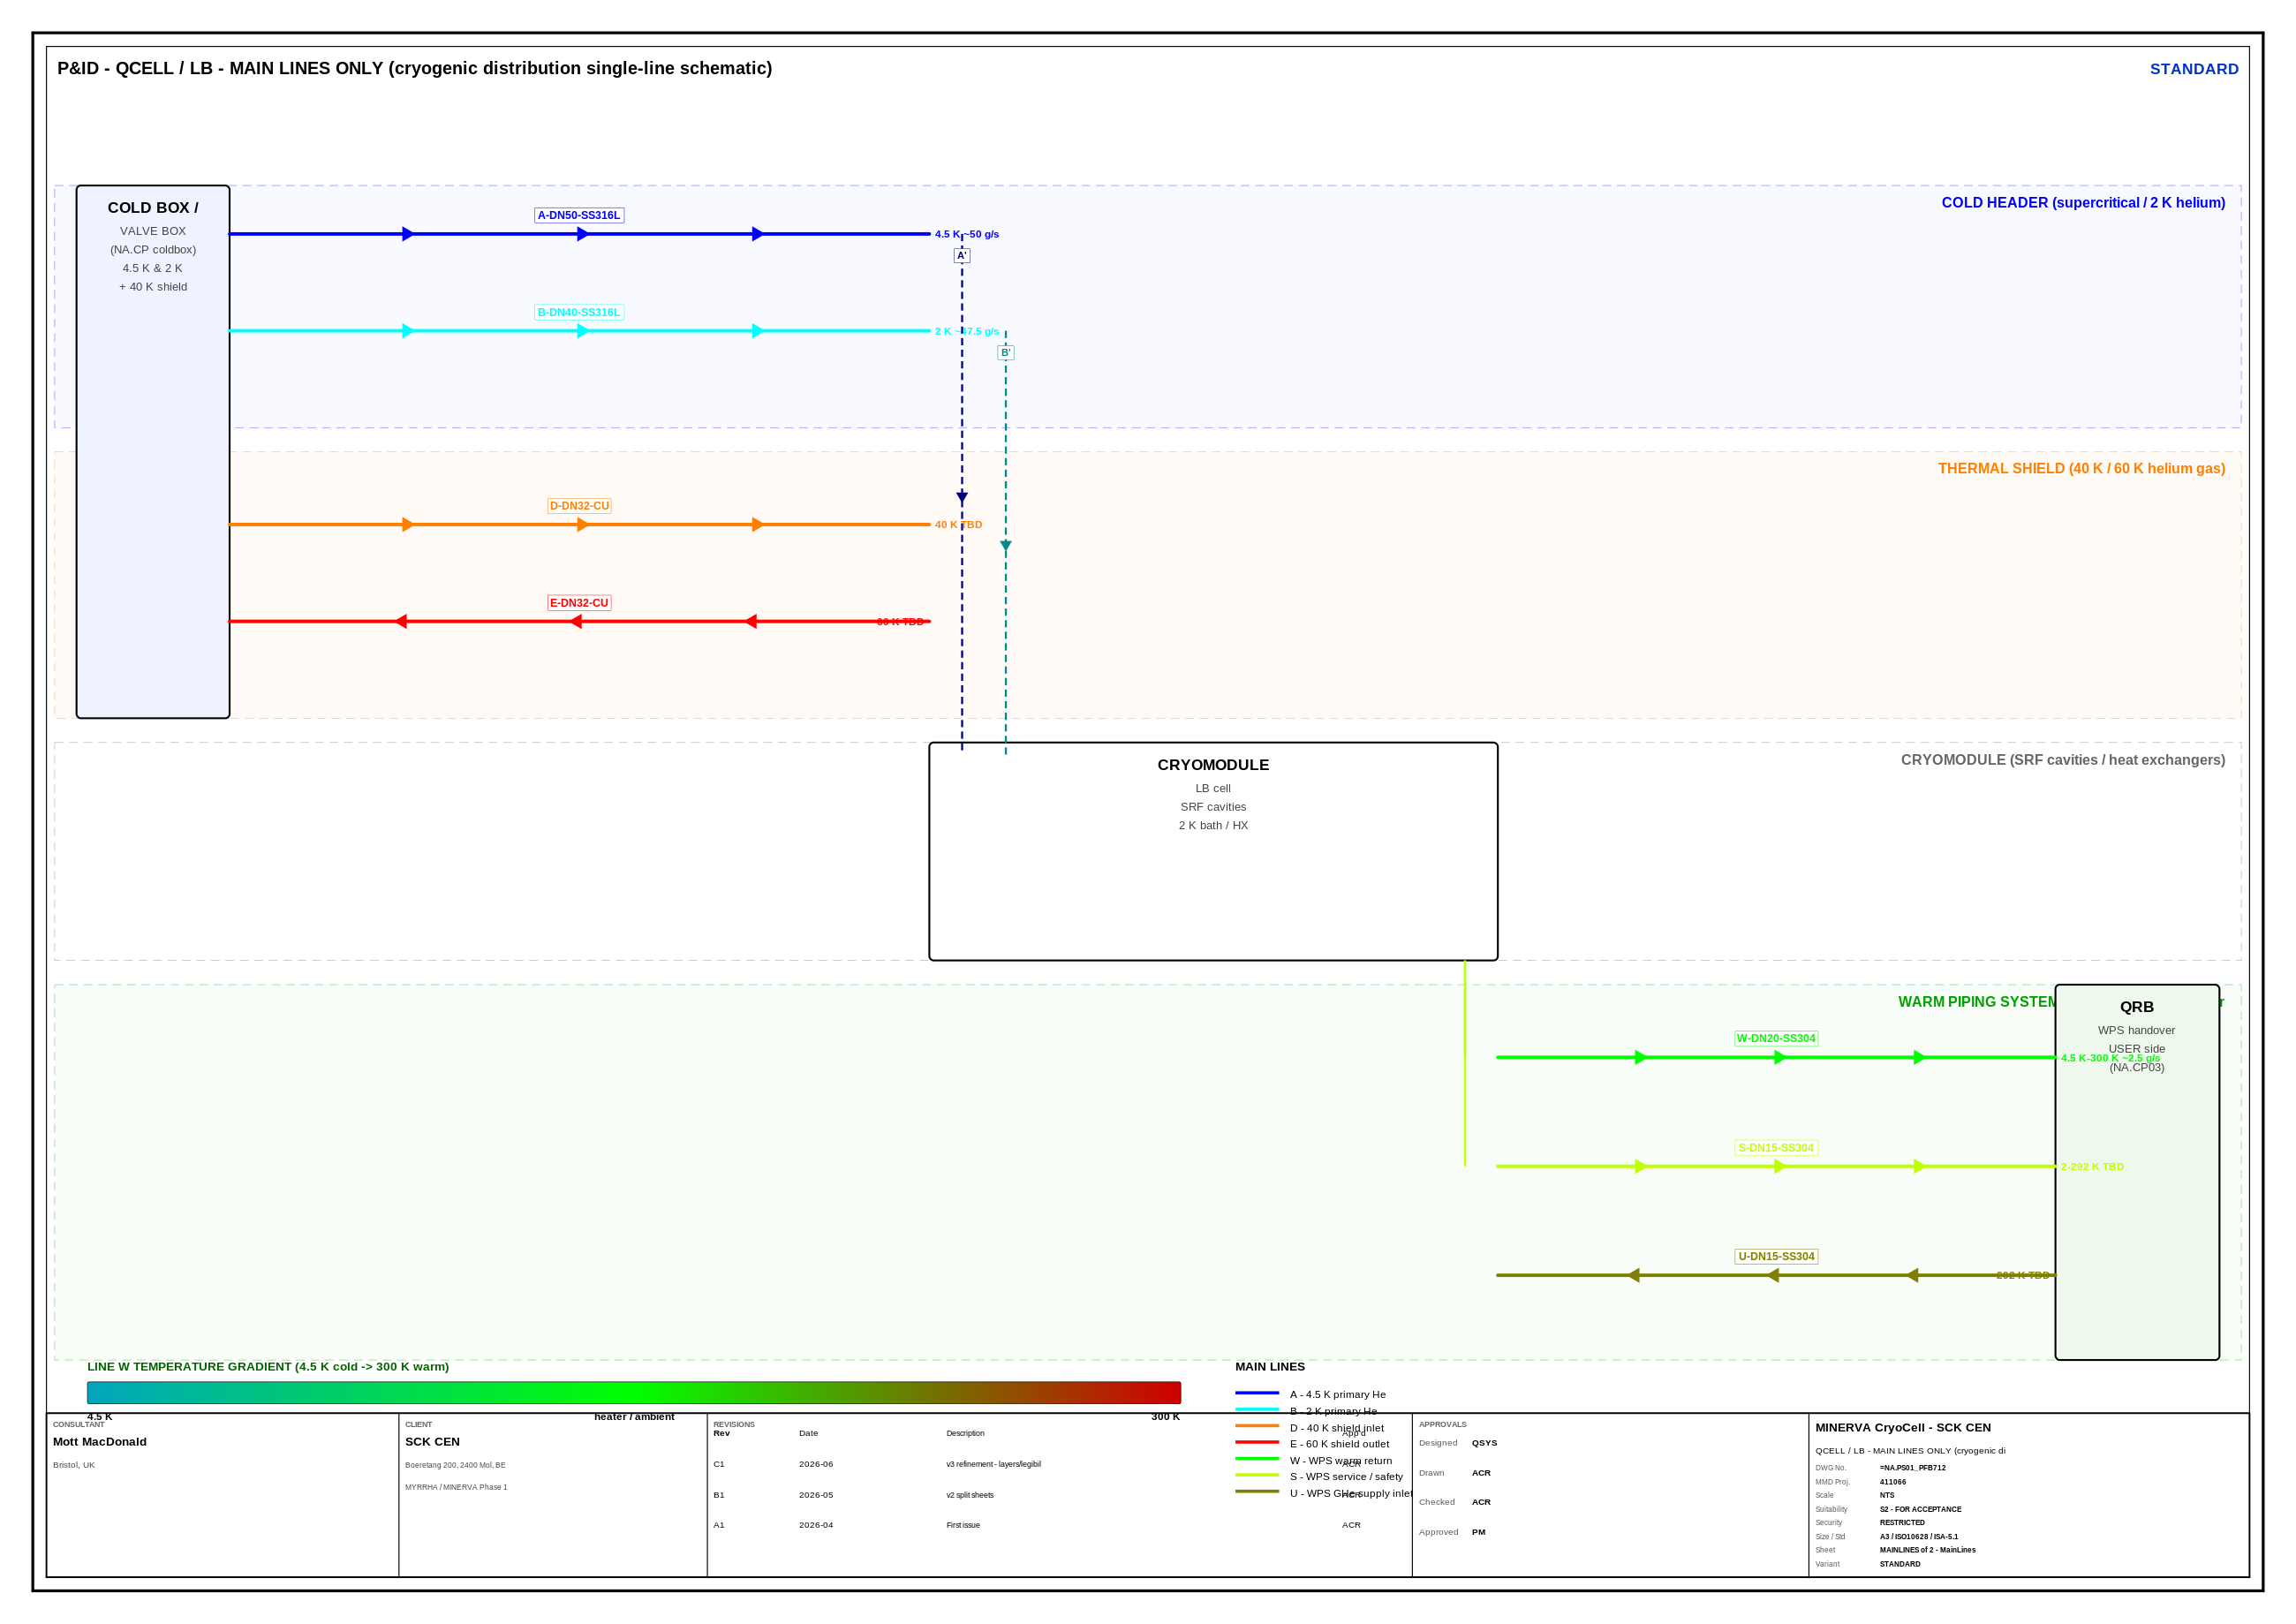
What Changed in v5
02
Ten-phase revision of the v4 deliverable — cryogenic clarity first
• Cryogenic-focus colour scheme
– A 4.5 K blue · B 2 K cyan · D 40 K orange · E 60 K red
– warm WPS: W green · S lime · U olive
• Spatial reorganisation (zone bands)
– cold header top → thermal shield → equipment → warm bottom
• [LINE]-[SIZE]-[MOC] line labels (layer 04D)
• Flow-direction arrows on every run (layer 04G)
• Line specification table embedded in the legend
• MAIN-LINES-ONLY preset + standalone schematic
• Mono = line-weight + dash class differentiation
• Line W temperature gradient (4.5 K → 300 K)
QCELL — MAIN-LINES-ONLY single-line schematic (new in v5)
MINERVA CryoCell · P&ID v5 Dissection · SCK CEN / Mott MacDonald
AD_01.16 · ISO 10628 · ISA 5.1-2022

Slide 3
Line Classification & Colour Coding — revised v5 palette
03
Cold header (top) · thermal shield · warm piping system (bottom)
LINE
Description
Temp
Pressure
Flow
DN
MOC
COLD HEADER
A
4.5 K primary He
4.5 K
3 bar
~50 g/s
DN50
SS316L
A'
4.5 K branches
4.5 K
3 bar
varies
DN25
SS316L
B
2 K primary He
2 K
27 mbar
~47.5 g/s
DN40
SS316L
B'
2 K branches
2 K
27 mbar
varies
DN25
SS316L
THERMAL SHIELD
D
40 K shield inlet
40 K
14 bar
TBD
DN32
Cu
D'
40 K branches
40 K
14 bar
varies
DN20
Cu
E
60 K shield outlet
60 K
13 bar
TBD
DN32
Cu
E'
60 K branches
60 K
13 bar
varies
DN20
Cu
WARM PIPING SYSTEM (WPS)
W
WPS warm return
4.5 K-300 K
6 bar
~2.5 g/s
DN20
SS304
S
WPS service / safety
2-292 K
1.05 bar
TBD
DN15
SS304
U
WPS GHe supply inlet
292 K
14 bar
TBD
DN15
SS304
Temperature increases top → bottom (4.5 K → 300 K). Primary lines are saturated; branches (′) use the darker / lighter shade of the same hue.
MINERVA CryoCell · P&ID v5 Dissection · SCK CEN / Mott MacDonald
AD_01.16 · ISO 10628 · ISA 5.1-2022

Slide 4
Line Nomenclature & Branching — new in v5
3.5
[LINE]-[SIZE]-[MOC] tags · MAIN → BRANCH (A → A′) hierarchy
Tag anatomy
• Primary trunk vs branch decided by run length
– 55th-percentile threshold per class splits primary / branch
– primary on layers 04/05/06; branches on 04B/05B/06B
• Branch = same hue, reduced bore, same fluid
– A′/B′ darker shade; D′/E′ lighter shade
• Size reduces along the distribution chain
– DN50/DN40 headers → DN25/DN20 branches → instrument tube
• Labels render on layer 04D, offset along the pipe normal
A - DN50 - SS316L
• [LINE] class designator (A, B, D, E, W, S, U)
• [SIZE] nominal bore (DN50, DN40, DN32 …)
• [MOC] material of construction (SS316L, Cu, SS304)
Main → branch hierarchy
A DN50
→
A′ DN25
4.5 K take-offs
B DN40
→
B′ DN25
2 K take-offs
D DN32
→
D′ DN20
40 K shield branches
E DN32
→
E′ DN20
60 K shield branches
Branch drops A′/B′ into the cryomodule (schematic detail)
MINERVA CryoCell · P&ID v5 Dissection · SCK CEN / Mott MacDonald
AD_01.16 · ISO 10628 · ISA 5.1-2022

Slide 5
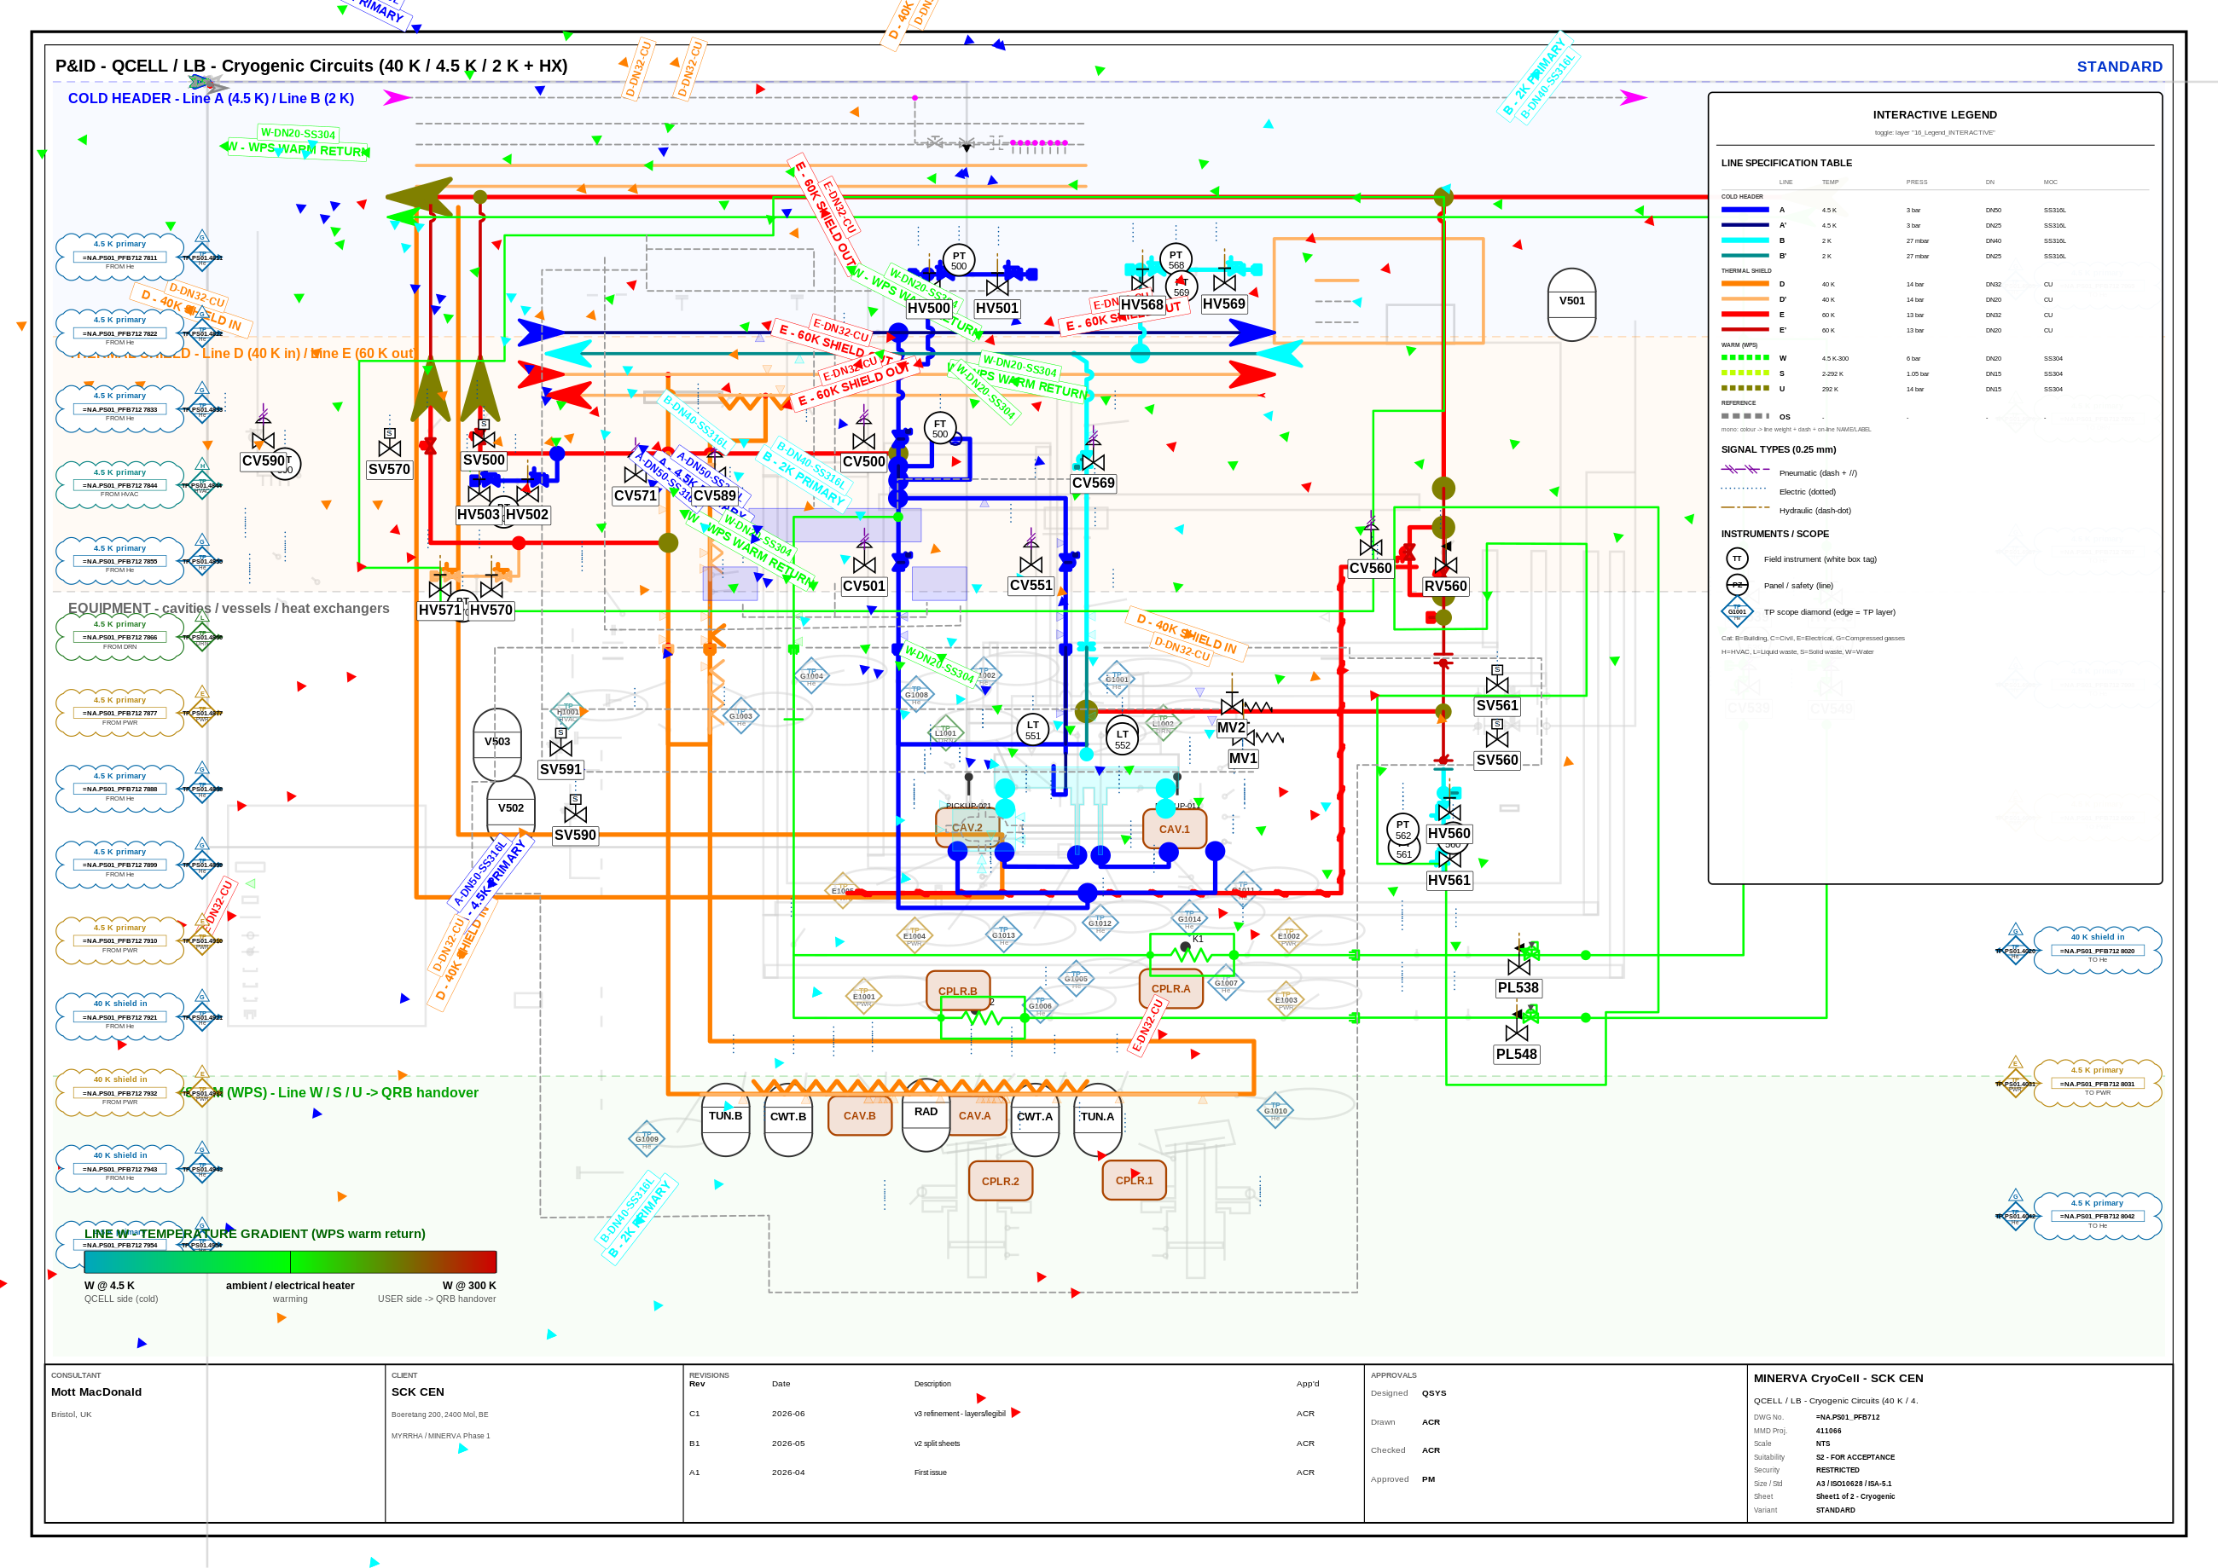
Spatial Reorganisation — Cold Top / Warm Bottom
04
Zone bands group the sheet by temperature class (layer 02C)
Reading order
• COLD HEADER (top)
– A 4.5 K / B 2 K
• THERMAL SHIELD
– D 40 K in / E 60 K out
• EQUIPMENT
– cavities / vessels / HX
• WARM PIPING (bottom)
– W / S / U → QRB handover
• Bands are reference overlays — extracted geometry is preserved, not re-routed.
MINERVA CryoCell · P&ID v5 Dissection · SCK CEN / Mott MacDonald
AD_01.16 · ISO 10628 · ISA 5.1-2022

Slide 6
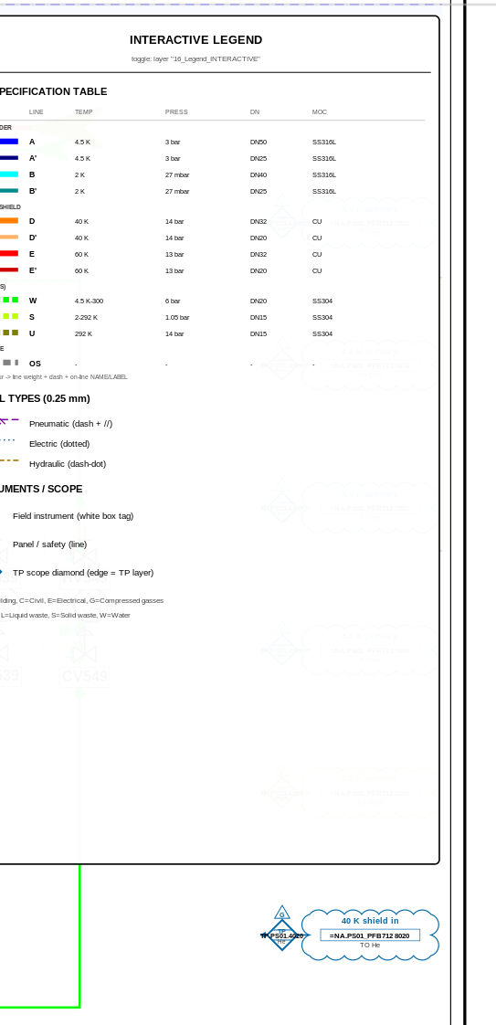
Line Specification Table & MAIN-LINES-ONLY View
05
Embedded legend table (layer 16) + VIEW_MAINLINES_ONLY preset
Standalone QCELL-MAINLINES_VIEW.svg single-line schematic
• Table lists every line: colour, temp, pressure, DN, MOC
• MAIN-LINES preset hides branches & instrumentation for a clean distribution overview
Specification table embedded in the on-sheet legend
MINERVA CryoCell · P&ID v5 Dissection · SCK CEN / Mott MacDonald
AD_01.16 · ISO 10628 · ISA 5.1-2022

Slide 7
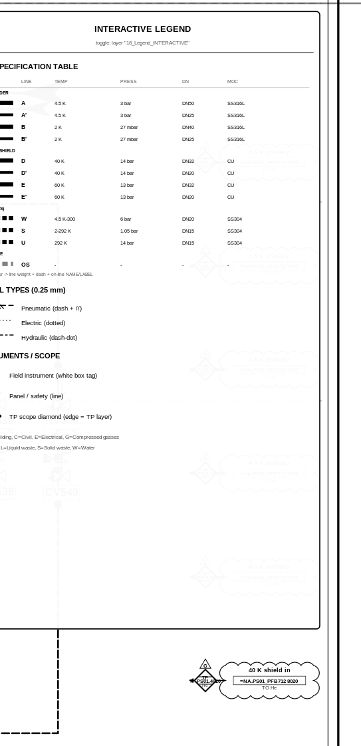
Colour vs Monochrome — Class by Weight & Dash
06
Mono survives B/W plotting: cold = heavy solid, warm = dashed
STANDARD (full colour)
STANDARD_MONO (line-weight + dash)
MINERVA CryoCell · P&ID v5 Dissection · SCK CEN / Mott MacDonald
AD_01.16 · ISO 10628 · ISA 5.1-2022

Slide 8
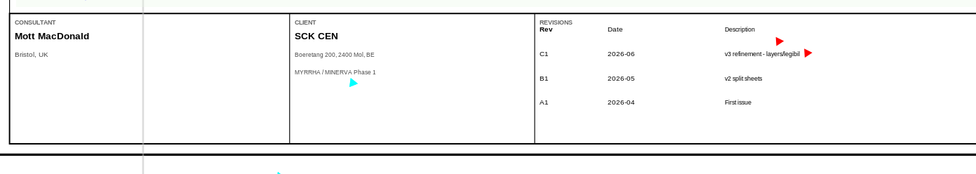
Line W — Temperature Gradient Annotation
07
WPS warm return: 4.5 K (QCELL side) → 300 K (USER side / QRB)
• Line W carries cold helium that is progressively warmed back to ambient before the QRB handover
– cold end 4.5 K (QCELL / cold box side)
– electrical heater / ambient gain along the run
– warm end ~300 K at the USER side (NA.CP03 QRB)
• Flow rate ~2.5 g/s · DN20 · SS304
• Gradient bar drawn on layer 15_Temperature_Gradient and reproduced in the MAIN-LINES schematic
MINERVA CryoCell · P&ID v5 Dissection · SCK CEN / Mott MacDonald
AD_01.16 · ISO 10628 · ISA 5.1-2022

Slide 9

v5 Deliverables
08
Everything ships under output_v5/
• 16 production sheets
– QCELL + RFCELL × 2 sheets × {STANDARD, CONTROL-CENTRIC} × {colour, mono}
– each as SVG + A3 PDF + review PNG
• 2 MAIN-LINES-ONLY schematics (QCELL + RFCELL)
• LINE_SPECIFICATION_MASTER.xlsx
– 01_Line_Specification · 02_Main_vs_Branch · 03_Source_Circuits
• MINERVA_PID_DISSECTION_v5.pptx (this deck)
• COLOR_SCHEME_REVISION_GUIDE.pdf
• TEMPERATURE_GRADIENT_VISUALIZATION.pdf
RFCELL — MAIN-LINES-ONLY schematic
MINERVA CryoCell · P&ID v5 Dissection · SCK CEN / Mott MacDonald
AD_01.16 · ISO 10628 · ISA 5.1-2022

