Slide 1
QPS LINE S RECOVERY
RTM-292 Pressure Analysis & LOOP Boil-off Transient
ABACUS PR #582 | Branch w001 → main | 2026-06-26
V_eff = 3.12 m³ | P_limit = 1.30 bar | HP_max = 112 g/s
Confidential — SCK CEN / GBOGEB

Slide 2
Key Resolved Parameters
All 4 ASSUM gates closed — merge_allowed: true
• Binding Line S ceiling P_limit = 1.30 bar
• Source: He-line-safety p_fullop_backpressure (NOT 1.50 bar — that is closed vessel relief)
• Allowable ΔP = 0.20 bar (1.30 − 1.10 nominal)
• Effective volume V_eff = 3.12 m³ (legacy 120 m³ RETIRED — 38× too large)
• Breakdown: bath vapour 0.289 + cold 90m 1.590 + warm 60m 1.060 + QVE 0.185
• HP compressor max suction = 112 g/s (350 kW diesel confirmed)
• C30 LHe inventory = 391.5 kg (2700 L × 0.145 kg/L)
• SSOT Table 28: a_cond = −3.60 m (Q1), −1.38 m (Q2) [LINAC_30]

Slide 3
Governing Equations
Four equations form the complete model
Eq 1 — Pressure rise (ideal gas, isothermal)
dP/dt = P · ṁ_net / m_gas [bar/s]
m_gas = ρ · V_eff = (P·10⁵) / (R_He · T_line) · V_eff
t_available = ΔP_allowed / (dP/dt) = 0.20 bar / (dP/dt)
Eq 2 — Conduction (SSOT Table 28 lumped coefficient)
Q_cond = a_cond · ∫[T_from → T_to] λ_SS(T) dT [W]
a_cond [m] is signed — negative in SSOT → positive Q when hot→cold
Eq 3 — Radiation (SSOT Table 28 lumped coefficient)
Q_rad = a_rad · (T_hot⁴ − T_cold⁴) [W]
a_rad [W/K⁴] from SSOT Table 28
Eq 4 — NIST AISI 304 conductivity (1–300 K)
log₁₀(λ_SS) = Σ(i=0..8) cᵢ · [log₁₀(T)]ⁱ
c = [−1.4087, +1.3982, +0.2543, −0.6260, +0.2334, +0.4256, −0.4658, +0.1650, −0.0199]
Evaluated via Simpson's rule (n=64); error <0.001% vs n=512

Slide 4
Sample Calculations — T_TS = 50 K, LINAC_30
Worked example at initial condition
λ_SS at key temperatures (Eq 4):
Q2 conduction — ambient 300K → TS 50K (Eq 2):
λ_SS( 4 K) = 0.2724 W/(m·K)
λ_SS(50 K) = 5.7302 W/(m·K)
λ_SS(300 K) = 15.3087 W/(m·K)
∫[300→50] λ dT = -2890.99 W/m (negative)
Q2_cond = −1.38 × (-2890.99) = 3989.6 W
Q1 conduction — TS 50K → bath 2K (Eq 2):
Q2 radiation — ambient 300K → TS 50K (Eq 3):
∫[50→2] λ dT = -140.23 W/m (negative: T_to < T_from)
Q1_cond = −3.60 × (-140.23) = 504.8 W
Q2_rad = 6.58e-7 × (300⁴ − 50⁴)
= 6.58e-7 × 8.094e9 = 5325.7 W
Q2 total = 3989.6 + 5325.7 = 9315.3 W
Q1 radiation — TS 50K → bath 2K (Eq 3):
Energy balance at t=0:
Q1_rad = 2.24e-5 × (50⁴ − 2⁴) = 140.0 W
Q1 total = 504.8 + 140.0 = 644.8 W
dH_TS/dt = Q2 − Q1 = 9315 − 645 = 8670 W
→ TS Mass warms rapidly from initial 50 K
→ as T_TS rises, Q1 grows (more conduction)
→ boil-off rate accelerates over time
Boil-off flow rate:
ṁ = Q1 / h_fg(2K) = 644.8 / 23300 = 27.6742 kg/s = 27674.2 g/s
dP/dt — LOOP_100, cold section (Eq 1):
m_gas = (1.10e5)/(2077.2×4.0)×3.124 = 41.359 kg
dP/dt = 1.10 × 0.100 / 41.359 = 2.66 mbar/s
t_available = 200 mbar / 2.66 mbar/s = 75 s (1.3 min)

Slide 5
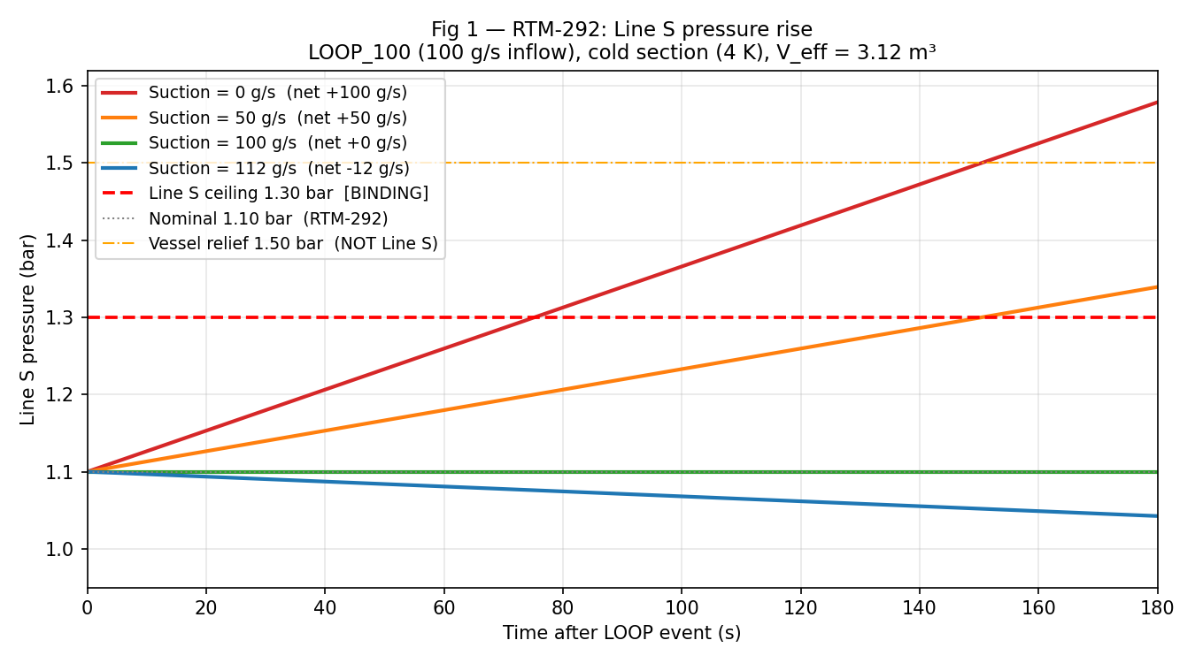
Pressure Rise — LOOP_100, Cold Section (4 K)
Eq 1 applied across suction sensitivity
• 0 g/s suction → hits 1.30 bar in 75 s (~1.3 min)
• 100 g/s balanced → pressure flat at nominal ∞ time
• 112 g/s HP max → pressure falls, actively clearing the line
• Warm section (300 K): ALL cases except balanced reach 1.30 bar in <1 s
• Conclusion: HP suction must be ON before the event, not after

Slide 6
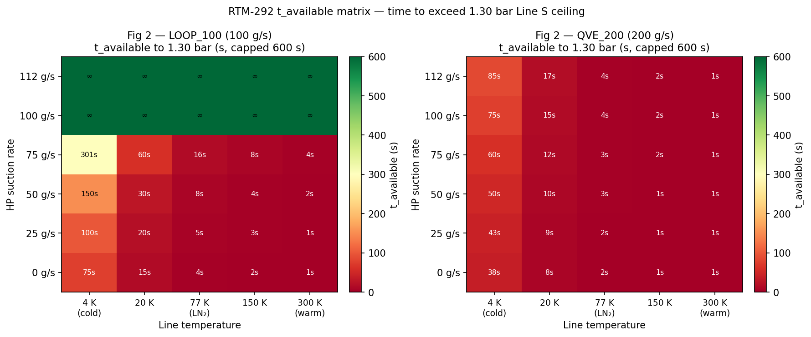
t_available Matrix — RTM-292 Compliance Map
Time to exceed 1.30 bar: red = critical, green = safe (>600 s)
LOOP_100: ≥100 g/s suction → safe at all temperatures | QVE_200 (200 g/s spike): 112 g/s HP gives ~85 s on cold section — covers 100 s spike window

Slide 7
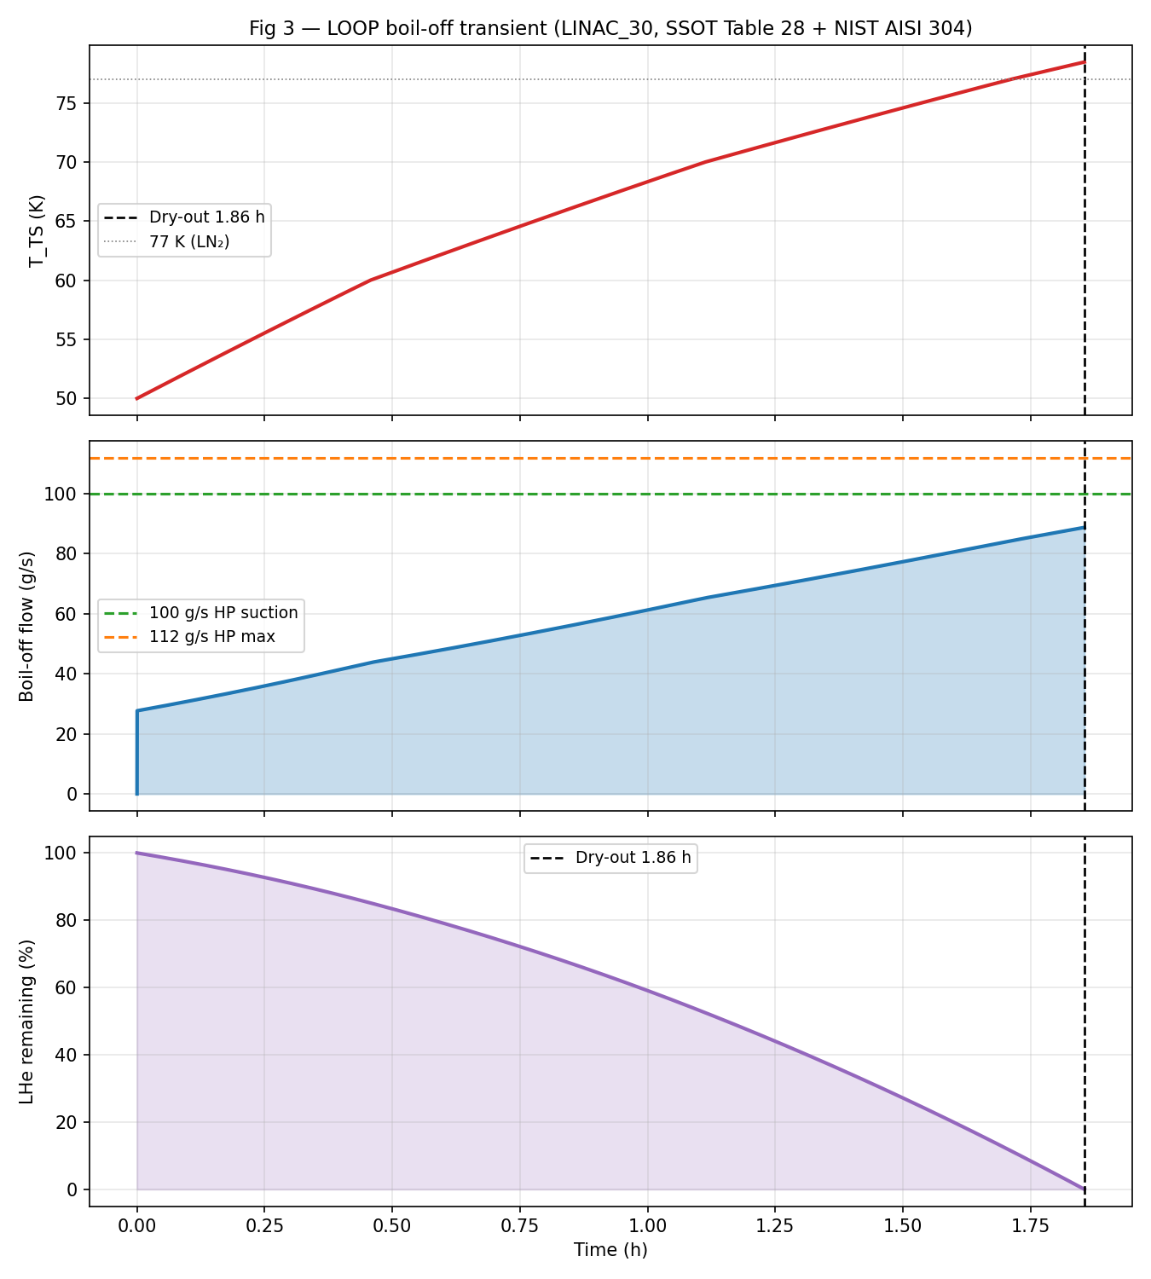
LOOP Boil-off Transient — LINAC_30
SSOT Table 28 + NIST AISI 304 (Equations 2, 3, 4)
• Dry-out: 1.86 h (D2.1 baseline ~2 h)
• Peak boil-off: 88.7 g/s (D2.1 target >150 g/s)
• Average boil-off: 58.6 g/s (D2.1 target >120 g/s)
• Gap vs D2.1: modelling scope — single lump, no early bath transient
• HP at 100 g/s covers entire boil-off duration — never exceeded
• T_TS rises 50 → 78.5 K at dry-out
• Boil-off rate accelerates as T_TS warms (Q1 grows — see Eq 2)

Slide 8
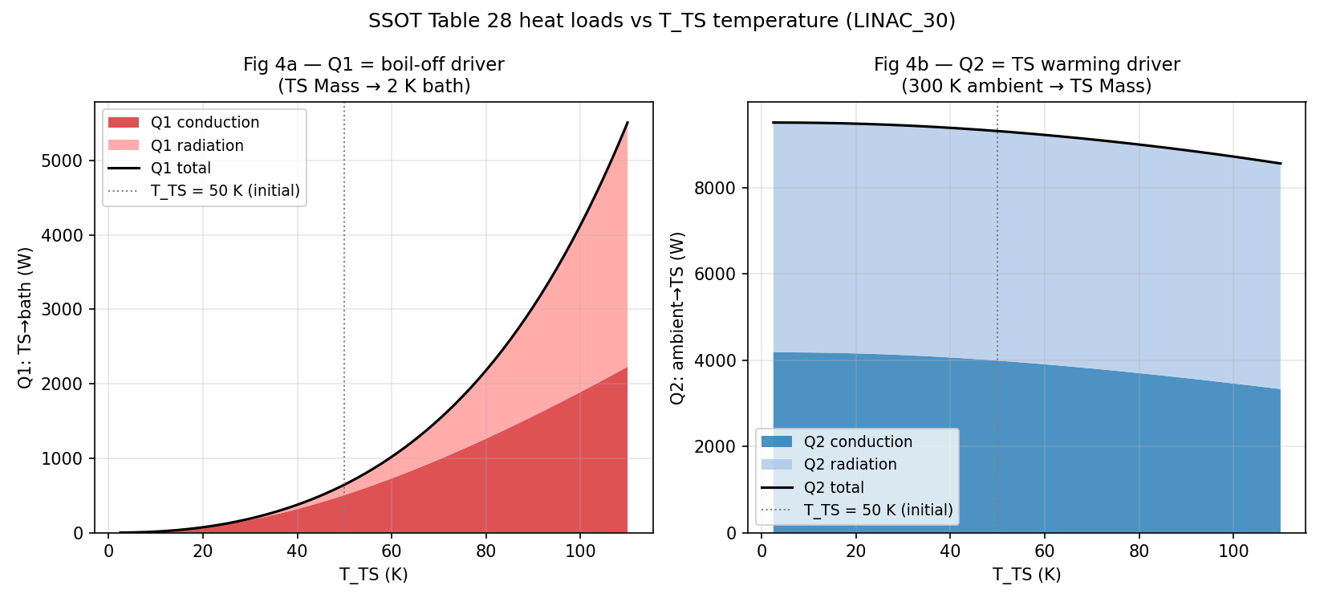
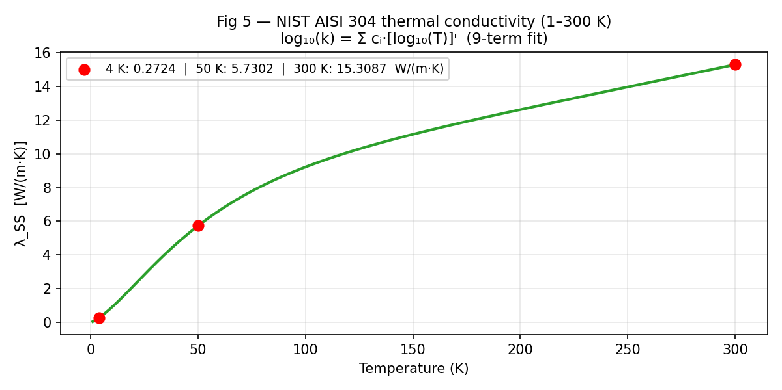
Heat Loads & NIST 304 Conductivity
SSOT Table 28 Equations 2, 3, 4
• At T_TS = 50 K: Q1 = 645 W | Q2 = 9315 W
• Q1 grows steeply — conduction ~10× from 30→110 K
• Q2 ~flat — dominated by radiation (T_amb⁴ term)
• λ_SS(4K)=0.272 λ_SS(50K)=5.730 λ_SS(300K)=15.309 W/(m·K)

Slide 9
Conclusion — RTM-292 Compliance
All 4 ASSUM blockers resolved | merge_allowed: true
Compliance verdict by scenario:
LOOP_100 (100 g/s in) + 100 g/s suction
∞ — balanced, nominal pressure
LOOP_100 (100 g/s in) + 112 g/s HP max
∞ — pressure falls
QVE_200 spike (200 g/s, 100 s) + 112 g/s
~85 s cold margin > 100 s spike
Any scenario, warm line (300 K), 0 suction
<1 s — FAILS immediately
▶ The 112 g/s HP compressor satisfies RTM-292 and RTM-261 provided suction is running at event onset.
• Remaining open (non-blocking): q_ts_design_w discrepancy | MDOT_IN trace | V_eff isometric check
• D2.1 average gap (60 vs 120 g/s avg) is a modelling-scope difference — documented, not a blocker

Slide 10
Data Provenance & Traceability
Wave 0 MDA spine — all numbers trace to register
• SSOT Table 27 — lumped cold/TS masses (LINAC_30: 12356 / 10753 kg)
• SSOT Table 28 — heat-load a_cond [m] and a_rad [W/K⁴] coefficients
• SSOT Table 29 — specific enthalpy 1–300 K (TS column, inverse lookup)
• NIST AISI 304 / UNS S30400 — 9-term log polynomial, valid 1–300 K
• D2.1 = CEA DSBT-TN-24-37 — LOOP timing (Figs 15-18), 2700 L inventory
• He-line-safety sheet — P_limit 1.30 bar (p_fullop), relief 1.50 bar (vessel only)
• RTM-292 — nominal 1.10 bar, min allowable 1.05 bar, use-case envelope
• assumptions_register.yaml — gate status, open_gates: [], merge_allowed: true

