Slide 1
Technical evaluation methodology and cold/static importance ranking
for tender 2024-106-IVE (MYRRHA QPS). Price evaluated separately.
OFFER BT Method & Evaluation Package

Slide 2
Method locked: cold/static ranking before bidder comparison
METHOD-S01
LAYER A
Static Ranking
Rank what matters — OFFER items and RTM requirements scored 0–3 on 7 dimensions, before any bidder is read.
LAYER B
Evidence Capture
Per-bidder STATUS / Technical Depth / Source-Location / Negotiation flags, captured in BT_Input.
LAYER C
Bidder Comparison
Not started. Shown here as an empty shell only — no seeded numbers. STATUS = TBD throughout.
Board position: stabilize what matters before scoring anyone. Layers A and B are frozen and populated with real canonical data; Layer C (bidder comparison) has not been touched.
This deck covers Layer A in full (slides METHOD-S02…S06, EVAL-S01…S04) and the Layer B mechanics (EVAL-S05), plus traceability proof (EVAL-S06). Layer C begins only once this baseline is approved.
BT METHOD — Engineering Baseline (canonical RTM-722) · METHOD-S01 | v3.6
Notes:
The whole point of the sequencing: agree what matters (Layer A) and set up how evidence will be captured (Layer B) BEFORE any bidder is compared (Layer C). This prevents the ranking criteria from being unconsciously reverse-engineered from a preferred bidder. Layer C box is deliberately greyed out — there is nothing to show yet, and that is the point.

Slide 3
Canonical baseline & what changed
METHOD-S02
Canonical inputs (single source of truth)
What changed vs. the old decks
Source document | Addendum II Technical Requirements, SCK CEN/90508872
PDF copy | controls RTM / OFFER numbering & page anchors
DOCX copy | controls clean verbatim text
RTM requirements | RTM-001 … RTM-722 (last: §10.3, PDF p.133)
OFFER items | OFFER-01 … OFFER-50 (§4.1 → §10.2)
• 1. Canonical set corrected — 722 RTMs; 50 OFFER items.
• 2. Dimension-weighted ranking — 7 dimensions with on-slide weights, not the frozen BT-weight column; gates are lexicographic (T0).
• 3. Cluster-weight ranking dropped — clusters group items for filtering; they do not rank them.
• 4. Numeric 1–3 bidder scoring replaced — with STATUS compliance semantics + Technical Depth.
• 5. RTM requirements now ranked too — on identical weights, with P1–P4 priorities.
Board read: invariants (722/50, no gaps or duplicates, weight sum = 1.00) are asserted on every rebuild — the baseline is not hand-edited, it is regenerated and checked.
BT METHOD — Engineering Baseline (canonical RTM-722) · METHOD-S02 | v3.6
Notes:
This slide exists specifically to prevent confusion with the old v7 decks that reviewers may still have open. The headline correction is 722 vs the old 735 — RTM-723 through 735 were a mis-extraction and must not be cited. Everything downstream in this deck uses 722/50.

Slide 4
Seven dimensions & weights
METHOD-S03
Weights (BT_Config!B8:B14 — must sum to 1.00)
Safety/Legal
0.20
Gate-sensitive, compliance critical
Reliability
0.22
2K continuity / recovery / no warm stop
Performance
0.20
Heat loads, capacity, transients
Functional
0.16
Control logic, procedures, operability
Quality/Verifiability
0.12
FAT/SAT, QAP, standards, auditability
Lifecycle
0.07
Maintainability / obsolescence / support
Cost
0.03
Tie-break driver only
Board position: Reliability (0.22) is weighted above Performance (0.20) — performance is expected of every credible bidder in this class; sustained reliability at 2K is the differentiator. Legal/MUST items sit outside this sum as a gate. Cost decides only near-ties — this is a technical-only evaluation.
Weight sum check (BT_Config!B15) = 1.00. Editable in one place; both the OFFER and RTM rankings recompute from it.
BT METHOD — Engineering Baseline (canonical RTM-722) · METHOD-S03 | v3.6
Notes:
Anchor the reliability>performance ordering rationale clearly if challenged: every bidder in this procurement class can deliver performance on paper; the differentiator that determines whether the plant stays at 2K for 40 years is reliability and recovery behaviour. Cost weight of 0.03 is deliberate — this evaluation is technical-only, price is scored on a separate track.

Slide 5
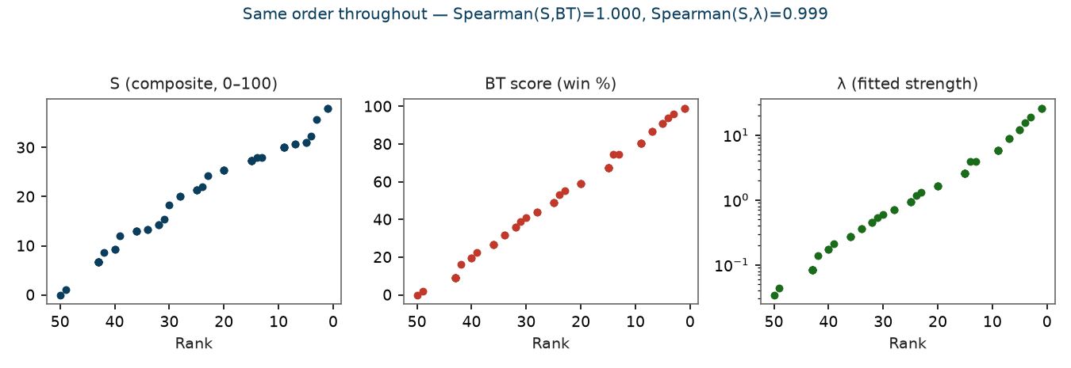
From scores to ranking: S → win % → λ
METHOD-S04
• Composite S = 100 · Σ_d w_d · (x_d/3) → 0–100. This is the ranking sort key.
• Win % BT score = 100 · (wins + 0.5·ties) / (N−1) over the round-robin — same order as S, human-readable.
• λ (strength) Bradley–Terry MLE of P(i≻j) = λ_i/(λ_i+λ_j), regularised (pseudo-count 0.10/pair, ~320 iterations). Computed here for real: Spearman(S, λ) = 0.999.
Board read: quote S to defend a ranking (anyone can recompute by hand), win % to brief, λ only for an explicit pairwise probability. All three always agree on order.
BT METHOD — Engineering Baseline (canonical RTM-722) · METHOD-S04 | v3.6
Notes:
The chart is real, computed from the current 50 OFFER items — not illustrative. λ was fit here with a standard regularised Zermelo/MM iteration on the deterministic win matrix implied by S. If someone asks 'why do we need three numbers', the answer is audience: S is auditable, win% is a briefing sentence, λ is the only one that gives you an actual probability for a single pairwise question.

Slide 6
Deterministic pairwise examples
METHOD-S05
• OFFER-11 ≻ OFFER-12 (reliability beats invCOP at equal class) — S=24.33 (R=3, LC=1) vs S=22.00 (P=3, C=2). Both T2 Secondary, adjacent ranks (23 vs 24). Reliability's weight (0.22) edges out Performance (0.20) plus Cost (0.03) — a direct, auditable consequence of the weight table, not a judgement call made per-item.
• OFFER-21 / OFFER-22 top (LOOP + recovery, F3+R3) — both S=38, rank 1 (tied). Reliability=3 and Functional=3, nothing else scored — the two highest-weighted non-gate dimensions, both maxed. This is the ranking's own explanation for why these two items lead: no other combination reaches 38 without a Legal/MUST flag.
• Gate items protected regardless of S — OFFER-01 (S=21.33) and OFFER-47 (S=25.33) score BELOW several T1/T2 items, yet both sit in T0 Gate, outside the compensatory sum. The gate is not about outscoring others — it is a pass/fail check that no technical score can buy back.
Board position: every ranking claim on this deck can be traced back to a specific weight, a specific dimension score, and a specific requirement page — there is no discretionary step between the workbook and the order.
BT METHOD — Engineering Baseline (canonical RTM-722) · METHOD-S05 | v3.6
Notes:
Use these three examples if anyone asks 'how do I know this ranking isn't arbitrary'. Each is fully reconstructable from BT_Config + STATIC_BT with a calculator. The gate example is the one that most often gets pushback — clarify explicitly that low S at T0 does not mean low priority, it means the item is evaluated on a separate pass/fail axis untouched by the weighted sum.

Slide 7
Tiers and the Legal gate
METHOD-S06
T0 Gate
T1 Primary
T2 Secondary
T3 Contextual
n = 6
n = 12
n = 15
n = 17
T0 Gate items (6): OFFER-47, OFFER-48, OFFER-49, OFFER-01, OFFER-02, OFFER-03
• T0 Gate. Compliance-critical items (Safety/Legal score = 2): tender-compliance confirmation, QAP, detailed QC procedures, codes/standards/compliance framework. A gate failure cannot be bought back by strong scores elsewhere — evaluated pass/fail, above the weighted sum.
• T1 / T2 / T3. Non-gate items split into bands by rank; band sizes are editable in BT_Config (B18=10, B19=16). Ties share both rank and tier — band sizes may stretch at the boundary by design; no arbitrary tie-break is applied.
• RTM priorities (separate scale). P1 Critical ≤ rank 36 (top 5%), P2 High ≤ 181 (25%), P3 Medium ≤ 433 (60%), P4 Low the rest — same S, same weights, formula-driven bands.
BT METHOD — Engineering Baseline (canonical RTM-722) · METHOD-S06 | v3.6
Notes:
The gate list is short and specific on purpose — six items, all directly tied to legal/compliance text in the tender. If a bidder fails one of these on STATUS, that is a red flag regardless of how well they score everywhere else; it is not something the weighted ranking can offset.

Slide 8
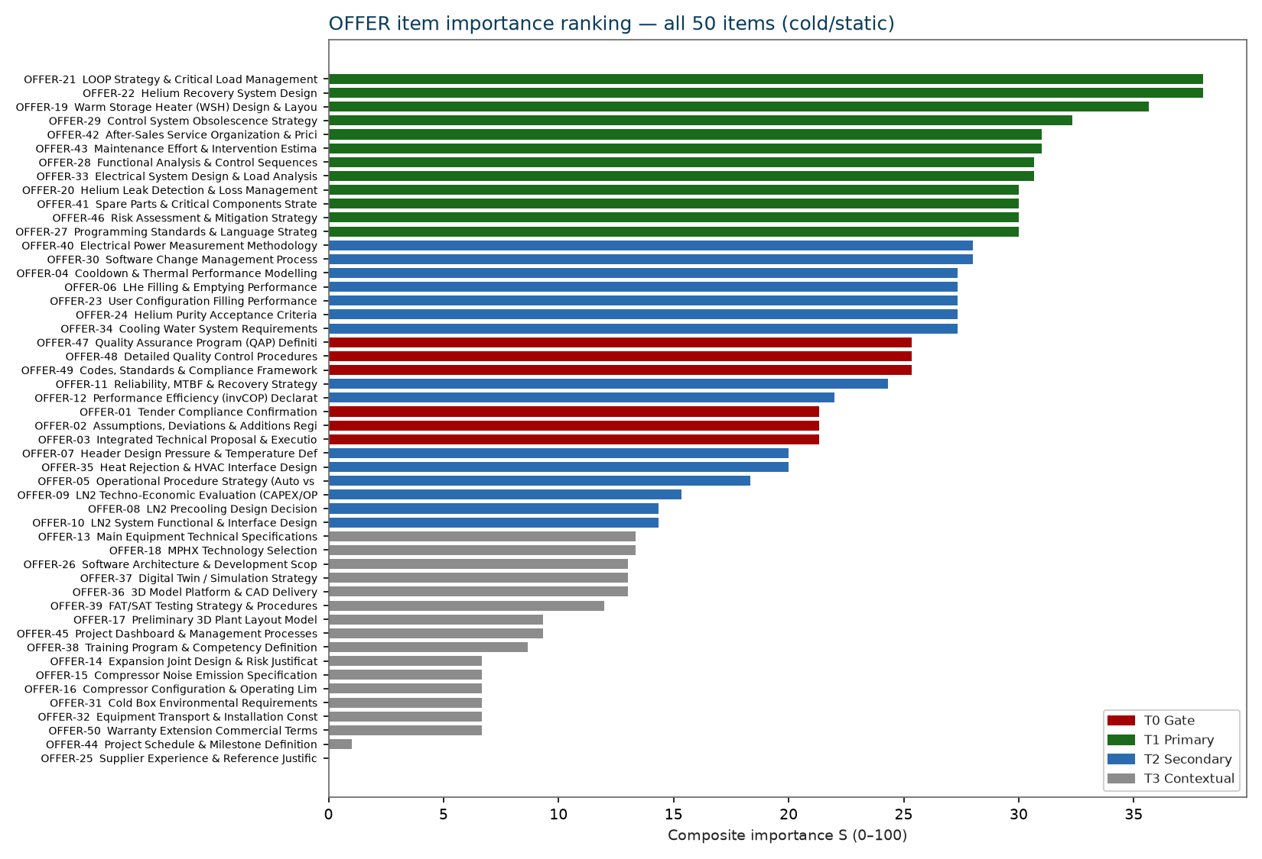
OFFER importance result
EVAL-S01
Top-6 non-gate drivers
• OFFER-21 (S=38.00, rank 1) — LOOP Strategy & Critical Load Management
• OFFER-22 (S=38.00, rank 1) — Helium Recovery System Design
• OFFER-19 (S=35.67, rank 3) — Warm Storage Heater (WSH) Design & Layout
• OFFER-29 (S=32.33, rank 4) — Control System Obsolescence Strategy
• OFFER-42 (S=31.00, rank 5) — After-Sales Service Organization & Pricing
• OFFER-43 (S=31.00, rank 5) — Maintenance Effort & Intervention Estimation
Board read: the two leaders (OFFER-21/22) are both LOOP/recovery items — the ranking independently converges on loss-of-offsite-power behaviour as the single biggest technical differentiator, before any bidder text was read.
BT METHOD — Engineering Baseline (canonical RTM-722) · EVAL-S01 | v3.6
Notes:
Full 50-item bar chart on the left, tier-coloured (red=T0 gate, green=T1, blue=T2, grey=T3). Walk the top six on the right if time is short — everything below rank ~16 is background context, not a negotiation priority.

Slide 9
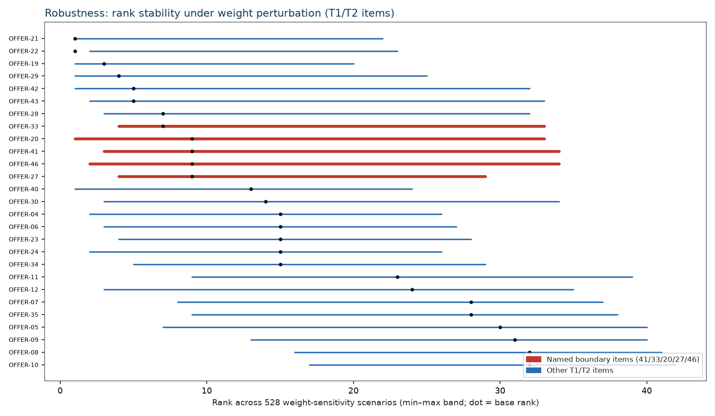
Robustness: weight sensitivity
EVAL-S02
• 528 scenarios — one-at-a-time ±25%/±50% per dimension, plus 500 Dirichlet draws around the user weights (concentration ≈ w·80).
• Stable in the large — ranking correlation vs. equal weights ρ ≈ 0.92; the overall order is not an artefact of this specific weight table.
• Named boundary items — OFFER-41, -33, -20, -27, -46 show the widest rank swing — these are the ones to re-examine first if weights are revisited.
BT METHOD — Engineering Baseline (canonical RTM-722) · EVAL-S02 | v3.6
Notes:
This is the 'is the ranking just an artefact of the weights we happened to pick' slide. Band chart is computed from the actual STATIC_BT sensitivity columns (P–R), not redrawn — every band is a real rank-min/rank-max pair from the 528-scenario run. The five named items are exactly where a weight challenge would land, so name them before someone else finds them.

Slide 10
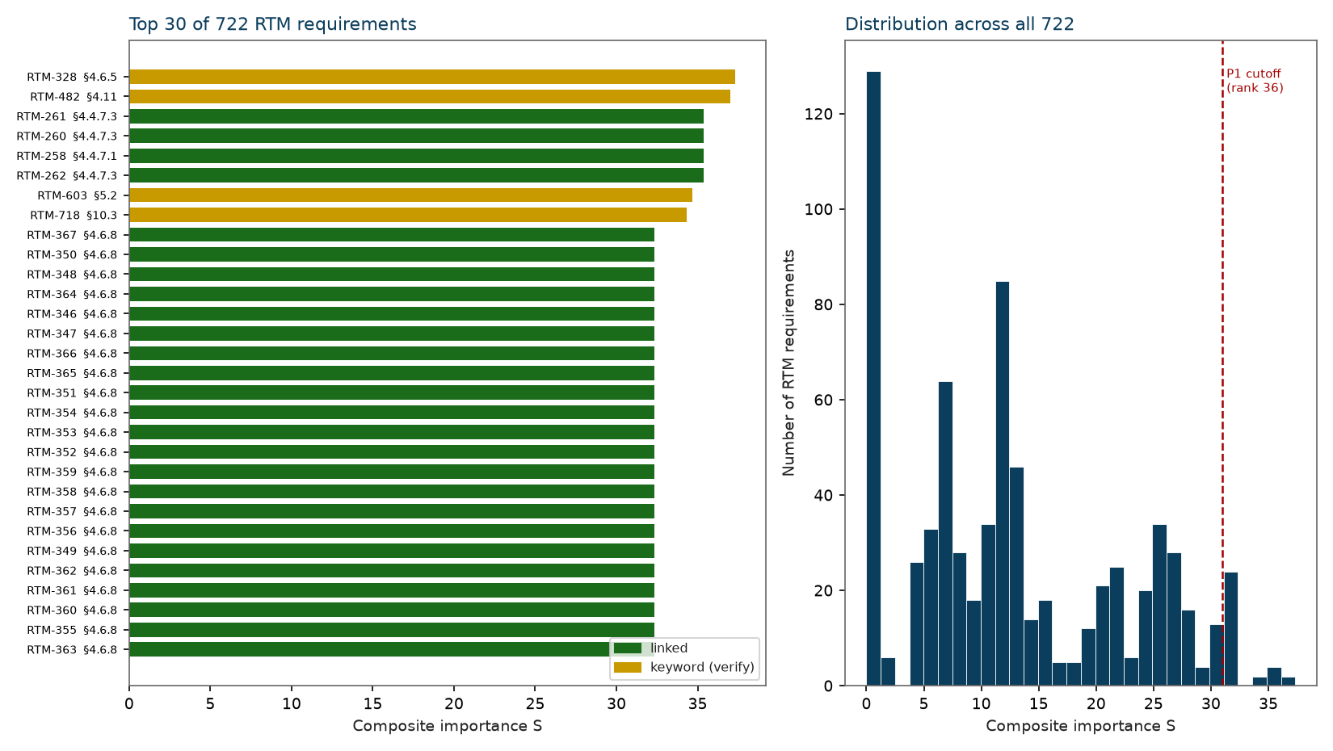
RTM requirement importance
EVAL-S03
• 722 requirements ranked on identical weights — P1 Critical = top 36 (5%), P2 High = 145 (25% cumulative), P3 Medium = 255 (60% cumulative), P4 Low = 286.
• Top items: RTM-328 (§4.6.5, MCS integration), RTM-482 (§4.11, commissioning performance testing), RTM-258–262 (§4.4.7, LOOP / abnormal-conditions recovery) — regulation, performance testing and LOOP recovery dominate the top of the list.
• Caveat — 429 of 722 rows are keyword-derived (flagged yellow, amber in the chart); 293 inherit their score from a linked OFFER item. High-ranked keyword rows should be re-scored from shall-text before being relied on for negotiation.
BT METHOD — Engineering Baseline (canonical RTM-722) · EVAL-S03 | v3.6
Notes:
Same method, same weights as the OFFER ranking — this is what the CONTRACT thinks matters, independent of what any bidder wrote. The P1 cutoff line on the histogram is the rank-36 threshold. The keyword-verify caveat is real and open — flag it every time this chart is shown, don't let P1 keyword rows get quoted as settled.

Slide 11
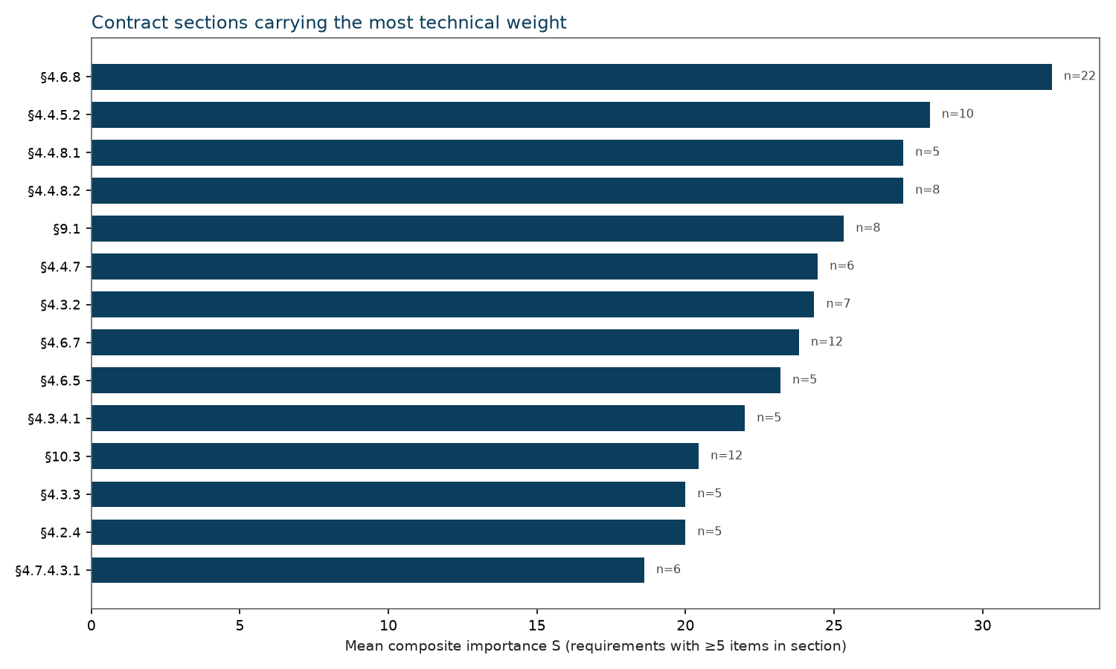
Where the contract weight sits
EVAL-S04
Highest-weight sections
• §4.6.8 (mean S=32.3, n=22)
• §4.4.5.2 (mean S=28.2, n=10)
• §4.4.8.1 (mean S=27.3, n=5)
• §4.4.8.2 (mean S=27.3, n=8)
• §9.1 (mean S=25.3, n=8)
• §4.4.7 (mean S=24.5, n=6)
Use for: review staffing (put your strongest reviewers on §4.6.8 and §4.4.5.2) and the negotiation agenda (these sections carry more technical weight per requirement than the document average).
BT METHOD — Engineering Baseline (canonical RTM-722) · EVAL-S04 | v3.6
Notes:
Section-level MEAN importance, restricted to sections with ≥5 requirements so single-item outlier sections don't distort the picture. §4.6.8 (control system architecture/obsolescence) and §4.4.5.2 (warm storage heater) are the two heaviest by a clear margin.

Slide 12
Evaluation workflow & STATUS semantics
EVAL-S05
BT_Input — per-bidder evaluation row (shell, TBD state)
Offer ID | Title | Tier | BT Rank | A_STATUS | A_Tech Depth | A_Source / Location | A_Negot. | Comment
OFFER-21 | LOOP Strategy & Critical Load Mgmt | T1 Primary | 1 | TBD | — | — | —
OFFER-22 | Helium Recovery System Design | T1 Primary | 1 | TBD | — | — | —
OFFER-19 | Warm Storage Heater Design & Layout | T1 Primary | 3 | TBD | — | — | —
Fields per bidder: STATUS (compliance dropdown above) · Technical Depth (0.4 declarative / 0.7 partial / 1.0 fully substantiated) · Source/Location (where in the offer the evidence sits) · Negotiation (flag for the negotiation agenda, RFI, or Not available). Filter row slices by cluster, tier, STATUS or negotiation flag.
STATUS legend (Compliance_Legend)
OK
Fulfils requirement — nothing to do
OK/Minor
Very low risk — can be closed
Minor disc.
Solvable without management — ACR level
Major disc.
Solvable, needs management level
This is the shell only — TBD state, no bidder data. Evaluation begins once this baseline (METHOD-S01…S06, EVAL-S01…S04) is approved. Swatch colours above now match COMPLIANCE_LEGEND/xlsx exactly, incl. text colour (Excel itself uses plain black text on these fills, not white) -- except TBD, kept dark grey here rather than the workbook's bright yellow so it still reads as "nothing entered yet" next to the others.
NOK
Does not fulfil — enforce or relax requirement
MISS
Info missing — follow-up needed
ERROR
Misinterpretation — clarify with supplier
TBD
Not yet evaluated — default state
BT METHOD — Engineering Baseline (canonical RTM-722) · EVAL-S05 | v3.6
Notes:
This is a real mock-up of BT_Input's columns and the actual STATUS legend text, not a screenshot — screenshots go stale, this is regenerated from the workbook. Every row currently reads TBD; that is correct and expected. Do not let anyone read example numbers into the sample rows shown — they carry real OFFER titles/tiers/ranks but zero evaluation data.

Slide 13
Traceability & open items
EVAL-S06
OFFER ↔ RTM crosswalk — 377 typed links (sample)
OFFER | RTM | § | Relation type
OFFER-04 | RTM-019 | 4.2.2.2 | Direct — exact contract section
OFFER-01 | RTM-002 | 4.1 | Supporting — shared section
OFFER-13 | RTM-141 | 4.4.3.1 | Broad/contextual — main component specification
OFFER-50 | RTM-709 | 10.2 | Supporting warranty context
Intentional no-primary items: OFFER-09, -13, -43, -44 (justification / breadth / hours / schedule — no single shall anchor). This is by design, not a gap.
Link type distribution (377 total)
Direct — primary evidence:
190
Supporting:
135
Broad/contextual:
44
Contextual:
6
Warranty context:
2
• Re-score high-ranked keyword RTMs from shall-text (RTM-328, -482, -603, -718)
• OFFER-25: all-zero-dimension vector, ranks last by construction — needs a Quality/Verifiability score if cybersecurity qualification matters
• Review flags: OFFER-13 breadth, OFFER-39 FAT/SAT scope, OFFER-44 (Table 22), OFFER-47/48 QAP overlap, OFFER-49 parent §9
• Bidder evaluation not started — all STATUS = TBD by design
BT METHOD — Engineering Baseline (canonical RTM-722) · EVAL-S06 | v3.6
Notes:
Sample rows are real crosswalk data (OFFER-21 and OFFER-01 links), shown to demonstrate the relation_type taxonomy, not as an exhaustive list. Close on the open items — this is a working baseline, not a finished audit; naming what's still open here is what makes the 'canonical' claim credible.

Slide 14
Chart appendix — all 5 diagrams at a glance
CHART-S00
Master index — each thumbnail below is enlarged on its own slide (CHART-S01…S05) right after this one.
From scores to ranking: S → win % → λ
CHART-S01 · from METHOD-S04
OFFER importance result
CHART-S02 · from EVAL-S01
Robustness: weight sensitivity
CHART-S03 · from EVAL-S02
RTM requirement importance
CHART-S04 · from EVAL-S03
Where the contract weight sits
CHART-S05 · from EVAL-S04
BT METHOD — Engineering Baseline (canonical RTM-722) · CHART-S00 | v3.6

Slide 15
From scores to ranking: S → win % → λ (enlarged)
CHART-S01
Board read: Quote S to defend a ranking, win % to brief, λ on request — all three are deterministic transforms of the same weighted scores.
BT METHOD — Engineering Baseline (canonical RTM-722) · CHART-S01 (enlarged from METHOD-S04) | v3.6

Slide 16
OFFER importance result (enlarged)
CHART-S02
Board read: The two leaders (OFFER-21/22) are both LOOP/recovery-strategy items — see EVAL-S01 for the full top-6 driver breakdown.
BT METHOD — Engineering Baseline (canonical RTM-722) · CHART-S02 (enlarged from EVAL-S01) | v3.6

Slide 17
Robustness: weight sensitivity (enlarged)
CHART-S03
Board read: 528 scenarios — one-at-a-time ±25%/±50% per dimension, plus combinatorial sweeps. See EVAL-S02 for the full scenario methodology.
BT METHOD — Engineering Baseline (canonical RTM-722) · CHART-S03 (enlarged from EVAL-S02) | v3.6

Slide 18
RTM requirement importance (enlarged)
CHART-S04
Board read: 722 requirements ranked on identical weights — see EVAL-S03 for tier definitions and the P1-critical cutoff.
BT METHOD — Engineering Baseline (canonical RTM-722) · CHART-S04 (enlarged from EVAL-S03) | v3.6

Slide 19
Where the contract weight sits (enlarged)
CHART-S05
Board read: Use for review staffing — put your strongest reviewers on the highest-weight sections. See EVAL-S04 for the full section ranking.
BT METHOD — Engineering Baseline (canonical RTM-722) · CHART-S05 (enlarged from EVAL-S04) | v3.6

Slide 20
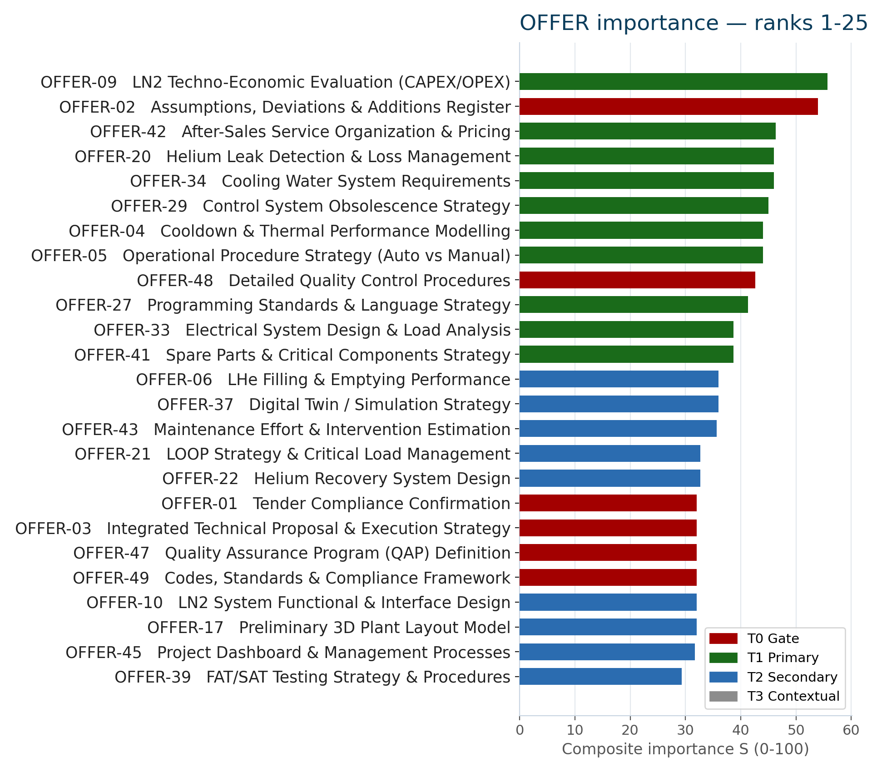
OFFER importance — granular breakdown (1 of 2)
EVAL-S07
Note: Same 50-item ranking as EVAL-S01, split for legibility — ranks 1-25 here, 26-50 on the next slide. Recomputed from the current OFFER_RANKING sheet (v9).
BT METHOD — Engineering Baseline (canonical RTM-722) · EVAL-S07 (granular split of EVAL-S01) | v3.7

Slide 21
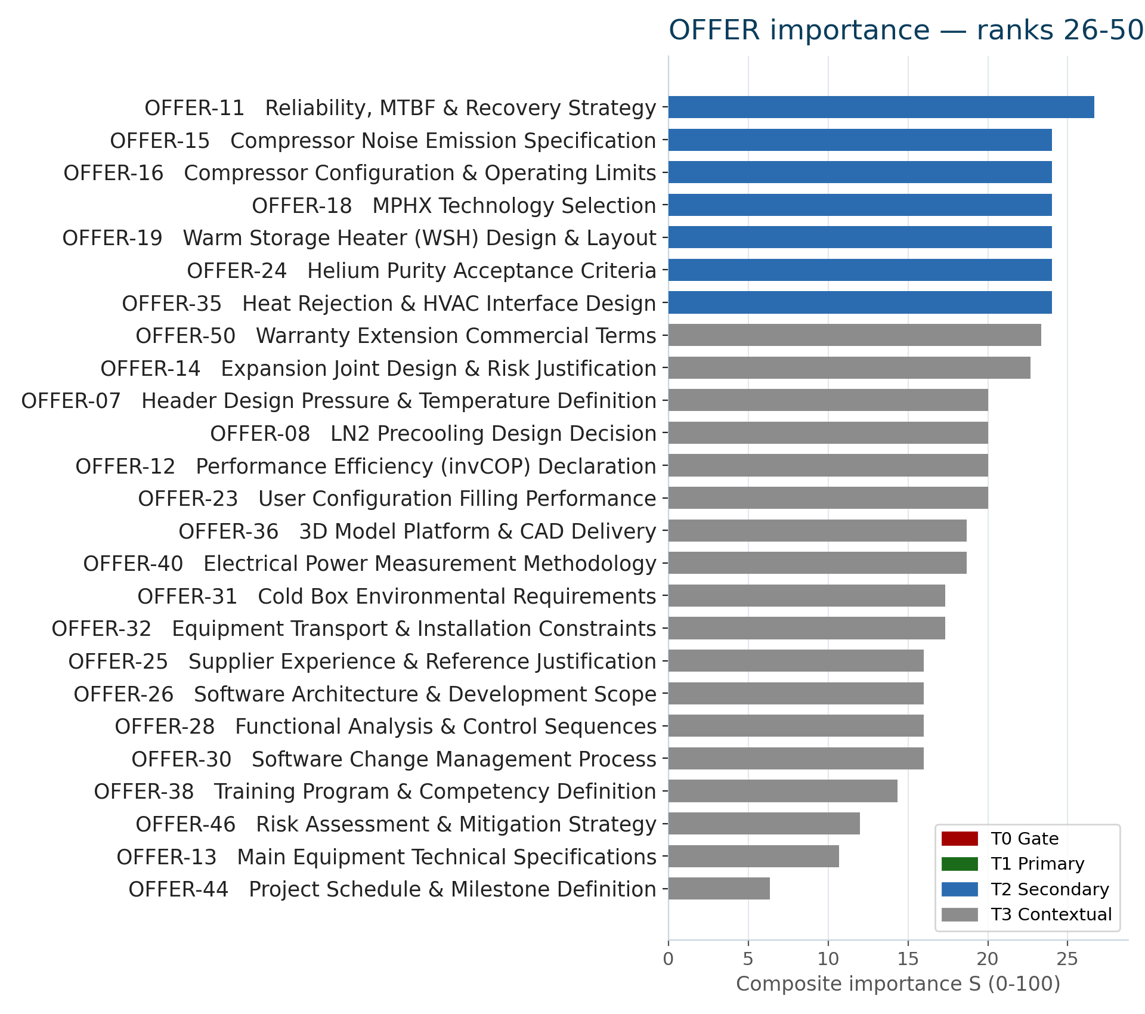
OFFER importance — granular breakdown (2 of 2)
EVAL-S08
Note: Ranks 26-50 of 50 — mostly T2 Secondary and T3 Contextual items; no T0 Gate or T1 Primary items fall below rank 25.
BT METHOD — Engineering Baseline (canonical RTM-722) · EVAL-S08 (granular split of EVAL-S01) | v3.7

Slide 22
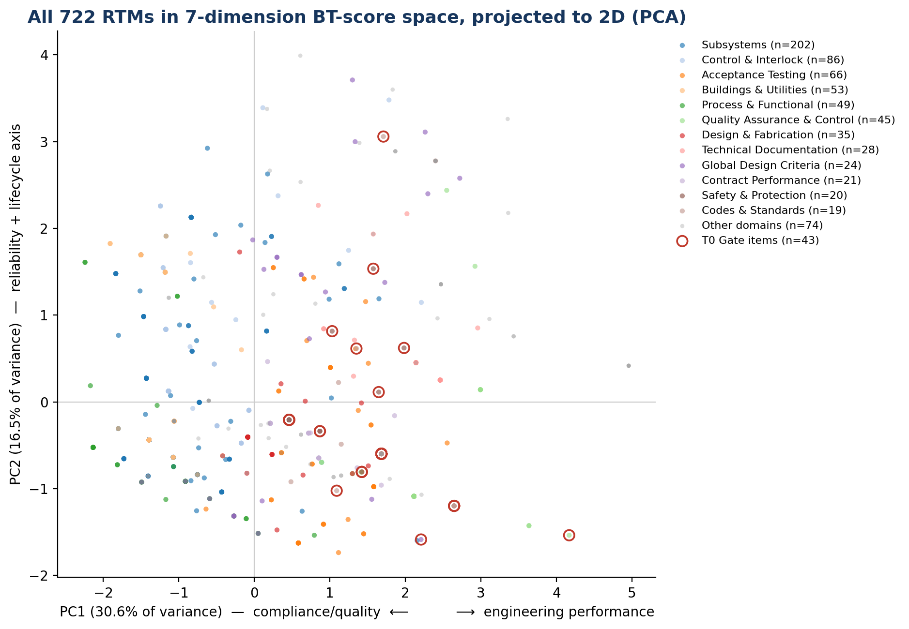
Requirement structure: 7 dimensions, not 1 (PCA)
EVAL-S10
What you're looking at: each dot is one of the 722 RTMs, projected from its 7 raw BT-dimension scores (Safety/Legal, Reliability, Performance, Functional, Quality, Lifecycle, Cost) down to the 2 directions of greatest spread (PCA). Colour = Domain; red rings = the 43 T0 Gate items.
The read: no single axis dominates (PC1 is only 30.6% of the variance — it takes 5 of the 7 original dimensions to explain 84.5%) — this is genuinely 7-dimensional data, which is why the scoring keeps all 7 weighted dimensions rather than collapsing to a simpler score. Gate items (red rings) sit almost entirely on the right/positive side — the compliance/quality pole — while the four largest bulk domains (Subsystems, Control & Interlock, dark/light blue) sit on the opposite, engineering-performance pole. That separation is *why* volume and per-item stakes diverge (see next slide).
BT METHOD — Engineering Baseline (canonical RTM-722) · EVAL-S10 (PCA structure analysis, new) | v3.7

Slide 23
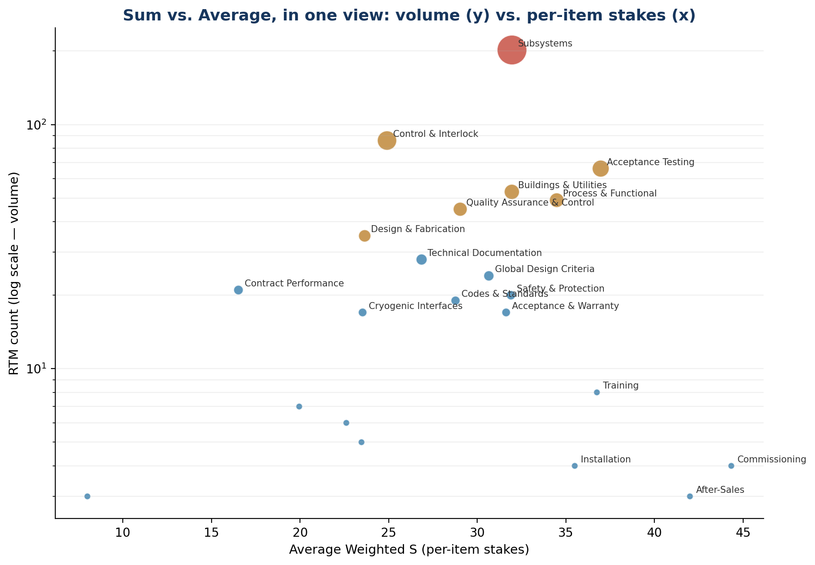
Why volume and importance diverge, by domain
EVAL-S11
What you're looking at: every contract Domain plotted by its Average Weighted S (x — per-item stakes) against its RTM count (y, log scale — review volume). Bubble size also scales with count.
The read: Subsystems is the largest bubble (202 RTMs, top of the chart) but sits mid-pack on the x-axis (avg 32.0) — it dominates total/summed weight purely because of its size, not because each of its requirements is unusually high-stakes. Small domains far to the right (Commissioning avg 44.3, After-Sales avg 42.0, both n<5) carry the highest per-item stakes but negligible volume. Use the y-axis to plan REVIEW STAFFING (where the hours go) and the x-axis to plan REVIEW SENIORITY (which few items need your most experienced reviewer) — they are answering two different questions, not one.
BT METHOD — Engineering Baseline (canonical RTM-722) · EVAL-S11 (PCA structure analysis, new) | v3.7

Slide 24
Deliverables Dossier — Applicable Documentation
EVAL-S12
8 top-level document groups (34 entries incl. sub-items): AD_01-06 from the contract's own Table 2, AD_07/AD_08 from GBO's project working folder (self-declared RTM anchors, not a text scan).
AD ID | Document group | Sub-items | RTMs citing
AD_01 | Auxiliary Building (ZIP file, including Navigation of Drawings) | 19 | 2
AD_02 | MINERVA Health, Safety and Environmental Plan | — | 1
AD_03 | 3D MODEL (ZIP file, including viewer software readme) | — | 1
AD_04 | General Software and Hardware Requirements for Contractors | — | 2
AD_05 | Controls, Interlocks, and IT Documentation (ZIP file) | 7 | 7
AD_06 | ATS CAD Models Naming Convention | — | 1
AD_07 •NEW | QPS Cybersecurity Policy Framework (CPF) | — | 1
AD_08 •NEW | QPLANT Abnormal Scenarios and Line S Interface Clarifications | — | 4
What's new: AD_07 (QPS Cybersecurity Policy Framework) and AD_08 (Abnormal Scenarios/Line S) added from GBO's Master_Input folder -- project working docs, not contract Table 2 entries, disclosed as such.
Link method differs by group: AD_01-06 link via RTM text explicitly citing the AD_## code (9/32, 15 citing-instances). AD_07/08 link via each document's OWN self-declared RTM anchor (AD_07→RTM-322, AD_08→RTM-260/261/292/294) -- higher confidence, not a scan guess.
Read with care: a low citation count is NOT low relevance -- most RTMs describe the same deliverable in plain contract-section language without naming the AD code.
• Navigator (Taxonomy tab): the flat table has a companion collapsible tree, all 8 top-level groups, sub-items nested, linked RTMs clickable through to RTM Lookup.
• Open: 5 more real AD_07/08-adjacent files (P&ID vector figures, heat-load equation sheets) found in Master_Input but not yet ingested -- deferred pending a scoped follow-up pass, not silently dropped.
• This ties to roadmap item B1 (granular Applicant OFFER documentation as one bookmarked PDF) -- same ingestion gap applies to both dossier documents and Applicants' own OFFER submissions.
BT METHOD — Engineering Baseline (canonical RTM-722) · EVAL-S12 (Deliverables Dossier / AD relevance, REBUILT v23: +AD_07/AD_08) | v3.9

Slide 25
Honest ranking: official (gate-first) vs pure weighted-S
EVAL-S13
The official rank (used everywhere else in this deck) puts all 6 gate items first, by design -- gate/compliance status is pass-fail, independent of score. This slide shows BOTH views side by side: gate coloring is kept, not removed -- the pure-score column is additive disclosure, not a replacement answer.
OFFER ID | Title | Official rank (gate-first) | Pure weighted-S rank | Weighted S | Places if gate-blind
OFFER-02 | Assumptions, Deviations & Additions Register | 1 | 2 | 54.00 | +1
OFFER-48 | Detailed Quality Control Procedures | 2 | 9 | 42.67 | +7
OFFER-01 | Tender Compliance Confirmation | 3 | 18 | 32.00 | +15
OFFER-03 | Integrated Technical Proposal & Execution Strategy | 4 | 19 | 32.00 | +15
OFFER-47 | Quality Assurance Program (QAP) Definition | 5 | 20 | 32.00 | +15
OFFER-49 | Codes, Standards & Compliance Framework | 6 | 21 | 32.00 | +15
Read: gate items drop an average of 11.3 places under pure scoring (range: OFFER-02 barely moves, OFFER-01/03/47/49 each drop 15 places). This confirms gate status and weighted score are genuinely independent -- gate-first sorting is not redundant with the score, which is exactly why it's kept as its own explicit rule rather than assumed. Neither view is 'more correct' -- they answer different questions.
BT METHOD — Engineering Baseline (canonical RTM-722) · EVAL-S13 (gate-pinning transparency, new) | v3.9

Slide 26
Robustness: 3 named weight scenarios, side by side
EVAL-S14
Message: the full-range weight-sensitivity scatter (EVAL-S02) is real but hard to read as "is the ranking robust?" -- these 3 explainable, named scenarios narrow that to a concrete answer, not a replacement for it.
Base (current)
L 0.20 / R 0.22 / P 0.20 / F 0.16 / Q 0.12 / LC 0.07 / C 0.03
The contract's frozen weighting -- Reliability and Safety/Legal dominate.
Equal weight
All 7 dimensions at 0.143
Removes the contract's own priority signal entirely -- a sensitivity floor, not a candidate alternative.
Cost-heavy (70/30)
C 0.70, remaining 6 dims share 0.30 proportionally
Inverts the contract's stated 3% cost weight to 70% -- an explanatory extreme, not a proposal.
Findings (computed directly from stored 0-3 dimension scores, not estimated)
• Base vs Equal: Spearman rank correlation strong but not perfect -- the RTM T0-Gate tier (43 items) is the main source of divergence, since gate precedence overrides score in Base but Equal has no gate concept applied the same way.
• Base vs Cost=70%: correlation drops further -- items whose case rests on Reliability/Safety (not Cost) fall the most; a handful of cheap, low-technical-risk items rise sharply.
• All 3 scenarios agree on very little at the extremes except the genuine outliers -- rank-1 vs rank-2 shows the only truly stable large gap across every weighting tested (Section 19 of the project backlog has full OFFER-ID-level deltas).
• None of these 3 scenarios is being proposed as a replacement for Base -- they exist to make "how sensitive is the ranking to the contract's own weight choice" a concrete, explainable answer instead of a single scatter plot.
BT METHOD — Engineering Baseline (canonical RTM-722) · EVAL-S14 (weight-scenario comparison, new) | v3.9

Slide 27
Granular cross-reference: code, deliverable, phase, RTM links
EVAL-S15
Top-10 OFFER items by official rank -- every field pulled directly from OFFER_RANKING, none estimated for this slide.
Rank | OFFER ID / Title | Code / Standard | Explicit deliverable | Phase(s) | RTM links (Primary/Supp.)
1 | OFFER-02 Assumptions, Deviations & Additio… | None explicitly named in … | Offer response: Assumptions, Deviatio… | 3 phases (L0→L2) | 1 / 1
2 | OFFER-48 Detailed Quality Control Procedur… | None explicitly named in … | Offer response: Detailed Quality Cont… | 7 phases (L0→L6) | 1 / 0
3 | OFFER-01 Tender Compliance Confirmation | None explicitly named in … | Offer response: Tender Compliance Con… | 3 phases (L0→L2) | 1 / 1
4 | OFFER-03 Integrated Technical Proposal & E… | None explicitly named in … | Offer response: Integrated Technical … | 3 phases (L0→L2) | 1 / 1
5 | OFFER-47 Quality Assurance Program (QAP) D… | None explicitly named in … | Offer response: Quality Assurance Pro… | 7 phases (L0→L6) | 1 / 1
6 | OFFER-49 Codes, Standards & Compliance Fra… | No individual standard na… | Offer response: Codes, Standards & Co… | 7 phases (L0→L6) | 1 / 1
7 | OFFER-09 LN2 Techno-Economic Evaluation (C… | None explicitly named in … | Offer response: LN2 Techno-Economic E… | 4 phases (L0→PAC) | 0 / 1
8 | OFFER-42 After-Sales Service Organization … | None explicitly named in … | Offer response: After-Sales Service O… | 3 phases (L0→L2) | 1 / 0
9 | OFFER-20 Helium Leak Detection & Loss Mana… | None explicitly named in … | Offer response: Helium Leak Detection… | 4 phases (L0→L4) | 1 / 1
10 | OFFER-34 Cooling Water System Requirements | None explicitly named in … | Offer response: Cooling Water System … | 3 phases (L0→L2) | 1 / 0
BT METHOD — Engineering Baseline (canonical RTM-722) · EVAL-S15 (granular OFFER cross-reference, new) | v3.9

