Slide 1
Cryoplant MTBF and System Design
MTBF Policy · Flow Assumptions · Acceptance + CIS/MCS Integration

Slide 2
DMAIC Roadmap (1/3) — Define & Measure
DEFINE
How to read this master deck, part 1 — scope, requirements, and baseline data | Without LOOKING at OFFERS
DEFINE (Slides 5–7, 13, 20–21)
What the system must achieve: scope, RTM obligations, the operating-state hierarchy, and failure-class definitions with their MTBF targets.
MEASURE (Slides 8–12, 16–18)
What the fleet can actually deliver: OEM flow data, N−1 capability, unit energy economics, acceptance-test criteria, and liquid-buffer coverage time.
This is a MASTER slide set — each third of this roadmap can be lifted into its own briefing.
307 g/s
24 QM target flow (design envelope 320–350 g/s)
N − 1
sizing rule: fleet must survive one unit down
A>5y · B>10y · C>15y
MTBF targets by failure-consequence class
350 kW
installed power per HP compressor (validated Slide 10)
SAMPLE CALC N−1 check, FSD 575: 3 × 112.5 g/s @ 72 Hz = 337.5 g/s ≥ 307 g/s target → passes with +30 g/s margin (Slide 9).

Slide 3
DMAIC Roadmap (2/3) — Analyze
ANALYZE
How to read this master deck, part 2 — why the numbers behave the way they do
ANALYZE (Slides 22–28)
This is the deck's math core: the Poisson/exponential campaign-success model, the 94–95% reliability ceiling, the Wrong / Better / Chosen architecture trade-off, and the Weibull wear-out relation that eventually limits any MTBF-only argument.
This section is intentionally chart-heavy — the technical-blue banner marks it as the deck's quantitative narrative, distinct from the definitional purple sections either side.
This is a MASTER slide set — the Analyze section alone can be lifted into a standalone reliability-math briefing.
SAMPLE CALC — Poisson MTBF = 5 y → λ = 1/5 = 0.200 / y. P(zero trips, 90 d) = e^(−λt) = e^(−0.200 × 0.246) ≈ 95.3% → the origin of the deck's ~95% campaign figure (Slides 22–23, 25).
SAMPLE CALC — Weibull β = 2.5, η = 114,400 h (cold compressor). P(fail in next 90 d | age = 5 y) is ≈ 235× the same-window probability right after a good-as-new overhaul (Slide 28) — the mechanism that IMPROVE (part 3) responds to.
94–95%
90-day campaign success ceiling (single-train)
β > 1
hazard rises with age → MTBF alone understates risk

Slide 4
DMAIC Roadmap (3/3) — Improve & Control
CONTROL
How to read this master deck, part 3 — from prediction to a maintenance policy
IMPROVE (Slides 29–34)
Why MTBF matters, when it stops being trustworthy, and the component evidence (compressors, PVPS, turbines) that proves it.
CONTROL (Slides 35–38)
Predictable, usage-based service replacement; the reset-to-new renewal principle; and the governance loop that keeps the system inside the assumptions MTBF requires.
This is a MASTER slide set — Improve + Control together form a standalone maintenance-policy pack.
SAMPLE CALC Same β=2.5, η=114,400 h cold-compressor pair as part 2 → replace at ≈ 0.65×η (≈ 74,000 h) instead of running to MTBF-implied end of life — the deadline is set before the hazard curve turns upward, not after (Slide 36).
1
MEASURE exposure
2
TRACK age vs. η
3
REPLACE before wear-out
4
RESET & feed back

Slide 5
Objectives & Scope
DEFINE
MTBF Policy · Flow Assumptions · Acceptance + CIS/MCS Integration
Fleet baseline
Consolidate compressor fleet assumptions — ≥ 3 units minimum, Option A baseline = 4 × FSD 575.
RTM alignment
Align with Addendum II canonical RTMs, incl. 'To be offered…' statements.
Acceptance & integration
Define acceptance tests (24×2 K SB & 24×2 K OP) and CIS/MCS integration checkpoints (Slides 12, 14).
Operating scope
24 QM with FFT operating mode — below the 307 g/s nominal design target.
Design envelope
320–350 g/s total flow — the envelope every capability check in this deck is measured against (Slide 9).
307 g/s
24 QM nominal target flow
320–350
g/s design envelope (Slide 9)
SCOPE IN ONE LINE Everything from here to the closing governance loop exists to keep the fleet inside this envelope, provably.
Notes:
Full baseline bullet text (verbatim), condensed on-slide for readability:
- Consolidate compressor fleet assumptions (≥ 3 units min., Option A baseline = 4 × FSD 575)
- Align with Addendum II canonical RTMs (incl. 'To be offered…' statements)
- Define acceptance tests (24×2 K SB & 24×2 K OP), integration checkpoints (CIS/MCS)
- Scope: 24 QM with FFT operating mode (< design 307 g/s nominal)
- Design envelope: 320 – 350 g/s (total flow)

Slide 6
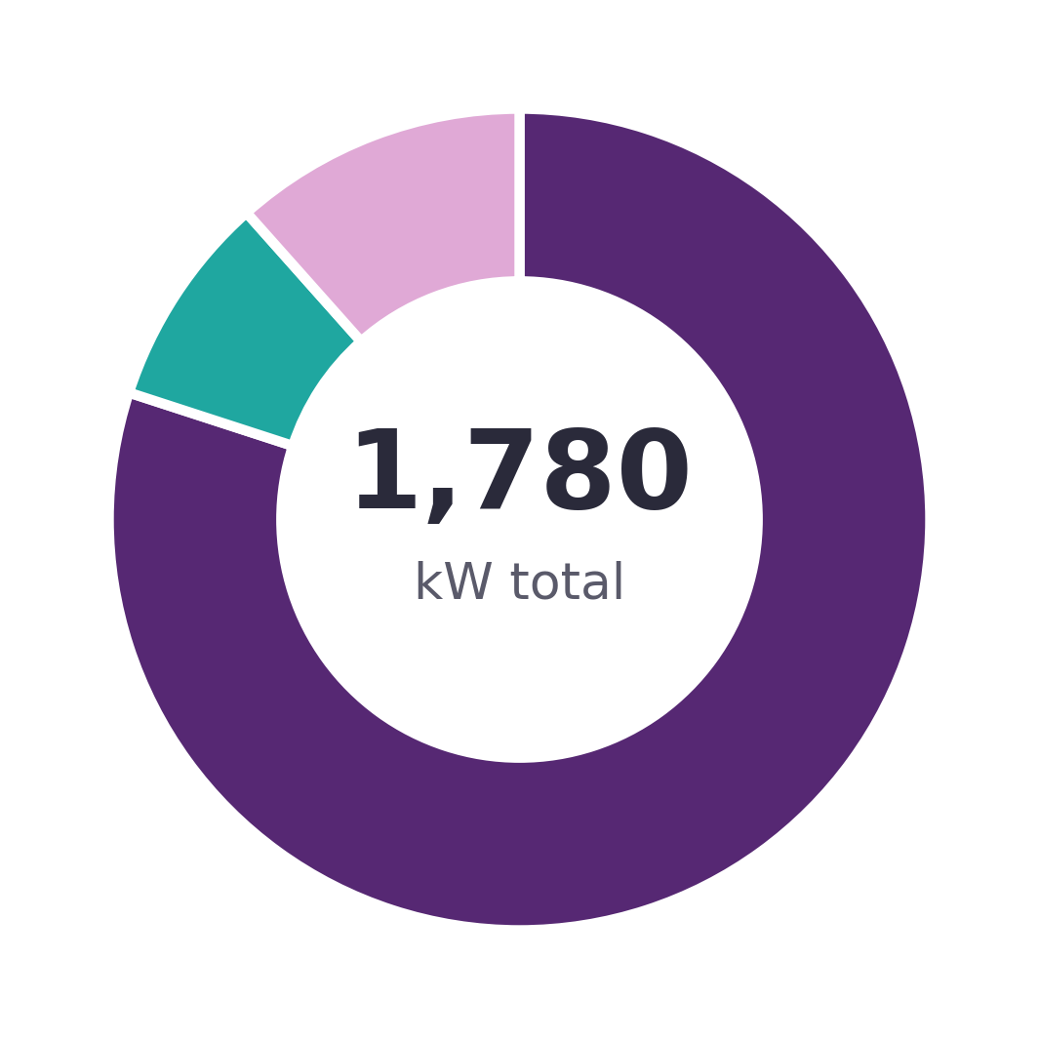
Configuration Baseline (Option A – 4× HSD Combi)
DEFINE
Fleet Sizing and Utilities Envelope
Fleet power
4 × 350 kW HP compressors ≈ 1.4 MW total installed.
Cooling water
27→ 37°C supply/return (ΔT 10 K) nominal; up to 42°C return (ΔT 15 K) for PS01 at reduced flow.
Piping
Shared header, looped feed/return.
4th-unit deferral
Fully stubbed install position — enforceable by SCK CEN at grant or EoCD.
Pressure control
≈ 14 bar discharge maintained; VFD trims flow (feeds the Unit Economics model, Slide 10).
Applicant shall
Deliver layout & piping stubs if the 4th unit is deferred.
1.4 MW
installed (4×350 kW)
14 bar
discharge pressure
10–15 K
cooling ΔT range
WHY IT MATTERS This power/water/pressure envelope is the input to the Unit Economics energy-cost model (Slide 10) and the Utilities hub-and-spoke diagram (Slide 15).
■ HP Compressors — 1,424 kW (80%)
■ PVPS — 150 kW (8%)
■ Rest of plant — 206 kW (12%)
RTM-395, Table 19–20 (excl. back-up diesel)
KEY TAKEAWAY Open baseline question: pressure-constant vs. pressure-swing control — not yet decided.
Notes:
Full baseline bullet text (verbatim), condensed on-slide for readability:
- 4× 350 kW HP compressors (≈ 1.4 MW total installed)
- Cooling water: 27 °C supply · 37 °C return (Δ T 10 K) → up to 42 °C return with reduced flow (15 K Δ T for PS01)
- Shared header (looped feed/return)
- Install deferral option (4th position fully stubbed – enforceable by SCK CEN at grant or EoCD) This is up to them – pressure constant or pressure swing?
- Maintain ≈ 14 bar discharge pressure; VFD does flow trimming
- Applicant shall: deliver layout & piping stubs (if 4th unit deferred)

Slide 7
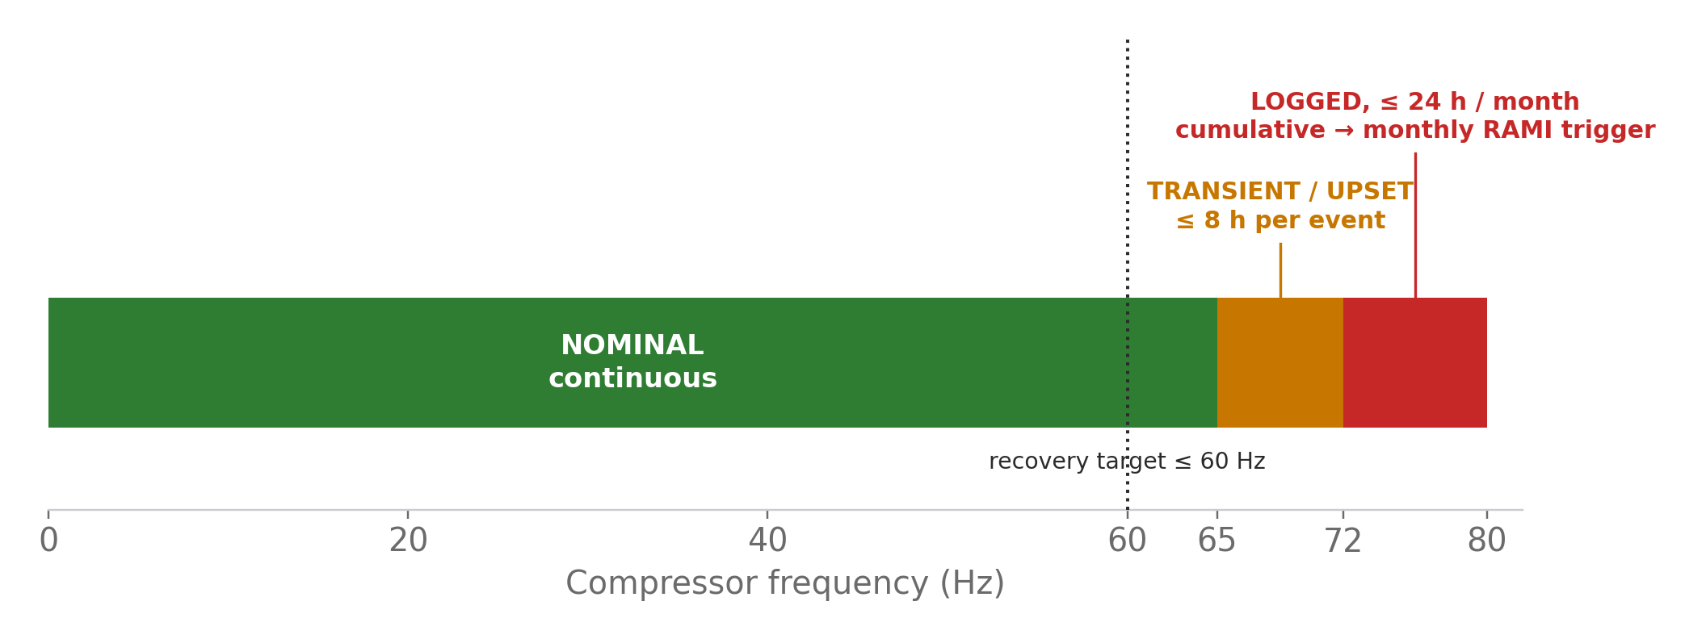
Frequency and Upset Policy
DEFINE
Operating Limits and Logging Requirements
Nominal: ≤ 65 Hz, sustainable continuous operation.
Transient / upset up to 72 Hz, ≤ 8 h per event (covers service or trip recovery, 8 h MTTR).
Cumulative > 72 Hz: ≤ 24 h / compressor / month — logged, triggers monthly RAMI review if exceeded.
Recovery: return to ≤ 60 Hz to re-stabilize after a repair.
Applicant shall quantify sustained MTBF vs. frequency band (≤ 60 Hz, 60–68 Hz, ≥ 68 Hz).
Notes:
Full baseline bullet text (verbatim), condensed on-slide for readability:
- Nominal Operation: ≤ 65 Hz (sustainable continuous)
- Transient / Upset: up to 72 Hz, ≤ 8 h per event (cover service or trip recovery, 8 h MTTR)
- Cumulative > 72 Hz: ≤ 24 h / compressor / month (logged, monthly RAMI trigger if exceeded)
- Logging: Mandatory (Start/Stop · Duration · Cause) stored in CIS + RAMI DB
- Recovery: Return ≤ 60 Hz to re-stabilize post-repair In the Offer the Applicant shall:
- Applicant shall quantify sustained MTBF vs frequency band (≤ 60 Hz, 60‑68 Hz, ≥ 68 Hz)

Slide 8
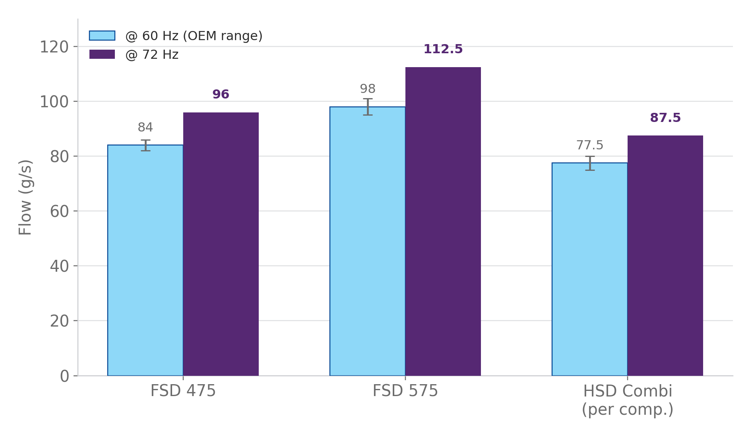
Compressor Flow Capability
MEASURE
OEM Performance Figures
OEM reference figures at 60 Hz and 72 Hz for the three candidate compressor types.
FSD 575 gives the largest per-unit margin — carries directly into the N−1 case (Slide 9).
HSD Combi figures are Option A basis, flagged in the baseline as an estimate ('guess').
Controls principle: hold discharge pressure, use VFD turndown; avoid > 60 Hz except upsets.
Notes:
Full baseline bullet text (verbatim), condensed on-slide for readability:
- FSD 475: Flow @ 72 Hz ≈ 96 g/s | Flow @ 60 Hz ≈ 82 – 86 g/s (Kaeser OEM figures)
- FSD 575: Flow @ 72 Hz ≈ 112.5 g/s | Flow @ 60 Hz ≈ 95 – 101 g/s (OEM Higher-capacity)
- HSD Combi: ≈ 87.5 g/s / comp (175 /combi) @ 72 Hz | ≈ 75 – 80 g/s @ 60 Hz (Option A basis) - guess
- Scaling: 4 × FSD‑475 → ≈ 65.6 Hz to hit 87.5 g/s each
- Controls principle: hold pressure → apply VFD turndown; avoid > 60 Hz except upsets

Slide 9
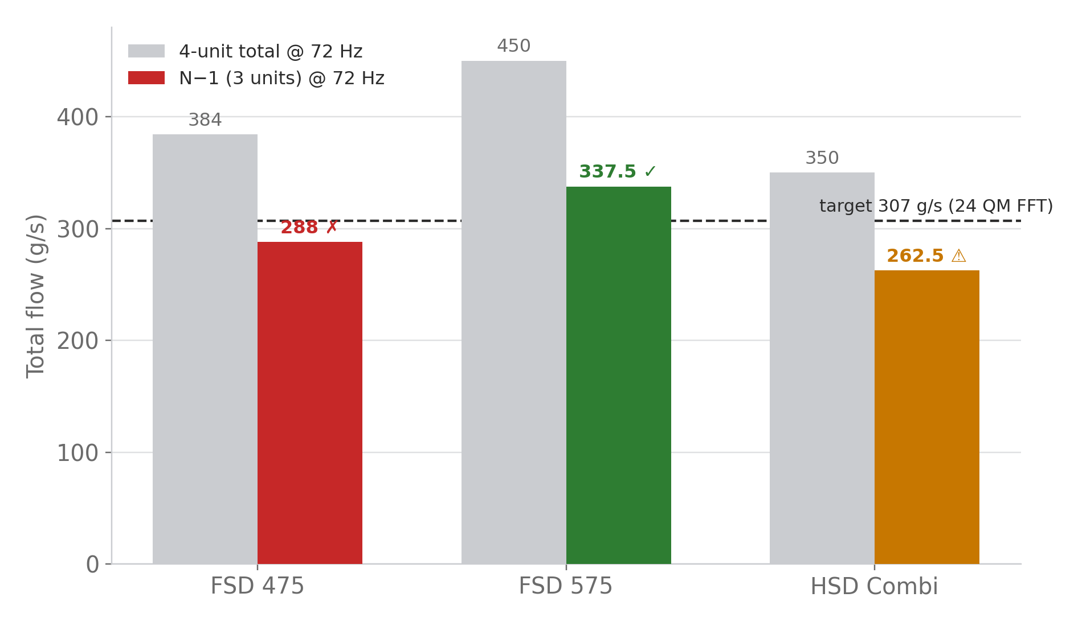
Total Flow and N−1 Snapshots
MEASURE
Fleet Comparison for 307 g/s Target
Target: 307 g/s total flow (24 QM, FFT operating mode).
FSD 575 is the only type whose N−1 case clears the target outright (+30 g/s margin).
FSD 475's N−1 shortfall (≈19 g/s) is covered by a 5 m³ liquid buffer (≈12 h repair window, Slide 18).
HSD Combi N−1 is marginal — usable only as a short-term check mode.
Notes:
Full baseline bullet text (verbatim), condensed on-slide for readability:
- FSD 475: 4 × @ 72 Hz = 384 g/s | N−1 (3 @ 72 Hz) = 288 g/s | ❌ short ≈ 19 g/s
- FSD 575: 4 × @ 72 Hz = 450 g/s | N−1 (3 @ 72 Hz) = 337.5 g/s | ✅ OK (+ 30 g/s margin)
- HSD Combi (2 Combis = 4 comp): 4 × @ 72 Hz = 350 g/s | N−1 = 262.5 g/s | ⚠ short for 307 g/s
- FSD‑475 N−1 insufficient → use liquid buffer (5 m³ tank, 0.4 m³/h descent rate = ≈ 12 h repair window)
- FSD‑575 N−1 covers 24 QM operation (≈ 307 g/s)

Slide 10
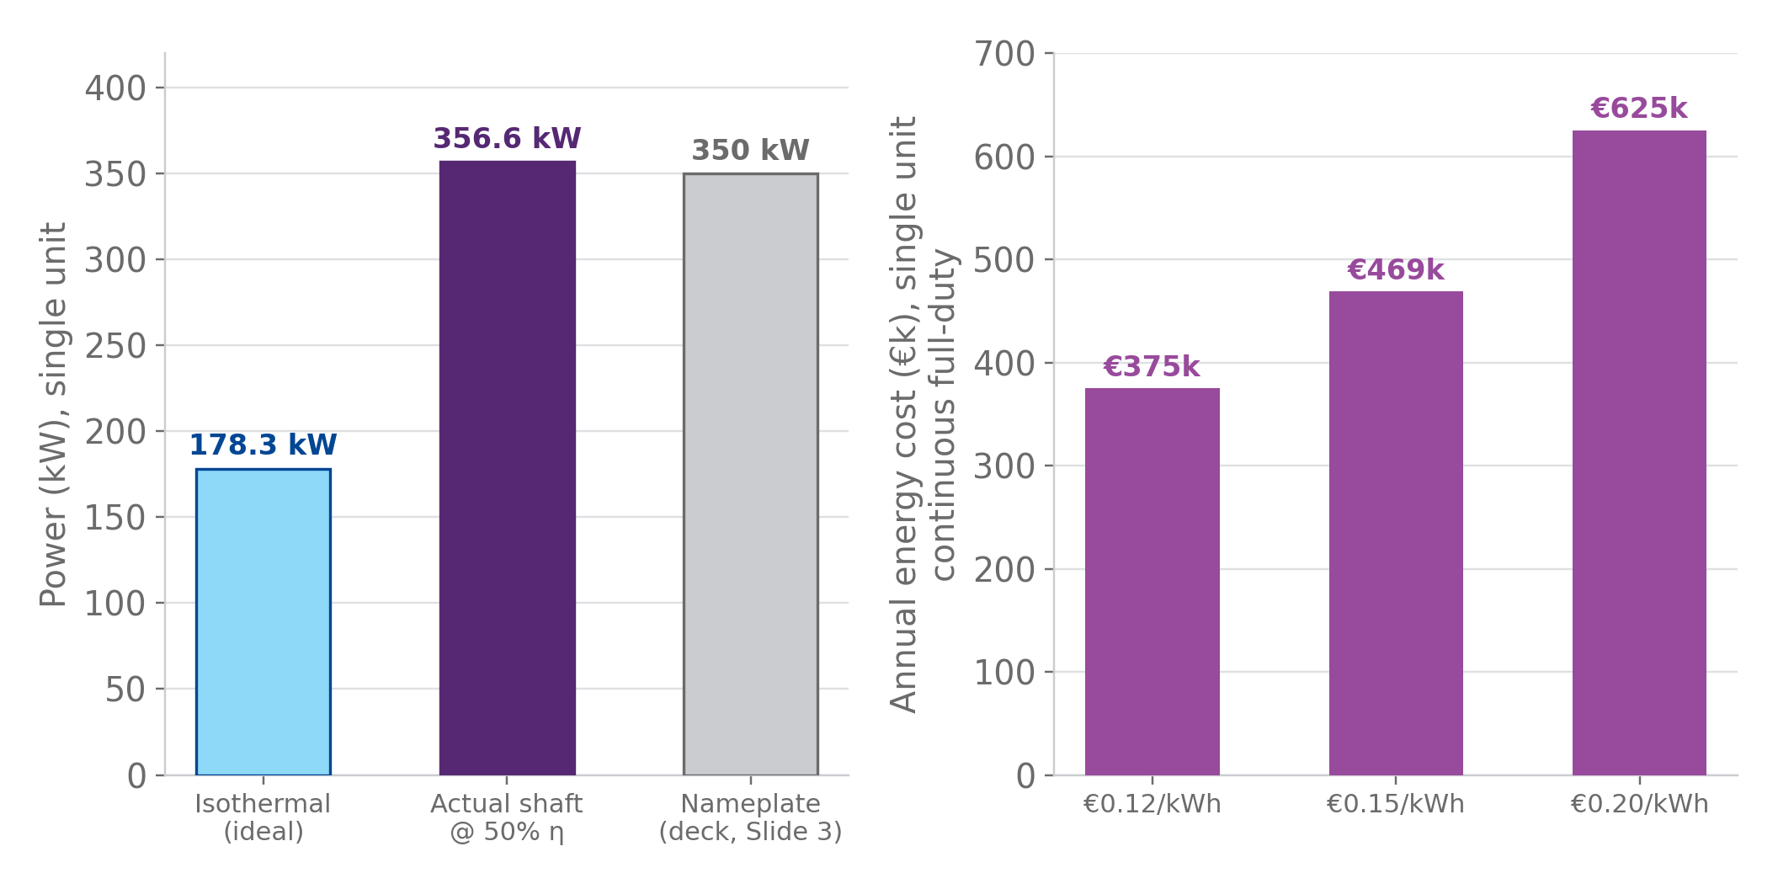
Unit Economics — Single HP Compressor
MEASURE
Isothermal Compression Power & Energy Cost (new — not in baseline)
Model
Isothermal compression, Ẇ = ṁ·R·T·ln(P₂/P₁) — the thermodynamic best case for a water-cooled, intercooled screw compressor.
Assumptions (flagged)
T=300 K inlet · P₂=14 bar(a) (Slide 6) · P₁≈1.1 bar(a) LP suction (assumed, not in RTMs) · η_isothermal=50% · helium, R=2077 J/(kg·K)
Flow point used
112.5 g/s = FSD 575 @ 72 Hz (Slide 8) — same per-unit number as the N−1 and Hz-requirement charts.
VFD & cooling note
Water-cooling keeps compression near-isothermal; VFD scales power ~linearly with flow, not cubically.
KEY TAKEAWAY The 50%-isothermal model, with a plausible 1.1 bar suction assumption, reproduces the deck's own 350 kW nameplate rating to within 2% — a useful sanity check on both numbers.
Notes:
This slide is new — it is not derived from a baseline slide. It fills a gap the deck's compressor sizing sections did not cover: what a single HP compressor actually costs to run. Isothermal compression is the correct idealisation for a water-cooled, intercooled screw machine (it is the thermodynamic lower bound on required work; real machines sit between isothermal and adiabatic depending on cooling effectiveness). The 50% isothermal efficiency figure is a reasonable planning assumption for this class of machine but should be confirmed against the OEM's actual performance curve. The suction pressure (1.1 bar) is not stated anywhere in the RTMs excerpted in this deck and is flagged as an assumption — sensitivity: 1.05-1.5 bar suction brackets 313-363 kW, i.e. the 350 kW nameplate sits comfortably inside that range. The energy-cost figures use illustrative tariff bands (€0.12-0.20/kWh); replace with the actual SCK CEN industrial electricity contract rate before using this for a budget submission. This slide's real purpose is to make the case, in Euros, for why the CONTROL section's predictable-replacement policy matters: running cost this large dwarfs a single overhaul, so keeping the compressor in its efficient operating window is itself worth money, independent of the reliability argument.

Slide 11
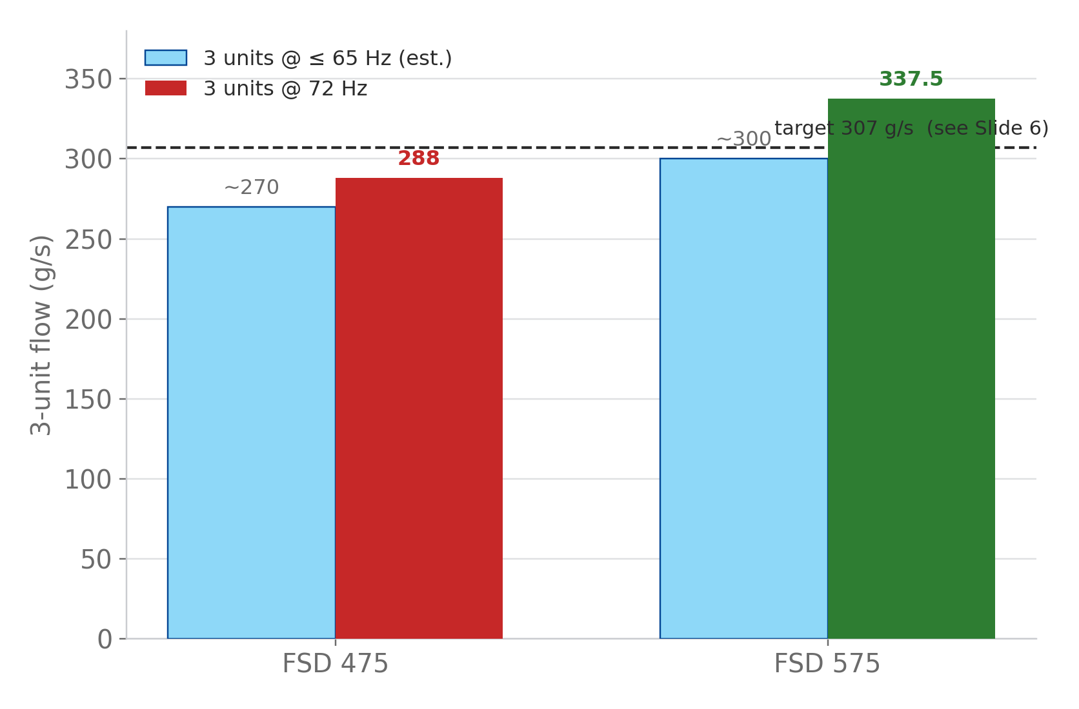
3-Only Envelope (Service / MTTR)
MEASURE
Flow vs Frequency, 3 Compressors Only
Same N−1 question as Slide 9, reframed as the live 3-compressor operating envelope.
FSD 575 clears 307 g/s at 72 Hz; FSD 475 does not.
At ≤ 65 Hz, 3-unit flow is marginal for both types but may meet target with buffer support.
Descent-rate check: 3-of-4 flow ≈ 0.4 m³/h → a 5 m³ buffer gives ≈ 12 h repair window (Slide 18).
Applicant shall simulate 2/3 and 3/4 flow cases (FRM/DBE loop analysis) and report restart capability.
Notes:
Full baseline bullet text (verbatim), condensed on-slide for readability:
- At 3 × FSD‑475 @ 72 Hz → 288 g/s (< target)
- At 3 × FSD‑575 @ 72 Hz → 337.5 g/s (≥ target)
- At 3 × ≤ 65 Hz → ≈ 270‑285 g/s → marginal but may meet with buffer
- Descent rate check: 3/4 flow → ≈ 0.4 m³/h; 5 m³ liquid gives ≈ 12 h repair window
- Applicant shall: simulate 2/3 and 3/4 flow cases (Fred/DBE loop analysis) and report restart capability

Slide 12
Acceptance & Test System
MEASURE
Test Objectives and Criteria
Four gated checks, run in sequence, before the plant is accepted for 24×2 K operation (SB and OP variants). Each step must pass before the next is credited.
1
72 Hz stress (per unit)
≥ 2 h continuous, no derate. Vibration / oil-temp / ΔT logged.
2
3-only envelope check
MTTR 8 h coverage; maintain 24 QM w/ FFT; flow + pressure trend recorded.
3
CIS / MCS exchange
Autonomy & data sync; RTM-330/331/332 pass; event logs + MTBF fields verified.
4
Recovery
Back to ≤ 60 Hz within ≤ 15 min post-upset; control loop verified.
Notes:
Applicant shall implement parametric scripts to estimate descent-rate and restart criteria with liquid inventory.
Full baseline text:
- 72 Hz Stress (per unit): Stability / no derate | ≥ 2 h continuous | Vibration, oil temp, ΔT log
- 3‑Only Envelope Check: MTTR 8 h coverage | Maintain 24 QM w/ FFT | Flow + P trend record
- CIS/MCS Exchange: Autonomy · data sync | RTM‑0237…0252 pass | Event logs + MTBF fields – to check and confirm since new numbers
- Recovery: Back to ≤ 60 Hz | ≤ 15 min post‑upset | Verified control loop
- Applicant shall implement parametric scripts to estimate descent‑rate and restart criteria with liquid inventory

Slide 13
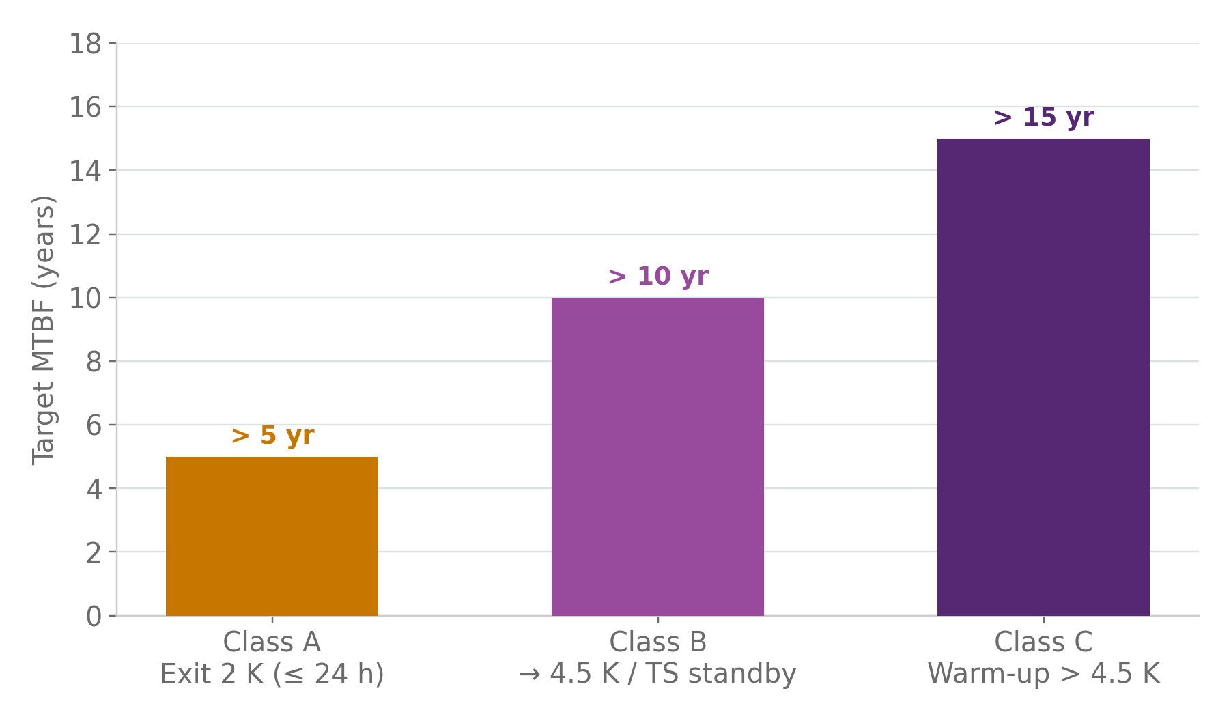
Reliability Targets and RAMI
DEFINE
MTBF Expectations and Maintenance Policy
MTBF targets scale with the consequence of the failure — Class A / B / C (defined Slide 19).
Planning assumption: rotary screw compressors run ≈ 40,000–80,000 h between major overhauls.
These targets are the input to the Poisson campaign-success model built in Slides 22–28.
Same three numbers are restated per failure-class in Slide 20 — same chart, different lens.
Applicant shall submit a RAMI dossier with component MTBFs, frequency bins, maintenance policy, and MTBF impact for ≥ 68 Hz operation.
Notes:
Full baseline bullet text (verbatim), condensed on-slide for readability:
- Unplanned transition out of 2 K: Target MTBF > 5 years (, minor recovery events)
- Transition to 4.5 K standby: Target MTBF > 10 years (, refrigerator‑backed)
- Warm‑up > 4.5 K: Target MTBF > 15 years (critical system event)
- Planning assumption: rotary screw compressors ≈ 40 000 – 80 000 h between major overhauls
- Applicant shall: submit RAMI dossier with component MTBFs, frequency bins, maintenance policy, and MTBF impact for ≥ 68 Hz operation

Slide 14
CIS Autonomy & MCS Exchange
DEFINE
Integration Requirements and Obligations
RTM-330 / 331 / 332
CIS Autonomy / MCS Exchange obligation (reconciled to canonical RTM-330/331/332, MCS Integration §4.6.5).
Applicant shall
Implement real-time linking of event IDs, Hz-band hours, and MTBF tracking per compressor.
Cross-references
Fig. 9, Addendum II §3.5.4, RTM-470 (VFD target ≤ 60 Hz nominal, per IEC 60034).
QPLANT compressors
CIS
MCS
event IDs · Hz-band hours · MTBF tracking, exchanged continuously in both directions
WHY IT MATTERS This live link is what makes Slide 13's MTBF dossier and the CONTROL section's governance loop possible — the data must flow before it can be tracked.
Notes:
Full baseline text:
- RTM 0237‑0252: CIS Autonomy / MCS Exchange (to check actual numbers again)
- 'In the offer …' Obligation: Verbatim text from Addendum II extracts
- Applicant Shall Elaboration: Implement real‑time linking of event IDs, Hz‑band hours, and MTBF tracking per compressor
- Cross‑References: Fig. 9, Addendum II § 3.5.4, RTM‑047 (VFD operation target nominal operation ≤ 65 Hz)

Slide 15
Utilities & Interfaces
DEFINE
Back-up (350 kW) and VFD HARMONICS
PAB12 & HV06
System Integration Points
Electrical
4 × 350 kW metered + aggregated log
Cooling Water
27→37°C (ΔT 10K) 42°C max (ΔT 15K, PS01)
Four utility interfaces size and constrain the compressor fleet's operating envelope used throughout this deck (Slides 8–18). Applicant shall design the mechanical & process tie-in kit. Control of PAB12 and HV06 flows and link to operational need of QPLANT (HCC specific) compressor fleet's operating envelope used throughout this deck (Slides 8–18). Applicant shall design the mechanical & process tie-in kit.
QPLANT
LHE USER + Return
Dewar+GHE recovery
Future WPS S, U, W
QRB provision pilot valve pads + IO stubs
WCS, WSH
Process Headers (INTERCONNECGà
14 bar supply setpoint VFD + trim valves
Future QDB 4.5K/2K Tie-in
QRB provision pilot valve pads + IO stubs
Notes:
Full baseline text:
- Electrical: 4 × 350 kW (metered + aggregated log feed)
- Cooling Water: 27 → 37 °C (Δ 10 K) | 42 °C max return (Δ 15 K for PS01) | Single loop header
- Process Headers: Maintain 14 bar supply setpoint | Controls via VFD + Trim valves
- Future 4.5 K / 2 K Vessel tie‑in: QRB provision | Pilot valve pads + IO stubs
- Applicant shall design mechanical & process tie‑in kit

Slide 16
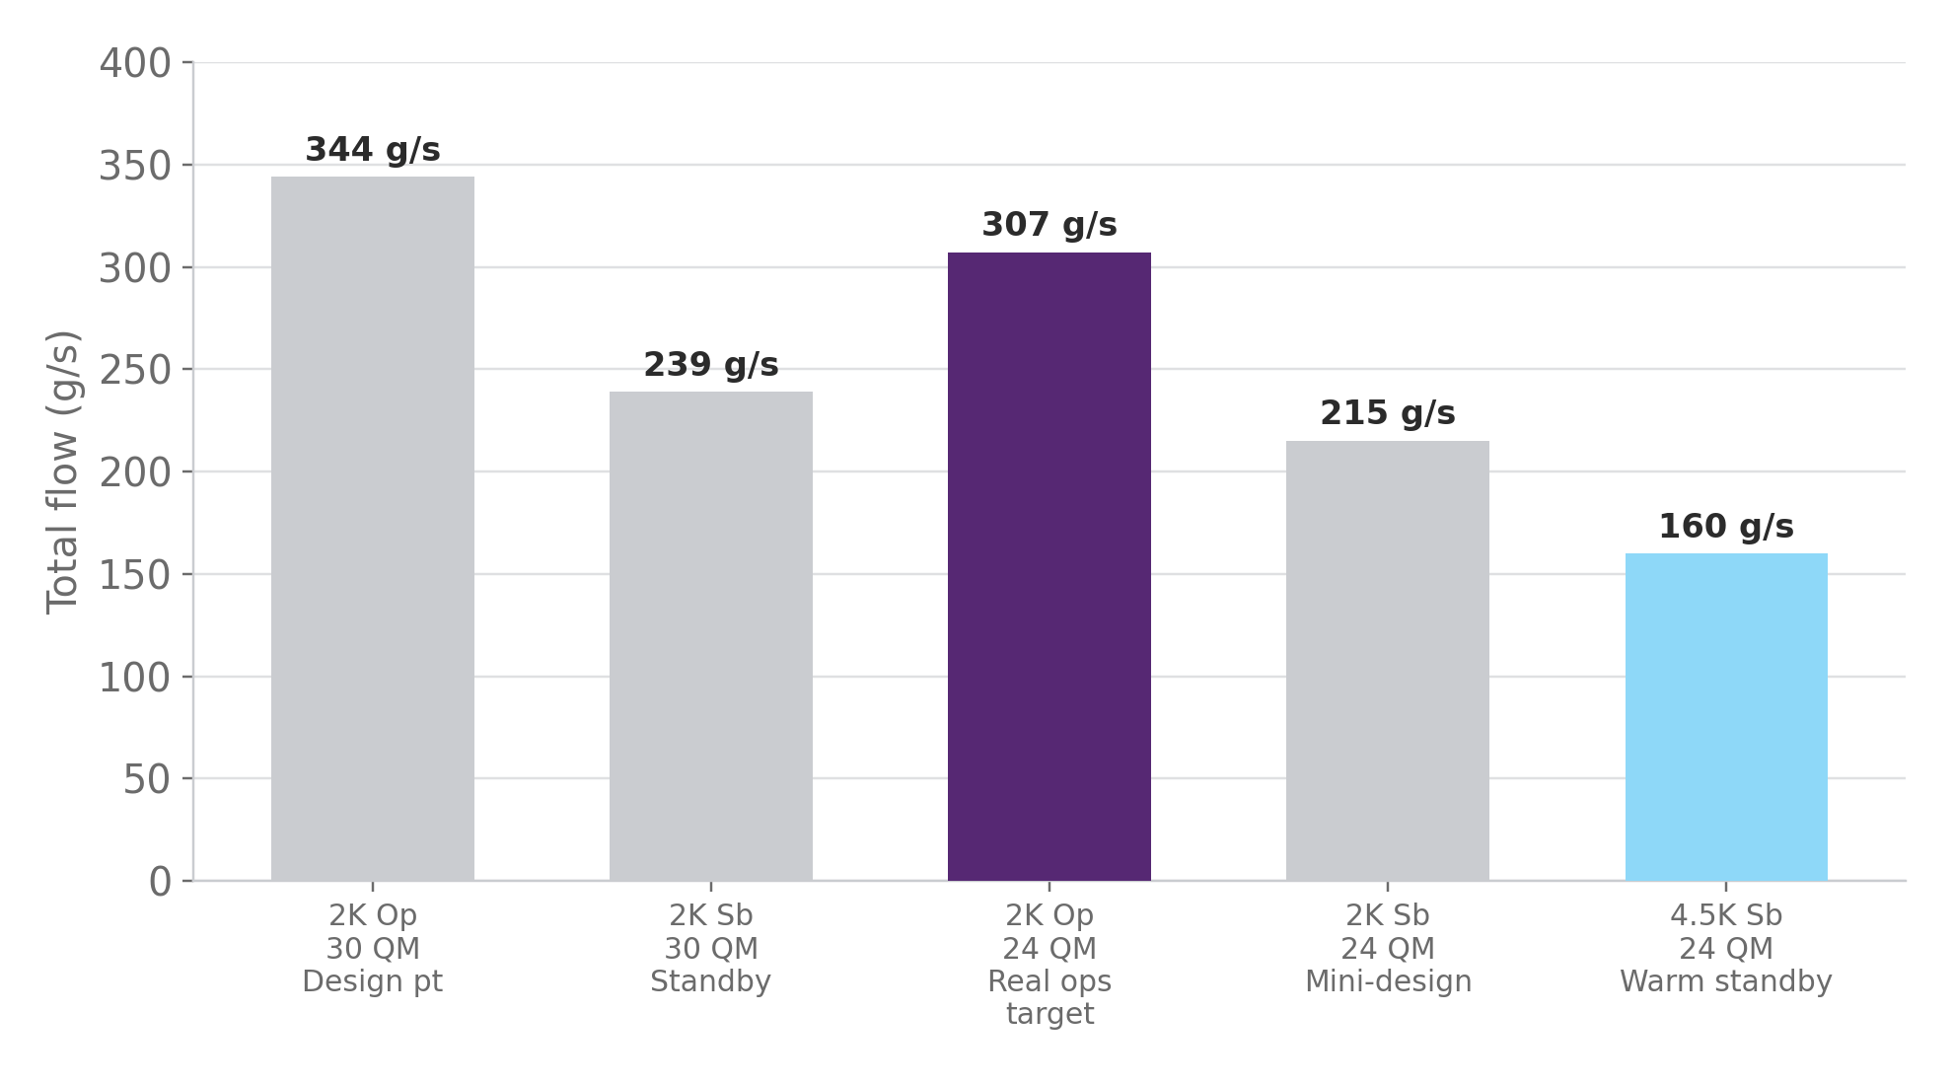
Appendix A — Canonical Scenarios
MEASURE
Cross-check Addendum II Table 3 and Fig. 6
Five canonical WCS HP-flow scenarios, cross-checked against Addendum II Table 3 / Fig. 6.
24 QM Operation (307 g/s) is the real operations target used throughout this deck.
30 QM Operation (344 g/s) is the design point — the margin above real operations.
Standby scenarios (both QM counts) size the fleet's low-flow / warm-standby envelope.
Notes:
Full baseline bullet text (verbatim), condensed on-slide for readability:
- 2 K Op 30 QM (margin): 900 W @ 2 K + 8600 W @ 40/60 K | 344 g/s | Design Pt
- 2 K Stdby 30 QM: 420 W @ 2 K + 6215 W @ 40/60 K | 239 g/s | Standby
- 2 K Op 24 QM (margin): 720 W @ 2 K + 7025 W @ 40/60 K | 307 g/s | Real Ops Target
- 2 K Stdby 24 QM: 340 W @ 2 K + 5100 W @ 40/60 K | 215 g/s | Mini‑Design
- 4.5 K Stdby 24 QM: 340 W @ 4.5 K + 5100 W @ 40/60 K | 160 g/s | | Warm Standby

Slide 17
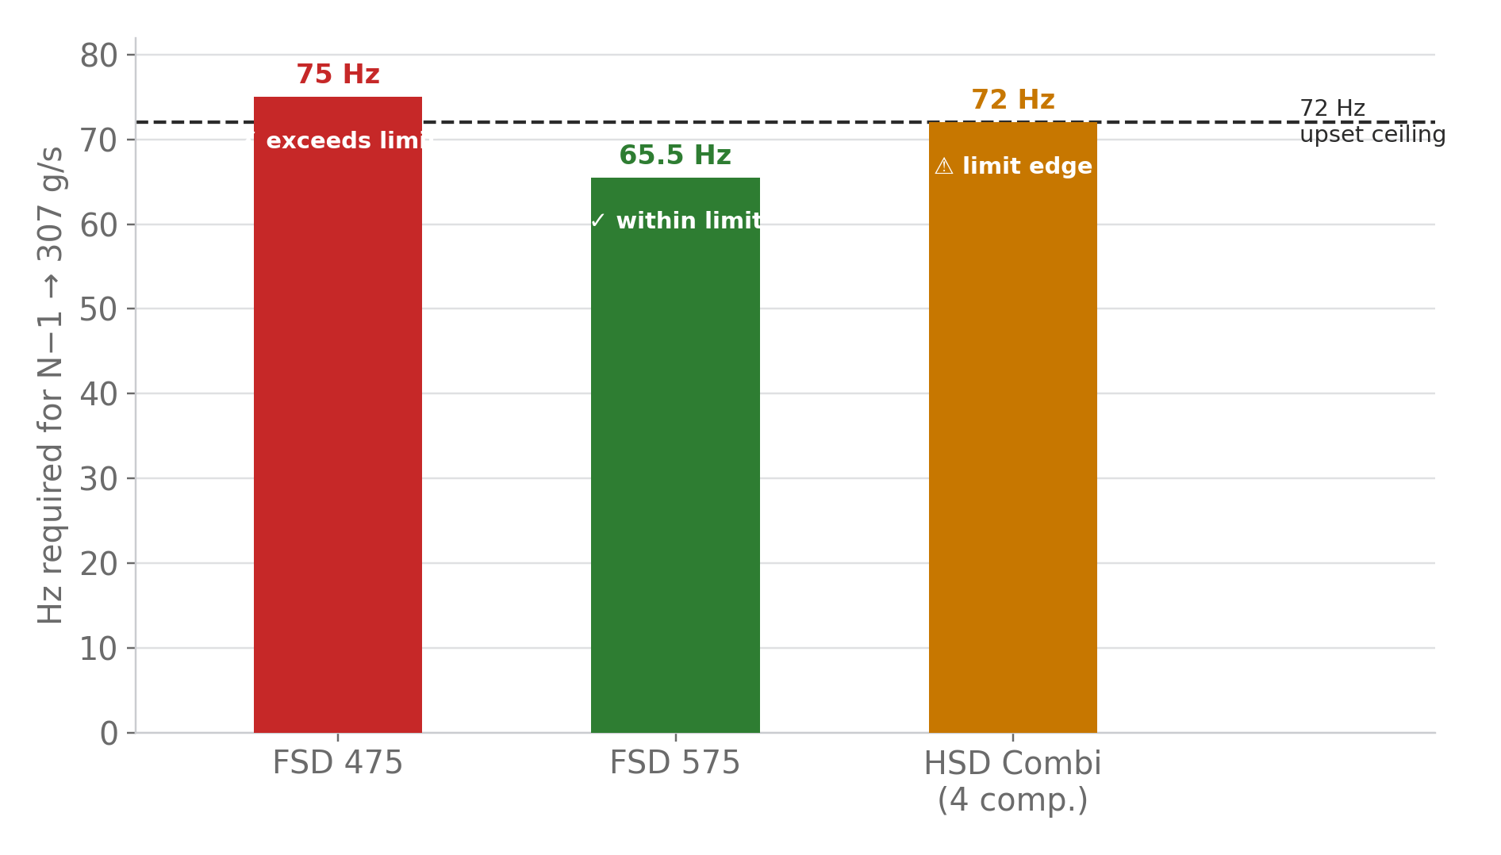
Appendix B — N−1 Hz Requirement
MEASURE
Hz to reach 307 g/s (N−1: 3 units)
Same N−1 question as Slides 9 and 11, now expressed as required frequency, not flow.
FSD 575 needs only ≈ 65–66 Hz — comfortably inside the ≤ 72 Hz upset ceiling (Slide 7).
FSD 475 needs ≈ 75 Hz — exceeds the limit outright; requires the liquid buffer or a 4th unit.
HSD Combi sits right at the 72 Hz edge — usable only as a short-term check mode.
Notes:
Full baseline bullet text (verbatim), condensed on-slide for readability:
- FSD‑475: Hz > 72 Hz (≈ 75 Hz est.) | ⚠ Exceeds limit | Requires buffer or extra unit
- FSD‑575: Hz ≈ 65–66 Hz | ✅ OK | Within limits · meets target
- HSD Combi (4 comp): Hz ≈ 72 Hz | ⚠ Limit edge | Use as short term check mode

Slide 18
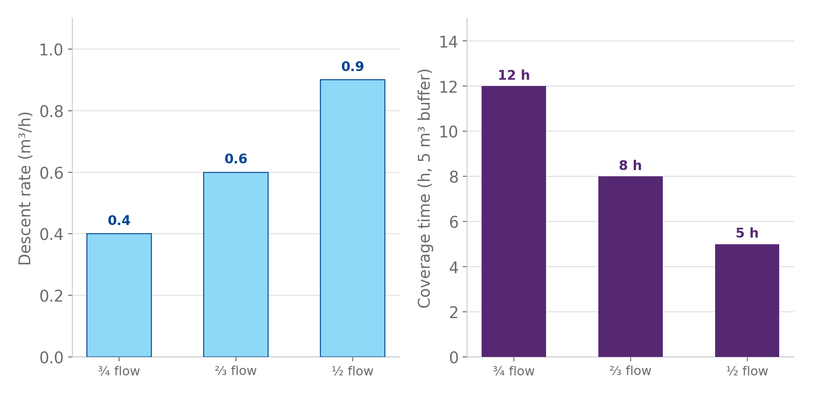
Appendix C — Liquid Buffer Coverage
MEASURE
Coverage Time Analysis
5 m³ liquid buffer converts an N−1 flow shortfall into a bounded repair window.
¾ nominal flow (the FSD 475 N−1 case, Slides 9/11): ≈ 12 h coverage before buffer depletion.
⅔ and ½ flow cases are progressively less forgiving — down to ≈ 5 h at half flow.
This coverage time is what sizes the acceptable MTTR in the acceptance-test criteria (Slide 12).
Applicant shall validate these loops (2/3, 3/4 nominal) and demonstrate restart criteria after flow recovery.
Notes:
Full baseline bullet text (verbatim), condensed on-slide for readability:
- ¾ flow (≈ 0.75× nom.): Descent‑Rate 0.4 m³/h | Buffer Volume 5 m³ | Coverage Time ≈ 12 h
- ⅔ flow: Descent‑Rate ≈ 0.6 m³/h (est.) | Buffer Volume 5 m³ | Coverage Time ≈ 8 h
- ½ flow (check): Descent‑Rate ≈ 0.9 m³/h (est.) | Buffer Volume 5 m³ | Coverage Time ≈ 5 h
- In the Offer the Applicant Shall:
- Applicant shall quantify and validate these loops (2/3 · 3/4 nominal) and submit as part of acceptance data package
- Demonstrate restart criteria after flow recovery and update control logic parameters

Slide 19
Failure Classification
DEFINE
RTM-061 — three consequence-based classes (Class A/B/C)
Class | Consequence
A | Exit from 2 K, recoverable ≤ 24 h
B | Transition to 4.5 K / TS standby
C | Warm-up > 4.5 K or > 24 h recovery
Every unplanned transition out of 2 K is classified by how far it falls and how long recovery takes — the classification alone doesn't set a number, it decides which MTBF target applies (Slide 20).
WHY IT MATTERS Class is assigned by consequence, not cause — a Class C warm-up from a sensor fault counts the same as one from a compressor failure. This keeps the MTBF budget honest.
Notes:
BSLN Slide 16 combined this table with the Reliability Targets content below it on one crowded slide (plus an unrelated leftover textbox duplicated from the Operational Philosophy slide, removed here as dead content). Split for readability — targets now on Slide 21.
Full baseline table:
- Class A: Exit from 2 K, recoverable ≤ 24 h
- Class B: Transition to 4.5 K / TS standby
- Class C: Warm-up > 4.5 K or > 24 h recovery

Slide 20
Reliability Targets by Failure Class
DEFINE
Same three classes as Slide 19 — MTBF target per consequence tier
MTBF requirements scale with severity of consequence
Applies to aggregated QPLANT contribution
Prevents trading rare catastrophic events against frequent minor ones
Target values (> 5 / > 10 / > 15 years) are read directly off the chart, right →
CROSS-CHECK These are the same three numbers Slide 13 feeds into the Poisson campaign-success model (Slides 22–28) — defined once here, used twice.
Same chart, different lens — first shown on Slide 13
Notes:
Second half of BSLN Slide 16 (see Slide 20's notes for the split rationale).
Full baseline text:
- MTBF requirements scale with severity of consequence
- Applies to aggregated QPLANT contribution
- Prevents trading rare catastrophic events against frequent minor ones
- Class A: > 5 years
- Class B: > 10 years
- Class C: > 15 years

Slide 21
Operational Philosophy: Cold ≠ Off
DEFINE
QPLANT is expected to operate continuously — nominal and standby modes are both valid operating states.
Standby ≠ unavailability. Warm Stop is the last resort, not a routine state.
2K-OP
Nominal
2K-SB
Standby, valid
4.5K-SB
Reduced avail.
TS-SB
Warm standby
WS
Last resort
READING THIS DIAGRAM Preferred hierarchy runs left → right. Every step right of 2K-OP is a deliberate, monitored trade-down — not a failure — until Warm Stop, which is.

Slide 22
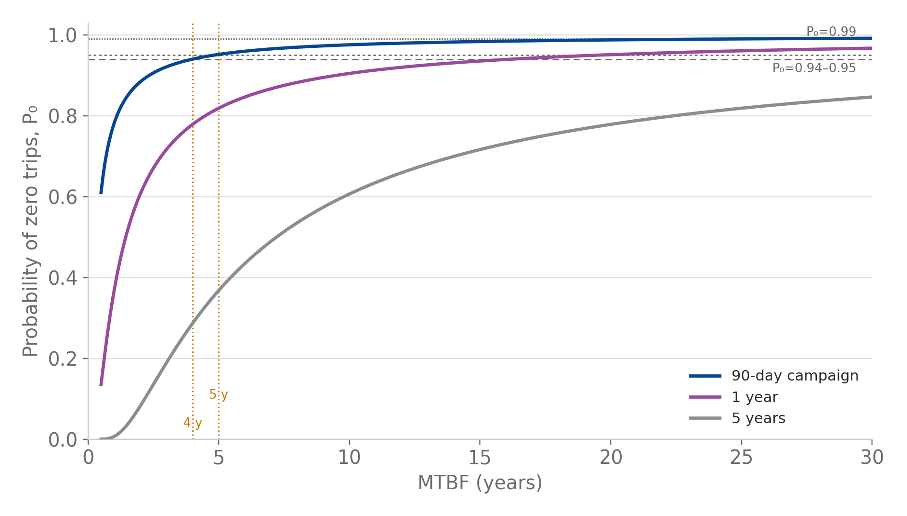
Appendix D (1/2) — Poisson Reliability Model
ANALYZE
Methodology behind every campaign-success number in this compendium
The model
Failures are modeled as a Poisson process with constant rate λ (events/year) — equivalent to assuming a constant hazard rate, i.e., MTBF = 1/λ.
What the chart shows
P₀ = probability of zero trips within a time window, as MTBF varies. Three windows are plotted: the 90-day campaign (the operational requirement), 1 year, and 5 years (long-term intuition check).
Formula
P(N=0) = e^(−λt), with t in years and λ = 1 / MTBF.
WHERE THIS GETS USED Appendix D (2/2) applies this to three specific cases; Appendix F uses it to derive a RTM-062-based 0.26 events/year limit; Appendix I applies the same logic with a Weibull (age-dependent) hazard instead of a constant one.
Notes:
This slide replaces 5 near-identical Poisson-curve screenshots from the original working deck (all plotting the same P0=e^-lambda*t relationship with progressively more annotation layered on) with one clean chart and the underlying formula stated once. Full original chart axis/curve legend: X-axis = trips per year (lambda), the Poisson event rate, equivalent to MTBF = 1/lambda. Y-axis = probability of zero trips over a given time window. Curves = 90-day campaign (physics continuity requirement), 1 year (operational intuition), 5 years (long-term cold-operation intuition). All curves follow P(N=0) = exp(-lambda*t).

Slide 23
Appendix D (2/2) — Worked Examples
ANALYZE
Three specific readings of the same P(N=0) = e^(−λt) relationship
Why three examples
The same curve answers three different questions this compendium must settle: what does the fleet realistically deliver, what does the contract require, and where does a naive reading of the requirement break down.
1 — REALISTIC CASE CC + PVPS single-train, λ ≈ 0.25/yr (MTBF ≈ 4 y): 90-day P₀ ≈ 94%, 1-year ≈ 78%, 5-year ≈ 29%. Consistent with MTBF ≈ 4 y and “good but not magical” reliability — see Appendix I for where this number comes from.
2 — CONTRACTUAL CASE Class-A target MTBF = 5 y (λ = 0.20/yr): 90-day P₀ ≈ 95% (RTM-062 compliant), 1-year ≈ 82%, 5-year ≈ 37%. This is the number RTM-062 (Appendix F) is built on.
3 — A COMMON MISREADING Reading “≥99% success” as a literal requirement over the full mission window (not per 90-day campaign) implies MTBF ≈ 387 years — impossible for a single-train cryoplant. This is why the RTM-062-derived cap is written as an annual event-rate limit, not a lifetime success probability.
Notes:
Consolidates three separate worked-example screenshots from the original working deck (the CC+PVPS realistic case, the contractual Class-A case, and the '100 occurrences' / '99% over 90 days' literal-reading walkthrough) into three compact takeaway boxes. Full original derivation for example 3: mission time ~46.7 months = ~34,090 hours; setting P(>=1 failure) = 1% over that window and solving for MTBF gives ~3.39 million hours (~387 years) -- confirming that a literal 99%-over-full-window reading is not the intended requirement, which is why RTM-05 (Appendix F) instead caps the annual SAE rate.

Slide 24
Appendix E — Maintenance Activity Matrix
ANALYZE
What's permitted in each operating state (states defined on Slide 21)
Same five states as the Slide 21 chevron diagram and the Slide 19 failure-consequence classes — this table is what makes those states operationally concrete.
Maintenance activity | 2K-OP | 2K-SB | 4.5K-SB | TS-SB | WS | Notes
Monitoring / diagnostics | ✓ | ✓ | ✓ | ✓ | ✓ | No operational impact
Software / control updates (non-intrusive) | ⚠ | ✓ | ✓ | ✓ | ✓ | With rollback + MOC
Instrument checks (non-isolating) | ⚠ | ✓ | ✓ | ✓ | ✓ | No venting or isolation
Helium inventory adjustment | ⚠ | ✓ | ✓ | ✓ | ✓ | No pressure excursion
Partial valve tests | ⚠ | ✓ | ✓ | ✓ | ✓ | Proven transient envelope
Rotating machinery minor service | ✕ | ⚠ | ✓ | ✓ | ✓ | Depends on redundancy
Cold compressor interventions | ✕ | ✕ | ⚠ | ✕ | ✓ | Below TS temperature
Cryogenic valve intrusive work | ✕ | ✕ | ⚠ | ✕ | ✓ | Boundary opening
Safety valve / pressure tests | ✕ | ✕ | ✕ | ✕ | ✓ | Warm Stop only
Cryostat / cold box opening | ✕ | ✕ | ✕ | ✕ | ✓ | Warm Stop only
✓ permitted ⚠ conditional ✕ not permitted
Notes:
Recreated as an editable table from the original screenshot (same data, unchanged). Legend: check = permitted, triangle = conditional (see Notes column), cross = not permitted. Columns are the same five operating states as the Slide 19 diagram: 2K-OP (nominal), 2K-SB (standby, valid), 4.5K-SB (reduced availability), TS-SB (warm standby), WS (Warm Stop, last resort).

Slide 25
Appendix F — Deriving the SAE Frequency Limit
ANALYZE
How the 90-day continuity requirement (RTM-062) becomes the annual SAE rate cap
1. Continuity requirement
QPLANT shall support ≥ 90 consecutive days at 2 K, with no unplanned operational-state transition — the user-relevant continuity metric.
2. Model it as Poisson
Class-A Service-Affecting Events (SAE) are modeled as a Poisson process, constant rate λ. For a 90-day window, t = 90/365 = 0.2466 y, and P(zero SAE) = e^(−λt) (Appendix D).
3. Invert for the rate cap
Requiring P(zero SAE) ≥ 0.95 over 90 days gives λ ≤ −ln(0.95)/0.2466 ≈ 0.208 SAE/year, i.e. MTBF_A ≥ 4.8 years — not an unrealistic number, once read correctly.
4. Duty-factor conversion
SAE statistics are gathered during active 2 K time. For the nominal duty factor d = 9/14, calendar time = active 2 K time / d — this is how a per-active-time rate becomes a calendar-year rate.
A COMMON MISREADING Reading the success target as ≤1% failure probability over the entire multi-year mission (not per 90-day campaign) implies MTBF ≈ 387 years — see Appendix D (2/2), example 3. This RTM-062-derived cap is deliberately written as an annual rate, not a lifetime probability.
DERIVED CAP (from RTM-062) The QPLANT design shall limit the frequency of Service-Affecting Events (SAE) attributable to QPLANT — unplanned transitions out of 2 K Operation — to λ_SAE ≤ 0.26 events per calendar year, averaged over representative operating periods. ≈ one SAE every 46.7 calendar months.
ANNEX X — METHOD Compliance is assessed with the same Poisson event-rate model (Appendix D), applied to the declared operational duty cycle. Worked check: λ ≈ 12/46.7 ≈ 0.257 SAE/yr → P(N=0, 90 d) ≈ e^(−0.257×0.2466) ≈ 0.94 — satisfies the RTM-062-derived cap.
Notes:
Condenses 6 screenshot-heavy slides from the original working deck (the '100 occurrences' scratch derivation, the 'Wrong' literal-reading demonstration, the 'Better' consistency-rule derivation, the RTM-05 text -- repeated 3 times in the original -- and Annex X) into one slide with the logical chain plus the two normative end-states. No numbers were changed: RTM-05's 0.26 events/calendar-year cap, the ~4.8-year equivalent MTBF, the 9/14 duty factor, and the Annex X worked check (lambda ~0.257/yr, P0~94%) all match the original document verbatim.

Slide 26
Appendix G — Component Reliability Reference
ANALYZE
MTBF / MTTR by component, from CERN feedback and published literature
Equipment | MTBF (h) | Source | Warm-up (h) | MTTR (h) | Recover (h) | MDT (h) | MTTR comment
Oil screw compressors | 333,450 | CERN + other projects | 0 | 20 | 6 | 26 | Bare compressor available
Turbines | 150,000 | REx AL-AT | 0 | 8 | 3 | 11 | Spare cartridge available
Cold compressors | 105,000 | REx AL-AT | 0 | 8 | 3 | 11 | Spare cartridge available
Control / on-off valves | 824,487 | [1] CERN | 0 | 3 | 3 | 6 | Spare part kits available
Cryovalves (positioner only) | 2,298,333 | [1] CERN | 0 | 3 | 3 | 6 | Spare part kits available
Cryovalves (tightness + positioner) | 482,927 | [1] CERN | 12 | 3 | 12 | 27 | Spare part kits available
Pressure sensors | 2,035,667 | [1] CERN | 0 | 2 | 2 | 4 | Spare transmitters available
Temperature sensors | 1,250,000 | EIReDA 98, p.239 | 0 | 2 | 2 | 4 | Spare transmitter available
[1] CERN — "First assessment of reliability data for the LHC accelerator and detector cryogenic system components", Perinić et al. Impurities analyzers and the vacuum system are not listed: not impacting cryo availability.
WHERE THESE NUMBERS FEED IN Oil screw compressor MTBF drives the Case File on Slide 32; cold compressor MTBF drives the cold-compressor-train calculation on Appendix I; turbine MTBF is cross-checked against OEM data on Appendix H.
Notes:
Recreated as an editable table from a screenshot of the original source table (all values unchanged). This is the base reference table — component MTBF/MTTR figures used everywhere else in this compendium trace back to this table.

Slide 27
Appendix H — Turbine OEM & Contractor Data
ANALYZE
Linde Kryotechnik TED-series field data, and a check against Contractor A's claim
Linde Kryotechnik AG field data, TED-series turbines in operation 2009–2019 (improved-design cartridges only) — cross-checks the 150,000-h turbine planning figure used on Appendix G.
Contractor A's claim
≥96% availability with maintenance intervals after 8,400 operating hours (1 year). Planned time 8,400 h/yr ⇒ allowed unavailability = 4% = 336 h/yr ≈ 14 days/yr.
This deck's RTM-062-derived figure
If read as 99% over 8,000 h: allowed unavailability = 1% = 80 h/yr ≈ 3.3 days/yr — about 4× stricter than Contractor A's figure, and stricter still against a full 8,760 h year.
Turbine type | In service since 2009 | Operating hours | Damages (turbine-related) | MTBF (h)
TED16 | 182 | 3,876,000 | 11 | 352,364
TED22 | 94 | 1,797,000 | 6 | 299,500
TED32 | 23 | 1,050,000 | 2 | 525,000
TED45 | 21 | 833,000 | 1 | 833,000
MTTR by spare-cartridge exchange: 2–3 h. By express repair at manufacturer site: 2 weeks. By standard repair at manufacturer site: 4 weeks (all four types).
READING THIS RIGHT The gap isn't a contradiction — it means this RTM-062-derived figure should be read either with a lower annual % target, a reduced planned-time basis, or (the best fit with what users feel) moderate annual availability paired with a stringent 2 K campaign-success requirement (Appendix F).
Notes:
Recreated as editable tables/text from Linde Kryotechnik AG document screenshots and the original 'Contrast with Contractor A' analysis (all figures unchanged). The comparison is presented as a reading-clarification, not a contradiction, per instruction to not let appendix content contradict the rest of the deck.

Slide 28
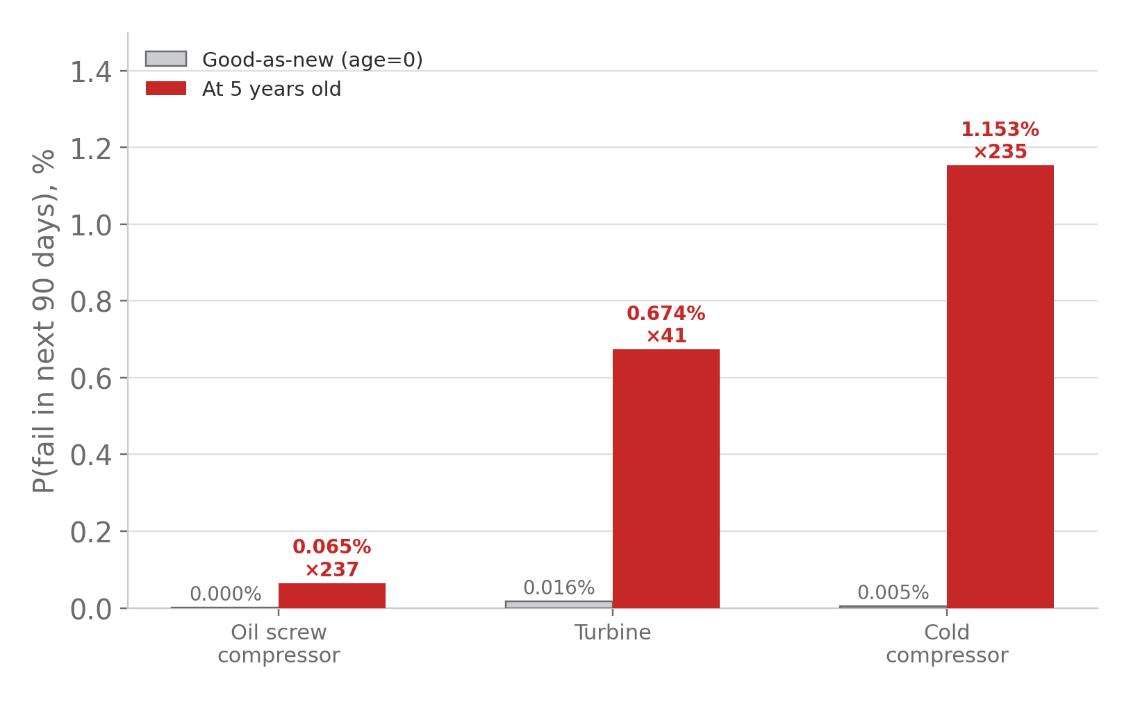
Appendix I — RCM/Weibull Applied: Cold-Compressor Train
ANALYZE
The worked example behind Slide 31's wear-out argument and Roadmap 2/3's sample calc
The system
3 cold compressors in series, no redundancy — losing one means the plant cannot maintain 27 mbar. A pure series system: λ_train = 3 × λ_stage.
Train MTBF
Single-stage MTBF = 105,000 h (Appendix G) ⇒ MTBF_train = 105,000 / 3 ≈ 35,000 h ≈ 4.0 years — the number used for Class A failure frequency and RTM-062 aggregation.
Why Weibull, not just MTBF
Slide 31 explains the general relation h(t) = (β/η)·(t/η)^(β−1): whenever β > 1, hazard rises with age. The table (right) applies it to real components instead of restating the formula.
Equipment | Weibull (β, η) | P(fail 90d) good-as-new | P(fail 90d) at age 5y | Increase
Oil screw compressor | β=2.5, η≈363,300 h | 2.7×10⁻⁶ (0.00027%) | 6.45×10⁻⁴ (0.0645%) | ×237
Turbine | β=2.0, η≈169,300 h | 1.63×10⁻⁴ (0.0163%) | 6.74×10⁻³ (0.674%) | ×41
Cold compressor | β=2.5, η≈114,400 h | 4.90×10⁻⁵ (0.0049%) | 1.15×10⁻² (1.153%) | ×235
MTBF_CC-TRAIN ≈ 35,000 h ≈ 4.0 y This is the correct number for Class A failure frequency and the RTM-062 90-day campaign probability — not the single-compressor 105,000 h figure.
Notes:
Consolidates two slides from the original working deck (the cold-compressor-train series calculation and the Weibull 'fresh vs 5-years-old' results table, which was duplicated across two slides in the original) into one. All figures unchanged. Interpretation unchanged: if the 90-day 2 K run starts right after a good-as-new overhaul, the wear-out contribution is tiny; if it starts at the end of the 5-year interval, the risk is dramatically higher, especially for beta=2.5 assets.

Slide 29
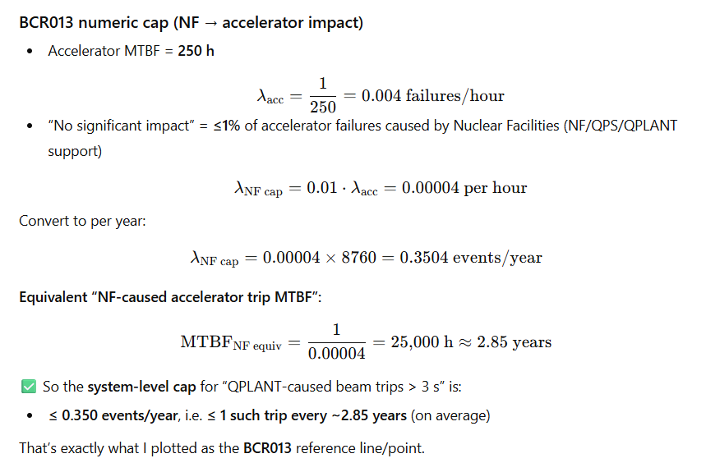
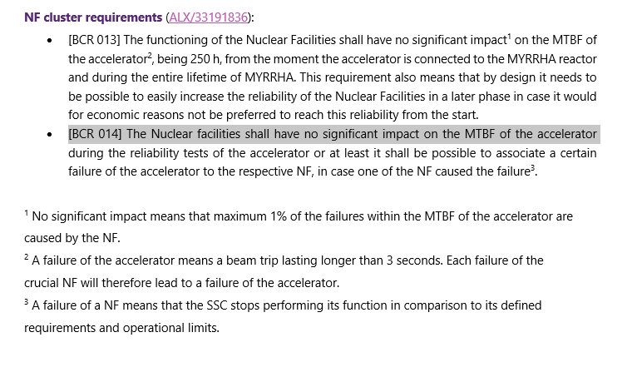
Why MTBF Matters
IMPROVE
Every number in this deck — the 5-year Class A target, the N−1 margins, the 94–95% campaign ceiling — reduces to one shared quantity: Mean Time Between Failures.
The BCR013 derivation opposite shows that budget in its rawest form: the accelerator's own 250 h MTBF caps how much unreliability QCELL/QPS/NF may add.
KEY TAKEAWAY MTBF is a shared 0.35-events/year budget, not a component property — every claim later in this deck draws on the same account.

Slide 30
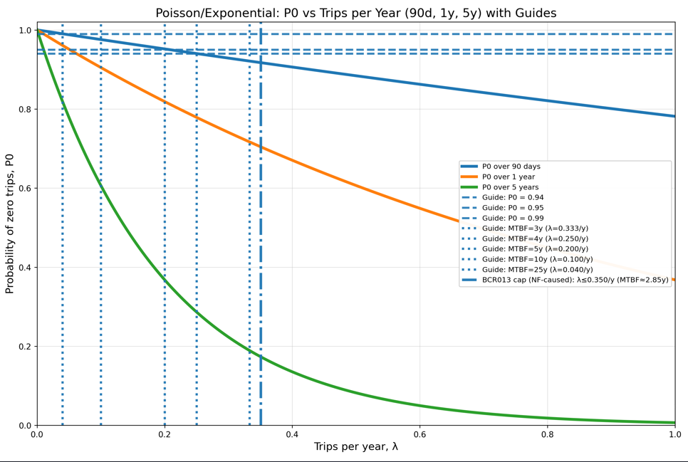
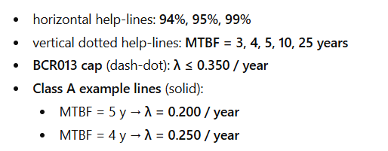
The Hidden Assumption
IMPROVE
MTBF only means what we want it to mean if failures arrive at random, at a constant rate — the Poisson/exponential assumption used throughout the ANALYZE section (Slides 22–28). Under that assumption, a component with MTBF = 5 years is exactly as likely to fail in month one as in month fifty.
That is a convenient mathematical fiction, not a description of real machinery. It holds well for random, external trips — it says nothing about wear. The chart opposite is the same Poisson relationship, one more time, as a reminder that everything to its left was built on a flat hazard rate.
KEY TAKEAWAY A single MTBF number silently assumes “no aging.” The next slides show why that assumption has an expiry date.

Slide 31
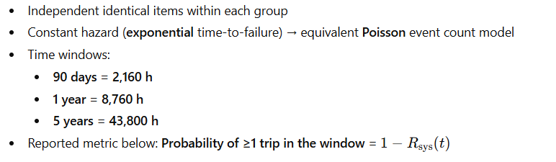
When MTBF Lies — the Wear-Out Boundary
IMPROVE
Assumptions
Appendix I's (Slide 28) RCM/Weibull relation, h(t) = (β/η)·(t/η)^(β−1), makes the limit explicit: whenever β > 1, hazard rate rises with age, and a single constant MTBF understates real short-term risk near end-of-life. Appendix I's worked example shows the effect is not small: for a β = 2.5 asset (oil screw / cold compressor), the chance of failing in the next 90 days after 5 years in service is 200–240× higher than the same 90 days right after a good-as-new overhaul.
KEY TAKEAWAY MTBF governs the plant's average reliability budget. Weibull shape (β) governs whether any one unit is quietly approaching a cliff.

Slide 32
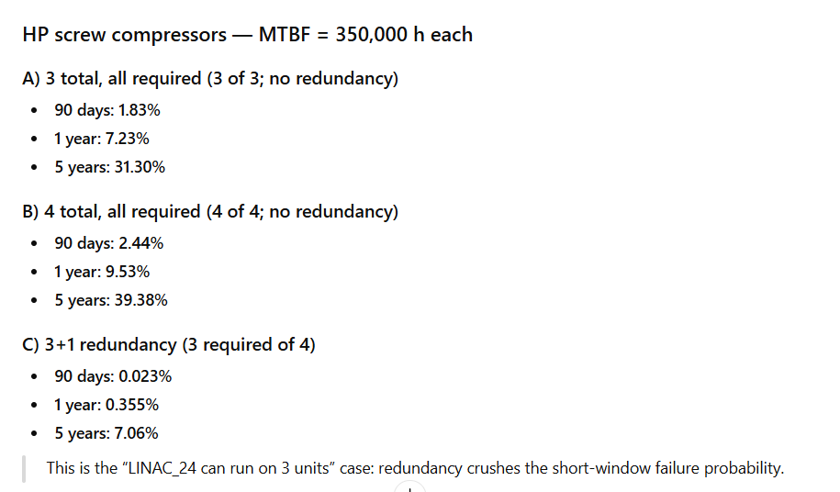
Case File: HP Compressors
IMPROVE
The HP screw compressors carry an assumed 350,000 h MTBF
— long enough that, under the Poisson model, a bare 3-of-3 no-redundancy train still clears 90 days with 98.2% probability. That number is comforting only while the compressors stay inside their flat-hazard useful-life window.
Screw compressors wear through bearings, seals and rotor packages on a calendar/duty-cycle clock that the Poisson model on the page knows nothing about.
The 3+1 redundancy case (right) does not just buy short-window margin — it buys the time needed to pull a unit for scheduled service before it enters its own wear-out region.
KEY TAKEAWAY Redundancy here is not only insurance against random failure — it is the maintenance window that makes predictable replacement possible.

Slide 33
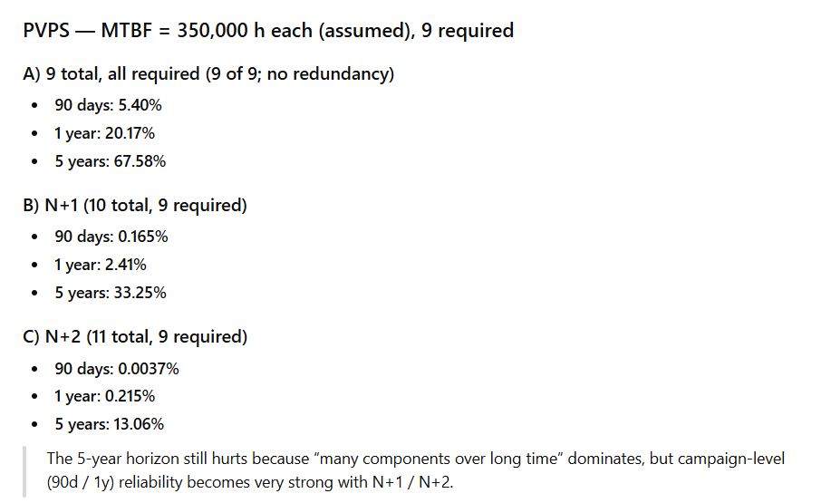
Case File: PVPS
IMPROVE
PVPS multiplies the same logic across (up to) nine parallel units. At 9-of-9 with no spare, the 5-year probability of at least one trip is 67.6%
— not because any single pump is unreliable, but because unreliability compounds as fleet size grows.
N+1 and N+2 sparing claw back the 90-day and 1-year numbers dramatically, but the 5-year figure stays stubborn (13–33%):
over long horizons, “more components” re-introduces the wear-out problem this section is about. Sparing buys statistical margin against random failure — it does not buy the fleet time out of its wear-out clock.
KEY TAKEAWAY For a 9-unit fleet, the honest 5-year reliability number is a scheduling problem, not just a redundancy problem.

Slide 34
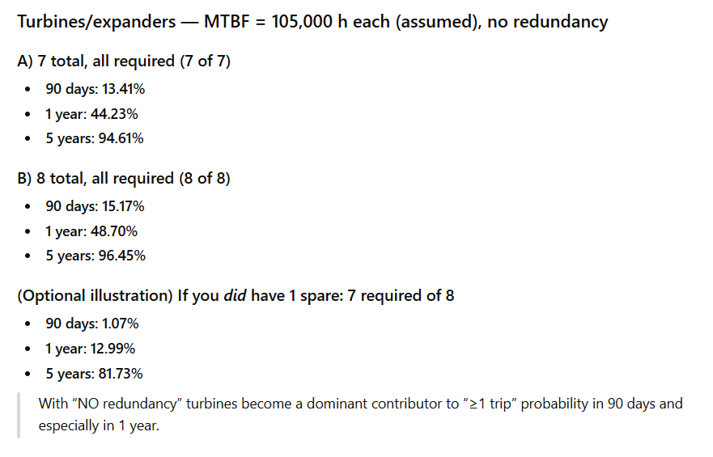
Case File: Turbines — Nowhere to Hide
IMPROVE
Turbines are the clearest case in this compendium for why MTBF-only thinking runs out. There is no credible spare position: cooling topology fixes each turbine's location in the cold-box train, so a “redundant” unit is not interchangeable the way a compressor is.
With 7-of-7 required and a 105,000 h assumed MTBF, the 5-year no-trip probability is already down to 94.6%; adding an 8th unit barely moves it. A fleet this exposed cannot be managed by waiting for an MTBF-driven alarm — it has to be managed by knowing, ahead of time, which unit is closest to end of usable life.
MTBF values indicative – since different values for type of turbine Spare, redundant NOT possible – since position of trips dictates the cooling – where would the spare be? >80 K stage – 2 to 3 turbines < 80 K stage – 4-5 turbines
KEY TAKEAWAY No spare position + no redundancy = the fleet where predictable, age-based replacement matters most, not least.

Slide 35
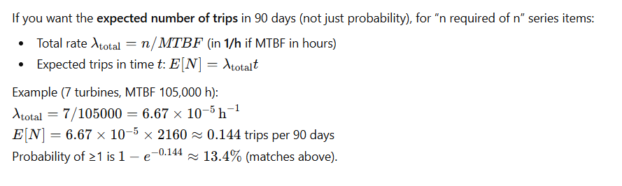
The Turn: From Predicting Failure to Preventing It
CONTROL
Every slide so far has used MTBF exactly as designed: to predict how often a well-behaved, randomly-failing fleet will trip. That is the right tool for budget-setting, architecture trade-offs, and acceptance testing.
It is the wrong tool for one aging turbine, compressor or PVPS unit that has quietly moved from the flat part of the bathtub curve onto the rising one. Once wear-out dominates — as the three case files above all confirm it eventually does — the right question stops being “what's the MTBF” and becomes “how much usable life is left, and when do we act.” That is the shift from reliability prediction to reliability control.
MTBF values indicative – since different values for type of turbine Spare, redundant NOT really possible – since position of trips dictates the cooling – where would the spare be? >80 K stage – 2 to 3 turbines < 80 K stage – 4-5 turbines
KEY TAKEAWAY MTBF tells you the odds. It does not tell you when to intervene — the remaining slides answer that question.

Slide 36
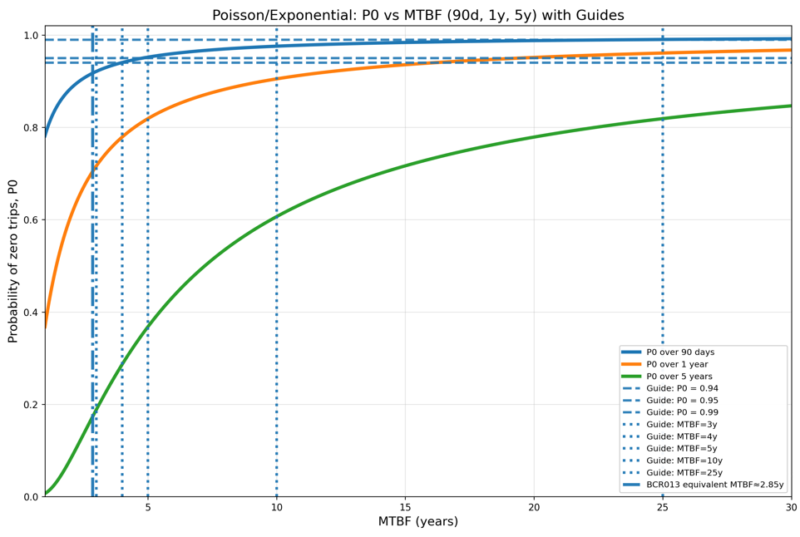
Predictable Service Replacement
CONTROL
The control response to a rising hazard rate is not a better MTBF estimate — it is a scheduled intervention set before the wear-out region is reached, sized from each component's Weibull characteristic life (η) rather than its long-run MTBF.
In practice: set overhaul/replacement intervals at a fraction of η (tightened further for Class B/C consequence items); track operating hours and Hz-band exposure per unit — data this deck already mandates the Applicant to log; and treat “still running at 340,000 hours” as a maintenance trigger, not a reliability success story.
KEY TAKEAWAY A predictable replacement interval is a Weibull-based deadline set before the hazard curve turns upward — not a reaction to it.

Slide 37
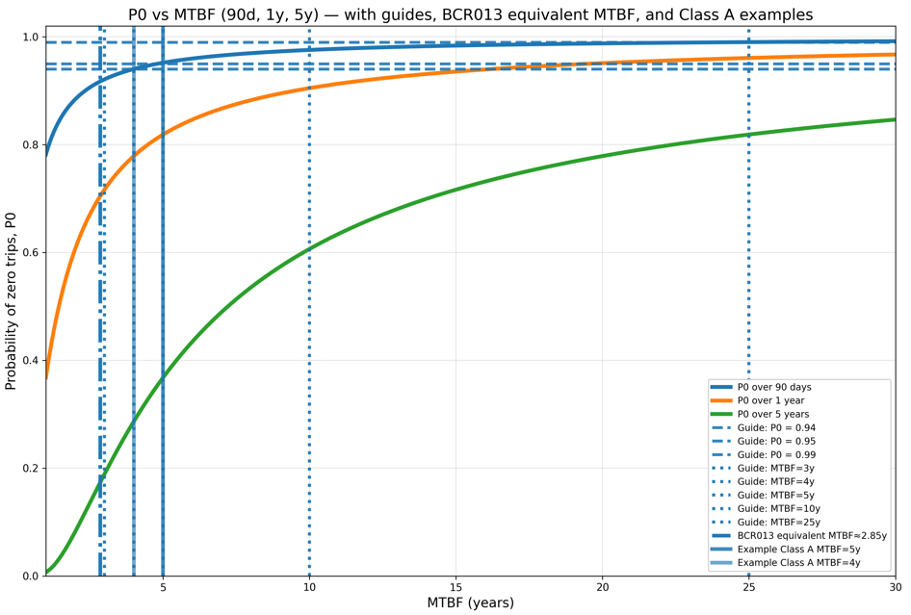
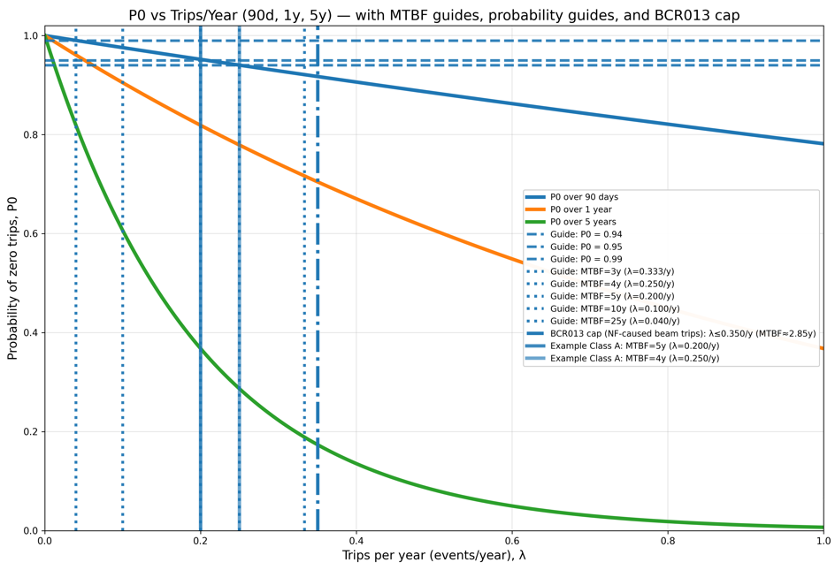
Reset to New
CONTROL
A full overhaul or unit exchange does more than avoid one failure — it resets the clock. A good-as-new replacement returns the component to t = 0 on its Weibull curve, restoring the low, flat hazard rate that every Poisson/MTBF probability in this compendium (Slides 22–28) depends on.
KEY TAKEAWAY “Reset to new” is what keeps the rest of this deck's mathematics honest — skip it, and every MTBF-based probability quoted earlier quietly becomes optimistic.

Slide 38
Reliability Governance — Closing the Loop
CONTROL
This compendium opened with a budget (Slide 29: 0.35 events/year) and closes with the mechanism that keeps the plant inside it: a continuous RAMI governance loop.
1
MEASURE exposure
Log operating hours and Hz-band time per unit (already mandated, Slide 7).
2
TRACK age vs. η
Compare accumulated life to each component's Weibull characteristic life.
3
REPLACE before wear-out
Trigger overhaul/exchange at a fraction of η — not at first symptom.
4
RESET & feed back
Log the renewal and roll it into next year's RAMI dossier (Slide 13).
KEY TAKEAWAY MTBF opened the story; predictable, logged, reset-to-new replacement is how the plant keeps living up to it.

