Slide 1
Debugging
By Philip Sutton
Notes:
Thanks for coming
Name,
Dislike of debugging learn to be good

Slide 2
Who am i
Started full time work 1991
Worked for Science, Travel, Management Consultancy, Finance, Medical, Education
Programmed in COBOL, Fortran, Visual Basic 6, VB.net and C# as well as Sql
C# since 2005
Twitter @GBPhilipSutton
Notes:
Previous language – has debugging changed –
Tweet

Slide 3
Introduction
Visual Studio Options
Debugging Attributes
Datatips
Debugging Windows
Dumps
Symbol Servers
Front End
Enterprise Features
Notes:
What I am going to talk about – before I start the code is often written to give examples of debugging techniques and problems – not necessarily the way I would write code

Slide 4
Visual Studio Options
Debugging Options
Exception Options

Slide 5
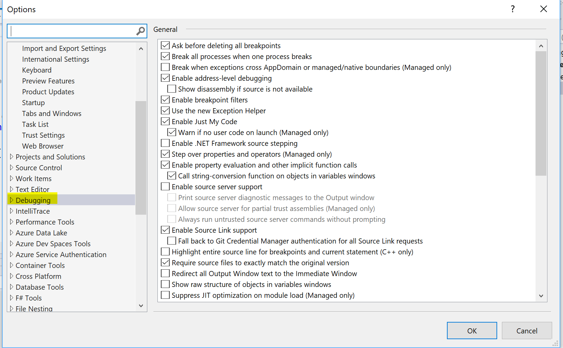
Debugging options
Notes:
Where
Large number
Usage through talk
Link at end

Slide 6
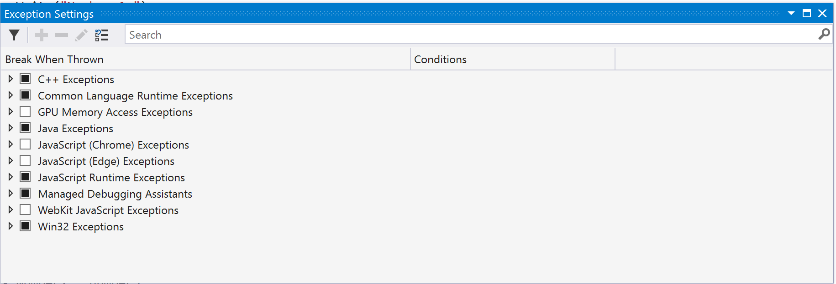
Exception options
Notes:
Debug>windows>exception setting
What happens when exception hit

Slide 7



Exceptions Settings
Demo
Notes:
Show code
Ability to search – overflow
Set conditions
Use stack dump
Doubles not divide zero

Slide 8
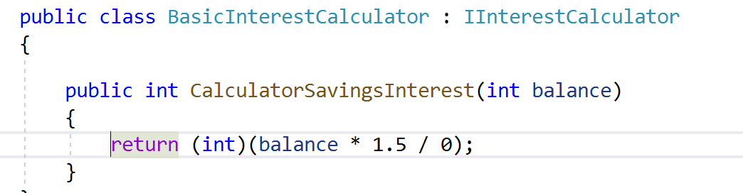
Exception Settings
Notes:
This will break if there is no try catch

Slide 9
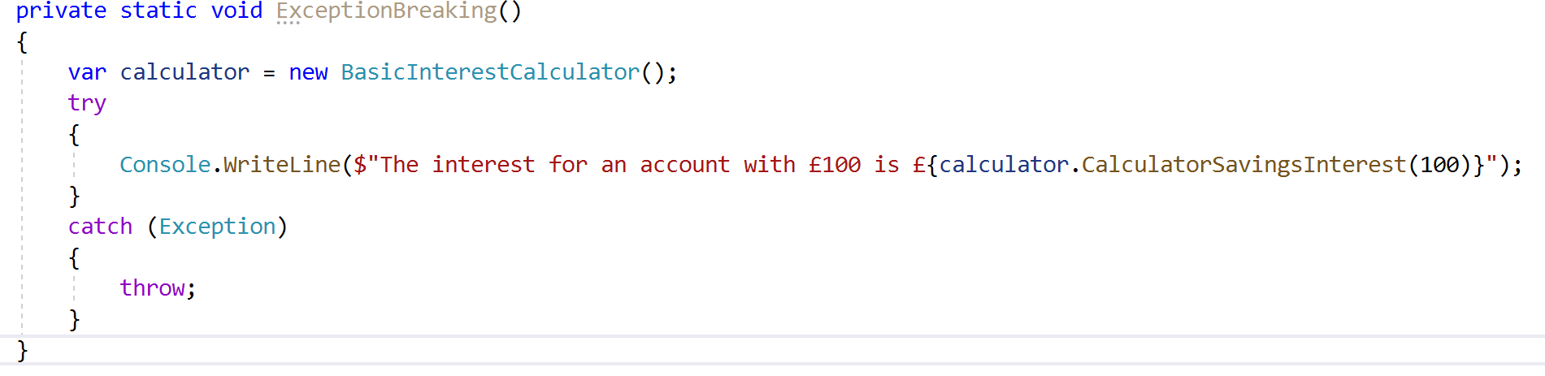
Exception Setting
Notes:
If there is a try catch it doesn’t break at the point of where the exception occurred bu tif you tick the box it will break.

Slide 10
Debugging Attributes
Debugger Display
Debugger Browsable
Debugger Type Proxy
Notes:
3 kinds

Slide 11
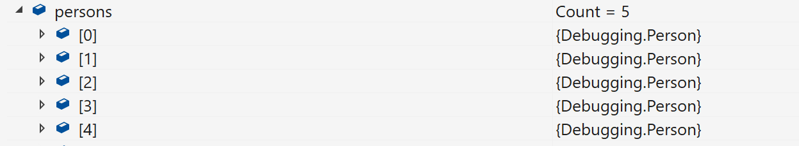
DebuggerDisplay
Notes:
List is not helpful

Slide 12
debuggerdisplay
[DebuggerDisplay("Name = {Name}")]
public class Person
{
public string Name { get; set; }
public int Age { get; set; }
}
Notes:
Attribute on class text and variables allowed

Slide 13
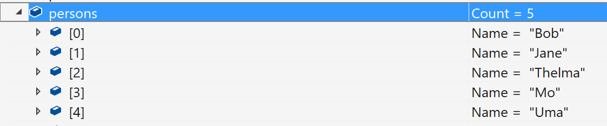
Debuggerdisplay
Notes:
List now shows that specified
Performance

Slide 14
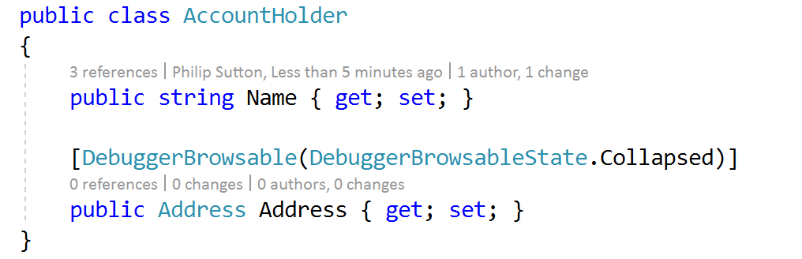

Debuggerbrowsable
Notes:
What is shown

Slide 15
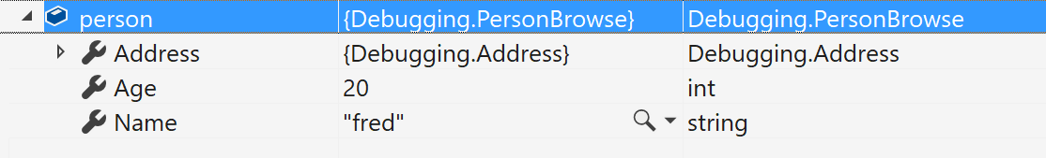
Debuggerbrowsable
Notes:
Address is shown with fields collapsed – this is the default

Slide 16
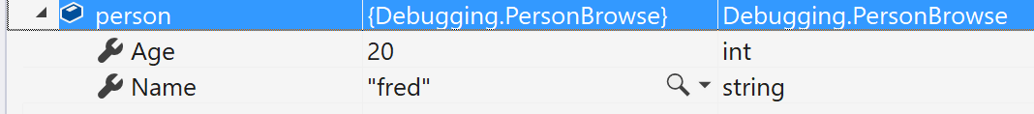
DebuggerBrowsable
Never
Notes:
Nothing shown

Slide 17
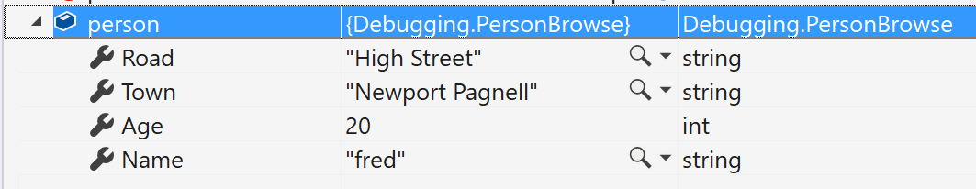
DebuggerDisplay
RootHidden
Notes:
Class level not shown

Slide 18
Debugger Proxy Type
Allows the significant and fundament change on the debugging view of a type.
Demo
Notes:
Project class through another class.
Raw info shown
Demo
Line 204 – check breakpoint enabled

Slide 19
Debugger visualisers
Some built in – xml, json, text, html
Many in the market place
Write your own
Notes:
Visualisers are a way of seeing data in a way that is more understandable than a single line of text.
There are some build in ones.
There are many in the marketplace.
Write own inherit from implement show. Documents/visual studio 2017/visualizers or with the standard visualisers
Shown code
Class library

Slide 20
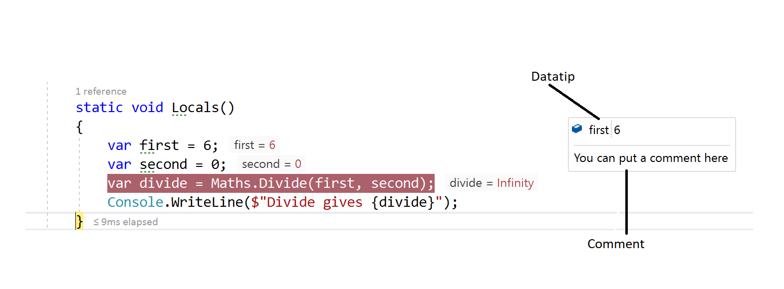
Datatips
Notes:
Putting mouse over the variable and clicking the pin,
The double chevron pointing down allows you to put a comment in.
Datatips can be exported under debug menu – someone else is to debug.

Slide 21
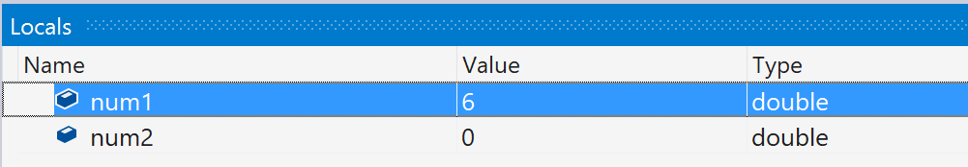
Debugging windows - Locals/Auto
Notes:
Watch window
the Locals – show the values of within the current scope, this will coincide with the focus of the call stack.
The autos window shows the values around the current breakpoint., also coinciding with the call stack. Return values are also shown and

Slide 22
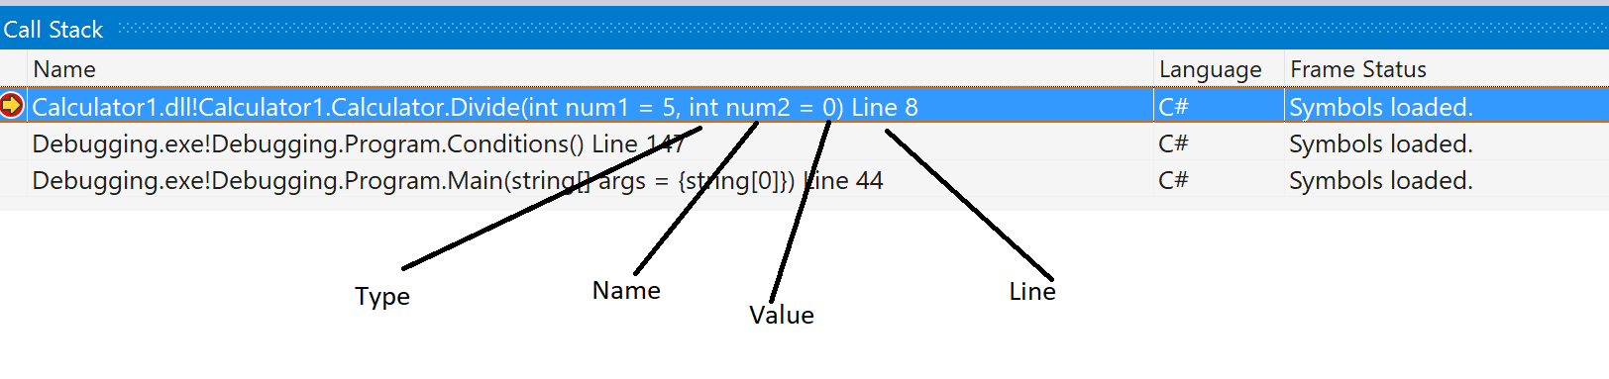
Debugging windows -Call Stack
Notes:
The call shows where you are and the calling methods.
You can show differing information as shown – parameter type, name and value and the line number that you are at.
Breakpoints can be set in the call stack.

Slide 23
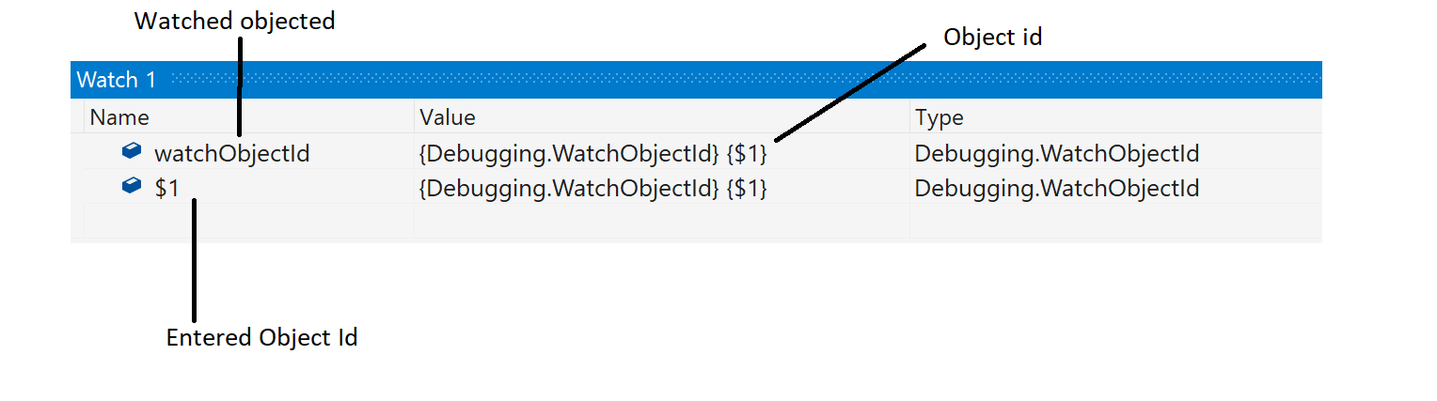
Debugging windows - Watch Window
Notes:
Allows to keep track of variables and methods.
$1
There is also the quick watch window which is a modal window make object id not see it

Slide 24
Multi-threaded applications
Thread Window
Debug Toolbar
Debug Location
Parallel Stacks
Parallel Watch

Slide 25
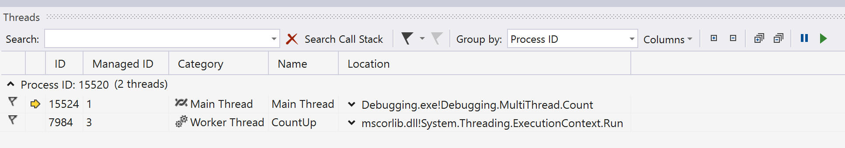
Multithreaded Debugging Windows - Threads
Notes:
Flag
Search
Freeze and thaw
Naming – tasks – thread pool
Showing columns

Slide 26
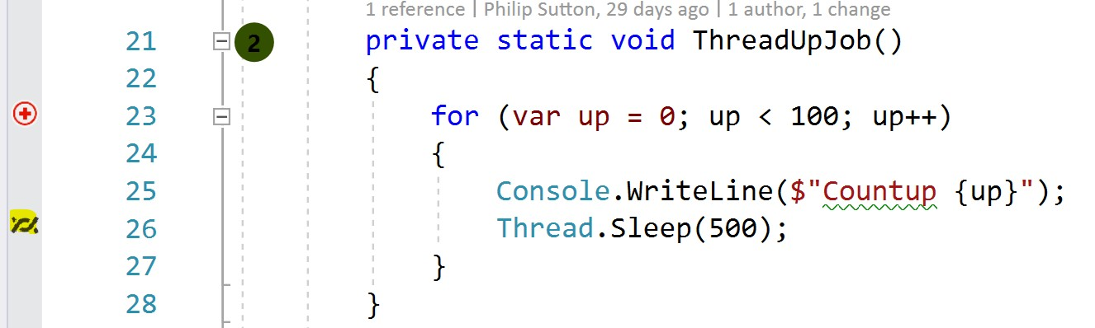



Multithreading windows – debug toolbar
Notes:
Where threads are

Slide 27
Multithreading windows debug location
Notes:
View>Toolbars
Select threads

Slide 28
Multithreading windows parallel stacks
private static void ParallelExample()
{
var names = new List<string> {"Bob", "Judy", "Chris", "Ashley"};
Parallel.ForEach(names, (name) =>
{
for (var i = 0; i < 10; i++)
{
Console.WriteLine($"Hello {name} {i}");
}
});
}
Notes:
Describe code watch window value of I, thread stacks

Slide 29
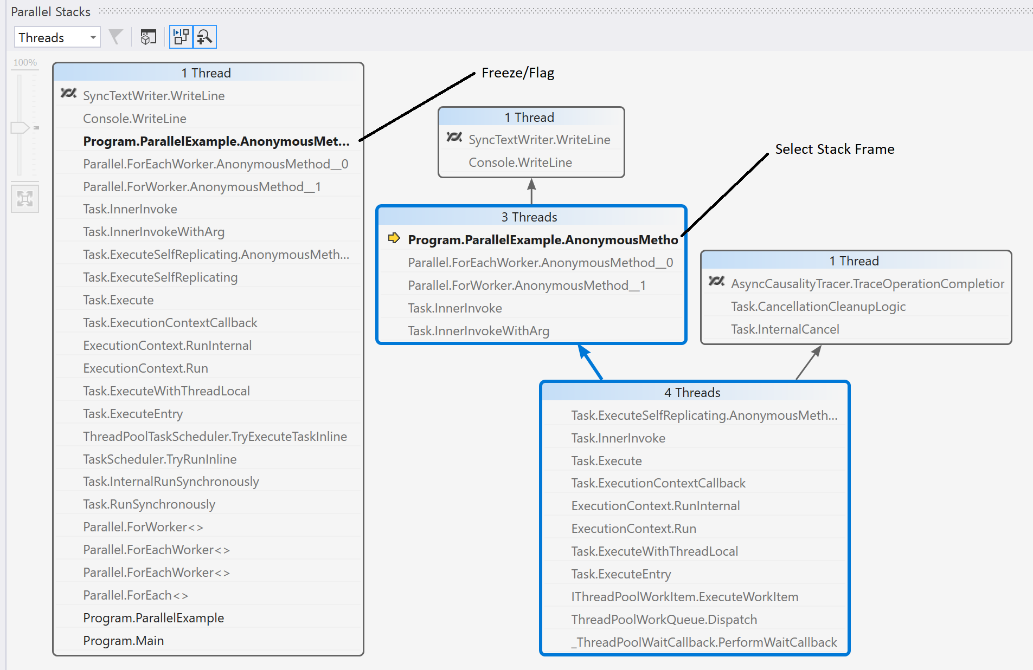
Multithreading windows parallel stacks
Notes:
Different views are to select stack trace for thread
3 views
Thread View
Task View
Method view

Slide 30
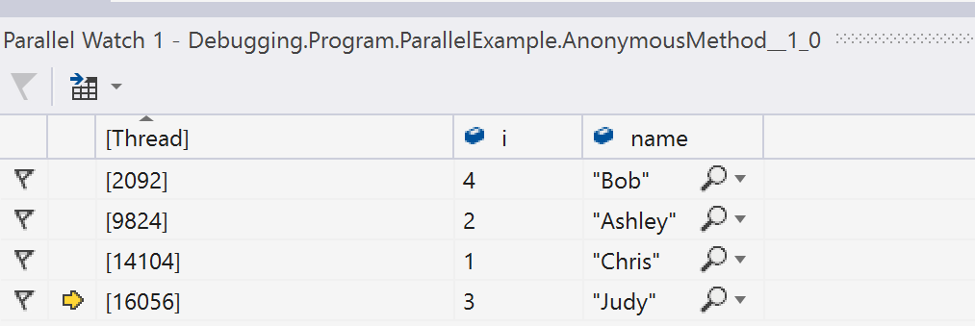
Multithreading windows parallel watch
Notes:
Show value of I from the code and name - horizontal
Filter can be added, also visualizers

Slide 31

Breakpoints
Data Breakpoints
Condition
Hit Count
Filter
When hit
Break at Function
Notes:
Breakpoins

Slide 32
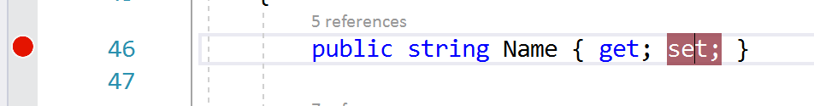
Breakpoints Data
Notes:
Set on set - memory

Slide 33
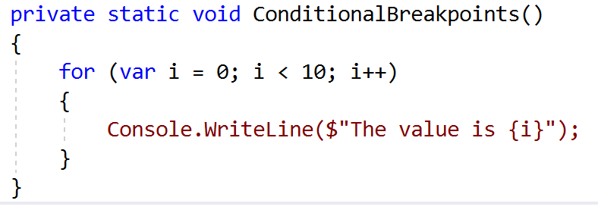
Breakpoints Conditional breakpoints
Notes:
Breakpoint I =5;

Slide 34
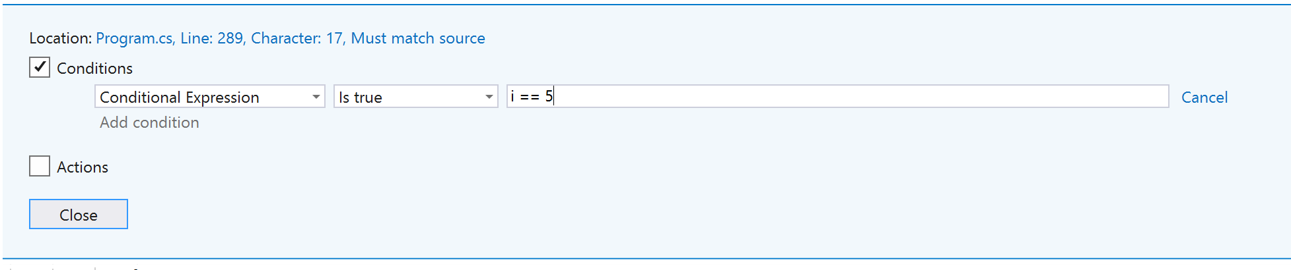
Breakpoints conditional
Notes:
Add contion – right click breakpoint

Slide 35
Breakpoints conditional
private static void ConditionalBreakpoints()
{
for (var i = 0; i < 10; i++)
{
if (i==5)
{
Debugger.Break();
}
Console.WriteLine($"The value is {i}");
}
}
Notes:
Performance
Safety add is attached

Slide 36
Breakpoints conditional
private static void ConditionalBreakpoints()
{
for (var i = 0; i < 10; i++)
{
if ((Debugger.IsAttached) && (i==5))
{
Debugger.Break();
}
Console.WriteLine($"The value is {i}");
}
}
Notes:
Performance
Safety add is attached

Slide 37
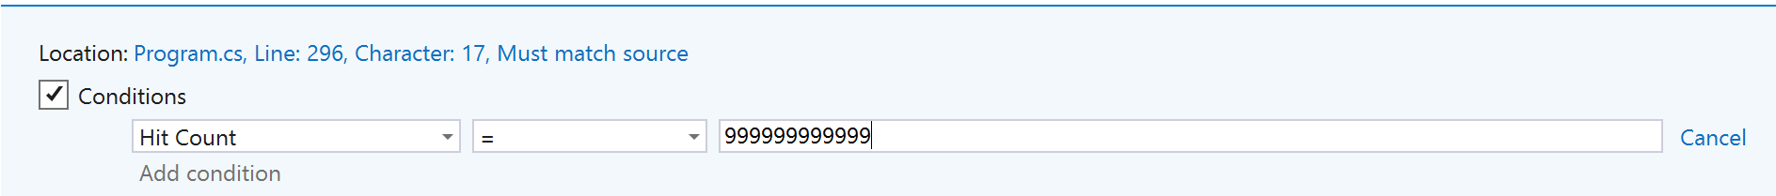
Breakpoints hit count
Notes:
Nth time set very high

Slide 38
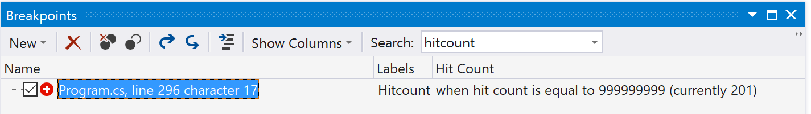

Breakpoints hit count
Notes:
Breakpoint window – debug>windows>breakpoint
Set hitcount to that amount

Slide 39
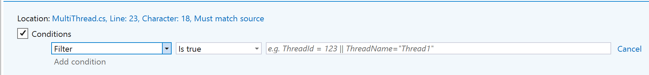
Breakpoints filter
Notes:
Filter for threads

Slide 40
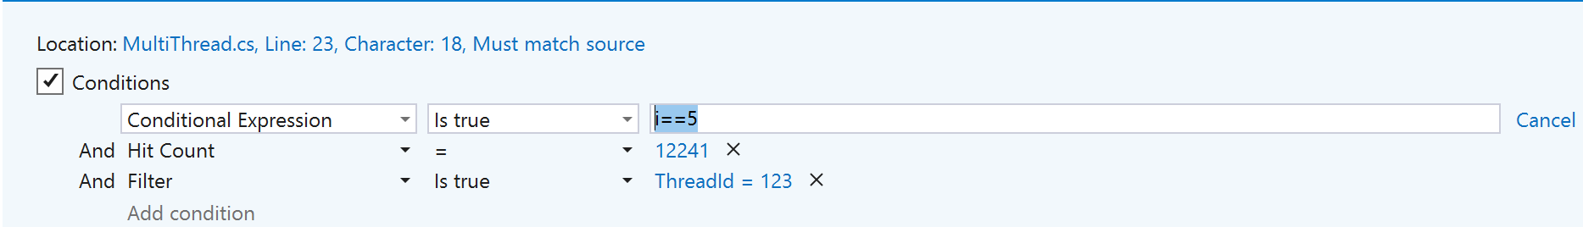
Breakpoints filter
Notes:
Combined, condition – hitcount - filter

Slide 41
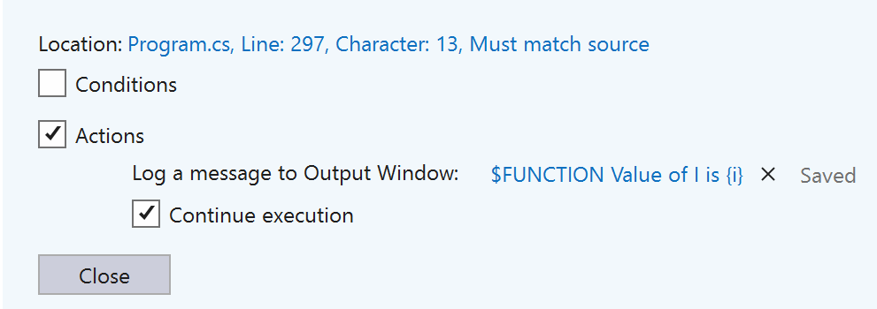
Breakpoints when hit
Notes:
Action – message
Continue /stop

Slide 42
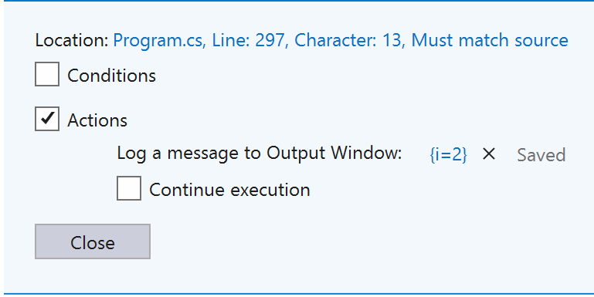

Breakpoints when hit
Notes:
Set a value
Private methods

Slide 43
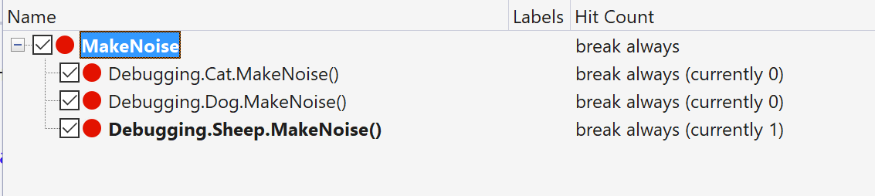
Breakpoints Break at function
Notes:
breakpoint window – new function
polymorphism

Slide 44
Address level debugging
Memory
Disassembly
Registers
Notes:
Enable address-level debugging:

Slide 45
WPF/UWP
Live Visual Tree
Live Property Explorer
Notes:
Uwp/ wpr

Slide 46
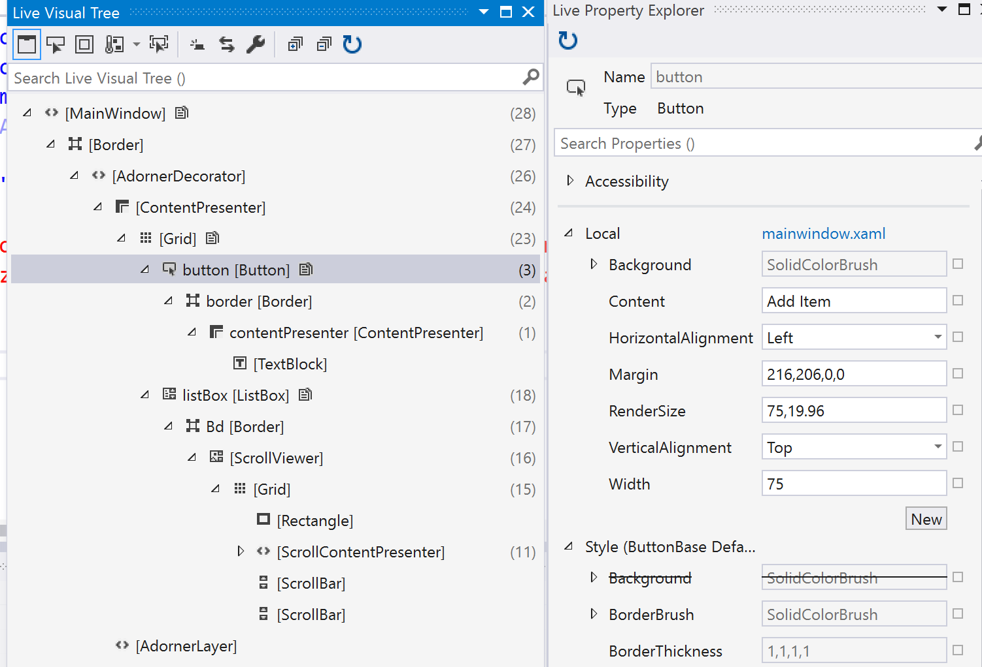
WPF/UWP Visual tree/ property explorer
Notes:
Look up fields and see values

Slide 47
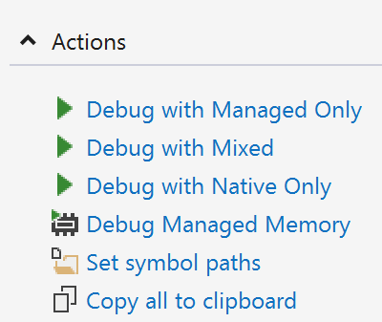
Dumps
Notes:
Open by visual studio

Slide 48
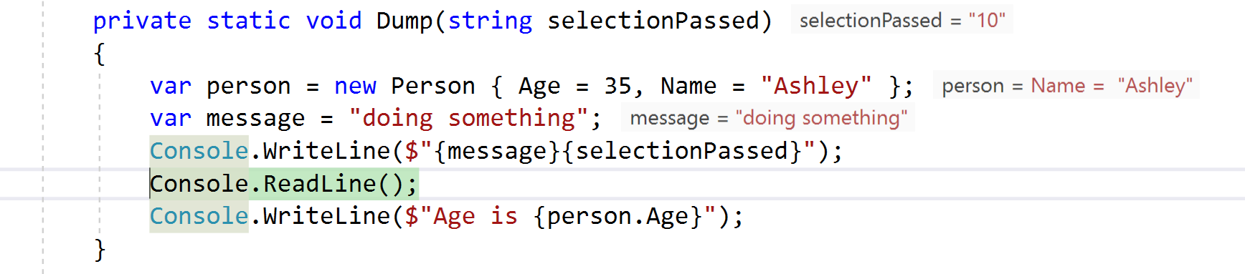
Dumps
Notes:
This is what you get dump was taken whilst on the readline

Slide 49
Symbol servers
The symbol server enables the debuggers to automatically retrieve the correct symbol files without product names, releases, or build numbers.
Notes:
Dumps, components find the correct code
30-40,000 Microsoft 2014 windows
Program Database
Release and Debug
Publish symbols when building – azure devops
Add symbol server – visual studio
Source server support
3rd party
Microsoft symbol server .net framework source stepping
Enable just my code
Source server support ticked
sourcelink

Slide 50
Front End
Javascript
Browser Link
Sync
Inspector
Notes:
Breakpoints in javascript – option – though when run pointed out
Many browsers at one time css relected
Web essentials add in
Sync enter one browser reflected on others ctrl alt enter – log in trouble with firefox
Inspector click on icon and code shown ctrl alt I and D edit page updates file

Slide 51
Enterprise
Code Maps
Intellitrace

Slide 52
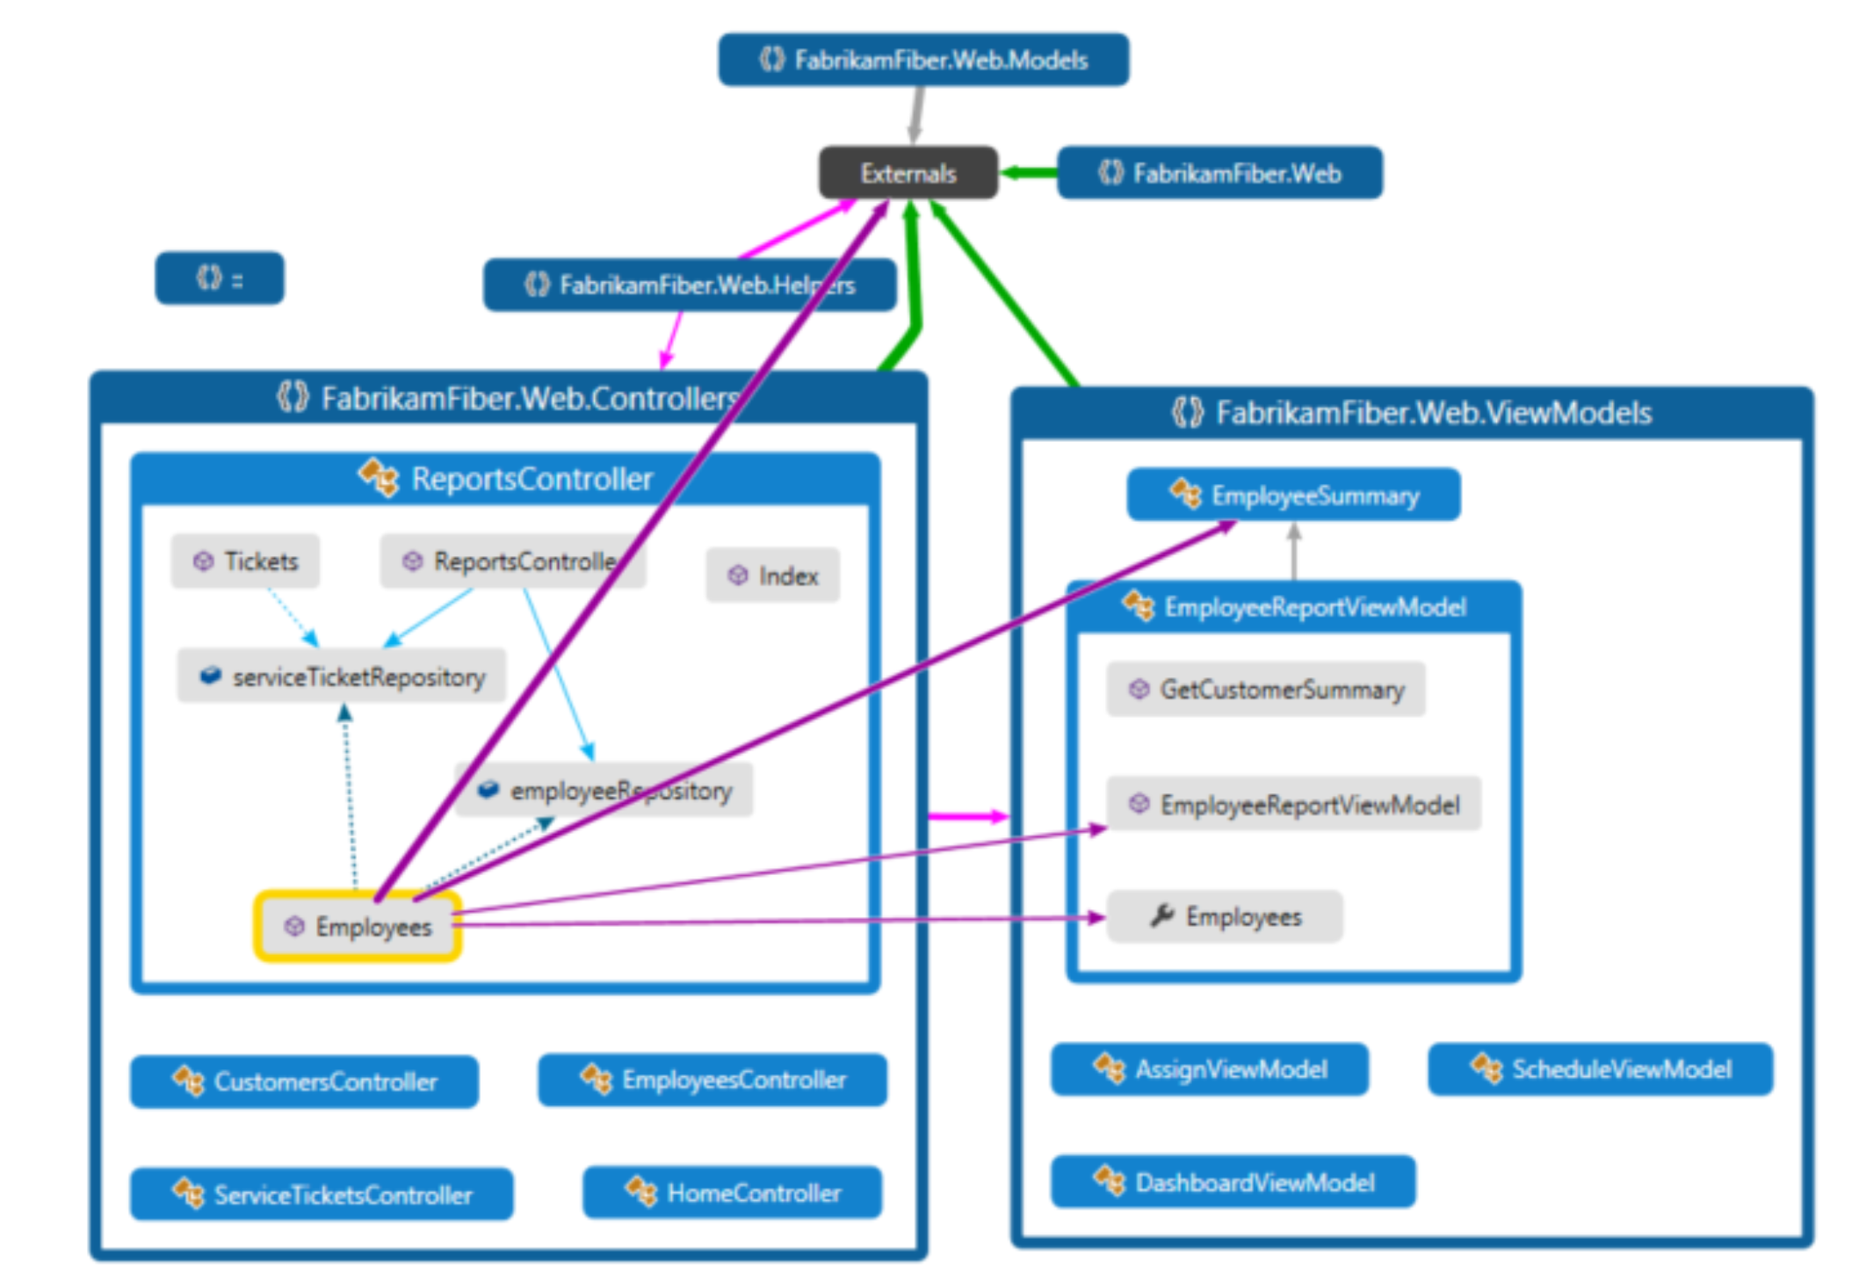
Enterprise code maps

Slide 53
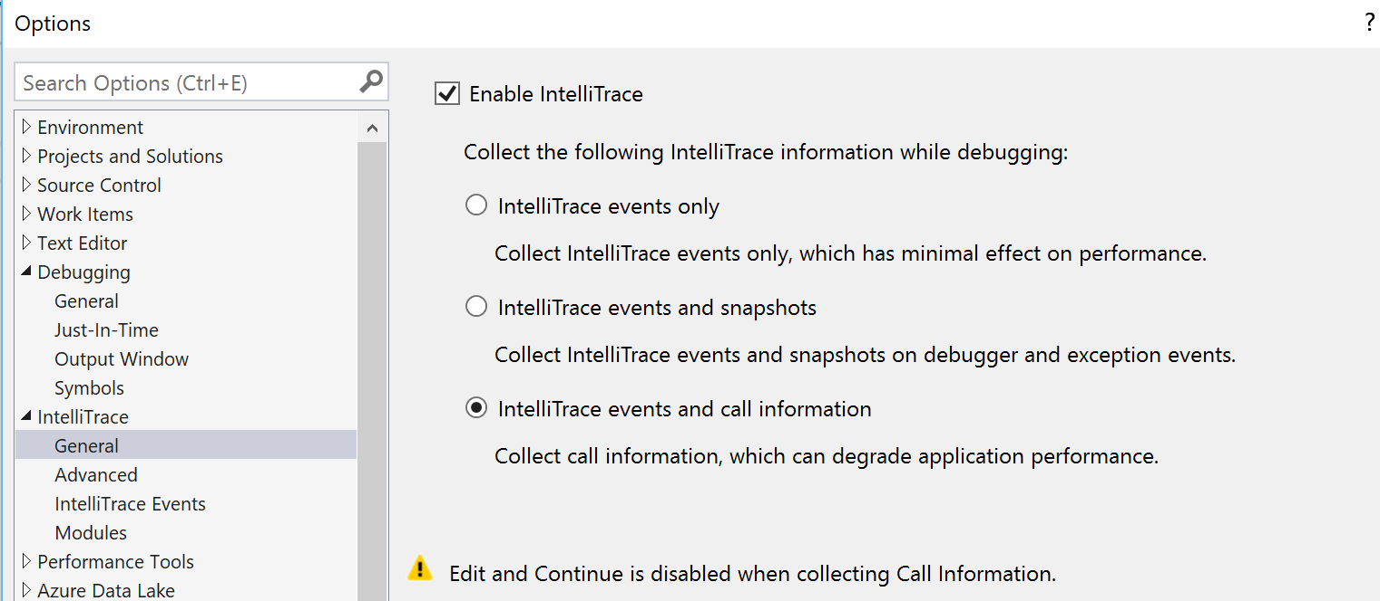
Enterprise Intellitrace

Slide 54
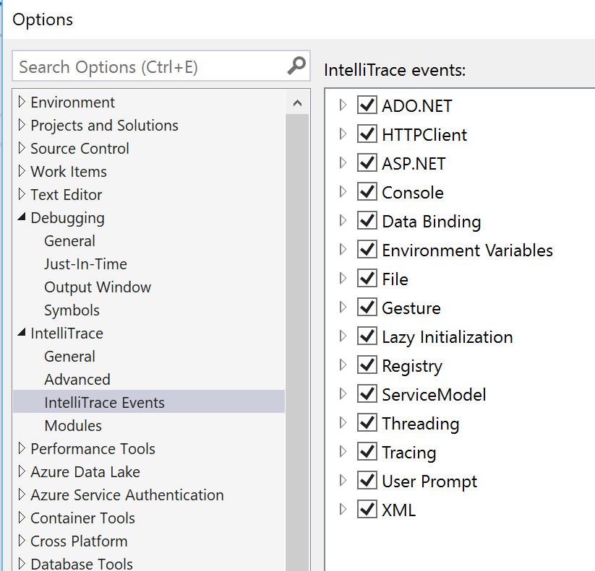
Enterprise Intellitrace

Slide 55
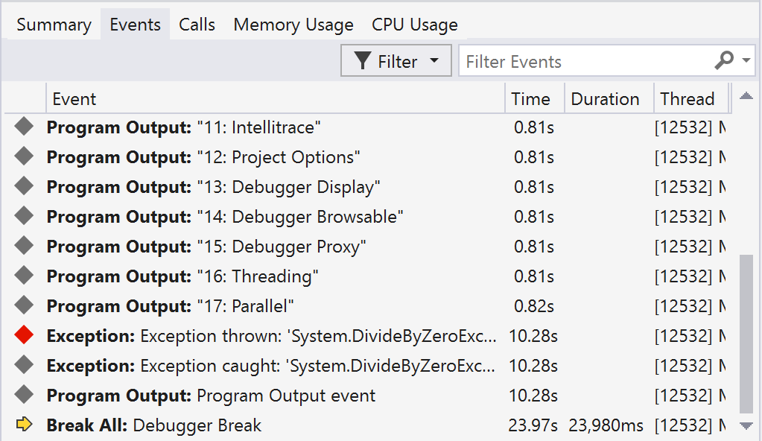
Enterprise Intellitrace
Notes:
Total value wrong

Slide 56
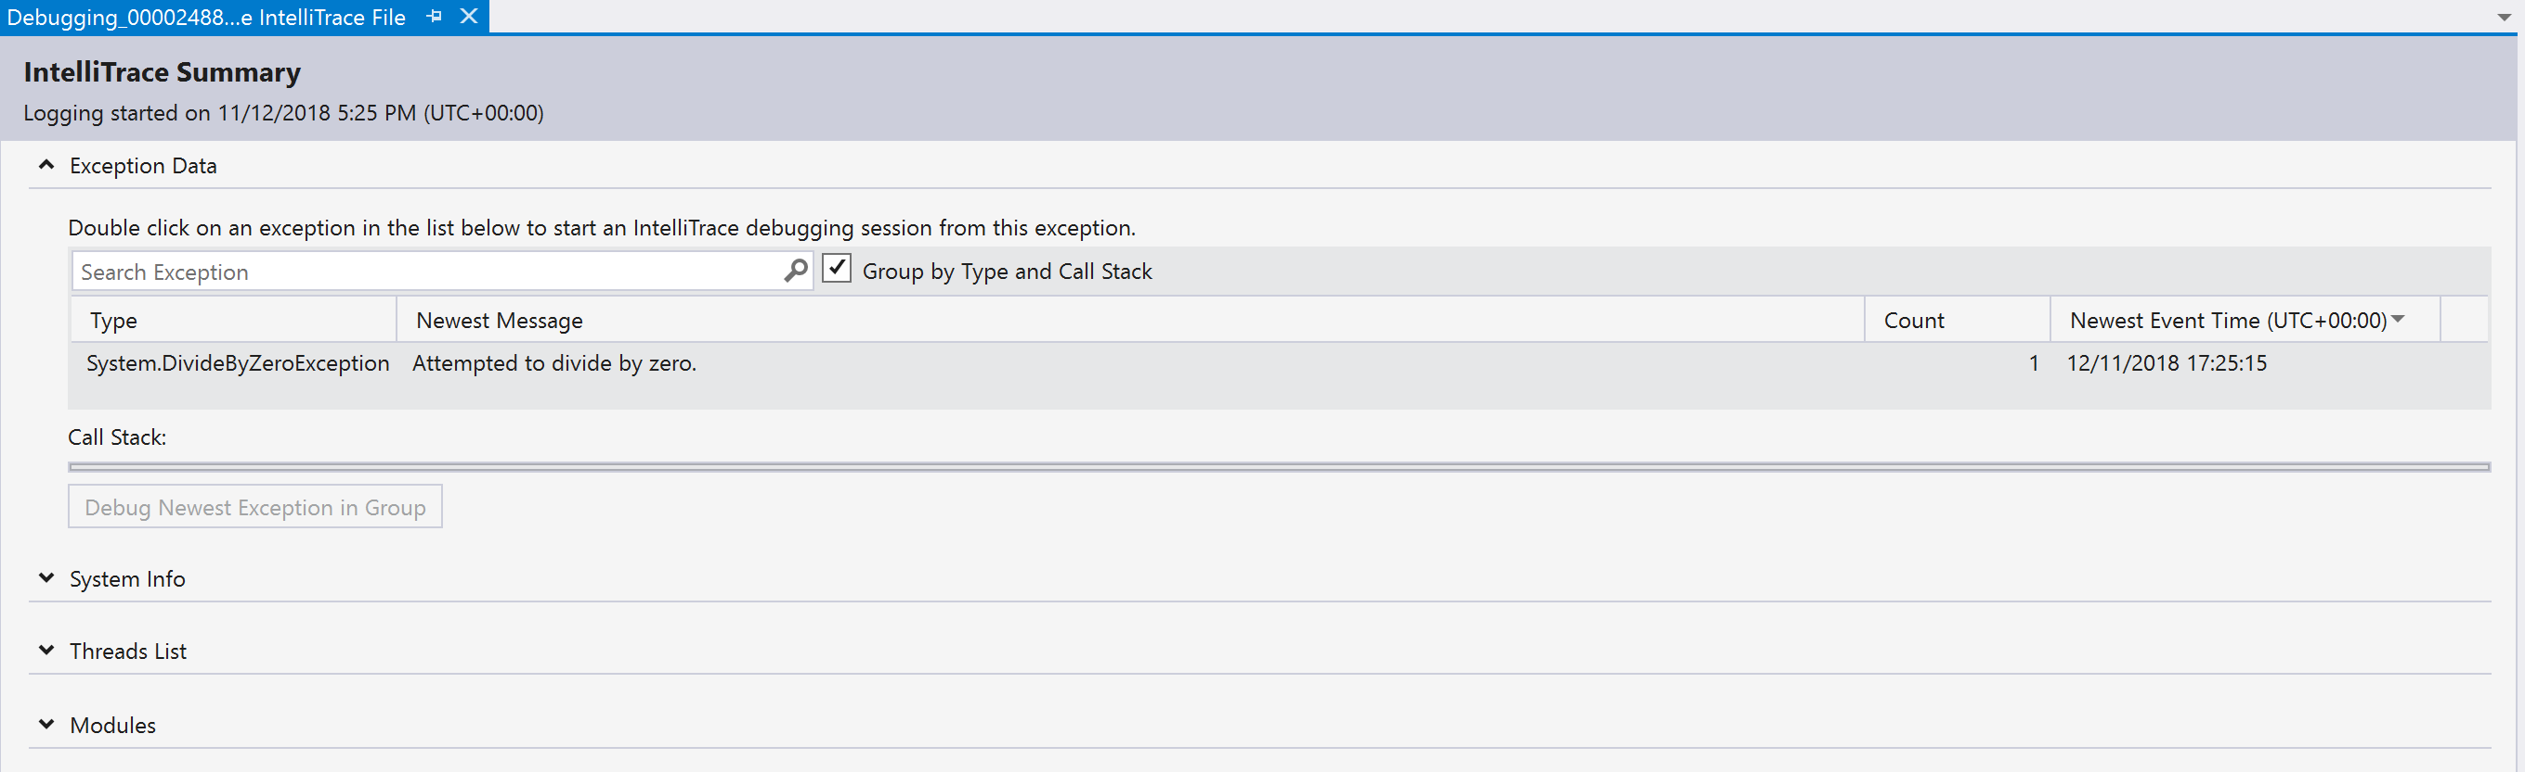
Enterprise Intellitrace

Slide 57
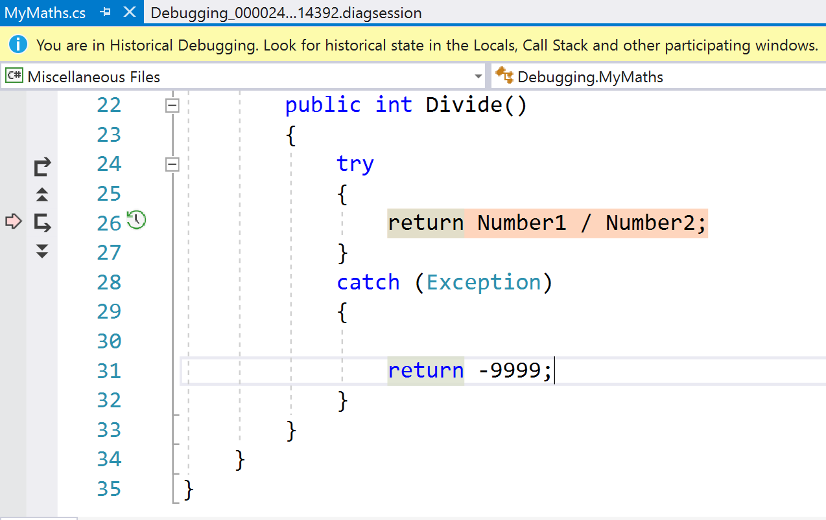
Enterprise Intellitrace

Slide 58
Other DEBUGGing items
Remote Debugging
Azure Debugging
Live Sharing
WinDbg
SOS
Notes:
ozcode

Slide 59
References
https://docs.microsoft.com/en-us/visualstudio/debugger - general debugging
https://docs.microsoft.com/en-us/visualstudio/debugger/general-debugging-options-dialog-box?view=vs-2017 debugging options
https://www.wintellect.com/pdb-files-what-every-developer-must-know/ pdb files
https://blogs.msdn.microsoft.com/jaredpar/2011/03/18/debuggerdisplay-attribute-best-practices/ (old) debugger display best practices
https://blogs.msdn.microsoft.com/visualstudio/2017/06/26/7-lesser-known-hacks-for-debugging-in-visual-studio/

Slide 60

Questions

