Slide 1
Debugging
By Philip Sutton
Notes:
Name,
Dislike of debugging

Slide 2
Who am i
Started full time work 1991
Worked for Science, Travel, Management Consultancy, Finance, Medical, Education
Programmed in COBOL, Fortran, Visual Basic 6, VB.net and C# as well as Sql
C# since 2005
Notes:
Previous language – has debugging changed

Slide 3
Introduction
Visual Studio Options
Debugging Attributes
Datatips
Debugging Windows
Dumps
Symbol Servers
Browser Link/Sync/Inspector
Enterprise Features
Notes:
What I am going to talk about

Slide 4
Visual Studio Options
Debugging Options
Exception Options

Slide 5
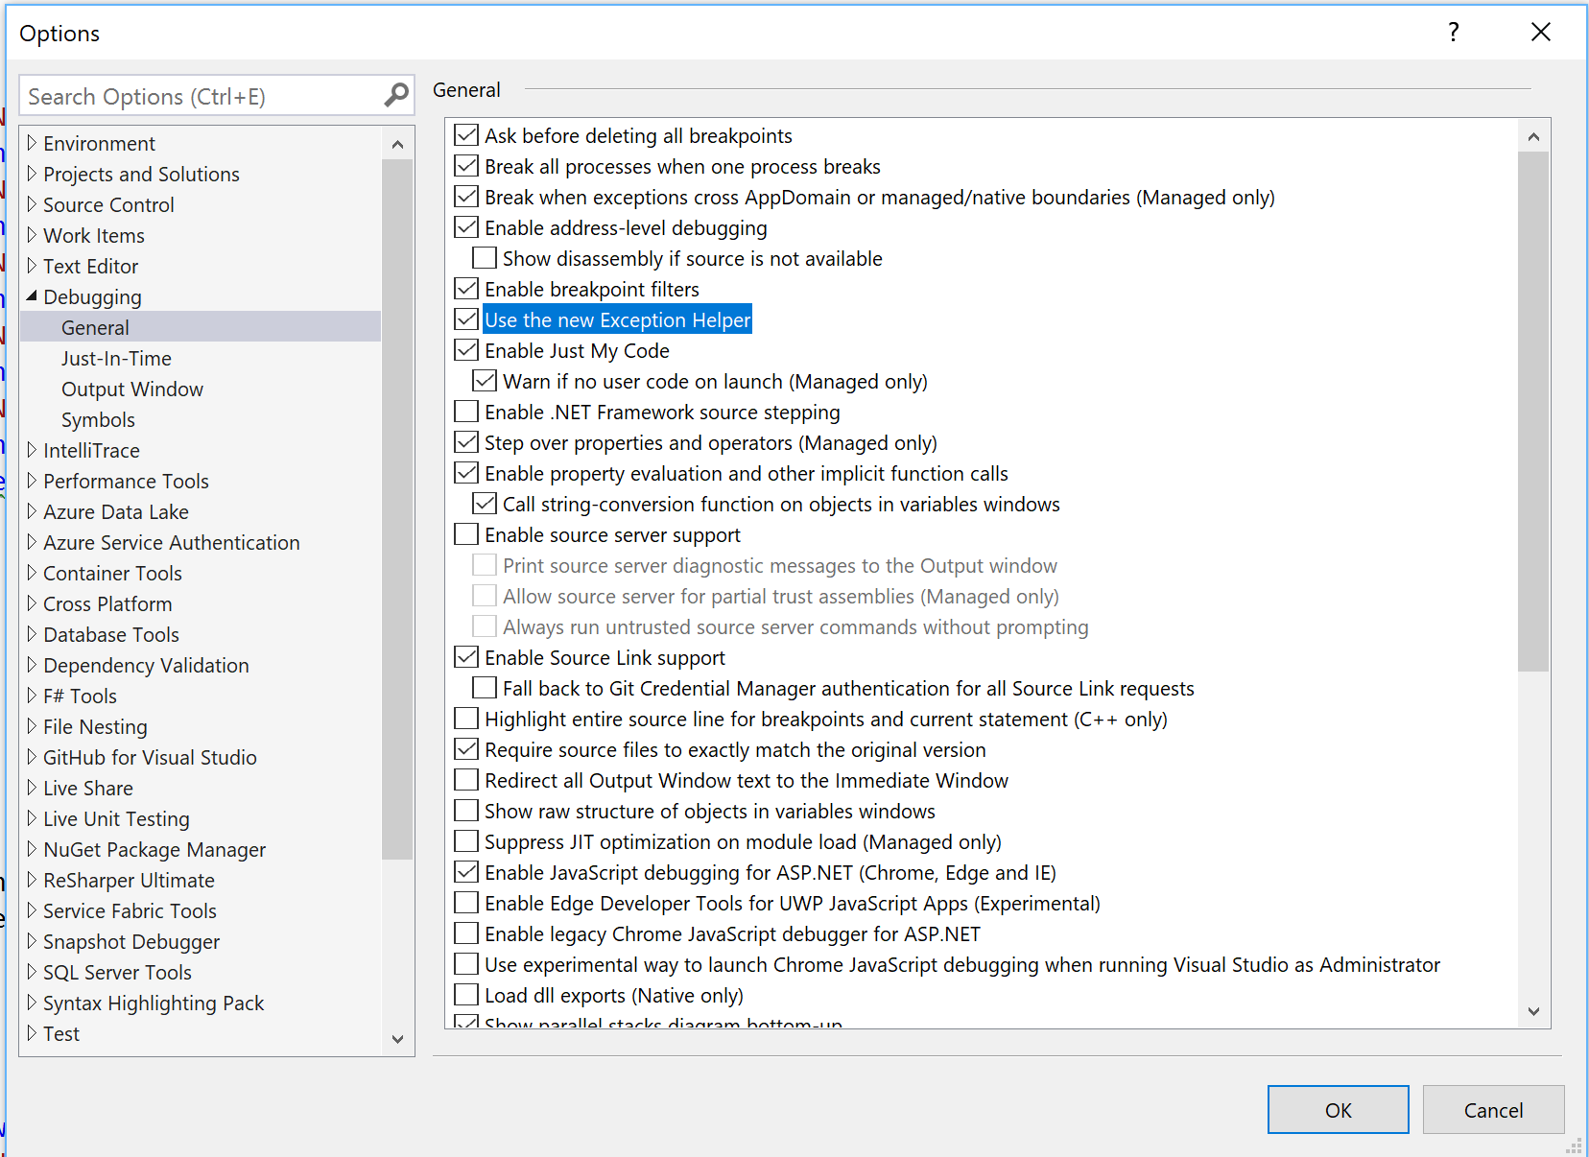
Debugging options
Notes:
Where
Just My Code –dbg, pdb optimisation
Same for Javascript and jquery 2013
Link at end

Slide 6
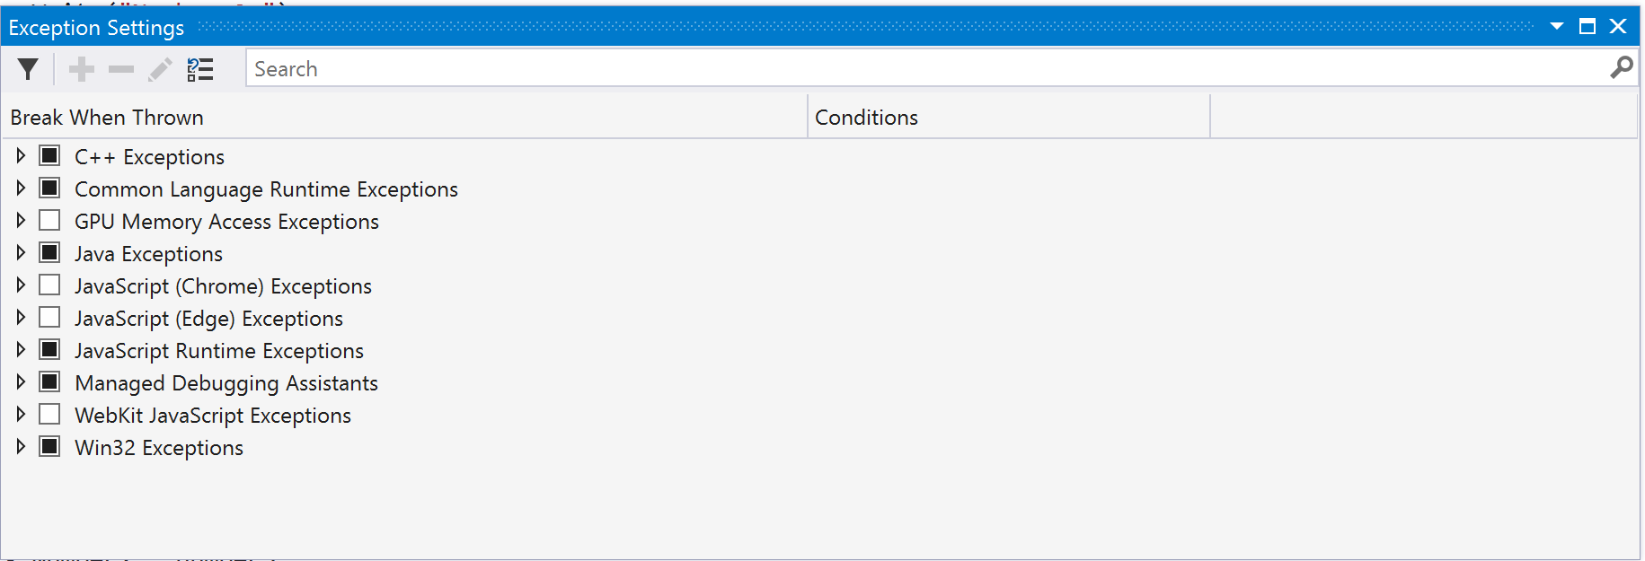
Exception options
Notes:
Debug>windows>exception setting
What happens when exception hit

Slide 7



Exceptions Settings
Demo
Notes:
Ability to seach – divide
Set conditions
Doubles not divide zero

Slide 8
Debugging Attributes
Debugger Display
Debugger Browsable
Debugger Type Proxy
Notes:
3 kinds

Slide 9
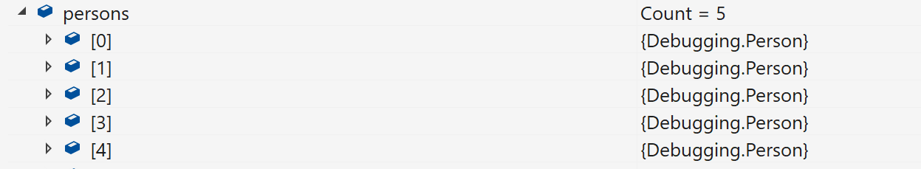
DebuggerDisplay
Notes:
List is not helpful

Slide 10
debuggerdisplay
[DebuggerDisplay("Name = {Name}")]
public class Person
{
public string Name { get; set; }
public int Age { get; set; }
}
Notes:
Attribute on class

Slide 11
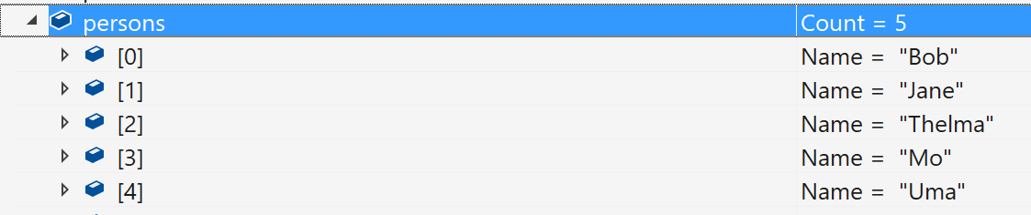
Debuggerdisplay
Notes:
List now shows that specified
Performance

Slide 12

Debuggerbrowsable
public class PersonBrowse
{
public string Name { get; set; }
public int Age { get; set; }
[DebuggerBrowsable(DebuggerBrowsableState.Collapsed)]
public Address Address { get; set; }
}
Notes:
What is shown

Slide 13
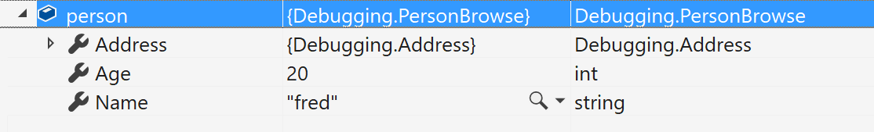
Debuggerbrowsable
Notes:
Address is shown with fields collapsed – this is the default

Slide 14
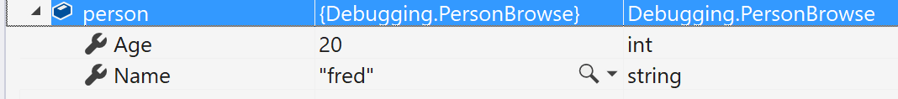
DebuggerBrowsable
Never
Notes:
Nothing shown

Slide 15
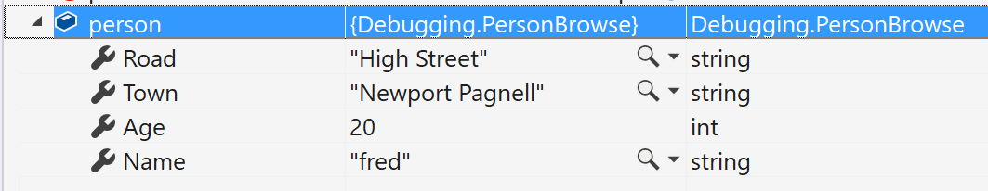
DebuggerDisplay
RootHidden
Notes:
Class level not shown

Slide 16
Debugger Proxy Type
Allows the significant and fundament change on the debugging view of a type.
Demo
Notes:
Project class through another class.
Raw info shown

Slide 17
Debugger visualisers
Some built in – xml, json, text, html
Many in the market place
Write your own
Notes:
Visualisers are a way of seeing data in a way that is more understandable than a single line of text.
There are some build in ones.
There are many in the marketplace.

Slide 18
Own Visualizers
Demo
Notes:
If you really need to you can write you own

Slide 19
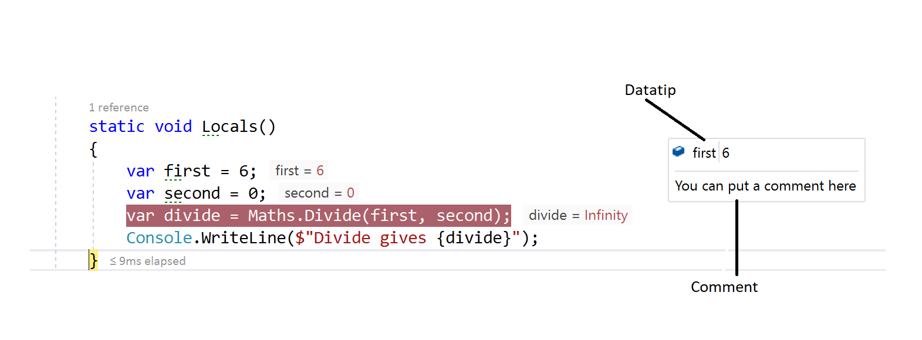
Datatips
Notes:
Putting mouse over the variable and clicking the pin,
The double chevron pointing down allows you to put a comment in.
Datatips can be exported under debug menu – someone else is to debug.

Slide 20
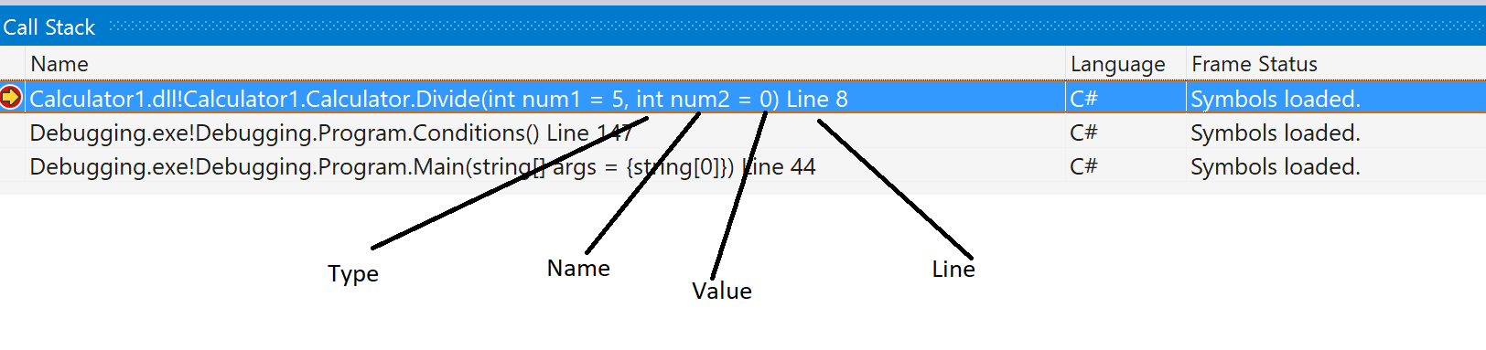
Debugging windows -Call Stack
Notes:
The call shows where you are and the calling methods.
You can show differing information as shown – parameter type, name and value and the line number that you are at.
Breakpoints can be set in the call stack.

Slide 21
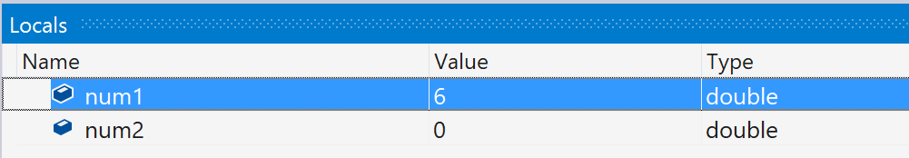
Debugging windows - Locals/Auto
Notes:
Watch window
the Locals – show the values of within the current scope, this will coincide with the focus of the call stack.
The autos window shows the values around the current breakpoint., also coinciding with the call stack. Return values are also shown and

Slide 22
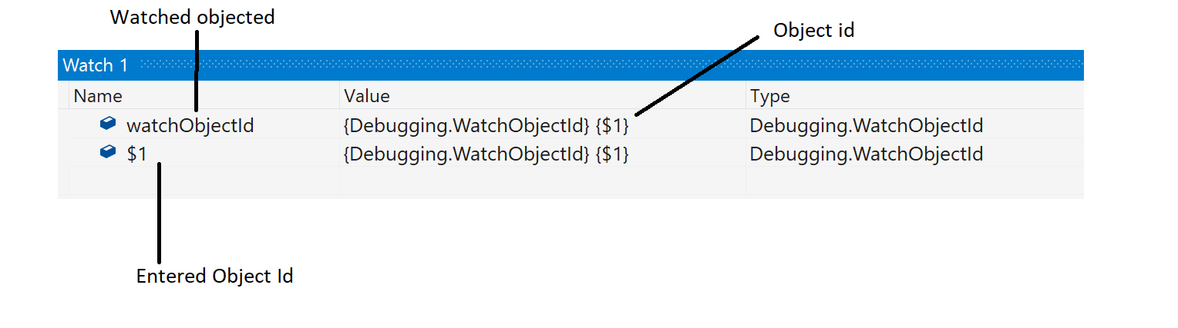
Debugging windows - Watch Window
Notes:
Allows to keep track of variables and methods.
$1

Slide 23
Multi-threaded applications
Thread Window
Debug Toolbar
Debug Location
Parallel Stacks
Parallel Watch

Slide 24
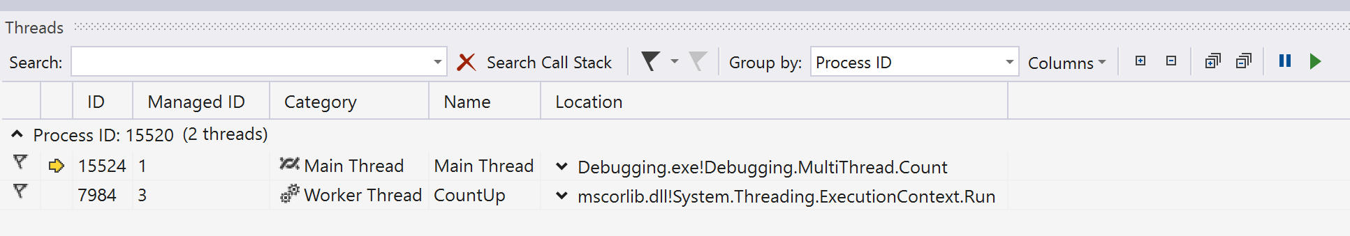
Multithreaded Debugging Windows - Threads
Notes:
Flag
Search
Freeze and thaw
Naming – tasks – thread pool
Showing columns

Slide 25
Multithreading windows – debug toolbar
Notes:
Where threads are

Slide 26
Multithreading windows debug location
Notes:
View>Toolbars
Select threads

Slide 27
Multithreading windows parallel stacks
private static void ParallelExample()
{
var names = new List<string> {"Bob", "Judy", "Chris", "Ashley"};
Parallel.ForEach(names, (name) =>
{
for (var i = 0; i < 10; i++)
{
Console.WriteLine($"Hello {name} {i}");
}
});
}
Notes:
Describe code watch window value of I, thread stacks

Slide 28
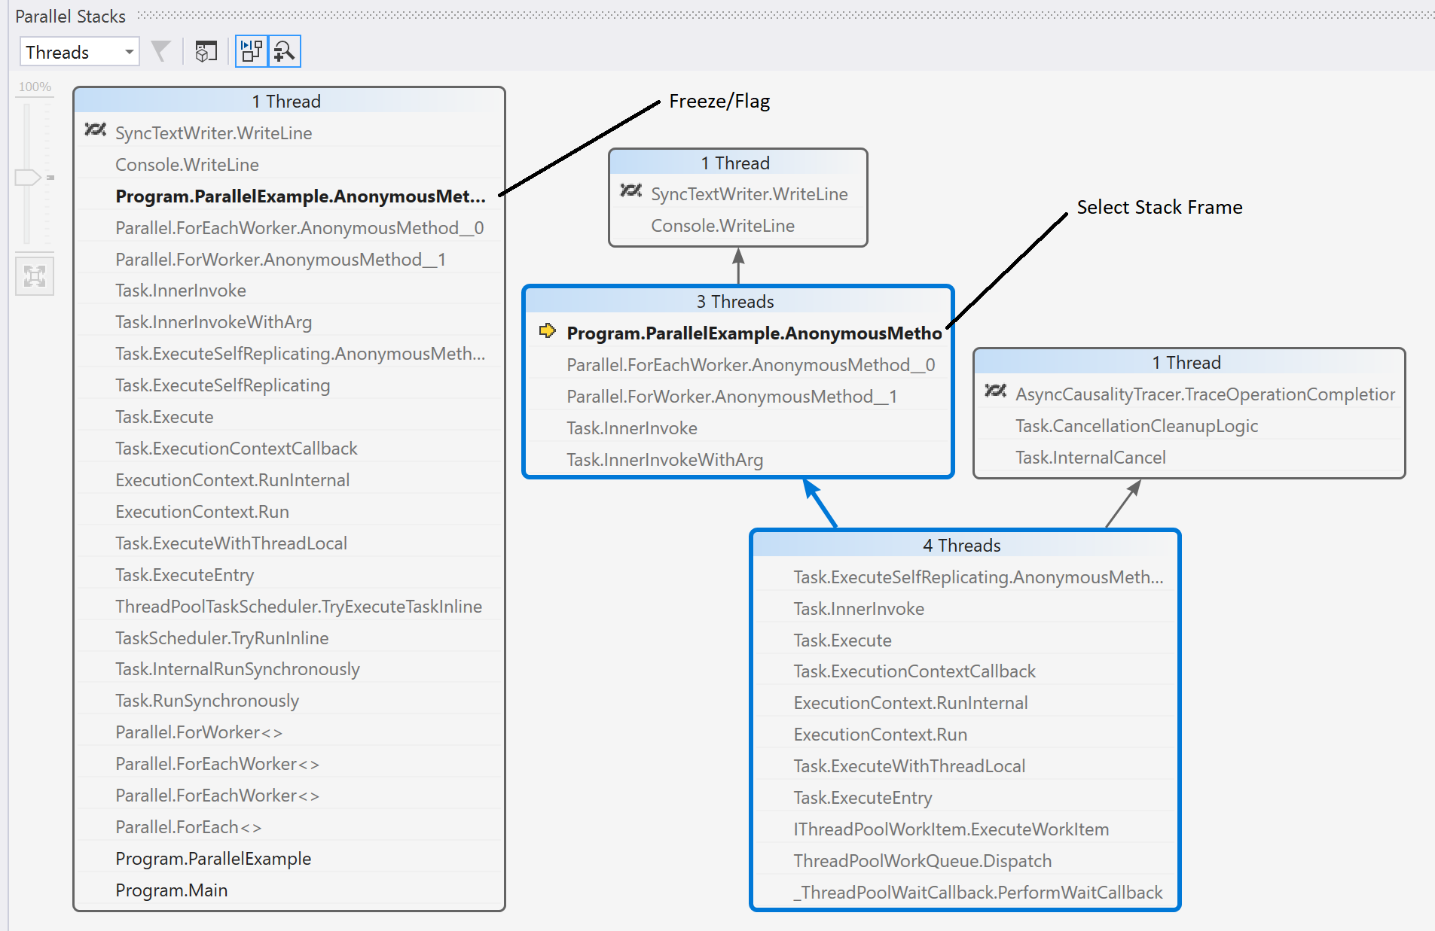
Multithreading windows parallel stacks
Notes:
Different views are to select stack trace for thread

Slide 29
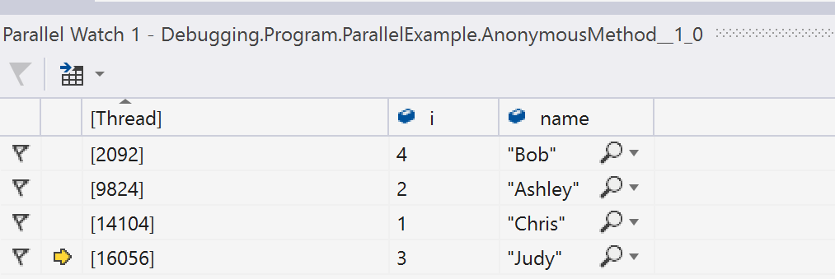
Multithreading windows parallel watch
Notes:
Show value of I from the code and name - horizontal
Filter can be added, also visualizers

Slide 30
Breakpoints
Data Breakpoints
Break on return
Condition
Hit Count
Filter
When hit
Break at Function
Label
Notes:
Breakpoins

Slide 31
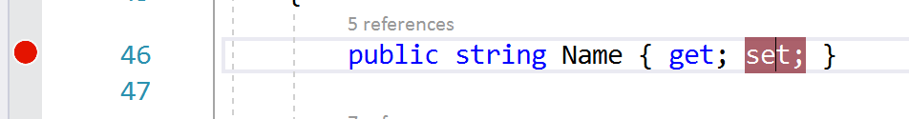
Breakpoints Data
Notes:
Set on set - memory

Slide 32
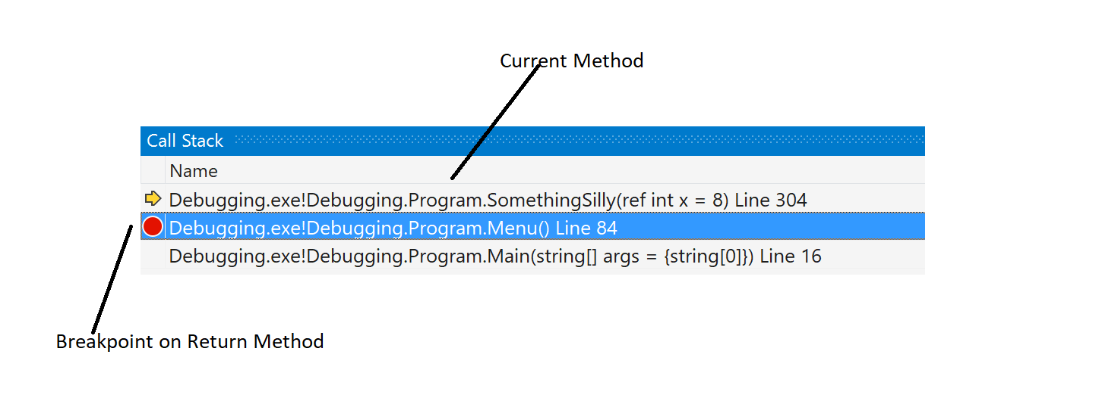
Breakpoints break on return
Notes:
Set breakpoint via stack trace
Step into method – look at stack trace

Slide 33
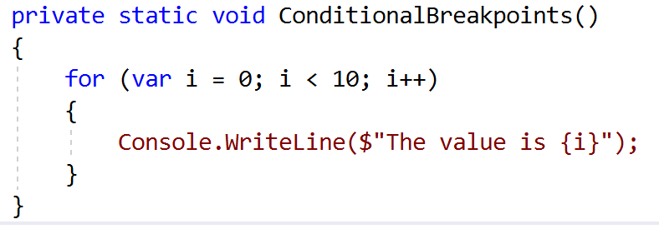
Breakpoints Conditional breakpoints
Notes:
Breakpoint I =5;

Slide 34
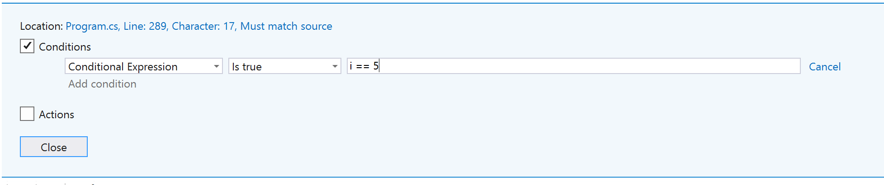
Breakpoints conditional
Notes:
Add contion – right click breakpoint

Slide 35
Breakpoints conditional
private static void ConditionalBreakpoints()
{
for (var i = 0; i < 10; i++)
{
if ((Debugger.IsAttached) && (i==5))
{
Debugger.Break();
}
Console.WriteLine($"The value is {i}");
}
}
Notes:
Performance
Safety add is attached

Slide 36
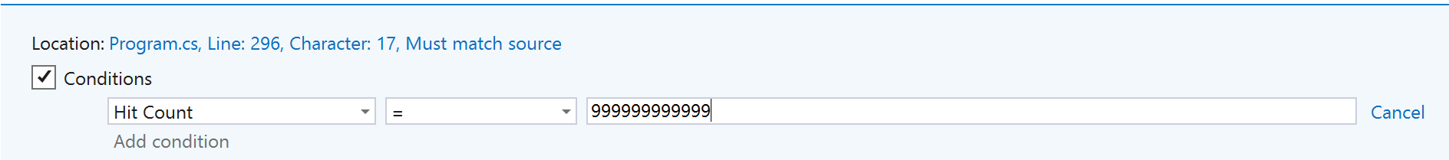
Breakpoints hit count
Notes:
Nth time set very high

Slide 37
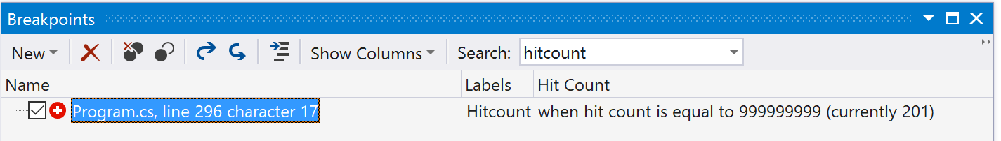


Breakpoints hit count
Notes:
Breakpoint window – debug>windows>breakpoint
Set hitcount to that amount

Slide 38
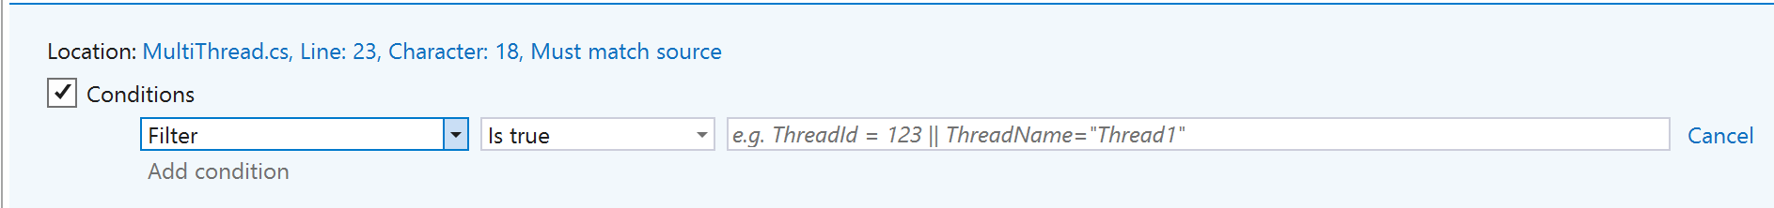
Breakpoints filter
Notes:
Filter for threads

Slide 39
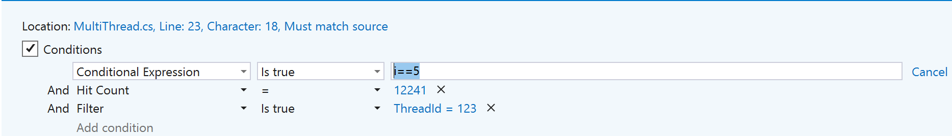
Breakpoints filter
Notes:
Combined, condition – hitcount - filter

Slide 40
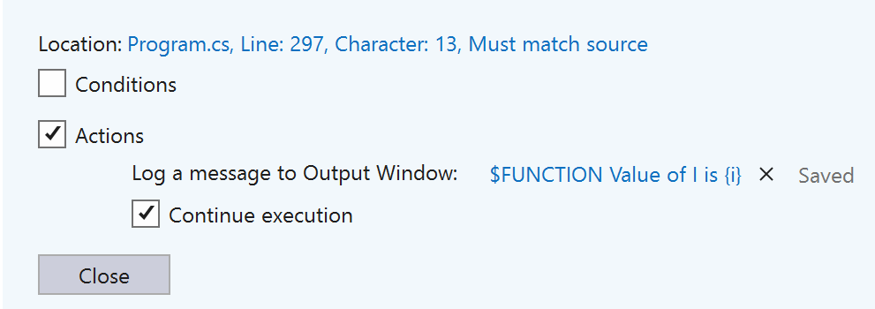
Breakpoints when hit
Notes:
Action – message
Continue /stop

Slide 41
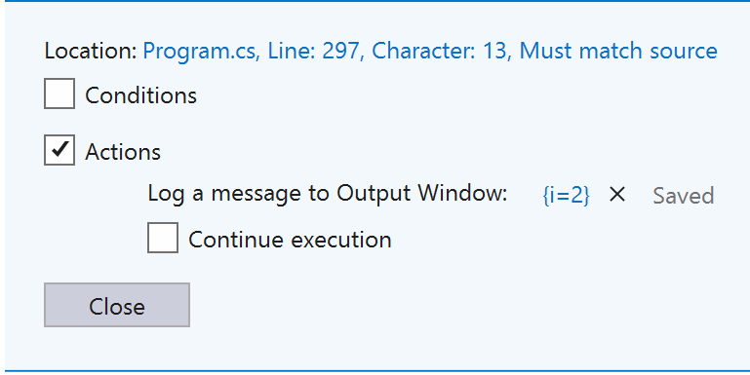

Breakpoints when hit
Notes:
Set a value
Private methods

Slide 42
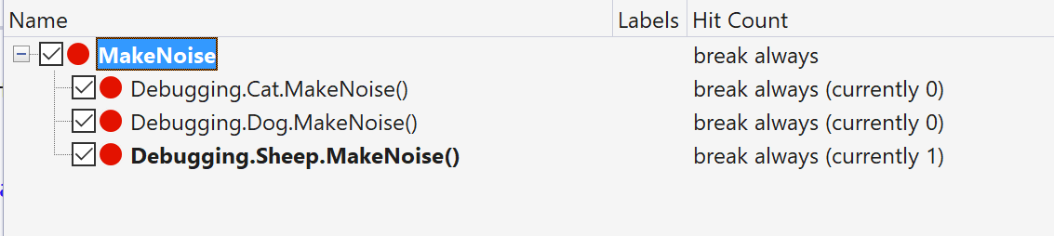
Breakpoints Break at function
Notes:
breakpoint window – new function
polymorphism

Slide 43
Address level debugging
Memory
Disassembly
Registers
Notes:
Debug?windows no depth

Slide 44
WPF
Live Visual Tree
Live Property Explorer
Notes:
Uwp/ wpr

Slide 45
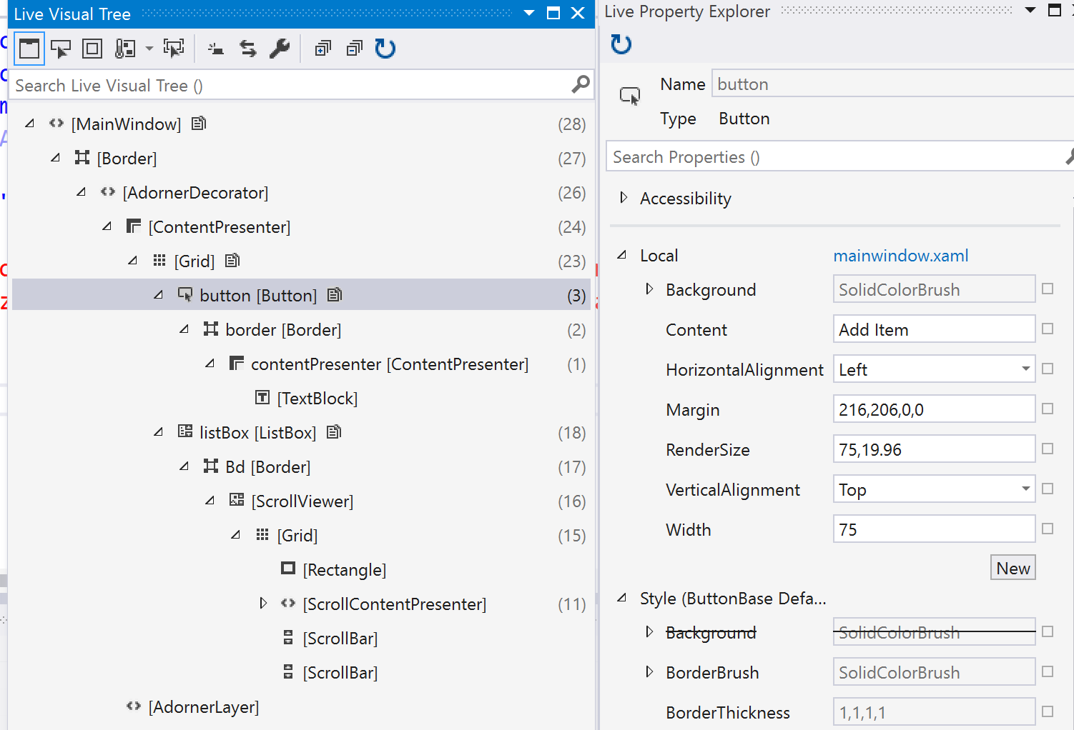
WPF/UWP Visual tree/ property explorer
Notes:
Look up fields and see values

Slide 46
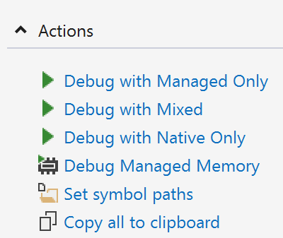
Dumps
Notes:
Open by visual studio

Slide 47
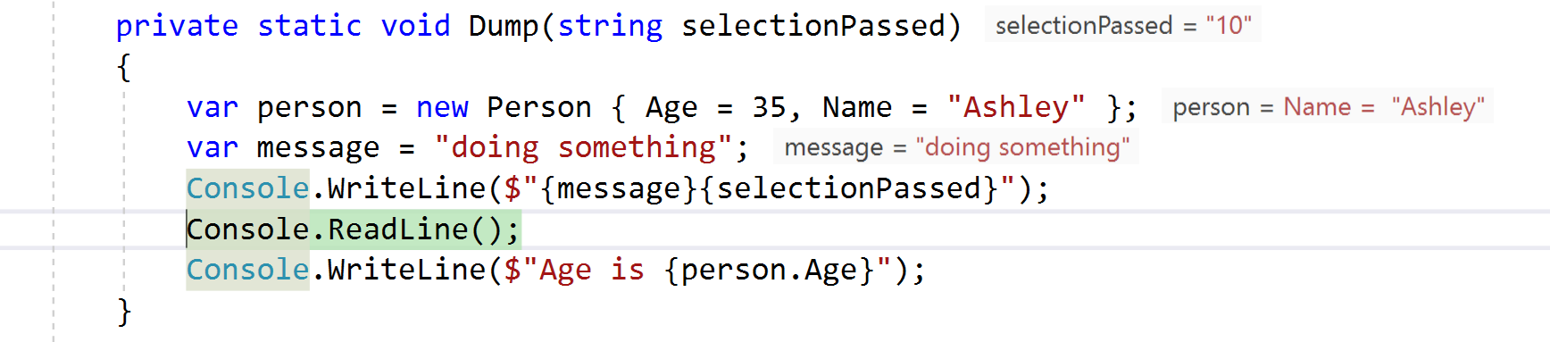
Dumps
Notes:
This is what you get dump was taken whilst on the readline

Slide 48
Symbol servers
The symbol server enables the debuggers to automatically retrieve the correct symbol files without product names, releases, or build numbers.
Notes:
Fundamental to much or debugging especially remote/ dumps

Slide 49
Front End
Browser Link
Sync
Inspector
Notes:
Many browsers at one time
Web essentials add in
Link css/html to code in visual stdio

Slide 50
Enterprise
Code Maps
Intellitrace

Slide 51
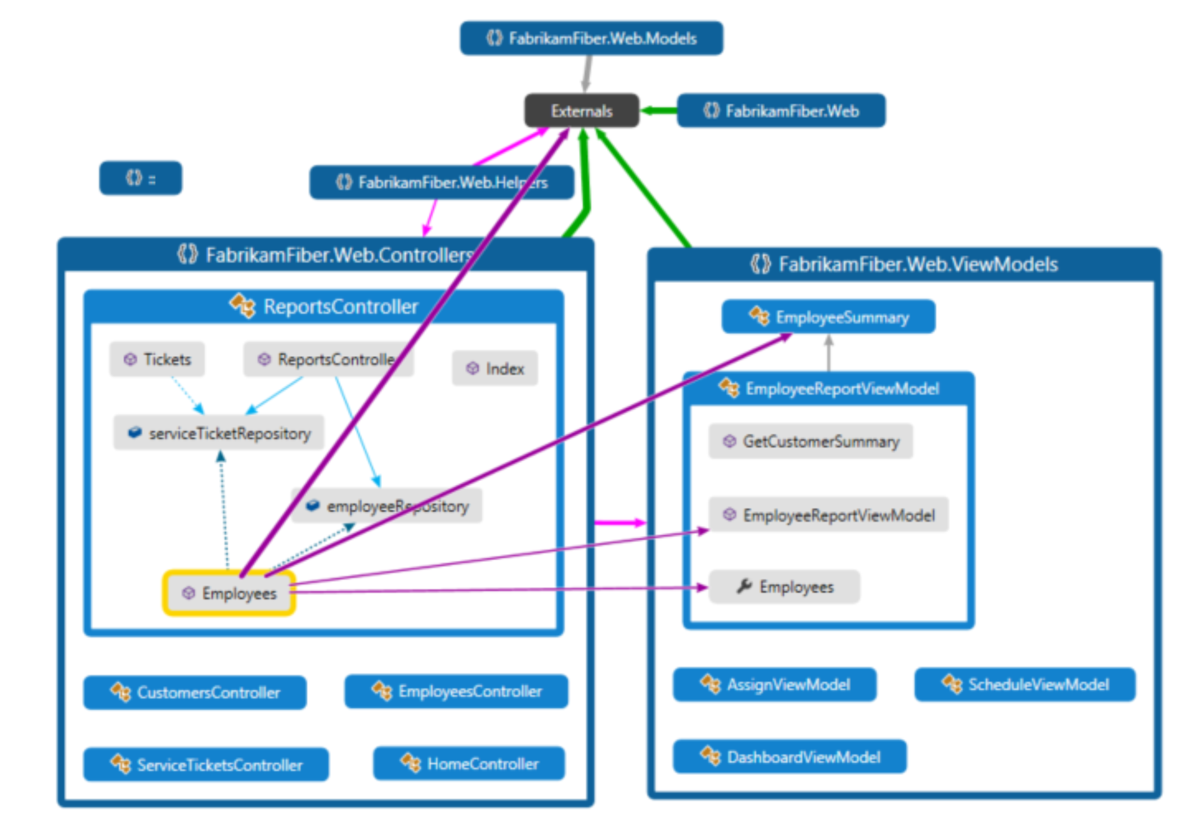
Enterprise code maps

Slide 52
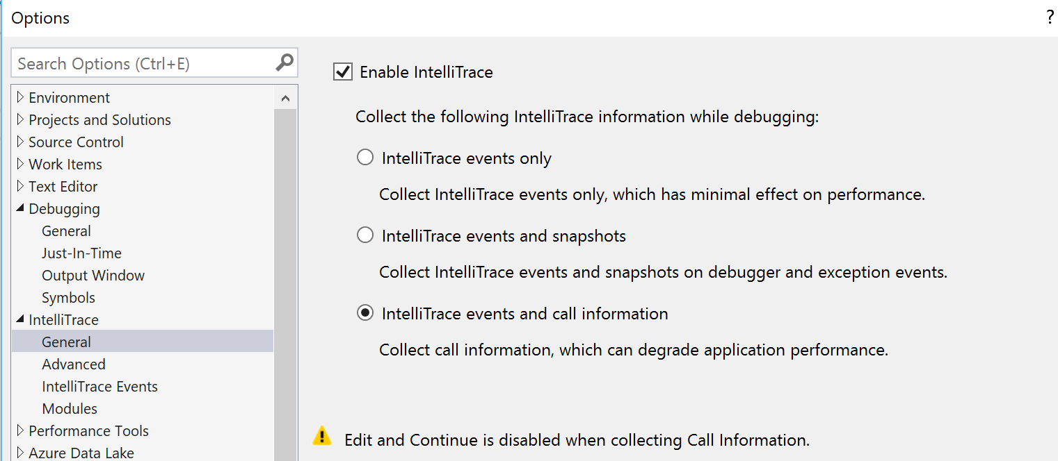
Enterprise Intellitrace

Slide 53
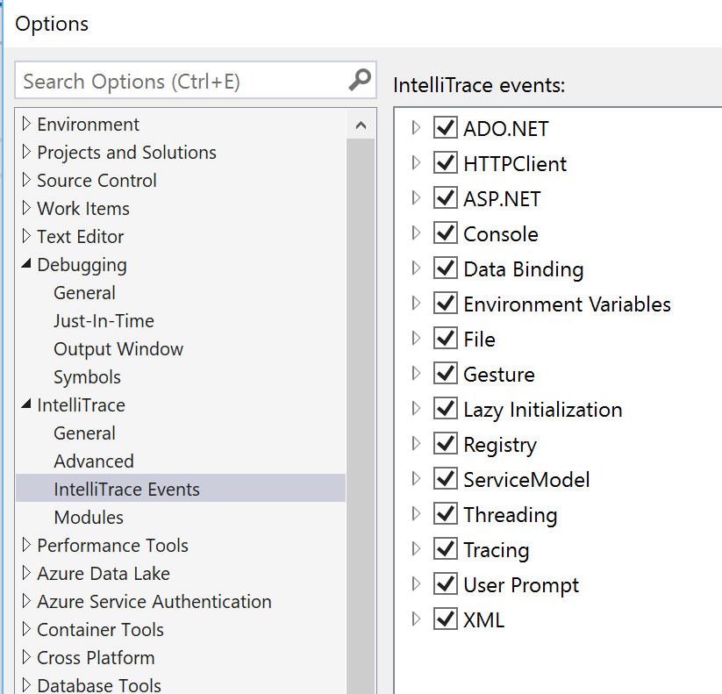
Enterprise Intellitrace

Slide 54
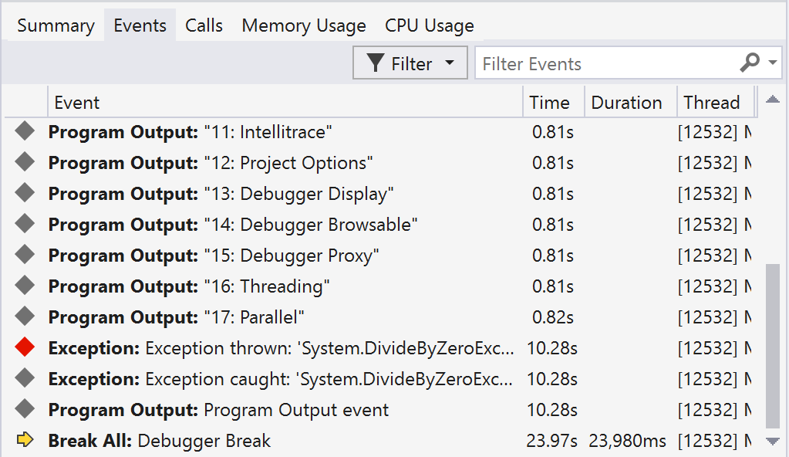
Enterprise Intellitrace

Slide 55
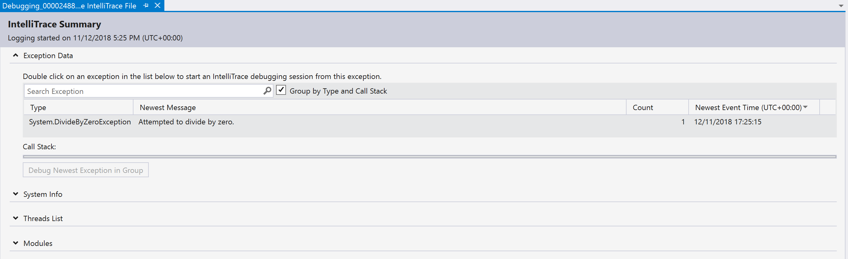
Enterprise Intellitrace

Slide 56
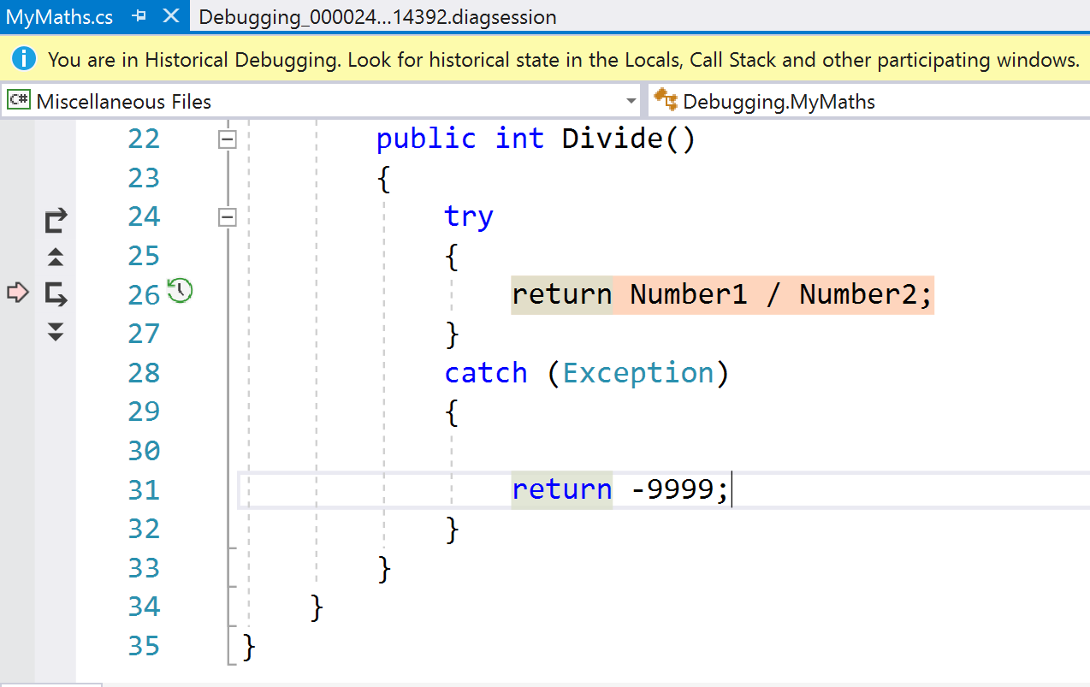
Enterprise Intellitrace

Slide 57
References
https://docs.microsoft.com/en-us/visualstudio/debugger
https://docs.microsoft.com/en-us/visualstudio/debugger/general-debugging-options-dialog-box?view=vs-2017
https://www.wintellect.com/pdb-files-what-every-developer-must-know/
https://blogs.msdn.microsoft.com/jaredpar/2011/03/18/debuggerdisplay-attribute-best-practices/ (old)
https://docs.microsoft.com/en-us/visualstudio/debugger/using-debuggertypeproxy-attribute?view=vs-2017
https://blogs.msdn.microsoft.com/visualstudio/2017/06/26/7-lesser-known-hacks-for-debugging-in-visual-studio/

Slide 58
Other DEBUGGing items
Remote Debugging
Azure Debugging
Live Sharing
WinDbg
SOS

