Slide 1
Debugging
By Philip Sutton

Slide 2
Who am i
Started full time work 1991
Worked for Science, Travel, Management Consultancy, Finance, Medical, Education
Programmed in COBOL, Fortran, Visual Basic 6, VB.net and C# as well as Sql
C# since 2005

Slide 3
Introduction
There is a bug
Visual Studio Options
Debugging Attributes
Datatips
Debugging Windows
Dumps
Symbol Servers
Browser Link/Sync/Inspector
Enterprise Features

Slide 4
There is a bug
Don’t panic
Arrange Time to Update
Gather details
Reproduce
Create Hypotheses
Write a test to reproduce bug

Slide 5
Visual Studio Options
UnderFlow/Overflow
Debugging Options
Exception Options

Slide 6
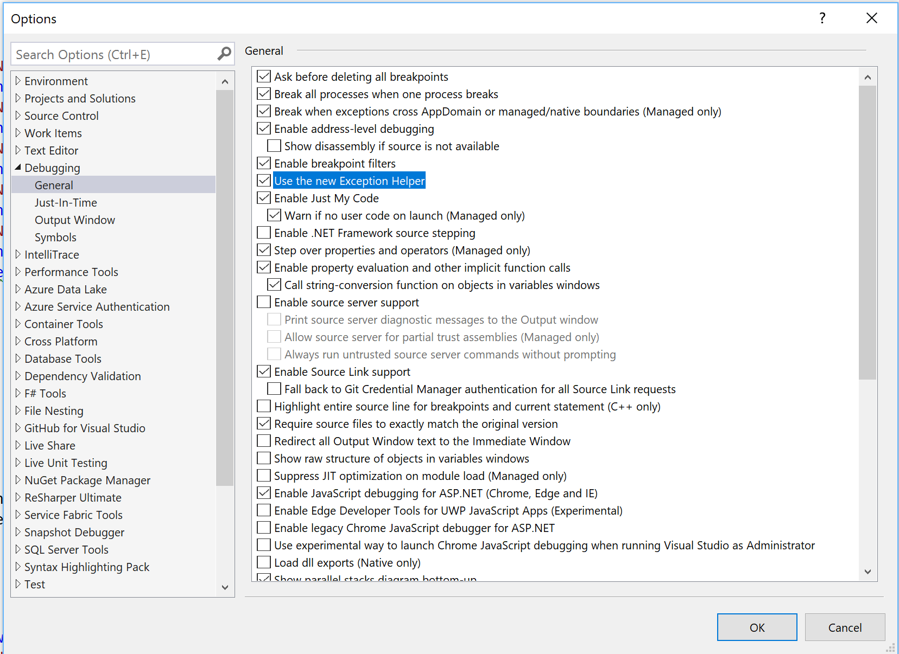
Debugging options

Slide 7
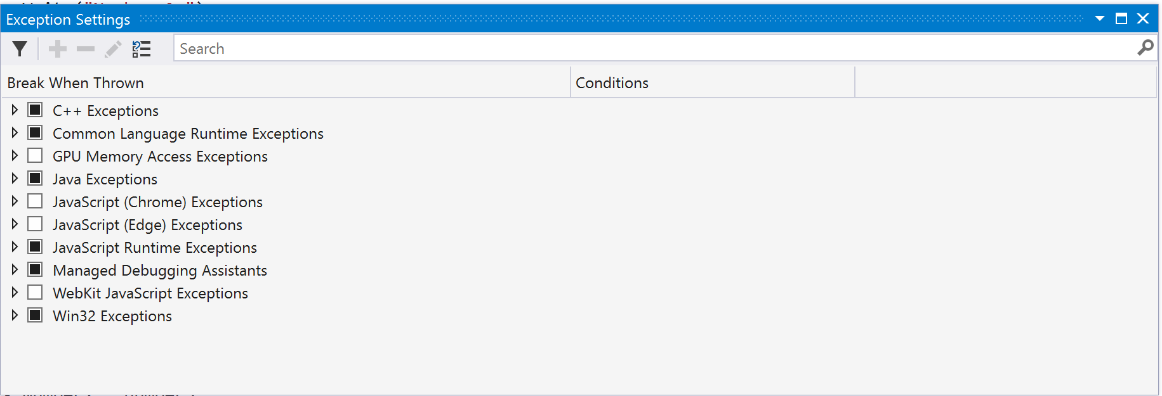
Exception options

Slide 8
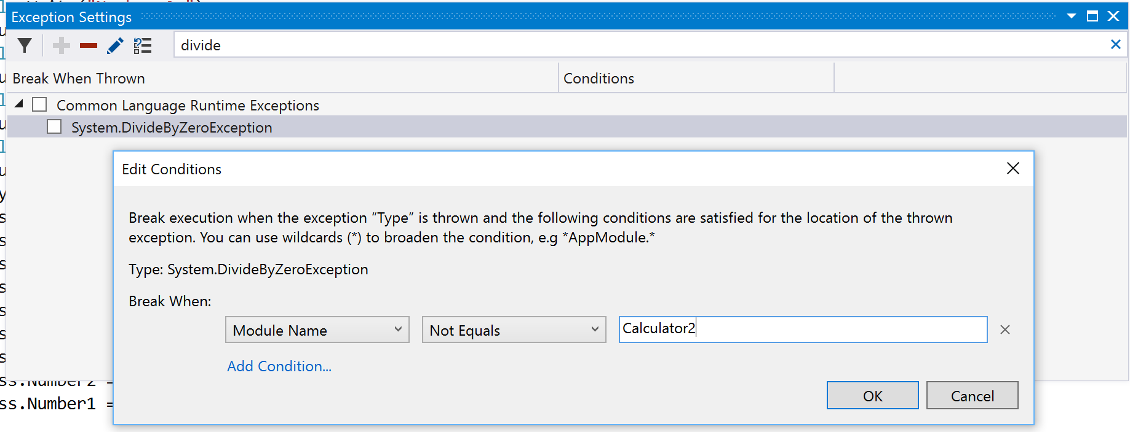



Exceptions Settings

Slide 9
Debugging Attributes
Debugger Display
Debugger Browsable
Debugger Type Proxy

Slide 10
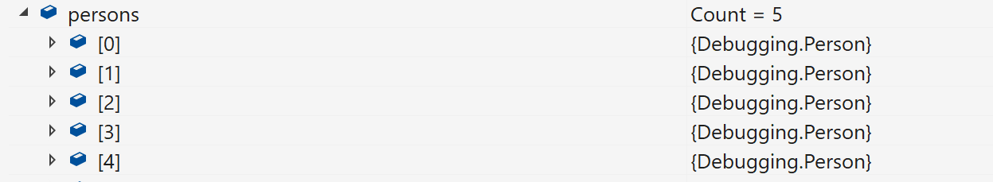
DebuggerDisplay

Slide 11
debuggerdisplay
[DebuggerDisplay("Name = {Name}")]
public class Person
{
public string Name { get; set; }
public int Age { get; set; }
}

Slide 12
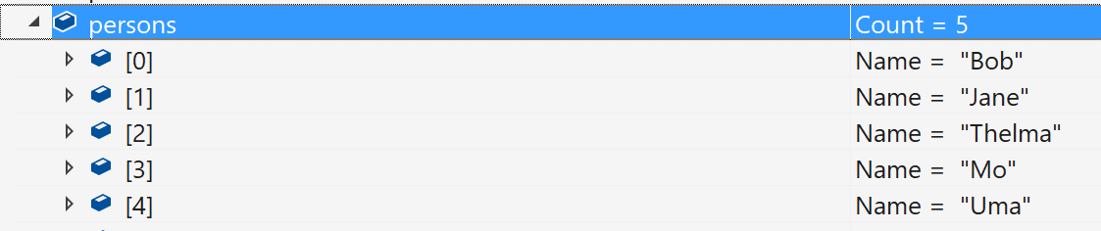
Debuggerdisplay

Slide 13

Debuggerbrowsable
public class PersonBrowse
{
public string Name { get; set; }
public int Age { get; set; }
[DebuggerBrowsable(DebuggerBrowsableState.Collapsed)]
public Address Address { get; set; }
}

Slide 14
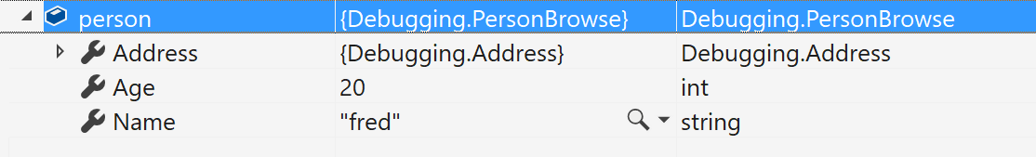
Debuggerbrowsable
Notes:
Address is shown with fields collapsed – this is the default

Slide 15
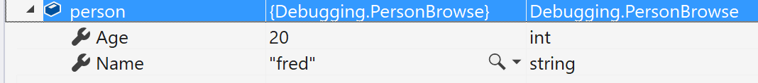
DebuggerBrowsable
None

Slide 16
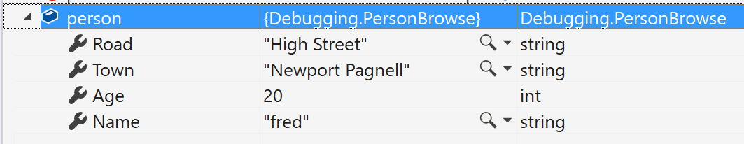
DebuggerDisplay
RootHidden

Slide 17
Debugger Proxy Type
Allows the significant and fundament change on the debugging view of a type.

Slide 18
Debugger visualisers
Some built in – xml, json, text, html
Many in the market place
Write your own
Notes:
Visualisers are a way of seeing data in a way that is more understandable than a single line of text. There are some build in ones. There are many in the marketplace. If you rewally need to you can write you won.

Slide 19
Own Visualizers
The debugger side runs within the Visual Studio debugger. The debugger-side code creates and displays the user interface for your visualizer.
The debuggee side runs within the process Visual Studio is debugging (the debuggee).
Notes:
Own

Slide 20
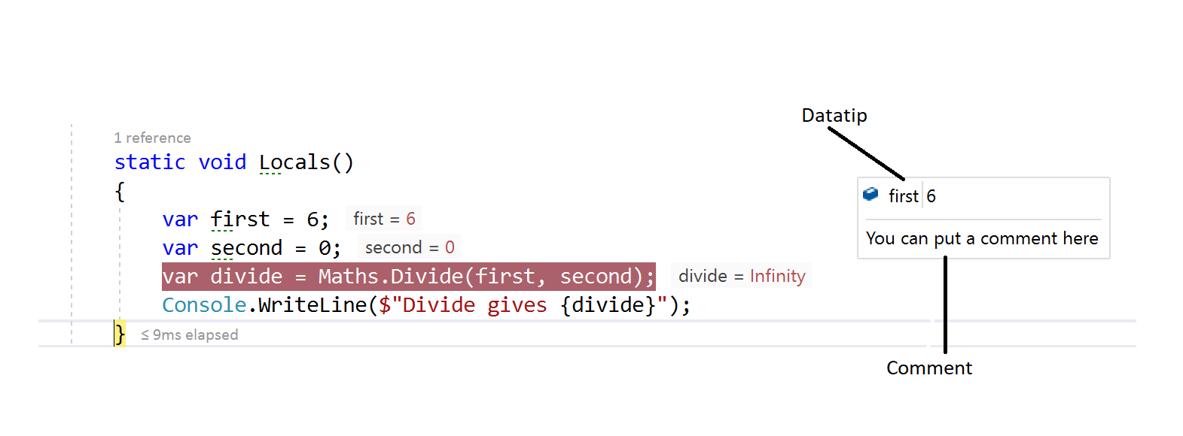
Datatips
Notes:
Putting muse over the variable and clicking the pin, the double chevron pointing down allows you to put a comment in. Datatips can be exported under debug menu – someone else is to debug.

Slide 21
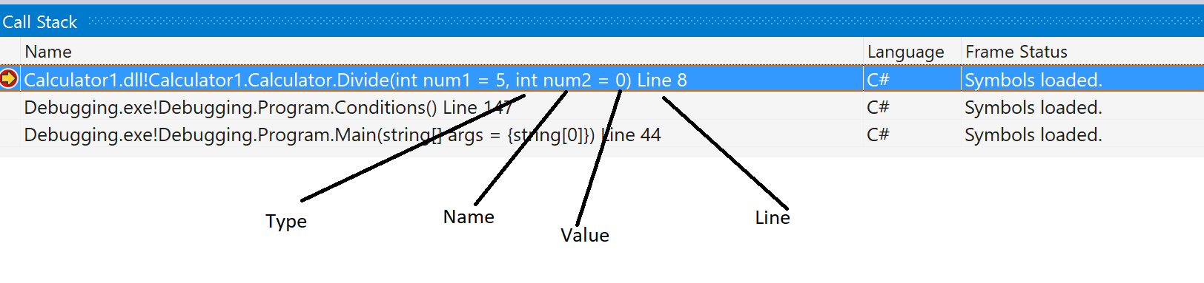
Debugging windows -Call Stack
Notes:
The call shows where you are and the calling methods. You can show differing information as shown – parameter type, name and value and the line number that you are at. Breakpoints can be set in the call stack.

Slide 22
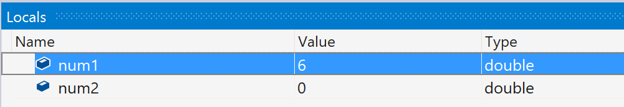
Debugging windows - Locals/Auto
Notes:
It isn’t necessary to watch everything the Locals – show the values of within the current scope, this will coincide with the focus of the call stack. The autos window shows the values around the current breakpoint., also coinciding with the call stack. Return values are also shown and

Slide 23
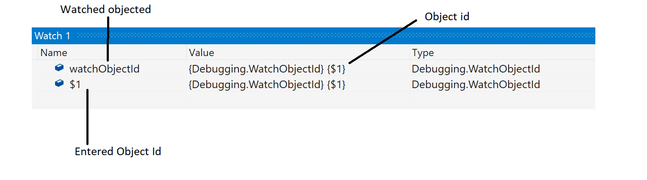
Debugging windows - Watch Window
Notes:
Allows to keep track of variables and methods.

Slide 24
Multi-threaded applications
Thread Window
Debug Toolbar
Debug Location
Parallel Stacks
Parallel Watch
Notes:
Able to freeze and flag.

Slide 25
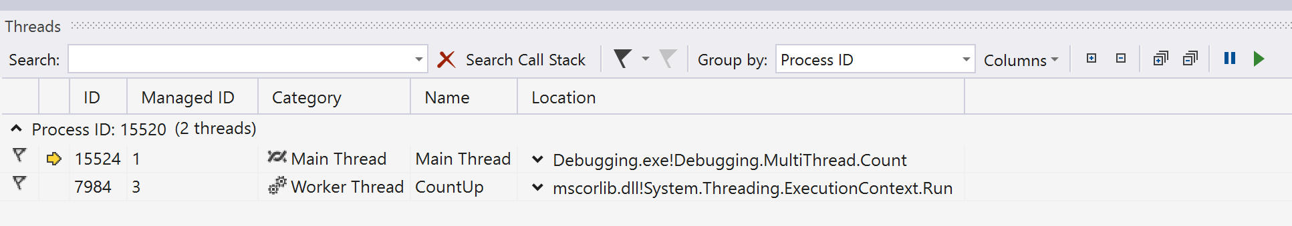
Multithreaded Debugging Windows - Threads

Slide 26
Multithreading windows – debug toolbar

Slide 27
Multithreading windows debug location

Slide 28
Multithreading windows parallel stacks
private static void ParallelExample()
{
var names = new List<string> {"Bob", "Judy", "Chris", "Ashley"};
Parallel.ForEach(names, (name) =>
{
for (var i = 0; i < 10; i++)
{
Console.WriteLine($"Hello {name} {i}");
}
});
}

Slide 29
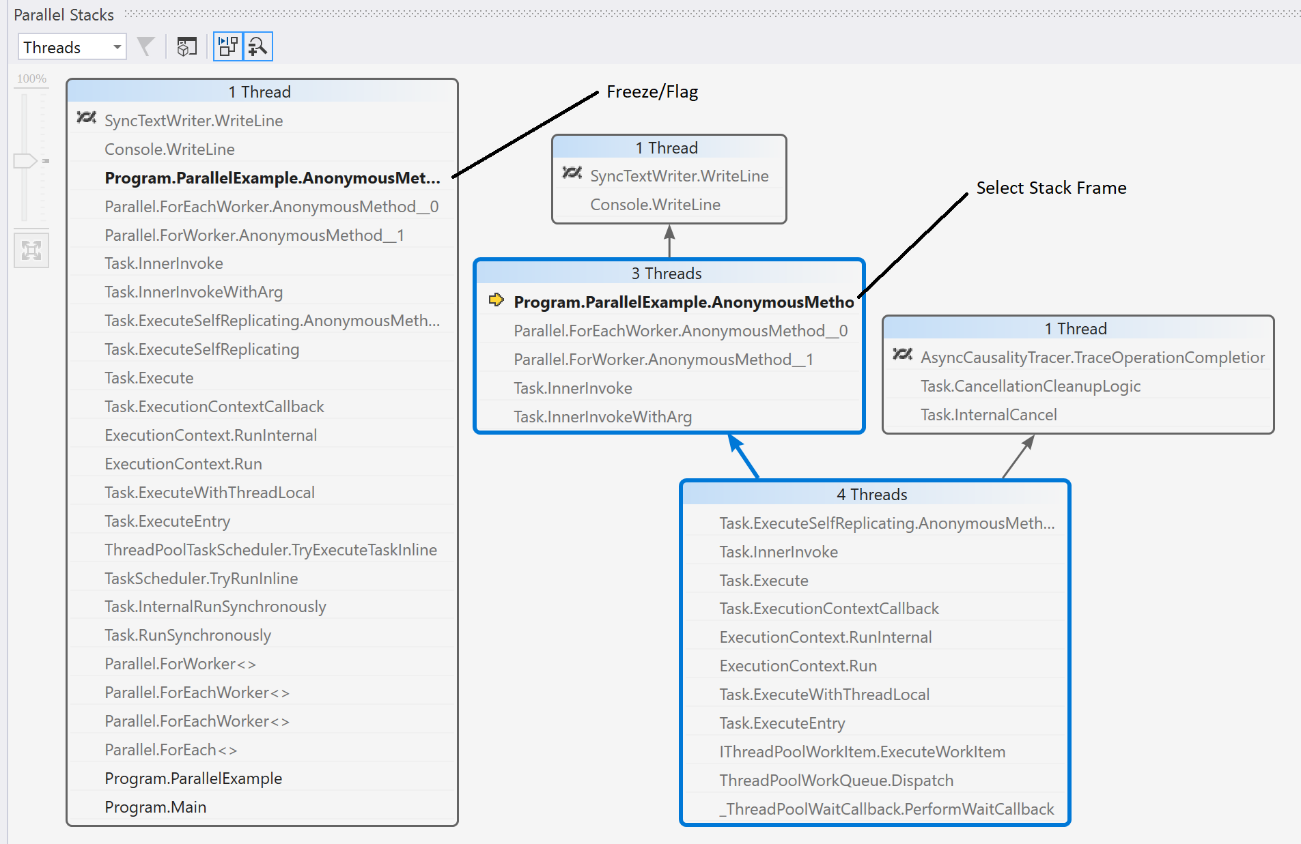
Multithreading windows parallel stacks

Slide 30
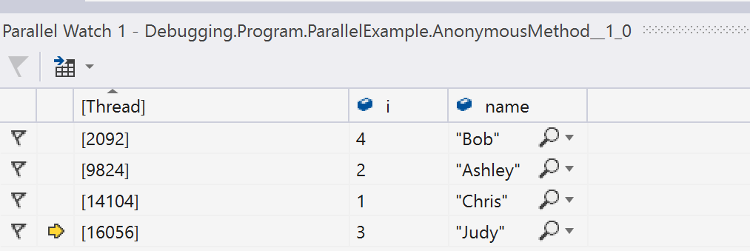
Multithreading windows parallel watch
Notes:
Filter can be added, also visualizers

Slide 31
Breakpoints
Data Breakpoints
Break on return
Condition
Hit Count
Filter
When hit
Break at Function
Label

Slide 32
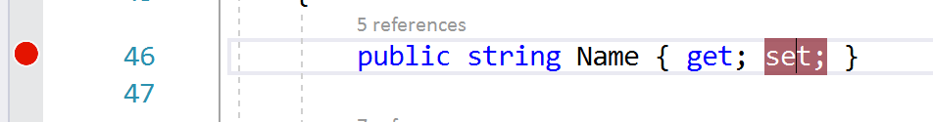
Breakpoints Data

Slide 33
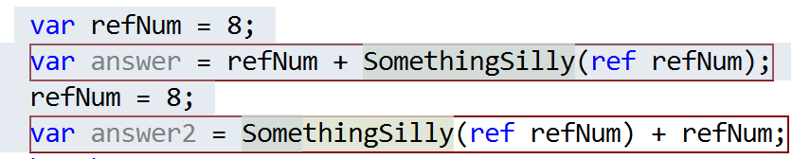
Breakpoints break on return

Slide 34
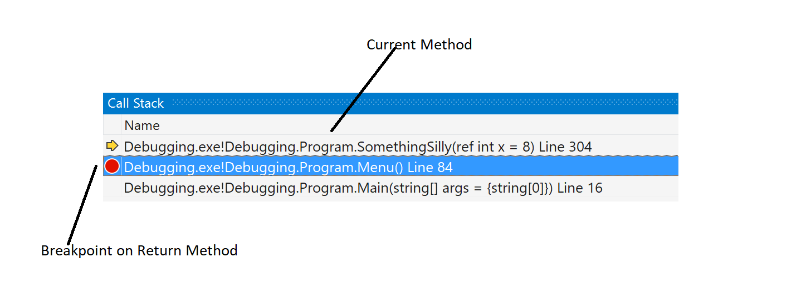
Breakpoints break on return

Slide 35
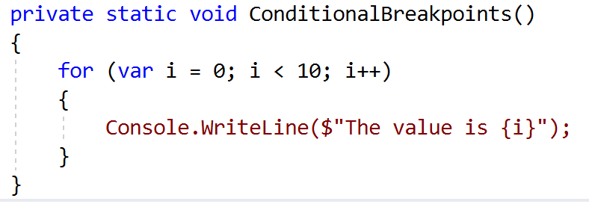
Breakpoints Conditional breakpoints

Slide 36
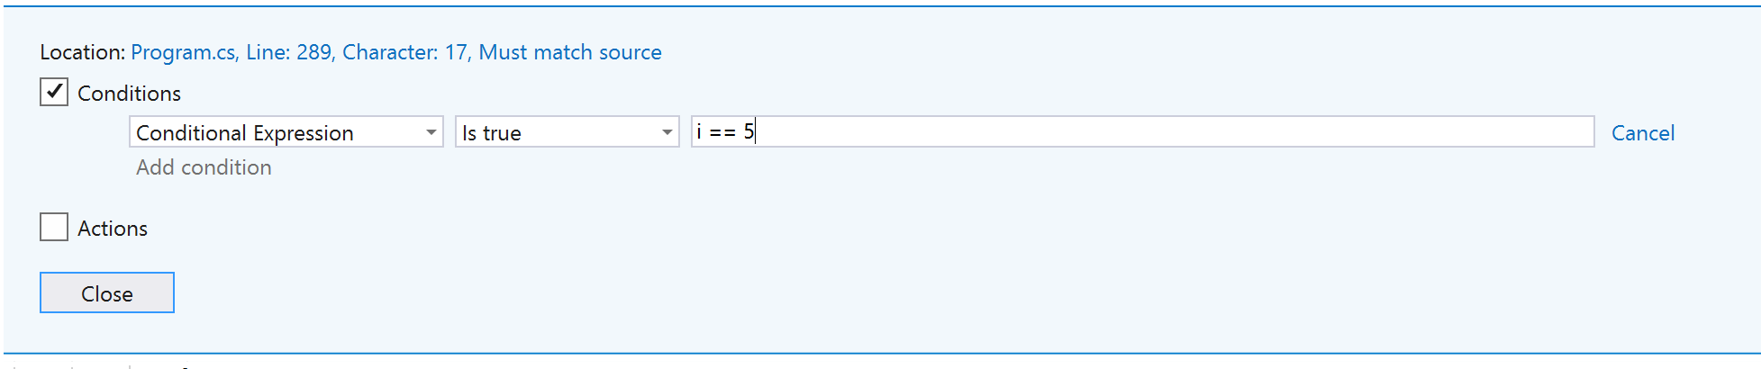
Breakpoints conditional

Slide 37
Breakpoints conditional
private static void ConditionalBreakpoints()
{
for (var i = 0; i < 10; i++)
{
if ((Debugger.IsAttached) && (i==5))
{
Debugger.Break();
}
Console.WriteLine($"The value is {i}");
}
}

Slide 38
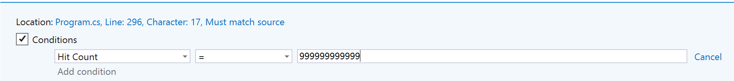
Breakpoints hit count

Slide 39
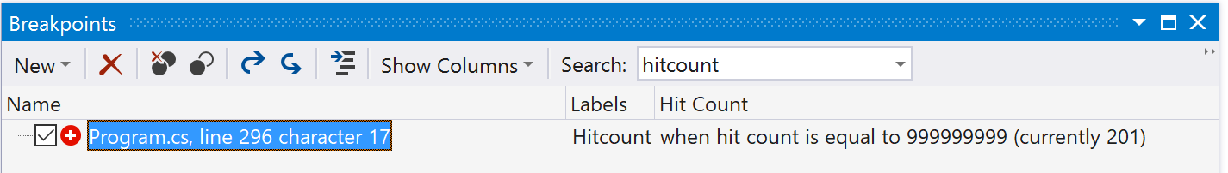
Breakpoints hit count

Slide 40
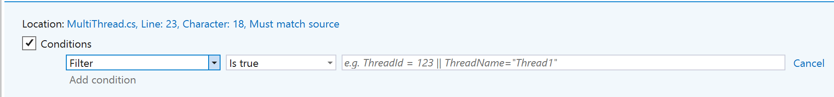
Breakpoints filter

Slide 41
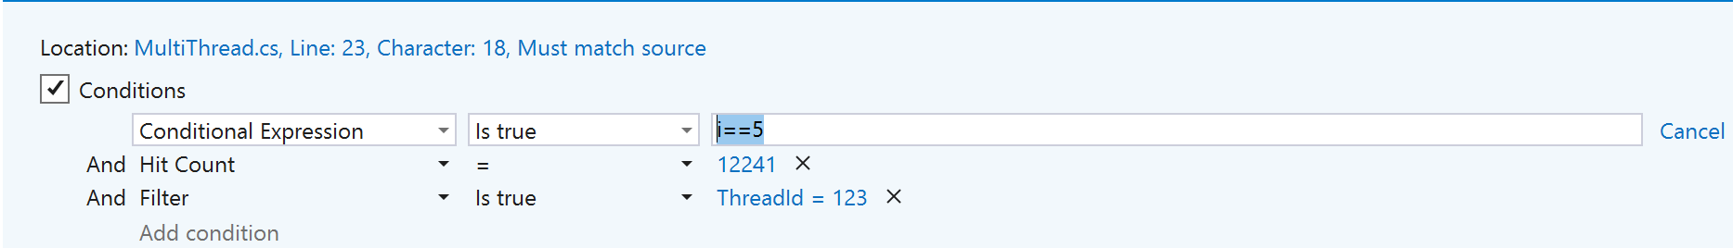
Breakpoints filter

Slide 42
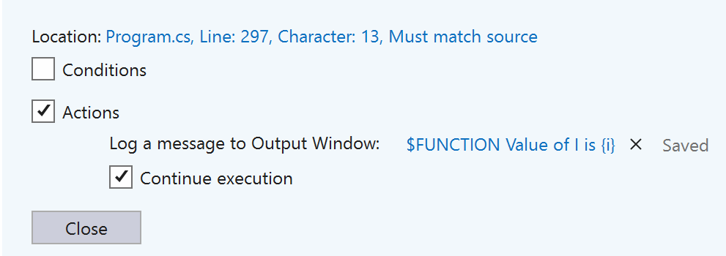
Breakpoints when hit

Slide 43
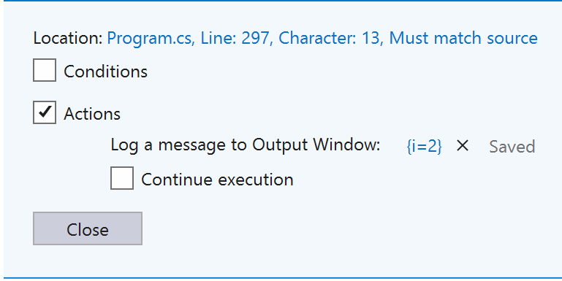
Breakpoints when hit

Slide 44
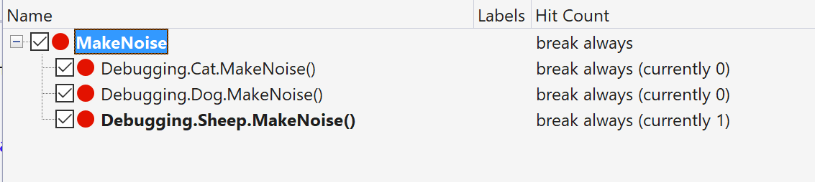
Breakpoints Break at function

Slide 45
Address level debugging
Memory
Disassembly
Registers

Slide 46
WPF
Live Visual Tree
Live Property Explorer

Slide 47
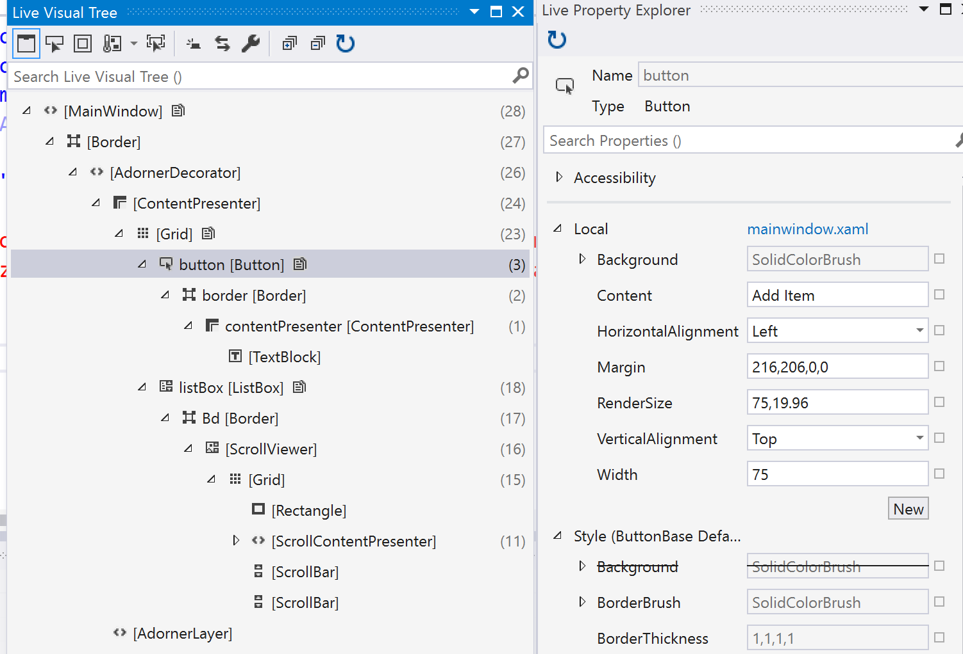
WPF/UWP Visual tree/ property explorer

Slide 48
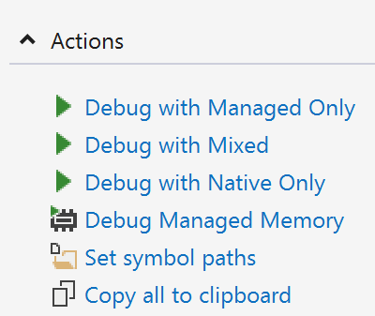
Dumps

Slide 49
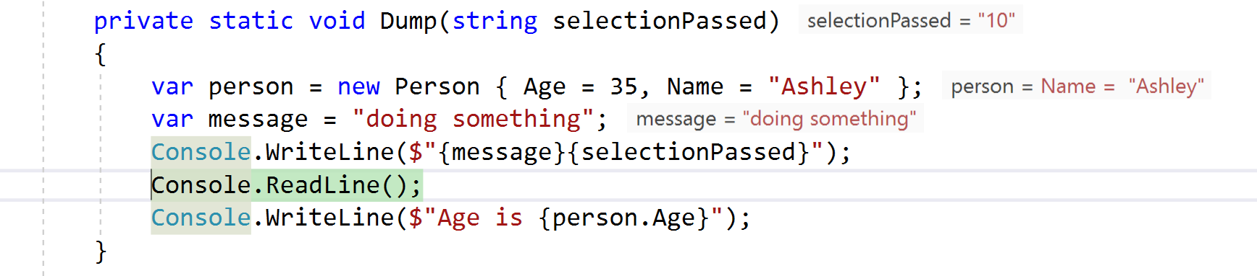
Dumps

Slide 50
Symbol servers
The symbol server enables the debuggers to automatically retrieve the correct symbol files without product names, releases, or build numbers.

Slide 51
Front End
Browser Link
Sync
Inspector

Slide 52
Enterprise
Code Maps
Intellitrace

Slide 53
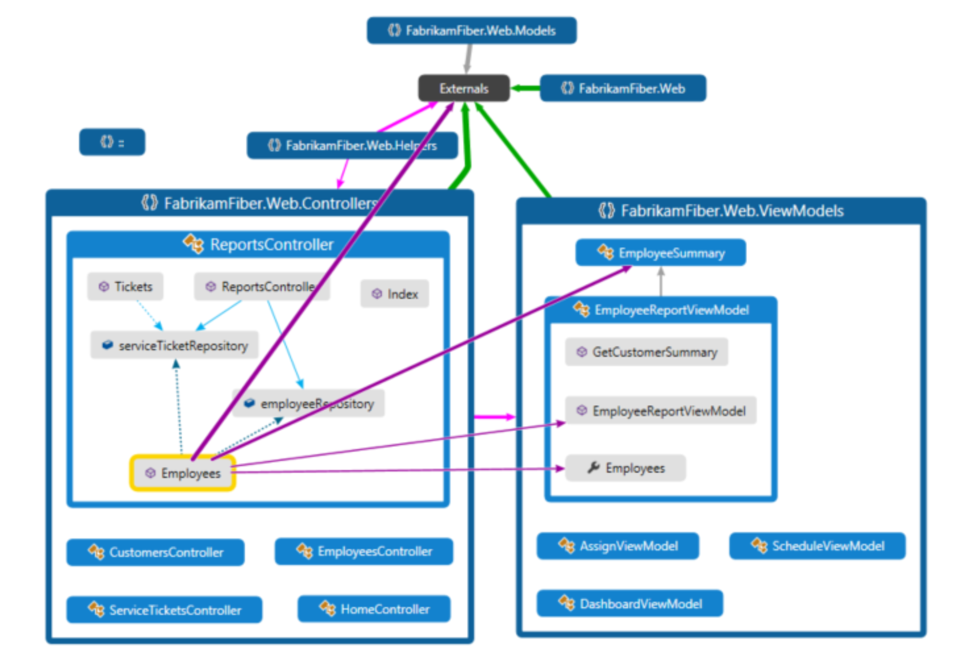
Enterprise code maps

Slide 54
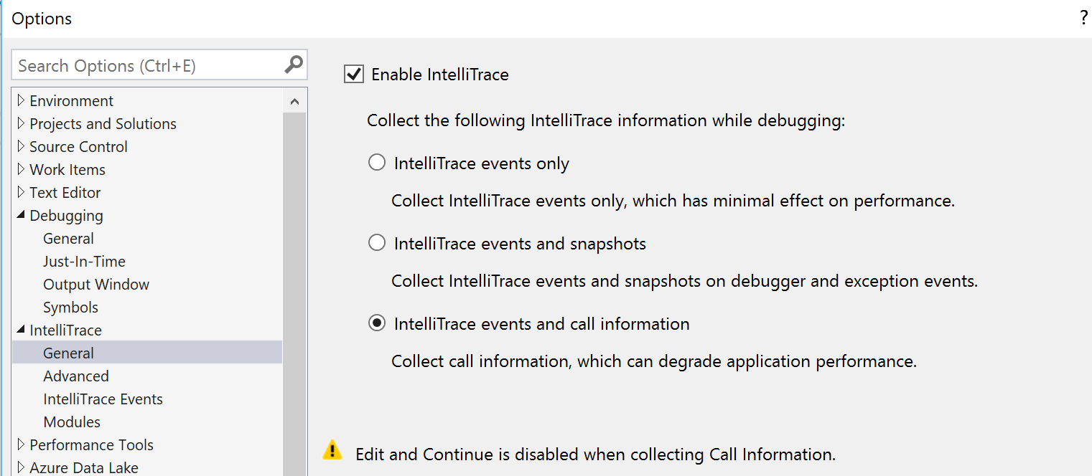
Enterprise Intellitrace

Slide 55
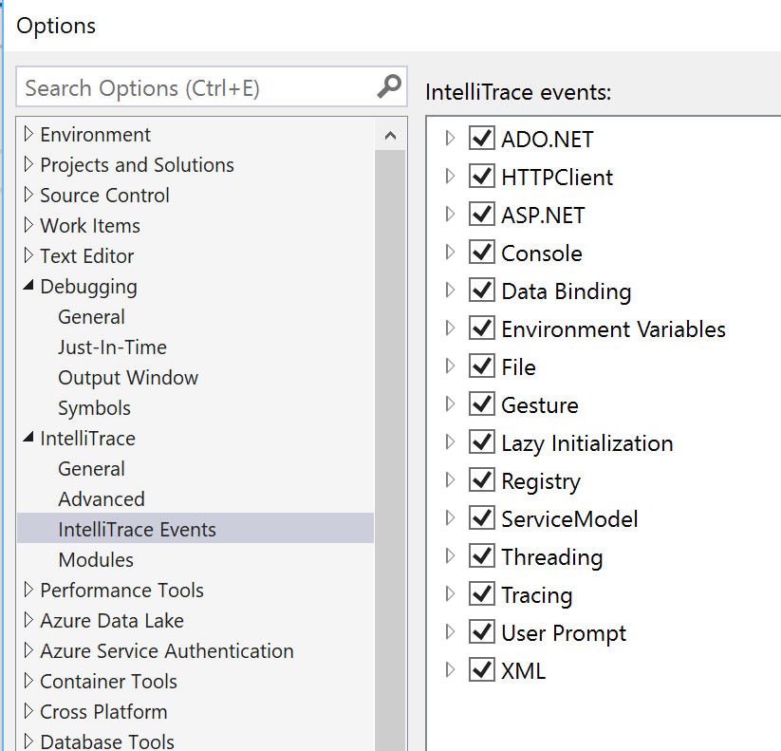
Enterprise Intellitrace

Slide 56
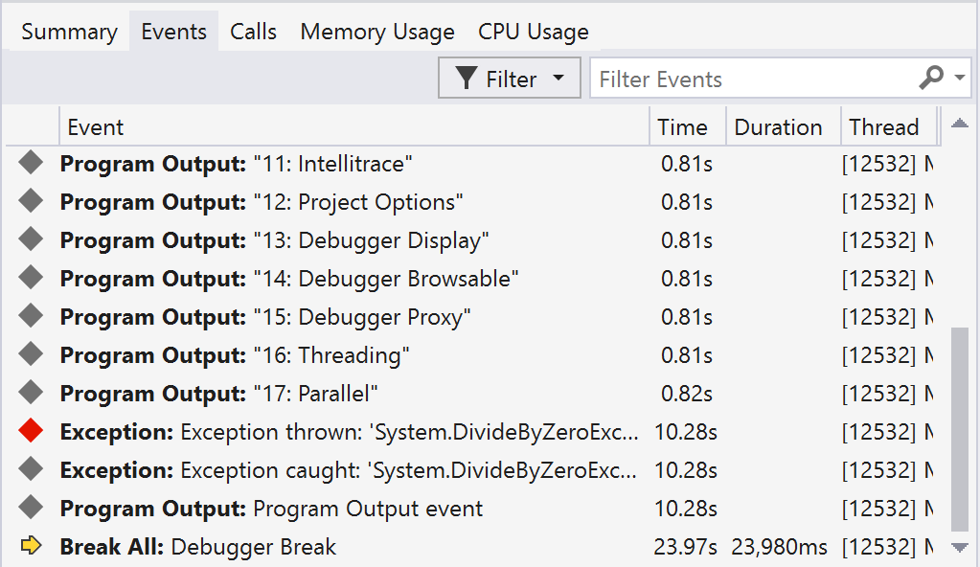
Enterprise Intellitrace

Slide 57
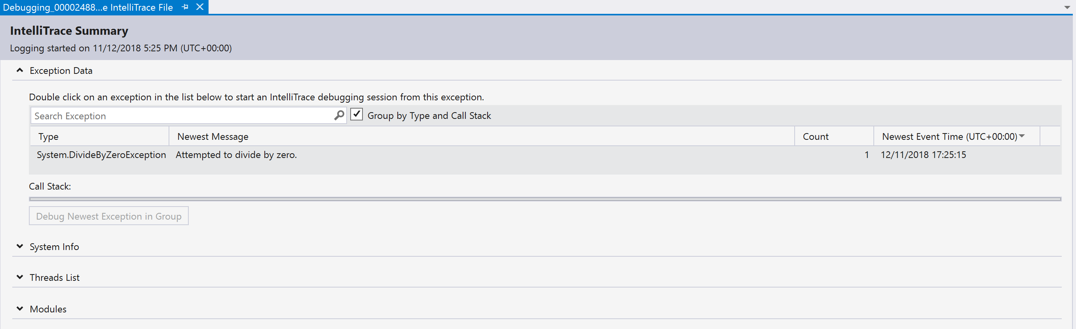
Enterprise Intellitrace

Slide 58
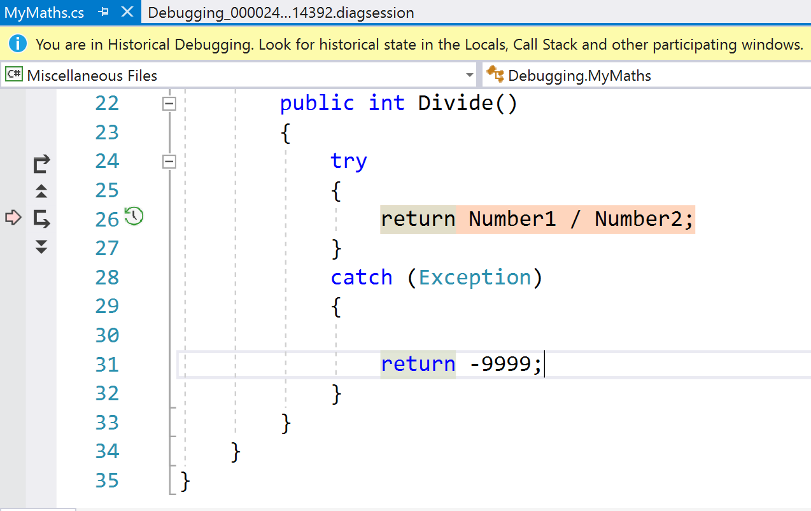
Enterprise Intellitrace

Slide 59
References
https://docs.microsoft.com/en-us/visualstudio/debugger
https://www.wintellect.com/pdb-files-what-every-developer-must-know/
https://blogs.msdn.microsoft.com/jaredpar/2011/03/18/debuggerdisplay-attribute-best-practices/ (old)
https://docs.microsoft.com/en-us/visualstudio/debugger/using-debuggertypeproxy-attribute?view=vs-2017

Slide 60
Other DEBUGGing items
Remote Debugging
Azure Debugging
Live Sharing
WinDbg
SOS

