Slide 1

19AIE304 – Big Data and Database Management System
Analysis of Weather Data Using Spark
Guided By:
Mr. Sarvanan S.
Done By:
G.Y. SAI VARUN
G. SAI SURYA TEJA
G.B.R. RAVI TEJA

Slide 2
INTRODUCTION
Problem Statement:
Air pollution is increasing every year which is growing rapidly, which is decreasing the quality of the air.
As it is getting worse, citizens are mainly concerned about the health. So, for focusing on the decreasing the pollution, it is necessary to make an analysis of the parameters like temperature, humidity, pressure etc.

Slide 3
INTRODUCTION
By using the Sofia Air Quality data Set, A Spark analysis and data prediction system is being designed where this model can-do real-time prediction using ML Algorithms like Linear Regression and Decision Tree Algorithm, by predicting the humidity, which gives a direct inference about greenhouse gases and global warming.
Since, Air Quality Data is very large implementing this using Spark will be more efficient in terms of speed, since it follows parallelism and live weather data will also be coming, which Spark Streaming Would take care off.

Slide 4
DATASET
https://www.kaggle.com/hmavrodiev/sofia-air-quality-dataset
Dataset Size: 7.8 GB
Attributes: 9
(_c0, sensor_id, location, lat, lon, timestamp, pressure, temperature, humidity)
No of Records : 97288452

Slide 5
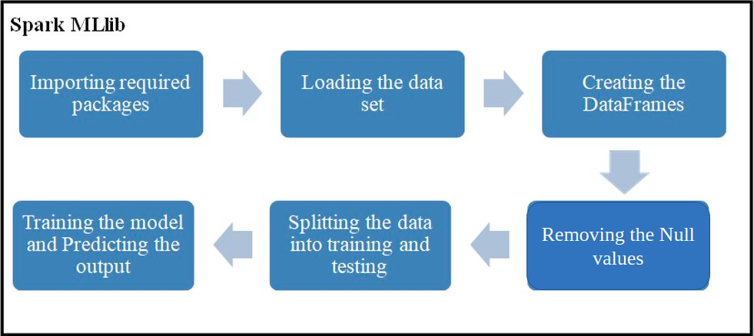
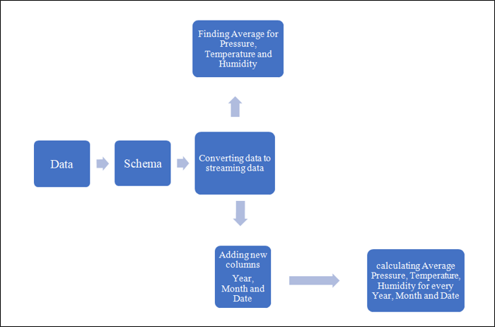
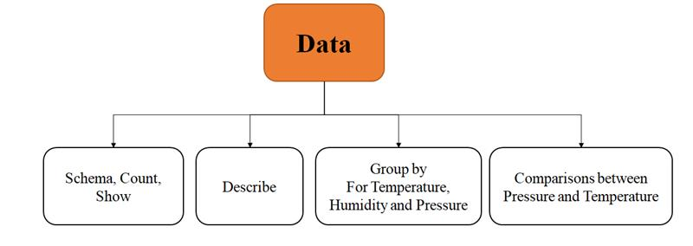
IMPLEMENTATION

Slide 6

THANK YOU!!

