Slide 1
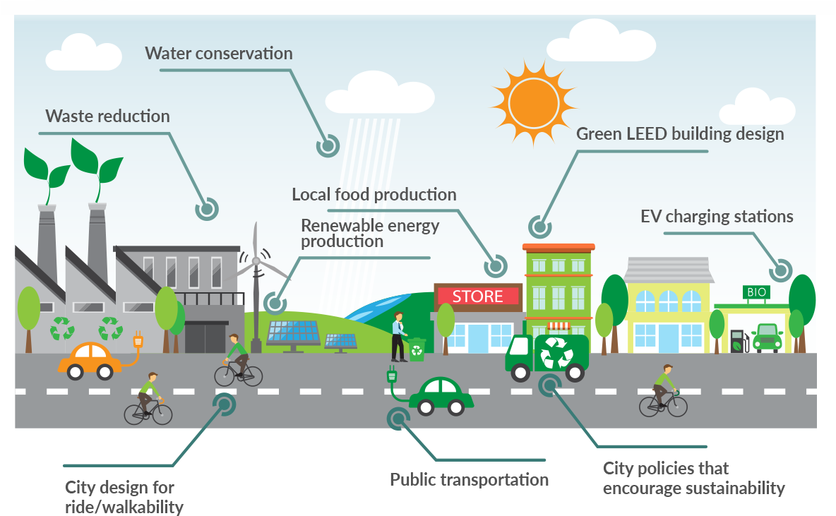
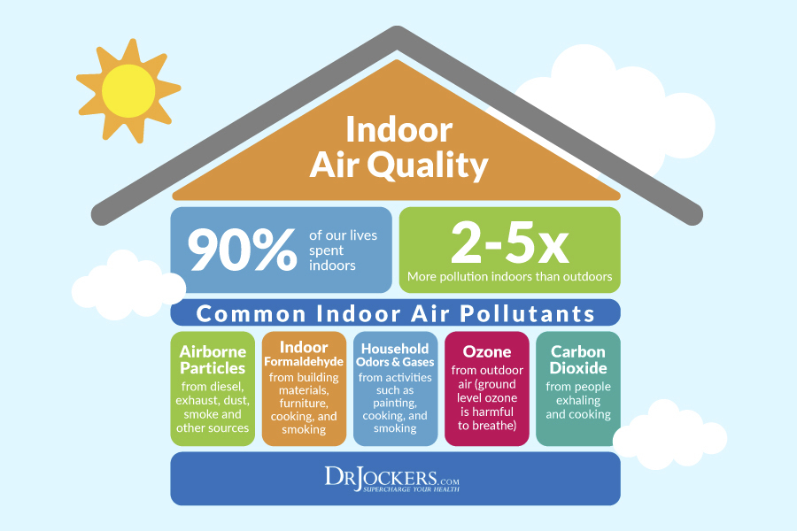
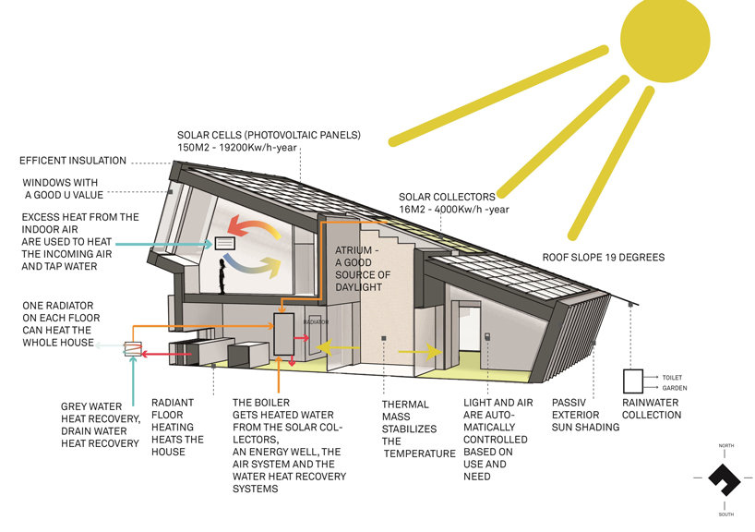
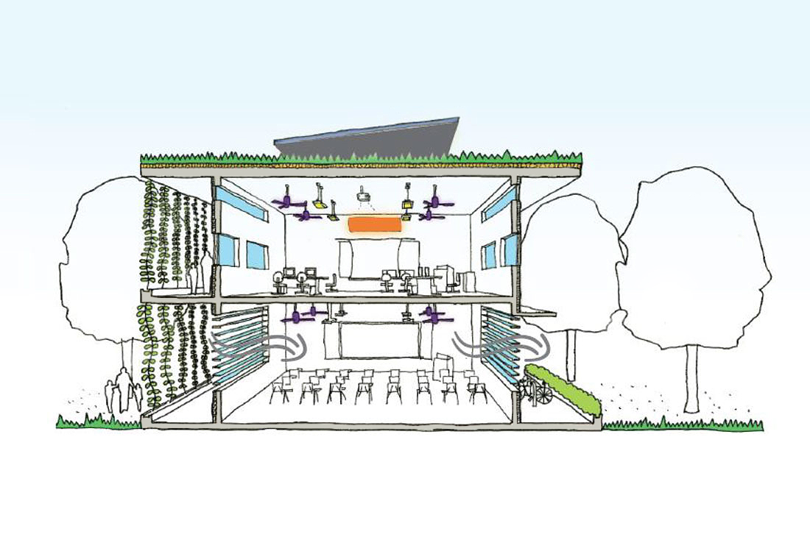
Building Energy Conservation and Eco-city
Indoor Air Quality
Building Light Environment and Solar Energy Utilization
Green Buildings Design.

