Slide 1
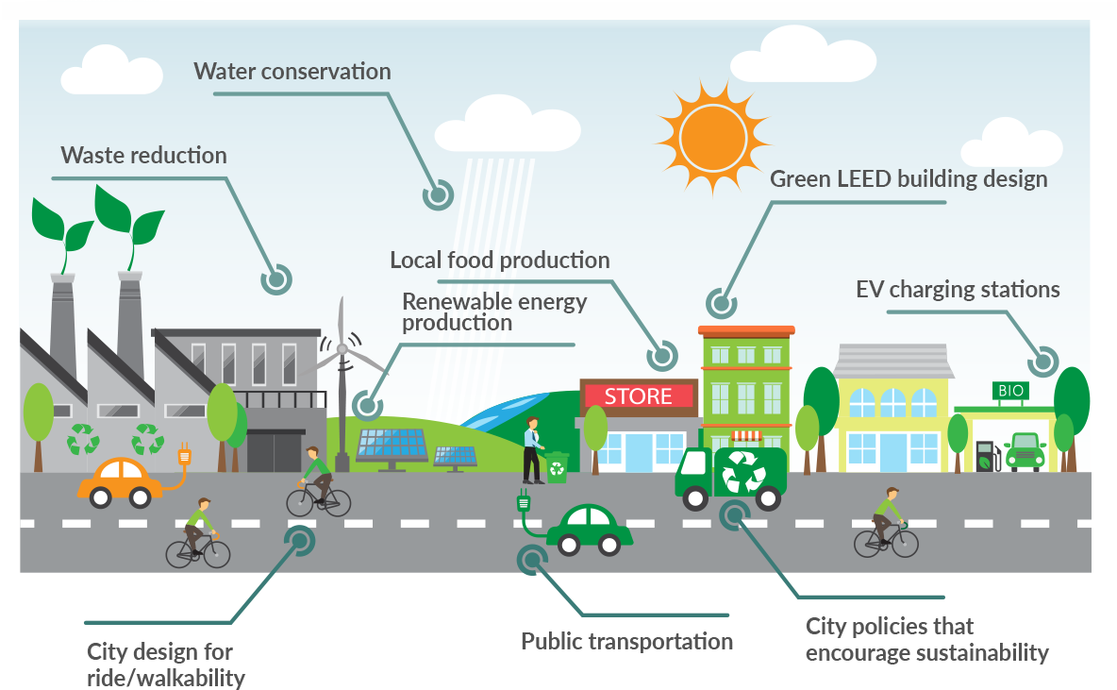
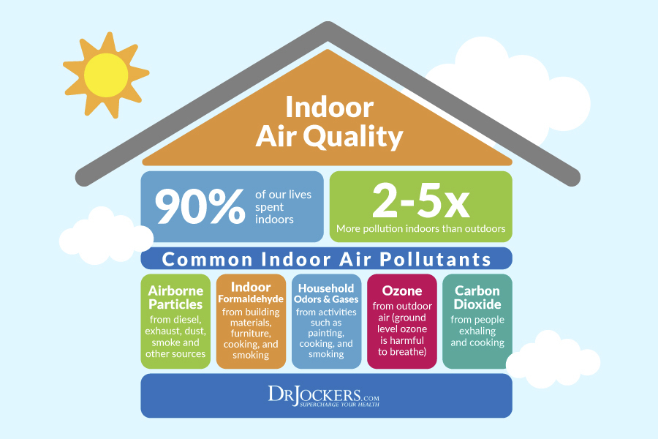
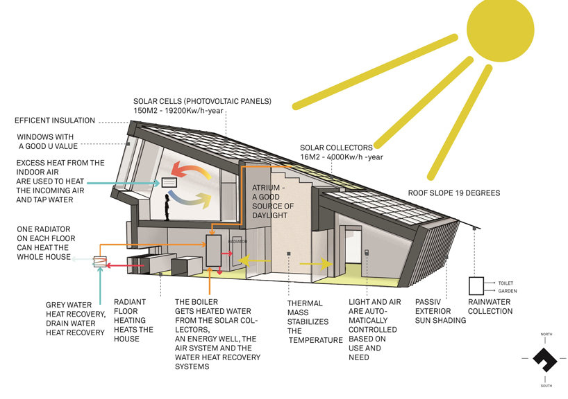
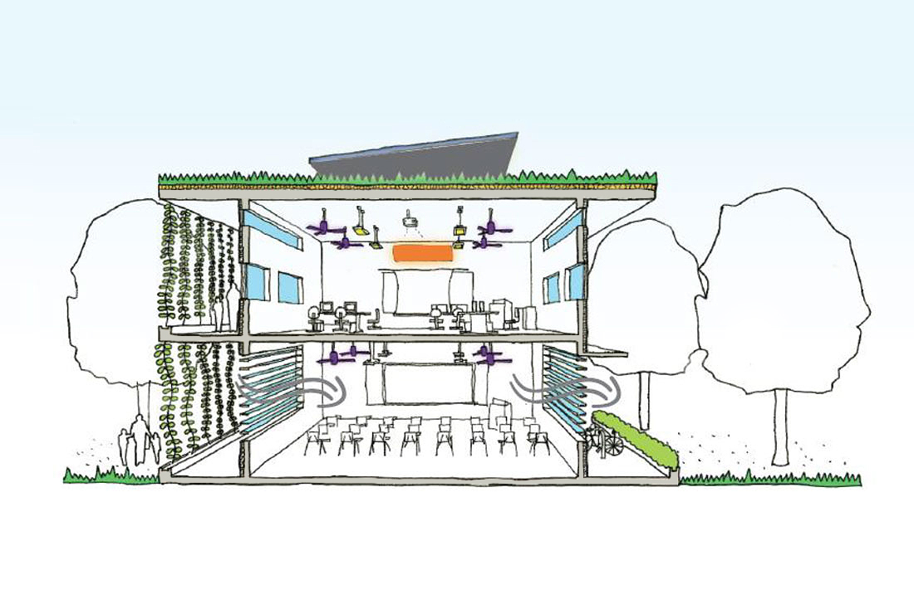
Building Energy Conservation and Eco-city
Indoor Air Quality
Building Light Environment and Solar Energy Utilization
Green Buildings Design.

Slide 2
1. 建筑节能与生态城市 Building Energy Conservation and Eco-city
2. 室内空气品质
Indoor Air Quality
3. 天然采光与太阳能利用Building Light Environment and Solar Energy Utilization
4. 绿色可持续设计Green Buildings Design.

Slide 3
1. 建筑节能与生态城市 Building Energy Conservation and Eco-city
2. 室内空气品质
Indoor Air Quality
3. 天然采光与太阳能利用Building Light Environment and Solar Energy Utilization
绿色可持续设计
Green Buildings Design
01
02
03
04

Slide 4
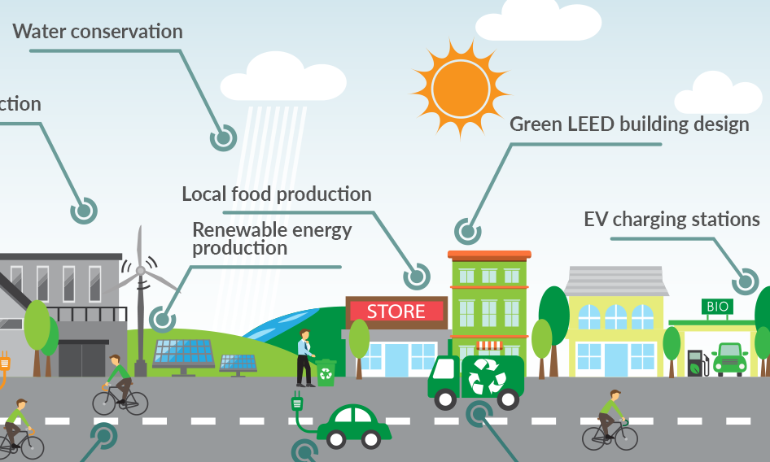
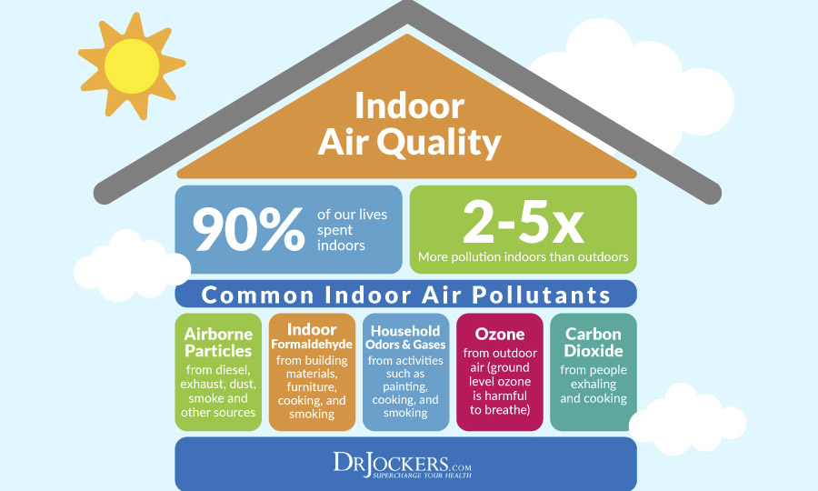
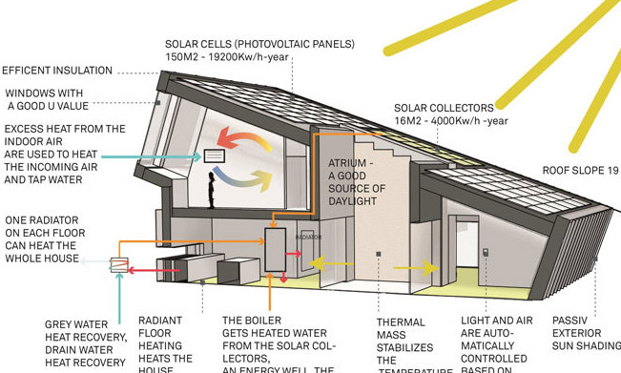
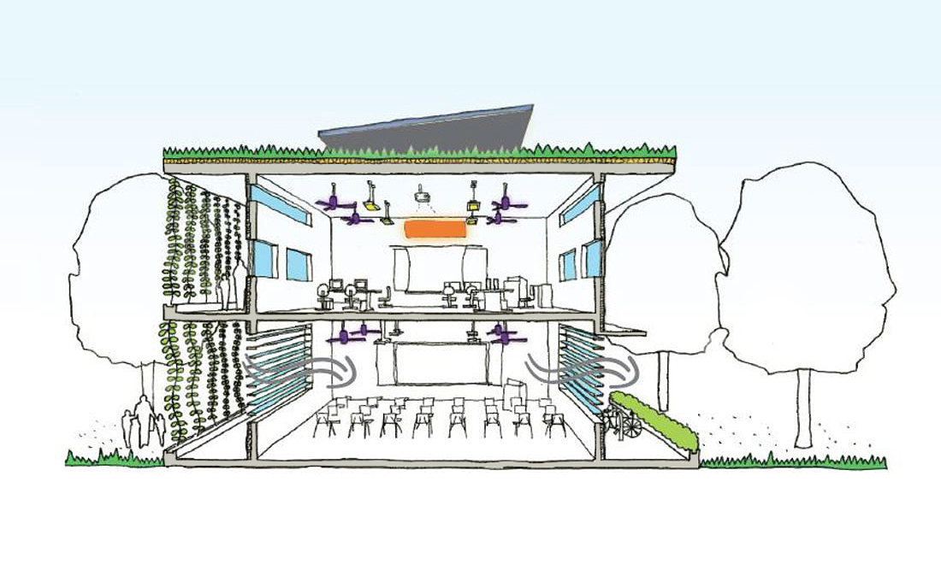
建筑节能与生态城市
Building Energy Conservation and Eco-city
室内空气品质
Indoor Air Quality
01
02
天然采光与太阳能利用Building Light Environment and Solar Energy Utilization
绿色可持续设计
Green Buildings Design
03
04

Slide 5
建筑节能与生态城市
Building Energy Conservation and Eco-city
室内空气品质
Indoor Air Quality
天然采光与太阳能利用Building Light Environment and Solar Energy Utilization
绿色可持续设计
Green Buildings Design
01
02
03
04

