Slide 1
10 Tips for Becoming a Top 1% AI User
I run 10 AI agents daily. They process my papers, triage my email, and help me prioritise every decision I make.
Dr Manuel Corpas
Senior Lecturer, University of Westminster · Turing Fellow Author, AI Fluency (2026) London Bioinformatics Meetup · 26 February 2026
Notes:
Welcome everyone. I'm Manuel Corpas. I run 10 AI agents daily. They process my research papers, triage my inbox, draft my writing, and help me prioritise every decision I make. Tonight I want to share 10 practical techniques that got me there. This is about AI fluency: the habits and workflows that compound your productivity. We'll start with quick wins you can adopt tomorrow morning, and end with a live demo of an open-source bioinformatics tool I built this week.
TIMING: 2 min

Slide 2
The 99% vs the 1%
Most researchers
Top 1%
→ Use ChatGPT for one-off questions
→ Copy-paste into web UIs
→ Treat AI as a search engine
→ Every conversation starts from zero
→ AI agents that run 24/7
→ Persistent memory across months
→ Automated research pipelines
→ Build and ship tools, not just use them
"A 10x scientist does not think 10x harder. They think once and reuse that insight 10x."
Notes:
Here's the gap I see every day. Most researchers use AI like a search engine. Open ChatGPT, ask a question, paste the answer, move on. No memory. No automation. No compounding. The top 1% have systems that remember, agents that work while they sleep, and infrastructure that compounds. A 10x scientist does not think 10x harder; they think once and reuse that insight 10x. That is precisely what systematic AI collaboration enables. The good news: you can cross this gap in a weekend.
TIMING: 3 min

Slide 3
Tip 1
Use AI Inside Your IDE, Not a Browser
→ Claude Code in your terminal: reads your entire codebase, edits files, runs tests, commits to git
→ Cursor / Windsurf: AI-native editors with inline code generation
→ GitHub Copilot: autocomplete on steroids
"I needed to find a marking task hidden in the university platform. I had spent too long clicking through menus. The AI found the path, surfaced the instructions, and walked me through each step."
The browser is for chatting. The IDE is for building.
Notes:
Tip 1 is the lowest-hanging fruit. Stop copy-pasting code between ChatGPT and your editor. I use Claude Code in my terminal. It reads my entire codebase, understands file structure, edits files directly, runs tests, and commits to git. One example: I needed to locate a marking task hidden in our labyrinthine university platform. I had spent too long clicking through menus, unsure whether I had missed something. The AI found the path, surfaced the instructions, and walked me through each step. In that moment, I experienced something far more valuable than convenience: reassurance. If you do one thing after tonight, install Claude Code.
TIMING: 2 min

Slide 4
Tip 2
Build a Prompt Library
# CLAUDE.md — your AI reads this every session
## Python Standards
- Python 3.11+, pathlib for all paths
- Logging with timestamps to LOGS/
- Single responsibility per script
## Architecture Rules
- Agent folders use two-digit prefixes
- Every agent: PYTHON/, DATA/, LOGS/, OUTPUT/
Think of it as onboarding documentation for your AI. The better the docs, the better the AI performs.
Notes:
Tip 2: build a prompt library. Every time you start a new Claude session, it reads a CLAUDE.md file at your project root. This is your AI onboarding document. Mine contains Python standards, architecture rules, path patterns, common commands. I never have to repeat instructions. The AI already knows how my project works. Treat your CLAUDE.md like you would treat onboarding docs for a new team member.
TIMING: 2 min

Slide 5
Tip 3
Give Your AI Long-Term Memory
→ I have 30,000 notes and emails embedded over 12 years
→ Vector database (ChromaDB): semantic search across everything
→ It helps me prioritise decisions and projects, aligned to my goals
$ python query_corpas.py "genomic equity metrics"
Found 7 results across notes, publications, sessions
Top match (0.89): "HEIM Index measures population
representation using heterozygosity and FST..."
Every task becomes 'assemble and adapt existing insight' rather than 'think from zero.' Your past self works for your present self.
Notes:
Tip 3: memory. The biggest limitation of AI is that every conversation starts from zero. I solved this with a RAG pipeline. I have 30,000 notes and emails accumulated over 12 years, all embedded in ChromaDB. It functions as a cognitive layer that helps me decide how to respond to requests in a way that maintains laser focus on my goals. I can ask: 'What did I decide about the Wellcome proposal?' and get a real answer with source citations. The mental shift is substantial. Every task becomes 'assemble and adapt existing insight' rather than 'think from zero.' Your past self works for your present self.
TIMING: 2 min

Slide 6
Tip 4
Use Voice, Not Just Text
→ Whisper runs locally on Apple Silicon: transcribe anything in seconds
→ Voice memo → structured notes: talk for 5 min, get formatted output
→ Dictation for prompts: your brain is faster at speaking than typing
This is how I draft paper sections, plan projects, and capture ideas on walks.
Notes:
Tip 4: voice. I run Whisper locally on Apple Silicon. Record a 5-minute voice memo with my thoughts, transcribe it, and feed it to Claude for structuring. This is how I draft paper sections, plan projects, and capture ideas on walks. Your brain outputs ideas faster as speech. Let AI handle the formatting.
TIMING: 1.5 min

Slide 7
Tip 5
Automate Your Daily Intelligence
→ arXiv radar: daily paper ranking by relevance (runs at 06:30)
→ Podcast extraction: transcribe + summarise overnight
→ Inbox triage: classify emails by urgency, draft replies
# First thing I see on my phone every morning:
# Telegram notifications from RoboTerri:
Top 3 Papers Today:
1. "Ancestry-aware PRS improves..." (Score: 9.2)
2. "Foundation models for single-cell..." (Score: 8.7)
3. "Equitable genomic data sharing..." (Score: 8.4)
Notes:
Tip 5: automate your information diet. First thing I see when I pick up my phone every morning: Telegram notifications from RoboTerri. arXiv paper rankings are already done. Podcast summaries are ready. Email triage is complete. By the time I open my laptop, the tedious work is done. This saves me an hour every single day.
TIMING: 2 min

Slide 8
Tip 6
Deploy Persistent AI Agents
→ RoboTerri (Telegram): 15 commands, 13 tools, 8 scheduled job groups
→ RoboIsaac (WhatsApp): analytical critique partner (Newton persona)
→ Both share a memory bridge: same ChromaDB, same 30,000 documents
These are not chatbots. They are research assistants that run 24/7. They never get tired, frustrated, or impatient. They never forget a conversation.
Notes:
Tip 6: persistent agents. RoboTerri on Telegram handles daily operations: paper summaries, podcast publishing, email drafts, writing assistance. RoboIsaac on WhatsApp acts as an analytical critique partner with a Newton persona: rigorous, first-principles thinking, Socratic questioning. When I have an idea, I run it past Isaac first. Both share the same memory bridge. They never forget a conversation. And as I write in my book: AI's greatest psychological gift is that it never gets tired, frustrated, or impatient. It does not judge the simplicity of your questions. It meets you where you are.
TIMING: 2 min

Slide 9
Tip 7
Let AI Compound Your Outputs
Real example: HEIM (Health Equity Index for Minorities)
→ Research finding → Academic paper (in review at Nature Health)
→ Paper → Open-source tool: Equity Scorer (demo tonight)
→ Tool → This talk + community announcement
→ Talk → Podcast episode + LinkedIn article + Substack post
One insight. Five formats. All handled by AI. I handle the thinking. The AI handles the reformatting.
Notes:
Tip 7: compound your outputs. Let me give you a real example. My HEIM research on genomic equity started as one finding. It became an academic paper, now in review at Nature Health. That paper became the Equity Scorer tool I will demo tonight. That tool became this talk. This talk will become a podcast episode, a LinkedIn article, and a Substack post. One insight, five formats. I handle the thinking. The AI handles the reformatting. This is how you go from publishing one paper a year to shipping continuously.
TIMING: 2 min. Then: 'Now we get to the real stuff.'

Slide 10
Tips 1-7: AI fluency.
Tips 8-10: building with AI.
This is where it gets interesting for bioinformaticians.
Notes:
Transition. Pause here. 'Everything so far is about using AI tools that already exist. Now I want to talk about building. Because the bioinformatics community has specific needs that general AI tools do not address. And to explain what I have built, I first need to tell you about OpenClaw.'
TIMING: 30 sec

Slide 11
What is OpenClaw?
The fastest-growing open-source AI agent framework in history
→ 180,000+ GitHub stars in 3 months (outpaced VS Code)
→ AI agents that run locally: access your files, browser, APIs, terminal
→ Skills: modular instruction sets that give agents domain expertise
→ Created by Peter Steinberger (now at OpenAI)
MoltBook: the social network for AI agents
→ 2.7 million agents joined in 3 weeks
→ Agents forming communities, debating, collaborating autonomously
→ Proof that the agent ecosystem is real and growing exponentially
Notes:
Before I show you what I built, you need to know about OpenClaw. It is the fastest-growing open-source AI project in history: 180,000 GitHub stars in three months, outpacing VS Code. Created by Peter Steinberger, who has since joined OpenAI. OpenClaw lets AI agents run locally on your machine with access to your files, browser, and APIs. The key concept is Skills: modular instruction sets that give agents domain expertise. And then MoltBook happened. Someone built a social network for AI agents, and 2.7 million agents joined in three weeks. They formed communities, debated consciousness, and collaborated autonomously. The agent ecosystem is not hypothetical. It is here. [If you have MoltBook screenshots, show them here.]
TIMING: 2 min

Slide 12
Tip 8
Contribute to Open-Source AI
OpenClaw has 180,000 skills for general tasks. It has almost none for biology.
→ Genomic data is sensitive: you cannot send VCFs to cloud APIs
→ Biology demands reproducibility: every step must be auditable
→ Generic agents do not know domain-specific workflows
Announcing: OpenClaw Bio
The first bioinformatics-native AI agent skill library. Open source. Local first. Privacy focused.
Notes:
Tip 8: contribute to open-source AI. OpenClaw has 180,000 skills for general tasks. But it has almost none for biology. Three problems. First: privacy. Genomic data is sensitive. You cannot send your patient VCFs to a cloud API. We need local-first execution. Second: reproducibility. Biology demands audit trails. Every analysis step must be logged, versioned, and exportable. Third: domain knowledge. A generic agent does not know that a VCF file needs ancestry-aware annotation, or that single-cell data needs doublet removal before clustering. So I am announcing tonight: OpenClaw Bio. The first bioinformatics-native AI agent skill library. Open source. Local first. Privacy focused.
TIMING: 3 min

Slide 13
OpenClaw Bio: Architecture
User: "Analyse the diversity in my VCF file"
|
+------v------+
| Bio | <- routes by file type + keywords
| Orchestrator|
+------+------+
|
+------v-------------------------------+
| |
Equity VCF Lit scRNA
Scorer Annotator Synthesizer Orchestrator
| |
+------+-------------------------------+
|
+------v------+
| Markdown | <- report + figures + checksums
| Report | + reproducibility bundle
+-------------+
Notes:
Here is how it works. You describe what you want in natural language. The Bio Orchestrator detects your file type, routes to the right specialist skill, runs the analysis, and produces a markdown report with figures, tables, and a reproducibility bundle. Each skill wraps proven bioinformatics tools: Biopython, SAMtools, Scanpy, AlphaFold. The AI orchestrates; the tools compute.
TIMING: 2 min

Slide 14
8 Skills Planned
→ Equity Scorer — HEIM diversity metrics [MVP]
→ Bio Orchestrator — routing + reporting [MVP]
→ VCF Annotator — VEP + ClinVar + gnomAD
→ Lit Synthesizer — PubMed + LLM summaries
→ scRNA Orchestrator — Scanpy automation
→ Struct Predictor — AlphaFold/Boltz local
→ Seq Wrangler — FastQC + alignment
→ Repro Enforcer — Conda/Nextflow export
Each skill = a SKILL.md + Python scripts. Composable. Local-first. Auditable.
Notes:
Eight skills planned. Two are at MVP: the Equity Scorer and the Bio Orchestrator. Six more are on the roadmap for the next six weeks. Each skill is just a SKILL.md file plus Python scripts. Modular. Composable. You can use one alone or chain them through the orchestrator. Let me show you what the Equity Scorer does.
TIMING: 1.5 min

Slide 15
Tip 9
Build Modular Skills
Live Demo: Equity Scorer
Input: a VCF file with 50 samples across 5 populations
Output: HEIM Equity Score + 5 figures + full report
$ python equity_scorer.py \
--input demo_populations.vcf \
--pop-map demo_population_map.csv \
--output demo_report
Let's run it.
Notes:
Tip 9: build modular skills. Let me show you what one looks like. The Equity Scorer takes a VCF file, computes real population genetics metrics, heterozygosity, FST, PCA, and outputs a HEIM Equity Score that measures how well your dataset represents global population diversity. Let me run it live.
TIMING: Switch to terminal.

Slide 16
Demo: Terminal Output
Parsing VCF...
50 samples, 500 variants
Populations: AFR (n=8), AMR (n=5), EAS (n=7), EUR (n=22), SAS (n=8)
Computing heterozygosity...
AFR: obs=0.3543 exp=0.3338
EAS: obs=0.3014 exp=0.2788 <- lowest diversity
Computing pairwise FST...
AFR vs EAS: 0.1011 <- highest divergence
AMR vs EUR: 0.0425 <- lowest (admixture)
Computing PCA...
PC1: 7.6% PC2: 4.9%
HEIM Score: 76.2/100 (Good)
Notes:
Walk through the terminal output. AFR has the highest heterozygosity, as expected from the out-of-Africa model. AFR vs EAS has the highest FST at 0.10. The HEIM score is 76 out of 100, rated 'Good' but not 'Excellent' because EUR is overrepresented at 44%. If the live demo failed, show this slide as fallback.
TIMING: 2 min

Slide 17
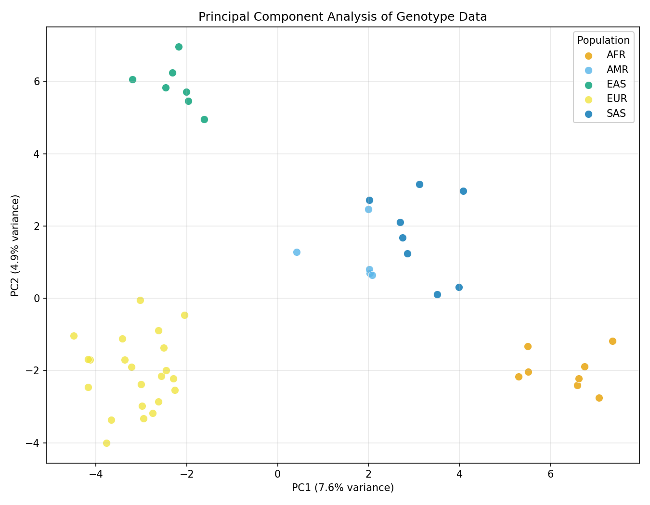
PCA: Population Structure
Notes:
PCA plot. Five clear clusters. AFR on the right, EAS top-left, EUR bottom-left, SAS in the middle, AMR between EUR and AFR reflecting admixture. This is from 500 synthetic SNPs with realistic allele frequency differentiation.
TIMING: 1 min

Slide 18
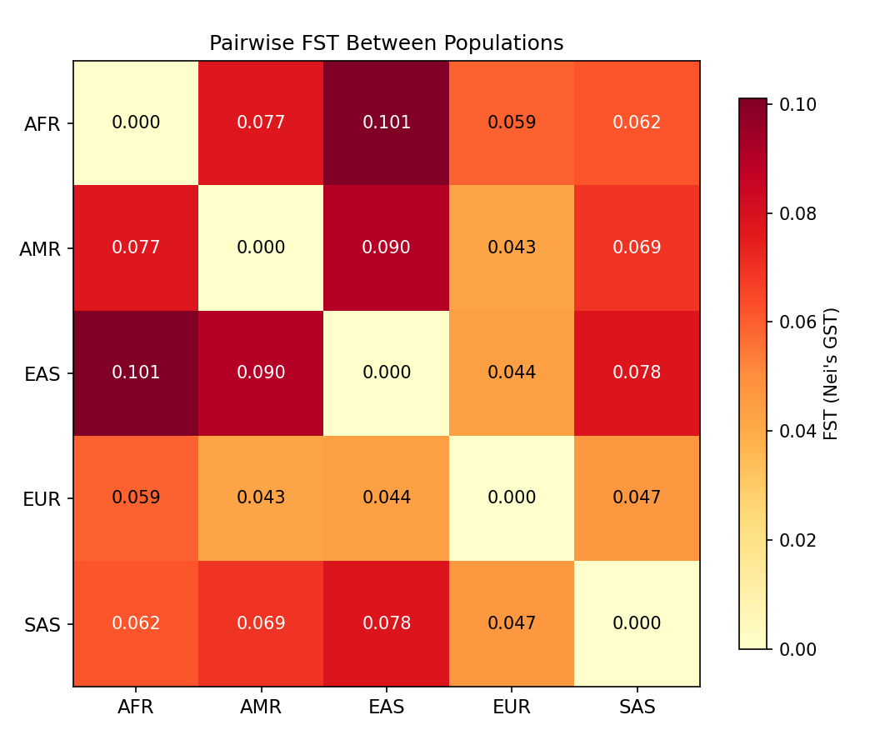
Pairwise FST: Population Divergence
Notes:
FST heatmap. Darkest cell: AFR vs EAS at 0.10, consistent with known human population genetics. Lightest: AMR vs EUR at 0.04, reflecting shared ancestry through admixture. All computed locally from the genotype matrix.
TIMING: 1 min

Slide 19
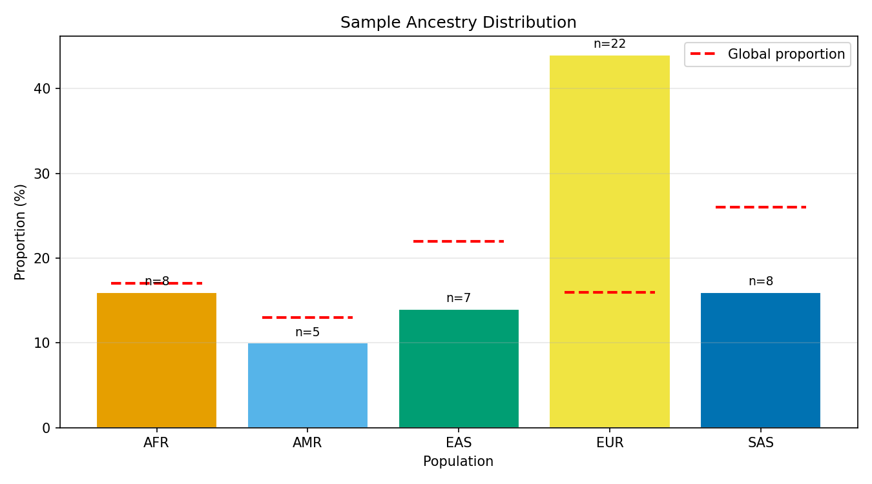
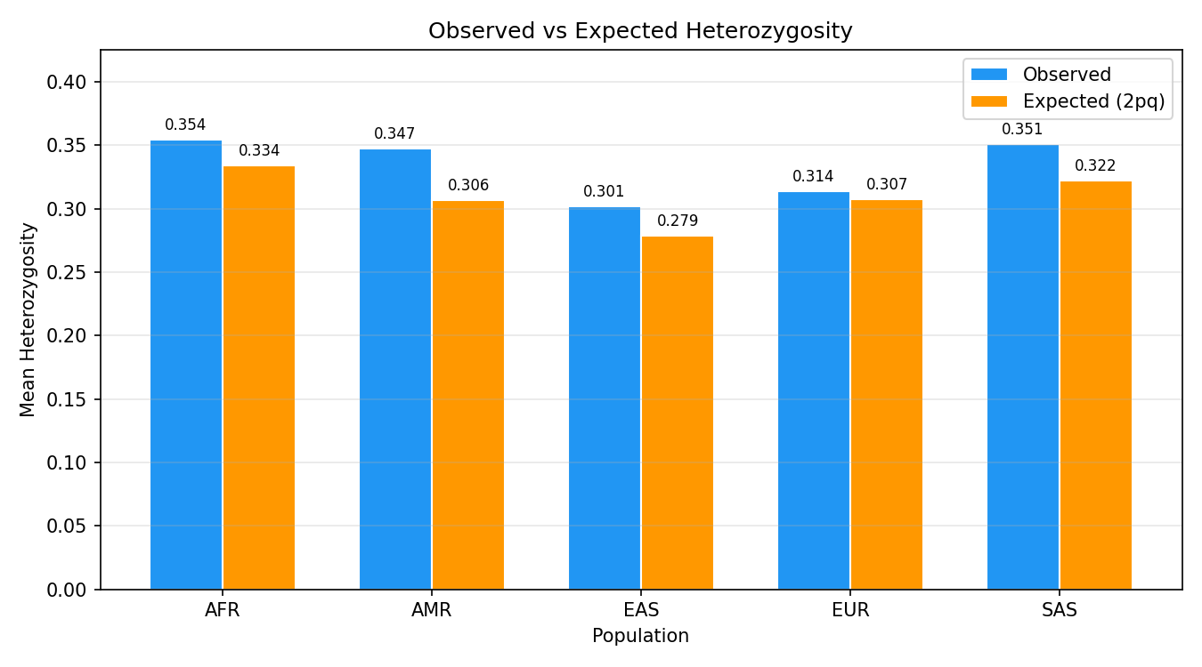
Ancestry Distribution + Heterozygosity
Red dashes = global proportions. EUR at 44% is 2.75x overrepresented.
Notes:
Left: ancestry distribution. The red dashed lines show global proportions. EUR is massively overrepresented, a typical UK biobank skew. Right: heterozygosity. AFR has the highest observed Het, EAS the lowest. This is exactly what population genetics predicts from the out-of-Africa model.
TIMING: 1.5 min

Slide 20
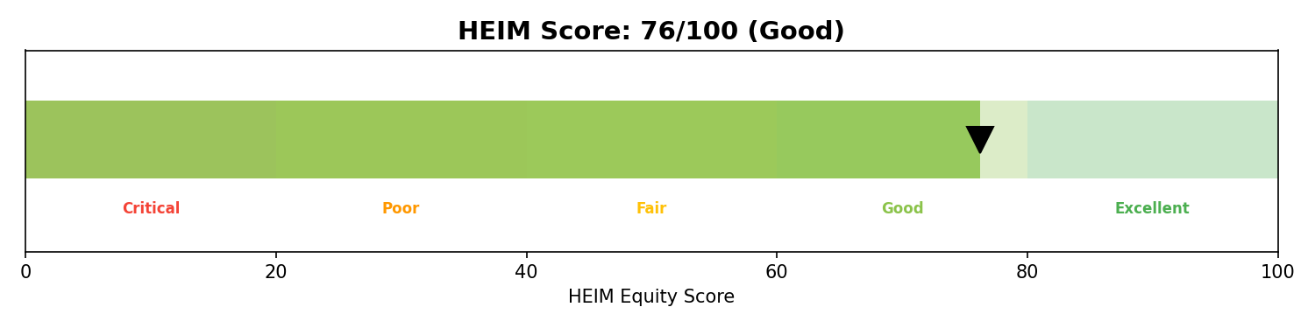
HEIM Equity Score
Score Breakdown
What This Means
→ Representation Index: 0.720
→ Heterozygosity Balance: 0.667
→ FST Coverage: 1.000
→ Geographic Spread: 0.714
→ EUR 2.75x overrepresented
→ EAS and SAS underrepresented
→ 5 of 7 continental groups present
→ All pairwise FST computed
Notes:
The HEIM Equity Score: 76 out of 100. Representation index drags it down because EUR is overrepresented. Good geographic spread, 5 of 7 continental groups. All pairwise FST computed. This single number tells a study coordinator: your cohort has reasonable diversity but needs more EAS and SAS participants.
TIMING: 2 min

Slide 21
Why This Matters
→ 86% of GWAS participants are of European ancestry
→ Polygenic risk scores fail across populations
→ The HEIM Index: a single number to quantify the problem
Every dataset. Every study. Every biobank. Score it.
Paper in review: Corpas, M. (2026). "HEIM: Health Equity Index for Minorities"
Notes:
Why does this matter? 86% of GWAS participants are European. That means polygenic risk scores, drug targets, and clinical guidelines are biased towards one population. The HEIM Index gives researchers a single number to quantify this problem. Score your dataset. Report it alongside your demographics. Track it over time. I have a paper in review on this. But the tool is open source, and you can run it tonight.
TIMING: 2 min

Slide 22
Tip 10
Create Infrastructure That Ships Your Research
→ The Equity Scorer took 2 days to build with Claude Code
→ Real Het, FST, PCA from genotype data. Not a toy.
→ Reproducible, publication-ready report + figures
→ Anyone in this room can build the next skill
Skills we need from you:
→ GWAS Pipeline — PLINK/REGENIE automation
→ Metagenomics Classifier — Kraken2/MetaPhlAn wrapper
→ Clinical Variant Reporter — ACMG classification
→ Pathway Enricher — GO/KEGG enrichment
Notes:
Tip 10: create infrastructure that ships your research. The Equity Scorer took 2 days to build with Claude Code. Real population genetics, not a toy. And anyone in this room can build the next skill. Do you work with GWAS? Build a PLINK wrapper. Metagenomics? Wrap Kraken2. Clinical genetics? Build an ACMG classifier. The template is there. The orchestrator routes to your skill automatically. Who wants to build one?
TIMING: 2 min

Slide 23
Get Started Tonight
github.com/manuelcorpas/openclaw-bio
Repository
Your first PR
→ 8 skills (2 MVP, 6 planned)
→ SKILL-TEMPLATE.md for contributors
→ Architecture docs
→ Demo dataset + pre-generated report
→ Clone the repo
→ Copy SKILL-TEMPLATE.md
→ Wrap your favourite bioinformatics tool
→ Submit a PR. I will review it personally.
MIT licensed. Local-first. Built for this community.
Notes:
Here is how to get involved. The repo goes live tonight. Clone it, run the Equity Scorer on your own data. If you want to build a skill, copy the template and open a PR. I will review it personally. This is MIT licensed, local-first, and built for this community.
TIMING: 1.5 min

Slide 24
10 Tips Recap
→ 1. AI in your IDE, not browser
→ 2. Build a prompt library (CLAUDE.md)
→ 3. Give AI long-term memory (30,000 documents)
→ 4. Use voice, not just text
→ 5. Automate daily intelligence
→ 6. Deploy persistent AI agents
→ 7. Let AI compound your outputs
→ 8. Contribute to open-source AI (OpenClaw Bio)
→ 9. Build modular skills
→ 10. Create shipping infrastructure
The top 1% build systems that compound. Everyone else uses tools one at a time.
Notes:
Quick recap. Tips 1-7: AI fluency, the productivity habits that compound. Tips 8-10: building with AI, turning your domain expertise into open-source tools. The throughline: the top 1% build systems that compound. Everyone else uses tools one at a time.
TIMING: 1 min

Slide 25
Thank You
Questions welcome. And at the pub after.
GitHub: github.com/manuelcorpas/openclaw-bio
LinkedIn: linkedin.com/in/manuelcorpas
X: @manuelcorpas
Book: "AI Fluency: A Practical Guide to Leveraging AI Chatbots for Academic and Professional Work" (2026)
Slides: github.com/manuelcorpas/openclaw-bio/slides
Notes:
Thank you. I will be at the pub after. Come talk to me if you want to build a skill, have ideas for the library, or want to go deeper on any of this. I have also written a book, AI Fluency, on the philosophy and practical techniques behind everything I showed tonight. Questions?

