Slide 1
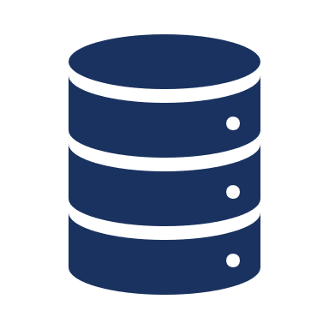
Establishment of Regis Healthcare Informatics Database - Continued
By Gilbert Anthony Bernal

Slide 2
Outline
Introduction
Goals and Requirements
Tools
Code Review
Create Server Database
Server Test
Chron Job Installment
HTML webform
Analysis
Conclusion

Slide 3
Introduction
Data Engineering project focus
Project Goal: Complete Regis Health informatics database.
Previous Project goal was to create database
Was not able to get database on server
Codes worked with a single format
No data governance added to database

Slide 4
requirements & Goal
Requirements
Goal
Create a way to allow for multiple file formats to be uploaded.
Create PostgreSQL database on sever
Create upload form
Automate python code processes
Complete creation of Regis server health informatics PostgreSQL database on server and automate all processes.

Slide 5

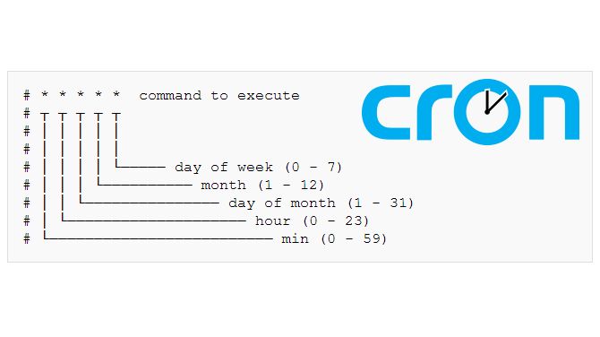




Slide 6
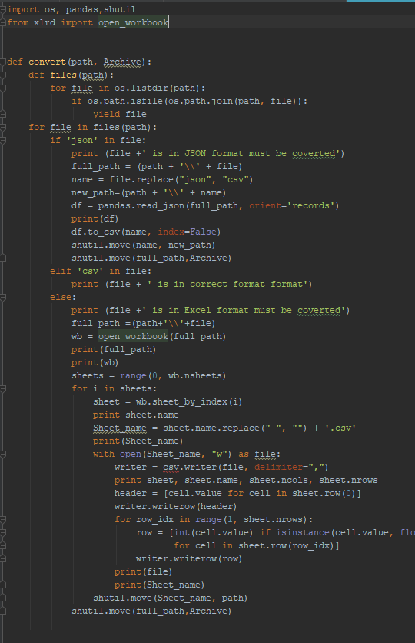
Convert.py

Slide 7
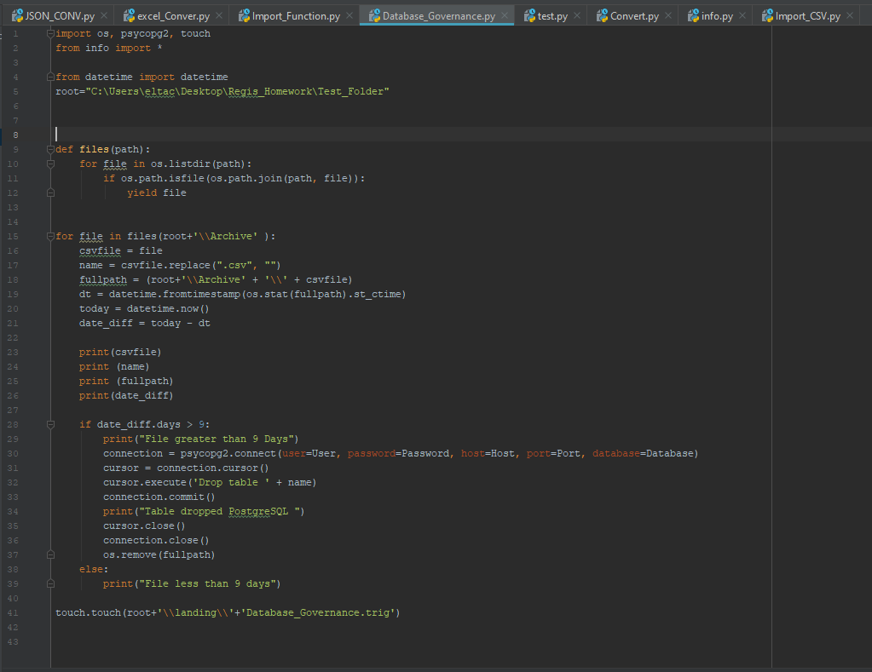
Database_Governance.py

Slide 8
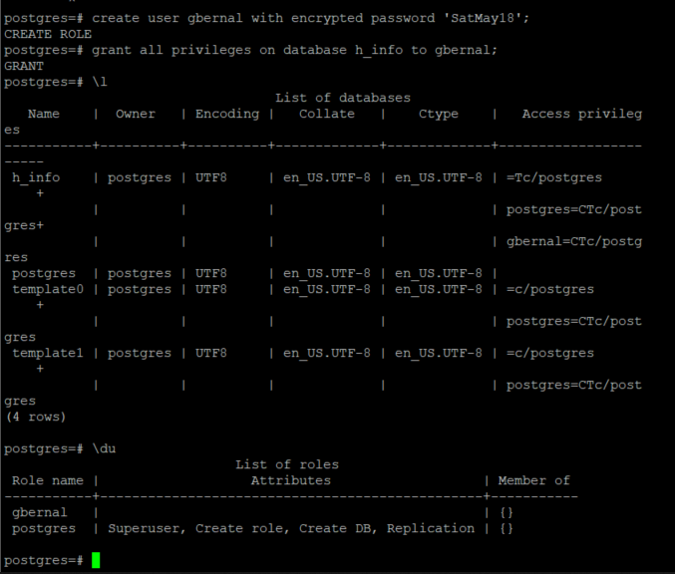
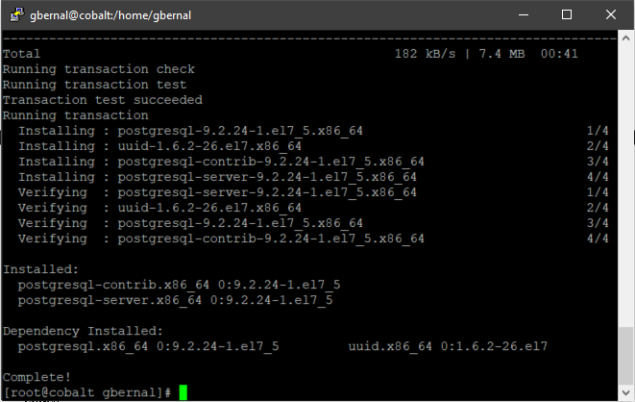
Create database

Slide 9
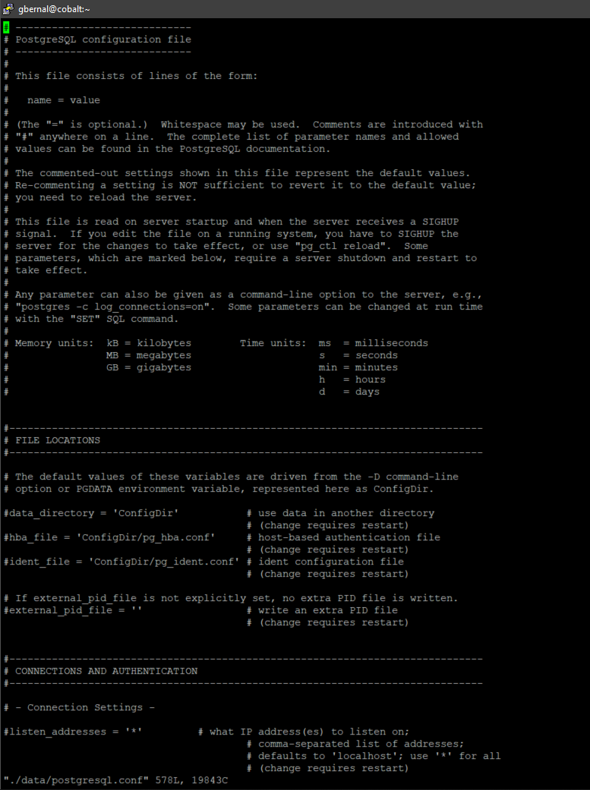
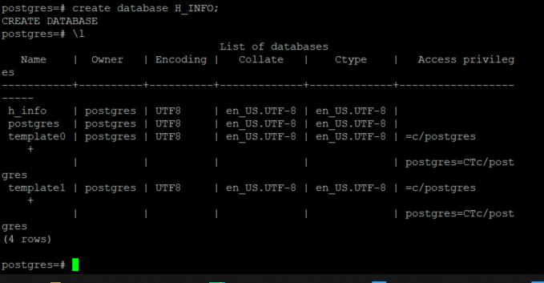
Create database - Continued

Slide 10
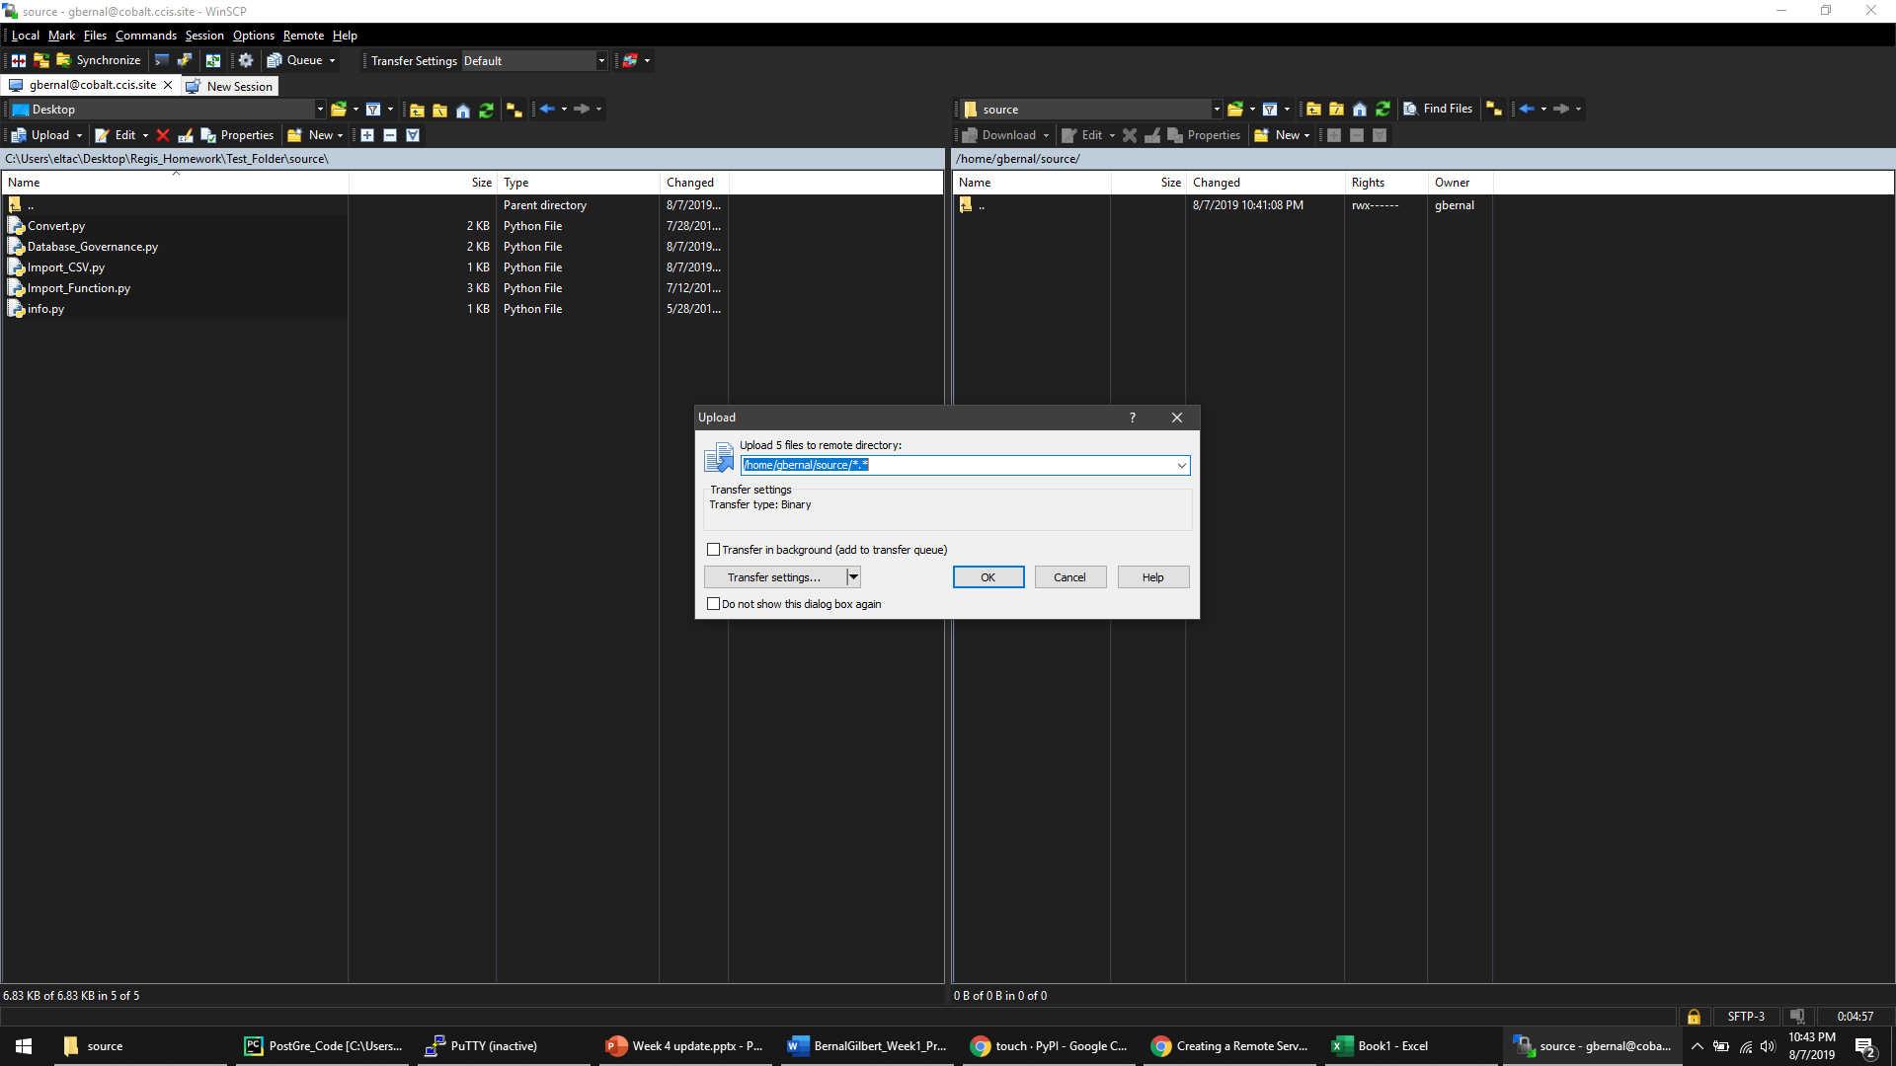
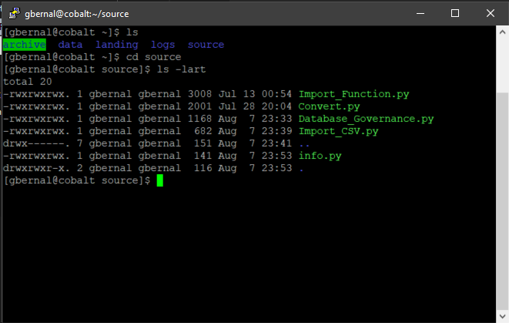
Copy and test python codes

Slide 11
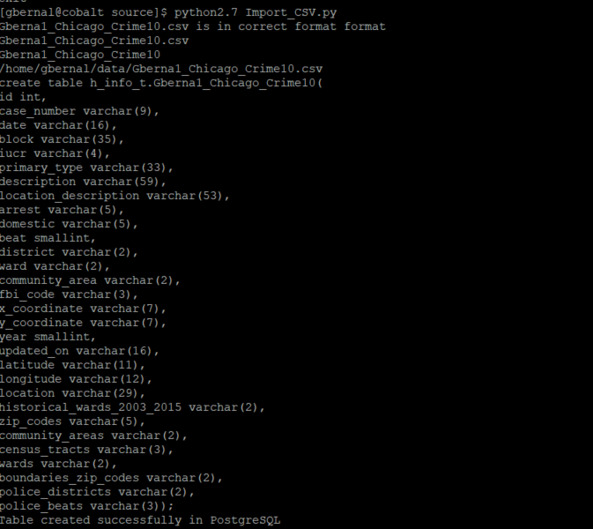
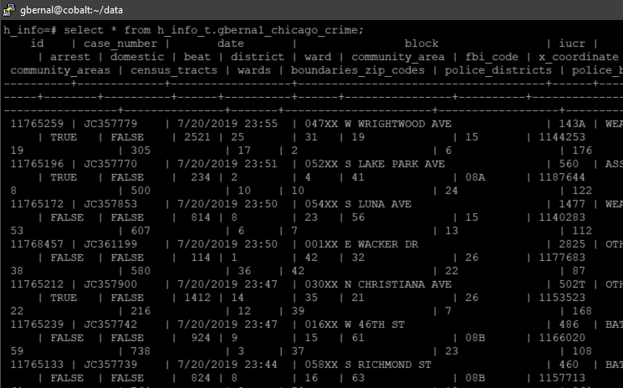
Copy and test python codes

Slide 12
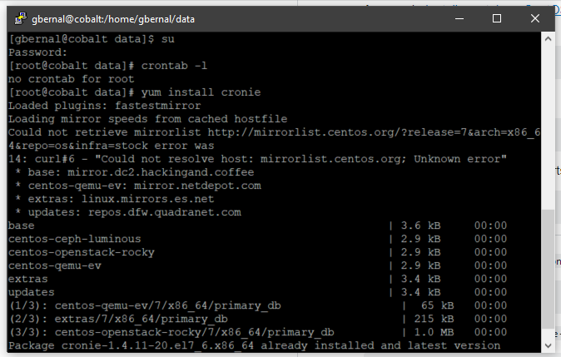
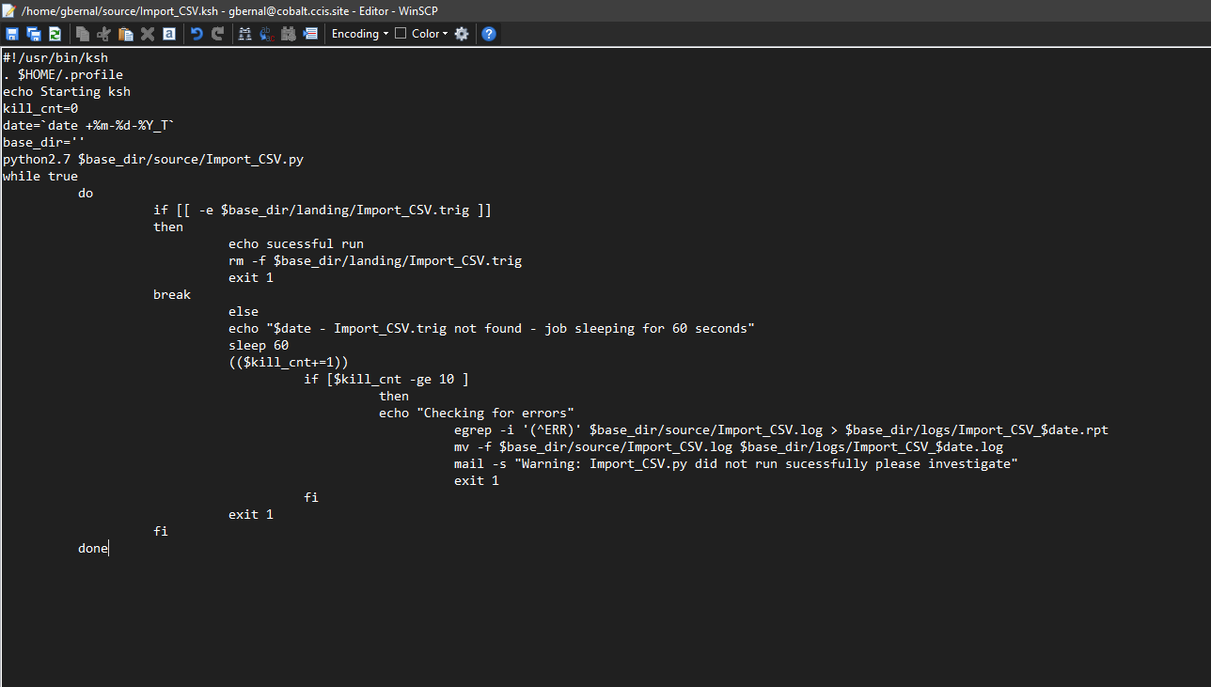
Install Chron

Slide 13
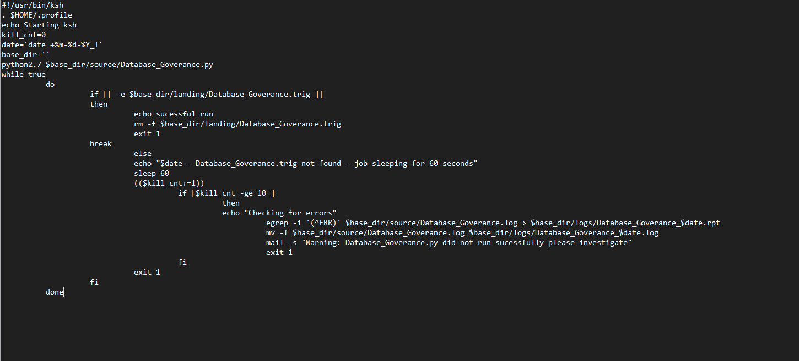
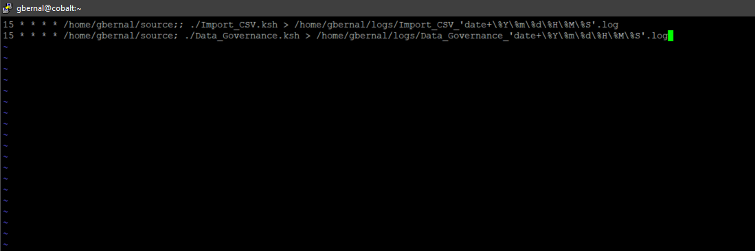
Install Chron

Slide 14
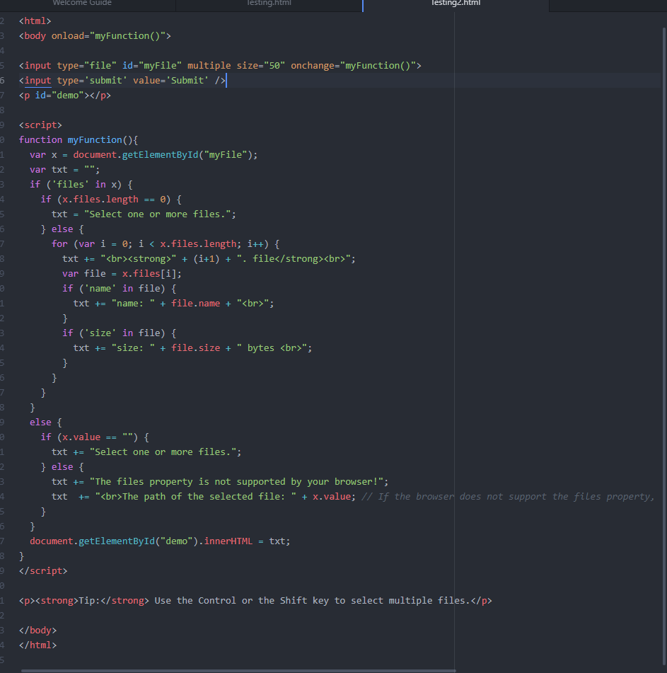
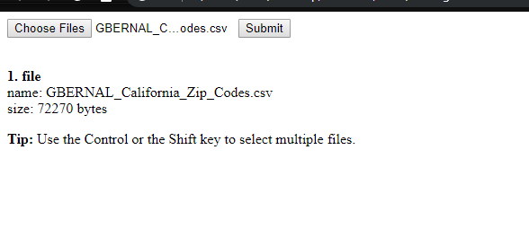
HTML Webform

Slide 15

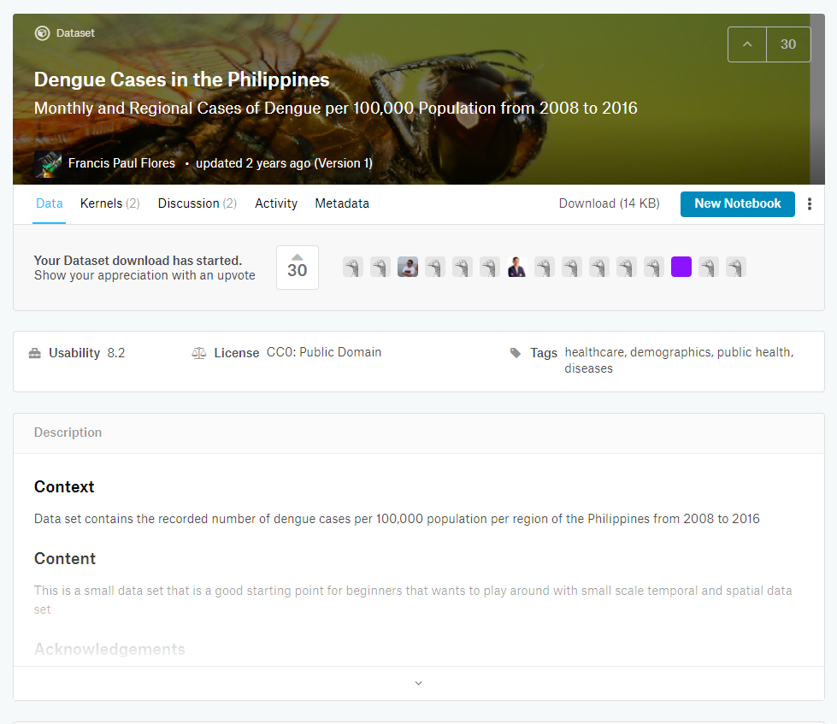
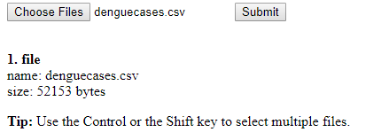
Analysis: Collect Data & Upload to server

Slide 16
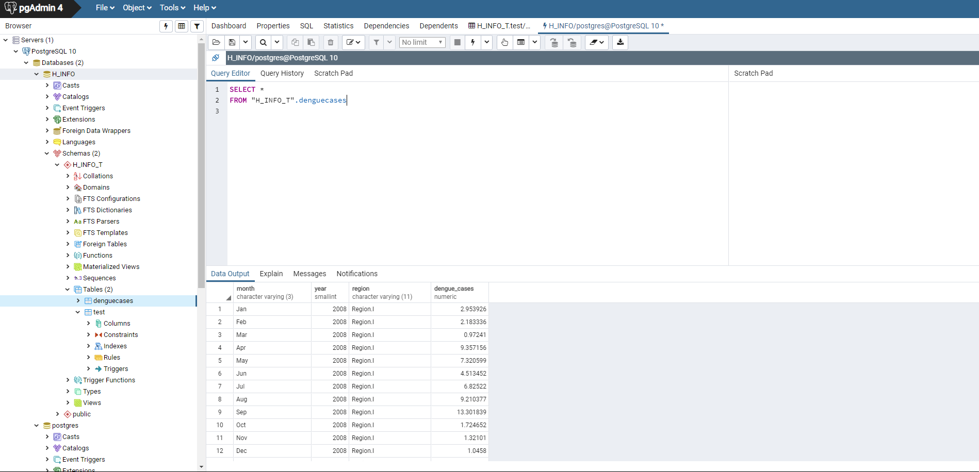
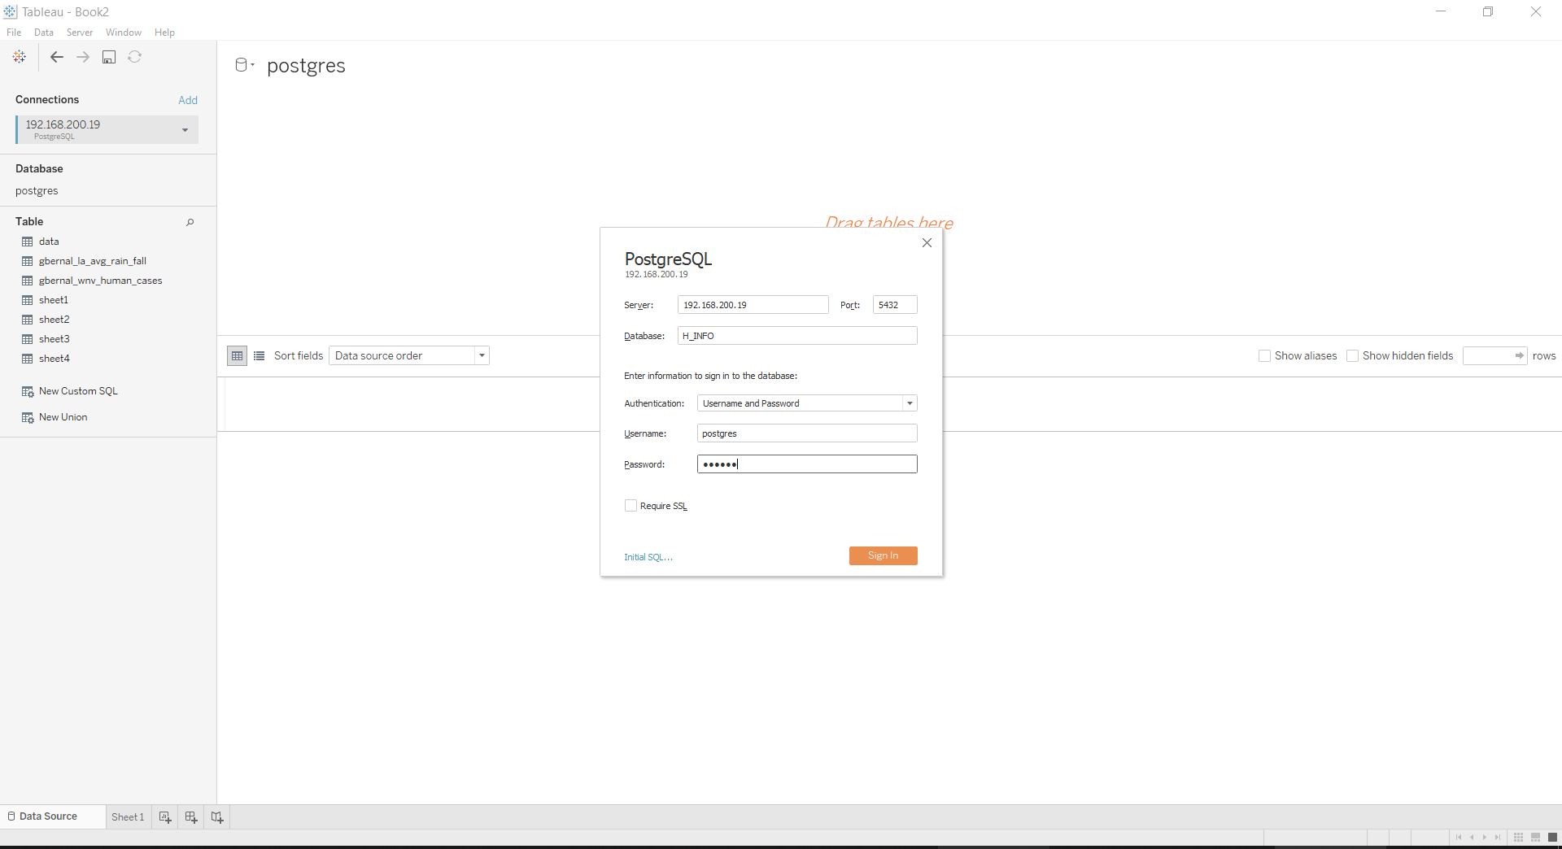
Analysis: Check data & connect to tableau

Slide 17
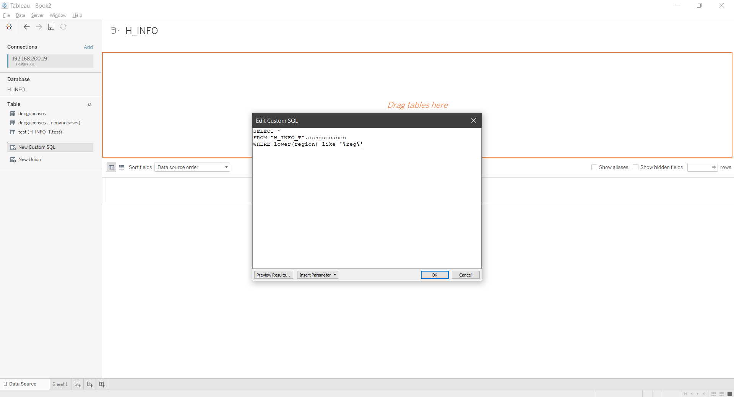
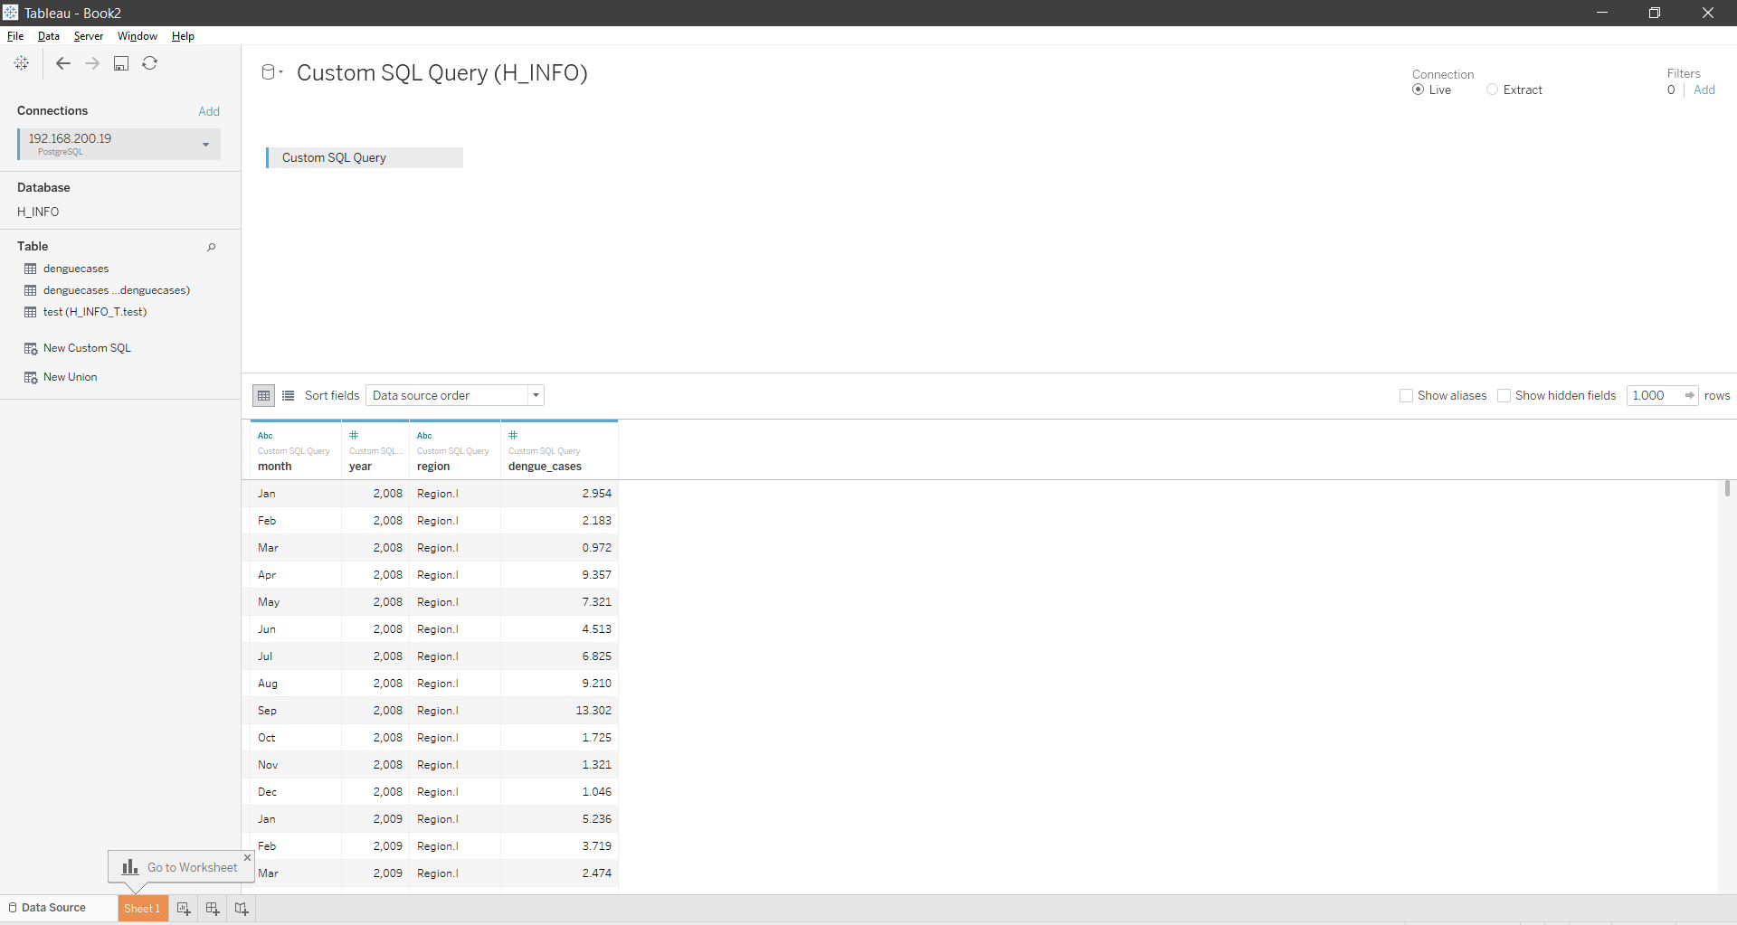
Analysis: Tableau SQL and data import

Slide 18
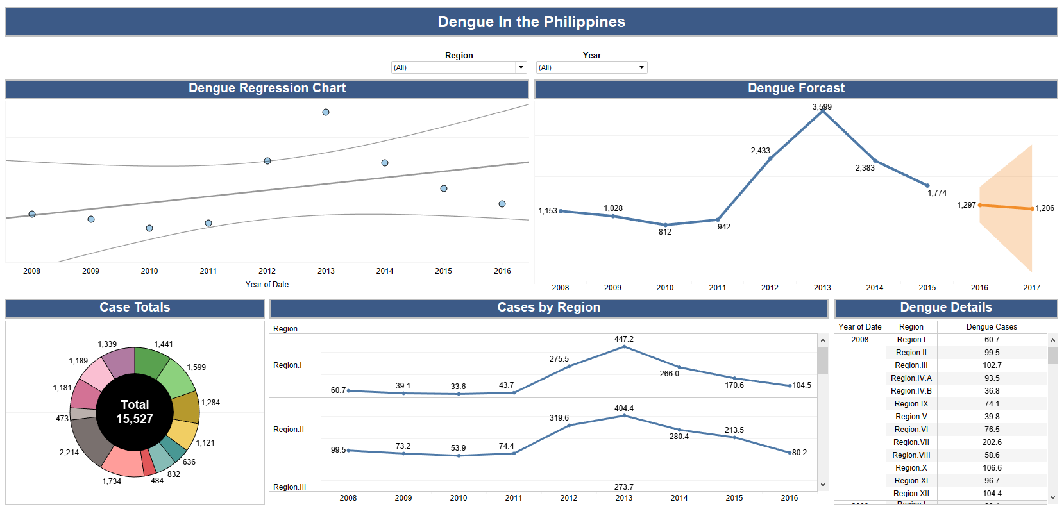
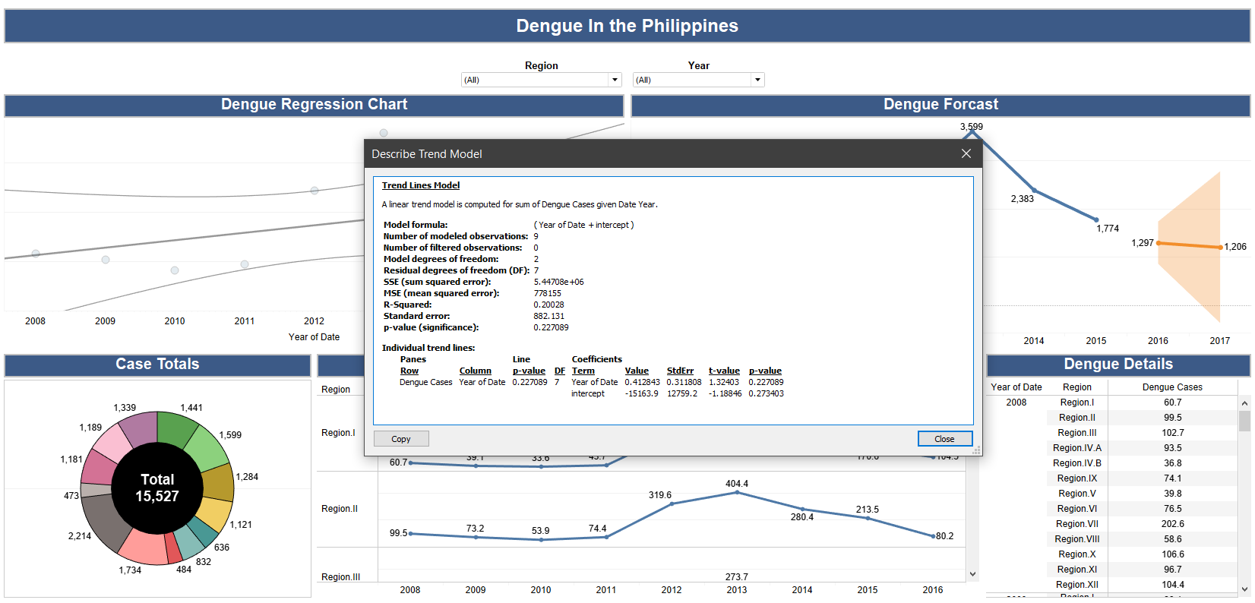
Analysis: Tableau Report & Results

Slide 19
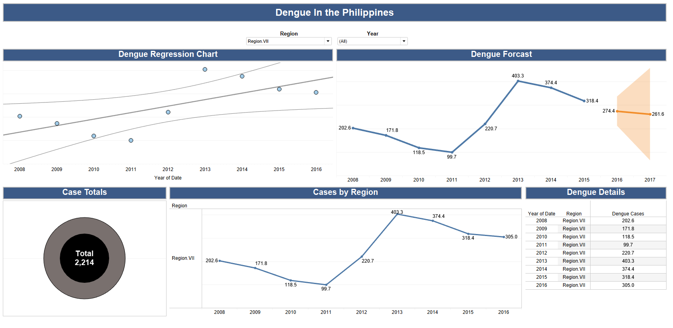
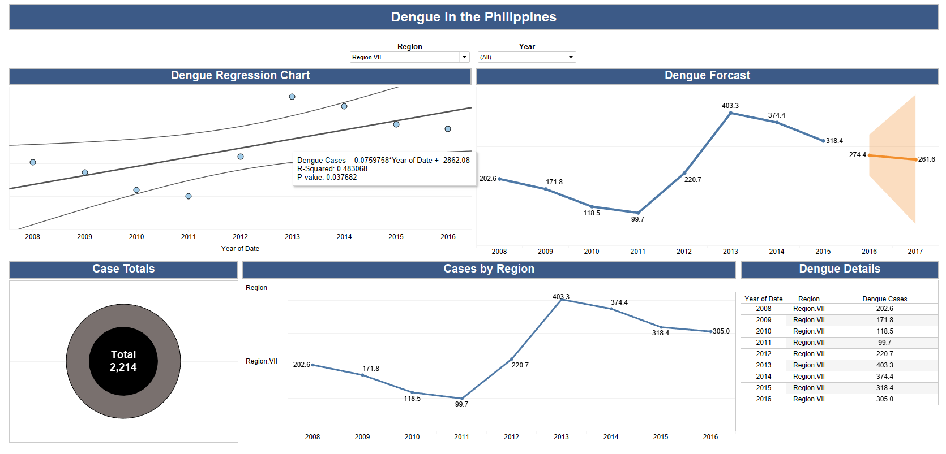
Analysis: Tableau Report & Results

Slide 20
Conclusion
Overall goals and requirement of project were met
Created a way to handle multiple file types for previous codes
Created PostgreSQL database on server
Added data governance to database
Automated database using python codes and Chron
Used automated process and Tableau to provide a proof of concept

Slide 21
References
Flores, F. P. (2017, October 30). Dengue Cases in the Philippines. Retrieved August 22, 2019, from https://www.kaggle.com/grosvenpaul/dengue-cases-in-the-philippines
The World's Most Advanced Open Source Relational Database. (n.d.). Retrieved June 26, 2019, from https://www.postgresql.org/
Welcome to Python.org. (n.d.). Retrieved June 26, 2019, from https://www.python.org/

