Slide 1

Establishment of Regis Healthcare Informatics Database
By Gilbert Anthony Bernal

Slide 2
Outline
Introduction
Database Requirements & Goals
Tools
Database Creation
Code Review
Analysis
Conclusion
Possible Projects

Slide 3




Introduction
Data Engineering project focus
Project Goal: Design a database for the Regis Health Informatics school to use.
Data used by health informatics school is from various health organization sources
Data comes in various formats
Most common format is a CSV

Slide 4
Database requirements & Goal
Requirements
Goal
Database should be able to store any individuals health care data
Must be able to create tables based off CSV file
Must be able to load all data from CSV into its unique file
Create a database and code that will be able to pull all CSV files in a directory, create unique tables based off the CSV file headers, and store the data from these files into its unique table

Slide 5



Tools

Slide 6
PostgreSql
Open source relational database system
Uses standard SQL language
Works with various datatypes
CSV, JSON, and XML
Works with various coding languages
Python and Java
Has method called COPY for uploading data files quickly

Slide 7
Python
Open source high level programming language
Various libraries to manipulate data and files
Works well with PostgreSQL
Has PYCOPG2 library
PYCOPG2 library is the most popular PostgreSQL adaptor for Python
Needed in order to use the COPY command for data upload

Slide 8
Tableau
Powerful analytical tool
Used for business intelligence
Connects directly to databases
Ability to use custom SQL to obtain results
Has built in functions to help with modeling and forecasting
Allows for the ability to use one dataset for the entire report

Slide 9
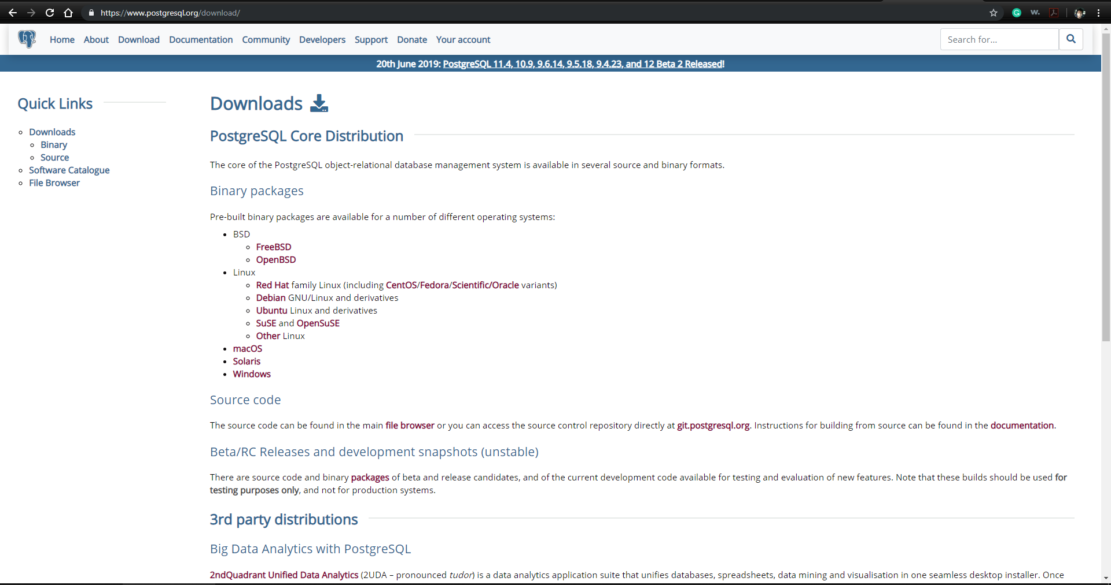
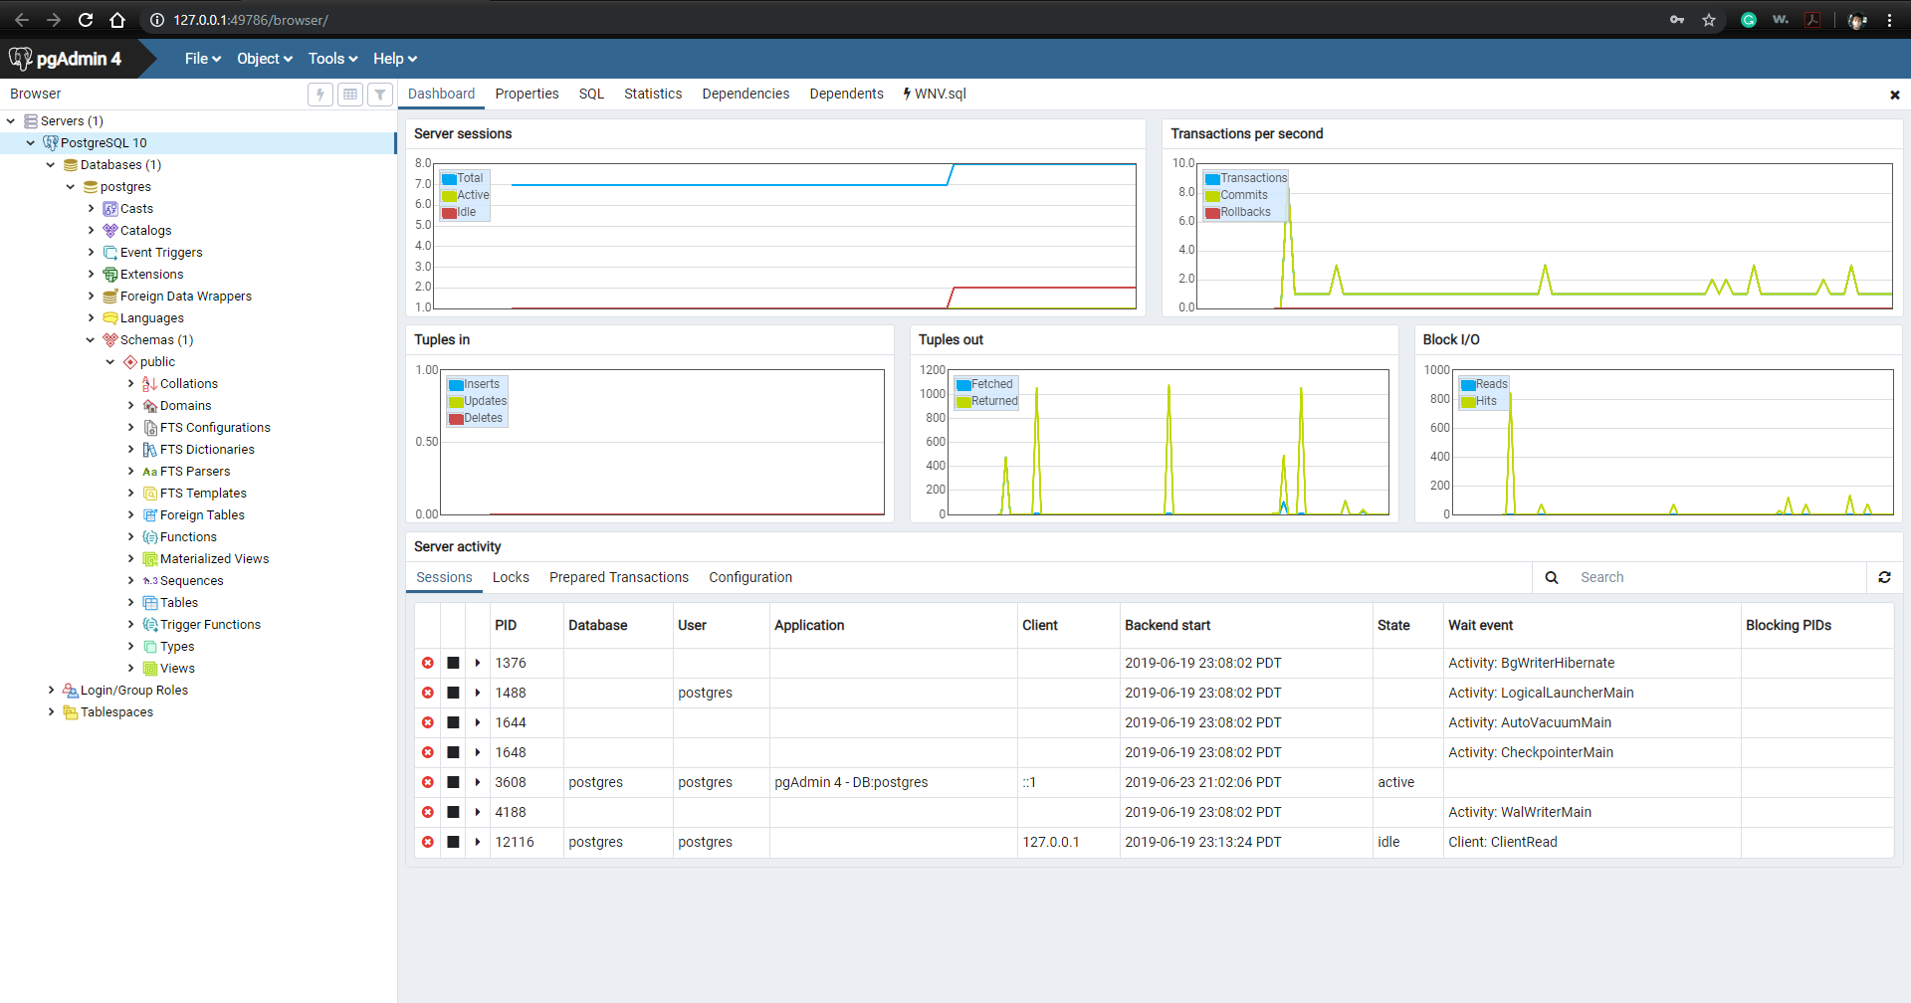
Creating the database

Slide 10
Code review
Info.py
Used to store admin credentials and PostgreSQL server information as variables
Import_Function.py
Used to generate a create table SQL statement based on the headers and data stored in a CSV file
Import_CSV.py
Used to obtain all CSV files within a directory and run the functions built in Import_Function.py to create the table and upload CSV data to its unique table. The code then moves the files to an archive directory.

Slide 11
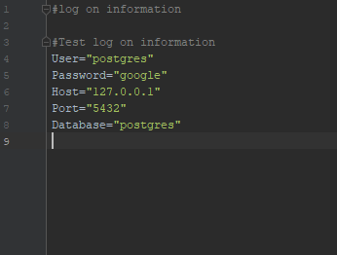
Info.py

Slide 12
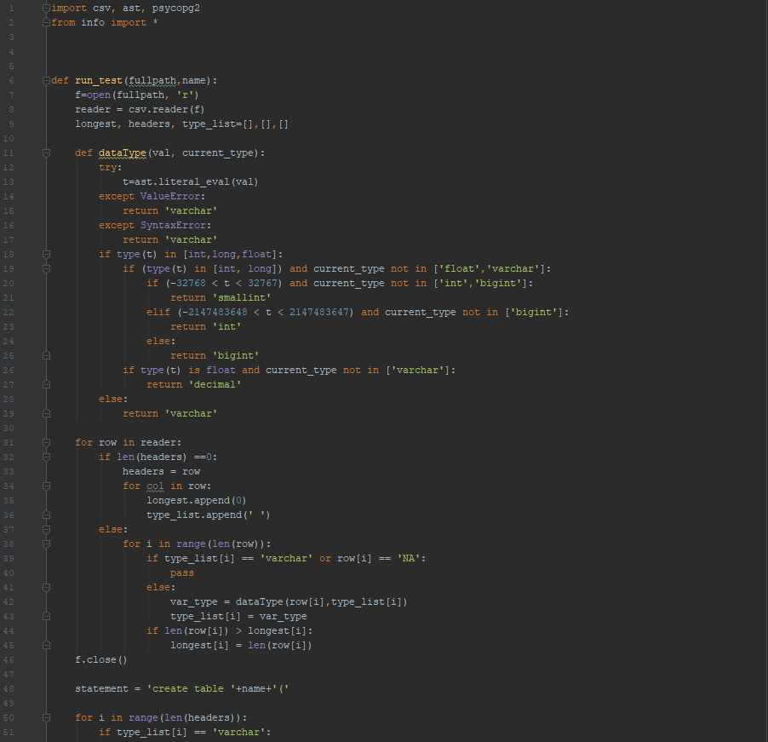
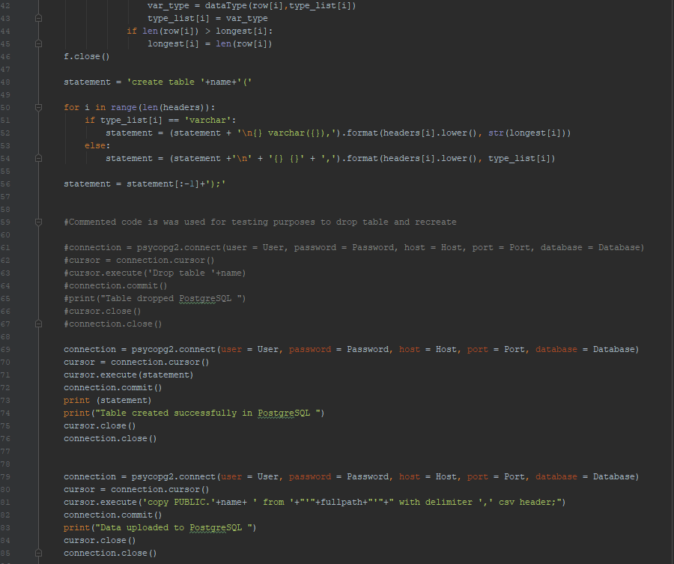
Import_Function.py

Slide 13
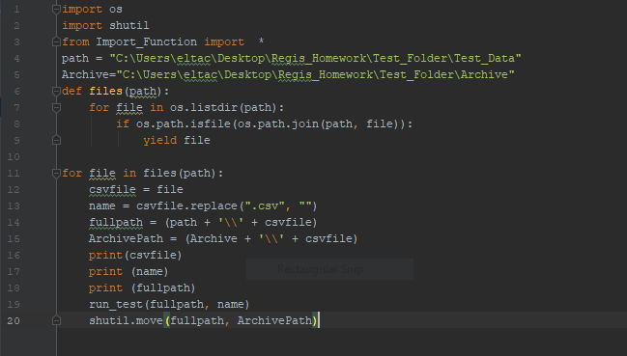
Import_CSV.py

Slide 14
Analysis
Analysis done to test database and code
Looked to see if there was a connection between rainfall and confirmed West Nile cases in Las Angeles California
West Nile virus is a common mosquito borne illness that occurs in the United States
Previous studies have shown that rainfall effects the Culex mosquito population
California has seen an increase number of West Nile cases

Slide 15

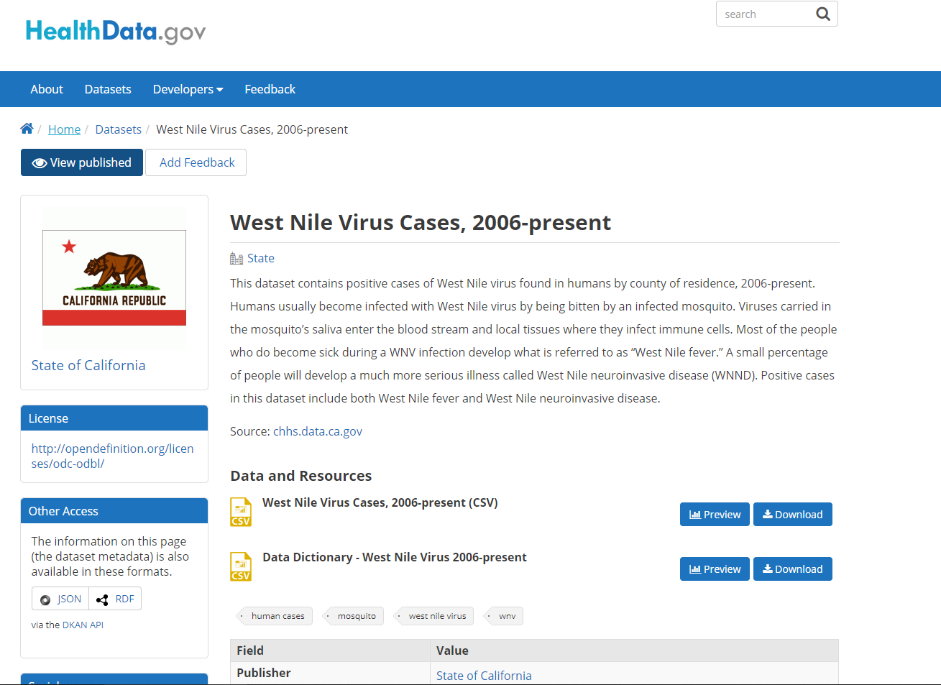
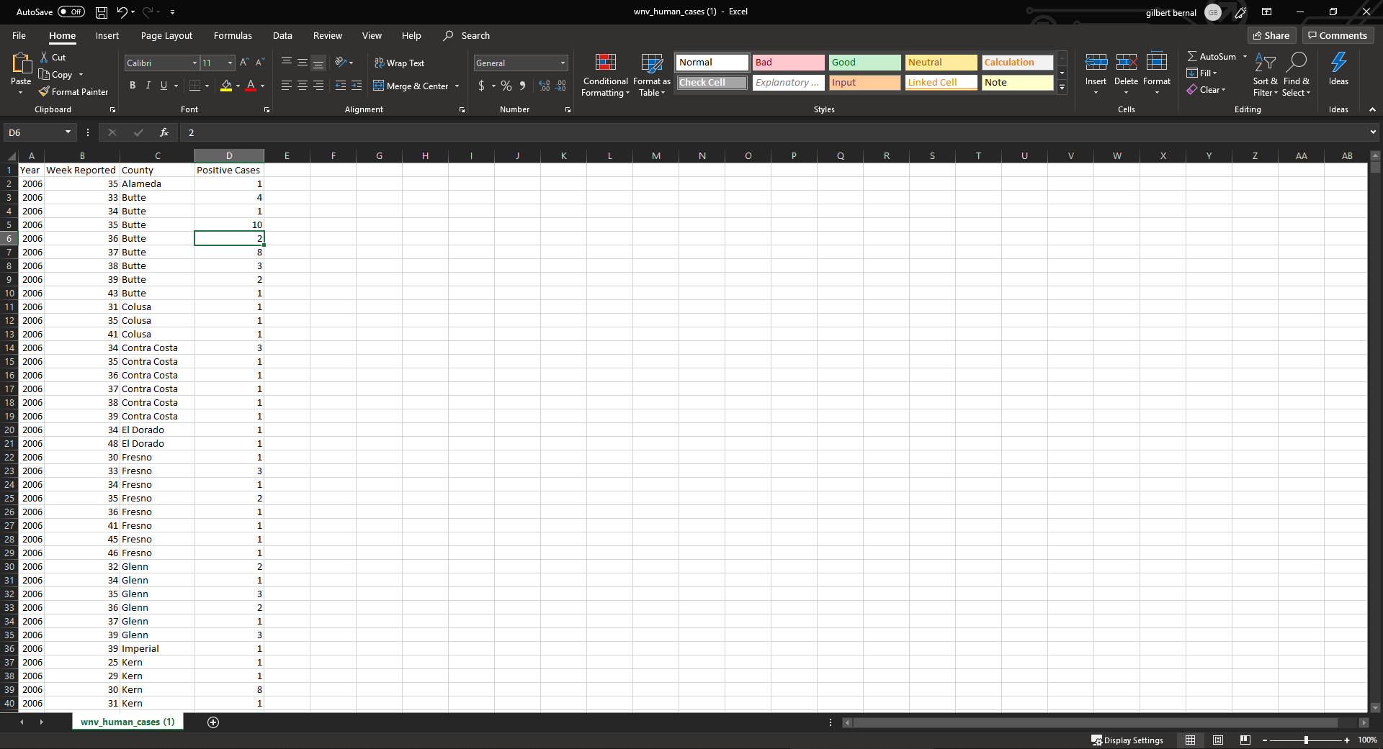
Analysis: Collect Data

Slide 16
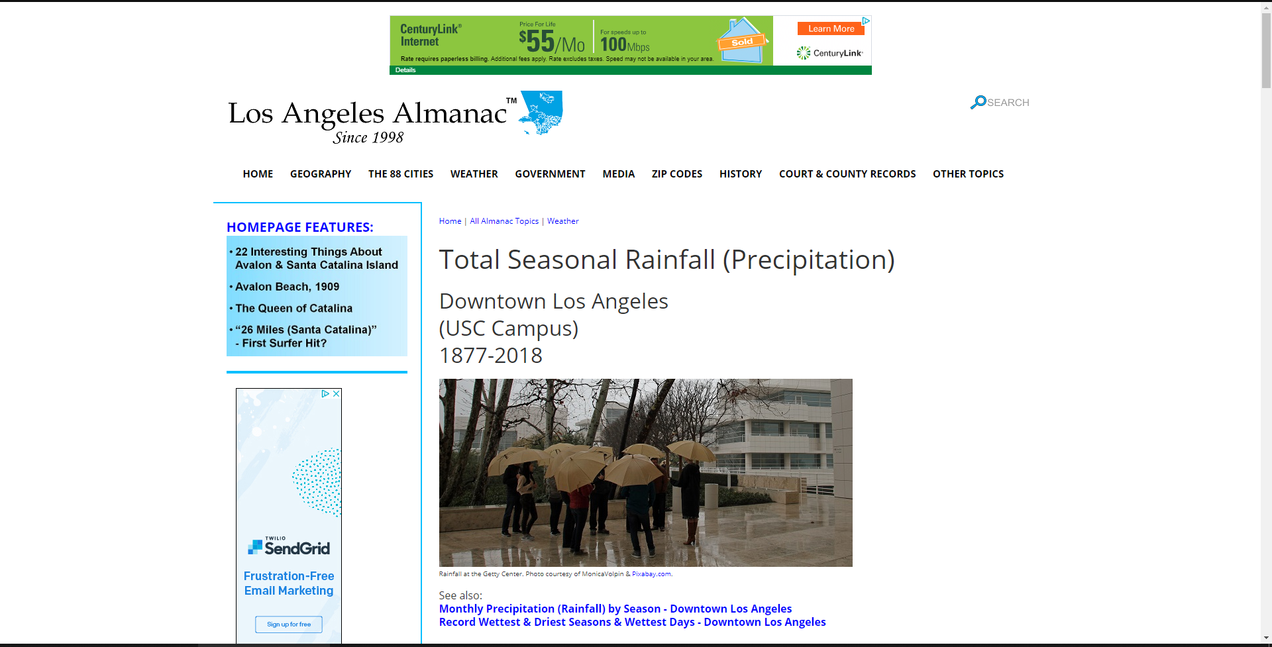
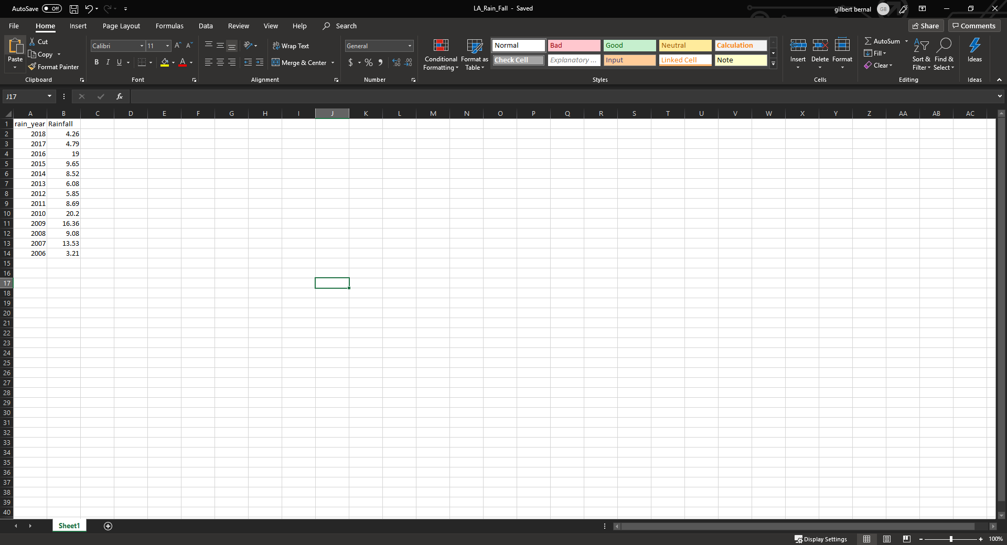
Analysis: Collect Data

Slide 17
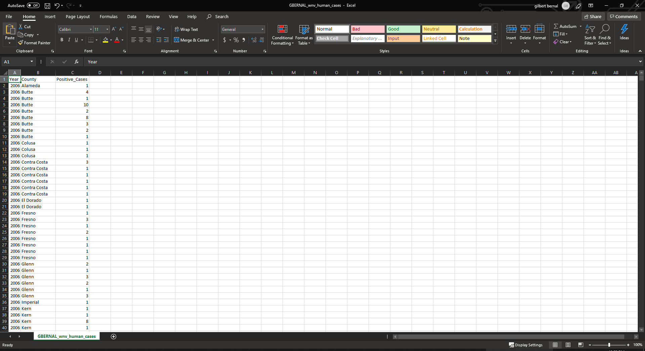
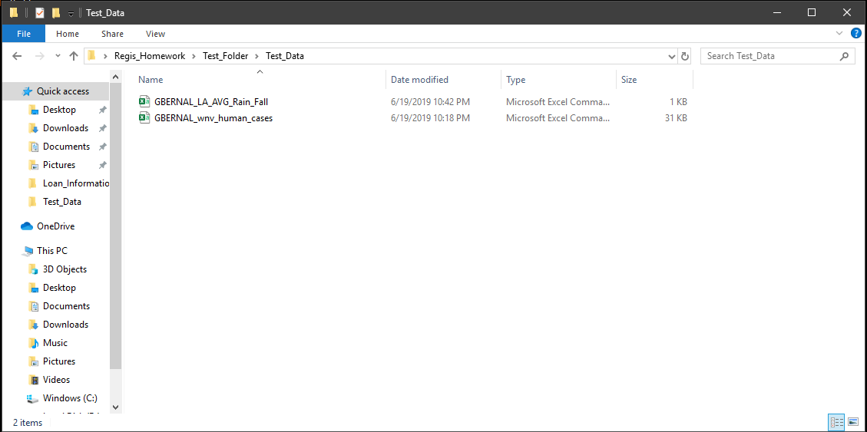
Analysis: Clean and rename files

Slide 18
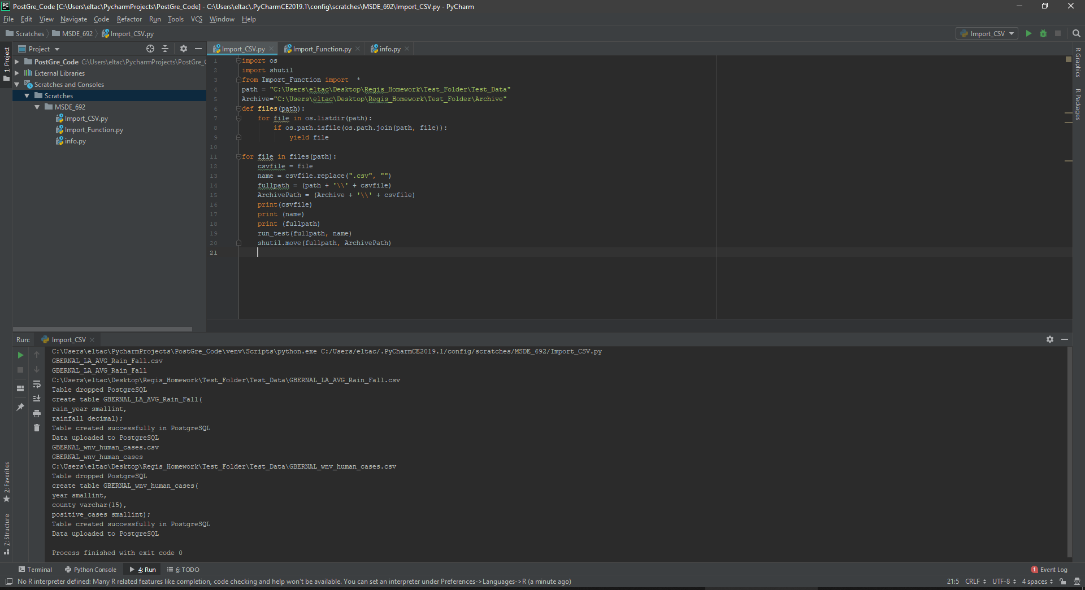
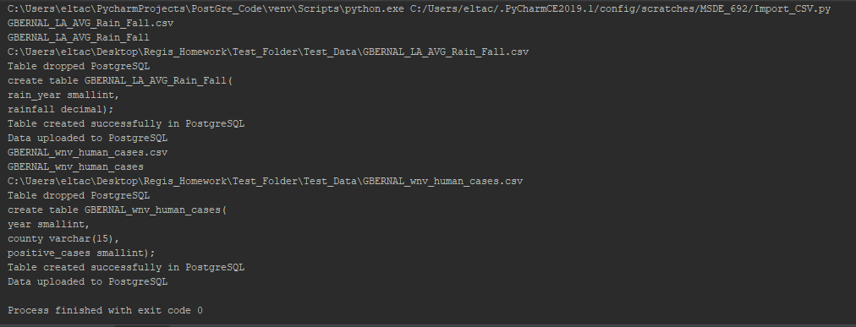
Analysis: Run import_CSV.py

Slide 19
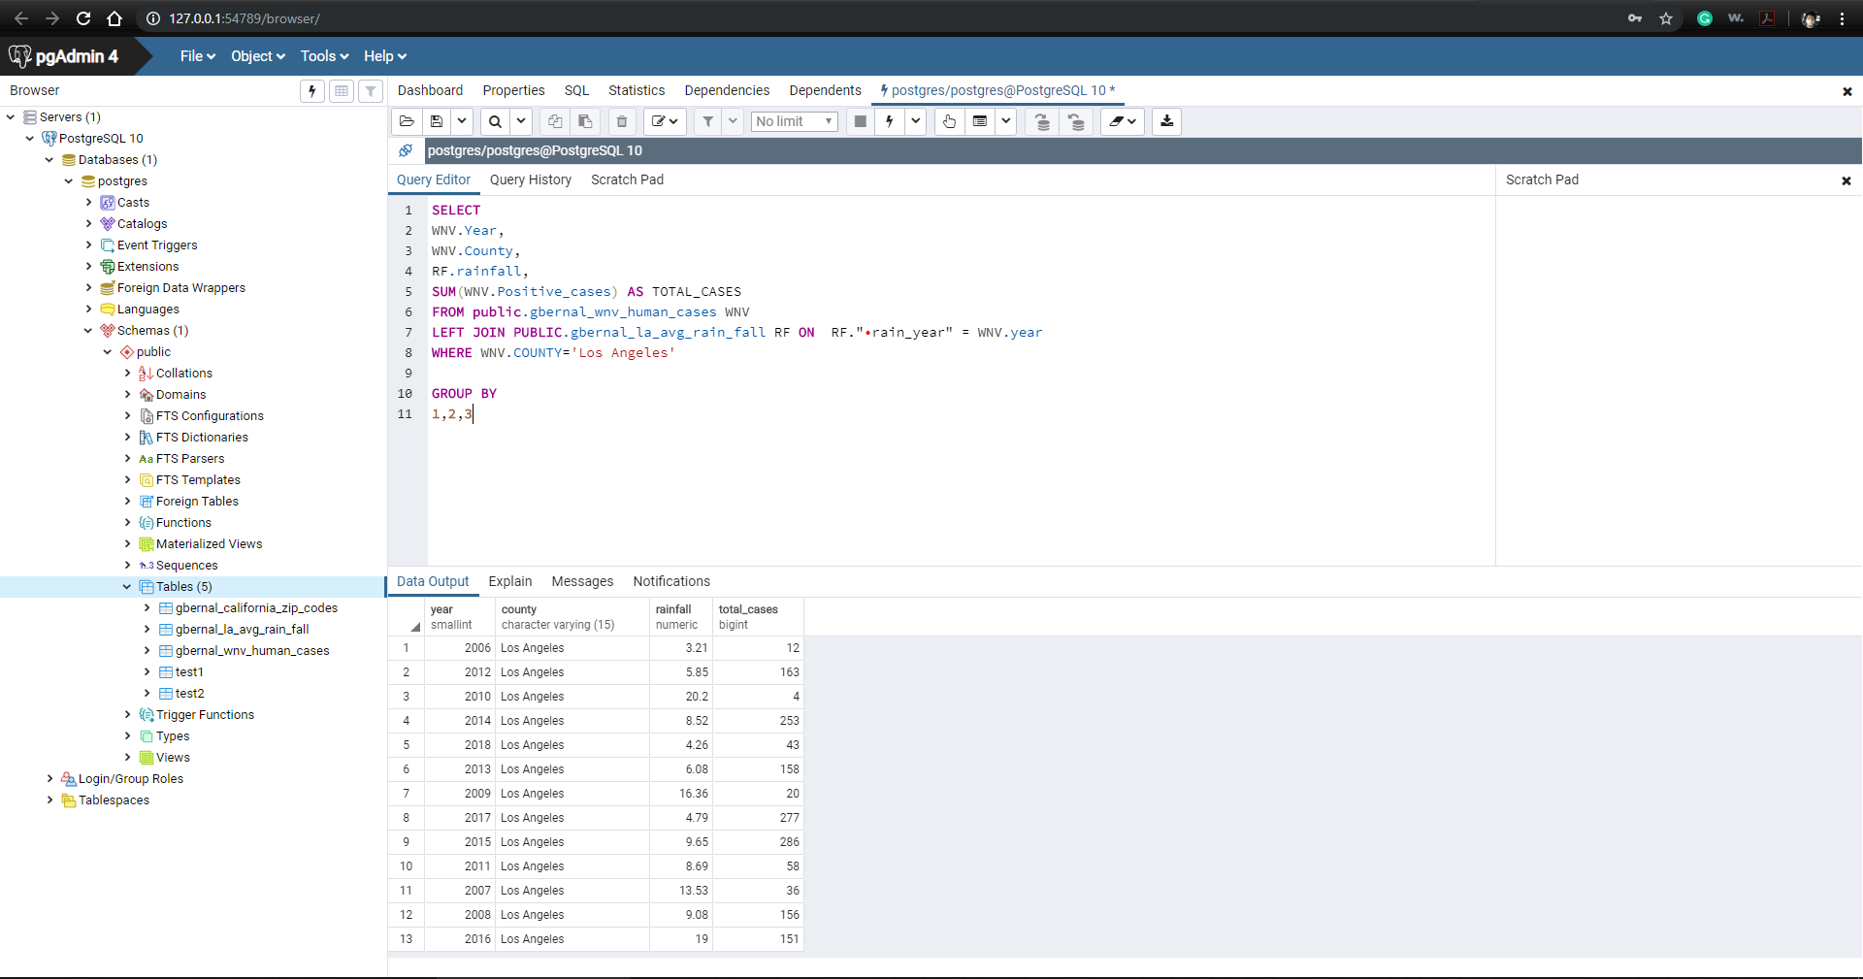
Analysis: Create Query

Slide 20
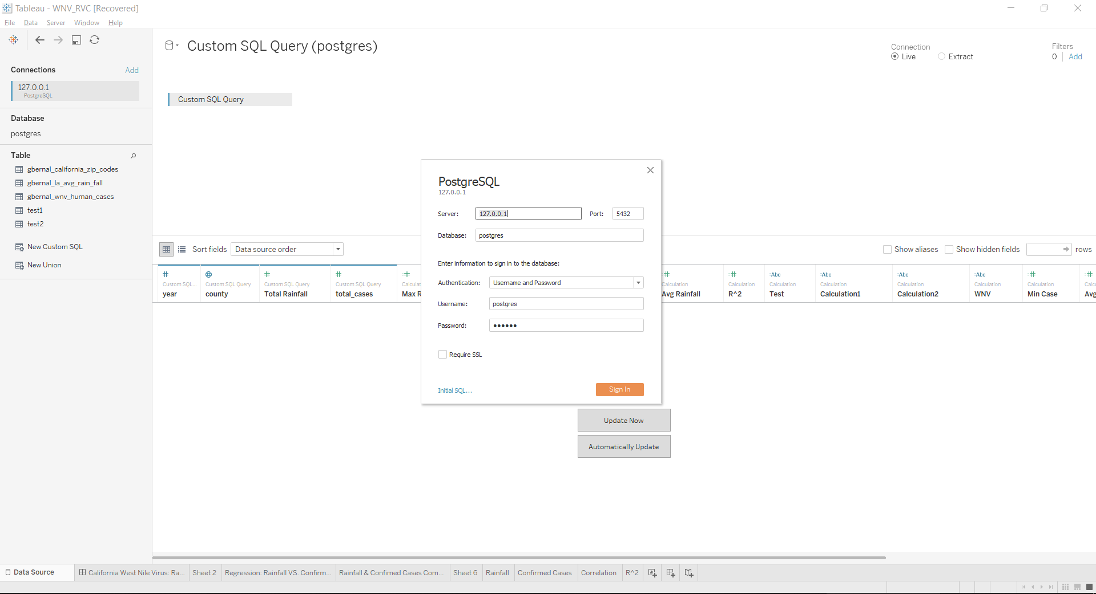
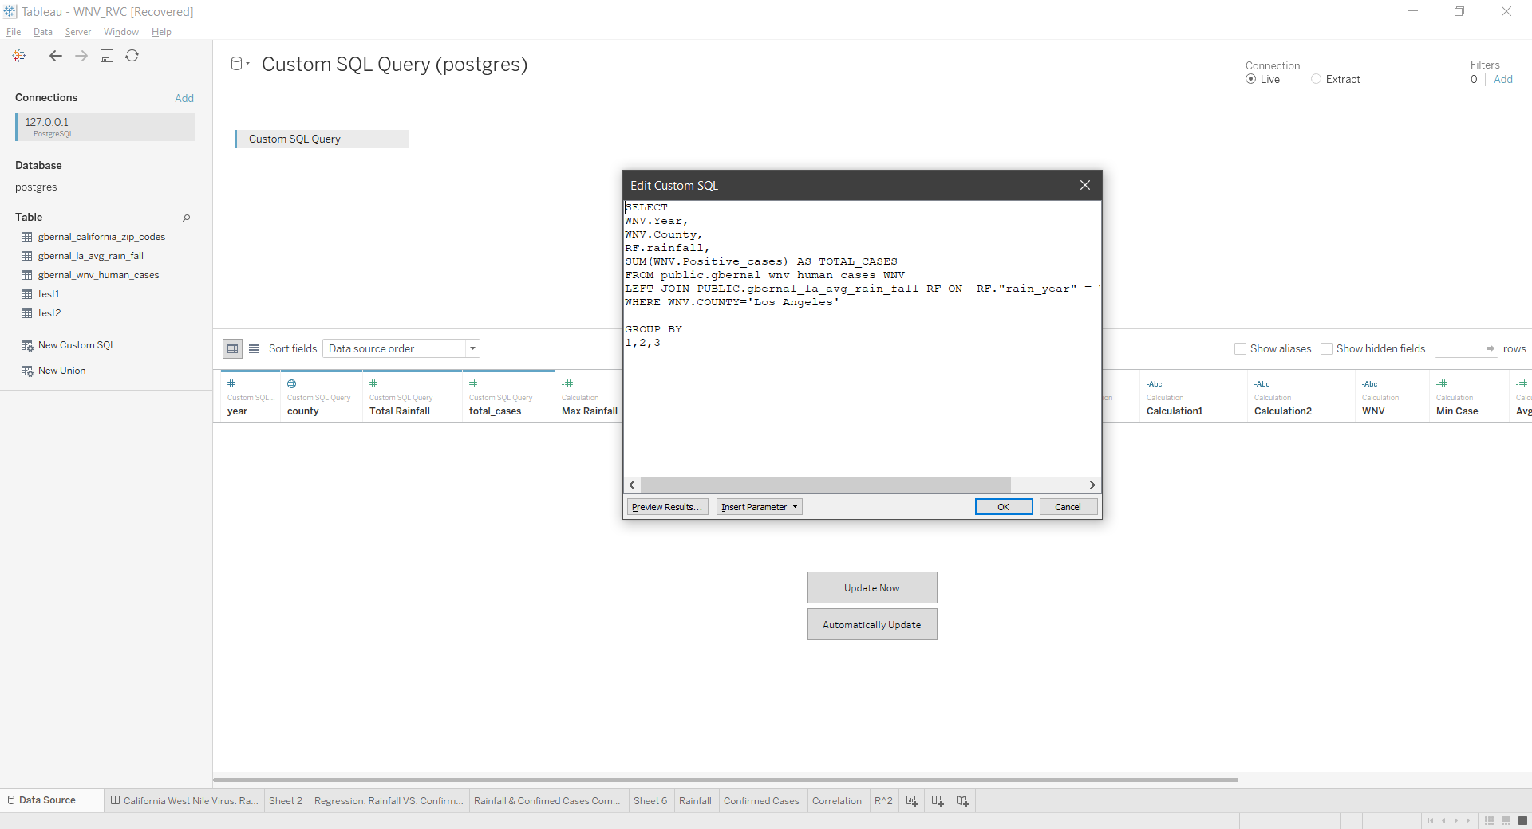
Analysis: Connect to Tableau

Slide 21
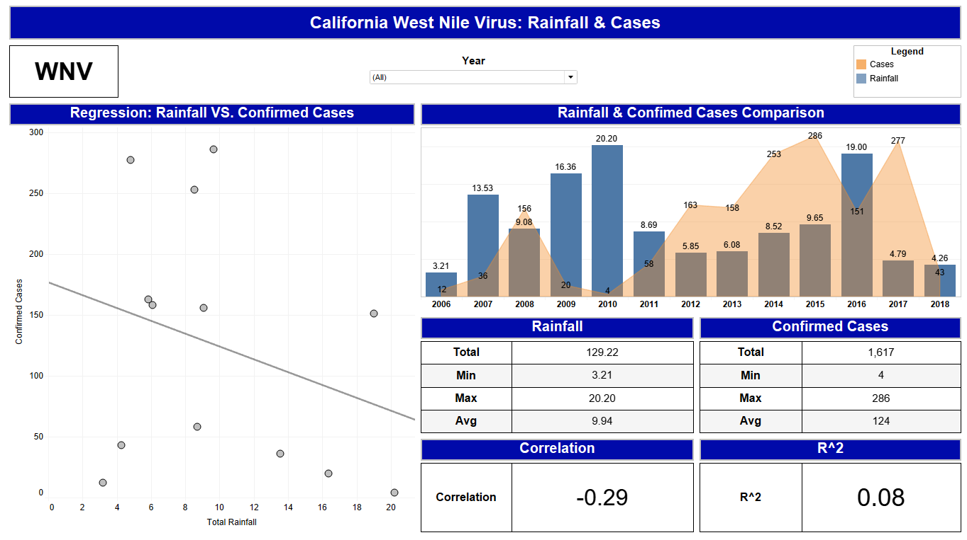
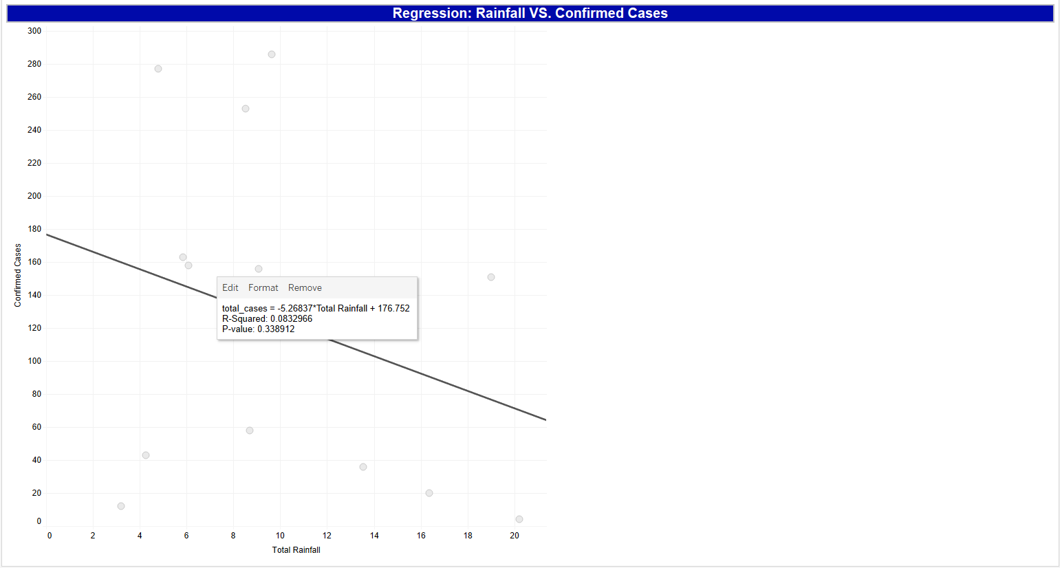
Analysis: Tableau Report & Results

Slide 22
Conclusion
The tools used and code created successfully worked as planned
PostgreSQL COPY command worked as expected
Code created the unique table based off the headers of the CSV file
Code imported the CSV data directly the unique table created
Database successfully connected to Tableau
Tableau was able to use the data to create model and repot to answer analysis question

Slide 23
Possible Projects
Add this project to Regis servers and add API
Add data governance
Update Import_Function.py to use other data formats

Slide 24
References
The World's Most Advanced Open Source Relational Database. (n.d.). Retrieved June 26, 2019, from https://www.postgresql.org/
Total Seasonal Rainfall (Precipitation). (n.d.). Retrieved June 26, 2019, from http://www.laalmanac.com/weather/we13.php
Valdez, L. (2018, October 10). Effects of rainfall on Culex mosquito population dynamics. Retrieved June 26, 2019, from https://arxiv.org/pdf/1703.08915.pdf
Welcome to Python.org. (n.d.). Retrieved June 26, 2019, from https://www.python.org/
West Nile virus. (2018, December 10). Retrieved June 26, 2019, from https://www.cdc.gov/westnile/index.html
West Nile Virus Cases, 2006-present. (2019, June 25). Retrieved June 26, 2019, from https://healthdata.gov/dataset/west-nile-virus-cases-2006-present

