Slide 1
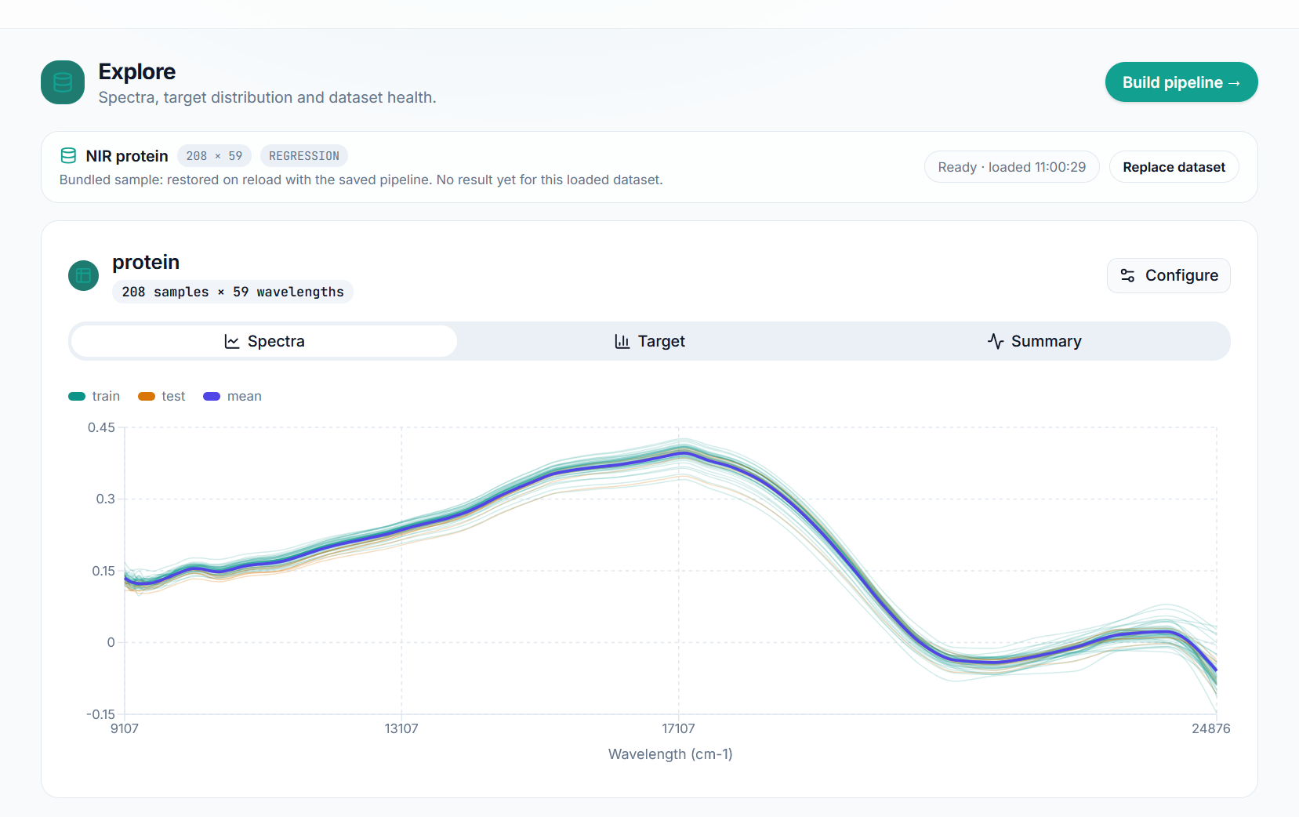
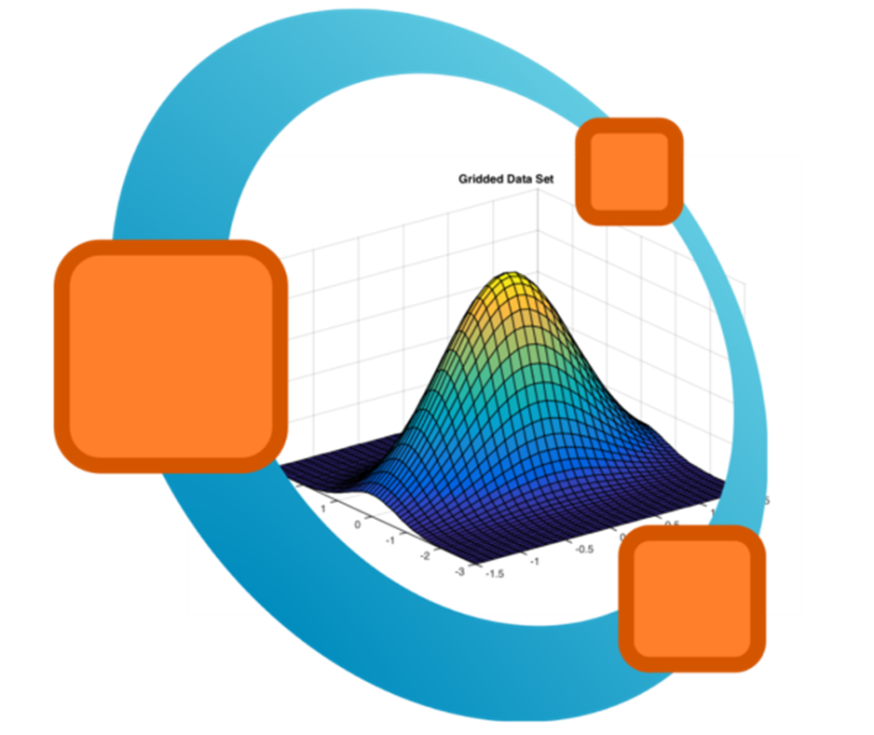








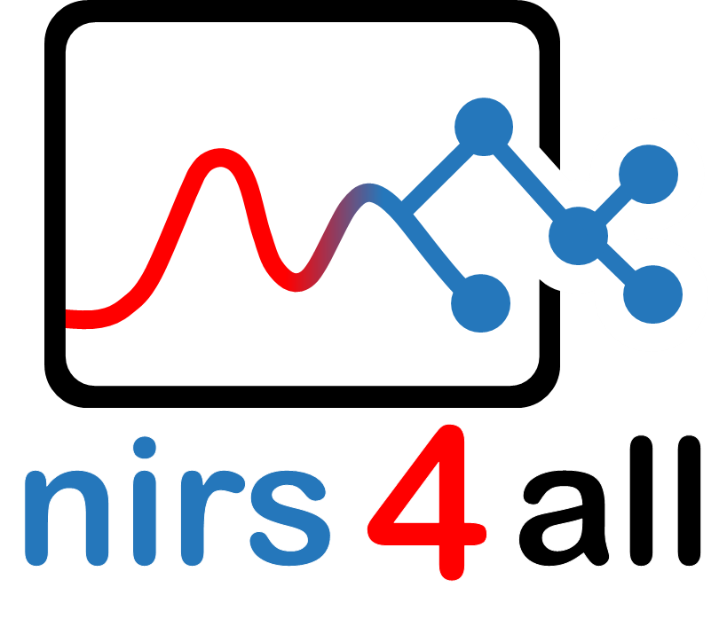
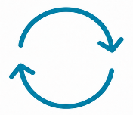
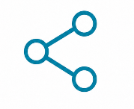






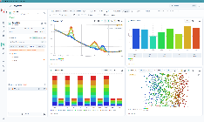
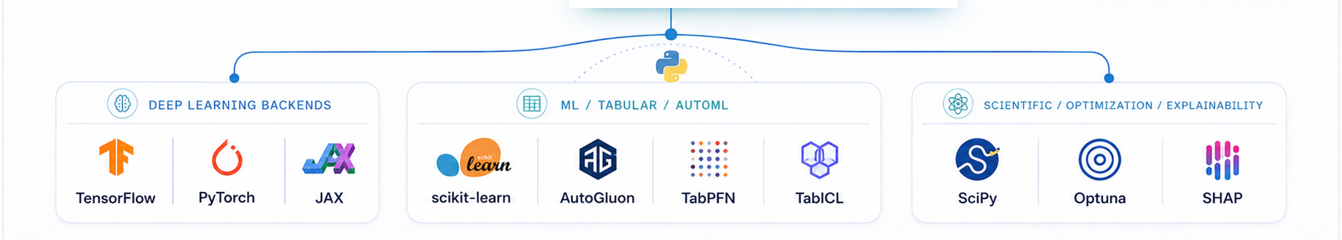




WEB
n4a-web
PACKAGE/INTEROP
dag-ml, n4a-methods
USER DATA
REPRODUCE
SHARE
READ
ASSEMBLE
ANALYZE
.n4a, .n4u
n4a-arena, n4a-bank
n4a-formats
n4a-io
nirs4all, n4a-methods
REFERENCE DATA
n4a-datasets
ML / OPTIM / EXPLAIN.
DEEP LEARNING BACKENDS
APPLICATION
n4a-studio

