Slide 1
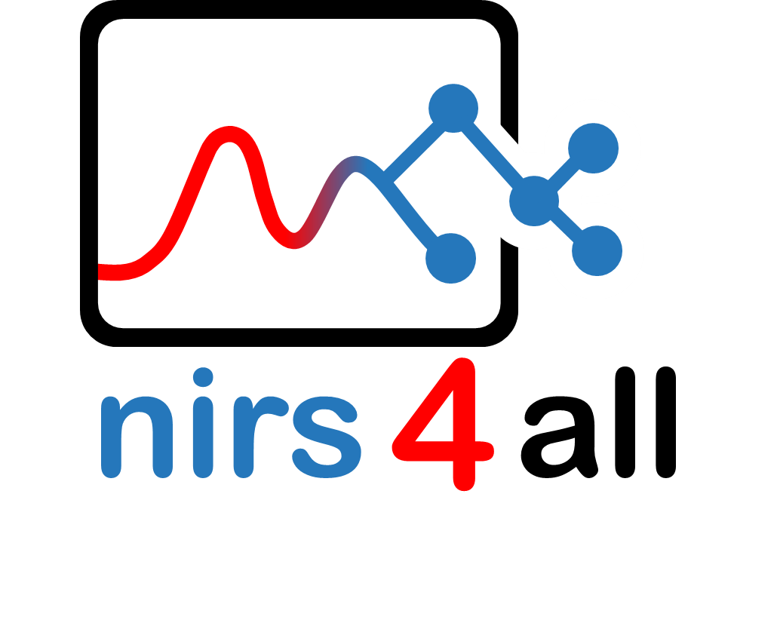

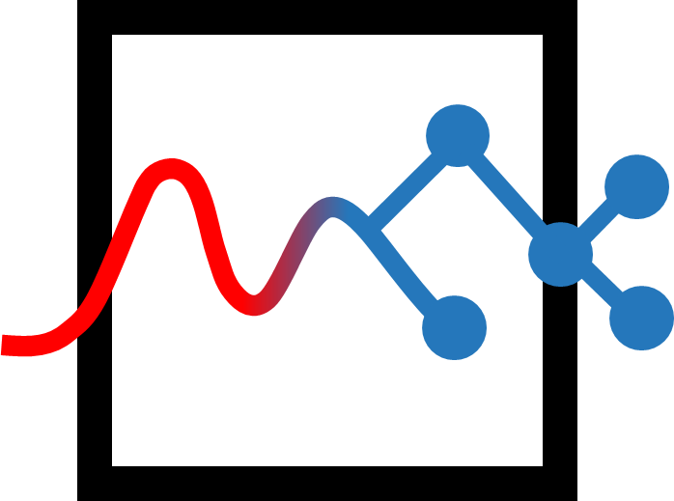
4
4
nirs
all
nirs
all

Slide 2
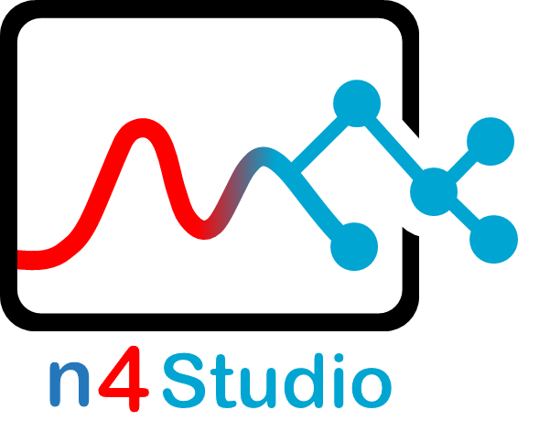
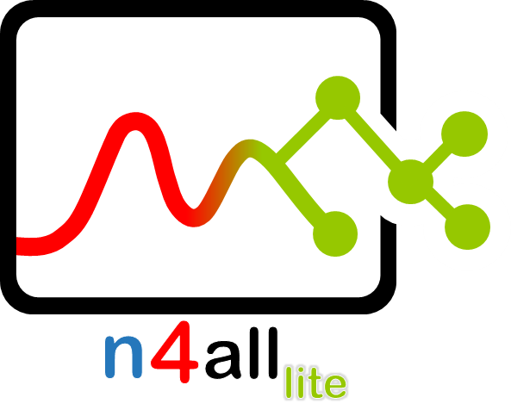
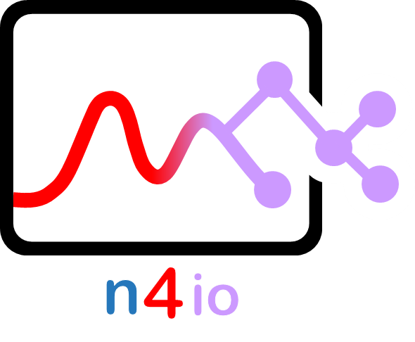

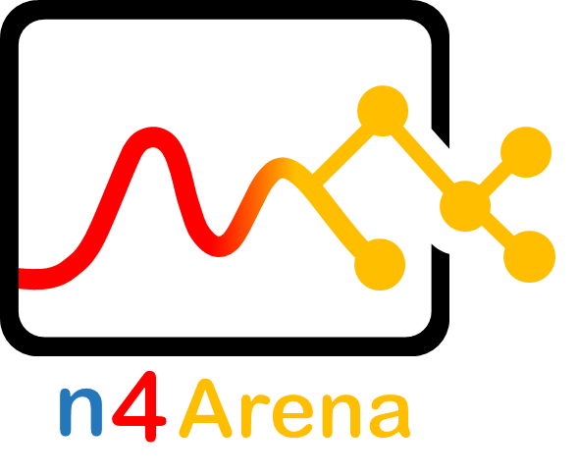
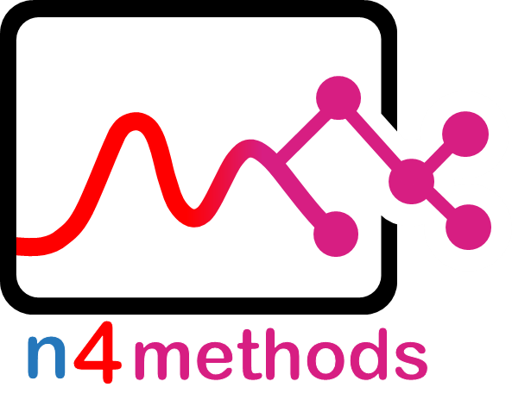

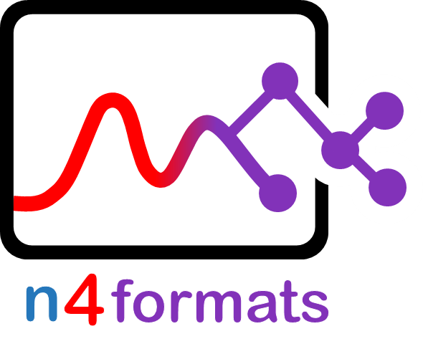
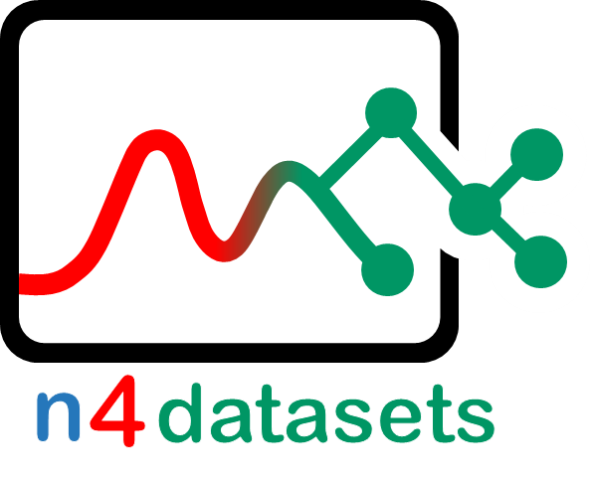


Slide 3
n
4
Studio
n
4
formats
n
4
Arena
n
4
io

Slide 4
n
4
methods
n
4
datasets
n
4
all
n
4
papers
lite

Slide 5
nirs
4
all

Slide 6
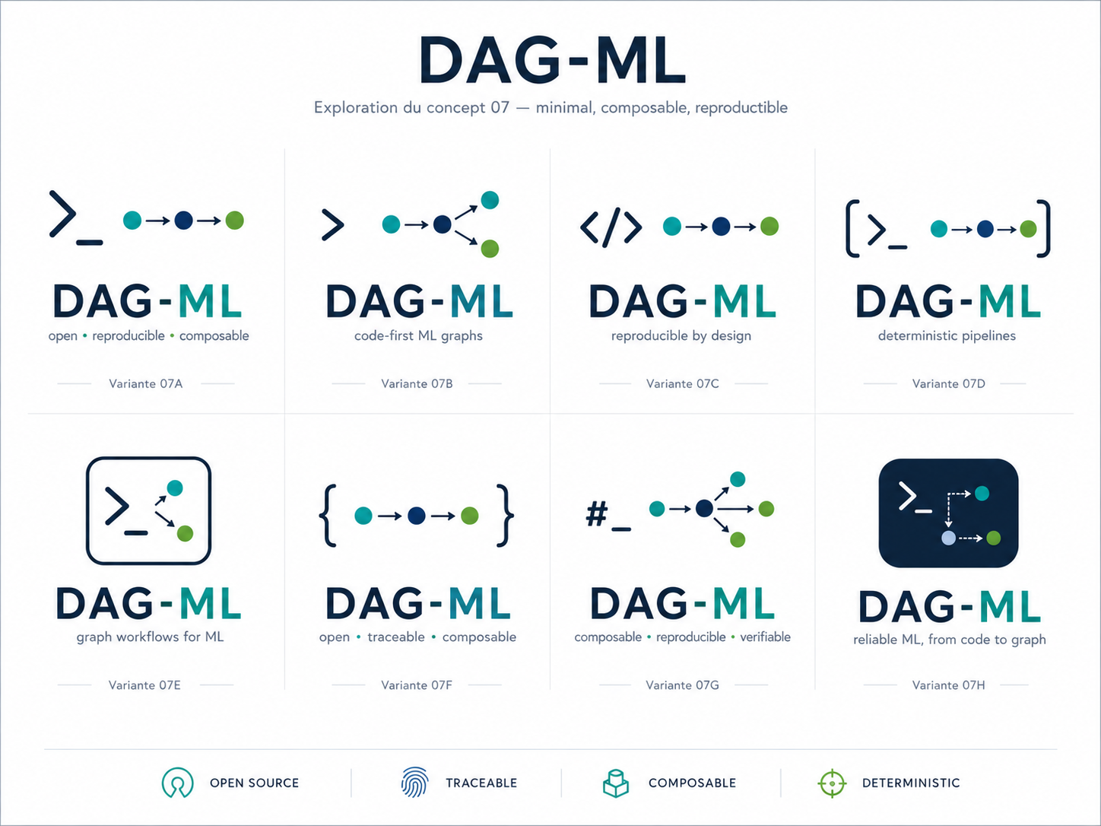
{
}
{
}
{
}
DAG-ML

Slide 7


n
4
formats
n4a
n4f
n4io
n4d
n4s
n4m
n4l
n4w
n4c
n4b
n
4
io
n
4
datasets
nirs
4
all
4
n
Studio
n
4
methods
n
4
lite
nirs
4
all
n
4
web
n
4
cluster

Slide 8



Slide 9
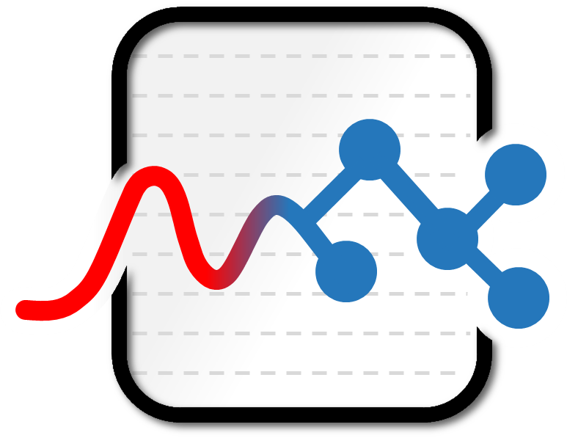
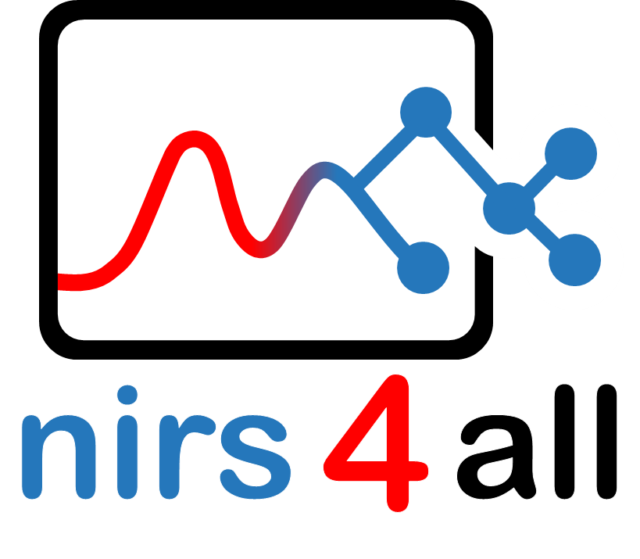
Studio

Slide 10
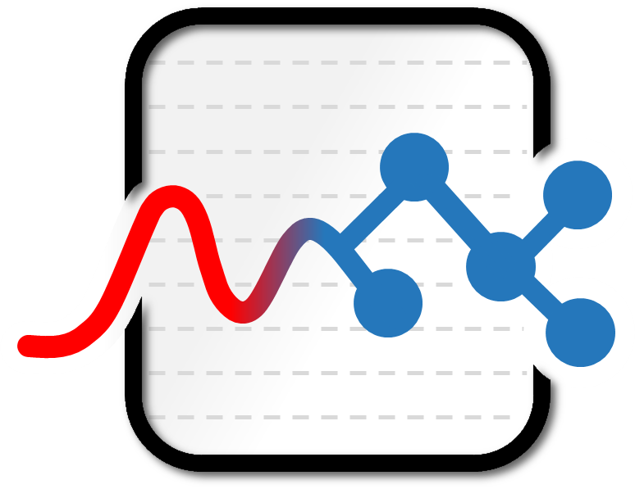


n
4
a
Studio

Slide 11
4
4
nirs
all
nirs
all

Slide 12
4
4
nirs
all
nirs
all

