Slide 1

IoT Infrastructure
    Embedded System and Codesign Lab
    Dept. of Computer Science and Engineering
Siddhant Rath
sid@tamu.edu
Ghanshyam Bhutra
gbhutra@tamu.edu

Slide 2
What is IoT?
There are several takes on the definition of IoT
The term “Internet of Things” was coined by British entrepreneur Kevin Ashton in 1999
The Internet of Things (IoT) is the network of physical objects or "things" embedded with electronics, software, sensors, and network connectivity, which enables these objects to collect and exchange data.
The Internet of Things (IoT) is an environment in which objects, animals or people are provided with unique identifiers and the ability to transfer data over a network without requiring human-to-human or human-to-computer interaction.
The Internet of Things (IoT) is an umbrella term used to describe a next step in the evolution of the Internet. While the first phase of the web can be thought of as a combination of an internet of hyper text documents and an internet of applications (think blogs, online email, social sites, etc.), one of the next steps is an Internet of augmented ‘smart’ objects – or ‘things’ – being accessible to human beings and each other over network connections. This is the internet of Things.

Slide 3
IoT Growth
Cisco estimates the IoT will consist of 50 billion devices connected to the Internet by 2020.
The “Internet of Things” is exploding. It is made up of billions of “smart” devices—from miniscule chips to mammoth machines—that use wireless technology to talk to each other (and to us). Our IoT world is growing at a breathtaking pace, from 2 billion objects in 2006 to a projected 200 billion by 2020. That will be around 26 smart objects for every human being on Earth! - Intel
As far as the reach of the Internet of Things, there are more than 12 billion devices that can currently connect to the Internet, and researchers at IDC estimate that by 2020 there will be 26 times more connected things than people. - International Data Co-operation
Connecting these devices on the present internet structure based on IPv4 with 32 bit address just isn’t enough.
Solution : IPv6 128 bit address space

Slide 4
Applications of IoT
Smart Cities
  Smart Parking
  Monitoring of parking spaces availability in the city.
  Structural health
  Monitoring of vibrations and material conditions in buildings, bridges and historical monuments.
  Traffic Congestion
  Monitoring of vehicles and pedestrian levels to optimize driving and walking routes
  Waste Management
  Detection of rubbish levels in containers to optimize the trash collection routes.
  Smart Roads
  Intelligent Highways with warning messages and diversions according to climate conditions and unexpected events like accidents or traffic jams.
Smart Environment
  Forest Fire Detection
  Monitoring of combustion gases and preemptive fire conditions to define alert zones.
  Air Pollution
  Control of CO2 emissions of factories, pollution emitted by cars and toxic gases generated in farms.
  Snow Level Monitoring
  Snow level measurement to know in real time the quality of ski tracks and allow security corps avalanche prevention
  Earthquake Early Detection
  Distributed control in specific places of tremors
Smart Metering
  Smart Grid
  Energy consumption monitoring and management.
  Tank level
  Monitoring of water, oil and gas levels in storage tanks and cisterns.
  Photovoltaic Installations
  Monitoring and optimization of performance in solar energy plants.
  Water Flow
  Measurement of water pressure in water transportation systems
Security & Emergencies
  Perimeter Access Control
  Access control to restricted areas and detection of people in non-authorized areas.
  Liquid Presence
  Liquid detection in data centers, warehouses and sensitive building grounds to prevent break downs and corrosion.
Retail
  Supply Chain Control
  Monitoring of storage conditions along the supply chain and product tracking for traceability purposes.
  NFC Payment
  Payment processing based in location or activity duration for public transport, gyms, theme parks, etc.
Logistics
  Quality of Shipment Conditions
  Monitoring of vibrations, strokes, container openings or cold chain maintenance for insurance purposes.
  Fleet Tracking
  Control of routes followed for delicate goods like medical drugs, jewels or dangerous merchandises.
Industrial Control ETC…

Slide 5
Connection Hierarchy
Device Server
The Cloud.
Smart Devices
A Smart Device host software stacks that handle multiple end devices. This is relatively a smarter device like a SoC.
End Devices
A typical end device would be a 8-bit microcontroller with GPIO Pins that can read data from a sensor or control an actuator.

Slide 6
Connection Profiles
Critical Connection
Thing
Gateway
Cloud
Standard Connection
Thing
Gateway
Cloud
Low Power Connection
Thing
Gateway
Cloud
Ultra Low Power Connection
Thing
Gateway
Cloud

Slide 7
Finding the ‘common thing’ in things
The fundamental stuff that build our ‘Things’ are either sensors or actuators or both. In other words they are composed of ‘Data receivers’ and/or ‘Data Transmitters’.
They need a microcontroller that interfaces them with a network.
There exists a device that hooks up with the microcontroller following some ‘communication protocols’ via Internet to a server. Either data is sent, received, or an event is associated with the data.
The Server Implements a middleware or a communication gateway for various devices to connect to it.
It is also associated with a domain specific application that conveys some meaning to the data and which also deploy some policies.

Slide 8
A ‘Generic’ Architecture for IOT
Sensor
Sensor
Actuator
Sensor
Sensor
Actuator
Microcontroller
Microcontroller
Microcontroller
Microcontroller
Cluster Head
Cluster Head
Generic
Device Server (Handles Communication)
App’s Server

Slide 9
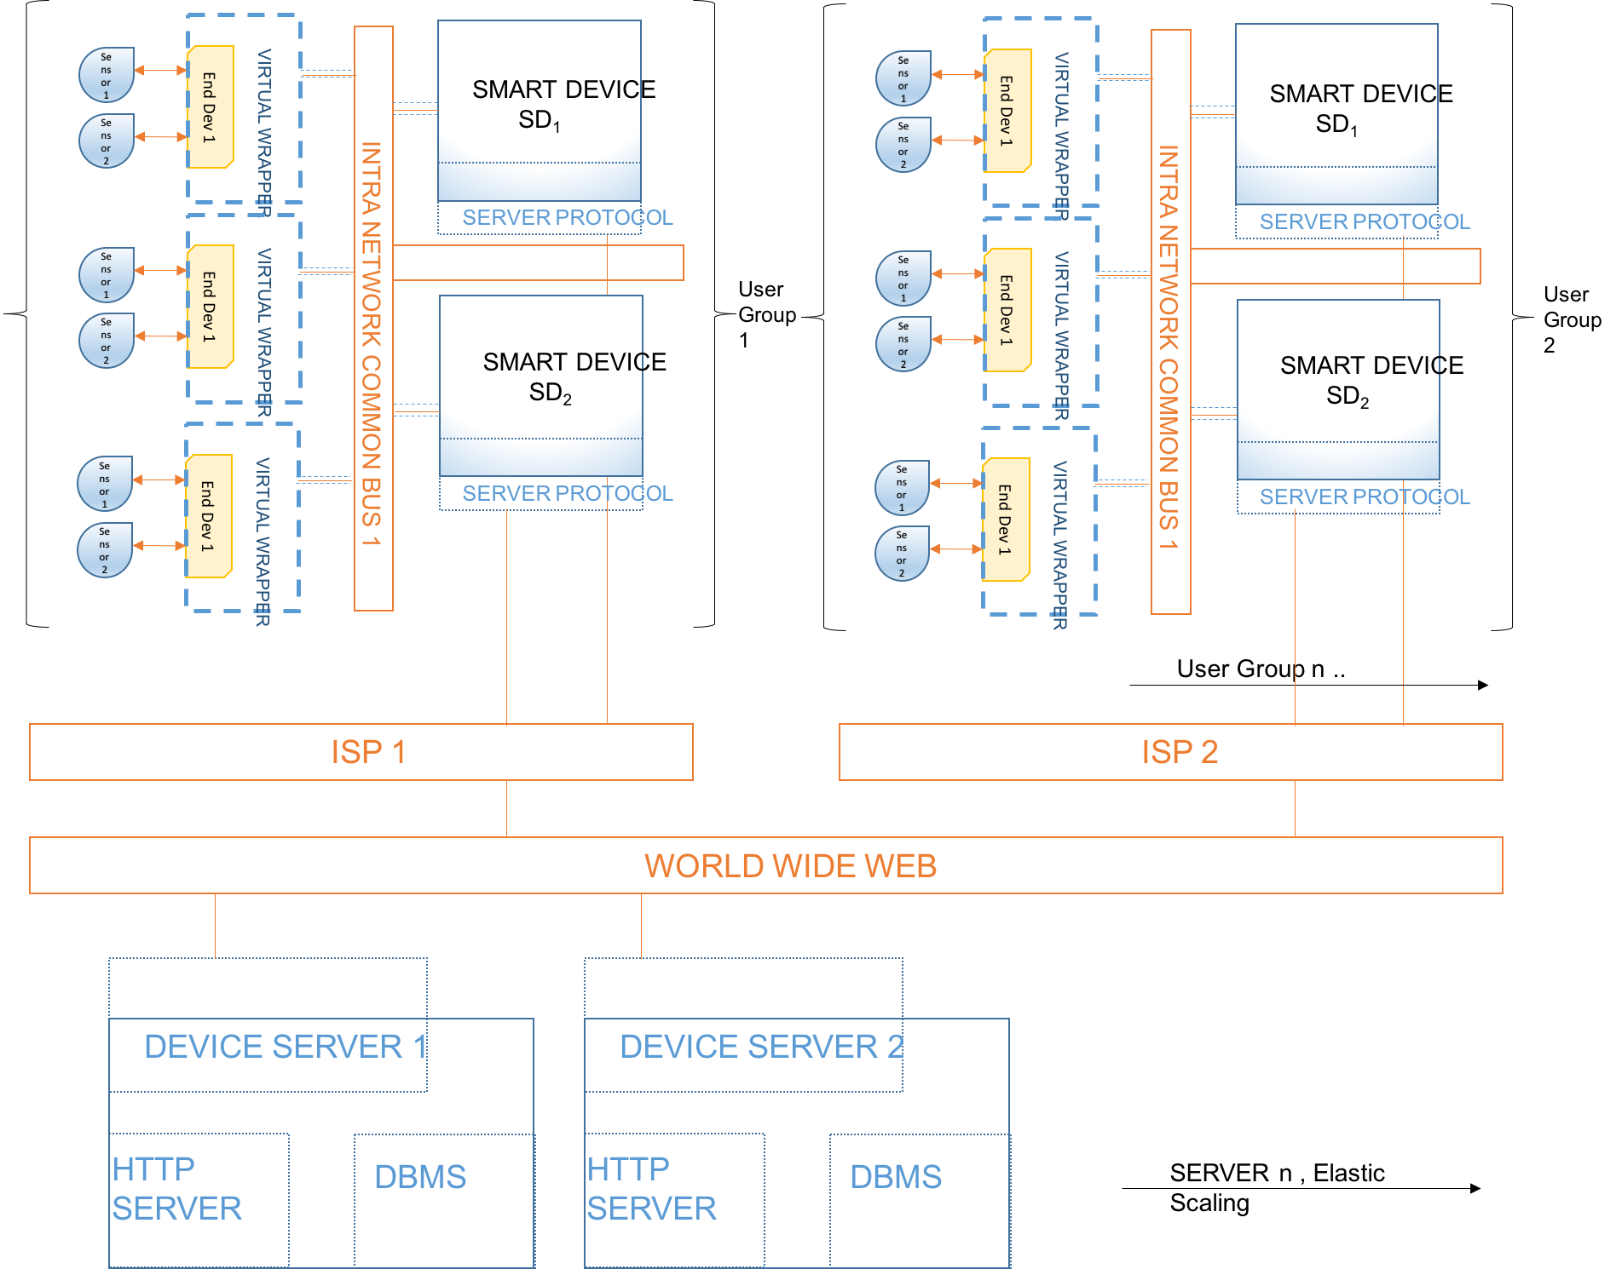
A ‘Generic’ Architecture for IOT

Slide 10
Goals
Setting up the infrastructure: a scalable cross platform software architecture which can incorporates “things” of all types. Resource constrained and otherwise.
Standardized Common protocol: Dynamic protocol between each layer which can support the different connection profiles with minimum power overhead.
Standalone Mode: Support intra-network features which would make the system efficient and robust during weak internet connections or outages.
Resource Management: Keeping Track of all the endpoints, their health and assigning them to security groups.
M2M Device Server : Analogous to a http server but handles requests from devices and machines instead of humans.

Slide 11
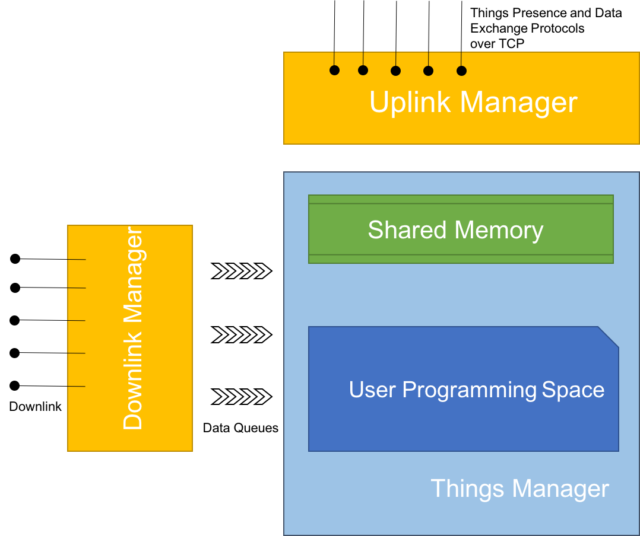
Smart Device Software Components

Slide 12
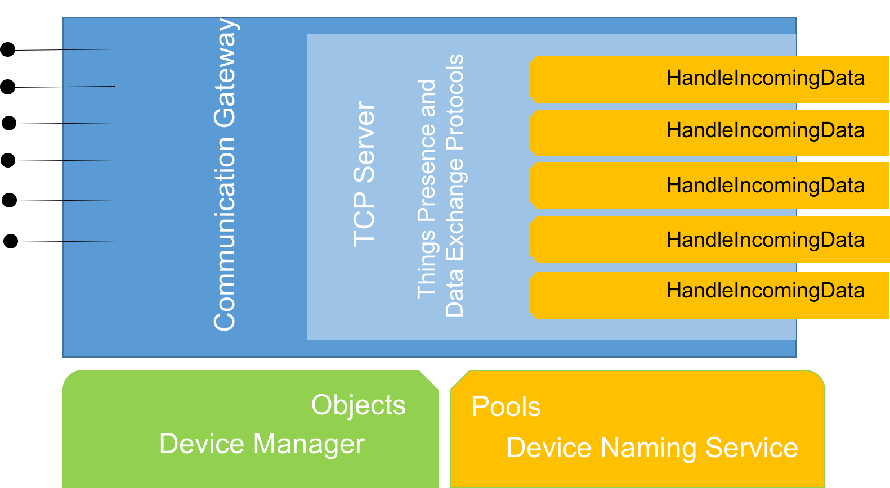
Server Communication Gateway
Incoming
Connections
From Smart
Device

Slide 13
Challenges
Little to no similar ‘Generic’ architecture exists
Scalability
Low-power consumption
Security
No existing standard protocols
Minimal storage on the ‘things’

