Slide 1
Thesis Meeting
& Review

Slide 2
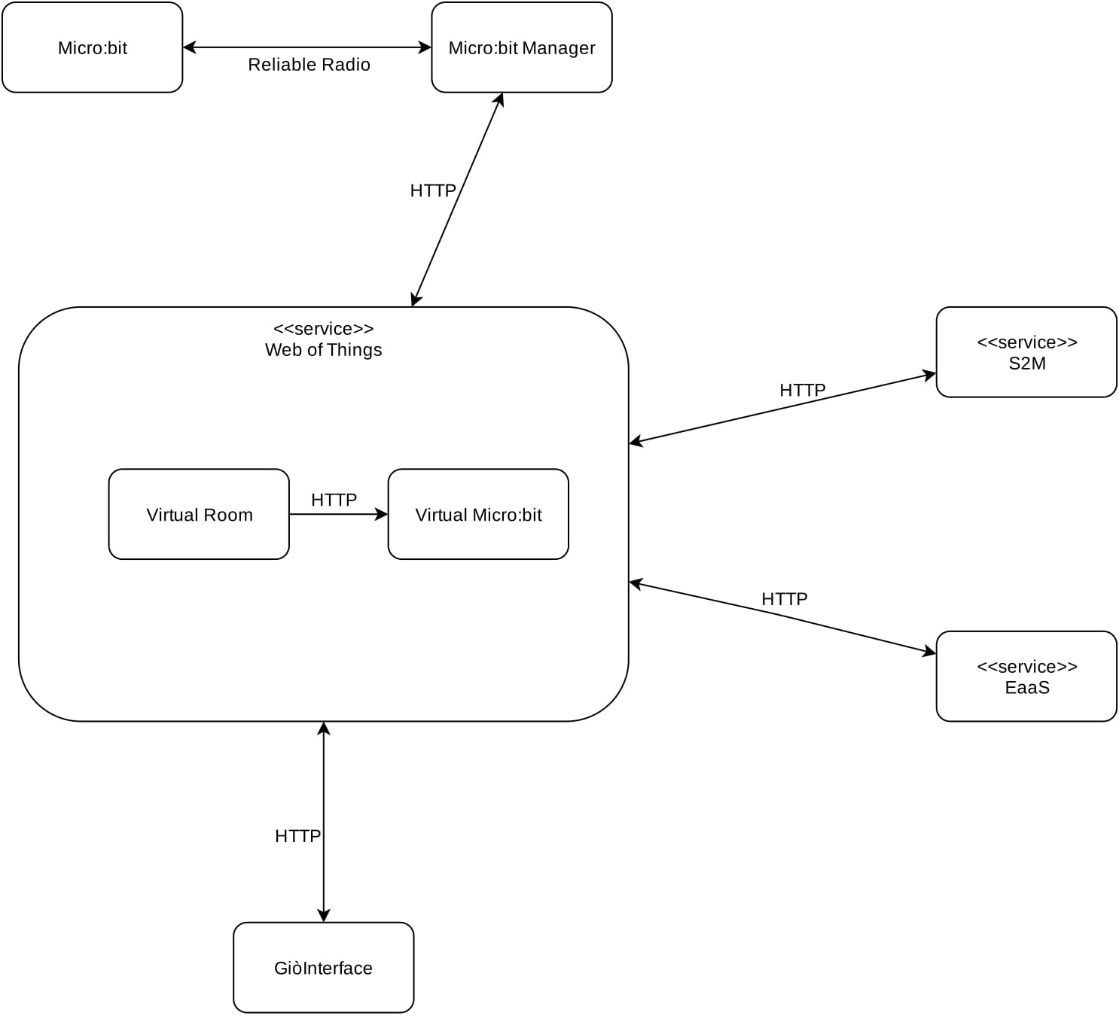
The system

Slide 3
The system
Micro:bit:
Detects&Sends the environmental parameters of the room
Receives the system’s requests
Micro:bit Manager:
Collects the microbits data and sends them to the WoT Service

Slide 4
The system
Web Of Things Service:
Mantains a digital twin of each micro:bit and room
Virtual Room:
The digital twin of a room
Stores which user is in the room
Receives the micro:bits updates
Starts users goals mediation
Virtual Micro:bit:
The digital twin of a micro:bit
Receives the micro:bits updates
Starts rooms goals mediation
Decides the actions to be taken

Slide 5
The system
Expert-As-a-Service:
Offers various services, for example: mediation, proof of theorems, inference of new facts…
GiòInterface:
Show the map of the department and the environmental parameters of each room
Simple Storage Microservice:
Stores all the system’s info

Slide 6
The system: communications
All the communications between the system’s components and service occurs through HTTP: each service offers a REST interface.
The only excpetions are the micro:bits communications, in fact they communicates through a proprietary radio protocol (Nordic Gazell 2.4GHz): we added a simple reliability mechanism thanks to acks messages and a mechanism for implementing unicast communication.
Micro:bits can communicate with the micro:bit manager thanks to a special intermediary server micro:bit: it receives all the micro:bit packets through the radio protocol and sends it through a serial port and viceversa.

Slide 7
The system: mediations
The system’s goal mediation occurs in three phases all realized by interacting with the EaaS:
Users Mediation
For each user in the room his preferences are collected.
All preferences are mediated (average)
Rooms Mediation
For each room served by a specific micro:bit its preferences are collected.
All preferences are mediated (average)
Admin Decisions
The final goal of a room is applied by querying the administration rules

Slide 8
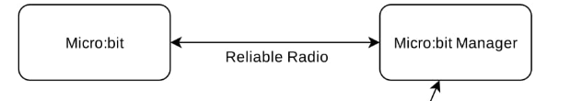
The journey of an information: the micro:bit and his manager
When a micro: bit detects a change in the environment it sends a packet with the new state through a reliable radio channel.
A special “server” micro:bit receives the packet and sends it, through a serial port, to a micro:bit manager.
The micro: bit manager first checks that the “sender” micro:bit has been approved (thanks to a pairing function) and then sends, through REST api, the update to the digital twin micro: bit and to all the rooms served by that micro: bits.

Slide 9
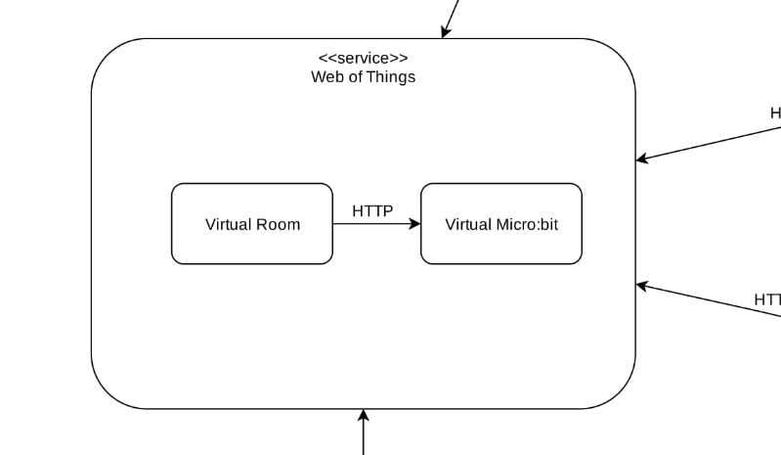
The journey of an information: the Web of Things Service
All the virtual micro:bits and virtual rooms are hosted in a Web of Things Server.
This server increases the standard WoT API: it offers functionality to create and delete things remotely and to send property updates.
When a user enters the room, the virtual room retrieves the user rules from S2M.
When a virtual room receives a property update it starts users mediation and sends the result to the appropriate virtual micro:bit

Slide 10
The journey of an information: the Web of Things Service
When a virtual micro: bit receives the result of a user mediation, a new mediation begins across the room served by that micro: bit.
At the end of the mediation the virtual micro:bit decides how to implement the new state by consulting the administrator's rules.
Then it emits an event with the actions to do.

Slide 11
The journey of an information: the micro:bit manager and its devices
When a micro:bit manager receives an event emit by a virtual microbit it sends the events’data to the «server» micro:bit that sends those information to the appropriate micro:bit

Slide 12
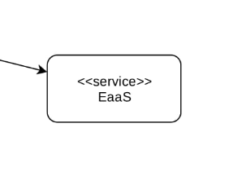
Expert-as-a-System
The EaaS (with the WoT) is the main service offered by the system: it’s a agnostic-content SaaS for implementing complex decision procedures.
Some of the main services offered concern:
proof of theorems
inference of new facts based on a user's rules and facts
mediation mechanism (max, min, avg, majority with or without quorum)

Slide 13
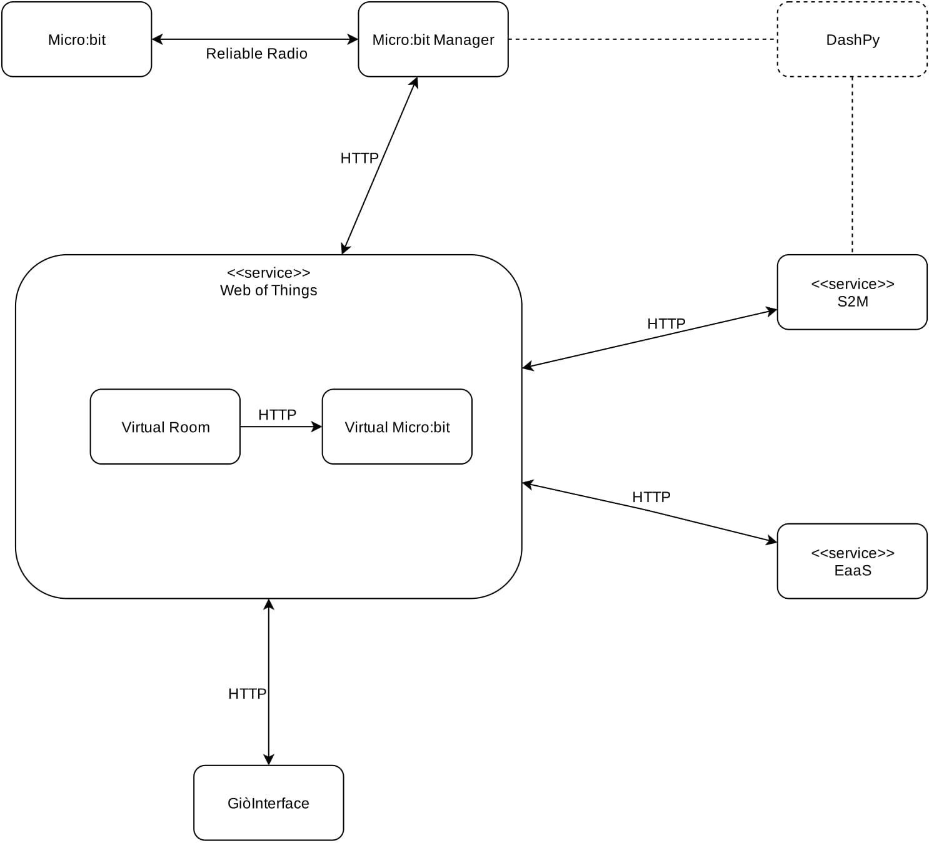
Monitoring the system: DashPy

Slide 14
An example: user rules
IF temperature(very_low) THEN do(temperature(low)).
IF temperature(low) and outdoor_temperature(medium) THEN do(temperature(medium)).
IF temperature(low) and outdoor_temperature(low) THEN do(temperature(medium)).
IF temperature(low) and outdoor_temperature(very_low) THEN do(temperature(medium)).
IF temperature(high) and outdoor_temperature(medium) THEN do(temperature(medium)).
IF temperature(high) and outdoor_temperature(high) THEN do(temperature(medium)).
IF temperature(high) and outdoor_temperature(very_high) THEN do(temperature(medium)).
IF temperature(very_high) THEN do(temperature(high)).
IF light(low) and outdoor_light(medium) THEN do(light(medium)).
IF light(low) and outdoor_light(low) THEN do(light(medium)).
IF light(medium) and outdoor_light(low) THEN do(light(high)).
IF light(medium) and outdoor_light(high) THEN do(light(low)).
IF light(high) and outdoor_light(high) THEN do(light(medium)).
IF light(high) and outdoor_light(medium) THEN do(light(medium)).

Slide 15
An example: admin rules
IF temperature(very_low) THEN do(temperature(18)).
IF temperature(low) THEN do(temperature(18)).
IF temperature(medium) THEN do(temperature(22)).
IF temperature(high) THEN do(temperature(24)).
IF temperature(very_high) THEN do(temperature(24)).
IF light(low) THEN do(light(180)).
IF light(medium) THEN do(light(220)).
IF light(high) THEN do(light(255)).

Slide 16
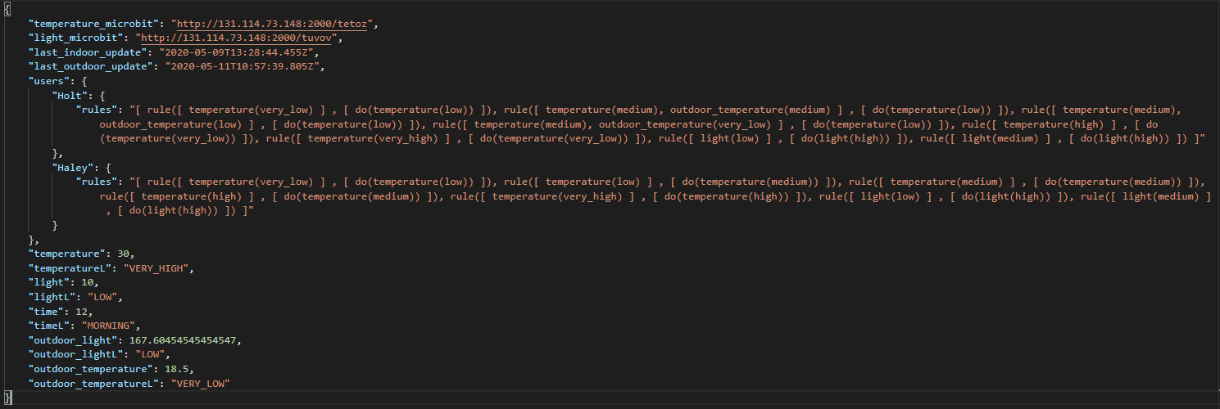
An example: room status

