Slide 1
US Elementary School Finance Analysis
Kar L Kam, Chen-Yu Hsieh
Intro to Data Analysis
6/14/18

Slide 2
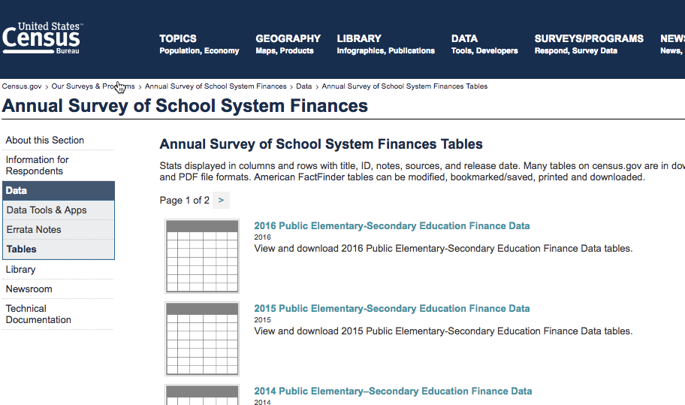

Data Source
Original data source is from US Census Bureau - https://www.census.gov/programs-surveys/school-finances/data/tables.html
Data is compiled by Roy Garrard and published in Kaggle- https://www.kaggle.com/noriuk/us-educational-finances

Slide 3
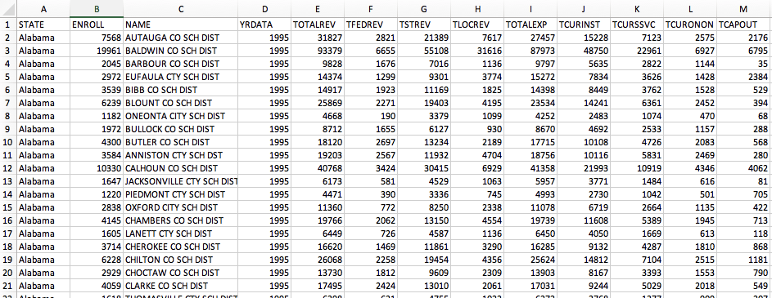
CSV file
359836 Rows
Use R-Studio and Packages for analysis
dplyr, ggplot2, mapproj, maps, maptools

Slide 4
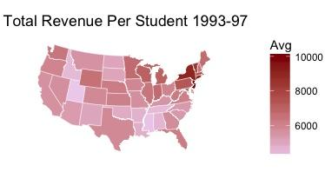
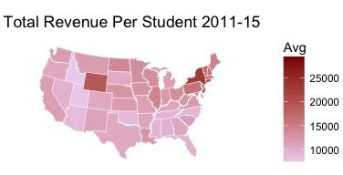
Total Revenue Per Student
Total Revenue per Student (Top & Bottom 5)
Rank | 1993 - 1997 mean=$6,258 |  | 2011-2015 mean=$12,584
1 | New Jersey | $10,168 | District of Columbia | $29,624
2 | New York | $9,066 | New York | $22,816
3 | Connecticut | $9,025 | New Jersey | $20,348
4 | Alaska | $8,973 | Alaska | $19,655
5 | District of Columbia | $8,857 | Connecticut | $19,274
47 | Alabama | $4,513 | North Carolina | $9,134
48 | Tennessee | $4,418 | Oklahoma | $8,886
49 | Idaho | $4,392 | Arizona | $8,707
50 | Mississippi | $4,146 | Utah | $7,759
51 | Utah | $4,072 | Idaho | $7,594

Slide 5
2. States with greatest jump and drop
States with the Greatest Jump/Drop in Ranking
State | Rank 1993-1997 | Rank 2011-20157 | Difference
North Dakota | 42 | 17 | Up 25
Louisiana | 45 | 24 | Up 21
Michigan | 12 | 31 | Down 19
Florida | 23 | 44 | Down 21
 | %Federal |  | %State |  | %Local |  | Students
State | 1990’s | 2010’s | 1990’s | 2010’s | 1990’s | 2010’s | 1990’s | 2010’s
North Dakota | 9.16% | 9.64 | 41.3 | 53.9 | 49.5 | 36.5 | 119K | 101K
Louisiana | 11.9% | 16.3 | 52.5 | 41.4 | 35.7 | 42.2 | 799K | 666K
Michigan | 4.47% | 7.89 | 54.2 | 58.8 | 41.3 | 33.3 | 1,625K | 1,393K
Florida | 7.25 | 13.3 | 49.1 | 37.7 | 43.7 | 49 | 2,109K | 2,685
15%
16%
27%

Slide 6
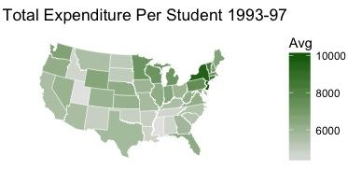
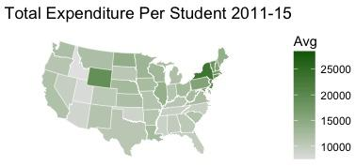
3. Total Expenditure Per Student
Total Spending per Student (Top & Bottom 5)
Rank | 1993 - 1997 mean=$6,325 |  | 2011-2015 mean=$12,577
1 | New Jersey | $10,214 | District of Columbia | $28,869
2 | New York | $9,543 | New York | $23,302
3 | Alaska | $9,469 | Alaska | $20,292
4 | District of Columbia | $8,955 | New Jersey | $19,929
5 | Connecticut | $8,837 | Wyoming | $19,114
47 | Alabama | $4,599 | Mississippi | $9,048
48 | Tennessee | $4,579 | Oklahoma | $8,753
49 | Idaho | $4,573 | Arizona | $8,529
50 | Mississippi | $4,196 | Utah | $7,853
51 | Utah | $4,190 | Idaho | $7,257

Slide 7
4. Correlation
1. Avg. Total Revenue is correlated to Avg. Local Revenue
2. Avg. Total Expenditure is correlated to Avg. Instruction Expenditure and Support Service Expenditure
3. Compared 2 time period, Avg. Capital Outlay has increased the correlation with Avg. Total Expenditure
TotalRevAvg FedAvg StateAvg LocalAvg
TotalRevAvg 1.0000000 0.4296798 0.3097040 0.802562884
TotalExpAvg InstAvg SServAvg
TotalExpAvg 1.0000000 0.95450121 0.9356861
1993-1997
TotalExpAvg CapOutAvg
TotalExpAvg 1.00000000 0.2241024927
2011-2015
TotalExpAvg CapOutAvg
TotalExpAvg 1.00000000 0.6176062

Slide 8
5. CA School District Revenue per Student 2015
Highest
 | YRDATA <int> | NAME <fctr> | STATE <fctr> | ENROLL <int> | total_rev_per_student_CA <dbl>
1 | 2015 | TRINITY COUNTY OFFICE OF EDUCATION | California | 15 | 485133.3
2 | 2015 | SAN MATEO CO SPL SCHS OPER BY CO SUPT | California | 403 | 394017.4
3 | 2015 | LAKE COUNTY OFFICE OF EDUCATION | California | 45 | 387111.1
4 | 2015 | SAN FRANCISCO CITY/CNTY SPECIAL SCHOOLS | California | 398 | 386419.6
5 | 2015 | LASSEN CO SPL SCHS OPER BY CO SUPT | California | 30 | 384600.0
6 | 2015 | NAPA CO SPL SCHS OPER BY CO SUPT | California | 140 | 350871.4
Lowest
 | YRDATA <int> | NAME <fctr> | STATE <fctr> | ENROLL <int> | total_rev_per_student_CA <dbl>
1 | 2015 | GORMAN ELEMENTARY SCHOOL DISTRICT | California | 2050 | 686.8293
2 | 2015 | RAVENDALE-TERMO ELEMENTARY SCHOOL DISTRICT | California | 665 | 939.8496
3 | 2015 | SPENCER VAL ELEM SCH DIST | California | 3205 | 1313.8846
4 | 2015 | MERIDIAN ELEM SCH DIST | California | 978 | 1491.8200
5 | 2015 | MARCUM ILLINOIS UNION ELEM SCHOOL DIST | California | 2283 | 1612.7902

Slide 9
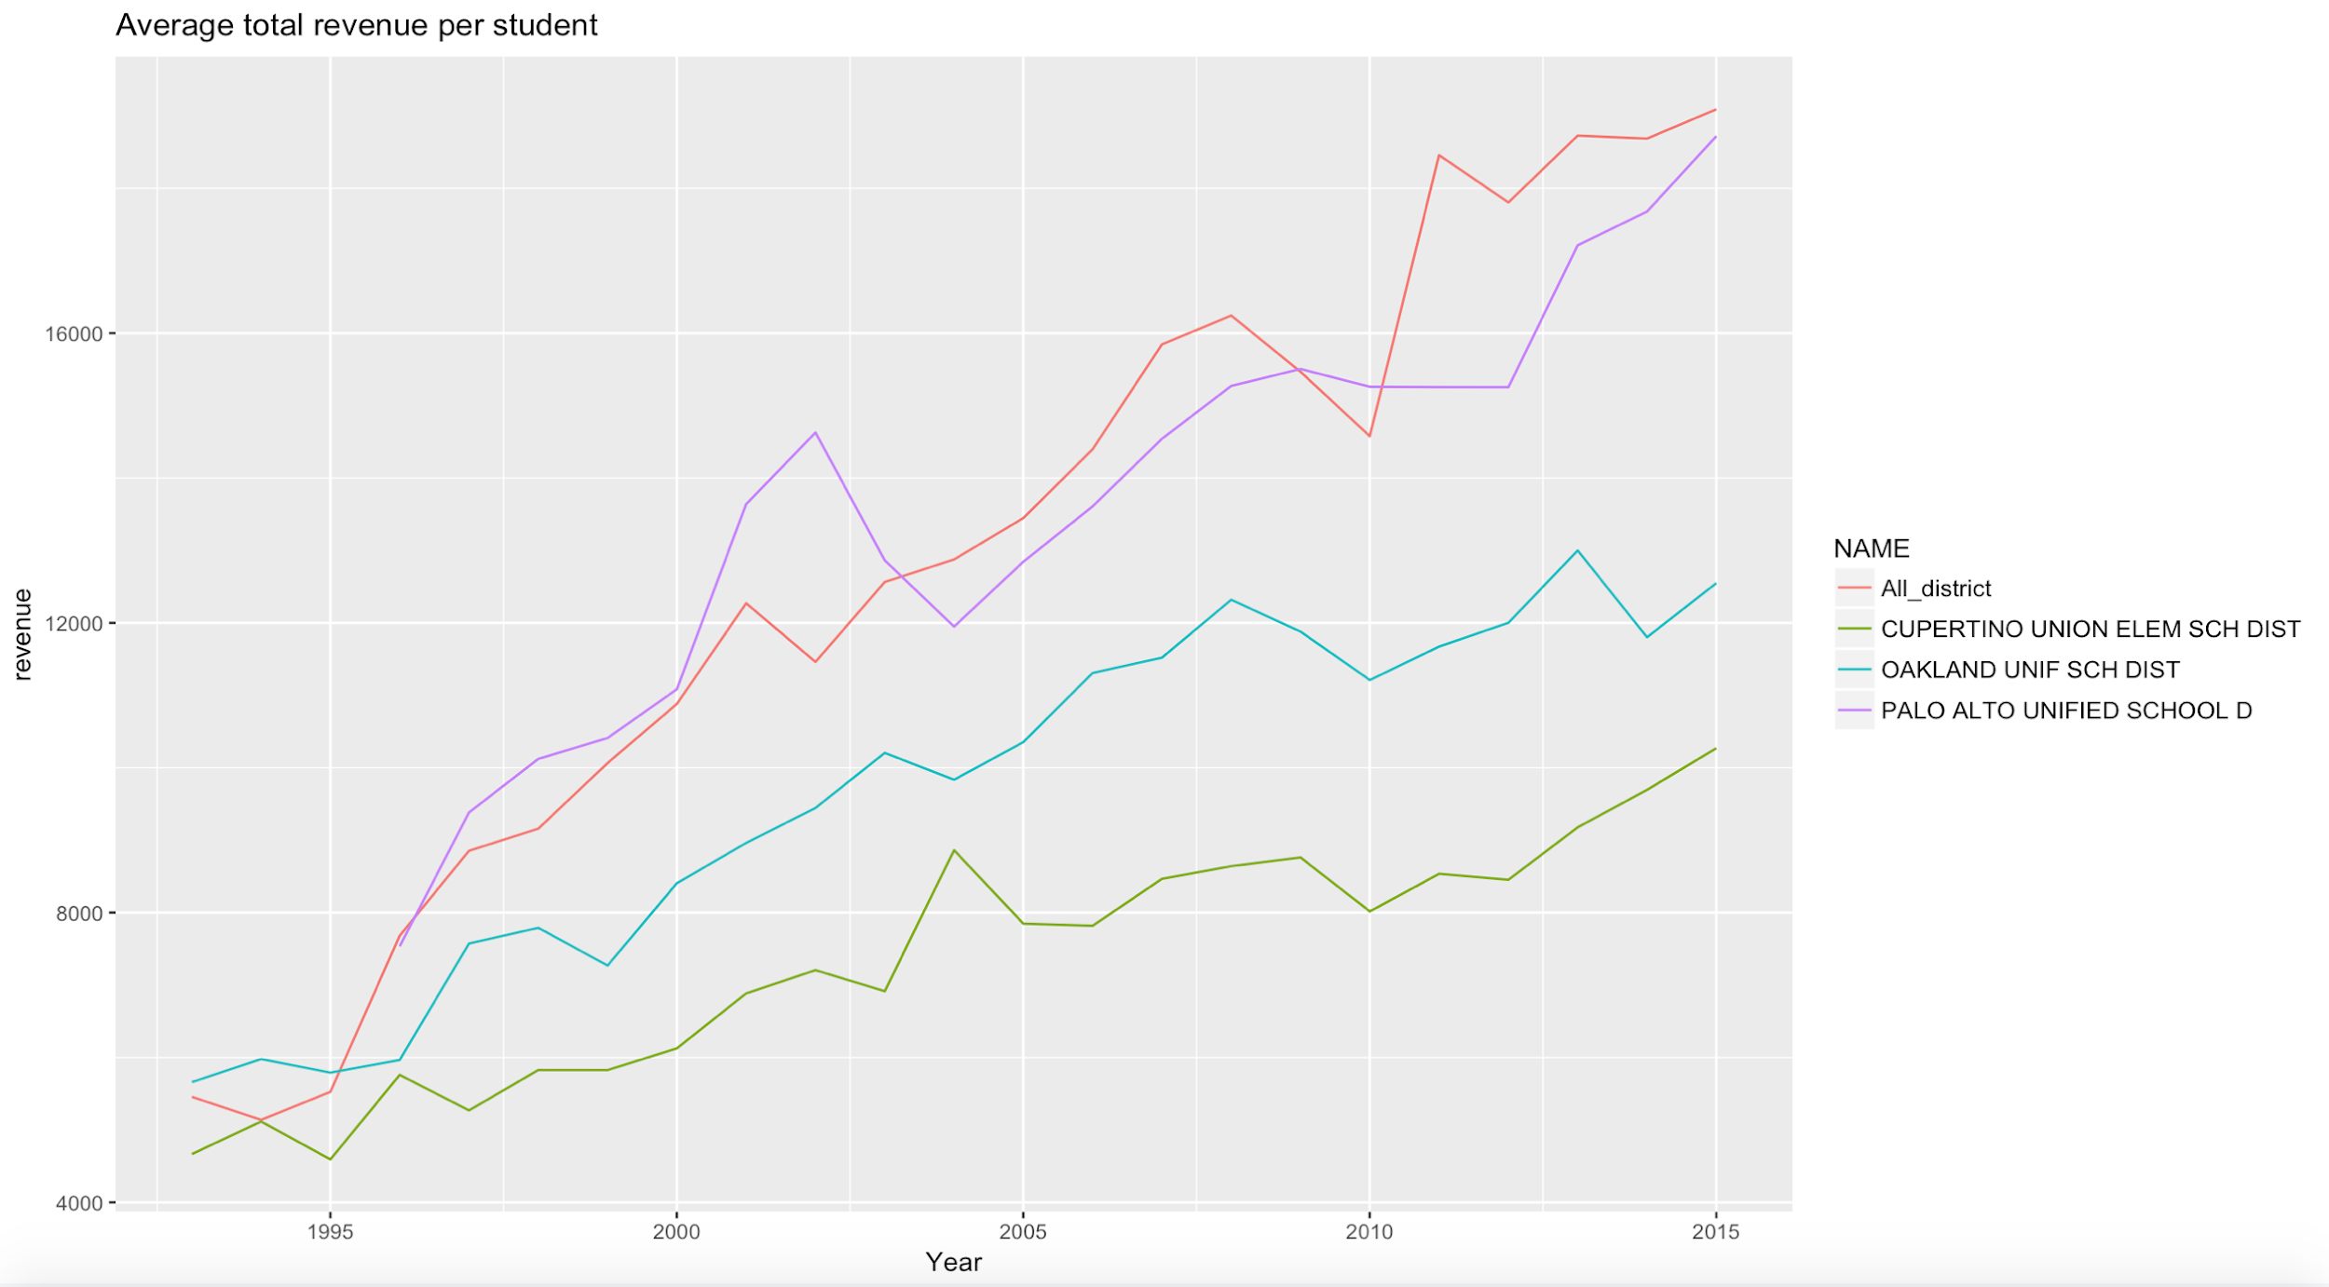
6. Avg. Total Revenue per Student - CA School District

Slide 10
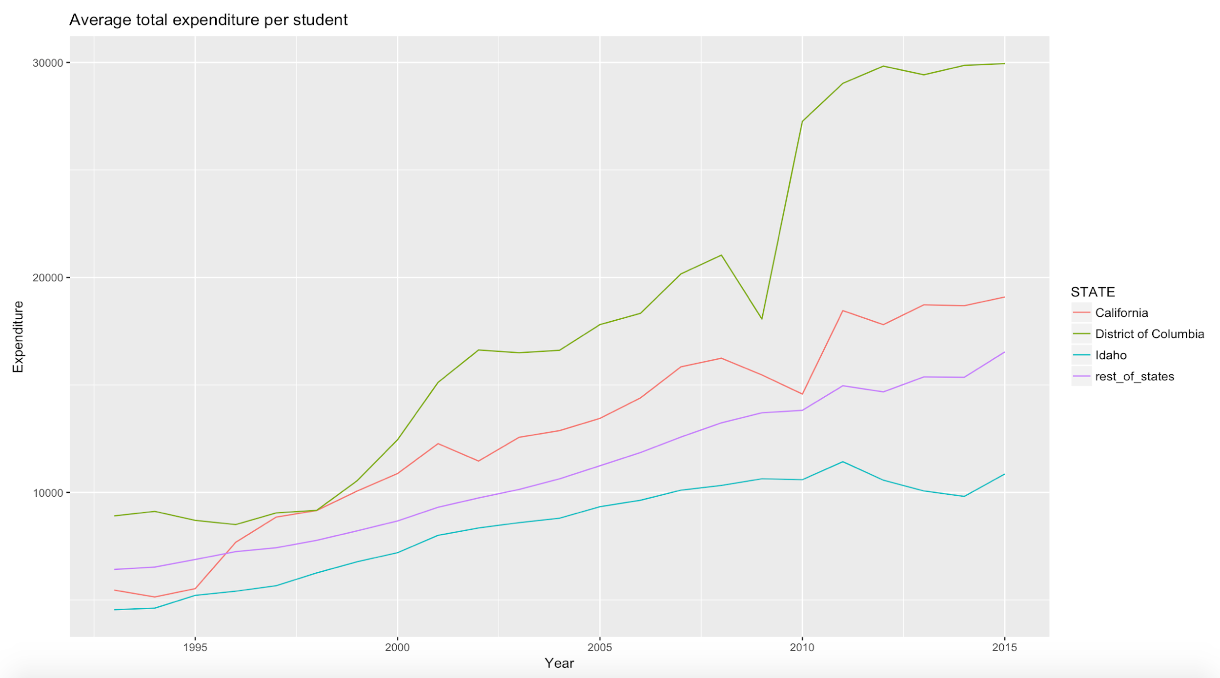
7. Avg. Total Expenditure per Student - CA vs States

Slide 11
Conclusion & Future Analysis
Conclusion
School districts spend as much as they make → no left over money
Instruction expenditure is the largest expense
Over the 20-year period, States with highest or lowest revenue/expenditure remain the same
Future Analysis
Include Cost of Living into analysis
Relate test scores or academic performance into analysis - Is money well spent?

