Slide 1




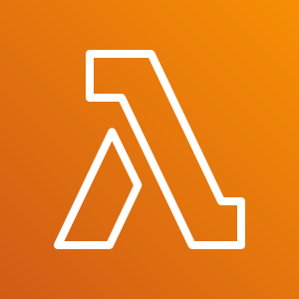

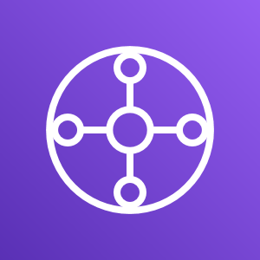





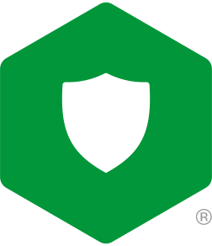

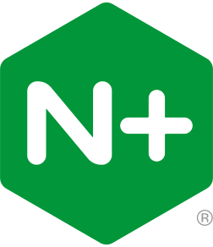


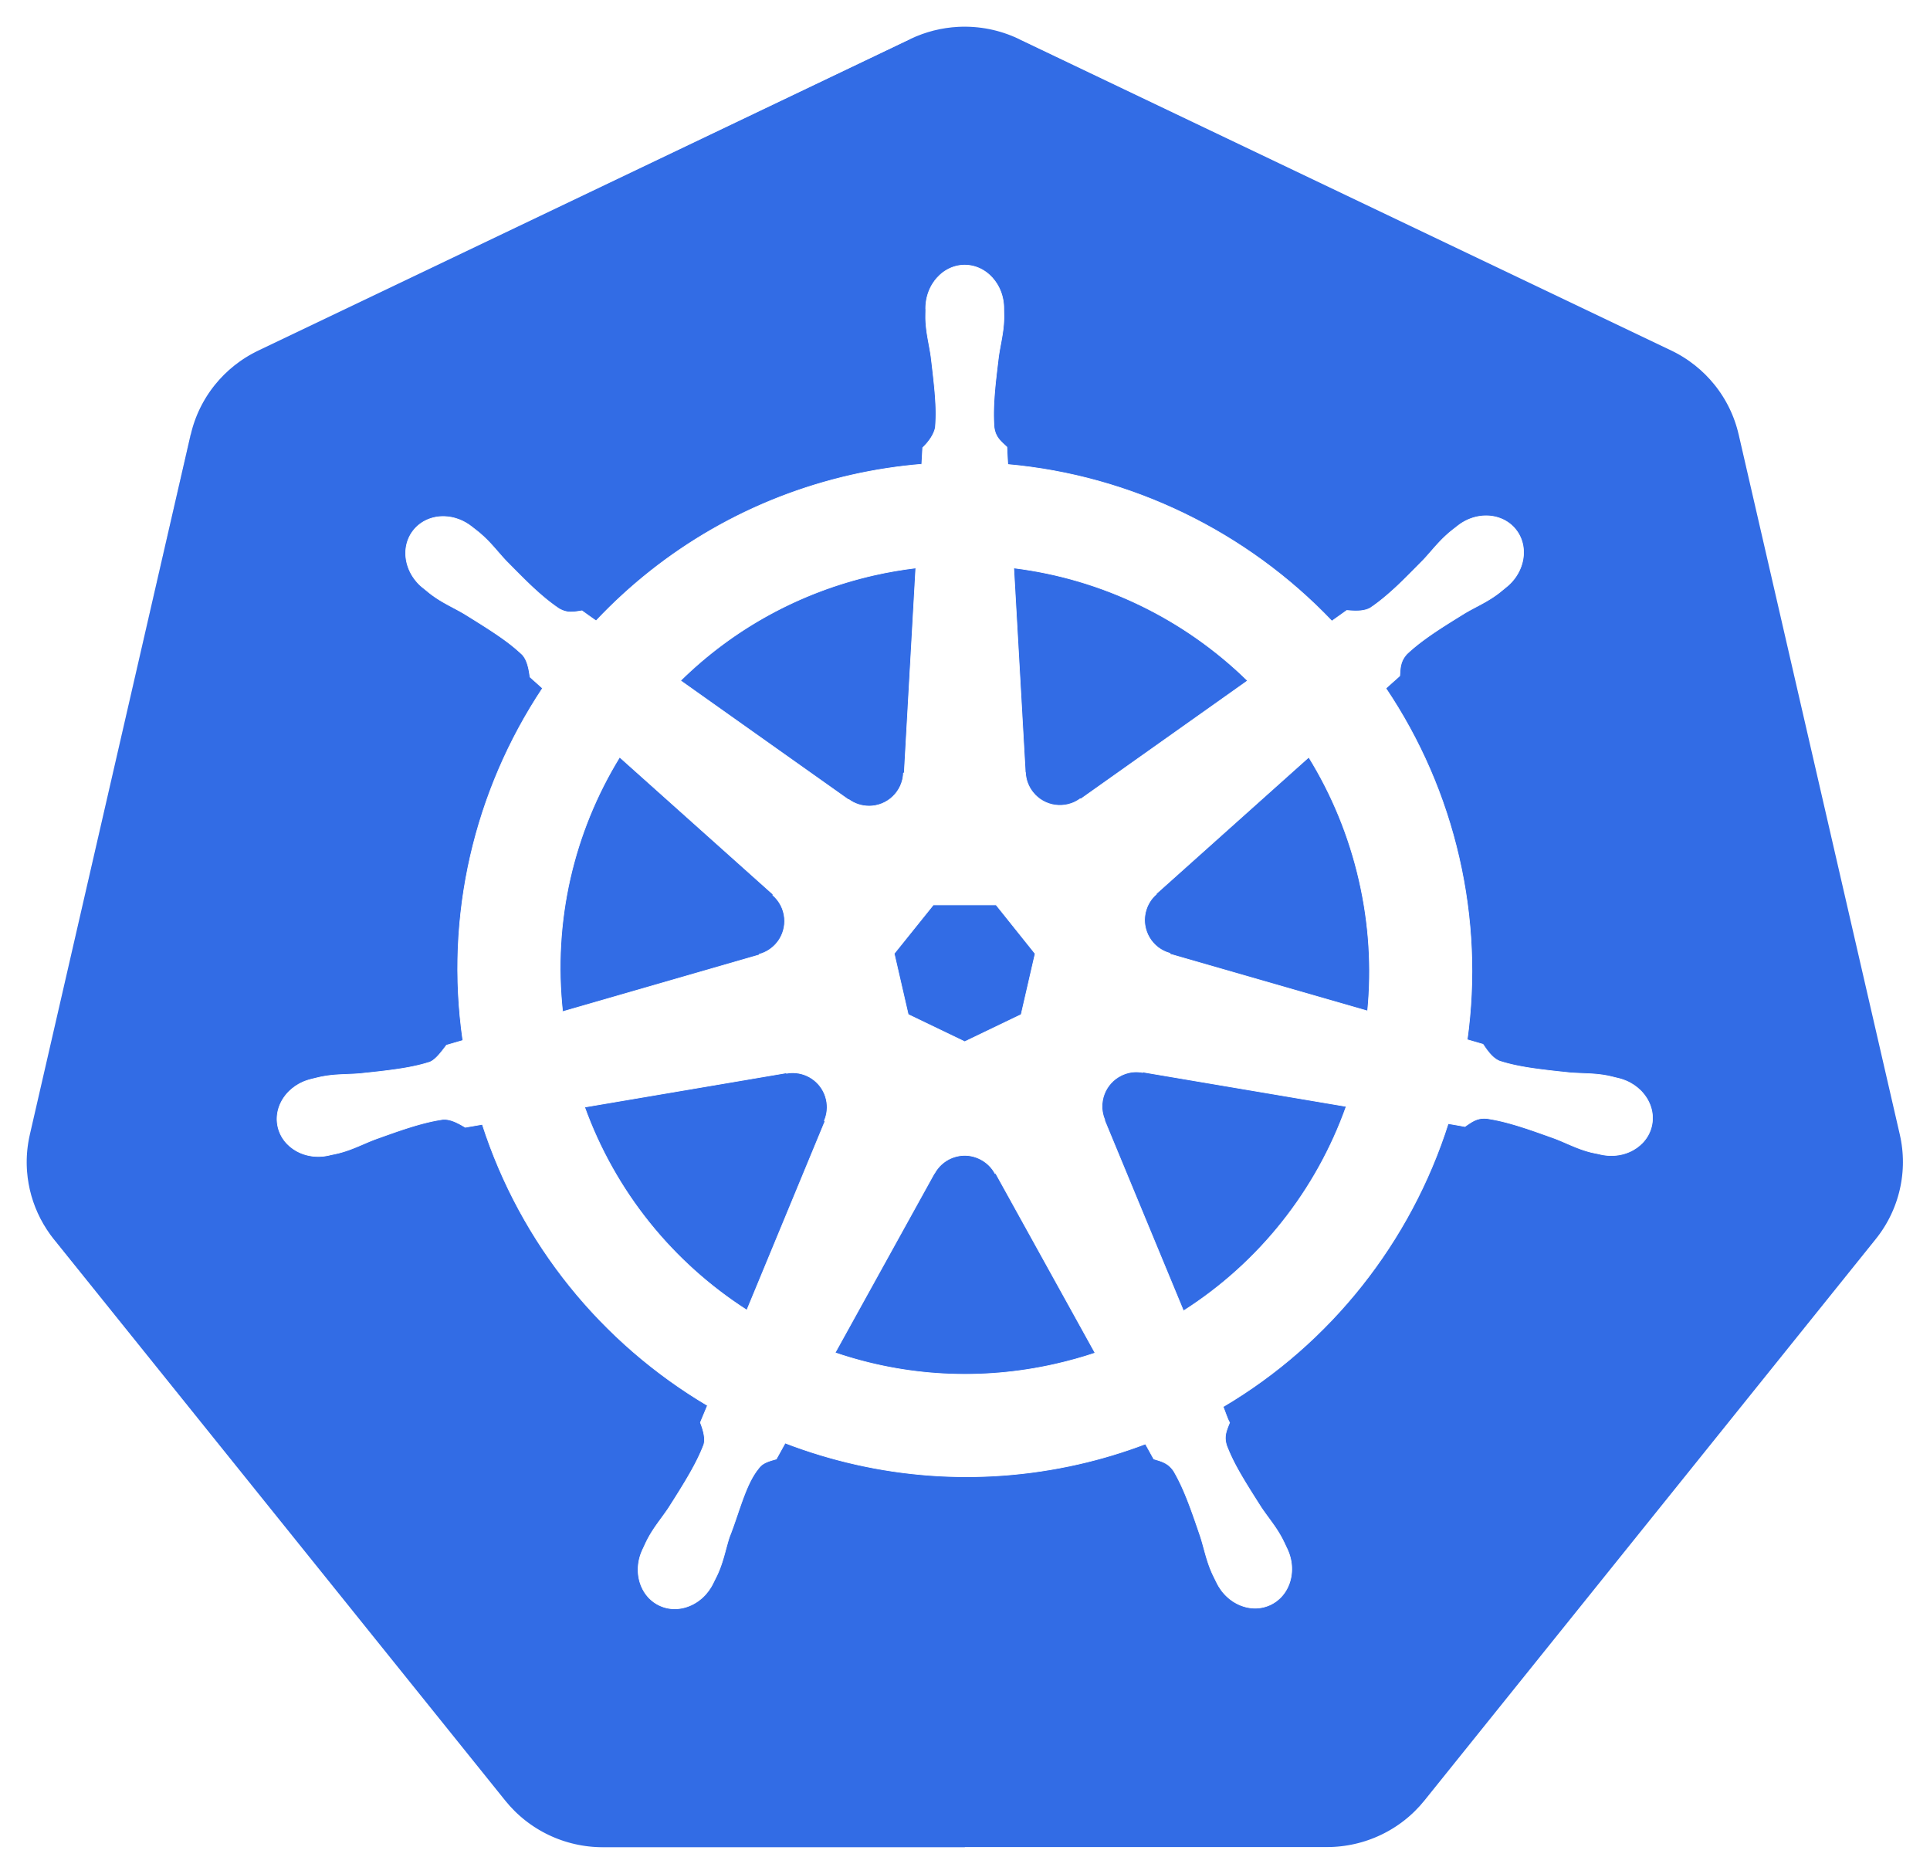



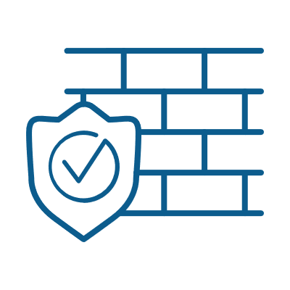
Digital CEC
AWS Cloud
Region
Cloud Services VPC
Share Service VPC
AWS Lambda
AWS SNS
Web App Firewall
Network Firewall
Global LB
Route Tables
NGINX VPC
Bot
DDoS + Bot Protection
Access Mgmt.
TLS Inspection
Credential Encryption
Users
AWS Transit Gateway
API Gateway
API Mgmt.
User Identity
Anti-fraud & Anti-abuse
Kubernetes VPC
Attacker
Multi-Vendor Security Inspection Tools
F5 Cloud Services
Student Jump Host VPC
Docker
Credentials
Terraform
Ansible
Notes:
Key Point:
F5 Cloud Services- Which has a goal to offer everything (long term) available in the security zone, but consumed as a Service! DNS, DNL Load Balancer are available today.
Built on AWS SaaS Factory, so it behaves more native
Consumption based payments, F5 offering the freedom to deploy how you choose!
Questions for Peter to ask:
So when is APM available and Load Balancing?
You said SaaS factory, but then it’s only in one region? How does it scale? HA?

