Slide 1


R.L. FOR AUTONOMOUS MERGING
MODELLING AND SIMULATION

Slide 2
HIGHWAY-ENV
Simulation framework developed to train and evaluate autonomous driving policies across a variety of traffic scenarios.
https://highway-env.farama.org/environments/merge/

Slide 3
ALGORITHM
PPO:
A2C: Multiple workers for efficiency.
TRPO: Trust region for stability.
Objective: Ensure the new policy doesn't deviate too much from the previous one.

Slide 4
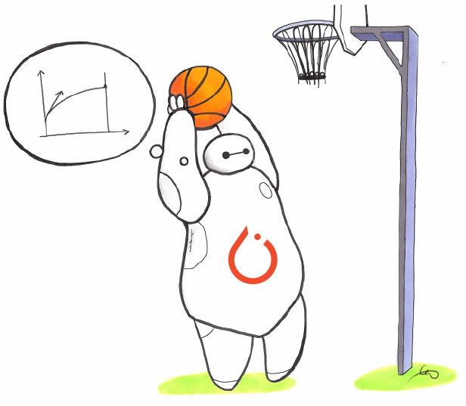
ALGORITHM
Stable-Baselines3:
PyTorch: Computational efficiency.
Modularity: Easy integration and customization.

Slide 5
ACTION/OBSERVATION SPACES
Action
Observation
DiscreteMetaAction:
TimeToCollision:
Predefined actions for safe merging
Accelerate, decelerate, maintain speed, change lanes.
Time until possible collision with nearby vehicles.
Calculated based on relative speed and location.

Slide 6
The Model and its Variables
Input Variables
Output Variables
Observation Space
Performance Metrics
Average Reward
Average Steps To Merge
No of Successful Merges
No of Collisions
No of Dangerous Episods
Average Episode Time
Model: Normative

Slide 7



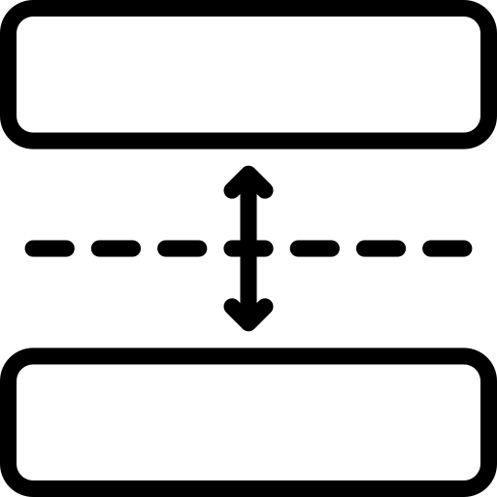

SCENARIOS
What action should the ego vehicle take while on the highway to minimize its own impact?
What action should the ego vehicle take while on the highway to minimize its impact on other vehicles?
What is the best action for the ego vehicle to take during merging to minimize its effect on other vehicles?
What is the optimal merging velocity for the ego vehicle?
What is the minimum gap, highway vehicles should have between them?

Slide 8
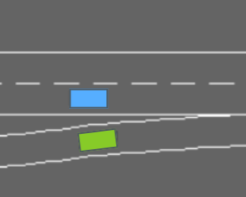
What is the optimal merging velocity for the ego vehicle?
Baseline Rewards
Collision Reward: -1
Right Lane Reward: +0.1
High Speed Reward: +0.2
Merging Speed Penalty: -5
Lane Change Penalty: -0.05

Slide 9
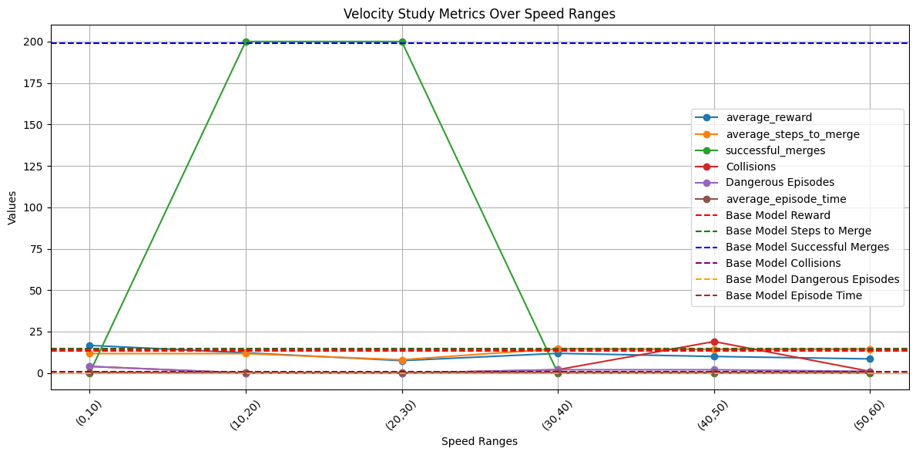
Results

Slide 10
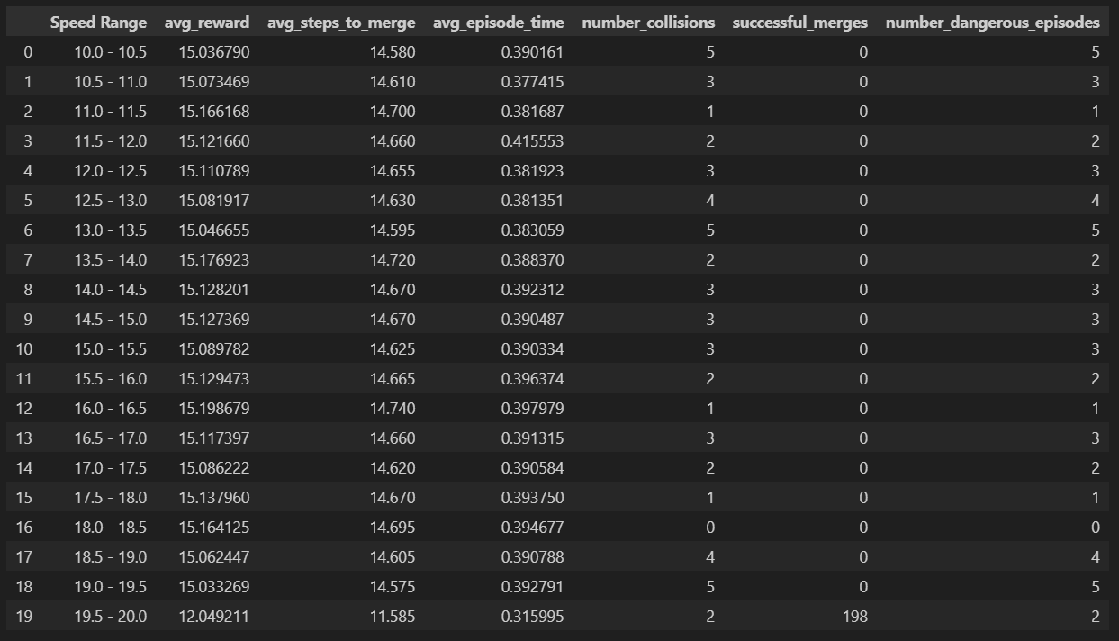
Narrowing the (10,20) interval

Slide 11
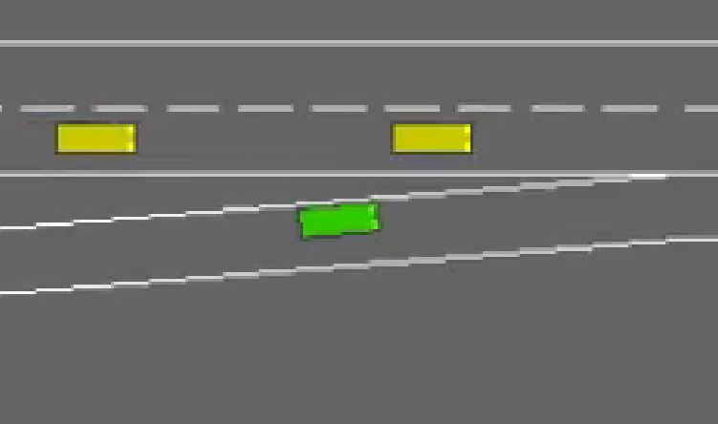
What is the minimum gap, highway vehicles should have between them?
+25 Points for staying in the same lane as the two other vehicles and maintaining the position between them.
+5 Points for staying ahead of the rear vehicle and behind the front vehicle.

Slide 12
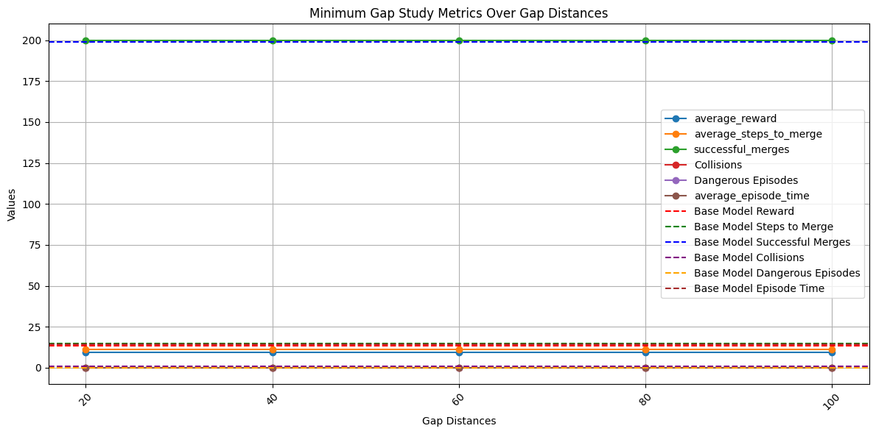
Results

Slide 13
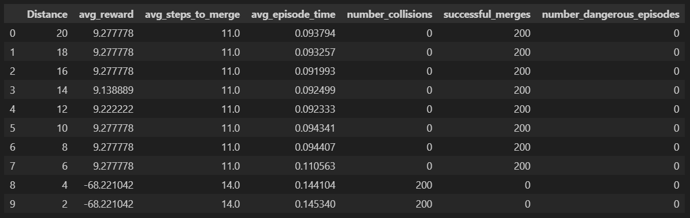
Narrowing the (10,20) interval

Slide 14
What is the best action for the ego vehicle to take during merging to minimize its effect on other vehicles?
Configuration | Braking | Accelerating
Balanced Values | Braking Bonus/Penalty: 5.0, Yielding Bonus/Penalty: 6.0, Influence Penalty: 15.0 | Influence Penalty: -5, Merging Bonus: 3, Merging Penalty: 2
Ego Lets Go Ahead | Braking Bonus/Penalty: 3.0, Yielding Bonus/Penalty: 12.0/6.0, Influence Penalty: 15.0 | Influence Penalty: -5, Merging Bonus: 3, Merging Penalty: 2
Severe Punisment on Influence | Braking Bonus/Penalty: 3.0, Yielding Bonus/Penalty: 6.0, Influence Penalty: 30.0 | Influence Penalty: -10, Merging Bonus: 1.5, Merging Penalty: 2
Safe Behaviour | Braking Bonus/Penalty: 3.0, Yielding Bonus/Penalty: 12.0/6.0, Influence Penalty: 30.0 | Influence Penalty: -10, Merging Bonus: 1.5, Merging Penalty: 4
Agressive Behaviour | Braking Bonus/Penalty: 12.0/3.0, Yielding Bonus/Penalty: 1.5/6.0, Influence Penalty: 15.0 | Influence Penalty: -5, Merging Bonus: 1.5, Merging Penalty: 4

Slide 15
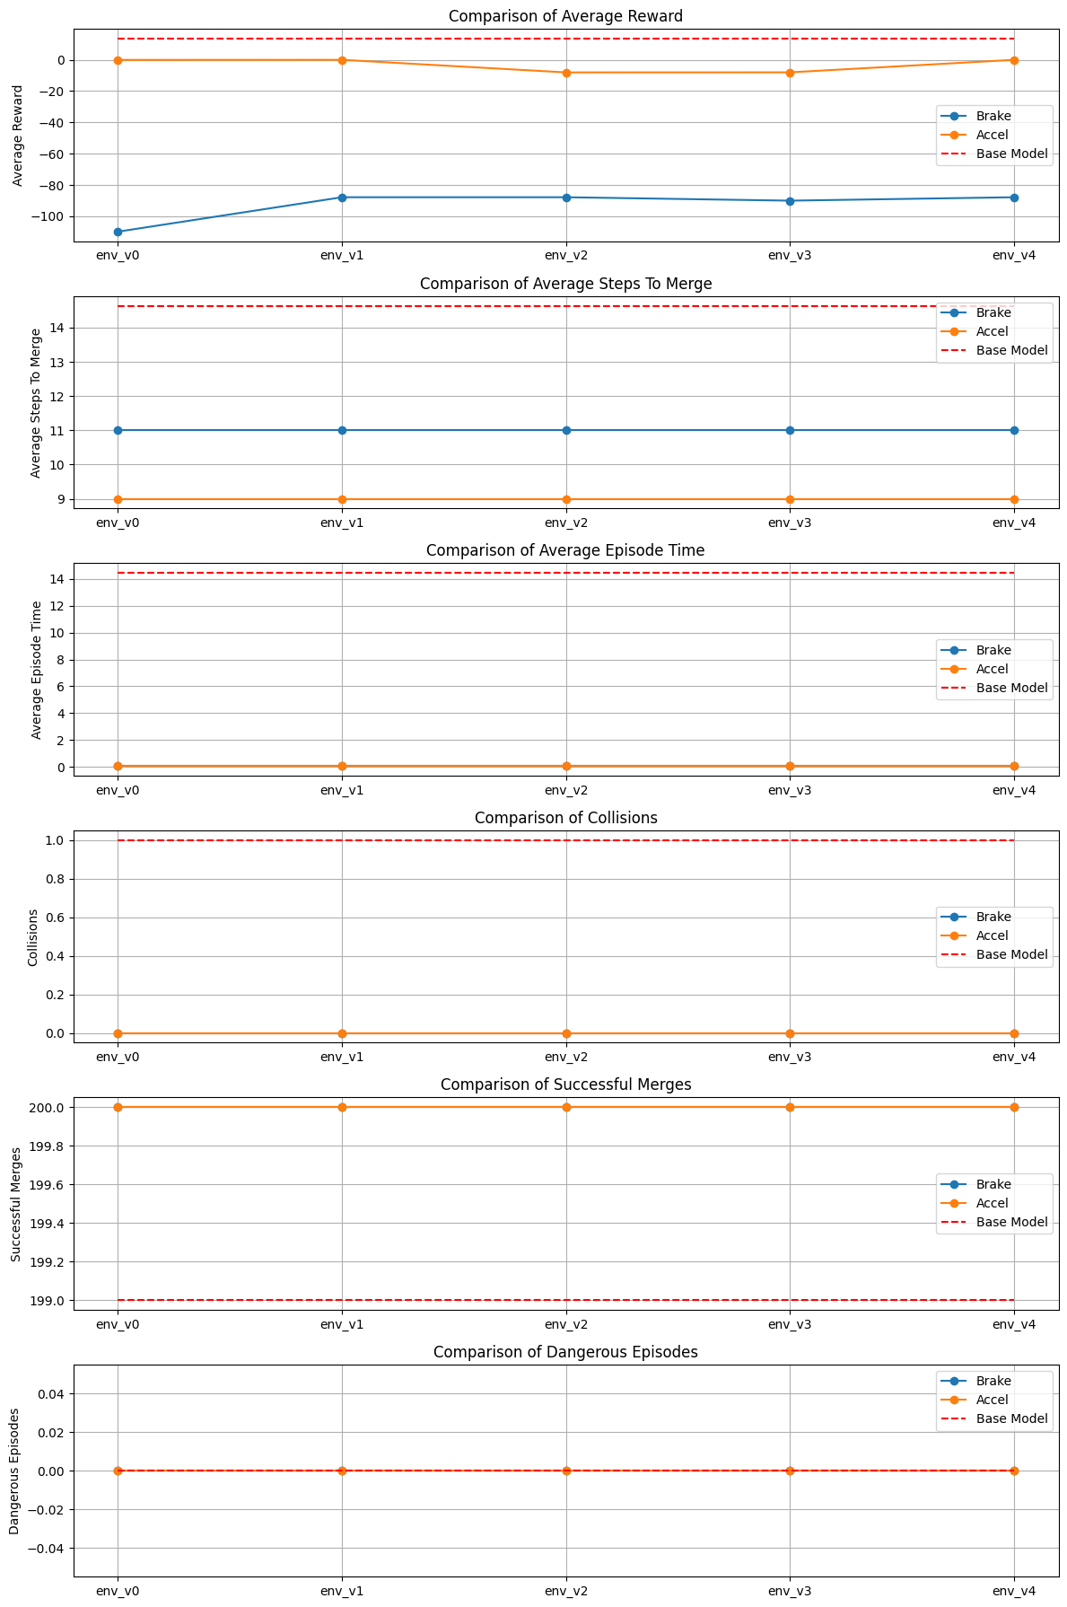
Results

Slide 16
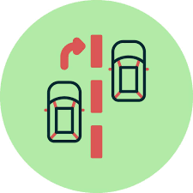

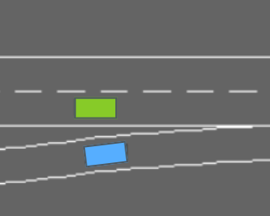
What action should the ego vehicle take while on the highway to minimize its own impact?
Fixed Rewards:
High Speed: +6
Right Lane: +3
Additional Rewards/Penalties:
Lane Change Near Merging Vehicle: +40
Overtaking: +25
Following Behind Merging Vehicle: -20
Fixed Rewards:
High Speed: +6
Lane Change: -5
Right Lane: +3
Additional Reward:
Braking: +5

Slide 17
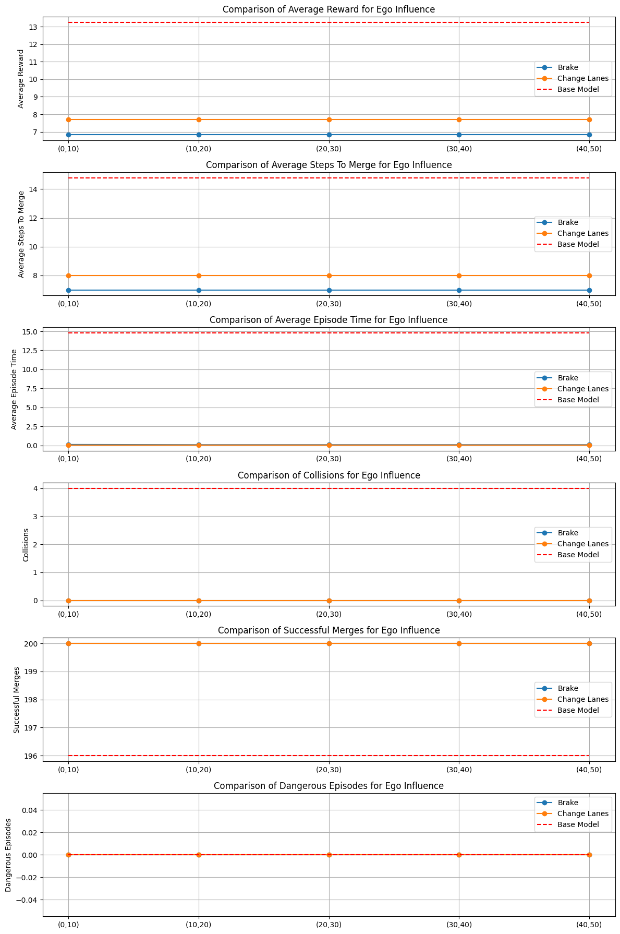
Results

Slide 18
What action should the ego vehicle take while on the highway to minimize its impact on other vehicles?
Fixed Rewards:
High Speed: +6
Right Lane: +3
Additional Rewards/Penalties:
Lane Change Near Merging Vehicle: +40
Overtaking: +25
Following Behind Merging Vehicle: -20
Influence Penalty: -15
Fixed Rewards:
High Speed: +6
Right Lane: +3
Additional Reward:
Braking: +5
Influence Penalty: -5

Slide 19
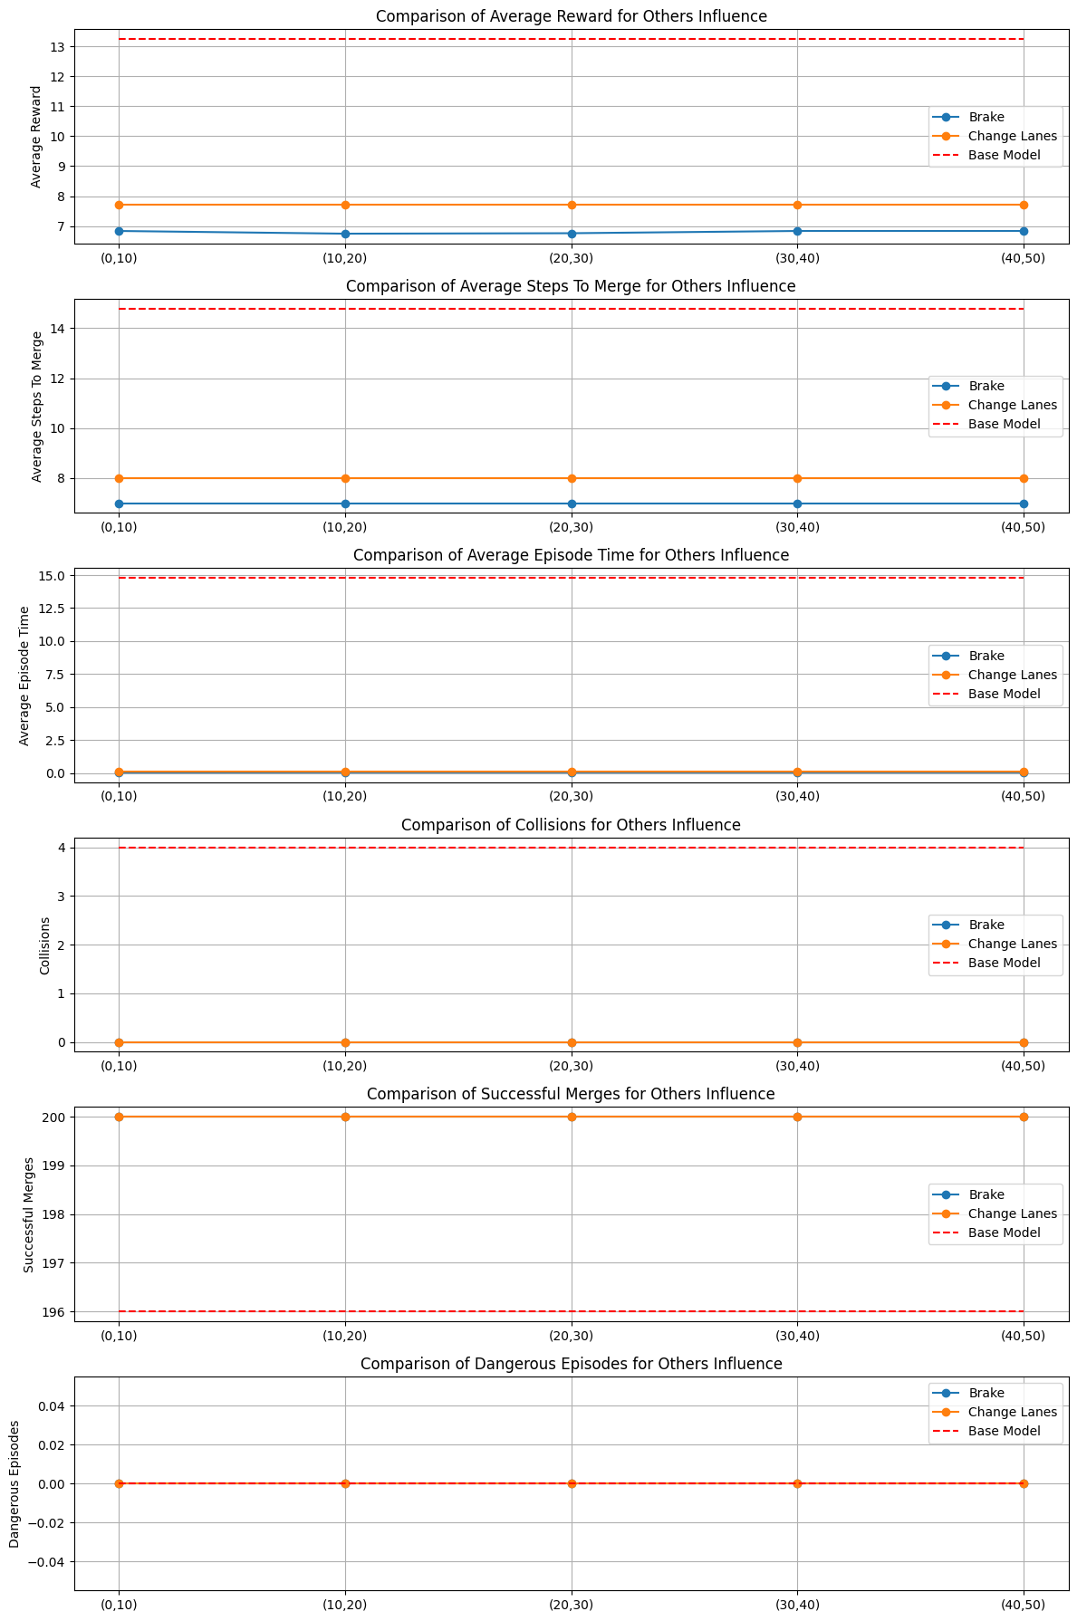
Results

Slide 20

BRAKE
Is it better being “selfish” or “altruistic”?

Slide 21
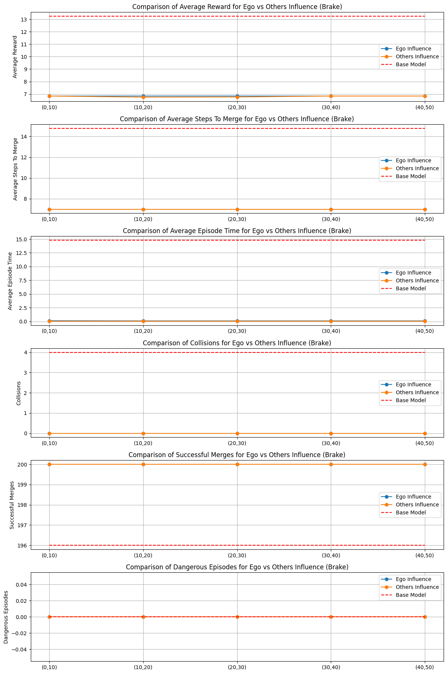
Results

Slide 22
CHANGE LANES
Is it better being “selfish” or “altruistic”?

Slide 23
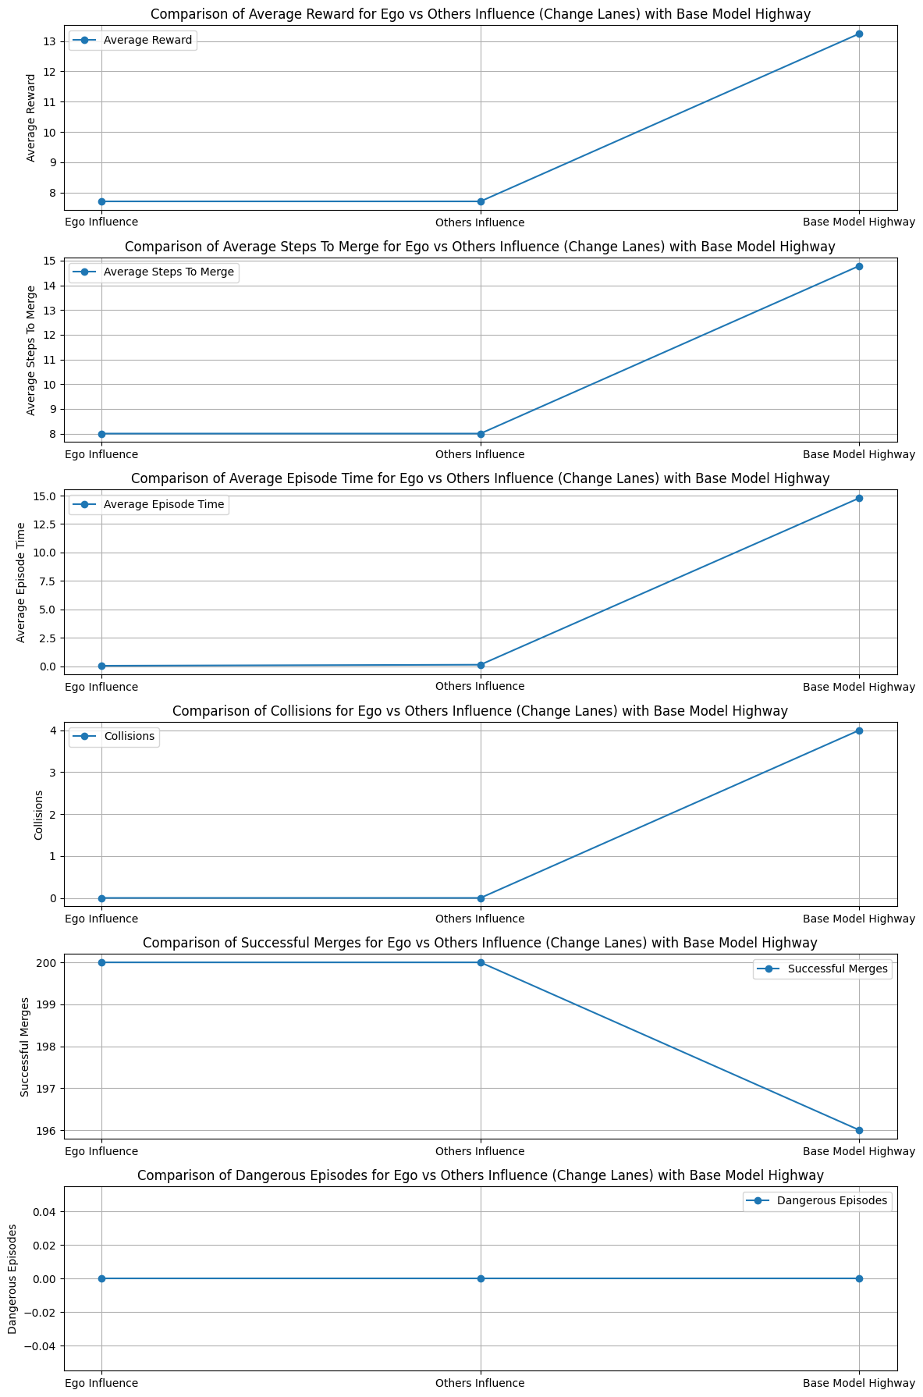
Results

Slide 24
DEMONSTRATION VÍDEOS

Slide 25
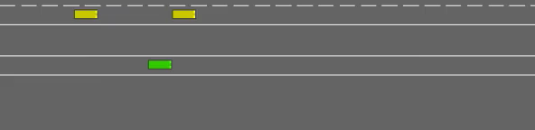
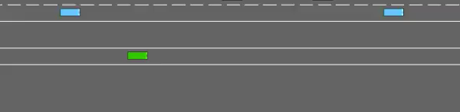
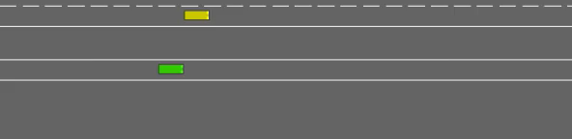

Ego Merging
Minimum Gap – distance = 20
Velocity Study – Speed Range = [10,20]
Accelerate
Brake

Slide 26
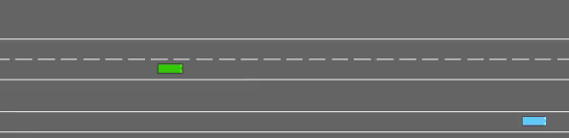
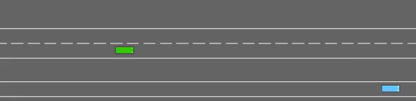
Ego On the Highway
Ego’s Influence – Brake (braking distance (40,50)
Ego’s Influence – Change Lanes
Other’s Influence – Change Lanes
Other’s Influence – Brake (braking distance (40,50)
Other’s Influence – Change Lanes

Slide 27
THANKS
Questions?
Catarina Monteiro – up202105279
Diogo Mendes – up202108102
Gonçalo Brochado - up202106090
2024/2025 – 1ºS/1ºY – M.IA

