Slide 1
TDI Project Proposal
Creating better informatics about group progression in online video game.
Garrick Bruening

Slide 2
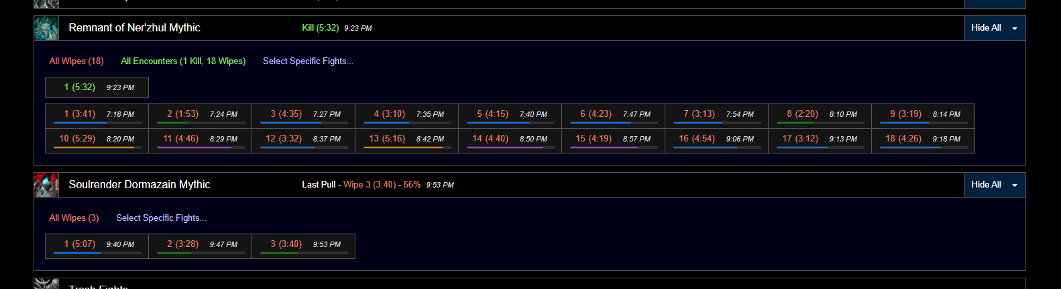
The problem
World of Warcraft is a game with millions of unique users every month.
Within the game, groups of people pull encounters with the intent of defeating them.
However, tools to visualize ones progress are lacking.
Garrick Bruening

Slide 3

Providing insights into group progression in world of warcraft.
An online video game where groups attempt to defeat encounters.
I propose building a tool to represent groups progress and a model to predict success based on recent events.
Garrick Bruening

Slide 4
Individual group data
Data can be obtained through either web scraping or a website API.
We can present each groups progression in easily understandable manner.
Garrick Bruening

Slide 5
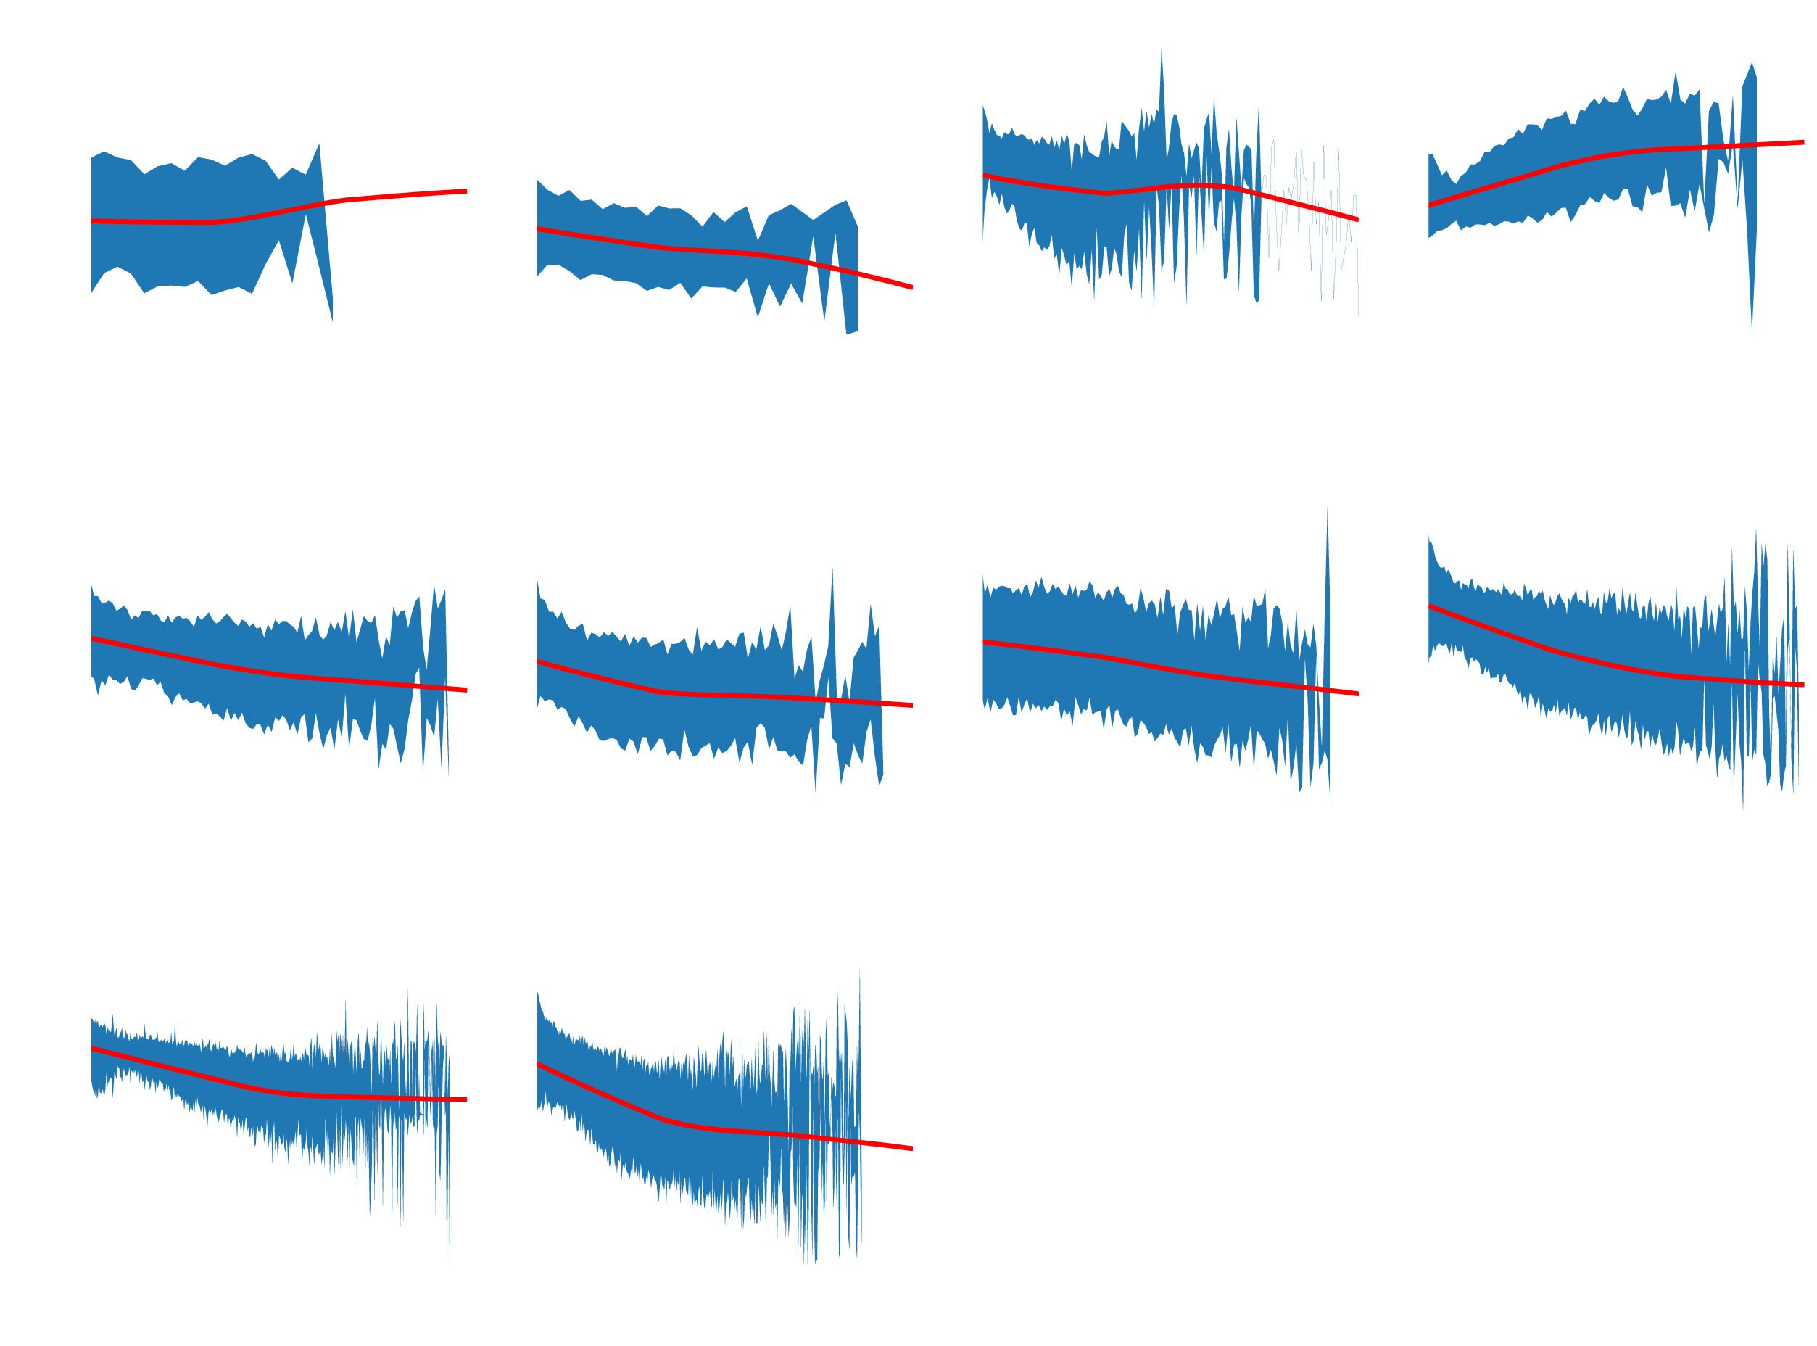
Aggregated Group data
Can also display the average progression of other groups.
Can also be shown with individual progress for comparison purposes.
This can be used to develop a model of possible success.
Garrick Bruening

Slide 6
Takeaway
Create app that makes it easier for users to view their progress.
Build a computational model to predict success based on recent trial history.
Garrick Bruening

