Slide 1
Main paper figures….

Slide 2
Fig. 1A: Industry (left), Conservation (right)
Notes:
Figure 1. Network of interactions among key variables (yellow nodes) in the Arctic Socio-Ecosystem. Two alternative scenarios, industry (right) and conservation (left), are represented in the bottom half of the network which contains nodes realation to the social system. Interactions between nodes are described by arrows. Feedback 2-loops are highlighted in red and blue to highlight amplifying and buffering loops respectivity. Green arrows highlight the feedback loop described by the original Gaia Theory.

Slide 3
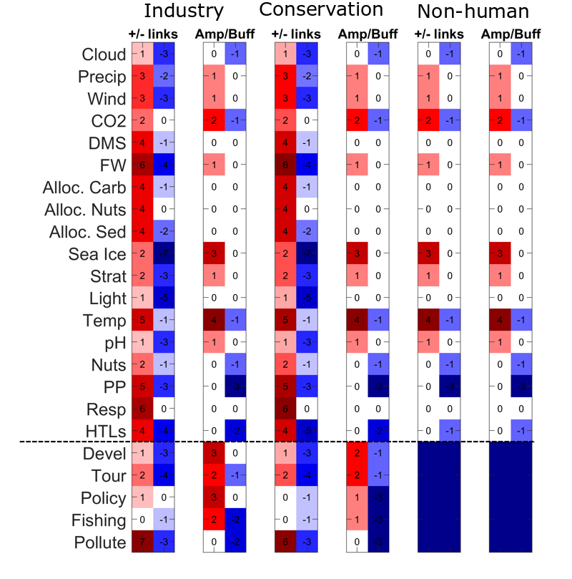
Fig. 1B: The number of links and loops each variable is involved in
The bottom half we compare between the numbers, the buffer should stay the same or reduce if the system works towards more mechanisms to absorb instability.
Notes:
Table of the total number of links (both and feedback loops (including both 2 and 3-loops ) each key variable is involved in. Red numbers indicate same direction interactions (+) and amplifying loops and blue numbers indicate opposite direction interactions (–) and buffering loops. The bottom part of the table shows the interactions involving the social system in the two different scenarios. Here we compare between the numbers: the system works to absorb instability if the number of amplifying loops is reduced or the number of buffering loops increases from one scenario to the other. Is this correct Victor?

Slide 4
Fig. 1B (alternative): The number of 2 loops each variable is involved in
The bottom half we compare between the numbers, the buffer should stay the same or reduce if the system works towards more mechanisms to absorb instability.
Notes:
Table of the total number of links 2 loops each key variable is involved in. Red numbers indicate same direction interactions (+) and amplifying loops and blue numbers indicate opposite direction interactions (–) and buffering loops. The bottom part of the table shows the interactions involving the social system in the two different scenarios. Here we compare between the numbers: the system works to absorb instability if the number of amplifying loops is reduced or the number of buffering loops increases from one scenario to the other. Is this correct Victor?

Slide 5
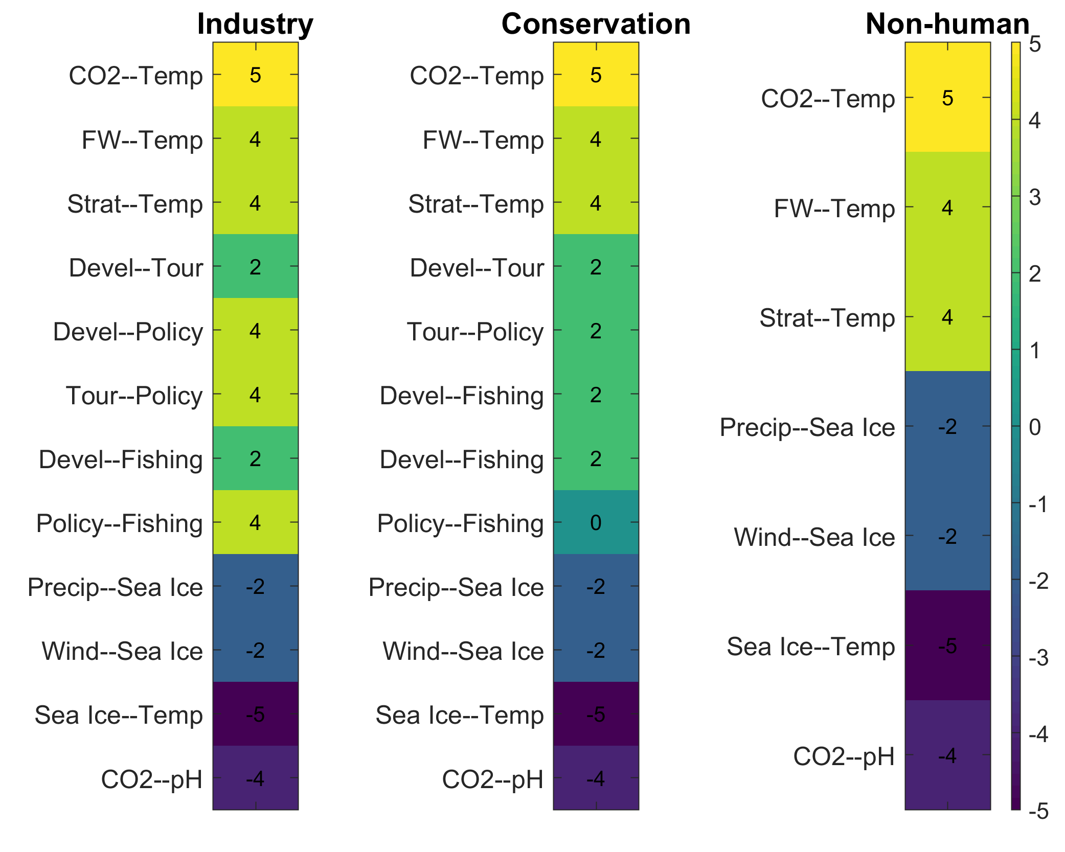
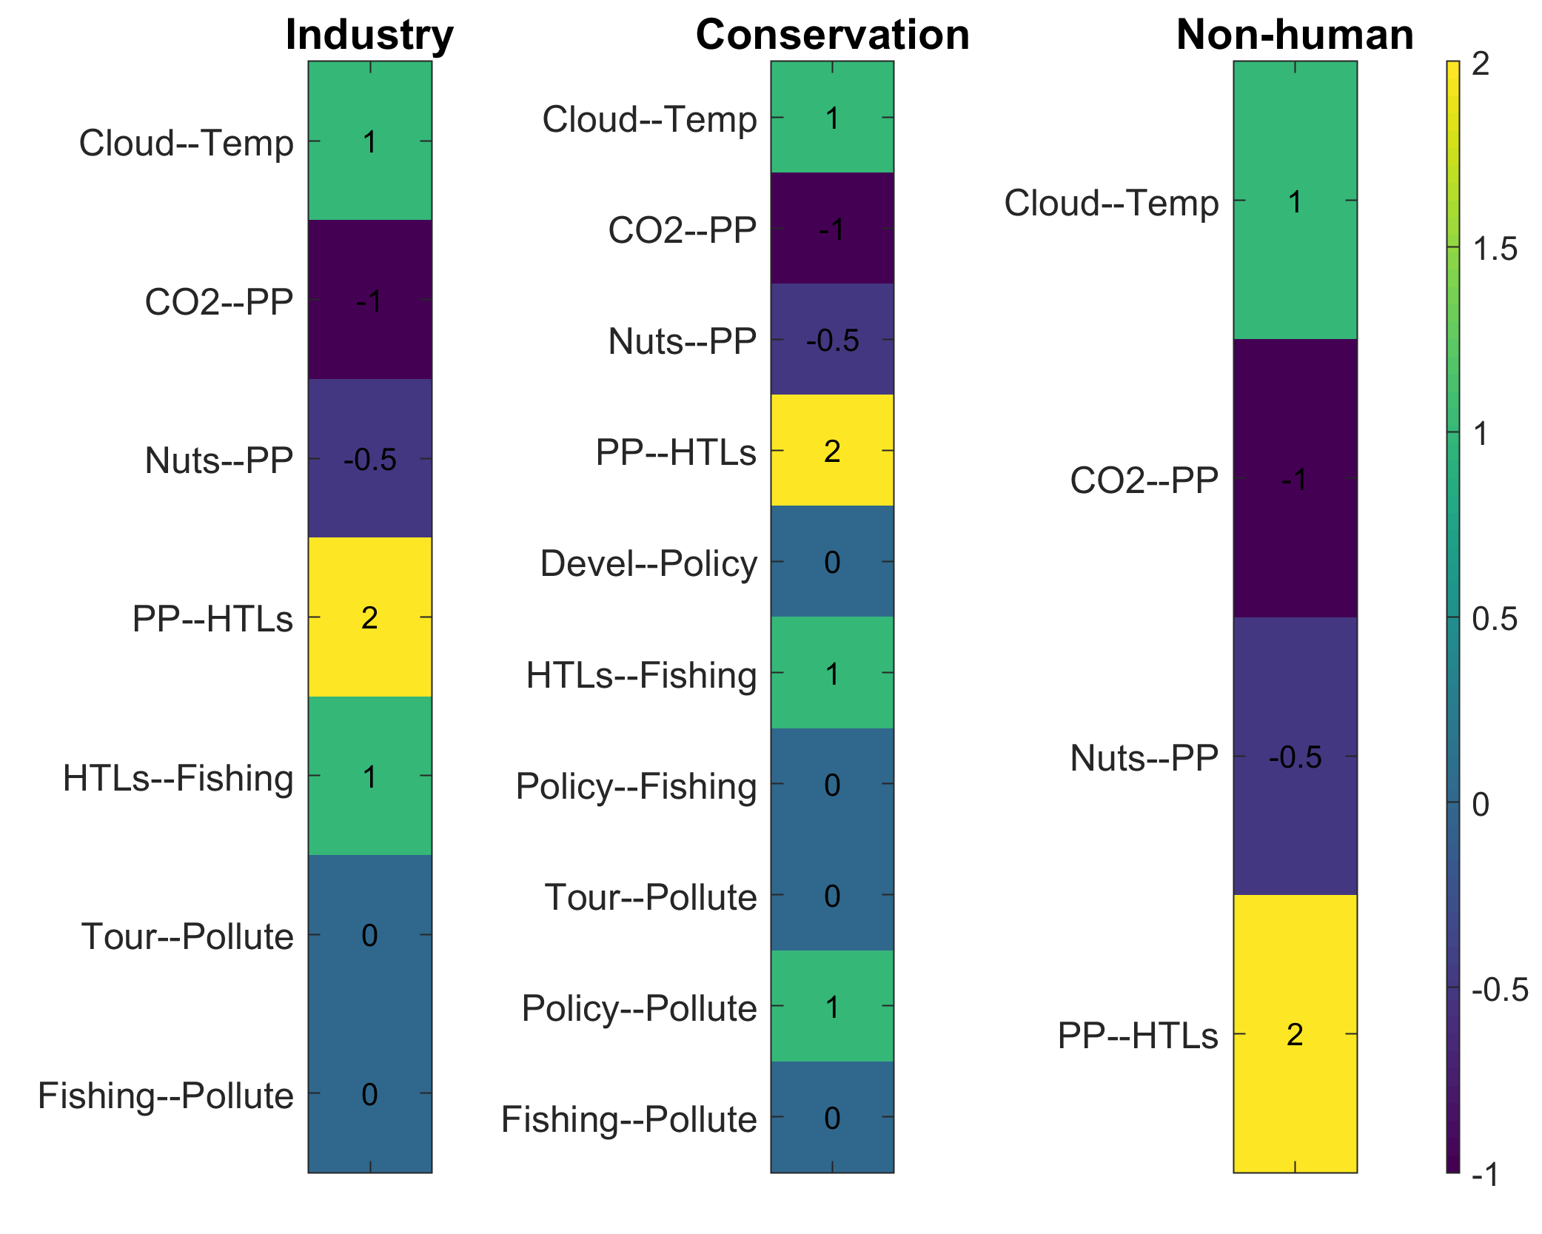
Fig. 2A & B: Strength of amplifying (left) and buffering (right) 2-loops
Scores for amplifying loops are the sum of the weights (e.g. +++, ---)
Scores for buffering loops are the absolute difference of the weights

Slide 6
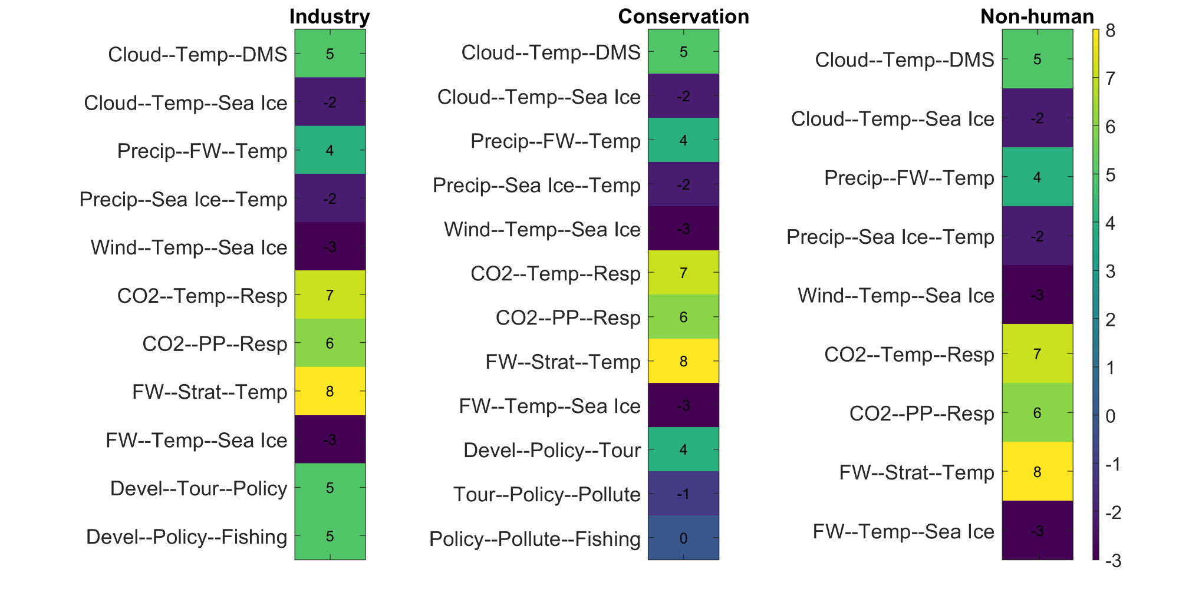
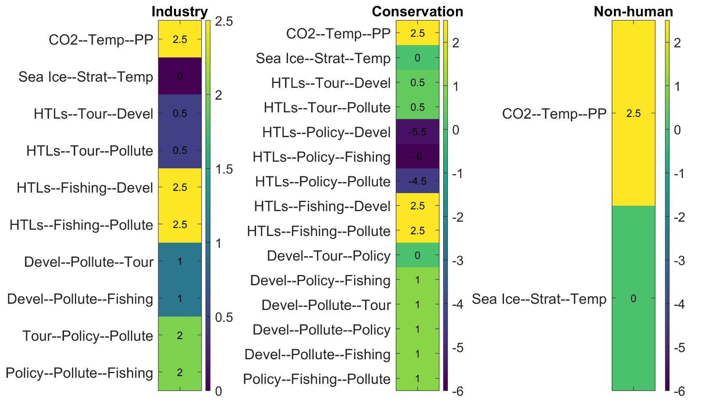
Fig. 2C & D: Strength of amplifying (left) and buffering (right) 3-loops

Slide 7
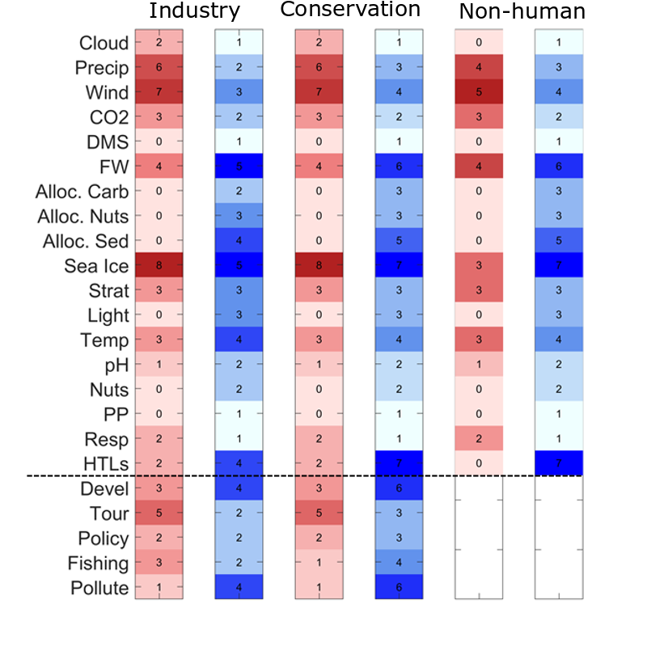
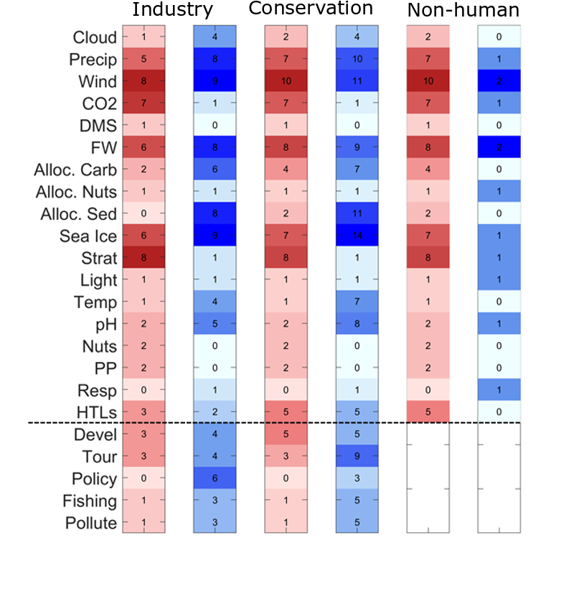
Fig. 3A & B: Drivers for 2- (left) and 3- (right) loops

Slide 8
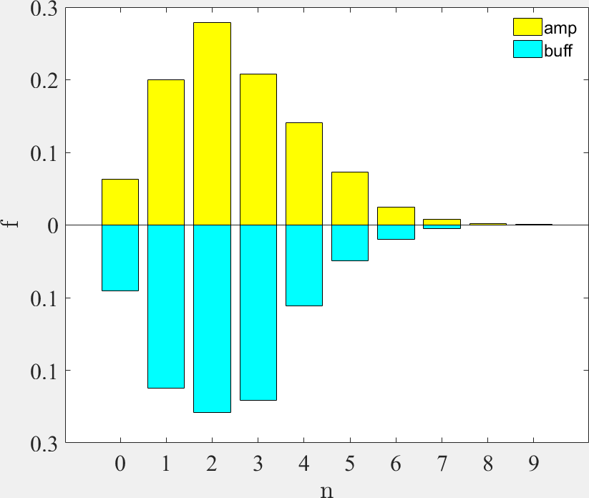
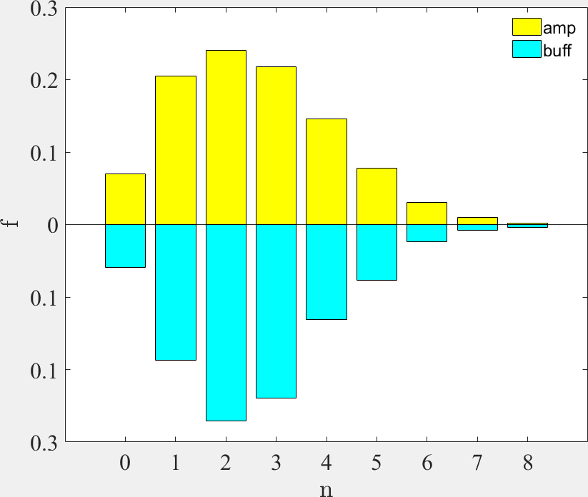
Fig. S1: Distribution of two-loops (amp/buff) compared to randomized sign network.
This the probability dist. to find in a randomized network a certain number of 2-loops. Our network has 12 amp/7 buff 2-loops, while these networks have mean of 2-3.
Industry
Conservation
Number of loops in original network for Industry : 12 amp / 7 buff and for Conservation: 10 amp / 10 buff

Slide 9
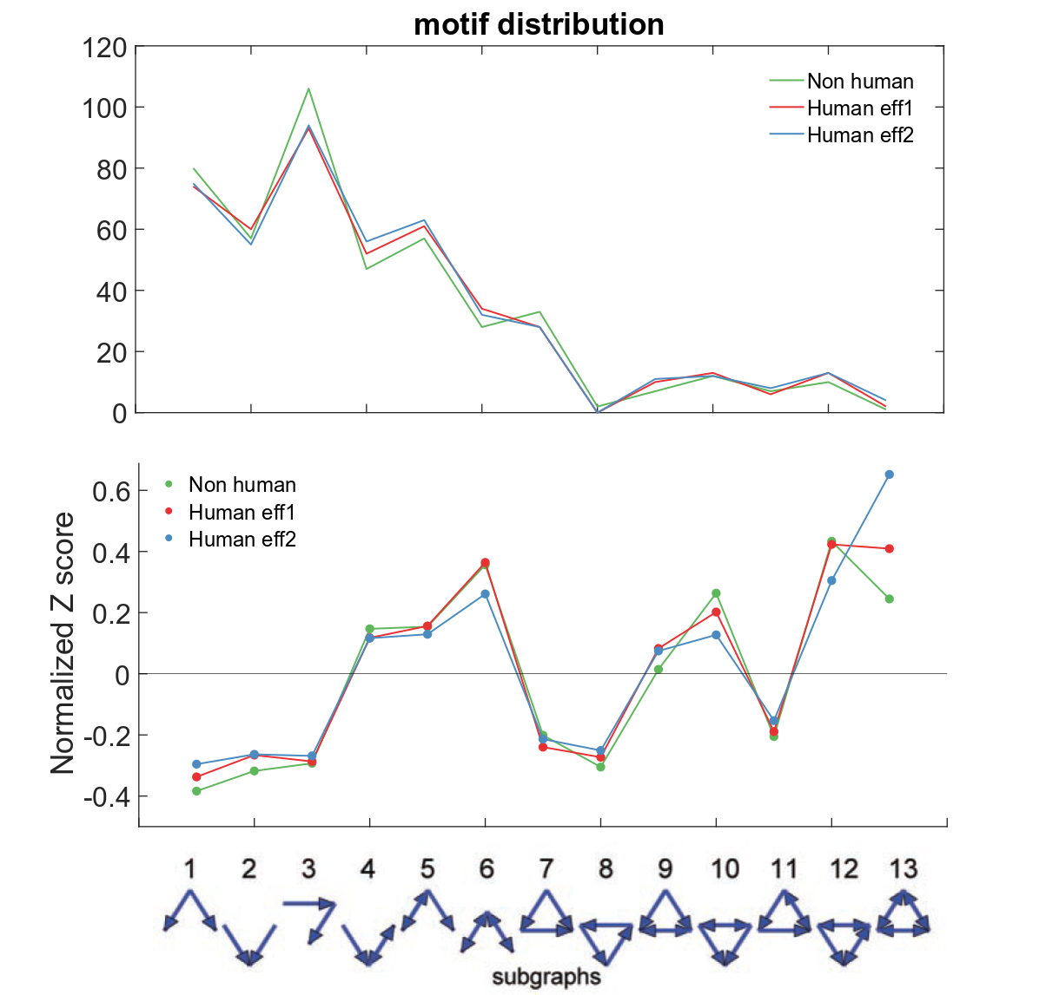
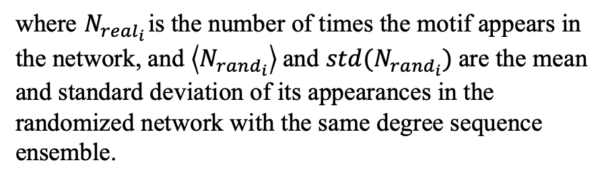

Fig. S2: Network structure based on the motif profiles (Milo et al. 2004)
So, there are less “more complex” motifs… the major motifs in our network are more simple, but the more complex the motif, the higher the Z score, the Z score is statistical significance, so our network actually has more motifs that are more complex compared to a randomized network, which is different than the other superfamilies identified (Milo et al. 2004). These motifs point to the complexity of the Arctic System, the chain-like nature of the loops, feeding back on themselves.
$$Z_{i}={(N}_{{real}_{i}}− <N_{{rand}_{i}}>)/std(N_{{rand}_{i}})$$
where $N_{{real}_{i}}$ is the number of times the motif appears in the network, and$\left\langle N_{{rand}_{i}}\right\rangle$and $std(N_{{rand}_{i}})$are the mean and standard deviation of its appearances in the randomized network with the same degree sequence ensemble.

Slide 10
Other figures….

Slide 11
Buffering loops
Amplifying loops

Slide 12
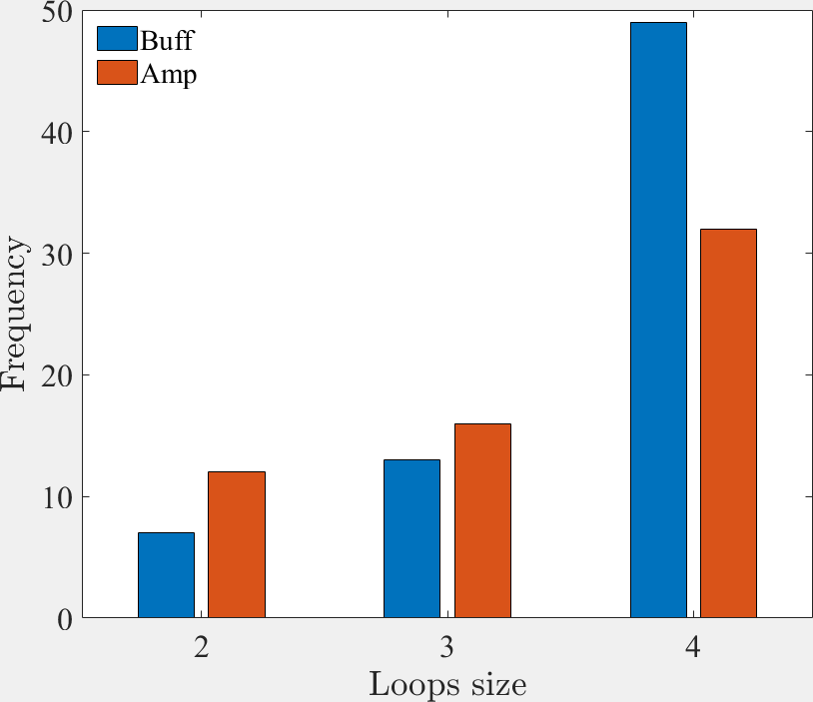
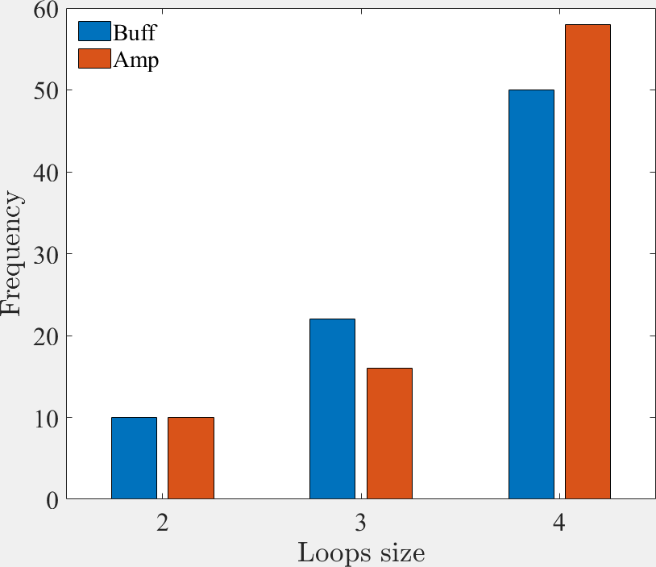
Network industry (left), conservation (right)
Why are the more buffering 4 loops in industry??

Slide 13
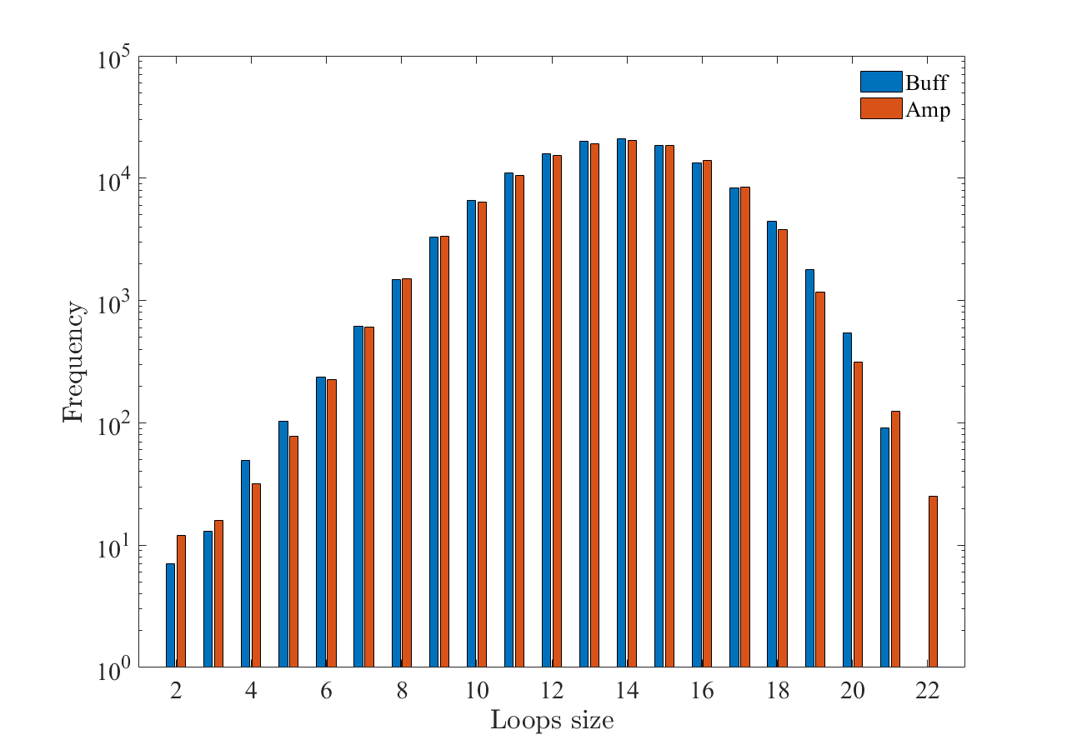
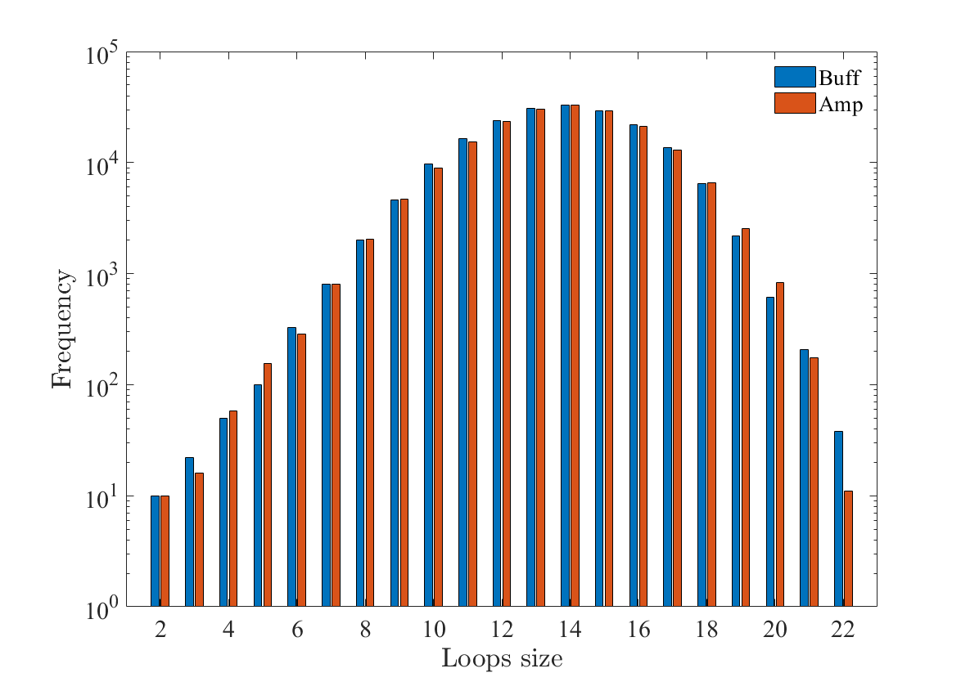
Distribution of n-loops (amp/buff)
Network industry (left), conservation (right)
This seems not very informative….

