Slide 1
THE HUNT-GROUP 01

Slide 2


Team Members Prasad Golla Durga(S538358) Sai Krishna Emmadishetty(S538340)

Slide 3
Introduction:-
The Hunt application is a web-based gaming software in which a person unearths the treasures primarily based totally at the treasure area and the application validates the person area and treasure area, if each fits then person gets the conformation with congratulations you have reached the location
Our project GitHub repo link:- https://github.com/GD-Prasad/Group-1-Treasure
project hosted Heroku app link:- https://group-1-treasure.herokuapp.com/

Slide 4
Features of App:
A single page Web Application.
The page displays two color box's.
When the user clicks on the first box, a coordinate of the Quest will be set as the destination coordinates
As user touches the first color to request a treasure location.
When the user clicks on the sound box, distance is calculated between the current location of the user and chosen Quest coordinates.

Slide 5
Stack:-
Platform: Node (v15.0.1)
Web Framework: Express
View engine: EJS
Web App Host: Heroku
ORM: Sequelize
Data store in Production:- Mongodb
Coding standards: ESlint

Slide 6
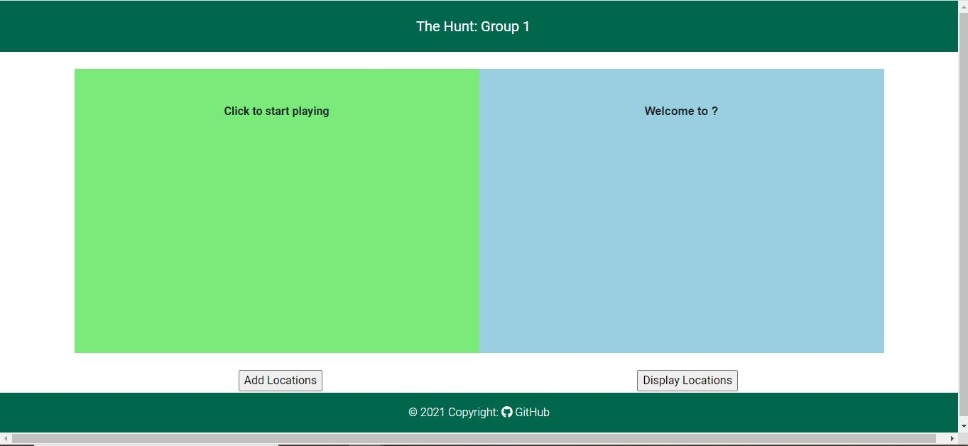
Index of our Application look like this. A user Hits on logo or app name, it displays the same.

Slide 7
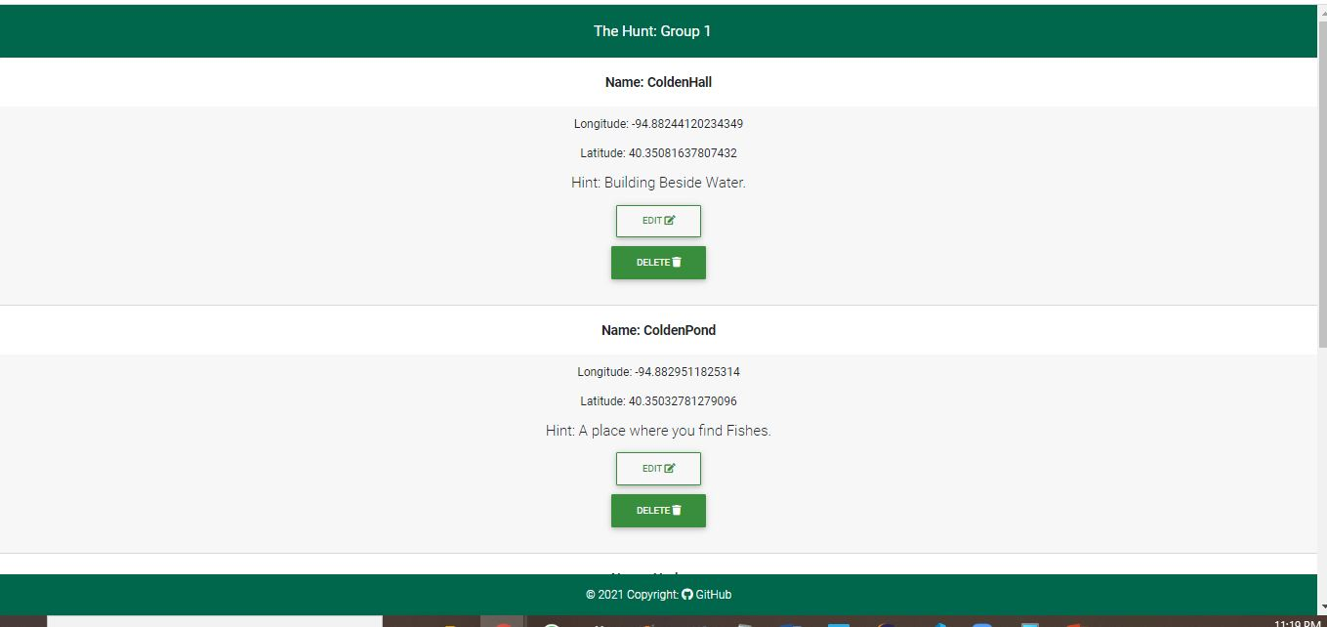
Displays the all locations what user has added and where a User can perform all the CRUDL operations of location.

Slide 8
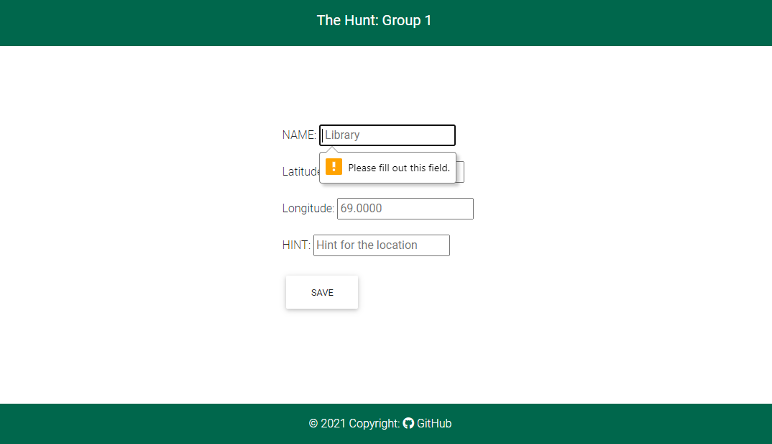
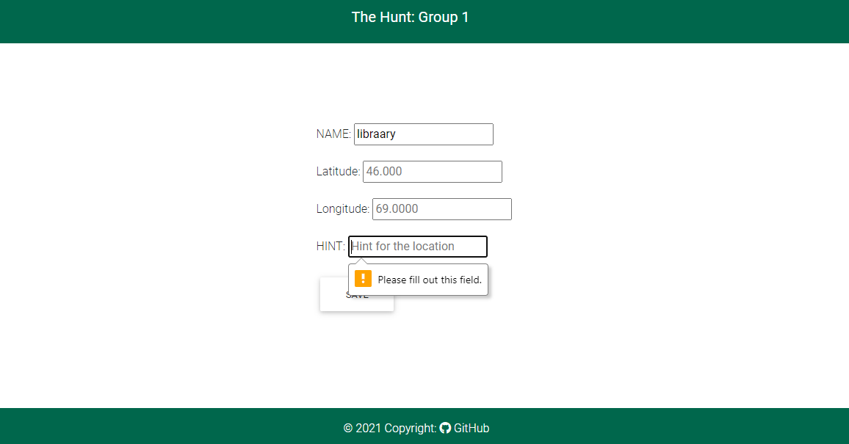
Validation on adding and updating a location.

Slide 9
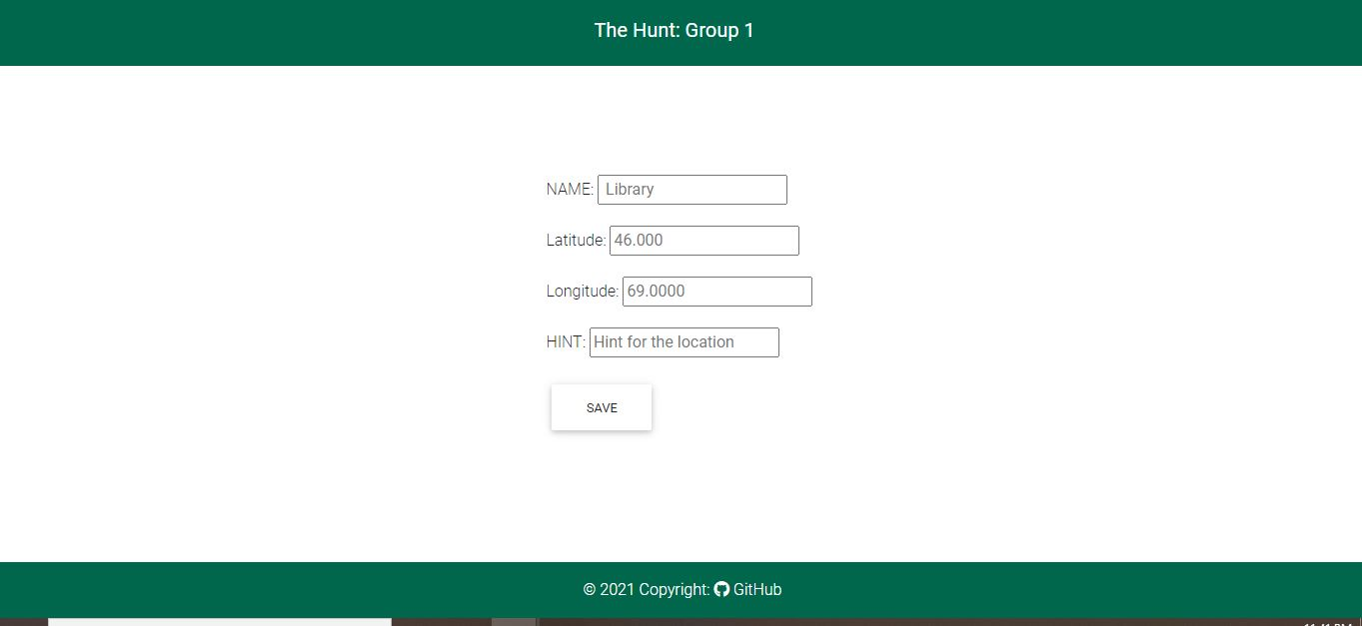
Add locations

Slide 10
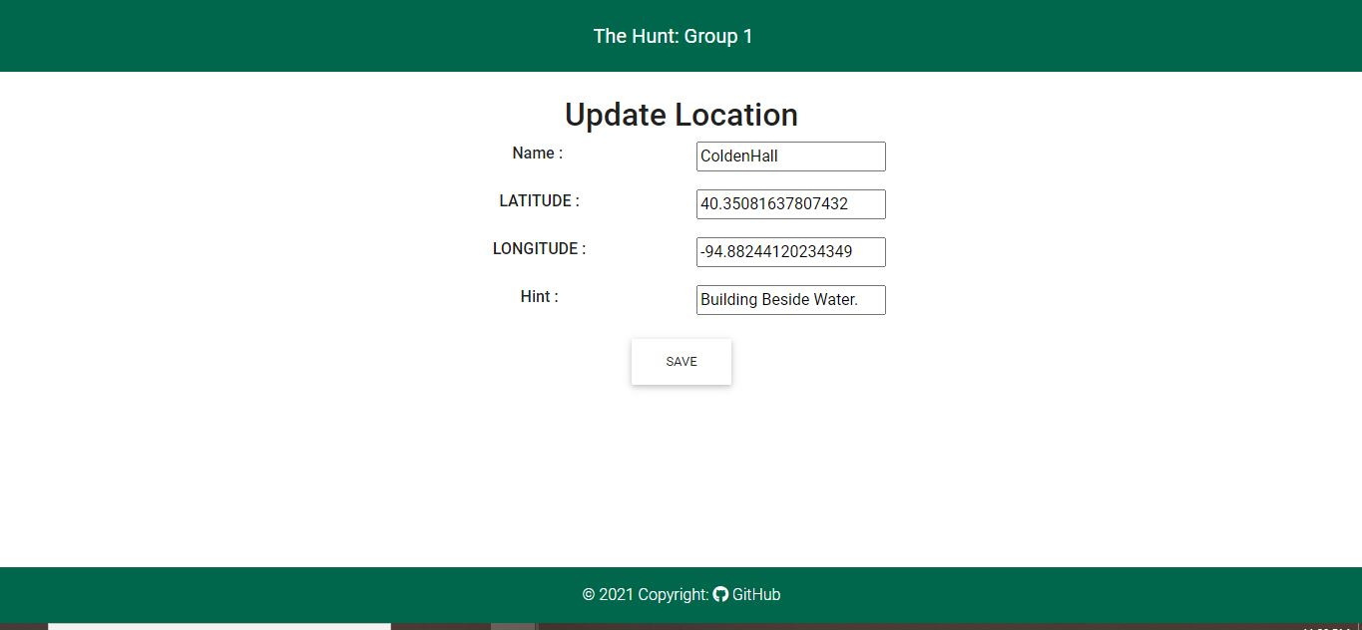

Edit location and Delete location

Slide 11
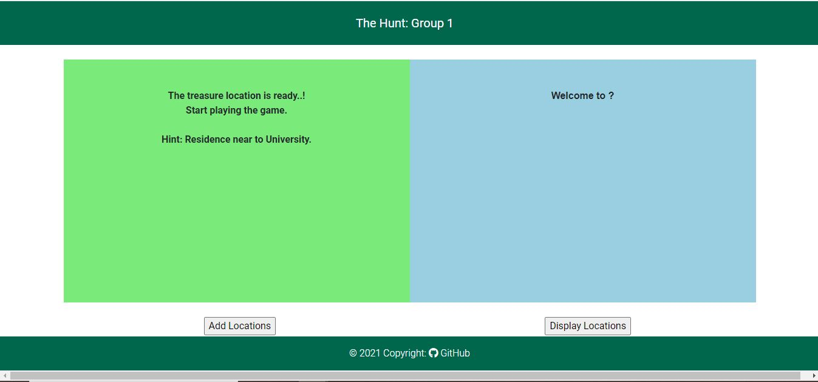
When a User clicks on first color component, then the app looks like below

Slide 12
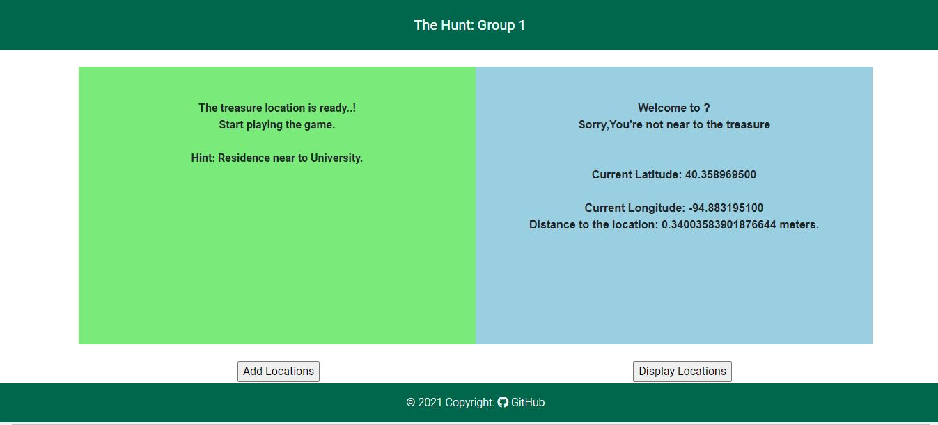
After clicking on second component , Incase User is away from target location then app displays like this and provides directions to reach the destination.

Slide 13
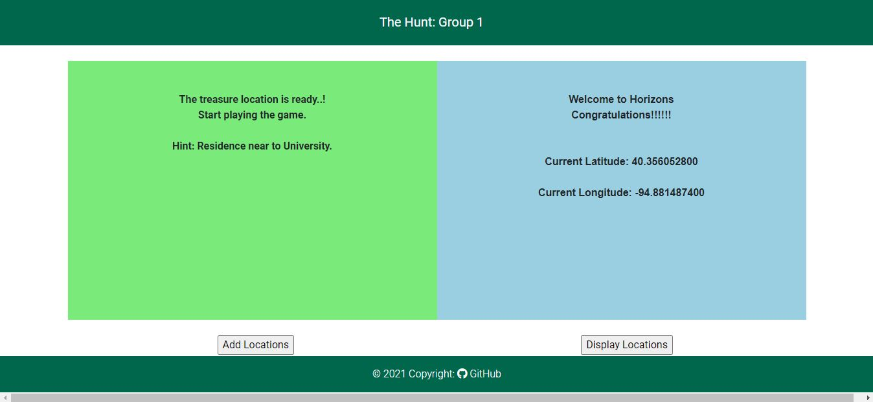
If a User is inside the selected target location, then our app says Congratulations and displays as below

Slide 14
Thank You

