Slide 1
HerediVar
Speaker: Marvin Döbel
Supervisor: Marc Sturm

Slide 2
Agenda
Overview HerediVar
DB Model
Current Implementation State
Screenshots Frontend Prototype
Next Steps
Feedback
Discussion & Questions from us

Slide 3
HerediVar
KeyCloak
Webinterface
HerediCare
0
4
1
2
DB
5
ClinVar
3
Annotation Service
External Databases
Notes:
4: consensus classification

Slide 4
Database Model (Simplified)
annotation_queue
id | int
variant_id | int
user_id | int
requested | datetime
status | enum {pending, success, error}
finished_at | datetime (n)
error_message | text (n)
Annotation Service
User classification
variant_annotation
id | int
variant_id | int
annotation_type_id | int
value | text
supplementary_document | blob (n)
classification
id | int
classification | enum {1-5}
variant_id | int
user_id | int
comment | text
date | datetime
user
id | int
first_name | text
last_name | text
affiliation | text
mail | text
secret | text
additional tables about
literature transcripts clinvar other static information
annotation_type
id | int
name | text
description | text
value_type | enum {int,float, text,…}
version | text
version_date | date
variant
id | int
chr | enum {chr1-22, chrX,chrY,chrMT}
pos | int
ref | text
alt | text
heredicare_seqid | int
error | tinyint1
error_description | text (n)
consensus_classification
id | int
variant_id | int
classification | enum {1-5}
comment | text
date | datetime
evidence_document | blob
gene
id | int
hgnc_id | text
symbol | text
name | text
type | text
variant_consequence
id | int
variant_id | int
transcript_name | text
hgvs_c | text (n)
hgvs_p | text (n)
consequence | text
impact | enum {high, moderate, low, modifier}
exon_nr | int (n)
intron_nr | int (n)
gene_id | int (n)
(n) = nullable

Slide 5
Annotation Service & Supported Databases
Variant import from VCF
Annotation service:
HGNC: Gene table
ensembl and refeseq transcripts (+ FLAGS: MANE select, MANE plus clinical, gencode basic, ensembl canonical)
gnomAD (AF, AC, popmax, #hom, #hemi, #het)
ClinVar
VEP: Variant Consequence, Protein domains (only PFAM atm), PubMed Ids
dbSNP: rsids
PhyloP, REVEL, CADD: pathogenicity scores
SpliceAI, MaxEntScan: scores
BRCA exchange: clinical significance
FLOSSIES: #eur, #afr
(ARUP BRCA: classifications, currently on hold)
Cancerhotspots: hotspots (AF, AC, tumor-type)

Slide 6
Current state: Frontend
Testing different technologies…

Slide 7
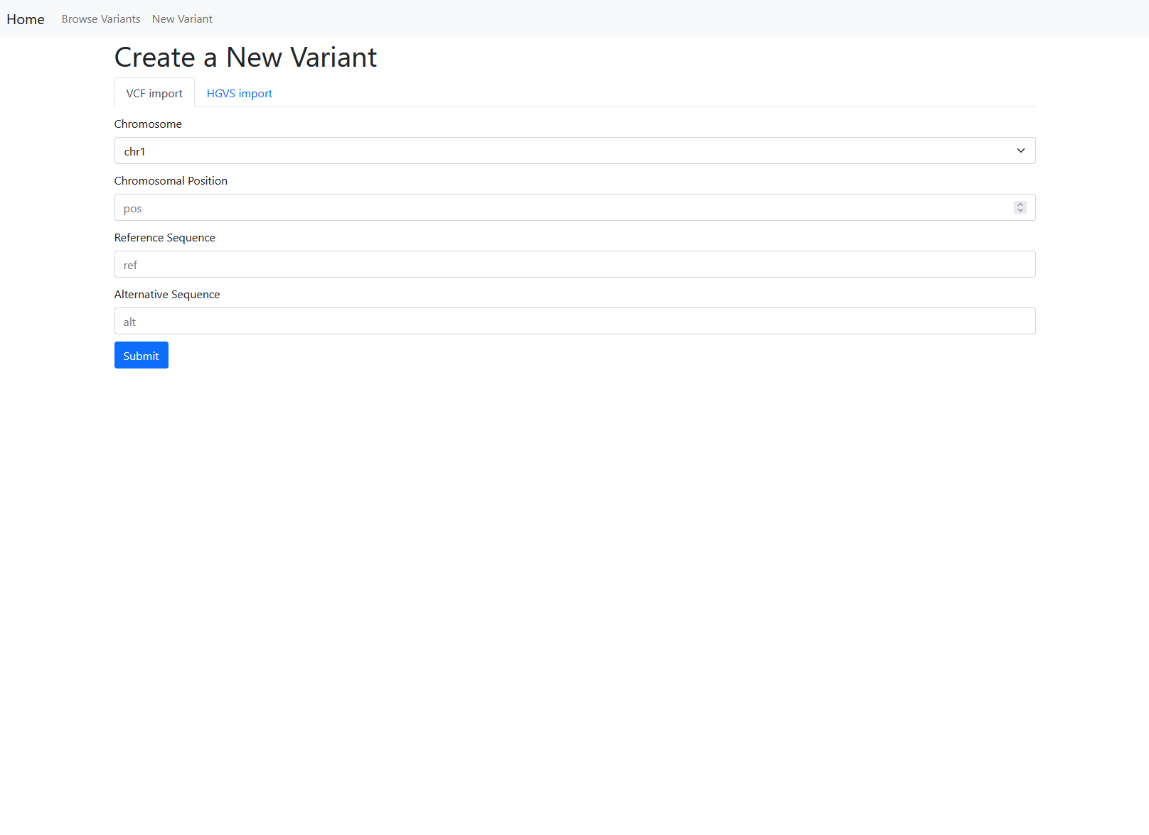
Variants are later imported from HerediCare, but you can create a new one as well!

Slide 8
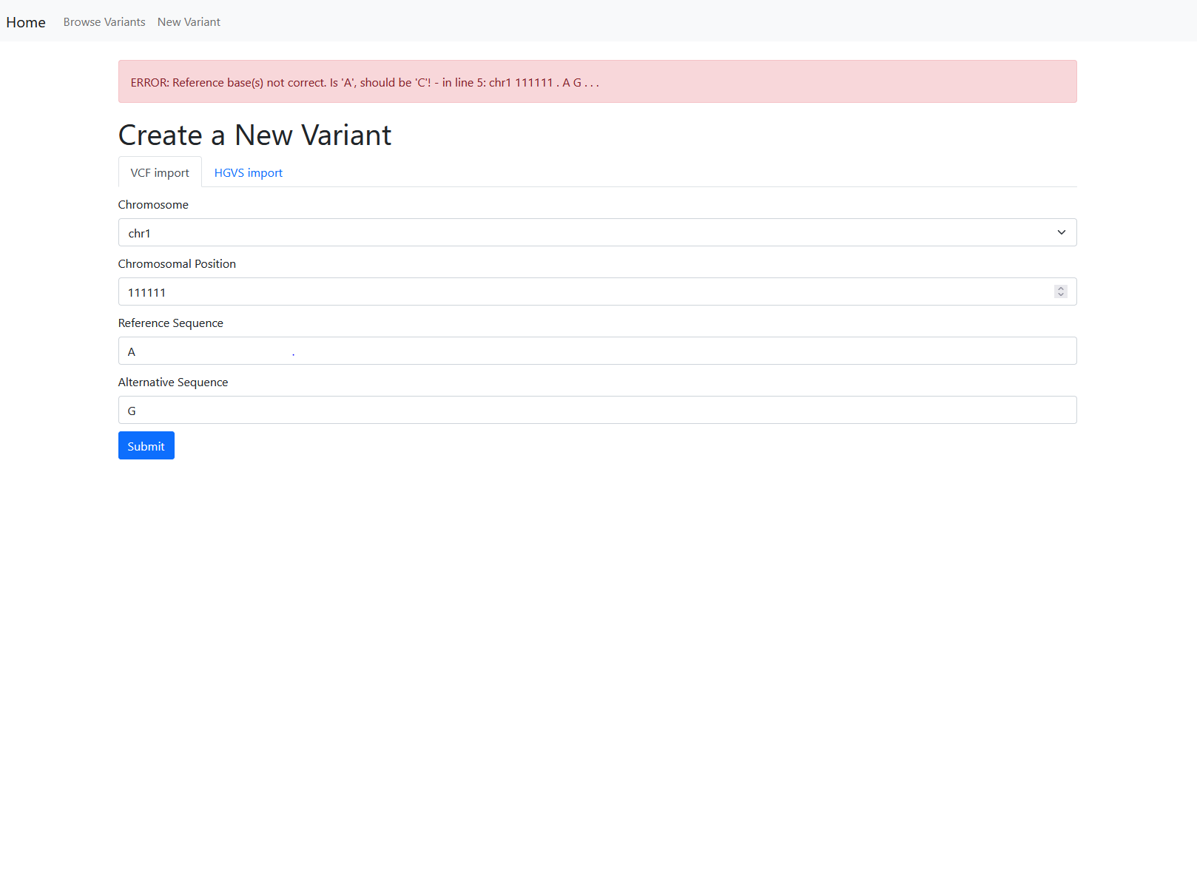
… meaningful error
messages

Slide 9
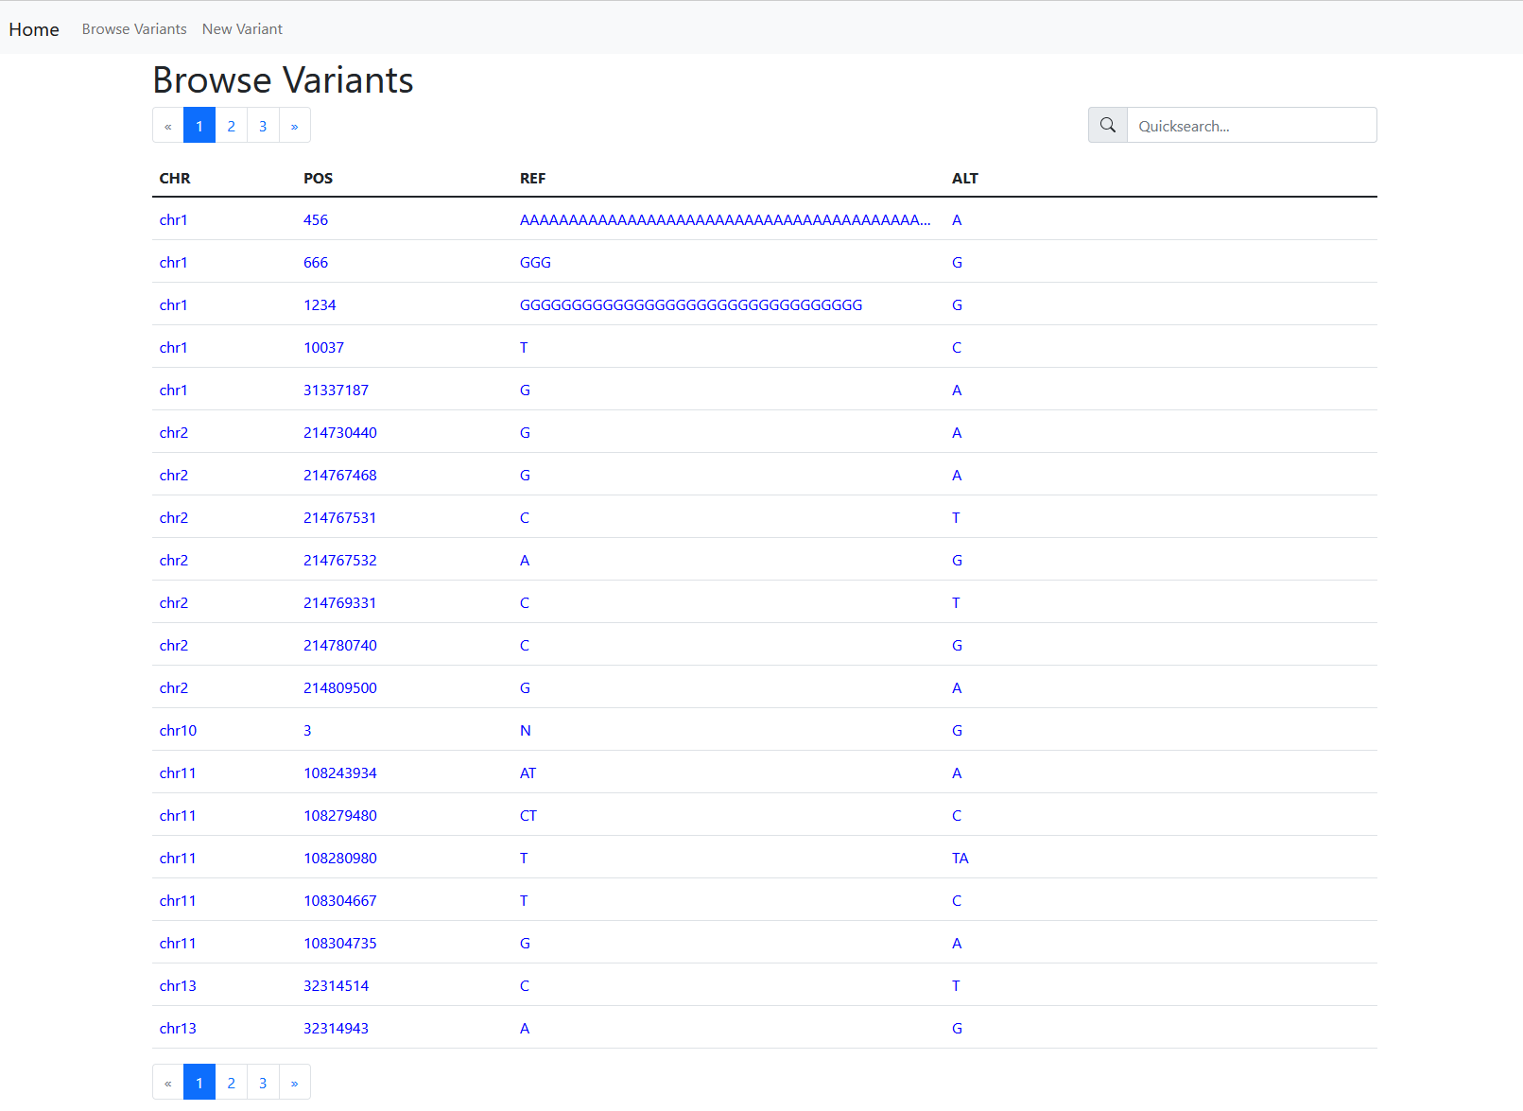

Slide 10
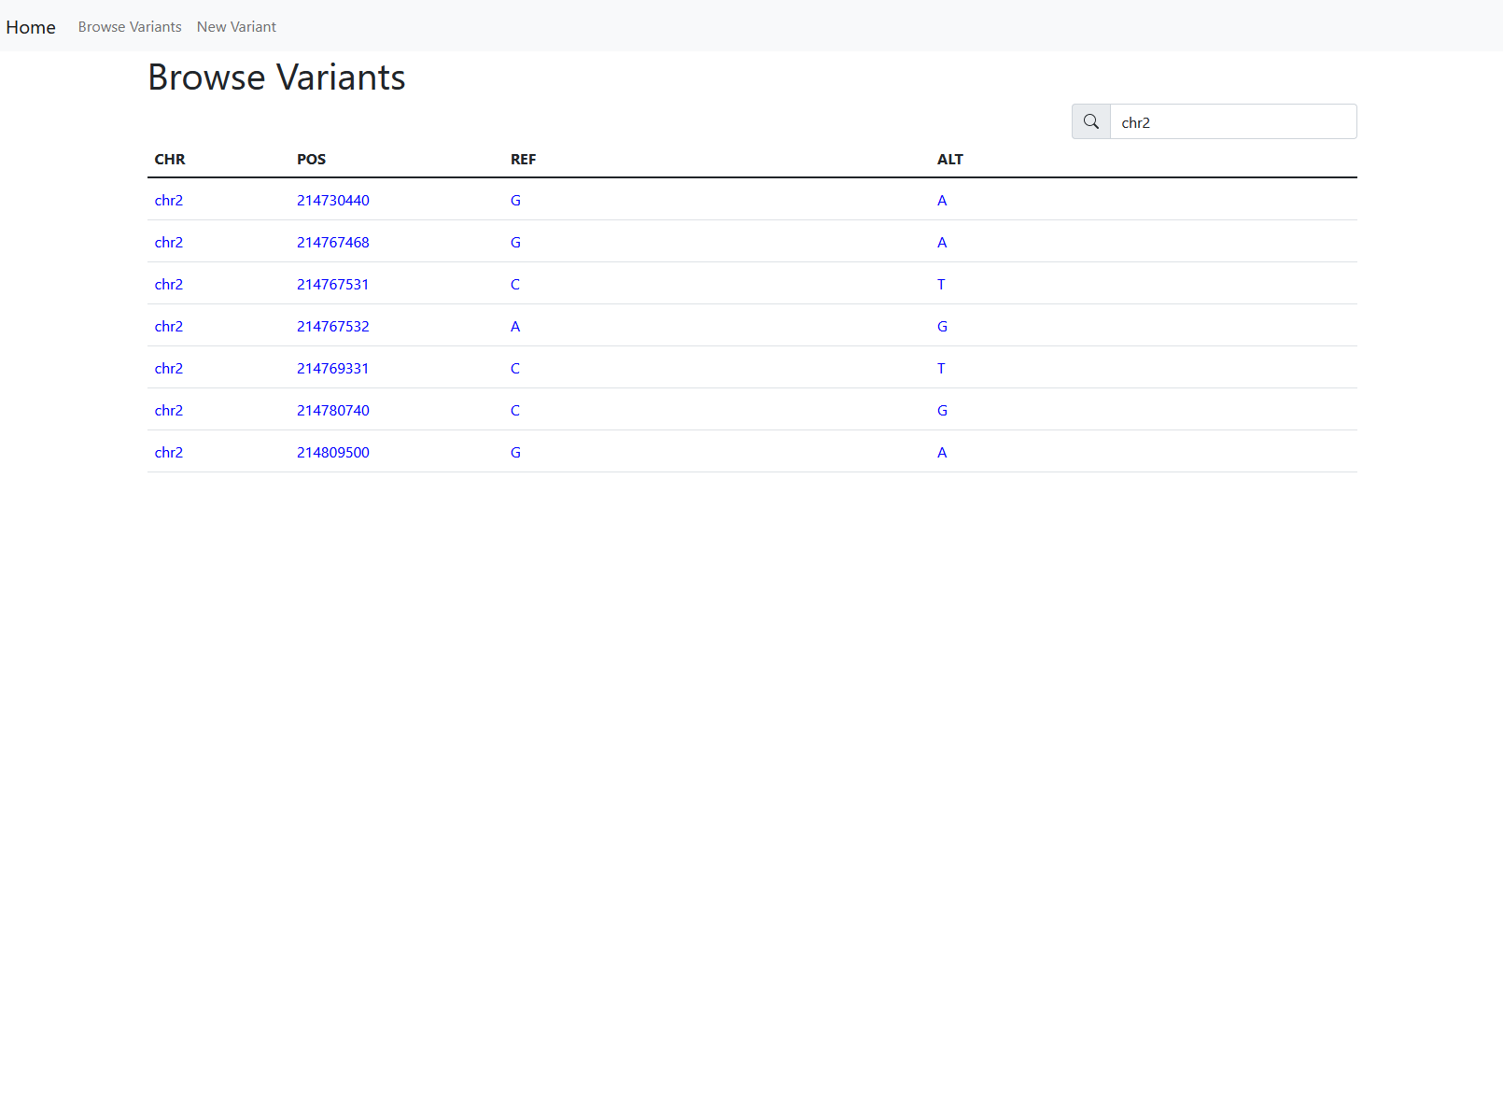
… featuring a quicksearch

Slide 11
… click the rows to display info!

Slide 12
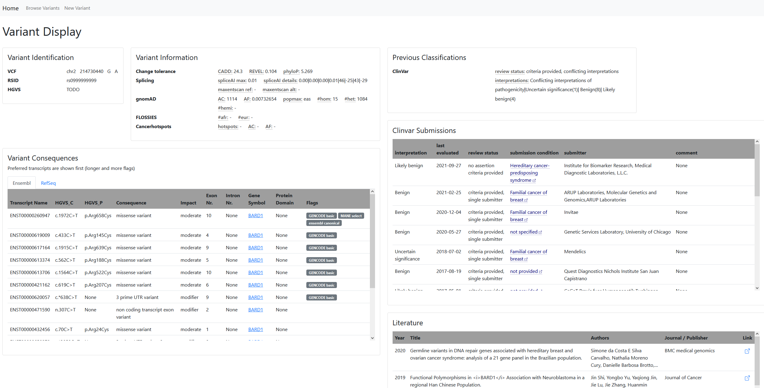
all of these have tooltips for more information or to view truncated data…

Slide 13
external links

Slide 14
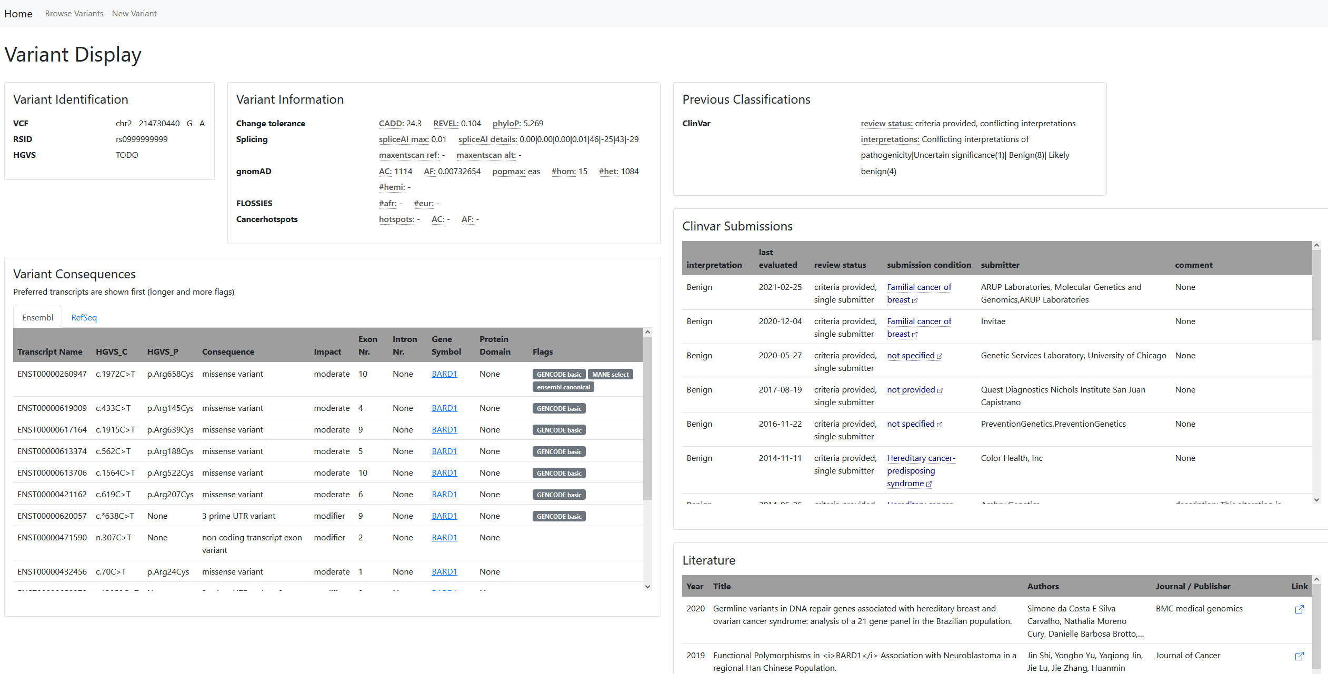
tables can be sorted ascendingly and descendingly

Slide 15
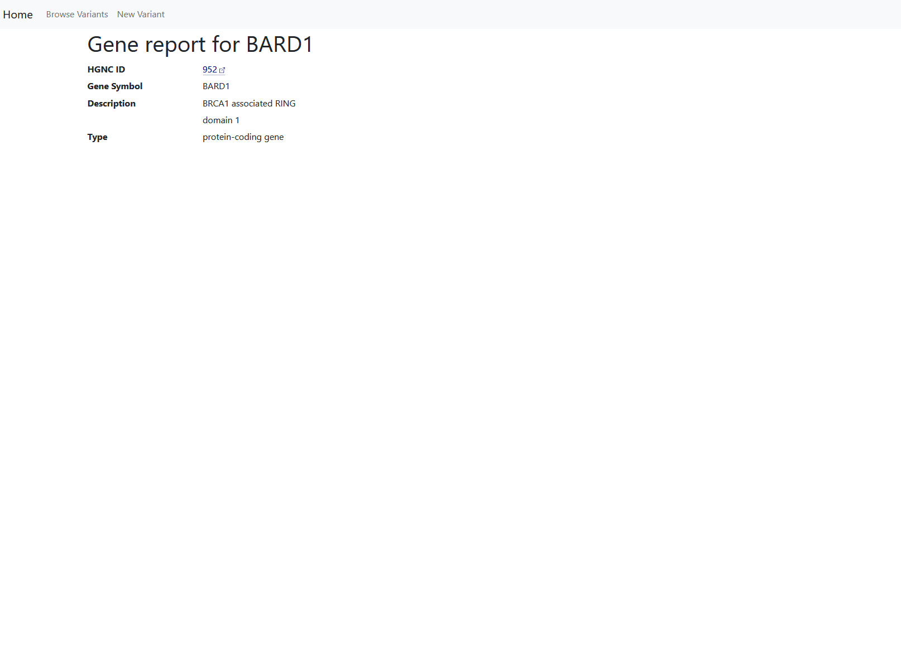
… WIP

Slide 16
Next Steps
Finish annotation service
Display additional information on the webpage
Finish gene-page (transcript table)
Establish login system
Test additional frontend toolchains

Slide 17
BACKUP/OUTDATED

Slide 18
Databases/Algorithms for Variant Annotation
VEP
genomAD
HerediCare
ClinVar
dbSNP
FOSSIES
Cancer hotspots
HCI Database of Prior Probabilities of Pathogenicity for Single Nucleotide Substitutions
TP53 Database
PHANTM classifier
Automatic classification developed in Hannover
... and more

Slide 19
0) Secure login-system through KeyCloak using OAuth2
User is redirected to KeyCloak login page and is granted accurate priviliges
Programmatic access to HerediCare
Update variant- & metadata through API on trigger through the webinterface
Perform reference genome liftover: from HG19 to HG38
Check validity of variant data (check VCF validity, multiple Seq-Ids might map to one variant)
Write valid information to the DB
Automatic annotation procedure
Key information from multiple databases are collected and saved into the DB
Consensus classification by experts
Publish data to ClinVar (pdf with classification criteria required) and export classification back to HerediCare

Slide 20
LRG/MANE: bring NCBI (RefSeq) and EMBL-EBI (Ensembl/GENCODE) together
LRG:
The aim of the project is to create an LRG for every locus with clinical implications.
As of August 2019, over 1323 LRGs have been created
most recent update: 24 August 2019: “MANE Select” flag
GRCh38 and GRCh37
MANE:
MANE Select, a single representative transcript for every protein-coding gene for clinical reporting and other applications
MANE Plus Clinical transcript for genes where the MANE Select alone is inadequate for describing all publicly available pathogenic variants
current version: v1.0 (31 January 2022)
covers ~90% of known protein-coding genes (>16k genes)
only GRCh38

Slide 21
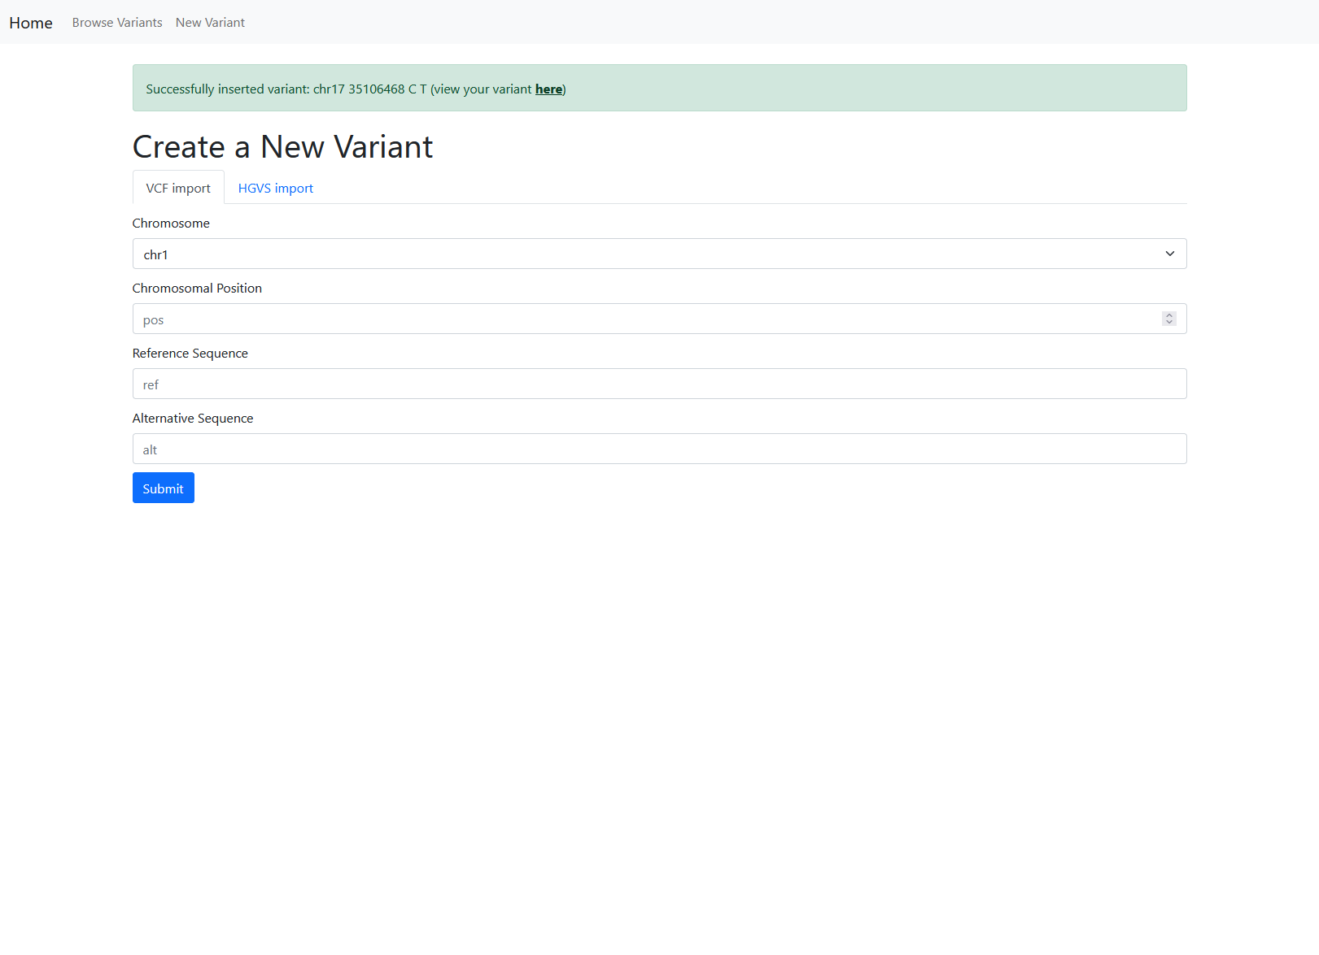
… with response
and working link

