Slide 1


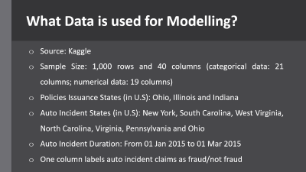
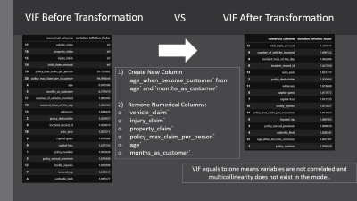
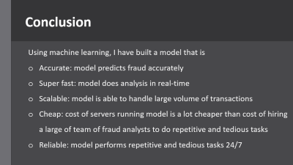
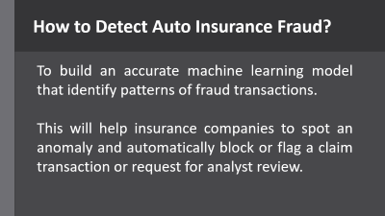
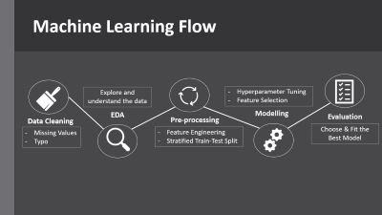
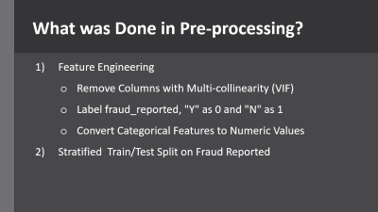
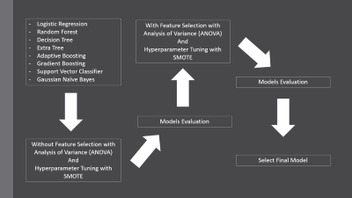
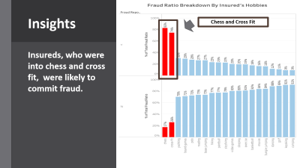
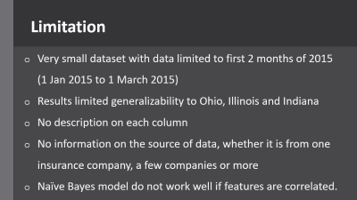
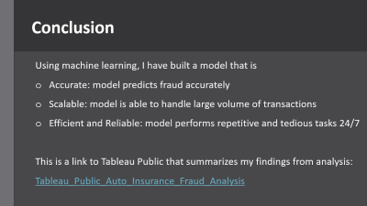
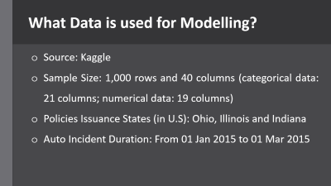

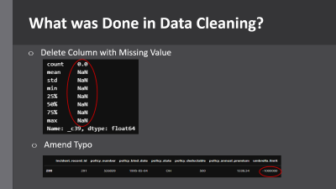
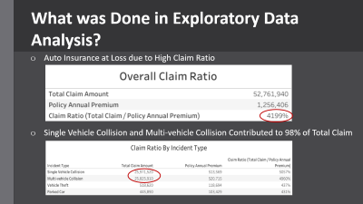
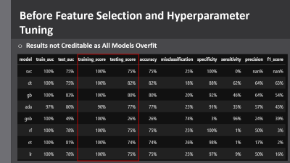
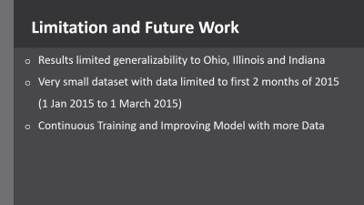
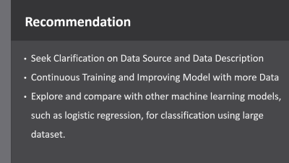
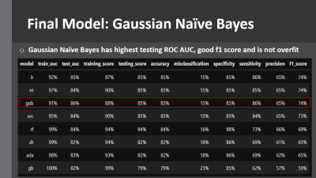

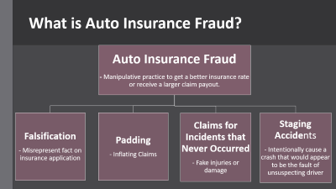
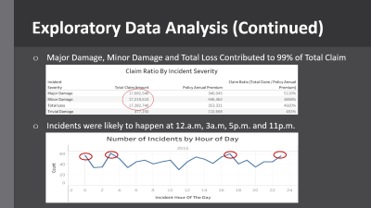

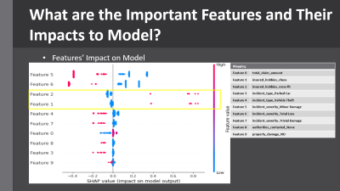

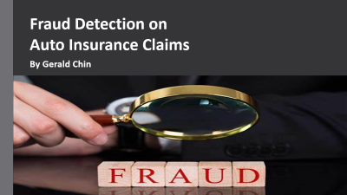
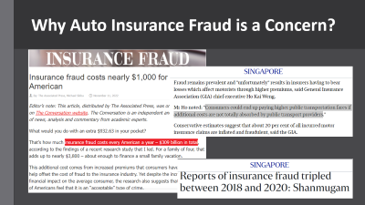
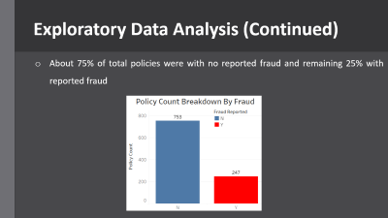
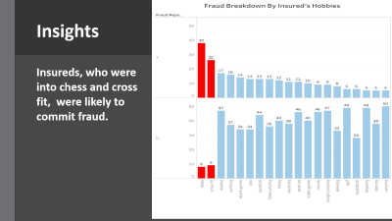
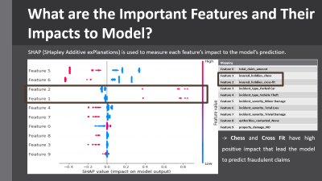
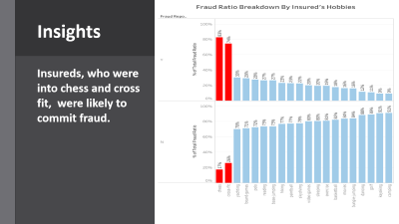
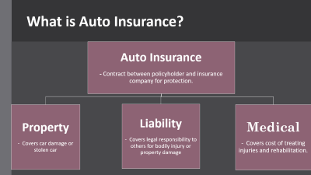
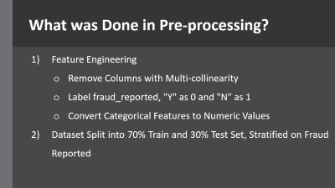
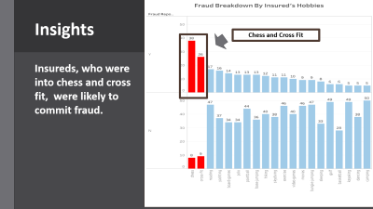

Slide 24
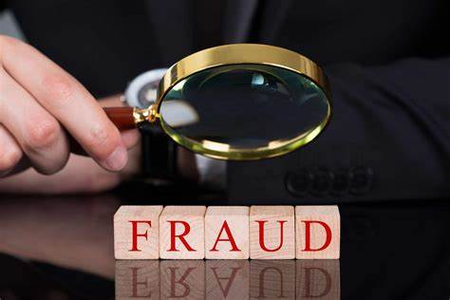
Fraud Detection on
Auto Insurance Claims
By Gerald Chin
Notes:
Hello, Good Afternoon everyone! My name is Gerald. I am General Assembly DSI-SG 32 student. Today, I am here to present fraud detection on auto insurance claims.

Slide 25
What is Auto Insurance?
Auto Insurance
- Contract between policyholder and insurance company for protection.
Liability
- Covers legal responsibility to others for bodily injury or property damage
Property
- Covers car damage or stolen car
Medical
- Covers cost of treating injuries and rehabilitation.
Notes:
First, let’s us understand what are auto insurance and auto insurance fraud.
Auto insurance is a contract between policyholder and insurance company that protects policyholder against financial loss due to car damage, stolen car, legal responsibility to others due to bodily injury or property damage and medical cost of treating injuries and rehabilitation.
Source: https://www.iii.org/article/what-auto-insurance

Slide 26
What is Auto Insurance Fraud?
Auto Insurance Fraud
- Manipulative practice to get a better insurance rate or receive a larger claim payout.
Padding
- Inflating Claims
Falsification
- Misrepresent fact on insurance application
Staging Accidents
- Intentionally cause a crash that would appear to be the fault of unsuspecting driver
Claims for Incidents that Never Occurred
- Fake injuries or damage
Notes:
Whereas auto insurance fraud is a manipulative practice to get a better insurance rate or receive a larger claim payout from insurance company. The manipulative practices include misrepresenting fact on insurance application, inflating claims, claims for incidents that never occurred and staging accidents.
Source: https://www.bankrate.com/insurance/car/fraud/

Slide 27
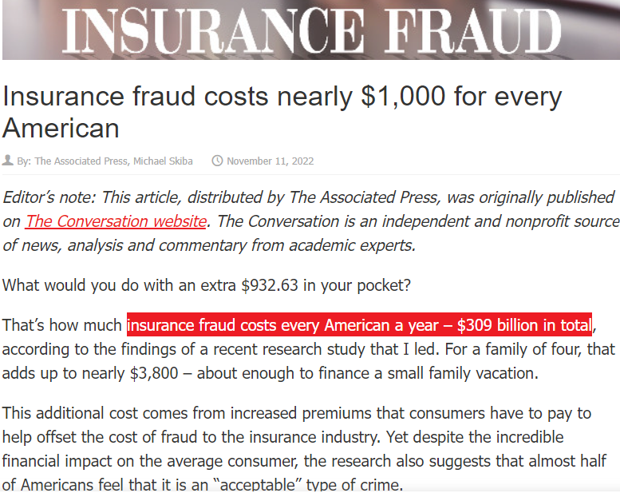
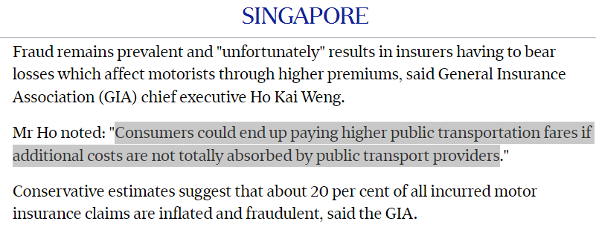
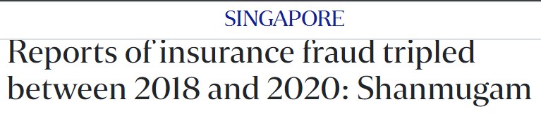
Why Auto Insurance Fraud is a Concern?
Notes:
Why auto insurance fraud is a concern?
Fraud is costly. In the U.S, it costs every American about $1k that comes from increased in premium. This translates to $309 billion in total. In Singapore, number of insurance fraud have tripled between 2018 and 2020 and consumers could end up paying higher public transportation cost if the additional cost due to fraud not bear by public transport provider.
Source:
(1) https://minnlawyer.com/2022/11/11/insurance-fraud-costs-nearly-1000-for-every-american/
(2) https://www.straitstimes.com/singapore/more-cases-of-motor-insurance-fraud-reported-as-police-and-insurers-intensify-efforts
(3) https://www.straitstimes.com/singapore/politics/reports-of-insurance-fraud-tripled-between-2018-and-2020-Shanmugam

Slide 28
How to Detect Auto Insurance Fraud?
To build an accurate machine learning model that identify patterns of fraud transactions.
This will help insurance companies to spot an anomaly and automatically block or flag a claim transaction or request for analyst review.
Notes:
Hence, as a data science student, I am tasked to build an accurate machine learning model that identify patterns of fraud transactions.
This will help insurance companies to spot an anomaly and automatically block or flag a claim transaction or request for analyst review.
Source: https://www.ravelin.com/insights/machine-learning-for-fraud-detection

Slide 29
What Data is used for Modelling?
Source: Kaggle
Sample Size: 1,000 rows and 40 columns (categorical data: 21 columns; numerical data: 19 columns)
Policies Issuance States (in U.S): Ohio, Illinois and Indiana
Auto Incident Duration: From 01 Jan 2015 to 01 Mar 2015
Notes:
Kaggle, a subsidiary of Google LLC. Kaggle allows users to find and publish data sets, explore and build models in a web-based data-science environment, work with other data scientists and machine learning engineers, and enter competitions to solve data science challenges.
Source: https://www.kaggle.com/datasets/buntyshah/auto-insurance-claims-data/

Slide 30





Machine Learning Flow
Explore and
understand the data
Hyperparameter Tuning
Feature Selection
EDA
Modelling
Evaluation
Data Cleaning
Pre-processing
Missing Values
Typo
Feature Engineering
Stratified Train-Test Split
Choose & Fit the
Best Model
Notes:
This is machine learning flow. First, data cleaning was done, followed by EDA, pre-processing, modelling and evaluation.

Slide 31
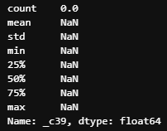
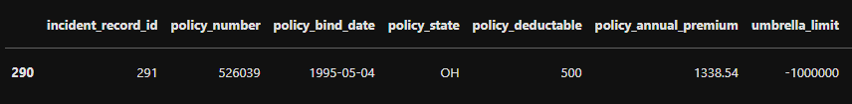
What was Done in Data Cleaning?
Delete Column with Missing Value
Amend Typo
Notes:
In Data Cleaning, column with missing value was deleted and typo were amended.

Slide 32
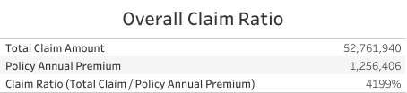
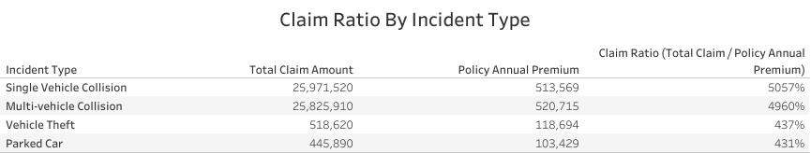
What was Done in Exploratory Data Analysis?
Auto Insurance at Loss due to High Claim Ratio
Single Vehicle Collision and Multi-vehicle Collision Contributed to 98% of Total Claim
Notes:
From EDA, we can see that auto insurance business was at significant loss due to high claim ratio at 4199%. Literally, total claim amount was about 42 times higher than that of policy annual premium. This claim ratio could be distorted as the dataset only contain policy annual premium from claim data and exclude policy annual premium from data that had no claim.
If we analyse claim ratio based on incident type, we can see that Single Vehicle Collision and Multi-vehicle Collision had highest and second highest claim ratio that contributed to 98% of total claim.

Slide 33
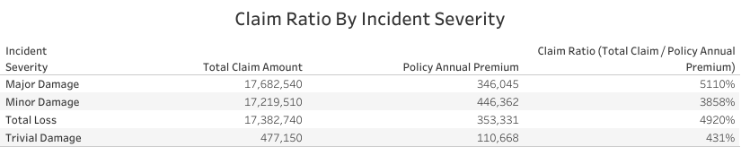
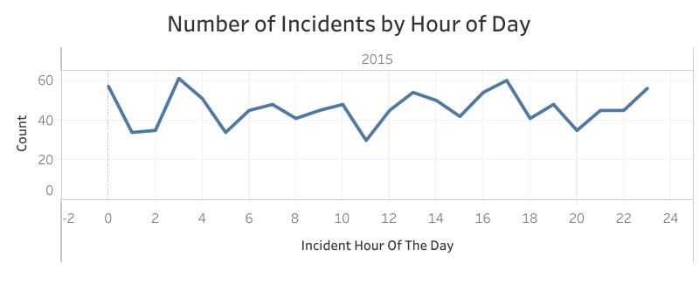
Exploratory Data Analysis (Continued)
Major Damage, Minor Damage and Total Loss Contributed to 99% of Total Claim
Incidents were likely to happen at 12.a.m, 3a.m, 5p.m. and 11p.m.
Notes:
Then, if we analyse claim ratio based on incident severity, we can see that major damage, minor damage and total loss had very high claim ratio that contributed to 98% of total claim.
Another interesting finding is that incidents were likely to happen at 12.a.m, 3a.m, 5p.m. and 11p.m. These could be peak period of people returning home from nights spent out at bars, office or restaurants.

Slide 34
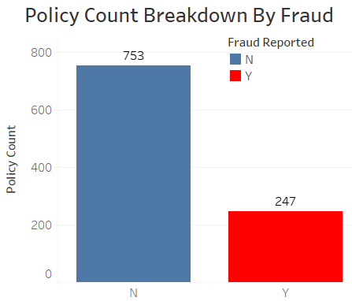
Exploratory Data Analysis (Continued)
About 75% of total policies were with no reported fraud and remaining 25% with reported fraud
Notes:
From dataset, 75% of the claims are with no fraud reported and only 25% of the claims are with fraud reported.

Slide 35
What was Done in Pre-processing?
Feature Engineering
Remove Columns with Multi-collinearity (VIF)
Label fraud_reported, "Y" as 0 and "N" as 1
Convert Categorical Features to Numeric Values
Stratified Train/Test Split on Fraud Reported
Notes:
In pre-processing, feature engineering was done to remove columns with multi-collinearity, label fraud_reported “Y” and “N” as 0 and 1; and convert categorical features to numeric values.
In addition, dataset is split into 70% train and 30% test set, stratified on fraud reported.

Slide 36
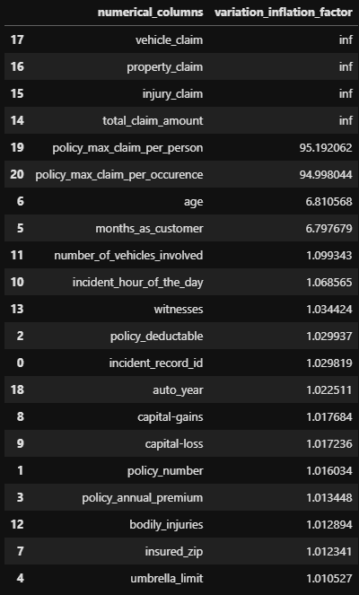
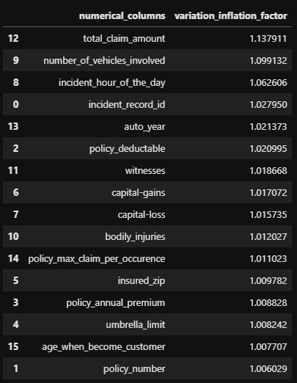
VIF Before Transformation
VS
VIF After Transformation
Create New Column `age_when_become_customer` from `age` and `months_as_customer`
Remove Numerical Columns:
`vehicle_claim`
`injury_claim`
`property_claim`
`policy_max_claim_per_person`
`age`
`months_as_customer`
VIF equals to one means variables are not correlated and multicollinearity does not exist in the model.
Notes:
VIF is used to check if there is strong correlation between one independent numerical and a group of other numerical columns.
VIF = 1 → No correlation VIF = 1 to 5 → Moderate correlation VIF >10 → High correlation
From the table on the left, we can see that vehicle_claim, injury_claim, property_claim, policy_max_claim_per_person, age and months_as_customer have VIF that is more than 5. Hence, these columns were removed.
Variation Inflation Factor (VIF) is used for better understanding the correlation of one independent numerical column with a group of other numerical columns
Source: https://towardsdatascience.com/how-to-detect-and-deal-with-multicollinearity-9e02b18695f1
Detecting multicollinearity is important because while multicollinearity does not reduce the explanatory power of the model, it does reduce the statistical significance of the independent variables.
Source: https://www.investopedia.com/terms/v/variance-inflation-factor.asp
VIF, range from 7 to infinity, represent critical levels of multicollinearity where the coefficients are poorly estimated, and the p-values (probability that the null hypothesis is true) are questionable.
Source: https://statisticsbyjim.com/regression/multicollinearity-in-regression-analysis
Null Hypothesis: coefficient of a variable is zero. This means that it does not contribute really to the model.
Source: https://stats.stackexchange.com/questions/284812/failing-to-reject-the-null-hypothesis-in-the-face-of-multicollinearity
A p-value less than 0.05 is typically considered to be statistically significant, in which case the null hypothesis should be rejected. A p-value greater than 0.05 means that deviation from the null hypothesis is not statistically significant, and the null hypothesis is not rejected.
Source: https://www.investopedia.com/terms/p/p-value.asp#:~:text=A%20p-value%20less%20than,null%20hypothesis%20is%20not%20rejected.

Slide 37
Modelling and Evaluation
Baseline Score
If we are to make a naïve prediction and just predict everything to be fraud:
Sensitivity: 100%
Specificity: 0%
Precision: 25%
F1 score: 40%
ROC AUC Score: 50% (aim for 70%)
Notes:
As our dataset is imbalance, accuracy is not a good measure of success. A high accuracy can be achieved by a poor model that only selects the majority class, hence, not detecting and measuring the accuracy of classifying the class of interest. In fact, predicting only the majority class will give an accuracy of 75%, specificity of 100% but a sensitivity of 0%.
As identifying as many frauds as possible is the goal, F1 score of 40% was used as a baseline. However, investigations into frauds can be time consuming and expensive and may even affect customer experience. Thus, ROC AUC score will also be used to measure how well we distinguish between Fraud and legit claims. The baseline ROC AUC score is 50%. Nonetheless, I aim to train a model with ROC AUC that is at least 70%.

Slide 38
Logistic Regression
Random Forest
Decision Tree
Extra Tree
Adaptive Boosting
Gradient Boosting
Support Vector Classifier
Gaussian Naïve Bayes
With Feature Selection with Analysis of Variance (ANOVA) And
Hyperparameter Tuning with SMOTE
Models Evaluation
Models Evaluation
Without Feature Selection with Analysis of Variance (ANOVA) And
Hyperparameter Tuning with SMOTE
Select Final Model
Notes:
This is the flow of modelling. Because this is a classification problem, these models are chosen for modelling.
First, these models are run without feature selection and hyperparameter tuning. Then, the models results were assessed.
As the models were overfit, Analysis of Variance is used to filter and select features with statistical differences and SMOTE is used to balance class distribution.
Analysis of Variance (ANOVA) is used to identify and select features that are important to modelling via P value. The smaller the P value the more significant the difference in the features.
Source: https://ml2021.medium.com/chi-square-and-anova-feature-selection-for-ml-5e1063ab0991
SMOTE is a commonly used oversampling method that attempts to balance class distribution by randomly increasing minority class labels by replicating them. SMOTE creates new minority labels between existing minority labels. SMOTE works by selecting labels that are close in the feature space, drawing a line between the labels in the feature space and drawing a new label at a point along that line.
As dataset is imbalanced, SMOTE is a good method to balance class distribution. Another option that is considered was class weights, where a heavier weightage is placed on the minority class and vice-versa for the majority class. However, SMOTE is selected as some models like Adaptive Boosting classifier and Gradient Boosting classifier cannot use class weights.

Slide 39
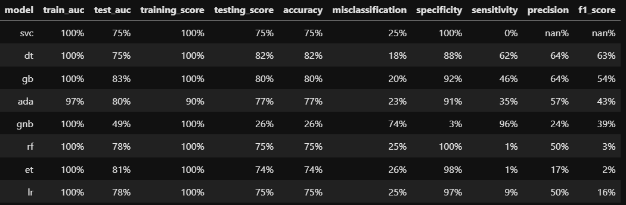
Before Feature Selection and Hyperparameter Tuning
Results not Creditable as All Models Overfit

Slide 40
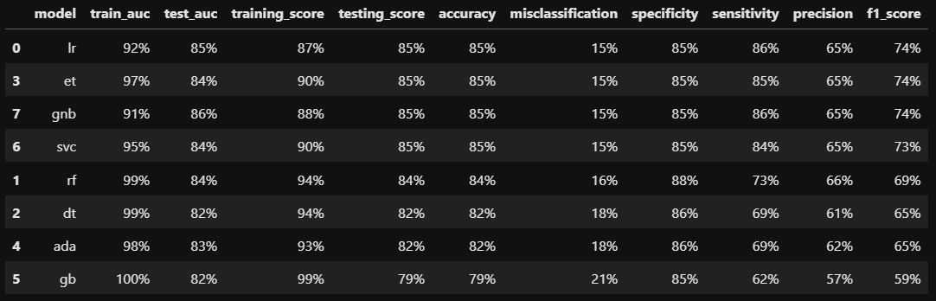
Final Model: Gaussian Naïve Bayes
Gaussian Naïve Bayes has highest testing ROC AUC, good f1 score and is not overfit
Notes:
**Observations**:
Logistic Regression, Extra Tree and Gaussian Naive Bayes have the highest f1 score at 74%.
Gaussian Naive Bayes has highest testing ROC AUC at 86%.
Hence, Gaussian Naive Bayes is selected as the final model.
Testing ROC curve has an AUC of 86%, meaning it ranks a random positive example higher than a random negative example 86% of the time.
F1 score is a harmonic mean of both sensitivity and precision.
Sensitivity measures the model's ability to detect Positive samples (e.g. positive fraud cases)
Precision refers to the number of true positives divided by the total number of positive predictions (i.e., the number of true positives plus the number of false positives).
Precision asks: of all the prevented customers, what proportion were fraudsters?
Recall asks: of all the fraudsters, what proportion did we prevent?
Source: https://www.ravelin.com/insights/machine-learning-for-fraud-detection

Slide 41
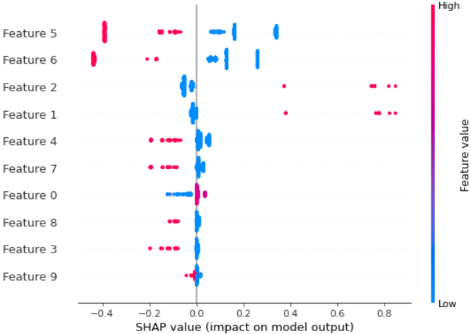
What are the Important Features and Their Impacts to Model?
SHAP (SHapley Additive exPlanations) is used to measure each feature’s impact to the model’s prediction.
Mapping
Feature 0 | total_claim_amount
Feature 1 | insured_hobbies_chess
Feature 2 | insured_hobbies_cross-fit
Feature 3 | incident_type_Parked Car
Feature 4 | incident_type_Vehicle Theft
Feature 5 | incident_severity_Minor Damage
Feature 6 | incident_severity_Total Loss
Feature 7 | incident_severity_Trivial Damage
Feature 8 | authorities_contacted_None
Feature 9 | property_damage_NO
-> Chess and Cross Fit have high positive impact that lead the model to predict fraudulent claims
Notes:
All variables are ranked in the order of feature importance, with incident, whose severity is minor damage, being the most important and no property damage being the the least important one. X-axis, SHAP value represents the likelihood of getting positive outcome, which is prediction of fraudulent insurance claims; or negative outcome, which is prediction of non-fraudulent insurance claims.
We can see that chess and cross fit have high positive impact that lead the model to predict fraudulent claims.
SHAP (SHapley Additive exPlanations) is used to measure the contributions to the final outcome from each feature separately among the coalition, while preserving the sum of contributions being equal to the final outcome.
Source: https://m.mage.ai/how-to-interpret-and-explain-your-machine-learning-models-using-shap-values-471c2635b78e

Slide 42
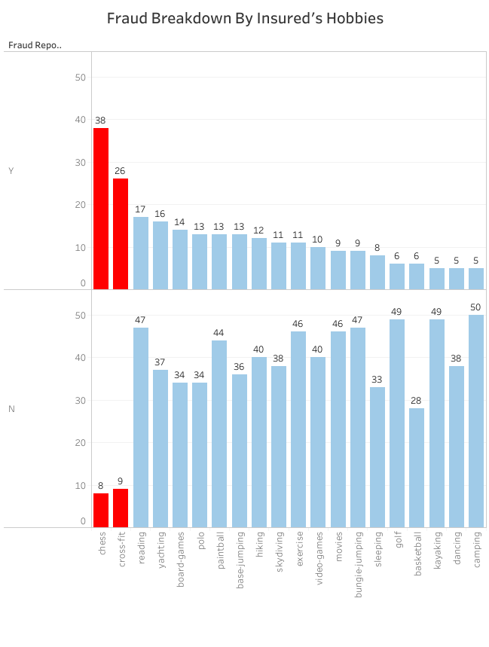
Insights
Chess and Cross Fit
Insureds, who were into chess and cross fit, were likely to commit fraud.
Notes:
Insight was derived based on model’s suggested features. This slide shows the count of fraud committed by insureds who were into chess and cross fit respectively.

Slide 43
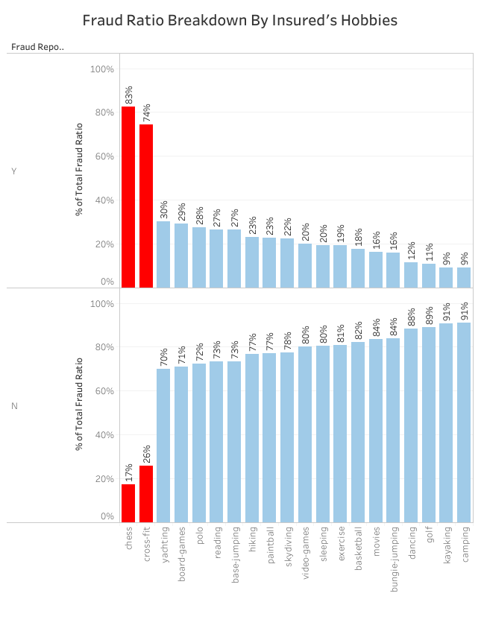
Insights
Chess and Cross Fit
Insureds, who were into chess and cross fit, were likely to commit fraud.
Notes:
This slide shows the fraud ratio by chess and cross fit respectively. From the insights, we can see that insureds, who were into chess and cross fit, were likely to commit fraud. As correlation does not imply causation, to prevent fraud, it is suggested to use this model to flag out claim transaction / request from insured, who are into chess and cross fit, to claims analysts for investigation before paying out claims.

Slide 44
Conclusion
Using machine learning, I have built a model that is
Accurate: model predicts fraud accurately
Scalable: model is able to handle large volume of transactions
Efficient and Reliable: model performs repetitive and tedious tasks 24/7
This is a link to Tableau Public that summarizes my findings from analysis:
Tableau_Public_Auto_Insurance_Fraud_Analysis

Slide 45
Limitation and Future Work
Results limited generalizability to Ohio, Illinois and Indiana
Very small dataset with data limited to first 2 months of 2015 (1 Jan 2015 to 1 March 2015)
Continuous Training and Improving Model with more Data

Slide 46
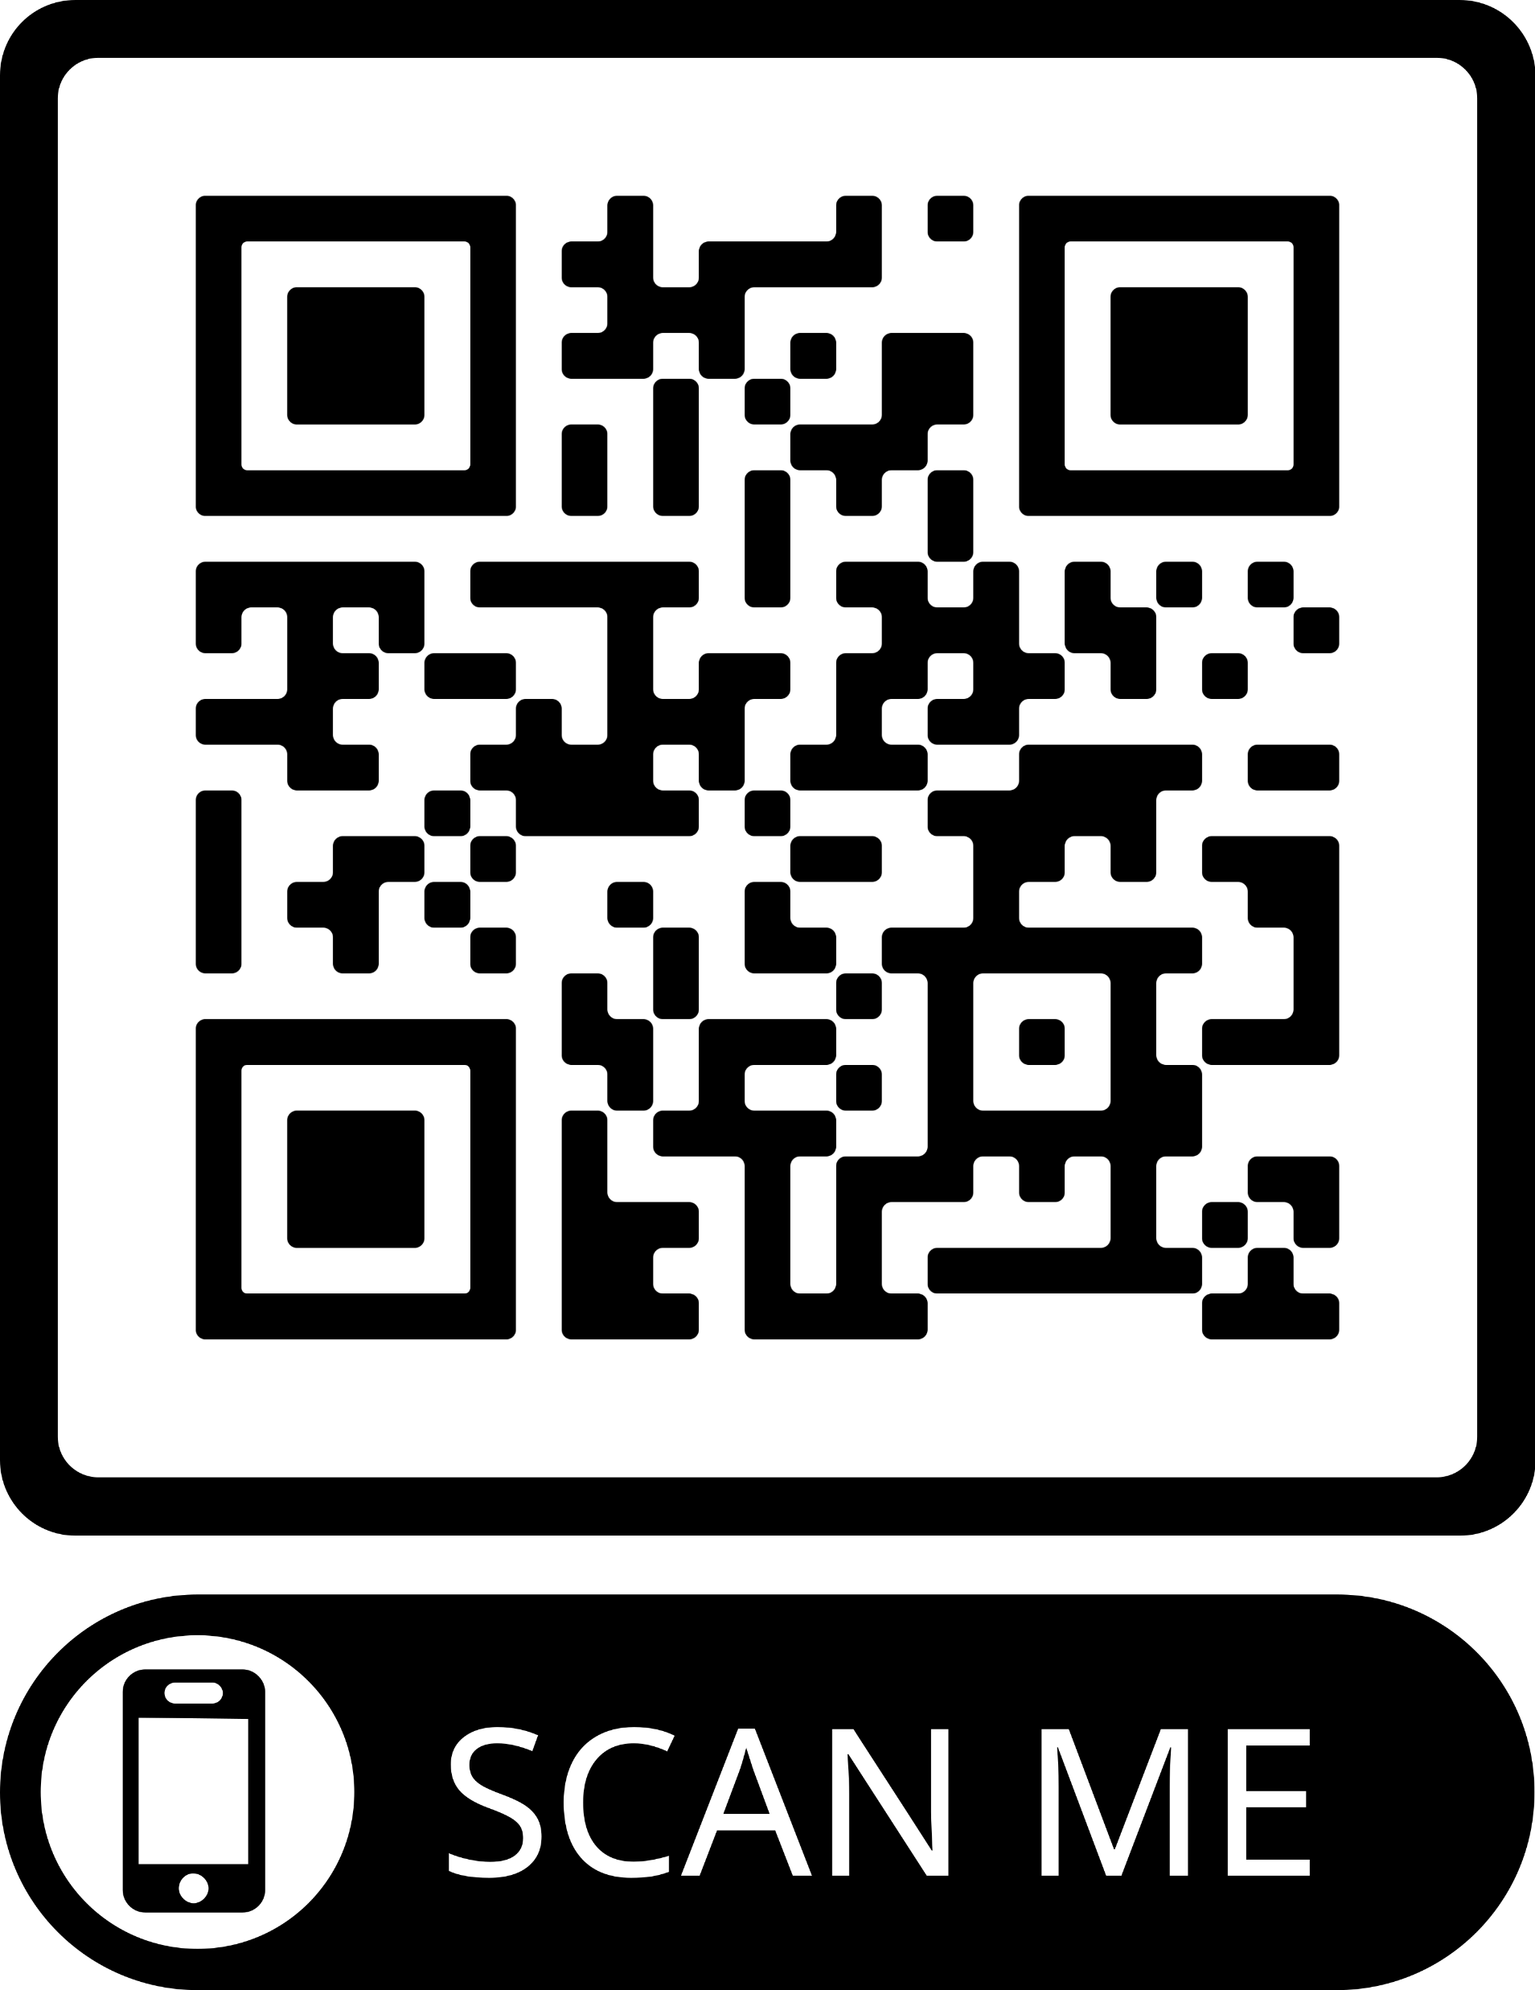
THANK YOU
Geraldk.chin@gmail.com
+65 8118 0985
www.linkedin.com/in/gerald-chin
Tableau Public URL:

