Slide 1



Health Connect
Team names

Slide 2


Introduction
Imagine waking up in the middle of the night with a sharp pain in your chest – and no access to a hospital , no insurances , and no one to call. For millions of people , this isn’t a story , it’s their reality. Today we are here to talk to you about an app that can assist you in your health problems . An app that can help you locate nearby hospitals , pharmacies and clinics , you name it! | How much would you pay to save your life or the life of someone you love? Would it surprise you to know that in some places, life saving care costs are less than a bottle of water and in others , it is complimentary . “Of all forms of inequality , injustice in health is the most inhumane.” Said Dr. Martin Luther King Jr. With these words in mind , let us look at where we stand today in providing fair , affordable and quality health care to everyone . Health care is not just a personal issue , it is a global crisis. In this presentation , we will look at how you are changing the world by using this app. | Health care access is crucial but often difficult during emergencies . Many struggle to find nearby hospitals , clinics , or pharmacies quickly. Language barriers make it even harder for diverse users to get help . HealthConnect is a desktop app designed to solve this by providing easy , multilingual health care location access

Slide 3

PROBLEM STATEMENT
We have realised that in the health sector we have several problems such as poor accessibility to health facilities [ they are scattered ] , existing solutions lack comprehensive data or multilingual support , poor medication adherence , lack of health information , delayed emergency response and there is a need for a user-friendly , multilingual healthcare locator app .
01
WHO DOES IT HELP?
This app can help patients needing immediate healthcare locations , Family members seeking nearby medical services , multilingual unfamiliar with local health care options and people with heart conditions or epilepsy and solo travelers.
02
SOLUTION
03
HealthConnect consolidates hospitals , clinics , and pharmacies in one app. Features include searchable database , categorized tabs , support multiple languages like Sesotho , Spanish and French . Emergency contact button for quick access to help .

Slide 4

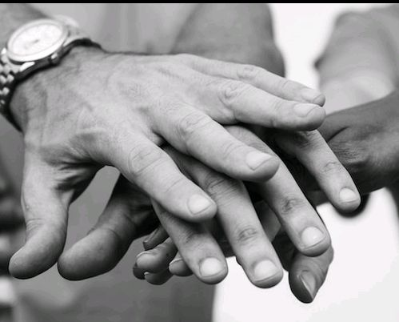

Offered Solutions
Innovation
Collaborative Team
Growth Potential

Slide 5


Here we talk about the challenges we faced:
Presenter Challenges
We faced challenges like restructuring resource folders and learn java localization handling , tight deadline forced focus on core features first [ managing time while juggling school] , ensuring smooth language switching and UI stability and overcoming technical and time challenges to deliver a functional app .

Slide 6

Thank You .
.

