Slide 1



A Nurturing Space for Youth Development

Slide 2

Group members
Hape Mokorosi- Editor
Mpho Ramaisa- Web Developer
Bafokeng Sutha- Graphics Designer
We’re a group of individuals with a burning passion to learn and carve our skills, while forging a path to our careers.

Slide 3
Problem;
Limited Access to Structured, Engaging Extracurricular Learning Resources for Youth
In many communities, young people lack accessible, engaging, and well-structured resources for learning extracurricular skills outside of formal education.
While platforms like YouTube offer countless videos, the content is unstructured, making it hard for young people to find cohesive, step-by-step guidance tailored to their learning goals.
Without mentorship, interactive practice, or community support, young people often struggle to stay motivated, measure their progress, or fully develop their skills.
This gap limits opportunities for youth to explore interests, gain confidence, and develop talents that can contribute to their personal growth and future success.

Slide 4
Solution;
A Dedicated Extracurricular Activities Learning Platform for Youth Empowerment
Our website provides a structured, youth-centered approach to extracurricular learning, empowering young people to gain new skills and knowledge in areas like sports, music, arts, cooking, and more.
Unlike general platforms, our site offers clearly defined learning paths for each activity, guiding users through progressively challenging tutorials.
It combines videos with interactive elements like quizzes and challenges, allowing users to test their knowledge, track progress, and set goals.

Slide 5
Technologies used
We used Eclipse IDE as our text editor
Ours is a dynamic web site because we wanted admins to be able to edit and upload content
HTML was used to structure our information
CSS was for customizing the website to communicate our brand identity and voice
We used JavaScript as well to make functions like user profiles to be captured

Slide 6
Key features
1. Progress Tracking and Milestones: Users can track their progress, mark tutorials as complete, and earn badges for reaching milestones, motivating them to continue learning.
2. Personalized Learning Paths: The platform offers recommendations based on users' interests and skill levels, helping them find relevant tutorials without the distraction of unrelated content.
3. Community and Mentorship Support: A dedicated forum or chat area allows learners to ask questions, seek feedback, and connect with mentors or peers, building a supportive community around their interests.
4. Offline Access for Limited Connectivity: Selected content can be downloaded, ensuring access even in areas with poor internet connectivity.
This platform empowers youth by giving them a focused, engaging, and supportive environment to explore and develop their talents. By making extracurricular learning accessible, structured, and motivating, it helps young people build skills, gain confidence, and work toward personal and career goals outside the classroom.

Slide 7
Long-term Impacts
Outside of class learning is essential in developing one’s interests and building their talents
Exposure to a world of possibilities will allow our youth to see beyond formal education and explore other avenues
Youth will be motivated to pursue their careers in a different manner and actually make a living out of them
Learning in the comfort of one’s home or comfort space has proven to increase motivation for Basotho youth as they are not restricted by anything and they are in control of their learning pace.
Having a significant amount of people enrolled into these tutorials will have a positive impact on the economy as they start using their acquired skills to make sales

Slide 8
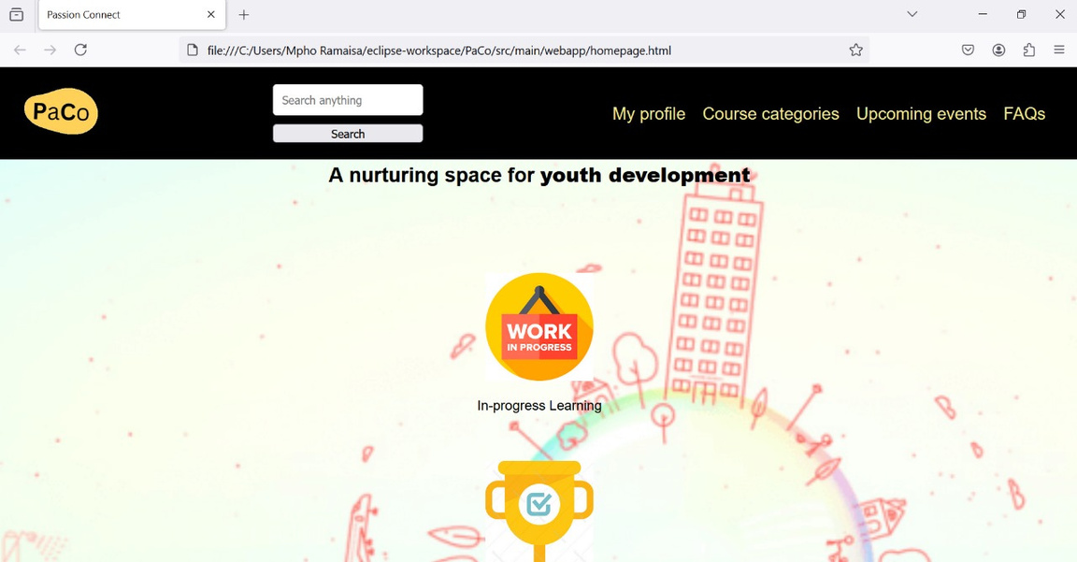
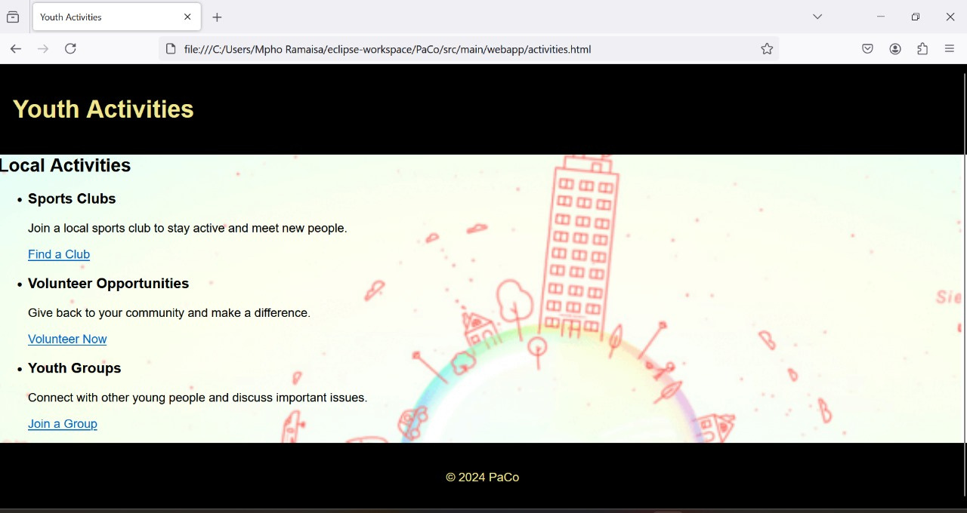
A list of activities a member can participate in
Our homepage

Slide 9
Thank you!

