Slide 1
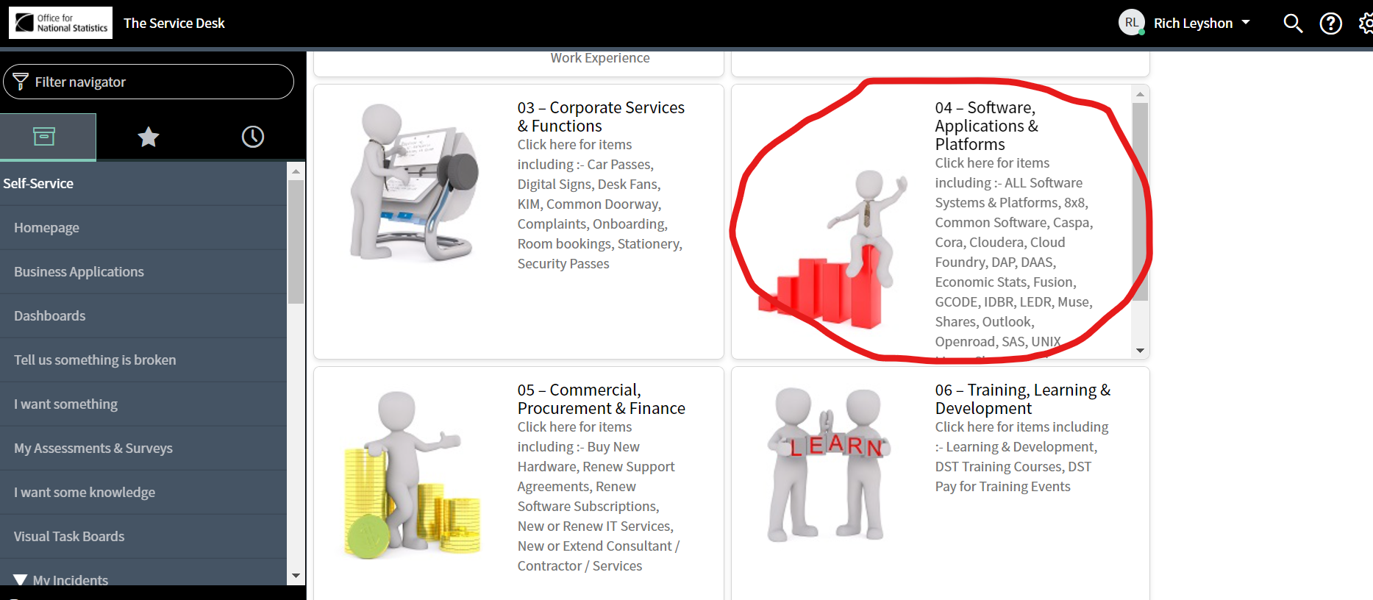
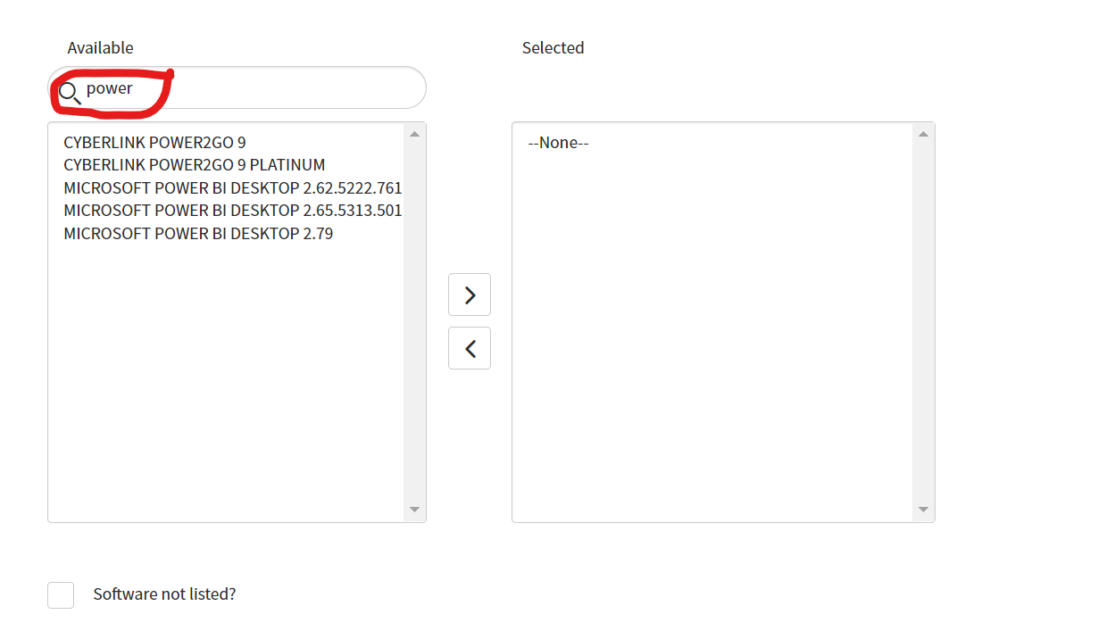
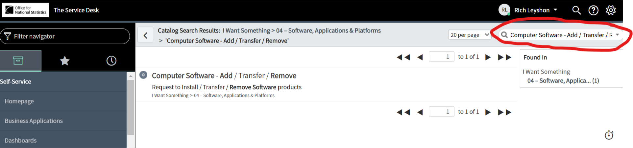
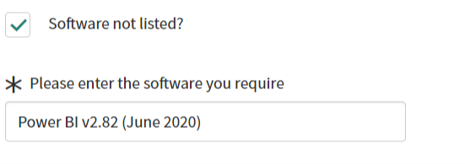
I don’t have PBI installed. How can I get it?
2. Search software in the search bar, click on ‘Computer Software – Add/Transfer/Remove’
1. go to service desk and select #4
3. On the next page, search the software for power and select 2.79 from the list. If you intend to create reports though, I would instead…
4. Select software not listed and input ‘Power BI v2.82 (June 2020)’. This is already available on the ONS estate but is not listed. It gives python integration among other improvements.

