Slide 1
The UK Statistical Authority’s Ethical Principles
Simon Whitworth
UK Statistics Authority

Slide 2
The Importance of Ethics
Reduce potential harm to all individuals involved.
Key factor in maintaining public acceptability.
Important enabler in mobilising the power of data to help Britain make better decisions.

Slide 3
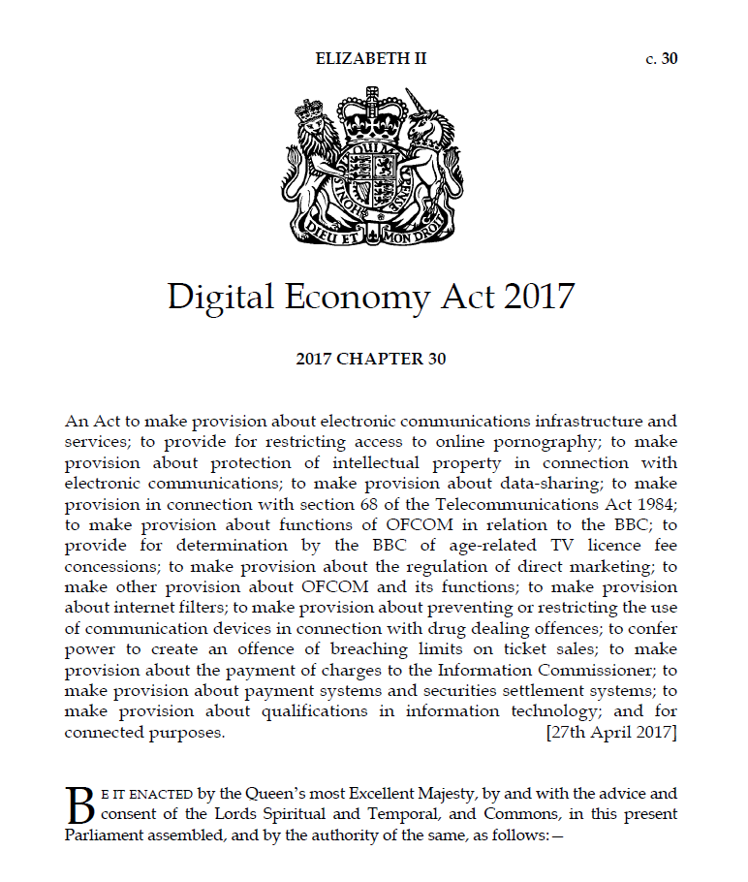
“a legal framework providing the Authority with access to data held by Crown bodies, other public authorities and undertakings (including charities) to support the Authority’s statistical functions.”

Slide 4
Digital Economy Act: Statistics Strand
Gives ONS a right of access to data for statistical/research purposes only
Enable secure data shares with Devolved Administrations to support their statistical needs from devolution
Protect privacy and security of data; reaffirm rigorous penalties for misuse
Duty to consult statisticians on changes to data systems
Uses of the DEA have to observe appropriate ethical standards

Slide 5
Ethical Principles
The use of data has clear benefits for users and
serves the public good.
Public Good
Confidentiality, data security
The data subject’s identity (whether person or organisation) is protected, information is kept confidential and secure, and the issue of consent is considered appropriately.
Methods and Quality
The risks and limits of new technologies are considered and
there is sufficient human oversight so that methods employed
are consistent with recognised standards of integrity and quality.
Legal Compliance
Data used and methods employed are consistent with legal requirements such as Data Protection Legislation, the Human Rights Act 1998, the Statistics and Registration Service Act 2007, and the common law duty of confidence.
Public views & engagement
The views of the public are considered in light of the data used and the perceived benefits of the research.
Transparency
The access, use and sharing of data is transparent, and is communicated clearly and accessibly to the public.
5
HS
5

Slide 7
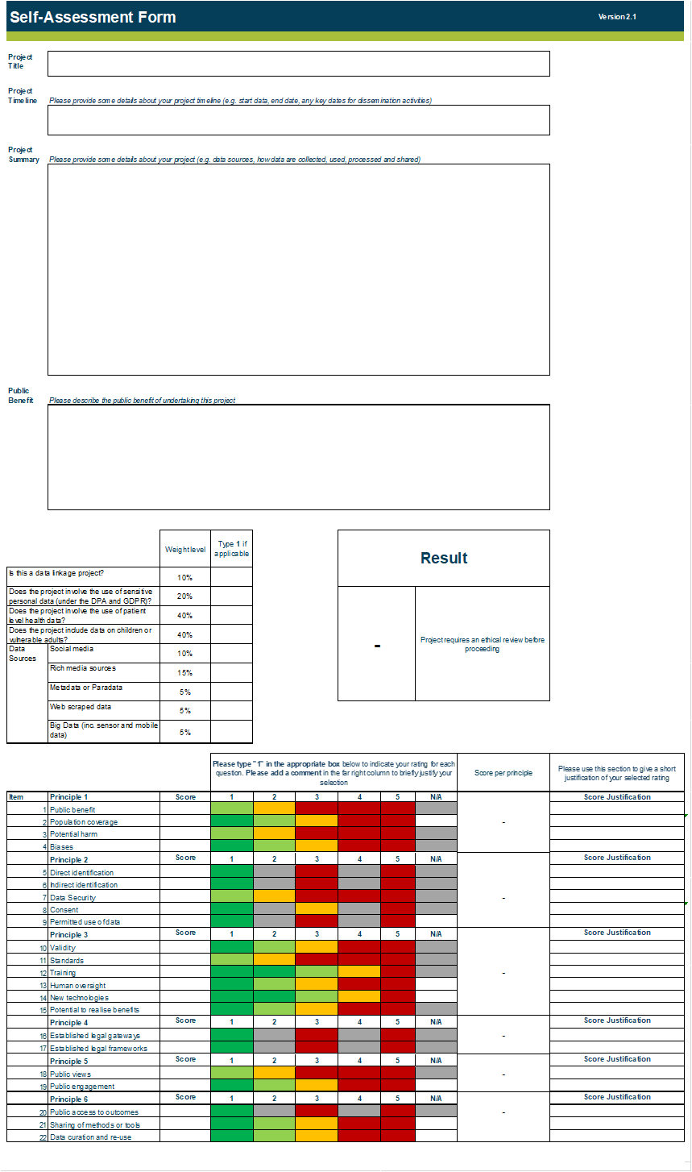
The Self-Assessment
The self-assessment consists of 3 main sections for the researcher to complete:
Basic information
Weightings
Item scoring scales

Slide 8
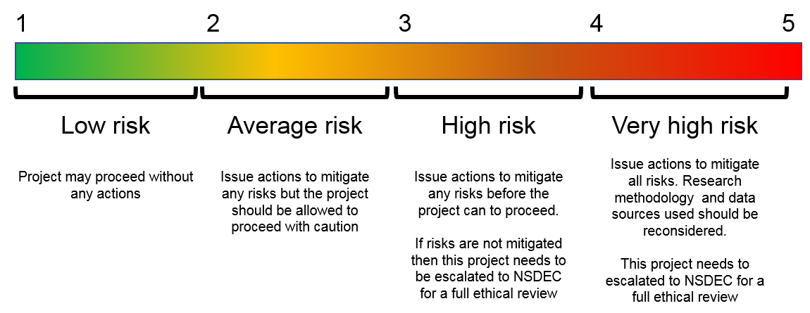
Outcomes
Project may proceed after confirmation from the Data Ethics team
Consult with the Data Ethics team to discuss actions to mitigate any highlighted risks before proceeding with the project
Consult with the Data Ethics team. If risks cannot be mitigated then this project should be presented to NSDEC for a full independent ethical review before proceeding
Consult with the Data Ethics team. If risks cannot be mitigated then this project should be presented to NSDEC for a full independent ethical review before proceeding

Slide 9

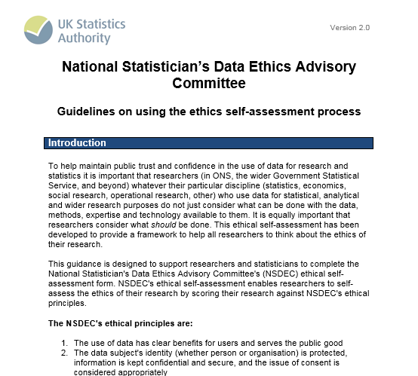
User Support

Slide 10
Guidance
Self-assess as early as possible in the research design phase (ethics by design)
Revisit the self-assessment throughout the project lifecycle
Involve others to get other perspectives and challenge

Slide 11

National Statistician’s Data Ethics Advisory Committee
Majority independent membership ensuring impartial and credible advice
External perspectives & challenge to uses of data
Supports consistency in ethical decision making across GSS and the wider research community.
Independent justification in the face of challenge
Greater transparency around how data is shared, linked, and used

Slide 12





Projects
Local Government
Other Central Government Departments
Academia
Who?
ONS
Devolved
Administrations
Commercial Sector

Slide 13
Example Projects
COVID-19 Infection Survey – COVID-19 tests and antibody in 20,000 households.
Linkage of Hospital Episodes records with Census data, mortality data and primary care data to determine the level of relative risk of hospitalisation or death from COVID-19
Environmental and socio-economic impact assessment for siting geological disposal facilities
Data for children: assessing the impact of family background on the outcomes of children in England

Slide 14
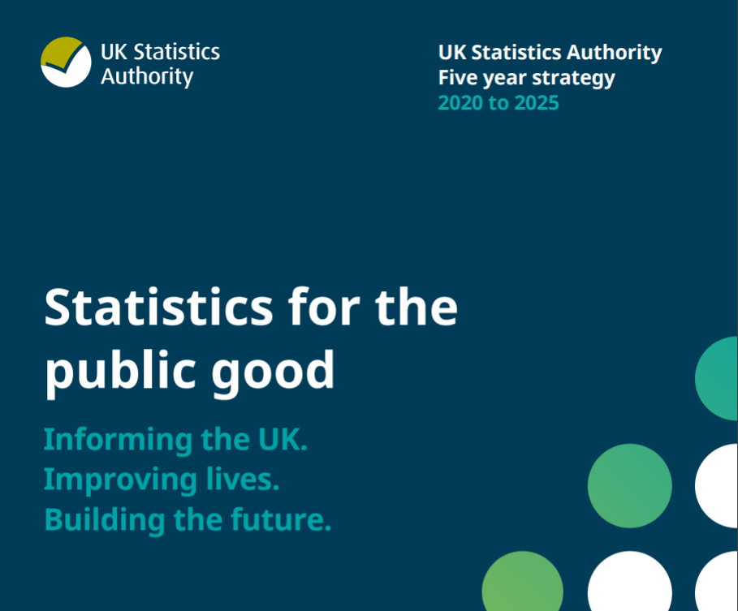
Strategy
“To be recognised world-leaders in the practical application of data ethics for statistics and research, with a centre of excellence to deliver this.”

Slide 15

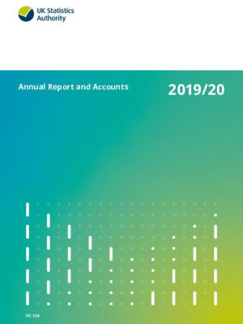

Centre of Excellence for Data Ethics
Continue to develop the
self-assessment tool and
guidance and provide
NSDEC
New online ethics training
Publish new
guidance on cross
cutting ethical issues
in research and statistics.
A new ethics user support service .
new collaborations both domestically
and internationally.

Slide 16
More information Contact: nsdec@statistics.gov.uk Website: https://www.statisticsauthority.gov.uk/about-the-authority/committees/nsdec/

