Slide 1

Dashboards with R: Shinydashboard & Shiny

Slide 2

Learning Outcomes
Awareness of dashboarding solutions in R
Use case analysis of these solutions
Begin to adjust User Interfaces
Investigate server-UI interactions

Slide 3
Schedule
Time | Item
1.15 pm | Shiny - Flexdashboard
2 pm | Shiny UI
2.30 pm | Shiny server
3 pm | Guest Speaker
3.30 pm | Group application
4 pm | Finish
Guest Speaker: Jay Sheppard, Data Analytics Officer, Audit Wales.

Slide 4


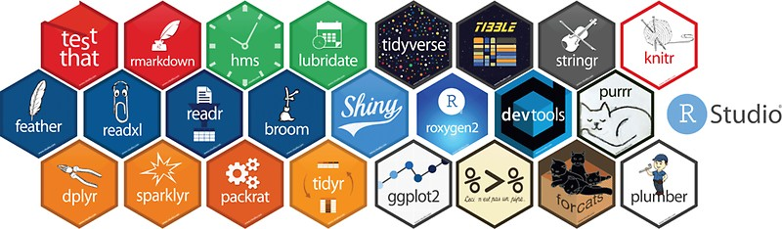
Dashboarding in
Notes:
Replace picture and move/crop as you please

Slide 5



More specifically
Notes:
Replace picture and move/crop as you please

Slide 6

Shiny can be hard, so why bother?
Allow non-programming folk to access your analysis
Extends reach
Allow users to query the data
High level of customisation
Lots of packages that help to flatten the learning curve
Notes:
Use white slides to add pictures

Slide 7
When shouldn’t you bother?
Large datasets – 3 GB downloads on launch!!
Troubleshooting Shiny can be hard…
Look carefully at required functionality, could you get away with a parameterised report, flexdashboard / shinydashboard / BI software instead?
Notes:
Use white slides to add pictures

Slide 8
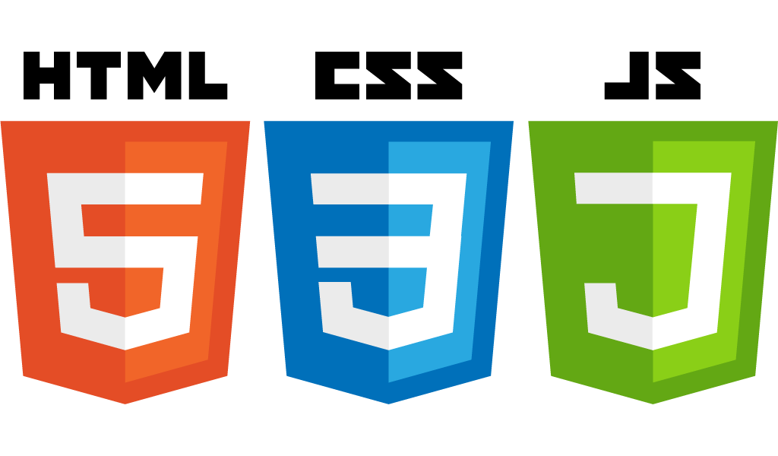
At the end of the day
All of the packages explored in this training are ways to use R to create HTML web pages, so the following can help:
Notes:
Use white slides to add pictures

Slide 9

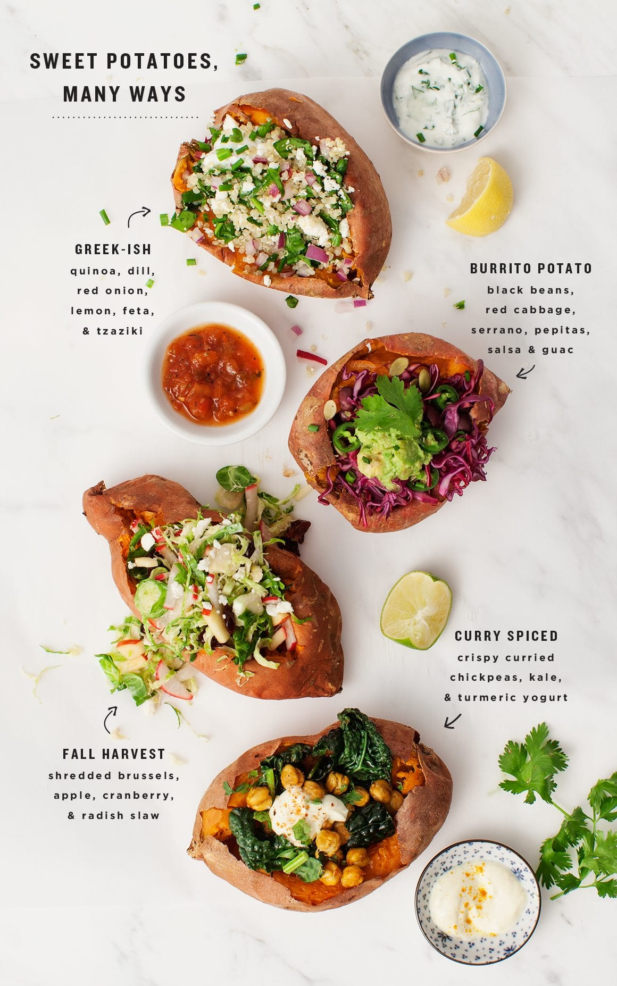
Procedural & Event-Driven Programming
Procedural
- A script that executes line by line until completion.
- Control flow may be included, if, else etc.
- Can be automated to execute when some condition is met.

Slide 10

Procedural & Event-Driven Programming
Event-Driven
- A script that executes based on interaction events.
- A user interacts with elements of the script.
- Observer functions notice changes to those elements and values within the environment are updated.

Slide 11
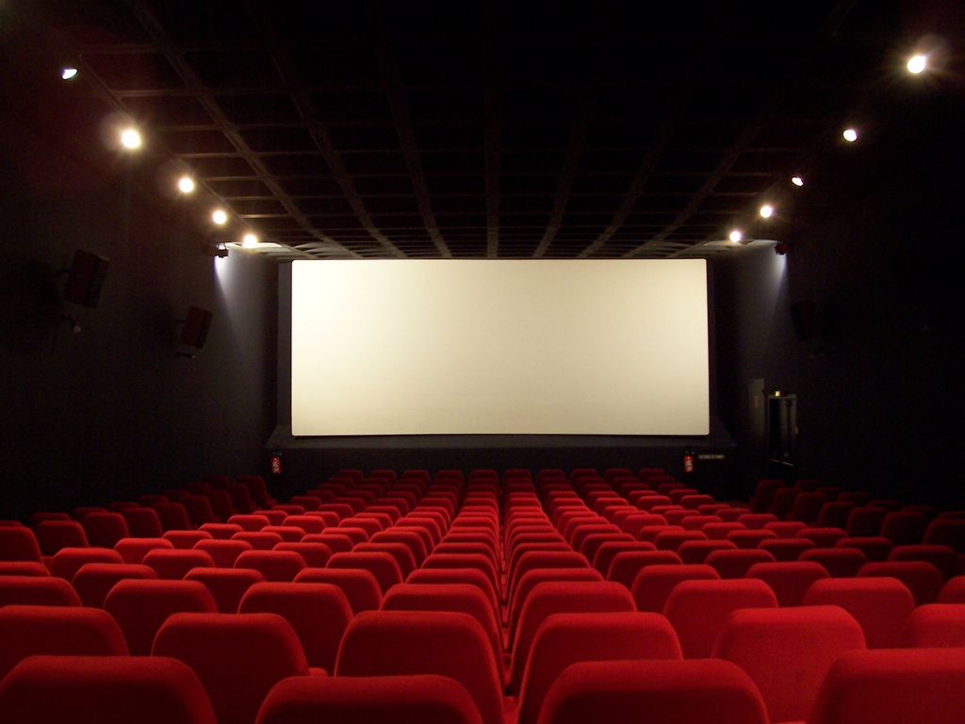
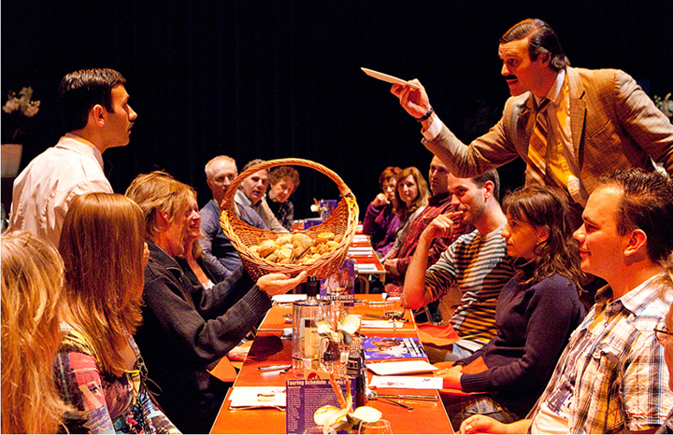
Analogy: Movie vs Immersive Theatre
Notes:
Use white slides to add pictures

Slide 12
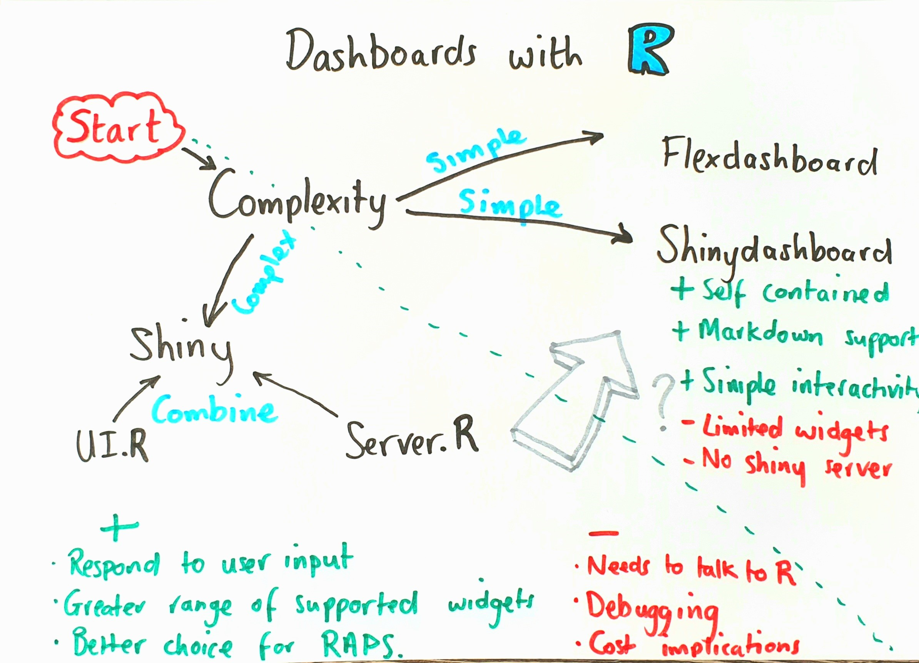

Slide 13
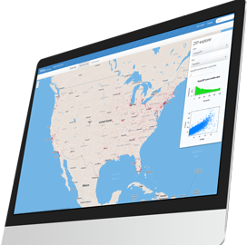
Deployment: Data security
Creating an account on shinyapps.io breaches security of our data.
Advise to only interact via off-network machine.
Only publish open data to a discoverable service.
Notes:
Replace picture and move/crop as you please

Slide 14

Production-Ready Shiny
Packrat is a package to help control package versions in R
Straight forward to use
Creates a local package library within your project directory
Snapshots this private library and is then used to recreate library on another machine
Improves reproducibility
Notes:
Use white slides to add pictures

Slide 15

Production-Ready Shiny
Golem is a framework for writing robust apps
Turns your application into a package
Modularises your app
Advantages in scaling and deployment
Notes:
Use white slides to add pictures

Slide 16

Production-Ready Shiny
Using docker to ‘containerize’ your apps
Control app dependencies within a virtual environment
Solve operating system-specific issues
Improves reproducibility
Notes:
Use white slides to add pictures

Slide 17
Learning Outcomes
Awareness of dashboarding solutions in R
Use case analysis of these solutions
Begin to adjust User Interfaces
Investigate server-UI interactions

Slide 18
Schedule
Day 2 | 22/07/2020 | Shiny - Flexdashboard | 09:30 - 12:30 | Event driven Programming with Shiny | 14:00 - 16:30
Day 3 | 23/07/2020 | Shiny: Idea to Deployment | 09:30 - 12:30 | Learning tool development | 14:00 - 16:30
Day 3 Guest Speaker: Jay Sheppard, Data Analyst, Audit Wales.

